Slide 1
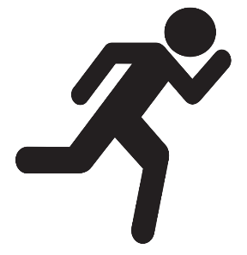

Instructor Guide Snapshot
Icon Key
Activity:
Video:
Instructor Demo:
Knowledge Check:
Instructional Time: 2.75 Hrs.
Preparation before class:
  Review all materials – Review all slides, talking points, and handouts before class to understand the structure and flow of the lesson. Pay special attention to animations within the slides.
  Prep for demos and activities – Review the full list of “Additional Materials” located in the Instructor Facilitation Toolkit. Gather and prepare all necessary materials.
Provided Course Materials:
  +Physics_Mechanical Foundations.pptx
  +Instructor Facilitation Toolkit_Physics.docx - For Instructor use only.
  +Participant Resource Guide_Physics.docx - Print one copy for each learner. All handouts that leaners need for activities are embedded in the Participant Resource Guide.
    Ramp Race_Physics
  Quiz_Physics.docx - Print one copy for each learner.
Additional Materials:
One per pair or small group for activity: Ramp (wooden board or sturdy cardboard), 2 small balls, 5 blocks to change ramp height, Stopwatch, Fabric to cover ramp
One of each for Demo: Hammer, Nail, Block of wood, Clamp or vice, Safety gloves, Safety goggles

Slide 2
Pacing Guide
Times have been rounded to the nearest .25 hours.
Total Time: 2.75 Hours
  (.25 Hrs) – Welcome and Warm Up
  (1 Hr) – 1.1 – Basic Physics Concepts & Principles
  (.75 Hrs) – 1.2 Newton’s Three Laws of Motion
  (.25 Hrs) – 1.3 Real World Applications & Safety
  (.5 Hrs) – Quiz and Wrap Up

Slide 3
Principles of Physics
Transit Core Competencies Curriculum
Mechanical Foundations
Notes:
Instructional Activity: Direction
Instructional Time: 1 min.
Do: Welcome learners to class. Introduce the course and module.

Slide 4
Objectives
Define physics and explain concepts such as force, motion, work, energy, power, resistance and friction.
Describe Newton’s Three Laws of Motion.
Apply basic principles to real world mechanical systems in transit maintenance.
Notes:
Instructional Activity: Direction
Instructional Time: 2 min.
Do: Review the module objectives.

Slide 5
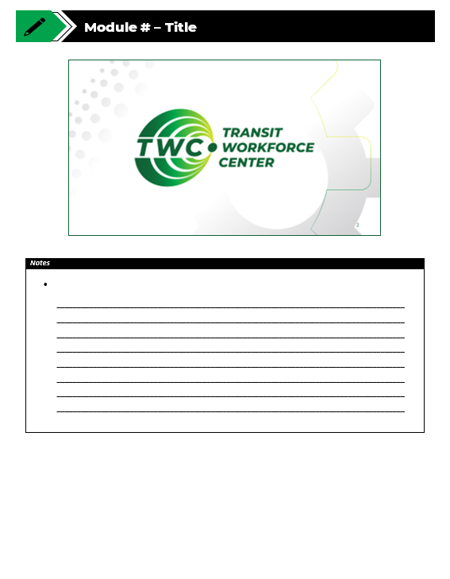
Agenda
Welcome and Warm Up
1.1 - Basic Physics Concepts & Principles
1.2 - Newton’s Three Laws of Motion
1.3 - Real World Applications & Safety
Quiz and Wrap Up
Notes:
Instructional Activity: Direction
Instructional Time: 2 min.
Do: Review the module agenda.

Slide 6
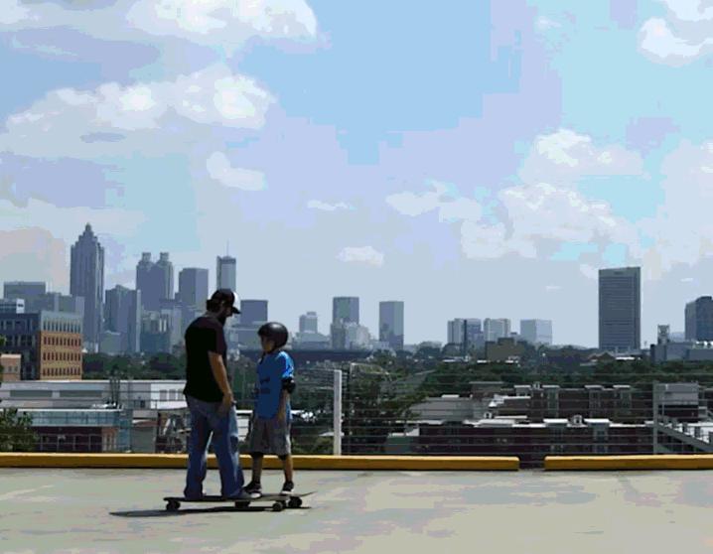
Warm Up
Imagine you and your nephew are standing on skateboards. If you push against each other, what happens? Why?
Notes:
*This slide contains animations. CLICK to reveal content.
Instructional Activity: Gain Attention
Instructional Time: 5 min.
Materials:
Do:
Review the talking points below.
Call on learners to respond and facilitate a short discussion.
Talking Points:
Let's start with a simple scenario. Imagine you and your nephew are both standing on skateboards, facing each other. Neither of you is moving.
Now imagine you place your hands against each other and push.
ASK: What do you think will happen? Will only one person move, or will both of you move? Will you travel the same distance? Why/Why not?
Take a minute to discuss your prediction with a partner or think about what you've experienced in real life.
We'll come back to this example as we learn about Newton's Three Laws of Motion and discover why both skateboarders move when they push against each other.

Slide 7

1.1 – Basic Physics Concepts & Principles
In this section, we’ll learn about basic physics concepts and how they apply to real-world situations.
Notes:
Instructional Activity: Direction
Instructional Time: 1 min.
Do: Introduce the section.
Talking Points: In this section, we’ll learn about basic physics concepts and how they apply to real-world situations.

Slide 8
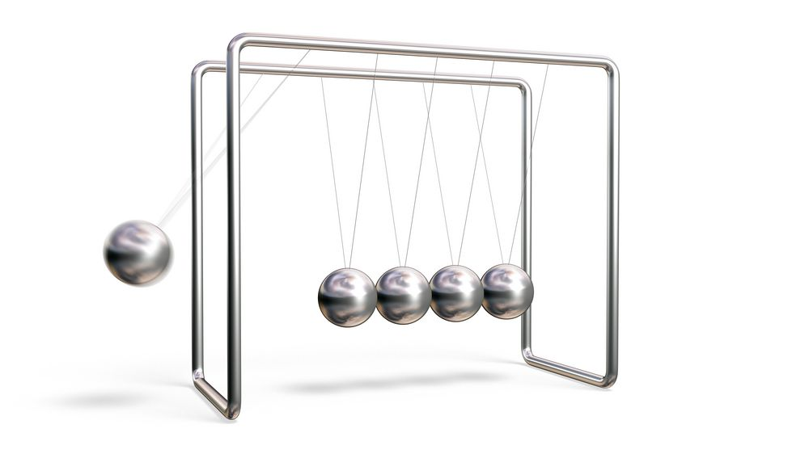
What is Physics?
Physics is the study of matter, energy, forces, and motion
  Explains how objects move and interact
  Helps us understand how mechanical systems work
  Helps maintenance workers work smarter and safer
Notes:
INSTRUCTIONAL ACTIVITY: Present Content
TIME: 2 minutes
TALKING POINTS:
Physics is the study of matter, energy, motion, and the forces that affect how objects move and interact.
We see physics everywhere—in the weather, technology, transportation systems, and even in our own bodies.
Although we may not think about it every day, physics explains nearly everything around us.
In transportation maintenance, physics helps us understand why a wrench turns a bolt, why a heavy bus begins moving when the engine applies force, and why brakes, suspension systems, and other mechanical components behave the way they do.
Throughout this module, we'll focus on the physics concepts that are most relevant to maintenance work, including force, motion, energy, friction, and resistance.
Understanding these principles gives you a framework for understanding how equipment moves, how mechanical systems respond to different forces, and why maintenance procedures are performed the way they are.
As we move through the module, you'll see how these concepts apply to real-world transit maintenance tasks, helping you troubleshoot problems, perform repairs safely, and make better maintenance decisions.

Slide 9

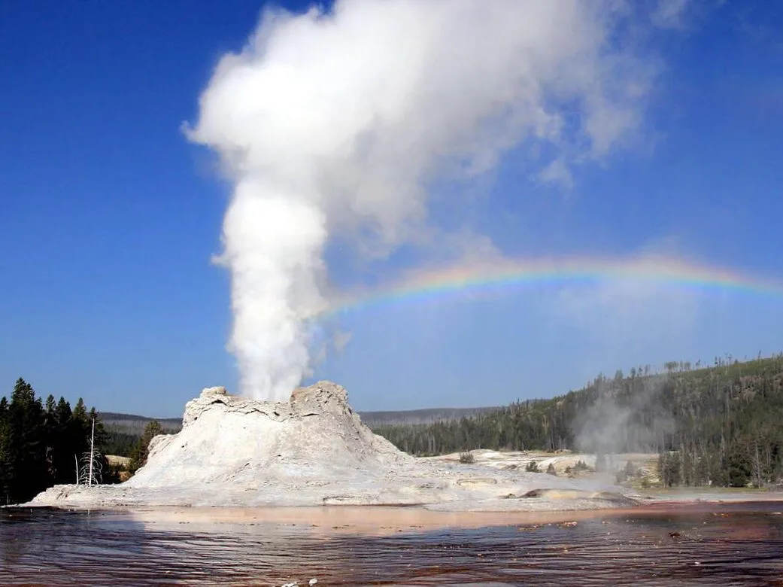

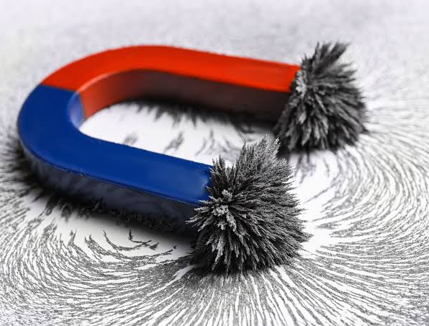
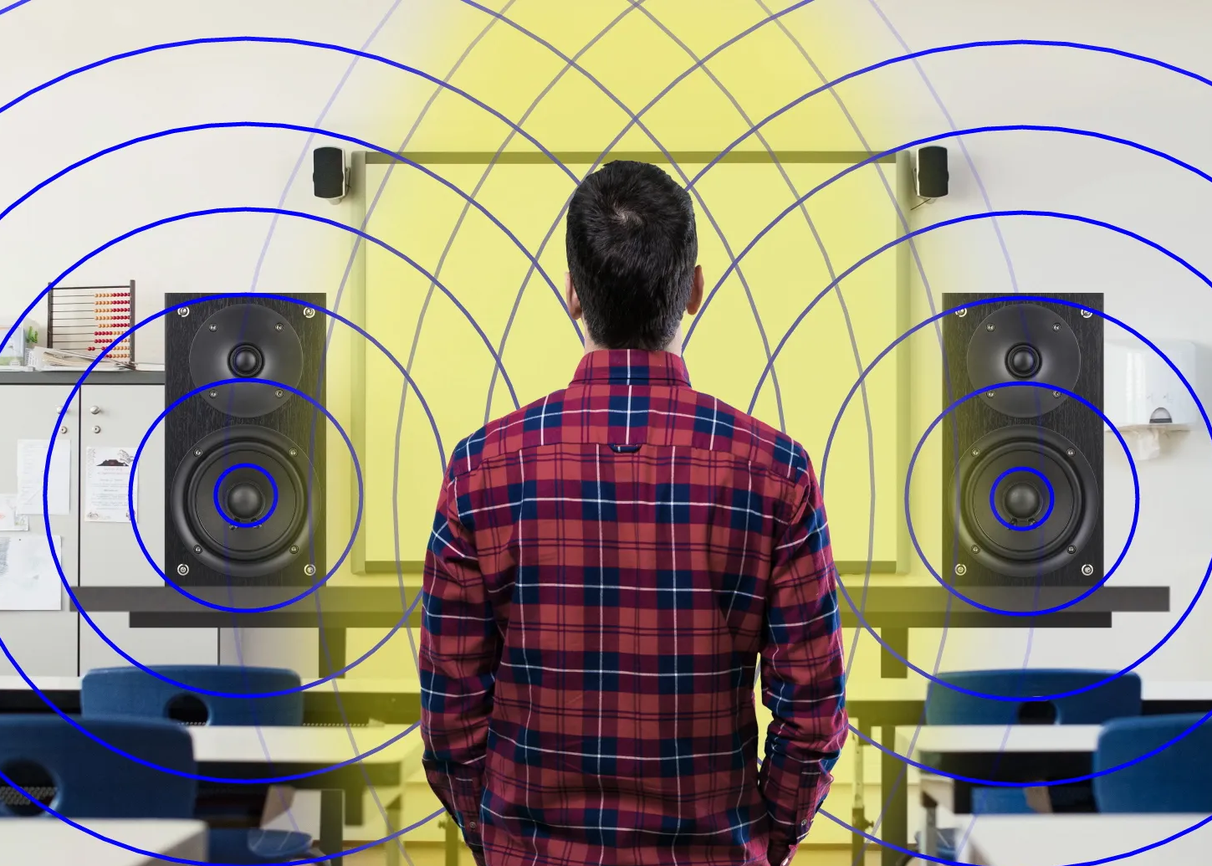
Important Concepts in Physics
Mechanics
Thermodynamics
Optics
Waves and Oscillations
Electricity and Magnetism
Notes:
INSTRUCTIONAL ACTIVITY: Present Content
TIME: 3 minutes
TALKING POINTS:
Physics is a broad field with many different areas of study. Each branch focuses on a different aspect of how the physical world works.
Mechanics is the branch we'll spend most of our time on because it's the most relevant to transportation maintenance.
Mechanics explains how objects move, what causes them to move, and how forces affect that motion.
Within mechanics, we'll explore concepts such as motion, force, Newton's Laws of Motion, work, energy, power, friction, and resistance. These principles help explain how tools, vehicles, and mechanical systems operate.
The other branches of physics are also important.
Thermodynamics focuses on heat and energy transfer.
Waves and oscillations include topics like sound and vibration.
Electricity and magnetism explain electrical circuits, motors, and magnetic fields.
Optics is the study of light and how it behaves.
For this course, we'll concentrate on the mechanics concepts that you'll apply regularly in transit maintenance.
As we move through the module, you'll see how these physics principles help you understand equipment operation, diagnose problems, and perform maintenance safely and effectively.

Slide 10
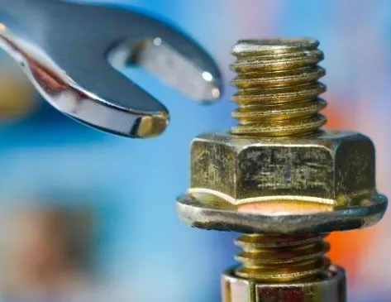
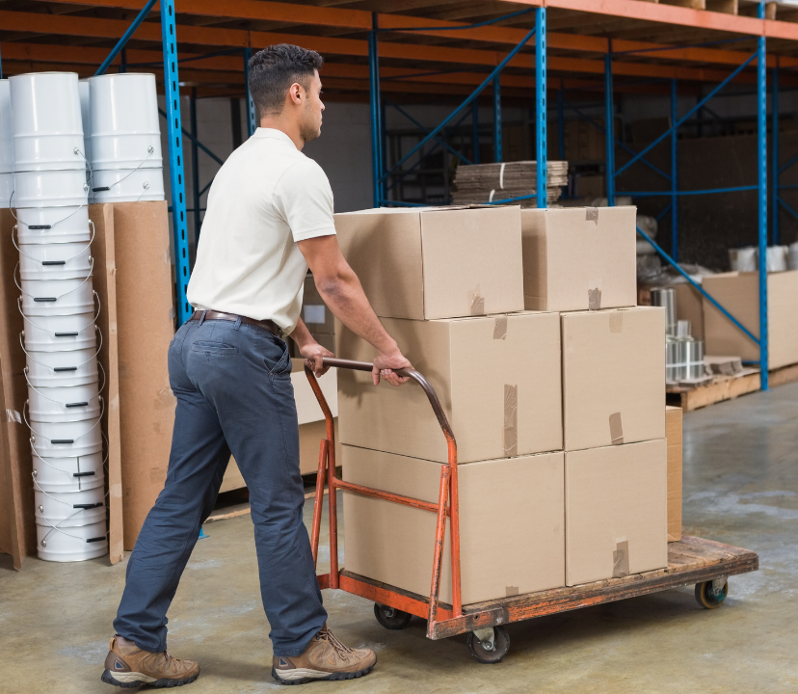
Force and Motion
Force - A push or pull on an object measured in Newtons (N)
Motion - A change in an object's position over time
Force causes motion. It can start, stop, speed up, slow down, or change the direction of an object.
Notes:
INSTRUCTIONAL ACTIVITY: Present Content
TIME: 2 minutes
TALKING POINTS:
Force is simply a push or pull on an object. Anytime you pick up a tool, tighten a bolt, push a cart, or open a heavy door, you're applying force.
Motion is the change in an object's position over time. Without motion, an object stays where it is. When enough force is applied, the object can begin moving, stop moving, speed up, slow down, or change direction.
One of the easiest examples from maintenance is using a wrench. When you pull on the wrench, you're applying force. That force creates motion by turning the bolt.
If you've ever worked with a stubborn or rusted bolt, you've probably noticed it takes more force to get it moving. Larger or heavier components also require more force to move than smaller, lighter ones.
You'll see this same relationship throughout transportation maintenance. Brakes use force to stop a moving vehicle. Hoists use force to lift heavy components. Pneumatic doors use air pressure to create the force needed to open and close.
Understanding the relationship between force and motion helps explain why mechanical systems behave the way they do and prepares us for Newton's Laws of Motion, which we'll cover next.

Slide 11
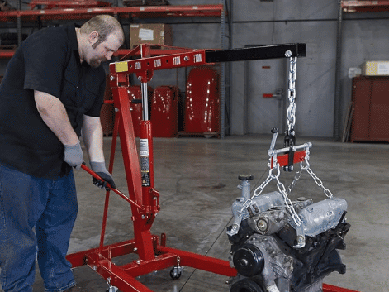
Work
Work is done when a force moves an object over a distance
If the object does not move, no work is done
Work = Force × Distance
Notes:
INSTRUCTIONAL ACTIVITY: Present Content
TIME: 2 minutes
TALKING POINTS:
In everyday conversation, we often think of work as any task we perform. In physics, however, work has a more specific meaning.
Work occurs when a force causes an object to move over a distance. Both force and motion are required. If you apply force but the object doesn't move, no work has been done in the physics sense.
For example, if you push against a wall and it doesn't move, you're using effort, but no physical work is being done because there is no movement.
A maintenance example would be lifting an engine with a hoist or pushing a loaded toolbox across the shop floor. In both cases, a force is applied, and the object moves, so work is being done.
Understanding work helps explain how tools and equipment accomplish tasks.

Slide 12
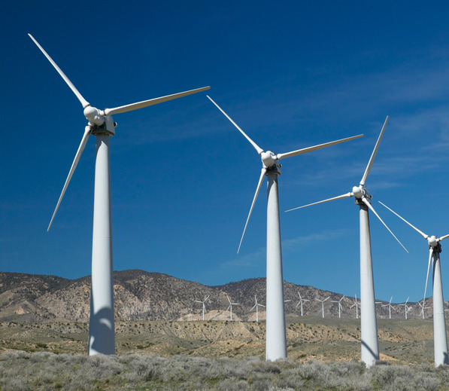
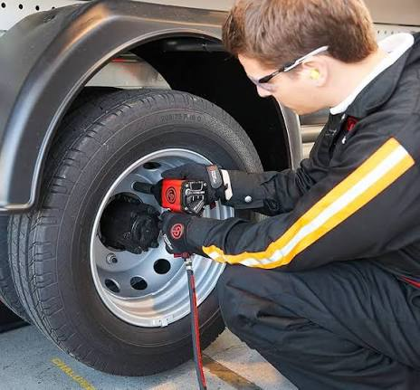
Energy
Energy is the ability to do work
Potential Energy: Stored energy ready to do work
  Ex: Compressed air, charged battery
Kinetic Energy: Energy of motion
  Ex: Moving bus, rotating wheel
Notes:
INSTRUCTIONAL ACTIVITY: Present Content
TIME: 2 minutes
TALKING POINTS:
Energy is what makes work possible. Without energy, nothing can move or perform a task.
There are many forms of energy, but we'll focus on two that you'll encounter frequently in maintenance: potential energy and kinetic energy.
Potential energy is stored energy. It has the ability to do work, even though nothing is moving yet. A compressed spring, compressed air in a pneumatic system, or a charged battery all store potential energy.
Kinetic energy is the energy of motion. Any object that is moving has kinetic energy. A rotating wheel, a moving bus, or even the wind are all examples of kinetic energy.
Many mechanical systems convert potential energy into kinetic energy. For example, a charged battery stores chemical energy until it powers an electric motor. The motor then converts that stored energy into motion.
Understanding energy helps explain how machines start, move, and perform work.

Slide 13
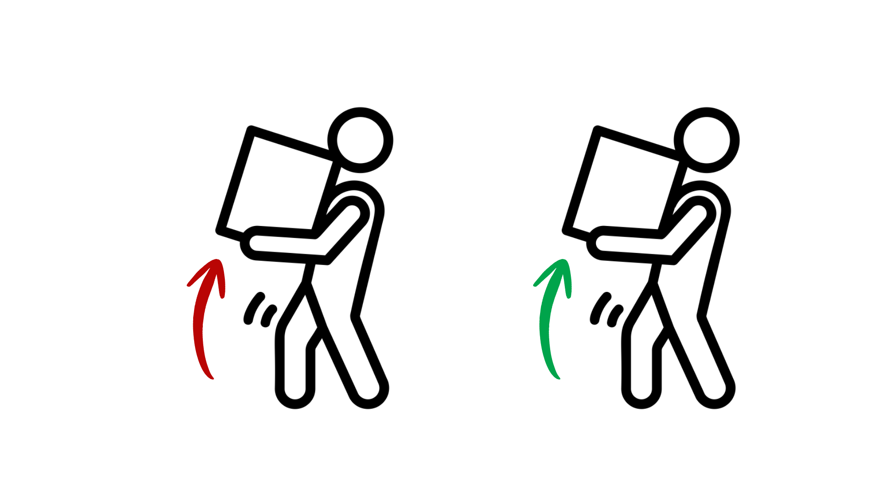
Power
Power is how quickly work is done
More work completed in less time means more power
  Ex: Horsepower in a car engine
Power = Work ÷ Time (P = W ÷ t)
Less speed, less power
More speed, more power
Notes:
INSTRUCTIONAL ACTIVITY: Present Content
TIME: 2 minutes
TALKING POINTS:
Power tells us how quickly work is done.
Imagine two technicians lifting the same engine using two different hoists. If both hoists lift the same load, they perform the same amount of work. However, if one hoist finishes the job in half the time, it is producing more power.
The same idea applies to engines. A higher-horsepower engine can do work faster, allowing a vehicle to accelerate more quickly or pull heavier loads more efficiently.
Power is directly related to work and time. Completing more work in less time—or transferring energy more quickly—means greater power.
While engineers often calculate power using an equation, the important takeaway for this course is understanding what power represents: how quickly a task gets done.

Slide 14

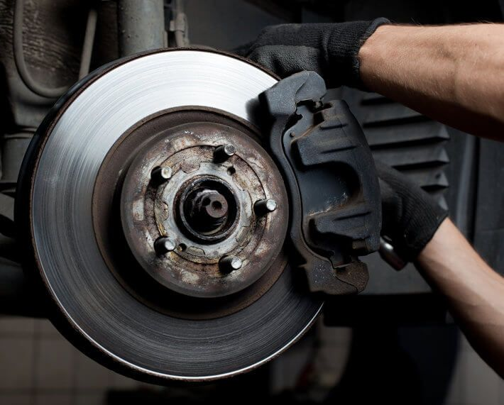
Resistance and Friction
Resistance
A force that opposes motion
Friction is one type of resistance
Ex: Biking into
wind
Friction
A force created when two surfaces rub against each other
Can help or hinder movement
Ex: Brake pads
Notes:
INSTRUCTIONAL ACTIVITY: Present Content
TIME: 2 minutes
TALKING POINTS:
Resistance is any force that opposes motion. Whenever something moves, there are often forces working against that movement.
For example, air pushes against a moving vehicle, creating air resistance. Low tire pressure increases rolling resistance, making a vehicle harder to push or requiring more energy to move.
One common type of resistance is friction. Friction occurs when two surfaces come into contact and rub against each other.
Friction can be helpful. Brake pads rely on friction to slow or stop a vehicle, and tires depend on friction to grip the road.
However, friction can also create unwanted heat and wear. Components like bearings, gears, and moving joints can wear out more quickly if friction isn't properly controlled.
That's why maintenance tasks such as lubricating moving parts, inspecting brake components, and adjusting equipment are so important. Proper lubrication reduces unwanted friction while allowing systems to operate smoothly and efficiently.
Understanding the difference between resistance and friction helps explain why some systems move easily while others require more force or maintenance.

Slide 15
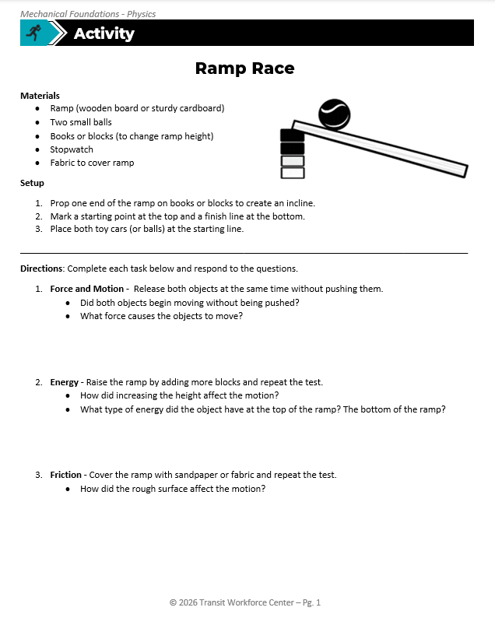
Ramp Race Activity
Use the materials and follow the set-up instructions to create a ramp.
Complete questions 1-3.
Be prepared to share your answers.
Notes:
*This slide contains animations. CLICK to reveal content.
Instructional Activity: Provide Guided Learning, Elicit Performance, Provide Feedback
Instructional Time: 20 min.
Materials:
Ramp Race_Physics
One per pair or small group
Ramp (wooden board or sturdy cardboard)
2 small balls
5 blocks to change ramp height
Stopwatch
Fabric to cover ramp
Do:
5 min.
Refer learners to the “Ramp Race” handout embedded in the Participant Resource Guide.
Sperate learners into groups and give them each a ramp, two small balls, books or blocks, a stopwatch, and a piece of fabric to cover the ramp.
Review the directions and answer any questions learners may have.
10 min.
Give learners time to work.
Circulate the room answering questions and providing feedback as needed.
5 min.
Review the answers by calling on learners to share their responses.
Encourage learners to explain which physics principles are being demonstrated in each task.

Slide 16
Knowledge Check
Force is _______________________.
(A). The change in an object’s position over time
(B). A push or pull on an object
(B). A push or pull on an object
(C). The study of fundamental laws of nature and the forces that act upon them
(D). A force that opposes motion
Notes:
*This slide contains animations. CLICK to reveal content.
Instructional Activity: Evaluate/Assess Performance, Provide Feedback
Instructional Time: 3 min.
Learning Objective: Define physics and explain concepts such as force, motion, work, energy, power, resistance and friction.
Do: Review the knowledge check question. Call on learners to share their responses.
Answer:
B – A push or pull on an object

Slide 17
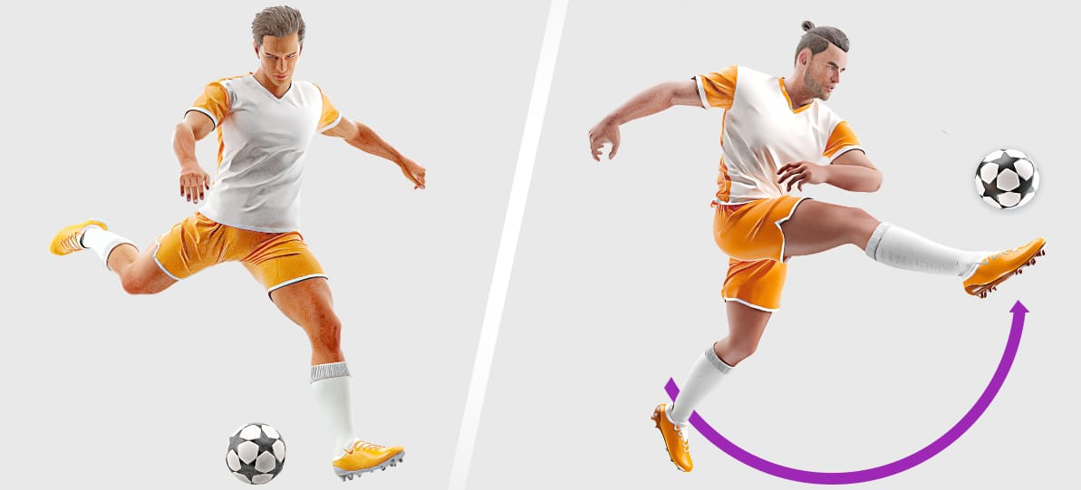
Knowledge Check
Which of the following images illustrates potential energy? Explain your choice.
A.)
B.)
Notes:
*This slide contains animations. CLICK to reveal content.
Instructional Activity: Evaluate/Assess Performance, Provide Feedback
Instructional Time: 3 min.
Learning Objective: Define physics and explain concepts such as force, motion, work, energy, power, resistance and friction.
Do: Review the knowledge check question. Call on learners to share their responses.
Answer:
A

Slide 18
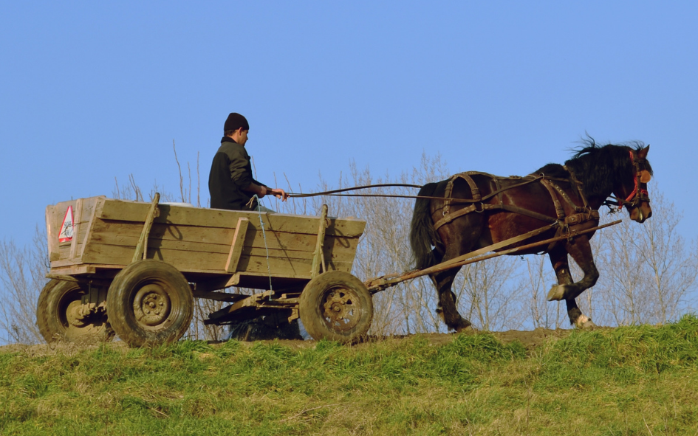
Knowledge Check
What physical principle is illustrated in this image?
    A.) Power
    B.) Energy
    C.) Work
    D.) Force
Notes:
*This slide contains animations. CLICK to reveal content.
Instructional Activity: Evaluate/Assess Performance, Provide Feedback
Instructional Time: 3 min.
Learning Objective: Define physics and explain concepts such as force, motion, work, energy, power, resistance and friction.
Do: Review the knowledge check question. Call on learners to share their responses.
Answer:
C - Work

Slide 19
Knowledge Check
A technician notices that a transit bus requires more effort to push into the maintenance bay than usual. After inspection, they discover one of the tires is significantly underinflated.
Which physics principle best explains why the bus is harder to move?
(A). Power
(B). Kinetic Energy
(D). Resistance
(C). Work
(D). Resistance
Notes:
*This slide contains animations. CLICK to reveal content.
Instructional Activity: Evaluate/Assess Performance, Provide Feedback
Instructional Time: 3 min.
Learning Objective:
Do: Review the knowledge check question. Call on learners to share their responses.
Answer:
D – Resistance

Slide 20
Summary and What’s Next
Physics explains how forces, motion, energy, and friction affect the way objects move and interact.
Force, work, energy, power, resistance, and friction are fundamental concepts used every day in transportation maintenance.
Next, we'll learn how Newton's Three Laws of Motion explain why objects move and how those laws apply to transit vehicles, tools, and mechanical systems.
Notes:
*This slide contains animations. CLICK to reveal content
Instructional Activity: Recall, Enhance Retention and Transfer
Instructional Time: 5 min.
Do:
Review the key takeaways from this section of the module.
Clearly explain how to connects to the next section of the module.
Talking Points:
Ask: What are the most important things we learned about screws in this section?
Call on learners to respond.
CLICK - We began by introducing physics as the study of how matter, energy, forces, and motion interact. Although these concepts may seem abstract, they're happening every time a vehicle accelerates, a technician uses a tool, or a mechanical system operates.
CLICK - We then explored several fundamental concepts, including force, motion, work, energy, power, resistance, and friction. Together, these principles help explain how mechanical systems function and why they behave the way they do.
CLICK - As a transportation maintenance technician, understanding these concepts will help you make better decisions when inspecting, maintaining, and troubleshooting equipment. Rather than simply following procedures, you'll have a better understanding of the physics behind them.
CLICK - Next, we'll build on this foundation by learning Newton's Three Laws of Motion. These laws explain how forces affect movement and form the basis for understanding everything from vehicle acceleration and braking to lifting equipment and tool operation.

Slide 21
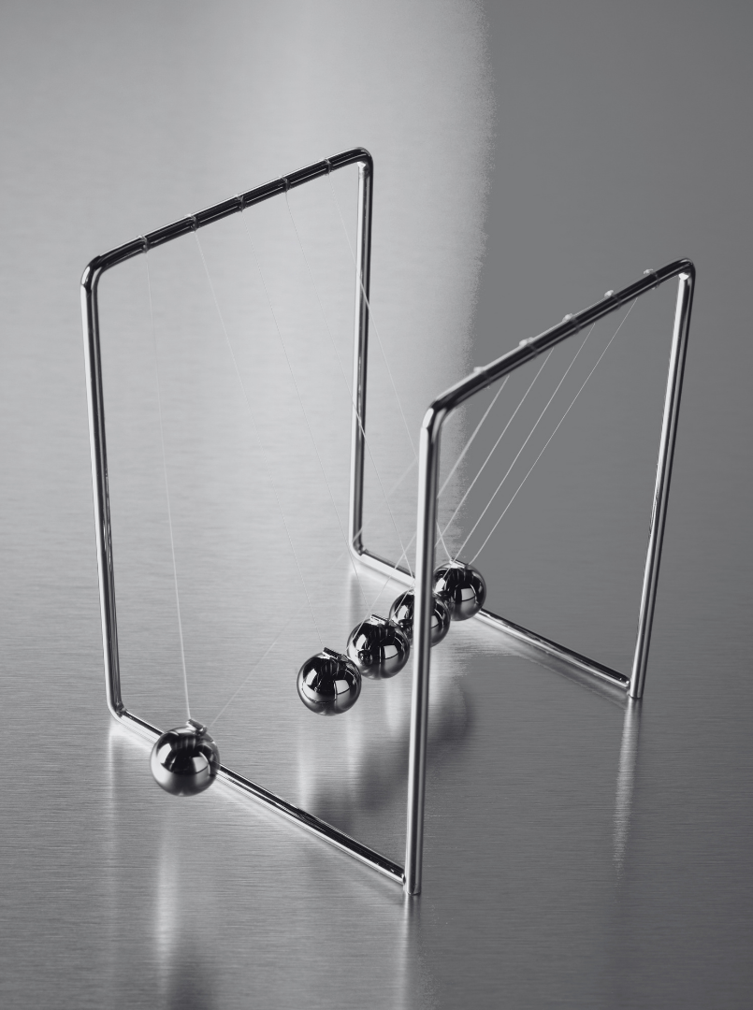
1.2 Newton’s Three Laws of Motion
In this section we’ll review how Newton’s Laws of Motion explains how objects move, accelerate, and interact with forces.
Notes:
Instructional Activity: Direction
Instructional Time: 1 min.
Do: Introduce the section.
Talking Points: In this section we’ll review how Newton’s Laws of Motion explains how objects move, accelerate, and interact with forces.

Slide 22
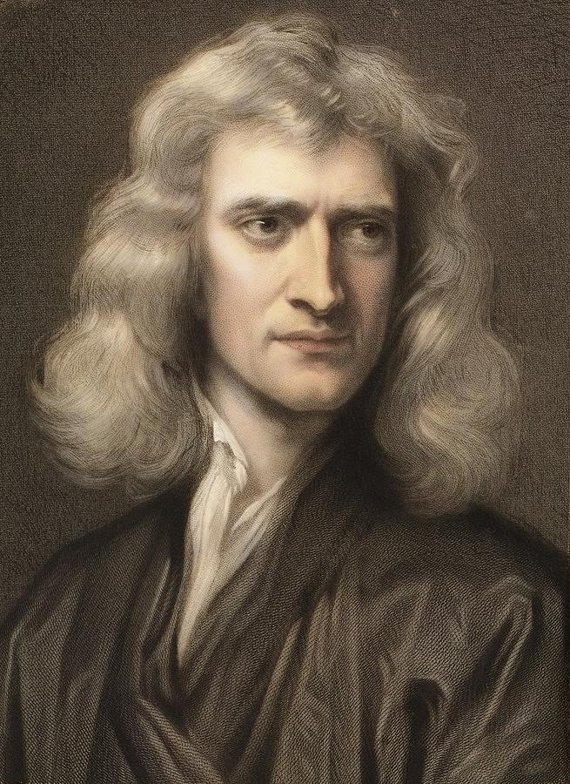
Isaac Newton
English mathematician and physicist (1642–1727)
Developed the Three Laws of Motion
Helped establish the foundation of classical physics
His laws explain how objects move and respond to forces
Notes:
Instructional Activity: Present Content
Instructional Time: 2 min.
Talking Points:
Before we explore the Three Laws of Motion, it's helpful to know a little about the person behind them.
Sir Isaac Newton was an English mathematician and physicist who lived from 1642 to 1727. He is widely regarded as one of the most influential scientists in history.
Newton developed the Three Laws of Motion, which explain how objects move and how they respond to forces. These laws became the foundation of classical physics and are still used today in science, engineering, and transportation.
Although Newton made many important contributions to science, we'll focus on the laws of motion because they help explain the behavior of vehicles, tools, and mechanical systems that maintenance technicians work with every day.
In the next few slides, we'll examine each of Newton's Three Laws and see how they apply to real-world transportation maintenance scenarios.

Slide 23
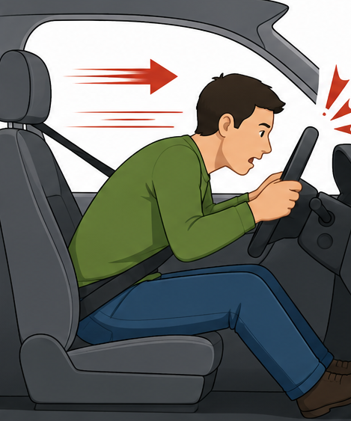


Newton’s First Law
Law of Inertia
An object at rest stays at rest, and an object in motion stays in motion unless acted upon by an external force.
Transit Examples:
Heavy transit vehicle on a lift
Train brakes stopping a vehicle
Bus accelerating from zero at a red light
Notes:
*This slide contains animations. CLICK to reveal content.
Instructional Activity: Present Content
Instructional Time: 3 min.
Talking Points:
Newton's First Law is also known as the Law of Inertia.
In simple terms, objects like to keep doing what they're already doing.
If an object is sitting still, it will stay still until a force causes it to move.
If it's already moving, it will continue moving until another force slows it down, stops it, or changes its direction.
You can see this with a soccer ball sitting on the ground. The ball won't move unless someone kicks it, pushing it forward.
Another everyday example is wearing a seatbelt in a car.
If the vehicle stops suddenly, your body naturally wants to continue moving forward.
The amount of force needed to move an object depends on its mass and how quickly you want it to accelerate.
The bigger or heavier something is, the more force it takes to get it moving, stop it, or change its direction.
The seatbelt applies the force needed to stop your motion safely. That's inertia in action.
Now let's look at how this same law applies to transit vehicles and maintenance operations.
CLICK – Newton's First Law is easy to recognize in transit maintenance because buses and rail vehicles have a great deal of mass.
First, imagine a bus parked on a lift for maintenance. The bus remains at rest until the hydraulic lift applies enough force to raise it. Once it's elevated, it stays there until another force lowers it.
Next, think about a brake test. When the operator lifts their foot off the accelerator, the bus doesn't stop immediately. It continues moving because of inertia until the brakes and friction apply enough force to slow it down and bring it to a stop.
Finally, consider a bus leaving a red light or bus stop. The bus naturally resists changing from rest to motion. The engine must produce enough force to overcome the vehicle's inertia and accelerate it.

Slide 24

Newton’s Second Law
Law of Force and Acceleration
The amount of force needed to move an object depends on its mass and how quickly you want it to accelerate.
Transit Examples:
Heavy transit vehicle on a lift
Full vs. empty bus accelerating
Breaker bar vs. standard ratchet
Notes:
*This slide contains animations. CLICK to reveal content.
Instructional Activity: Present Content
Instructional Time: 3 min.
Talking Points:
Newton's Second Law explains how force, mass, and acceleration work together.
Simply put, the heavier an object is, the more force it takes to get it moving, stop it, or change its direction. If you want a heavier object to accelerate as quickly as a lighter one, you have to apply more force.
Think about pushing an empty shopping cart compared to one that's full of groceries. The full cart requires much more effort to get moving because it has more mass.
CLICK - Now let's look at how this law applies to transit maintenance.
We can use the transit bus of a lift example again for the second law. The heavier the vehicle, the more lifting force is needed to raise it safely.
You can also see Newton's Second Law when comparing a full bus to an empty one. If both buses receive the same engine power, the fully loaded bus accelerates more slowly because it has much more mass to move.
Finally, consider loosening a stubborn fastener. A breaker bar has a longer handle than a standard ratchet, allowing you to apply greater turning force. That extra force makes it much easier to loosen bolts that would otherwise be difficult to remove.
Understanding Newton's Second Law helps maintenance technicians choose the right tools and equipment for the job and explains why heavier vehicles require greater force to move, lift, or accelerate.

Slide 25


Newton’s Third Law
Law of Action and Reaction
For every action, there is an equal and opposite reaction.
Transit Examples:
Bus tires push against the road
Bus climbing a hill
Bus suspension reacting to bumps
Notes:
*This slide contains animations. CLICK to reveal content.
Instructional Activity: Present Content
Instructional Time: 3 min.
Talking Points:
Newton's Third Law states that for every action, there is an equal and opposite reaction.
This means that forces always come in pairs. When one object pushes on another, the second object pushes back with an equal amount of force in the opposite direction.
A simple everyday example is walking. As you take a step, your foot pushes backward against the ground. At the same time, the ground pushes you forward, allowing you to move.
Another familiar example is swimming. A swimmer pushes water backward with their arms and legs. In response, the water pushes the swimmer forward.
CLICK - Now let's look at how this law applies to transit vehicles.
Every time a bus accelerates, its tires push backward against the road. The road pushes forward on the tires with an equal and opposite force, moving the bus forward.
When a bus climbs a hill, the tires continue pushing against the road surface. The road pushes back, providing the traction needed to move the bus uphill.
You can also see Newton's Third Law in the suspension system. As the tires hit a bump, the road pushes upward on the tires while the suspension pushes back to absorb the impact and help keep the vehicle stable.
Understanding Newton's Third Law helps maintenance technicians appreciate how tires, suspension systems, and vehicle components work together to safely transfer forces between the vehicle and the road.

Slide 26
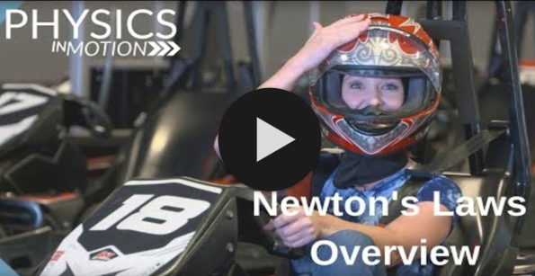
Physics in Motion
Click the image to play the video.
Discussion Questions:
How would you summarize Newton’s first law in your own words? How about the second? The third?
What is one real-world example of Newton’s Laws at work?
Notes:
Instructional Activity: Gain Attention, Recall, Provide Learning Guidance
Instructional Time: 10 min.
Materials: Video Link - https://www.youtube.com/watch?v=xMmFTA9AThw
Do:
Watch the video.
After watching the video, use the questions below to debrief.
Talking Points:
How would you summarize Newton’s first law in your own words? How about the second? The third?
Give a real-world example of Newton’s Laws at work.
Source: GPB Education. (2018, August 1). Physics in Motion: Segment 3A – Newton's laws overview [Video]. YouTube. https://www.youtube.com/watch?v=xMmFTA9AThw

Slide 27
Newton’s Law | Terms | Principle
1 | Inertia | Objects at rest stay at rest and objects in motion stay in motion unless acted upon by unbalanced force.
2 | Force and Acceleration | Acceleration depends on mass and amount of force [F =MA].
3 | Action and Reaction | When object exerts a force on second object, second object exerts equal and opposite force on the first object
Notes:
Instructional Activity: Direction
Instructional Time: 1 min.
Talking Points:
As we move through the rest of the lesson, use this chart in your Participant Resource guide as a reference.

Slide 28
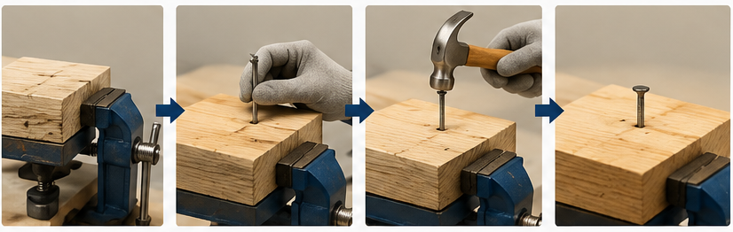
Hammer and Nail Demo
How are Newton’s Laws of Motion at work when hammering a nail?
Notes:
Instructional Activity: Provide Learning Guidance
Instructional Time: 10 min.
Materials:
Hammer
Nail
Block of wood
Clamp or vice
Safety gloves
Safety goggles
Do
Secure the wood in a clamp or vice.
Hold the nail upright on the wood.
Strike the nail with the hammer.
Observe how the nail moves into the wood.
Talking Points:
For this demonstration, we'll use a hammer, nail, block of wood, clamp or vice, and appropriate personal protective equipment, including safety gloves and safety goggles.
Here I have secured a block of wood in the clamp. I’ll place a nail upright on the wood and strike it with the hammer.
Strike the nail with the hammer.
Notice that the nail remains at rest until the hammer applies a force. This demonstrates Newton's First Law, also known as the Law of Inertia. An object at rest stays at rest until acted upon by an external force.
Next, we’ll compare a light tap with a harder strike.
Strike the nail with a light tap, then with a hard strike.
A harder hit applies more force, causing the nail to accelerate more quickly into the wood. This demonstrates Newton's Second Law, which explains that greater force produces greater acceleration when the mass remains the same.
Finally, when the hammer pushes on the nail, the nail pushes back on the hammer with an equal and opposite force. That reaction can be felt as vibration or a slight rebound in your hand. This demonstrates Newton's Third Law of Motion.
This simple demonstration shows how all three of Newton's Laws work together in a common maintenance task, helping explain how forces affect the tools and equipment you use every day.
Icon Attribution: “Work Management” icon by Soekahurip from Noun Project CC BY 3.0

Slide 29
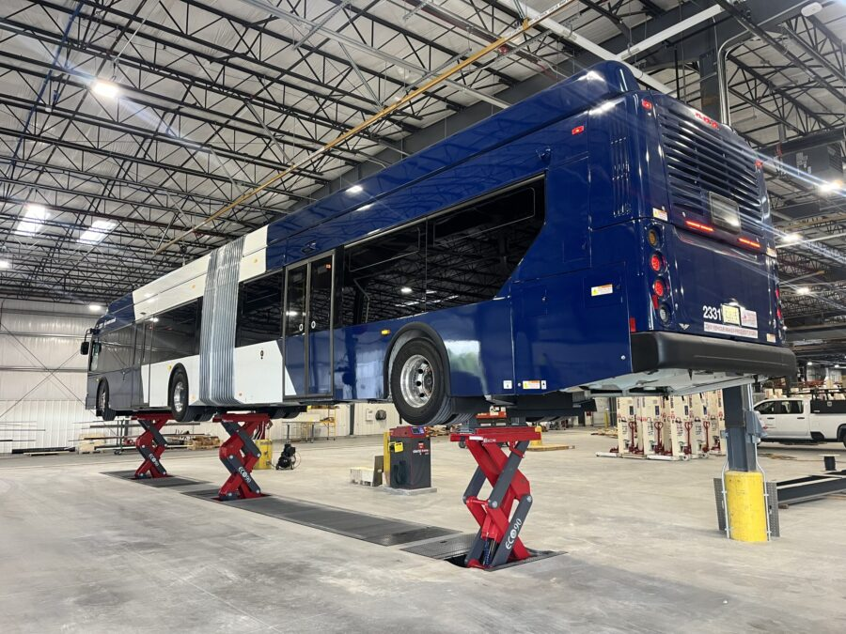
Knowledge Check
Explain how Newton’s first law applies to a bus on a lift.
Answer: The bus remains at rest until the hydraulic lift applies enough force to raise it. Once it's elevated, it stays there until another force lowers it.
Notes:
*This slide contains animations. CLICK to reveal content.
Instructional Activity: Evaluate/Assess Performance, Provide Feedback
Instructional Time: 3 min.
Learning Objective: Describe Newton’s Three Laws of Motion.
Do: Review the knowledge check question. Call on learners to share their responses.
Answer:
The bus remains at rest until the hydraulic lift applies enough force to raise it. Once it's elevated, it stays there until another force lowers it.

Slide 30
Knowledge Check
While inspecting a bus, a technician observes the suspension compress as the vehicle travels over a speed bump. Which statement best explains this using Newton's Third Law?
The suspension compresses because the bus loses inertia.
The road pushes upward on the tires as the tires push downward on the road.
The heavier the bus, the faster the suspension moves.
The suspension only moves because gravity is removed.
Notes:
*This slide contains animations. CLICK to reveal content.
Instructional Activity: Evaluate/Assess Performance, Provide Feedback
Instructional Time: 3 min.
Learning Objective: Describe Newton’s Three Laws of Motion.
Do: Review the knowledge check question. Call on learners to share their responses.
Answer:
B - As the tires push down on the road, the road pushes back with an equal and opposite force. The suspension helps absorb and manage these forces to provide a smoother ride.

Slide 31
Knowledge Check
Let’s revisit our warm-up question from the beginning of class.
Which TWO of Newton’s laws explain why the smaller person moves further and faster away when pushed?
Answer: Newton’s second and third laws
Notes:
*This slide contains animations. CLICK to reveal content.
Instructional Activity: Evaluate/Assess Performance, Provide Feedback, Recall
Instructional Time: 3 min.
Learning Objective: Describe Newton’s Three Laws of Motion.
Do: Review the knowledge check question. Call on learners to share their responses.
Answer:
This happens because of Newton's Third Law of Motion, which states that for every action, there is an equal and opposite reaction.
When you push on your nephew, your nephew pushes back on you with an equal amount of force, causing both skateboards to move apart.
The lighter person will usually roll away faster and farther because they have less mass.
This is explained by Newton's Second Law of Motion; the same force produces greater acceleration on an object with less mass.

Slide 32
Summary and What’s Next
Force causes objects to move.
Newton's First Law explains inertia.
Newton's Second Law relates force, mass, and acceleration.
Newton's Third Law explains action-reaction forces.
These laws apply to transit maintenance every day.
In the next section, you'll explore how the principles of physics apply to transit maintenance tasks
Notes:
*This slide contains animations. CLICK to reveal content
Instructional Activity: Recall, Enhance Retention and Transfer
Instructional Time: 5 min.
Do:
Review the key takeaways from this section of the module.
Clearly explain how to connects to the next section of the module.
Talking Points:
Ask: What are the most important things we learned about screws in this section?
Call on learners to respond.
In this section, you learned how Newton's Three Laws of Motion explain the way objects move and respond to forces.
CLICK – You saw that inertia keeps objects at rest or in motion until an outside force acts on them.
CLICK – You also learned that heavier objects require more force to accelerate, and that every action creates an equal and opposite reaction.
CLICK – Whether you're lifting a bus, using hand tools, or observing how tires interact with the road, these laws help explain how equipment and vehicles behave.
CLICK – In the next section, you'll explore how the principles of physics apply to transit maintenance tasks and how understanding forces, motion, and energy can help you work more safely around tools, equipment, and vehicles.

Slide 33

1.3 Real World Applications & Safety
This section will provide a glimpse at how the physics principles and Newton’s Three laws work in the real world.
Notes:
Instructional Activity: Direction
Instructional Time: 1 min.
Do: Introduce the section.
Talking Points: This section will provide a glimpse at how the physics principles and Newton’s Three laws work in the real world.

Slide 34
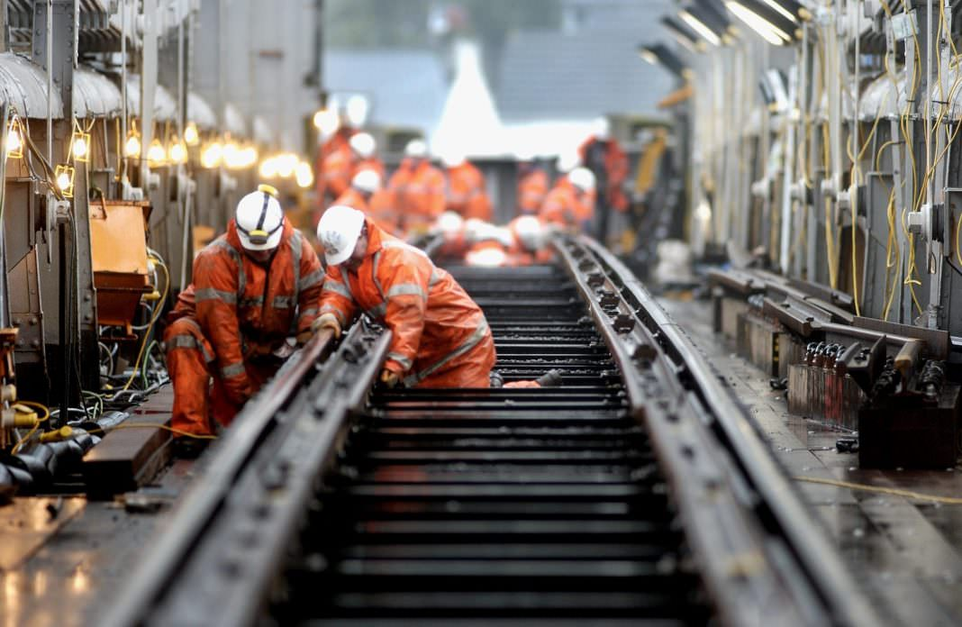
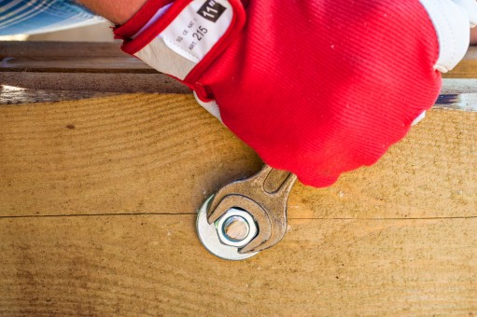
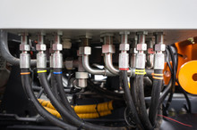
Maintenance Application
Lifting heavy parts - leverage and force
Hydraulic systems - pressure and force
Fastening systems - torque and friction
Track and vehicle maintenance - energy and motion
Notes:
Instructional Activity: Present Content
Instructional Time: 2 min.
Talking Points:
Physics is part of nearly every maintenance task you perform, whether you're lifting heavy components, tightening fasteners, or inspecting vehicles and equipment.
When lifting heavy parts, technicians rely on the principles of leverage and force to move objects safely and efficiently. Choosing the right lifting equipment helps reduce the effort required and lowers the risk of injury.
Hydraulic systems use pressure to create force. Equipment such as vehicle lifts, jacks, and hydraulic tools allow technicians to move or support loads that would be impossible to handle manually.
Fastening systems depend on torque and friction to create secure connections. Applying the correct torque ensures bolts are tight enough to hold components together without causing damage.
Finally, track and vehicle maintenance involve energy and motion. Understanding how vehicles accelerate, brake, and transfer forces helps technicians diagnose problems, perform repairs, and verify that equipment operates safely.

Slide 35
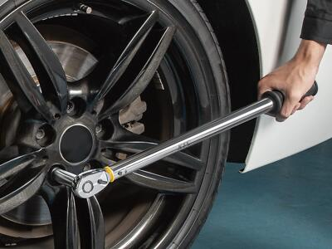
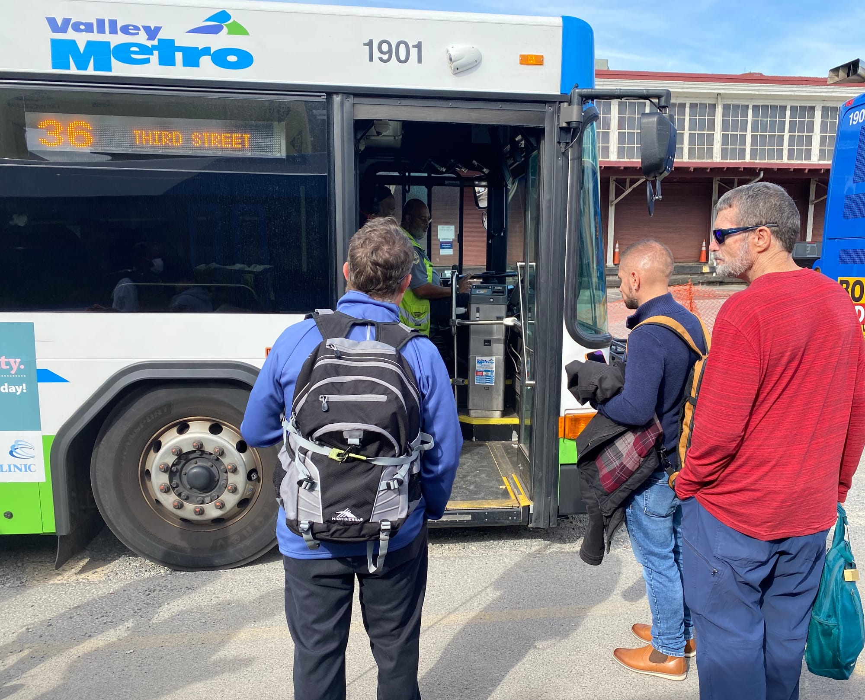
Safety and Physics
Why physics matters for safety:
Recognize forces in motion
Use tools and equipment safely
Avoid physical overexertion
Prevent equipment failures
Understand speed, friction, and braking
Notes:
Instructional Activity: Present Content
Instructional Time: 2 min.
Talking Points:
Physics isn't just a scientific concept. It plays an important role in keeping you safe on the job.
Every maintenance task involves forces, motion, or energy. Recognizing these forces helps you anticipate how tools, equipment, and vehicles will behave before you begin work.
Understanding physics also helps you use the right tool for the job and operate equipment safely.
Applying the correct amount of force can prevent damaged tools, broken components, and unsafe working conditions.
Knowing how leverage, force, and mechanical advantage work also helps you work smarter, not harder.
Using proper techniques reduces physical strain and lowers the risk of overexertion injuries.
Physics also helps prevent equipment failures.
Understanding how forces act on parts and fasteners allows technicians to recognize unsafe conditions before they become larger problems.
In transit operations, physics is equally important.
Operators and maintenance personnel rely on an understanding of speed, friction, momentum, and braking distance to help keep vehicles, passengers, and coworkers safe.
By understanding the basic principles of physics, you can make safer decisions, protect equipment, and perform maintenance more effectively.

Slide 36
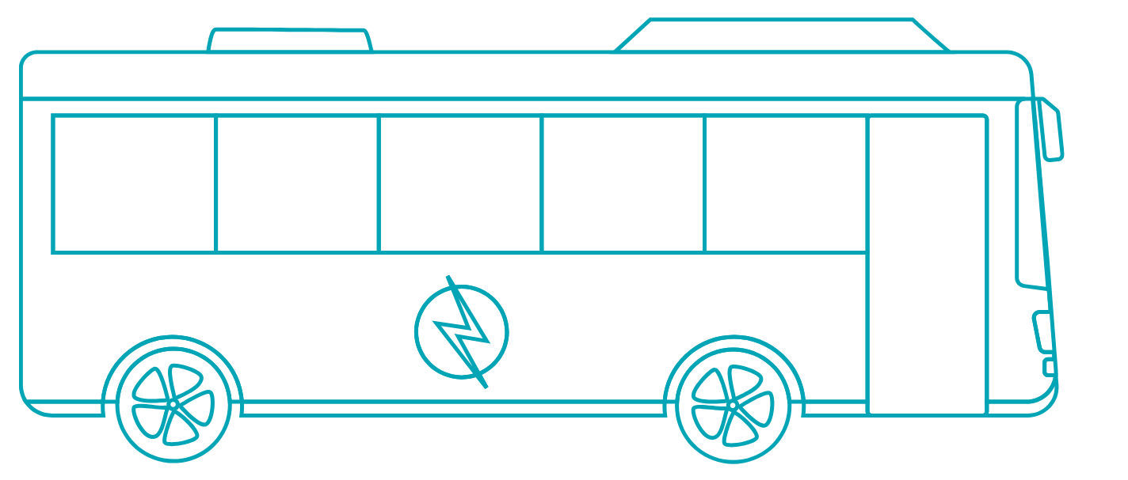

Discussion
Scenario: A transit agency is replacing its older diesel buses with new electric buses as part of its sustainability plan.
Electric buses produce no tailpipe emissions but are typically heavier than diesel buses because of their battery packs. They also use regenerative braking, which captures energy during braking and uses it to recharge the battery.
Using physics concepts as a guide, how will this change impact:
Safety (momentum, force, braking…)
Energy (efficiency, energy recovery…)
Cost (fuel costs, brake wear, maintenance…)
Sustainability (emissions, energy use…)
Notes:
*This slide contains animations. CLICK to reveal content.
Instructional Activity: Provide Guided Learning, Elicit Performance, Provide Feedback
Instructional Time: 15 min.
Do:
Read the scenario to the group.
Facilitate a discussion using the question and topics on the slide.
Encourage learners to connect their answers to physics concepts discussed throughout the lesson.
Answer Key
Safety
Electric buses have greater mass and momentum, requiring more force to accelerate and stop.
Their added weight may affect braking distance and vehicle handling.
Energy
Regenerative braking converts some motion into electricity and returns it to the battery.
Recovering energy improves efficiency and extends driving range.
Cost
Electricity may cost less than diesel fuel.
Regenerative braking reduces brake wear and maintenance.
Sustainability
Electric buses produce no tailpipe emissions, improving local air quality.
Their overall environmental impact depends partly on how the electricity is generated and how batteries are produced and recycled.

Slide 37

Quiz
Time for a quiz! Let’s see what you have learned from today’s lesson.
Notes:
Instructional Activity: Direction, Evaluate/Assess Performance
Instructional Time: 20 min.
Materials: Quiz_Physics
Do:
Ask learners if they have any lingering questions. Address them before distributing the quiz.
Pass out the quiz and review the directions.
Talking Points:
Time for a quiz! Let’s see what you have retained from today’s lesson.

Slide 38
Revisiting Objectives
Define physics and explain concepts such as force, motion, work, energy, power, resistance and friction.
Describe Newton’s Three Laws of Motion.
Apply basic principles to real world mechanical systems in transit maintenance.
Notes:
Instructional Activity: Enhance Transfer and Retention
Instructional Time: 5 min.
Do: Facilitate a short discussion to review the key topics in the lesson.
Talking Points:
If you were explaining today’s objectives to someone else, how would you summarize what they mean and why they matter?
Which of today’s objectives do you feel most confident about? Which were most challenging? Explain your reasoning.
Can you give an example of how you could apply one of today’s objectives in a real-world situation?
After Discussion:
This conclude this section of the module. Thank you for your participation.

Slide 39
Thank you!
Notes:
Instructional Activity: Enhance Transfer and Retention
Instructional Time: 2 min.
Do:
Thank learners for their participation.
If possible, stay after class to answer any lingering questions learners may have.

