Slide 1
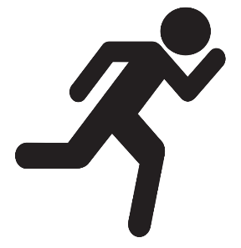

Instructor Guide Snapshot
Icon Key
Activity:
Video:
Instructor Demo:
Knowledge Check:
Instructional Time: 3.5 Hrs.
Preparation before class:
  Review all materials - Review all slides, talking points, and handouts before class to understand the structure and flow of the lesson. Pay special attention to animations within the slides.
  Measurement Exercises – If possible, schedule a field trip to complete the “Exercise” section for linear, area, and circular measurement on the handout.
Provided Course Materials:
  +Measurements_M4
  Measurement Cheat Sheet_M4
  Measurement Cheat Sheet_Volumn Answer Key M4
  Math and Measurement Challenge_M4
  Math and Measurement Challenge_Answer Key_M4
  Quiz_M4
  Quiz_Answer Key_M4
Additional Materials:
  Calculator - one per learner
  Measuring tape – one per learner or pair if sharing
  Calipers or flexible measuring tape – one per learner or pair if sharing
  Circular materials that relate to participants job tasks (Ex: a piece of pipe, metal rod, etc.)
  for measurement practice

Slide 2
Pacing Guide
Times have been rounded to the nearest .25 hours.
Total Time: 3.5 Hours
(.25 Hrs.) Welcome and Warm Up
(.75 Hrs.) 4.1 - Linear Measurement
(.5 Hrs.) 4.2 - Area Measurement
(.5 Hrs.) 4.3 - Circular Measurement
(.5 Hrs.) 4.4 - Volume Measurement
(.5 Hrs.) 4.5 - Math and Measurement Activity
(.5 Hrs.) Quiz and Wrap Up

Slide 3
Measurements
Shop Math
Transit Core Competencies Curriculum (TC3)
Notes:
Instructional Activity: Direction
Instructional Time: 1 min.
Do: Welcome learners to class. Introduce the course and module.

Slide 4
Objectives
Demonstrate the ability to solve mathematics problems involving measurement.
  Measure and calculate length using appropriate units and tools.
  Calculate the area of surfaces using appropriate formulas and units.
  Solve mathematics problems involving circular objects by calculating diameter, circumference, and area.
  Calculate volume using appropriate formulas and units.
Notes:
Instructional Activity: Direction
Instructional Time: 2 min.
Do: Review the module objectives.

Slide 5
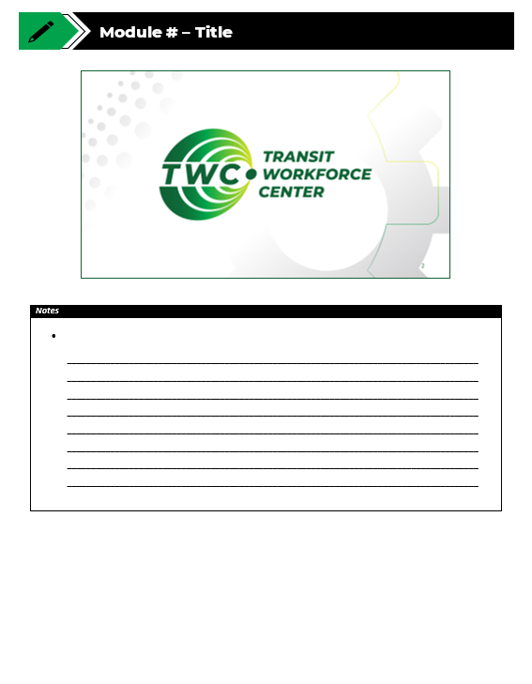
Agenda
Welcome and Warm Up
4.1 - Linear Measurement
4.2 - Area Measurement
4.3 - Circular Measurement
4.4 - Volume Measurement
4.5 – Math and Measurement Activity
Quiz and Wrap Up
Notes:
Instructional Activity: Direction
Instructional Time: 2 min.
Do: Review the module agenda.

Slide 6

Warm Up Discussion
Think about a time when you had to measure something at work, at home, or in everyday life.
What were you measuring?
What could happen if your measurement was off?
What did you do to ensure your measurement was accurate?
Notes:
Instructional Activity: Gain Attention, Recall
Instructional Time: 10 min.
Do: Use the discussion questions on the slide to facilitate a short discussion.
Talking Points:
Think about a time when you had to measure something in your everyday life or on the job.
It could be something simple, like measuring a space, hanging a picture, or fitting something into place.
Facilitate discussion using questions on slide.
These are the kinds of situations where measurement skills are important, and they connect directly to what we’ll be learning in this module.

Slide 7
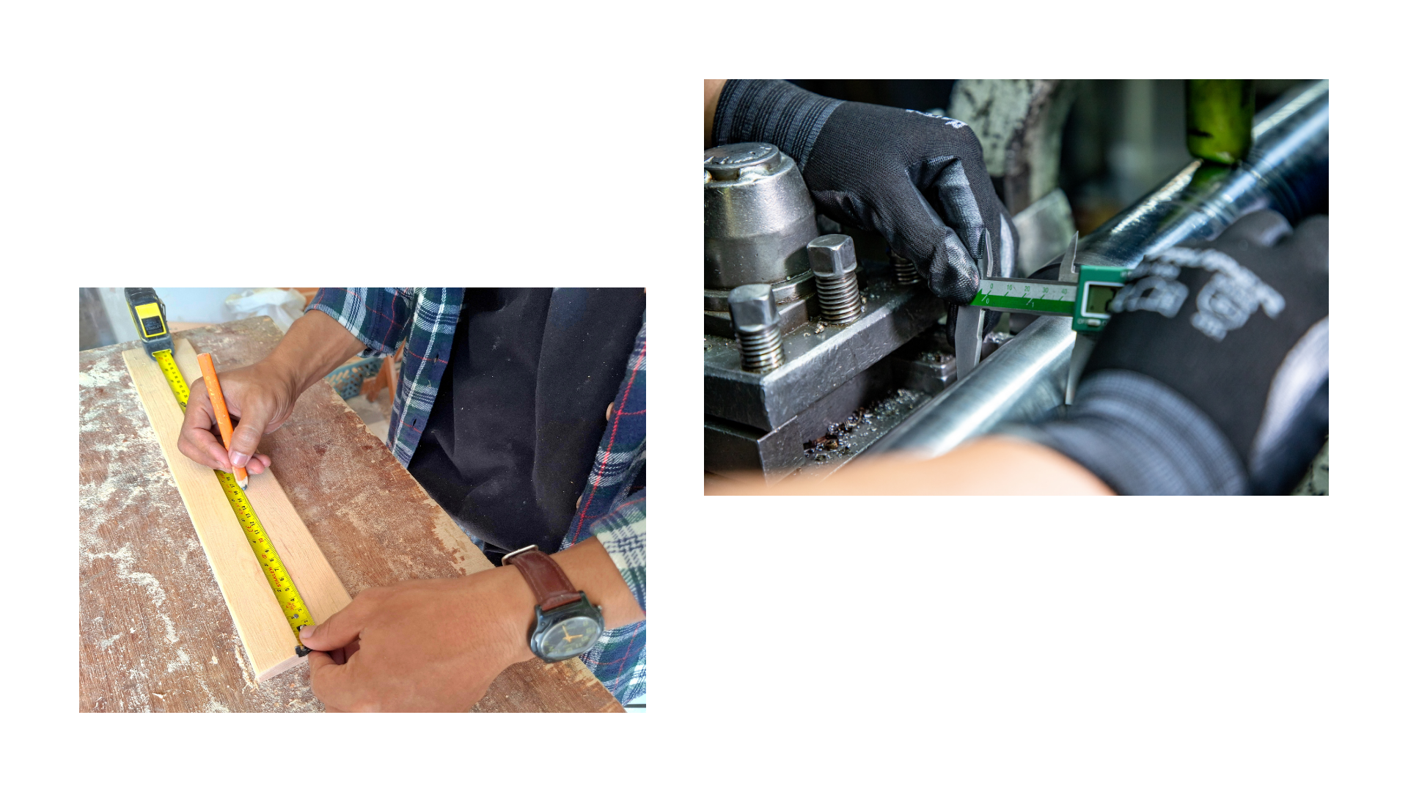
What is Measurement?
Measurement is the process of finding out how big, long, heavy, or full something is by using standard units.
Types of measurement: linear, area, circular, volume.
  Concept
  Units
  Tools
  Exercises
  Real-world applications
Notes:
Instructional Activity: Present Content
Instructional Time: 2 min.
Talking Points:
Measurement is the process of figuring out how big, long, heavy, or full something is using standard units.
In this course, we are going to focus on four types of measurement: linear, area, circular, and volume.
Each type of measurement helps us understand something different, like length, surface, or space inside an object.
As we move through the module, you will learn the key concepts behind each type of measurement.
You will also learn the units used, the tools needed, and how to perform the calculations.
Most importantly, we will connect these skills to real-world tasks you may perform on the job.
By the end of this module, you should feel more confident using measurement in practical situations.
Source: Mathnasium. (n.d.). Measurement. Mathnasium. https://www.mathnasium.com/math-terms/measurement

Slide 8
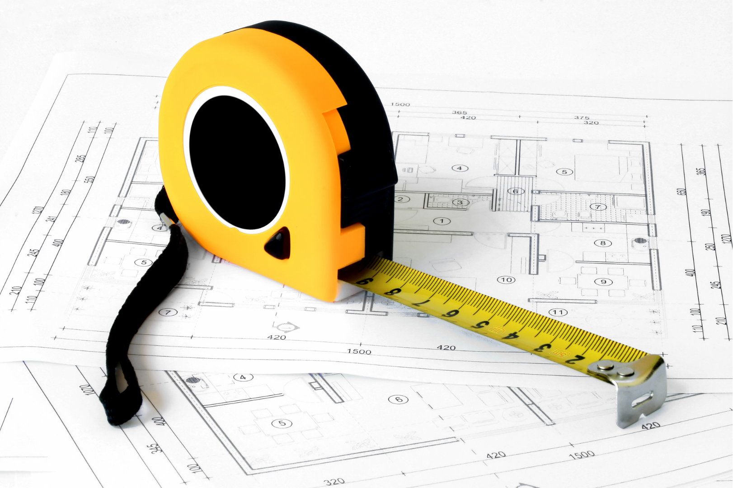
Why do Measurements Matter?
Ensures proper fit and alignment
Prevents wasted materials
Supports safety on the job
Saves time and money
Helps get the job done right the first time
Notes:
Instructional Activity: Present Content
Instructional Time: 2 min.
Talking Points:
Measurements are something you’ll use on almost every job task.
Even small errors like being off by half an inch can cause real problems.
If something doesn’t fit correctly, it can lead to rework, delays, or safety risks.
Accurate measurements help reduce waste, which saves both time and money.
This is especially important when materials and labor are expensive.
At the end of the day, good measurements help you do the job right the first time and a safe and efficient manner.

Slide 9
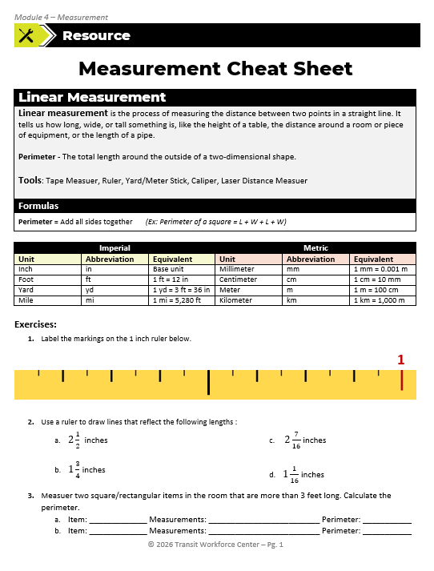
Measurement Cheat Sheet
In your Participant Resource Guide, you’ll find a Measurement Cheat Sheet.
This resource contains helpful notes and exercises we’ll complete throughout the lesson.
Notes:
Engagement Strategy – If possible, take a field trip to complete the “Exercise” section for linear, area, and circular measurement on the handout.
Instructional Activity: Direction
Instructional Time: 1 min.
Materials: Measurement Cheat Sheet_M4
Talking Points:
In your Participant Resource Guide, you’ll find a Measurement Cheat Sheet.
This resource contains helpful notes and exercises we’ll complete throughout the lesson.

Slide 10
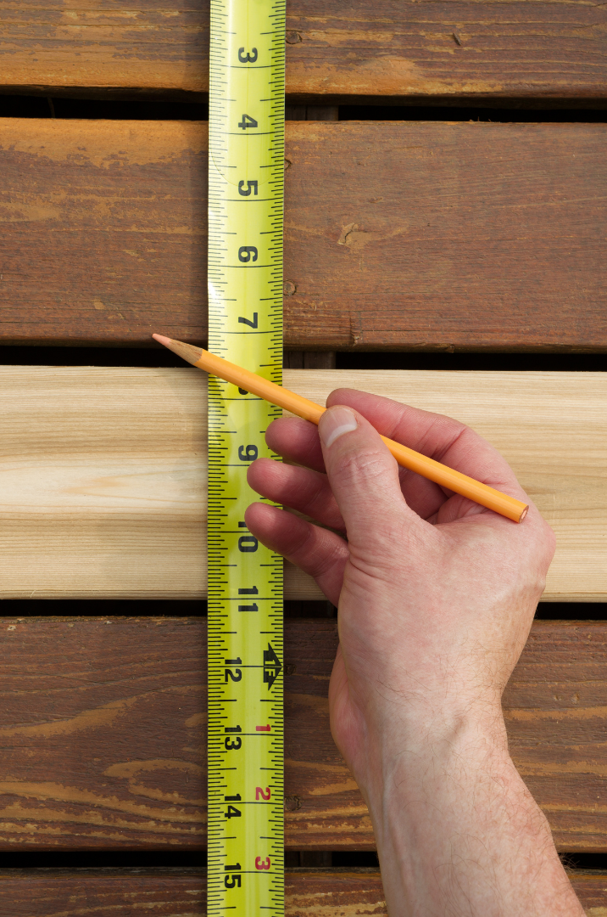
4.1 - Linear Measurement
In this section, we’ll review linear measurements including units, tools, basic calculations, and real-world applications.
Notes:
Instructional Activity: Direction
Instructional Time: 1 min.
Talking Points:
In this section, we’ll review linear measurements including units, tools, basic calculations, and real-world applications.

Slide 11
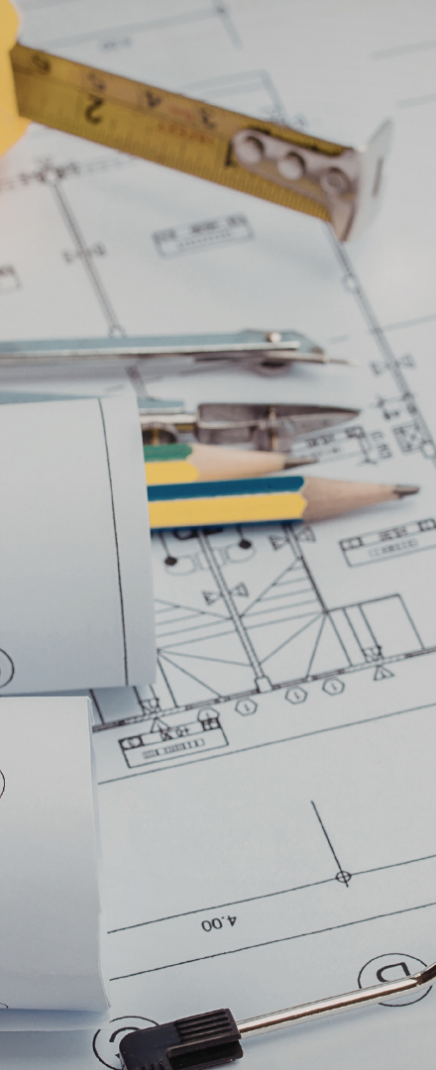
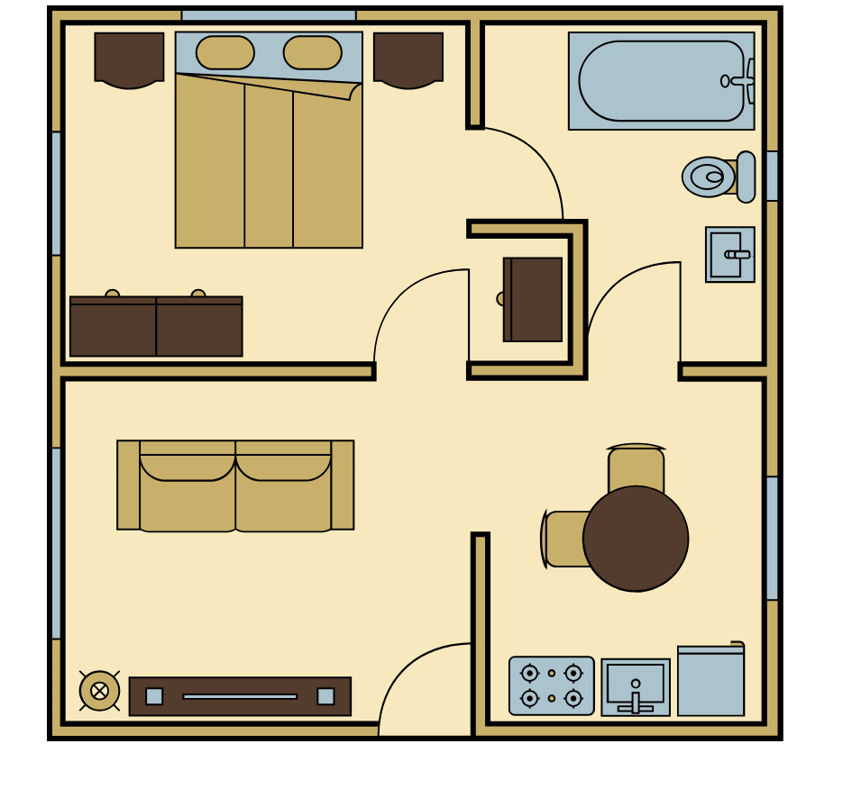
Concept
Linear Measurements
The process of measuring the distance between two points in a straight line.
It tells us how tall, wide, or long something is.
Units
Tools
Perimeter - The total length around the outside of a two-dimensional shape.
  Ex: Perimeter of a Square:
  P = L + W + L + W
  P = 10 + 10 + 10 + 10
  P = 40 Ft.
10 Ft.
Exercises
10 Ft.
10 Ft.
Application
10 Ft.
Notes:
*This slide contains animations. CLICK to reveal content.
Instructional Activity: Present Content
Instructional Time: 2 min.
Talking Points:
Linear measurement is the process of measuring the distance between two points in a straight line.
It tells us how long, wide, or tall something is, like the height of a table, the distance around a room or piece of equipment, or the length of a pipe.
Linear measurements can help us calculate the perimeter of a shape.
CLICK - Perimeter is the total length around the outside of a two-dimensional shape.
To calculate the perimeter, measure the sides of a share and add all the sides together.
For a square or rectangle, the formula would be P = L + W + L + W
ASK: What is the perimeter of the room pictured on the slide?
Call on learners to respond. CLICK to reveal the answer: P = 40ft
Source: Mathnasium. (n.d.). Length. Mathnasium. https://www.mathnasium.com/math-terms/length

Slide 12
Concept
Linear Measurement Units
Imperial
Unit | Abbreviation | Equivalent
Inch | in | Base unit
Foot | ft | 1 ft = 12 in
Yard | yd | 1 yd = 3 ft = 36 in
Mile | mi | 1 mi = 5,280 ft
Units
Tools
Metric
Unit | Abbreviation | Equivalent
Millimeter | mm | 1 mm = 0.001 m
Centimeter | cm | 1 cm = 10 mm
Meter | m | 1 m = 100 cm
Kilometer | km | 1 km = 1,000 m
Exercises
Application
Notes:
*This slide contains animations. CLICK to reveal content.
Instructional Activity: Present Content
Instructional Time: 2 min.
Talking Points:
There are two main systems used to measure length: the imperial system and the metric system.
The imperial system is the standard system used in the United States and measures length using units like inches, feet, yards, and miles.
Inches are used for smaller, more precise measurements, while feet are used for larger materials or distances.
Yards are used for measuring larger layouts, and miles are used for long distances.
Each unit builds on the one before it, with 12 inches in a foot and 3 feet in a yard, which helps when converting between units.
CLICK - The metric system is used in most other countries and is sometimes used in tools and equipment, and it is based on units of 10.
The metric system includes millimeters, centimeters, meters, and kilometers, which are used for different sizes of measurement.
Millimeters and centimeters are used for small measurements, meters are used for general length, and kilometers are used for long distances.
Even if you mainly use imperial units, it is important to recognize metric units when working with different tools or specifications.
Being familiar with both systems helps you read measurements accurately and avoid mistakes on the job.

Slide 13
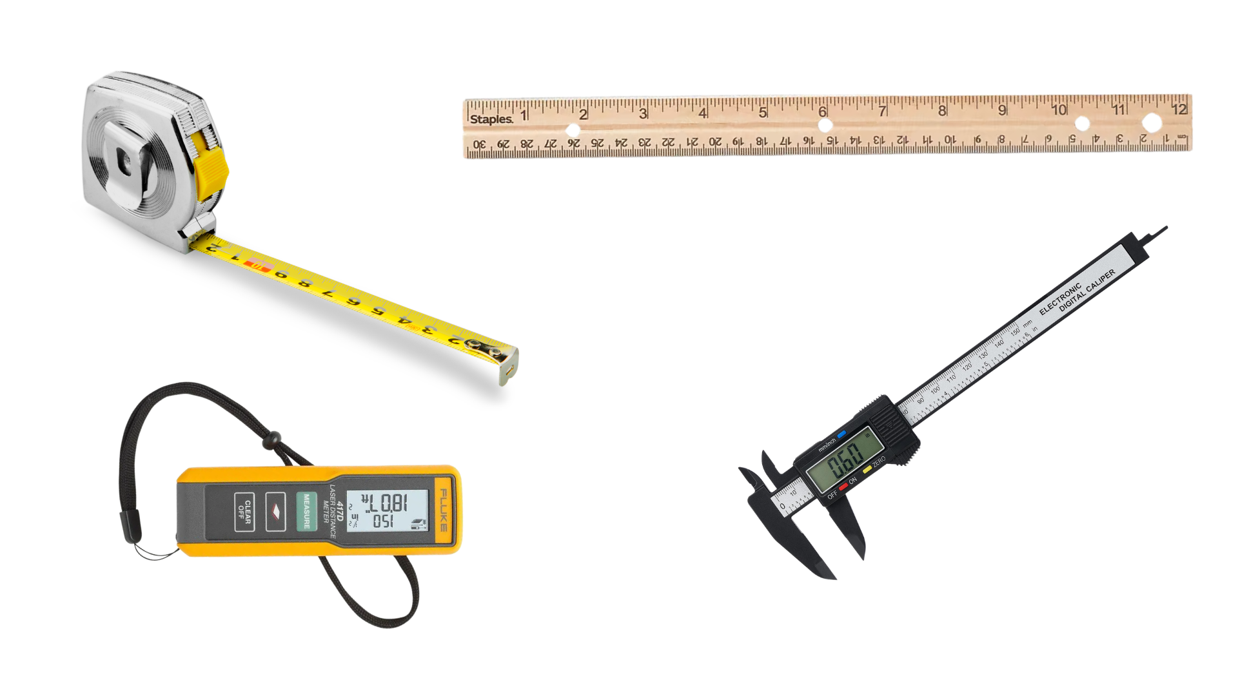
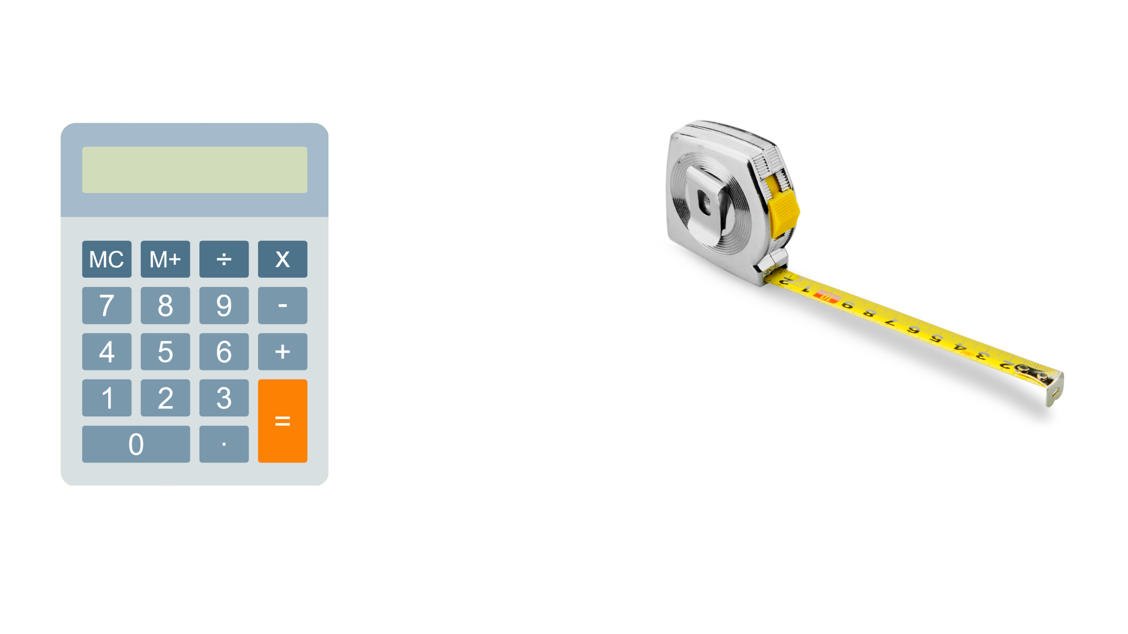
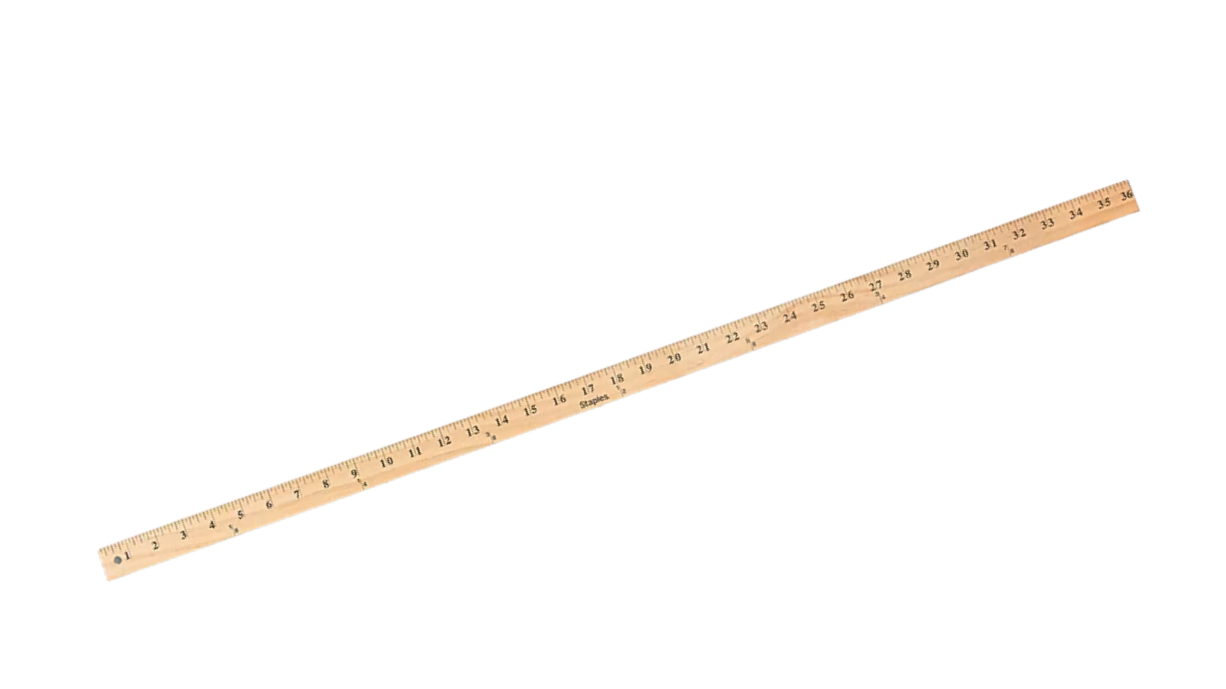
Concept
Linear Measurement Tools
Ruler
Units
Tape Measure
Tools
Exercises
Yard/Meter Stick
Calipers
Application
Notes:
Instructional Activity: Present Content
Instructional Time: 3 min.
Talking Points:
There are several tools used to measure length, and each one is designed for a different type of task.
A tape measure is the most commonly used tool in maintenance work because it is flexible and can measure both short and long distances. It has a retractable tape which comes in a variety of lengths (Ex: Small – 3 feet, Large – 40 feet).
A ruler is used for short, precise measurements and is typically used when working with smaller parts or detailed tasks.
A yardstick or meter stick is a rigid measuring tool that is useful for measuring longer, flat surfaces.
Calipers are used for very precise measurements and are designed to measure small dimensions with a high level of accuracy. They can measure the outside of an object, the inside of an opening, and the depth of a space, depending on how they are positioned
A laser distance measurer uses a laser to quickly measure longer distances by sending a beam to a surface and calculating how long it takes to return. It provides a digital reading, which makes it easy to read and reduces the chance of error.
Knowing which tool to use helps you measure accurately and efficiently depending on the task

Slide 14
















How to Read a Ruler
1
8
1
4
3
8
1
2
5
8
3
4
7
8
1
$$\frac{1}{16}$$
$$\frac{3}{16}$$
$$\frac{5}{16}$$
$$\frac{7}{16}$$
$$\frac{9}{16}$$
$$\frac{11}{16}$$
$$\frac{13}{16}$$
$$\frac{15}{16}$$
$$\frac{2}{16}$$
$$\frac{4}{16}$$
$$\frac{6}{16}$$
$$\frac{8}{16}$$
$$\frac{10}{16}$$
$$\frac{12}{16}$$
$$\frac{14}{16}$$
$$\frac{16}{16}$$
Notes:
*This slide contains animations. CLICK to reveal content.
Instructional Activity: Present Content, Provide Learning Guidance
Instructional Time: 4 min.
Do:
Use the animations on the slide to teach leaners how to read a ruler.
Start by explaining that each line on the rules equals 1/16.
Then explain how these 16th can be simplified to reflect 1/2, 1/4, and 1/8.
Talking Points:
One of the most useful and widely applicable skills on the job is knowing how to accurately read a ruler or tape measure.
Here is a close up of one inch on a tape measure.
We’ll need to use our understanding of fractions, including simplifying fractions, to accurately read the tape measure.
CLICK – There are 16 little lines within the inch. Each of these little lines represents $\frac{1}{16}$ . So, you have $\frac{1}{16},\frac{2}{16},\frac{3}{16}$ and so on down the line.
When we measure something, we’re measuring to the nearest 16th. However, these fractions can be simplified to make things a bit clearer.
CLICK – Take a look at $\frac{8}{16}$ . How could that be simplified?
Call on learners to respond. CLICK to reveal the answer: ½.
CLICK – How about $\frac{4}{16}$ and $\frac{12}{16}$ . How could those be simplified?
Call on learners to respond. CLICK to reveal the answer: ¼, ¾ .
So, if you measure something that is 5 $\frac{8}{16}$ inches, that’s the same as saying 5 ½ . Similarly, if you measure something that is 11 $\frac{12}{16}$ , that’s the same as saying 11 ¾ .
CLICK – How about $\frac{2}{16},$ $\frac{6}{16}$ $,$ $\frac{10}{16}$ and $\frac{14}{16}$ . How could those be simplified?
Call on learners to respond. CLICK to reveal the answer: 1/8, 3/8, etc.

Slide 15
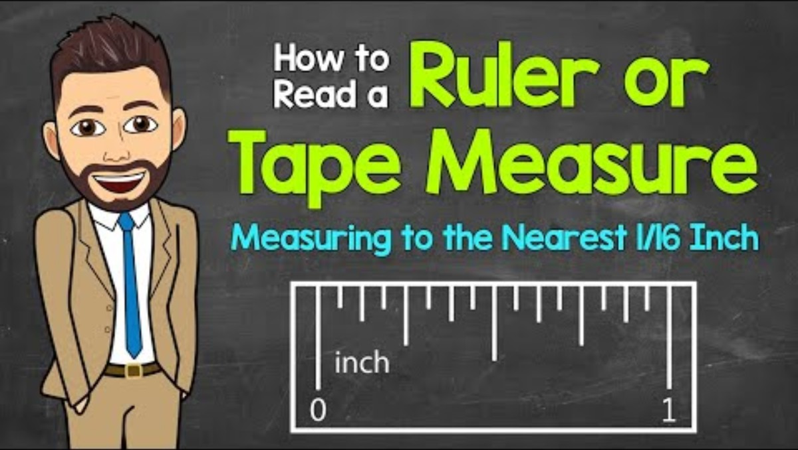
How to Read a Ruler
Pause at 09:20 Complete the practice problems
Pause at 12:23 Complete the practice problems
Notes:
Note to Instructors – This is an optional video to reinforce learning.
Instructional Activity: Provide Learning Guidance
Instructional Time: 20 min.
Materials: Video Link - https://www.youtube.com/watch?v=fRcrFdYXHj4
Do:
Play the video to reinforce how to read a ruler.
Pause the video at 09:20 and 12:23 to complete the practice problems as a group.
Source: Math with Mr. J, (2025, April 27). How to read a ruler or tape measure [Video]. YouTube. https://www.youtube.com/watch?v=fRcrFdYXHj4

Slide 16
Concept
Linear Measurement Exercises
Units
Tools
Exercises
Application
Notes:
Instructional Activity: Provide Learning Guidance, Elicit Performance, Provide Feedback
Instructional Time: 12 min.
Materials:
Measurement Cheat Sheet_M4
Measuring tape – one per learner or pair if sharing
Calculator - one per learner
Do:
Refer learners to the “Measurement Cheat Sheet_M4” handout embedded in the Participant Resource Guide.
Ask learner to complete the items listed under “Exercises.”
Circulate the room while learners work checking answers, answering questions, and providing feedback.
To review, ask learners to switch papers with a partner who will check their measurements.

Slide 17
Concept
Linear Measurement Applications
Measuring and cutting materials to the correct length
Checking spacing and alignment between components
Measuring small parts and clearances for proper fit
Measuring rooms or work areas for layout and planning
Verifying measurements from drawings or specifications
Units
Tools
Exercises
Application
Notes:
Instructional Activity: Present Content
Instructional Time: 2 min.
Talking Points:
Linear measurement is used in many everyday tasks on the job, especially when accuracy matters.
One of the most common uses is measuring and cutting materials to the correct length so they fit properly.
It is also used to check spacing and alignment between components to make sure everything is installed correctly.
For smaller parts, linear measurement helps ensure proper fit by measuring clearances and dimensions.
When planning a workspace, measurements are used to determine how much space is available and where equipment should go.
Linear measurement is also used to verify dimensions from drawings or specifications before starting work.
Overall, accurate measurement helps prevent mistakes, reduce waste, and ensure the job is done correctly.

Slide 18
Summary and What’s Next
Linear measurement tells us length, width, or height
Measured using standard units like inches and feet
Tools include tape measures, rulers, and laser measurer
Next, we will move from measuring lines to measuring surfaces using area.
Notes:
Instructional Activity: Enhance Retention and Transfer
Instructional Time: 2 min.
Talking Points:
Linear measurement helps us determine how long, wide, or tall something is.
We use standard units like inches and feet, along with tools like tape measures and rulers.
This type of measurement is used anytime we are working in a straight line.
Next, we will move from measuring lines to measuring surfaces using area.

Slide 19
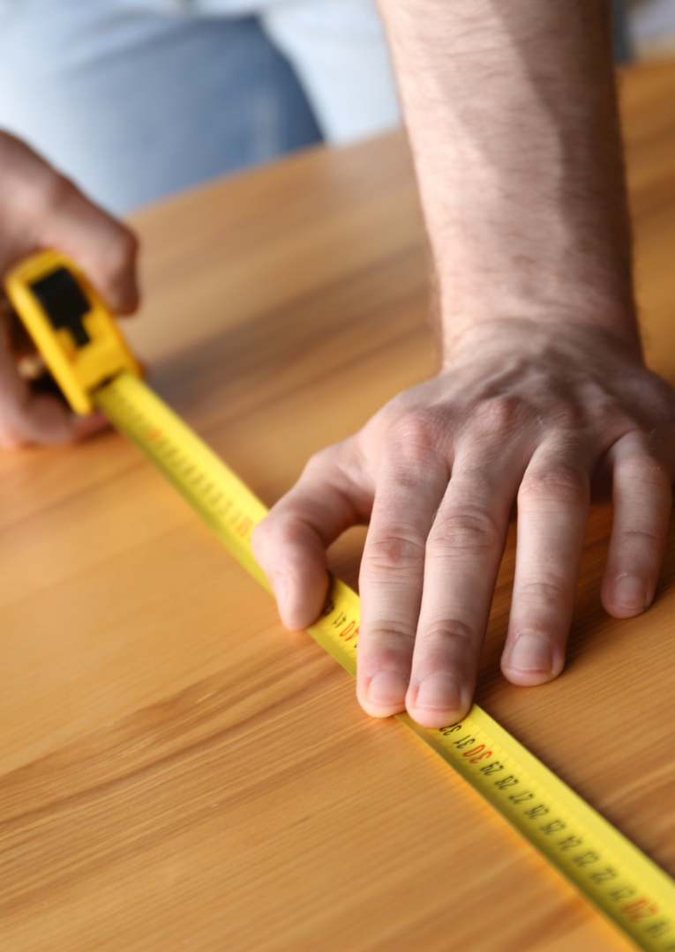
4.2 - Area Measurement
In this section, we’ll review area measurements including units, tools, basic calculations, and real-world applications.
Notes:
Instructional Activity: Direction
Instructional Time: 1 min.
Talking Points:
In this section, we’ll review area measurements including units, tools, basic calculations, and real-world applications.

Slide 20
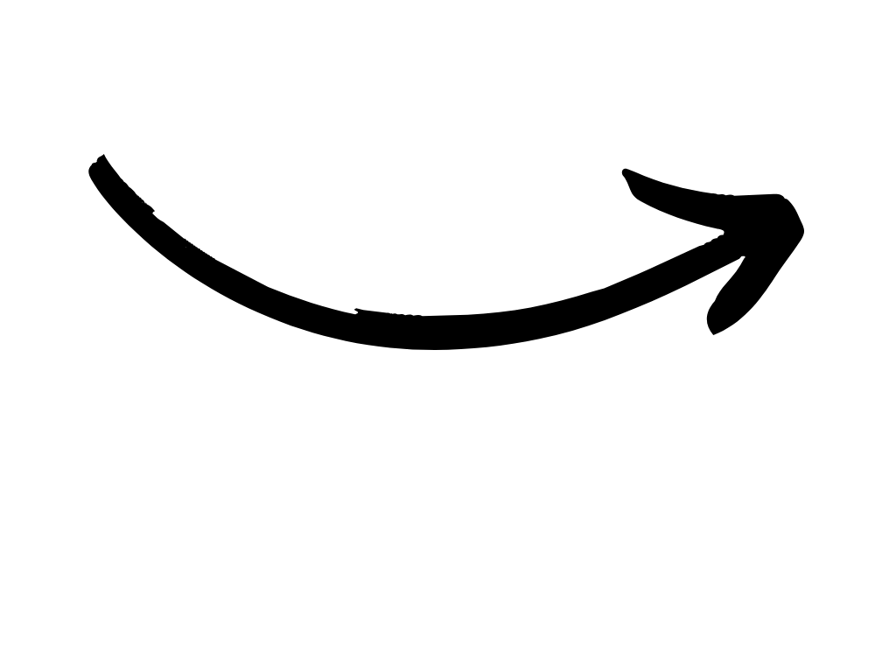
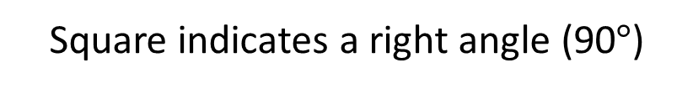
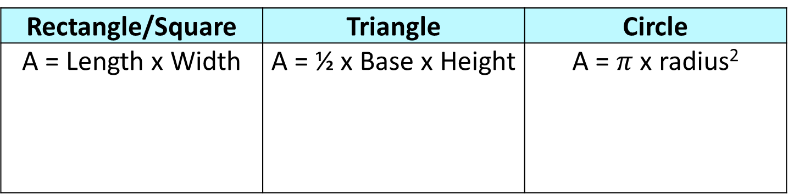
Concept
Area Measurement
Area is the amount of space inside a flat surface.
It tells us how many square units fit inside a two-dimensional figure.
  Ex: Flooring in a room, paint on a wall, etc.
Units
Tools
Rectangle/Square | Triangle | Circle
A = Length x Width | A = ½ x Base x Height | A = $π$ x radius²
Exercises
W
R
H
L
B
Application
Square indicates a right angle (90$°$)
Notes:
*This slide contains animations. CLICK to reveal content.
Instructional Activity: Present Content
Instructional Time: 2 min.
Talking Points:
Area is the amount of space inside a flat surface, and it tells us how much surface something covers.
It tells us how many square units fit inside a two-dimensional figure.
When we measure area, we're really asking: "How many of these 1-by-1 squares can fit inside this shape?"
This is different from linear measurement because now we are looking at surface space instead of just length.
You will use area anytime you need to cover something, like flooring in a room or paint on a wall.
CLICK - To calculate area, we use formulas based on the shape we are working with.
For rectangles and squares, we multiply length by width.
For triangles, we use one-half times the base times the height. When you see a square in the corner of the triangle, that means it’s a right angle (90 degrees).
For circles, we use pi times the radius squared.
Each formula is designed to match the shape, but they all help answer the same question: how much space does this cover?
Source: Mathnasium. (n.d.). Area. Mathnasium. https://www.mathnasium.com/math-terms/area

Slide 21
Concept
Area Measurement Units
Measured in square units, no matter the shape
Imperial (U.S.)
Square inches (in²)
Square feet (ft²)
Square yards (yd²)
Metric
Square millimeters (mm²)
Square centimeters (cm²)
Square meters (m²)
Units
5 ft.
Tools
5 ft.
Exercises
A = L x W
A = 5 x 5
A = 25 ft.
2
Application
Notes:
Instructional Activity: Present Content, Provide Learning Guidance
Instructional Time: 2 min.
Talking Points:
Area is always measured in square units, no matter the shape we are working with.
A square unit represents a space that is one unit by one unit, like one foot by one foot.
In the U.S., we typically use the imperial system and commonly use square inches, square feet, and square yards depending on the size of the surface.
Square inches are used for smaller surfaces, while square feet are used for things like rooms, floors, and walls.
Square yards are used for larger areas, but less frequently in everyday maintenance tasks.
The metric system also uses square units, including square millimeters, square centimeters, and square meters.
Remember, these metric units follow a base-10 system, which makes conversions more straightforward.
ASK: Looking at the example slide, what would the area of this square be if each side is 5 ft.?
Call on learners to respond. CLICK to reveal the answer: 25 feet squared.
Notice that the unit is squared, which shows we are measuring surface space, not just length.

Slide 22
Concept
Area Measurement Tools
Any tool that can measure length and width
Units
Tools
Exercises
Application
Notes:
Instructional Activity: Present Content
Instructional Time: 1 min.
Talking Points:
When it comes to tools for calculating area, we can use anything that can measure length and width.
Rulers, tape measurers, and laser distance measurers can all be useful for identifying length and width to calculate area.

Slide 23
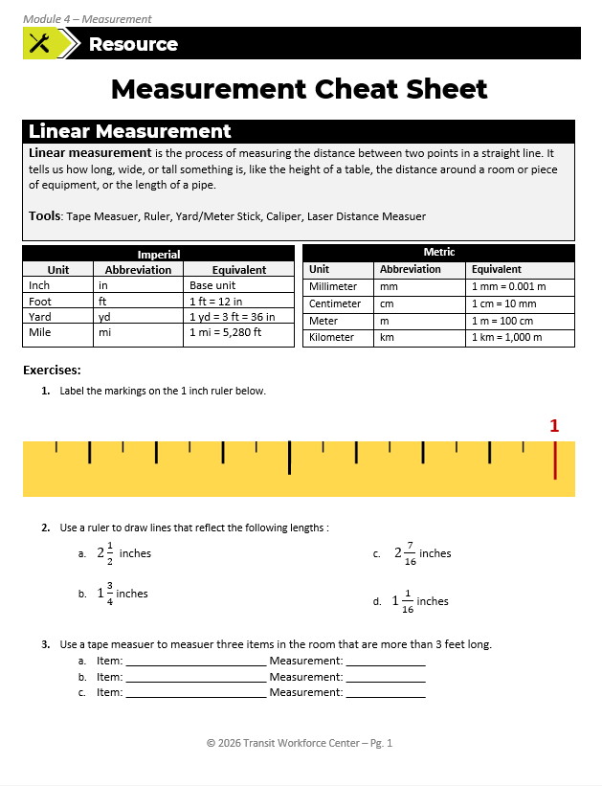
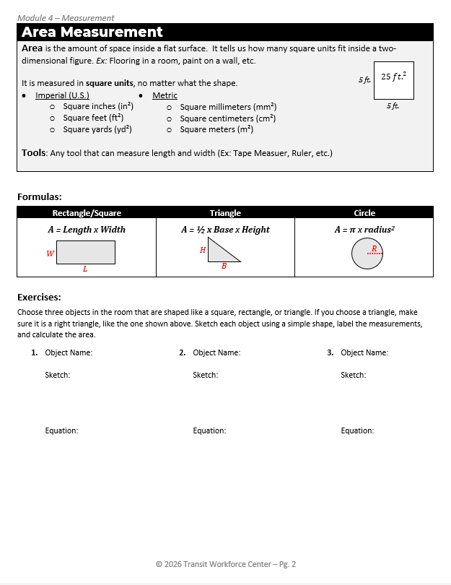
Concept
Area Measurement Exercises
Units
Tools
Exercises
Application
Notes:
Instructional Activity: Provide Learning Guidance, Elicit Performance, Provide Feedback
Instructional Time: 12 min.
Materials:
Measurement Cheat Sheet_M4
Measuring tape – one per learner or pair if sharing
Calculator - one per learner
Do:
Refer learners to the “Measurement Cheat Sheet_M4” handout embedded in the Participant Resource Guide.
Ask learner to complete the items listed under “Exercises” in the Area Measurement section on page. 2.
Circulate the room while learners work checking answers, answering questions, and providing feedback.
To review, ask learners to switch papers with a partner who will check their measurements.

Slide 24
Concept
Area Measurement Applications
Calculating how much paint or flooring material is needed to cover a surface
Measuring surface area for cleaning, sealing, or maintenance tasks
Planning workspace layouts to ensure there is enough room for equipment and safe movement
Estimating materials needed for coverings like panels, mats, or insulation
Units
Tools
Exercises
Application
Notes:
Instructional Activity: Present Content
Instructional Time: 2 min.
Talking Points:
Area measurement is used on the job anytime a surface needs to be covered or planned.
Workers use area to calculate how much paint or coating is needed for walls, equipment, or other surfaces. It is also used to determine how much flooring material is required for a workspace or maintenance area.
Area helps estimate materials needed for tasks like covering surfaces with panels, mats, or insulation.
It is also important for measuring surfaces that need to be cleaned, sealed, or maintained.
Area is used when planning layouts to make sure there is enough space for equipment and safe movement.

Slide 25
Knowledge Check
A maintenance worker needs to cut a piece of conduit to fit between two connection points that are 42 inches apart.
Which measurement represents the correct length of the conduit?
(A). 3.5 Ft
(A). 3.5 Ft
(B). 42 square inches
(C). 42 cubic inches
(D). 7 feet
Notes:
*This slide contains animations. CLICK to reveal content.
Instructional Activity: Evaluate/Assess Performance, Provide Feedback
Instructional Time: 3 min.
Learning Objective:
Do: Review the knowledge check question. Call on learners to share their responses.
Answer:
A

Slide 26
Knowledge Check
A worker needs to apply a protective coating to a rectangular metal panel that is 8 feet long and 5 feet wide.
How much surface area needs to be covered?
(A). 13 ft
(B). 40 ft squared
(B). 40 ft squared
(C). 40 ft cubed
(D). 26 ft squared
Notes:
*This slide contains animations. CLICK to reveal content.
Instructional Activity: Evaluate/Assess Performance, Provide Feedback
Instructional Time: 3 min.
Learning Objective:
Do: Review the knowledge check question. Call on learners to share their responses.
Answer:
B

Slide 27
Summary and What’s Next
Area measures the space inside a flat surface
Calculated using length × width
Always expressed in square units
Next, we will look at circular measurement and how to work with round objects.
Notes:
Instructional Activity: Enhance Retention and Transfer
Instructional Time: 2 min.
Talking Points:
Area tells us how much surface something covers, like a floor or wall.
We calculate area by multiplying length by width, and the answer is always in square units.
This is important for tasks like coating, flooring, and planning materials.
Next, we will look at circular measurement and how to work with round objects.

Slide 28
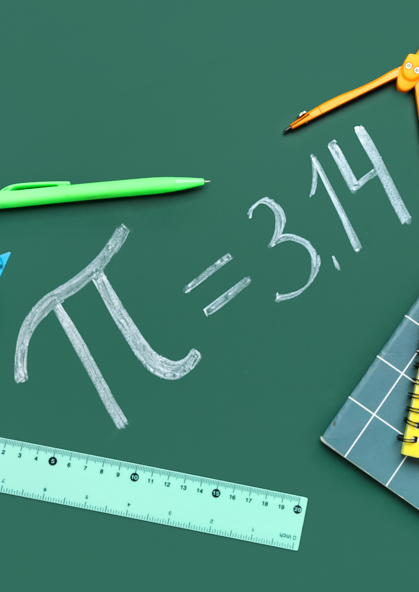
4.3 - Circular Measurement
In this section, we’ll review circular measurements including units, tools, basic calculations, and real-world applications.
Notes:
Instructional Activity: Direction
Instructional Time: 1 min.
Talking Points:
In this section, we’ll review circular measurements including units, tools, basic calculations, and real-world applications.

Slide 29
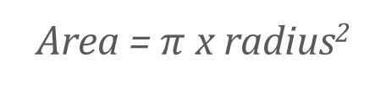
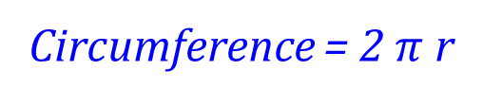
Concept
Circular Measurement
Circular measurements are used anytime you are working with round or curved objects.
  Radius - Distance from center to edge
  Diameter - Distance across
  Circumference - Distance around the outside
  Area of a circle - Space inside
Area = $π$ x radius²
Units
Radius
Radius
Tools
Diameter
Diameter = 2r
Exercises
Circumference = 2 $π$ r
Application
Notes:
*This slide contains animations. CLICK to reveal content.
Instructional Activity: Present Content
Instructional Time: 2 min.
Talking Points:
Circular measurements are used anytime you are working with round or curved objects.
To complete calculations involving circles, you need to know the parts of a circle.
CLICK - Radius is the distance from the center of a circle to the edge.
CLICK - Diameter is the distance across a circle from one side to the other, passing through the center. To calculate diameter, multiply 2 x the radius.
CLICK - Circumference is the distance around the outside of a circle. To calculate the circumference, multiply 2 x $π$ x the radius.
CLICK – As we have previously discussed, the area of a circle is the amount of space inside the circle. To calculate the area, multiply $π$ x radius^{2.}
These measurements are common when working with pipes, wheels, cables, and other rounded components.

Slide 30
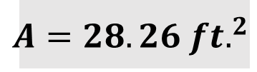
Concept
Circular Measurement Units
C = 18.84 ft.
Radius, Diameter, Circumference
  Standard Linear Units
    Imperial: Inches, Feet, Yards
    Metric: Milli, Centi, Meters
Area of a Circle
  Square Units
Units
R = 3 ft.
D = 6 ft.
Tools
Exercises
$${A=28.26 ft.}^{2}$$
Application
Notes:
*This slide contains animations. CLICK to reveal content.
Instructional Activity: Present Content, Provide Learning Guidance
Instructional Time: 2 min.
Materials: Measurement Cheat Sheet_M4
Talking Points:
Radius, diameter, and circumference are all measurements of distance, so they use standard linear units like inches, feet, and yards in the imperial system.
In the metric system, these measurements use units like millimeters, centimeters, and meters.
Even though the shape is a circle, we are still measuring distance, so the units stay the same as linear measurement.
Area of a circle is different because it measures the space inside the circle.
Because of that, area is always expressed in square units, such as square feet.
Looking at the example, a circle with a radius of 3 feet, would make the diameter 6 feet.
Use the formula on your Cheat Sheets to calculate the circumference and area
ASK:
What is the circumference? Call on learners o respond. CLICK to reveal the answer: About 18.84 feet.
What is the area? Call on learners o respond. CLICK to reveal the answer: 36 square feet.
This shows how the same measurement can lead to different values depending on what you are calculating.

Slide 31
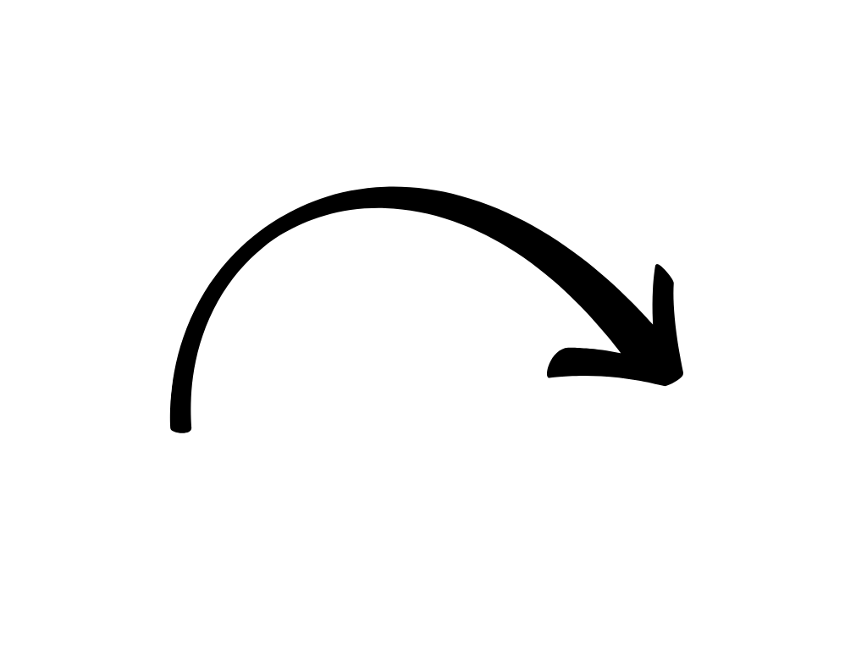
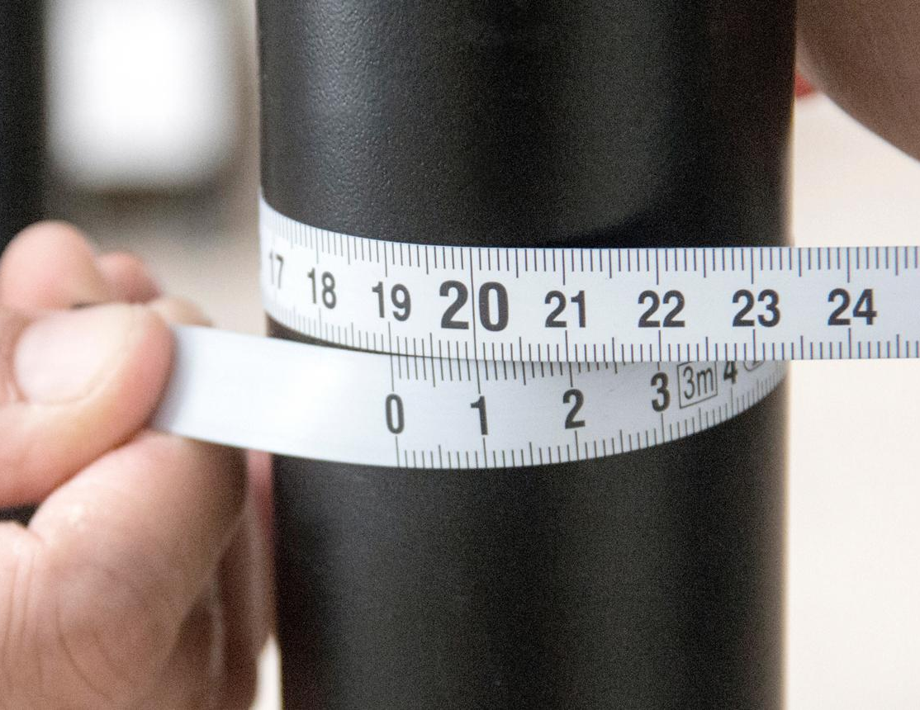
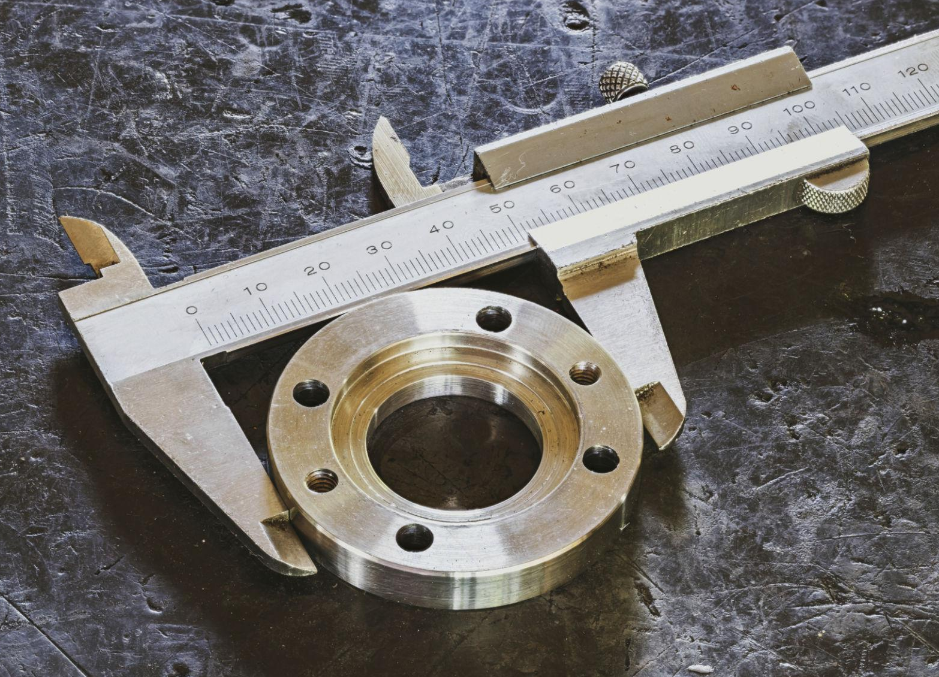
Concept
Circular Measurement Tools
Ruler, tape measure, calipers, etc.
Units
Flexible
Inside
Tools
Exercises
Outside
Application
Notes:
*This slide contains animations. CLICK to reveal content.
Instructional Activity: Present Content
Instructional Time: 1 min.
Talking Points:
Previously mentioned tools like a ruler, tape measure, and calipers are useful when it comes to circle measurements.
Consider using flexible options that can wrap around a pipe or tube to get an accurate measurement.
Many calipers have different features on either side to help workers measure the inside or outside of a circular object.

Slide 32
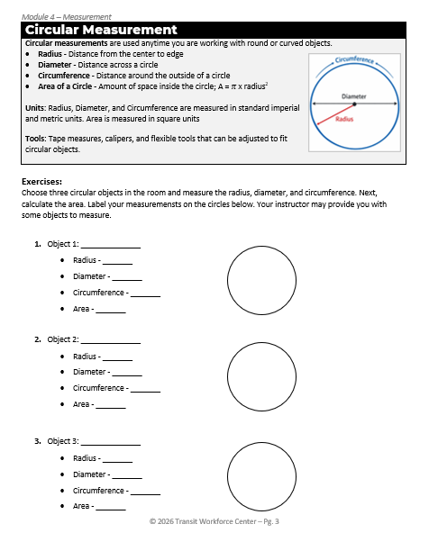
Concept
Circular Measurement Exercises
Units
Tools
Exercises
Application
Notes:
Instructional Activity: Provide Learning Guidance, Elicit Performance, Provide Feedback
Instructional Time: 12 min.
Materials:
Measurement Cheat Sheet_M4
Calipers or flexible measuring tape – one per learner or pair if sharing
Calculator - one per learner
Circular materials that relate to participants job tasks (Ex: a piece of pipe, metal rod, etc.)
Do:
Refer learners to the “Measurement Cheat Sheet_M4” handout embedded in the Participant Resource Guide.
Ask learner to complete the items listed under “Exercises” in the Circular Measurement section on page. 3.
Distribute circular items that relate to participant’s job tasks for measurement exercise.
Circulate the room while learners work checking answers, answering questions, and providing feedback.
To review, ask learners to switch papers with a partner who will check their measurements.

Slide 33
Concept
Circular Measurement Applications
Measuring the diameter of pipes or fittings to ensure proper size and connection
Calculating the circumference of pipes or cables to determine how much material is needed to wrap or cover them
Measuring wheels or rotating parts to check size and proper fit
Estimating materials needed for round covers, gaskets, or components
Units
Tools
Exercises
Application
Notes:
Instructional Activity: Present Content
Instructional Time: 2 min.
Talking Points:
You will use circular measurements on the job in a variety of ways.
Circular measurement is used anytime workers are dealing with round or curved objects on the job.
Workers use diameter to measure pipes, fittings, and other circular components to make sure they fit correctly.
Circumference is used to determine how much material is needed to wrap around pipes or cables.
Circular measurements are also used when working with wheels or rotating parts to check size and alignment.
Understanding circular measurements helps ensure proper fit, accurate material use, and safe operation of equipment.

Slide 34
Summary and What’s Next
Circular measurements include radius, diameter, and circumference
Used for round objects like pipes and wheels
Area of a circle uses π and the radius
Next, we will move into volume and learn how to measure space inside objects.
Notes:
Instructional Activity: Enhance Retention and Transfer
Instructional Time: 2 min.
Talking Points:
Circular measurement is used anytime we are working with round or curved objects.
We use radius, diameter, and circumference to describe the size and shape of a circle.
We can also calculate the area of a circle to understand how much surface it covers.
Next, we will move into volume and learn how to measure space inside objects.

Slide 35
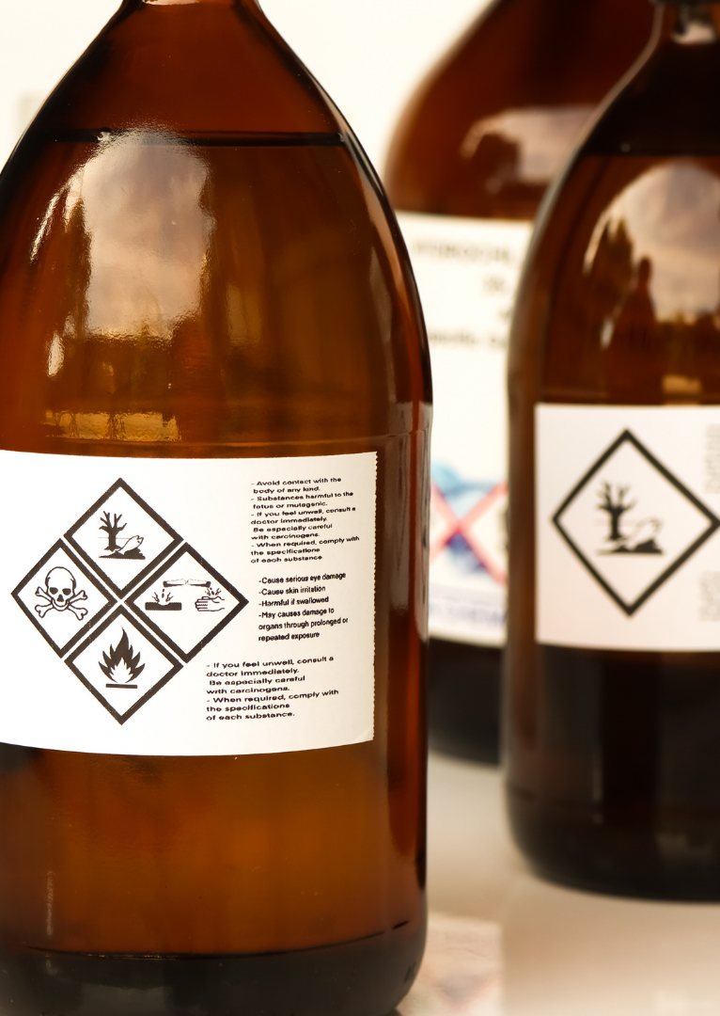
4.4 - Volume Measurement
In this section, we’ll review volume measurements including units, tools, basic calculations, and real-world applications.
Notes:
Instructional Activity: Direction
Instructional Time: 1 min.
Talking Points:
In this section, we’ll review volume measurements including units, tools, basic calculations, and real-world applications.

Slide 36
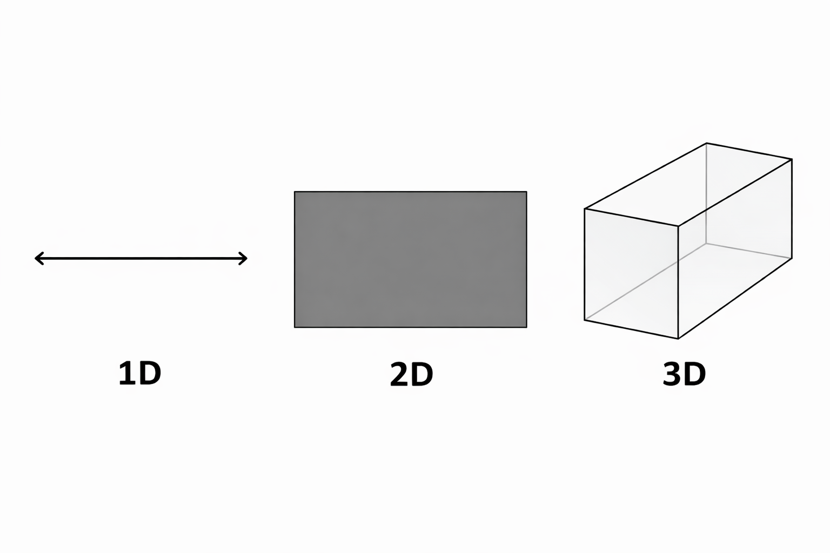
Concept
Volume Measurement
Volume is the amount of space inside a three-dimensional object. It tells us how much something can hold.
Three-dimensions: Length, Width, Height
Comparison
  Linear 1D
  Area 2D
  Volum3 3D
Units
Tools
Exercises
H
Application
L
W
Notes:
*This slide contains animations. CLICK to reveal content.
Instructional Activity: Present Content
Instructional Time: 2 min.
Talking Points:
Volume is the amount of space inside a three-dimensional object, and it tells us how much something can hold.
Volume uses three dimensions: length, width, and height.
All three measurements work together to describe the total space inside an object.
CLICK –
This is different from linear measurement, which is one-dimensional and measures length.
Area is two-dimensional and measures surface, while volume is three-dimensional and measures space inside.
As we move from 1D to 3D, we are adding dimensions and measuring more complex space.
Understanding this progression helps you choose the right measurement for the task.
Source: Mathnasium. (n.d.). What is volume in math? Mathnasium. https://www.mathnasium.com/blog/what-is-volume-in-math

Slide 37
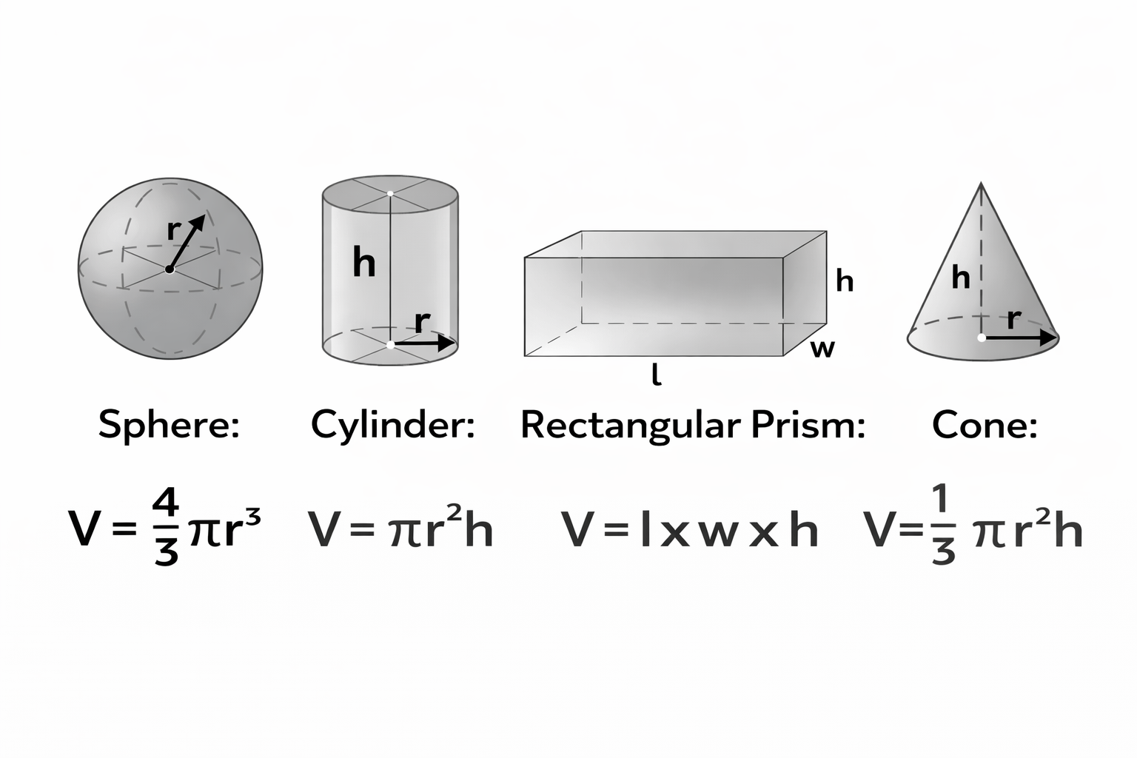
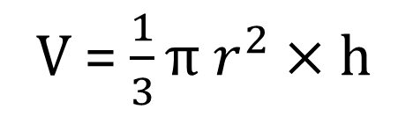
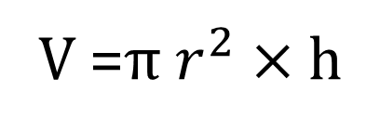
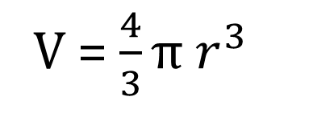
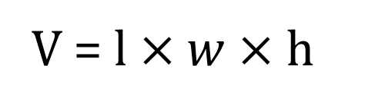
Volume Formulas
Sphere | Rectangular Prism
Cylinder | Cone
V = $\frac{4}{3}π r^{3}$
V = $l×w×$h
V =$π r^{2}$ $×$h
V = $\frac{1}{3}π r^{2}×\text{h}$
Notes:
Instructional Activity: Present Content
Instructional Time: 2 min.
Talking Points:
Volume formulas help us calculate how much space is inside different three-dimensional shapes.
Each shape has its own formula based on its structure and dimensions.
For a sphere, the volume is four-thirds pi times the radius cubed.
For a cylinder, the volume is pi times the radius squared times the height.
For a rectangular prism, the volume is found by multiplying length, width, and height.
For a cone, the volume is one-third pi times the radius squared times the height.
Even though the formulas look different, they all help us find the same thing, which is the space inside the object.
Understanding which formula to use depends on recognizing the shape you are working with.

Slide 38
Concept
Volume Measurement Units
Cubic units are used to measure volume because we are measuring three-dimensional spaces.
Imperial: in³,ft³,yd³, and mi³
Metric: cm³,m³, and km³.
Units
Tools
Exercises
H = 1
W = 1
L = 1
Application
Notes:
*This slide contains animations. CLICK to reveal content.
Instructional Activity: Present Content
Instructional Time: 2 min.
Talking Points:
Volume is measured in cubic units because we are measuring space in three dimensions.
A cubic unit represents a cube that is one unit long, one unit wide, and one unit high.
In the imperial system, common units include cubic inches, cubic feet, cubic yards, and cubic miles.
Cubic inches are used for very small volumes, while cubic feet are commonly used for spaces and materials.
In the metric system, common units include cubic centimeters, cubic meters, and cubic kilometers.
Remember, metric units are based on powers of ten, which makes them easier to convert between.
Source: Mathnasium. (n.d.). What is volume in math? Mathnasium. https://www.mathnasium.com/blog/what-is-volume-in-math

Slide 39
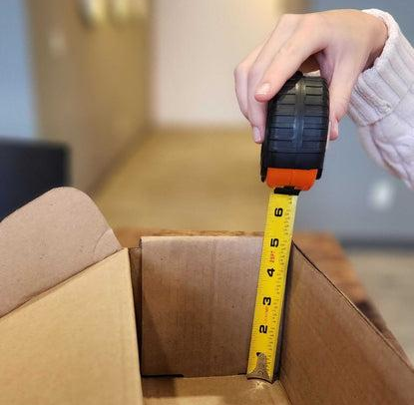
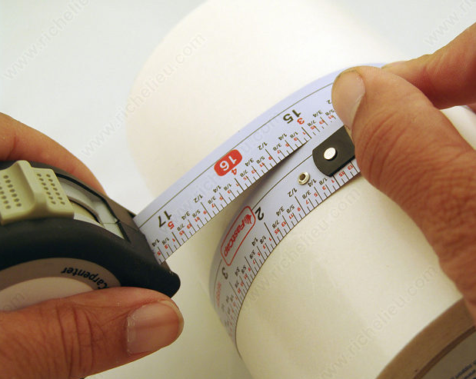
Concept
Volume Measurement Tools
Ruler, tape measure, calipers, etc.
Units
Tools
Exercises
Application
Notes:
*This slide contains animations. CLICK to reveal content.
Instructional Activity: Present Content
Instructional Time: 1 min.
Talking Points:
Much like circular and area measurements, we need basic measuring tools in order to calculate volume.
This includes rulers, tape measures, calipers, etc.
Remember that when measuring cylindrical items like pipes, a flexible tape measure may be most useful.

Slide 40
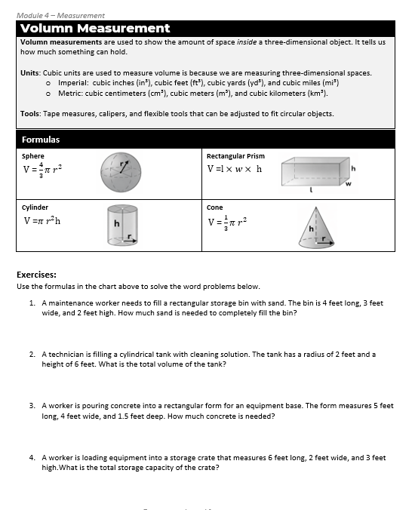
Concept
Volume Measurement Exercises
Units
Tools
Exercises
Application
Notes:
Instructional Activity: Provide Learning Guidance, Elicit Performance, Provide Feedback
Instructional Time: 12 min.
Materials:
Measurement Cheat Sheet_M4
Calculator - one per learner
Do:
Refer learners to the “Measurement Cheat Sheet_M4” handout embedded in the Participant Resource Guide.
Ask learner to complete the items listed under “Exercises” in the Volume Measurement section on page. 4.
Circulate the room while learners work checking answers, answering questions, and providing feedback.
To review, call on learners to share their answers. Use the answer key below to check their work.
Answer Key:
1. Filling a Storage Container (Rectangular Prism)
Formula: V = l × w × h
V = 4 × 3 × 2
V = 24 ft³
Answer: 24 cubic feet
2. Liquid in a Tank (Cylinder)
Formula: V = πr²h
V = π × (2²) × 6
V = π × 4 × 6
V = 24π
V ≈ 75.4 ft³
Answer: 24π ft³ (≈ 75.4 cubic feet)
3. Concrete for an Equipment Pad (Rectangular Prism)
Formula: V = l × w × h
V = 5 × 4 × 1.5
V = 30 ft³
Answer: 30 cubic feet
4. Packing a Storage Box (Rectangular Prism)
Formula: V = l × w × h
V = 6 × 2 × 3
V = 36 ft³
Answer: 36 cubic feet

Slide 41
Concept
Volume Measurement Applications
Determining how much liquid a container or tank can hold
Calculating how much material is needed to fill a space, such as concrete, gravel, or soil
Measuring storage capacity for bins, containers, or compartments
Units
Tools
Exercises
Application
Notes:
Instructional Activity: Present Content
Instructional Time: 2 min.
Talking Points:
Volume measurement is used anytime workers need to know how much space something can hold or contain.
Workers use volume to determine how much liquid a tank or container can hold.
It is also used to calculate how much material is needed to fill a space, such as concrete or gravel.
Volume helps measure storage capacity for containers, bins, and compartments.
It is used to estimate how much fluid is needed for systems like cooling or cleaning.
Volume measurement also helps when packing or storing equipment to make sure there is enough space available.

Slide 42
Knowledge Check
A worker needs to measure the distance around a pipe to determine how much insulation material is needed.
Which tool is the best choice for this task?
(A). Ruler
(B). Caliper
(C). Tape Measurer
(C). Tape Measurer
(D). Laser Distance Measurer
Notes:
*This slide contains animations. CLICK to reveal content.
Instructional Activity: Evaluate/Assess Performance, Provide Feedback
Instructional Time: 3 min.
Learning Objective:
Do: Review the knowledge check question. Call on learners to share their responses.
Answer:
C

Slide 43
Knowledge Check
A worker is filling a rectangular container that is 4 feet long, 3 feet wide, and 2 feet high.
What is the volume of the container?
(A). 9 ft. squared
(B). 24 ft. cubed
(B). 24 ft. cubed
(C). 24 ft.
(D). 12 ft. cubed
Notes:
*This slide contains animations. CLICK to reveal content.
Instructional Activity: Evaluate/Assess Performance, Provide Feedback
Instructional Time: 3 min.
Learning Objective:
Do: Review the knowledge check question. Call on learners to share their responses.
Answer:
B

Slide 44
Summary and What’s Next
Volume measures the space inside a 3D object
Calculated using length, width, and height
Expressed in cubic units
Next, you will apply everything you’ve learned in the Maintenance Math Challenge.
Notes:
Instructional Activity: Enhance Retention and Transfer
Instructional Time: 3 min.
Talking Points:
Volume tells us how much space something can hold or contain.
We calculate volume using three dimensions: length, width, and height.
The answer is always in cubic units because we are measuring three-dimensional space.
Next, you will apply everything you’ve learned in the Maintenance Math Challenge.

Slide 45
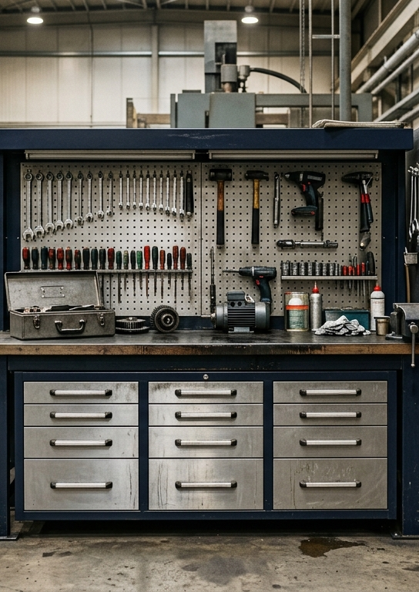
4.5 – Math and Measurement Activity
Next, we’ll put our skills to the test to in a math and measurement activity.
Notes:
Instructional Activity: Direction
Instructional Time: 1 min.
Do: Introduce the section.
Talking Points: Next, we’ll put our skills to the test to in a math and measurement activity.

Slide 46
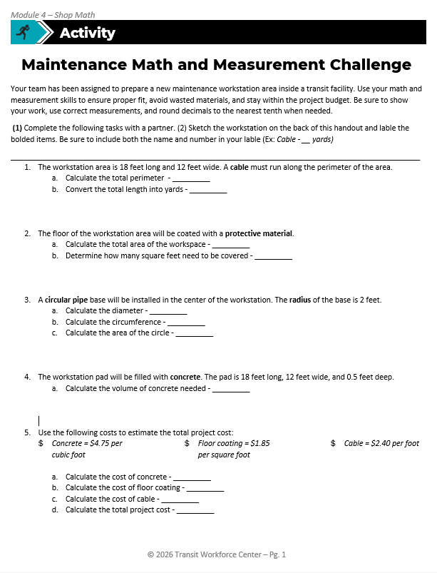
Math and Measurement Challenge
Scenario: Your team has been assigned to prepare a new maintenance workstation area inside a transit facility. Use your math and measurement skills to ensure proper fit, avoid wasted materials, and stay within the project budget. Be sure to show your work, use correct measurements, and round decimals to the nearest tenth when needed.
Complete questions 1-5 with a partner.
Sketch the workstation on the back of this handout and label the bolded items. Be sure to include both the name and number in your label.
Notes:
Instructional Activity: Provide Guided Learning, Elicit Performance, Provide Feedback
Instructional Time: 35 min.
Materials:
Math and Measurement Challenge_M4
Math and Measurement Challenge_Answer Key_M4
Do:
5 min.
Refer learners to the “Math and Measurement Challenge” handout embedded in the Participant Resource Guide.
Review the directions and answer any questions learners may have.
20 min.
Give learners time to work. Circulate the room answering questions and providing feedback as needed.
10 min.
Review answers together and ask volunteers to explain their reasoning.
Consider having leaners write their answers and equations on the white board. They can then review the answer and explain their work to the class.

Slide 47

Quiz
Time for a quiz! Let’s see what you have learned from today’s lesson.
Notes:
Instructional Activity: Direction, Evaluate/Assess Performance
Instructional Time: 20 min.
Materials: Quiz_M4
Do:
Ask learners if they have any lingering questions. Address them before distributing the quiz.
Pass out the quiz and review the directions.
Talking Points:
Time for a quiz! Let’s see what you have retained from today’s lesson.

Slide 48
Revisiting Objectives
Demonstrate the ability to solve mathematics problems involving measurement.
  Measure and calculate length using appropriate units and tools.
  Calculate the area of surfaces using appropriate formulas and units.
  Solve mathematics problems involving circular objects by calculating diameter, circumference, and area.
  Calculate volume using appropriate formulas and units.
Notes:
Instructional Activity: Enhance Transfer and Retention
Instructional Time: 5 min.
Do: Facilitate a short discussion to review the key topics in the lesson.
Talking Points:
If you were explaining today’s objectives to someone else, how would you summarize what they mean and why they matter?
Which of today’s objectives do you feel most confident about? Which were most challenging? Explain your reasoning.
Can you give an example of how you could apply one of today’s objectives in a real-world situation?
After Discussion:
This conclude this section of the module. Thank you for your participation.

Slide 49
Thank you!
Notes:
Instructional Activity: Enhance Transfer and Retention
Instructional Time: 2 min.
Do:
Thank learners for their participation.
If possible, stay after class to answer any lingering questions learners may have.

