Slide 1
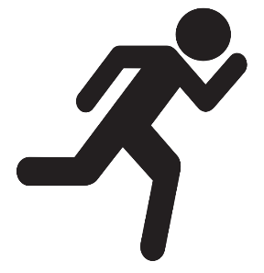

Instructor Guide Snapshot
Icon Key
Activity:
Video:
Instructor Demo:
Knowledge Check:
Instructional Time: 2.25 Hrs.
Preparation before class:
  Review all materials - Review all slides, talking points, and handouts before class to understand the structure and flow of the lesson. Pay special attention to animations within the slides.
Provided Course Materials:
  +Leverage_Mechanical Foundations.pptx
  +Instructor Facilitation Toolkit_Leverage.docx - For Instructor use only.
  +Participant Resource Guide_Leverage.docx - Print one copy for each learner. All handouts that leaners need for activities are embedded in the Participant Resource Guide.
  Quiz_Leverage.docx - Print one copy for each learner.
Additional Materials:
One per small group
Block of wood to use as a fulcrum
A heavy rock or object to use as the load
12" pry bar
24" pry bar
36" pry bar

Slide 2
Pacing Guide
Times have been rounded to the nearest .25 hours.
Total Time: 2.25 Hours
  (.25 Hrs) – Welcome and Warm Up
  (.5 Hrs) – 1.1 The Mechanical Lever
  (.75 Hrs) – 1.2 Classes of Levers
  (.25 Hrs) – 1.3 Transit Maintenance
  (.5 Hrs) – Quiz and Wrap Up

Slide 3
Leverage
Transit Core Competencies Curriculum (TC3)
Mechanical Foundations
Notes:
Instructional Activity: Direction
Instructional Time: 1 min.
Do: Welcome learners to class.

Slide 4
Objectives
Explain how leverage helps move or lift a load with less effort.
Recognize tools and maintenance tasks that use leverage.
Describe why leverage is important for safe and efficient transit maintenance.
Notes:
Instructional Activity: Direction
Instructional Time: 2 min.
Do: Review the module objectives.

Slide 5
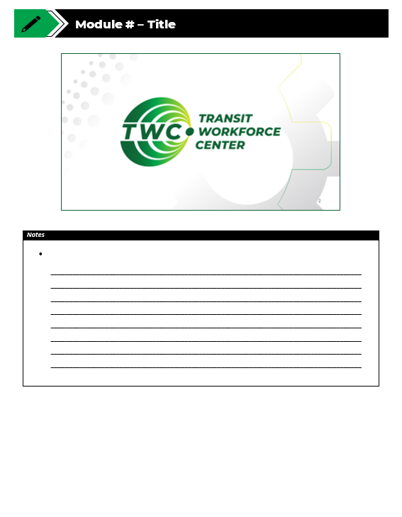
Agenda
Welcome and Warm Up
1.1 The Mechanical Lever
1.2 Classes of Levers
1.3 Transit Maintenance
Quiz and Wrap Up
Notes:
Instructional Activity: Direction
Instructional Time: 2 min.
Do: Review the module agenda.

Slide 6
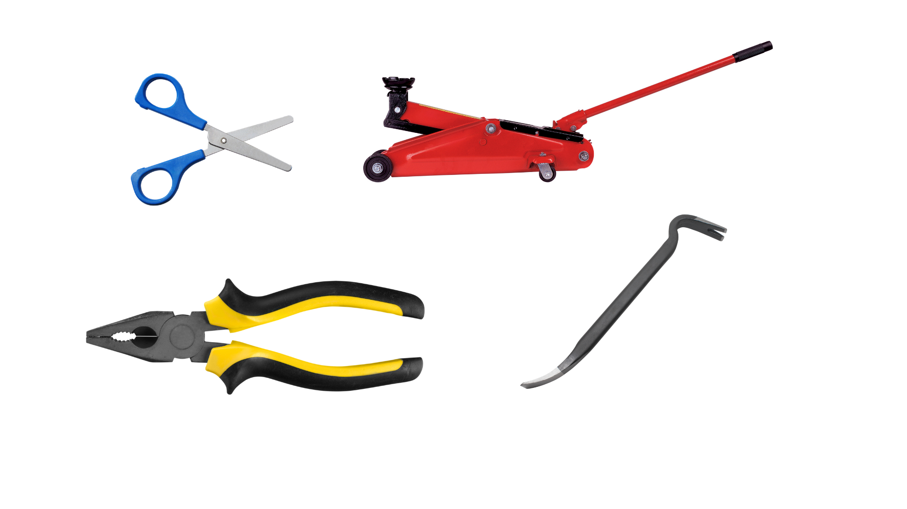
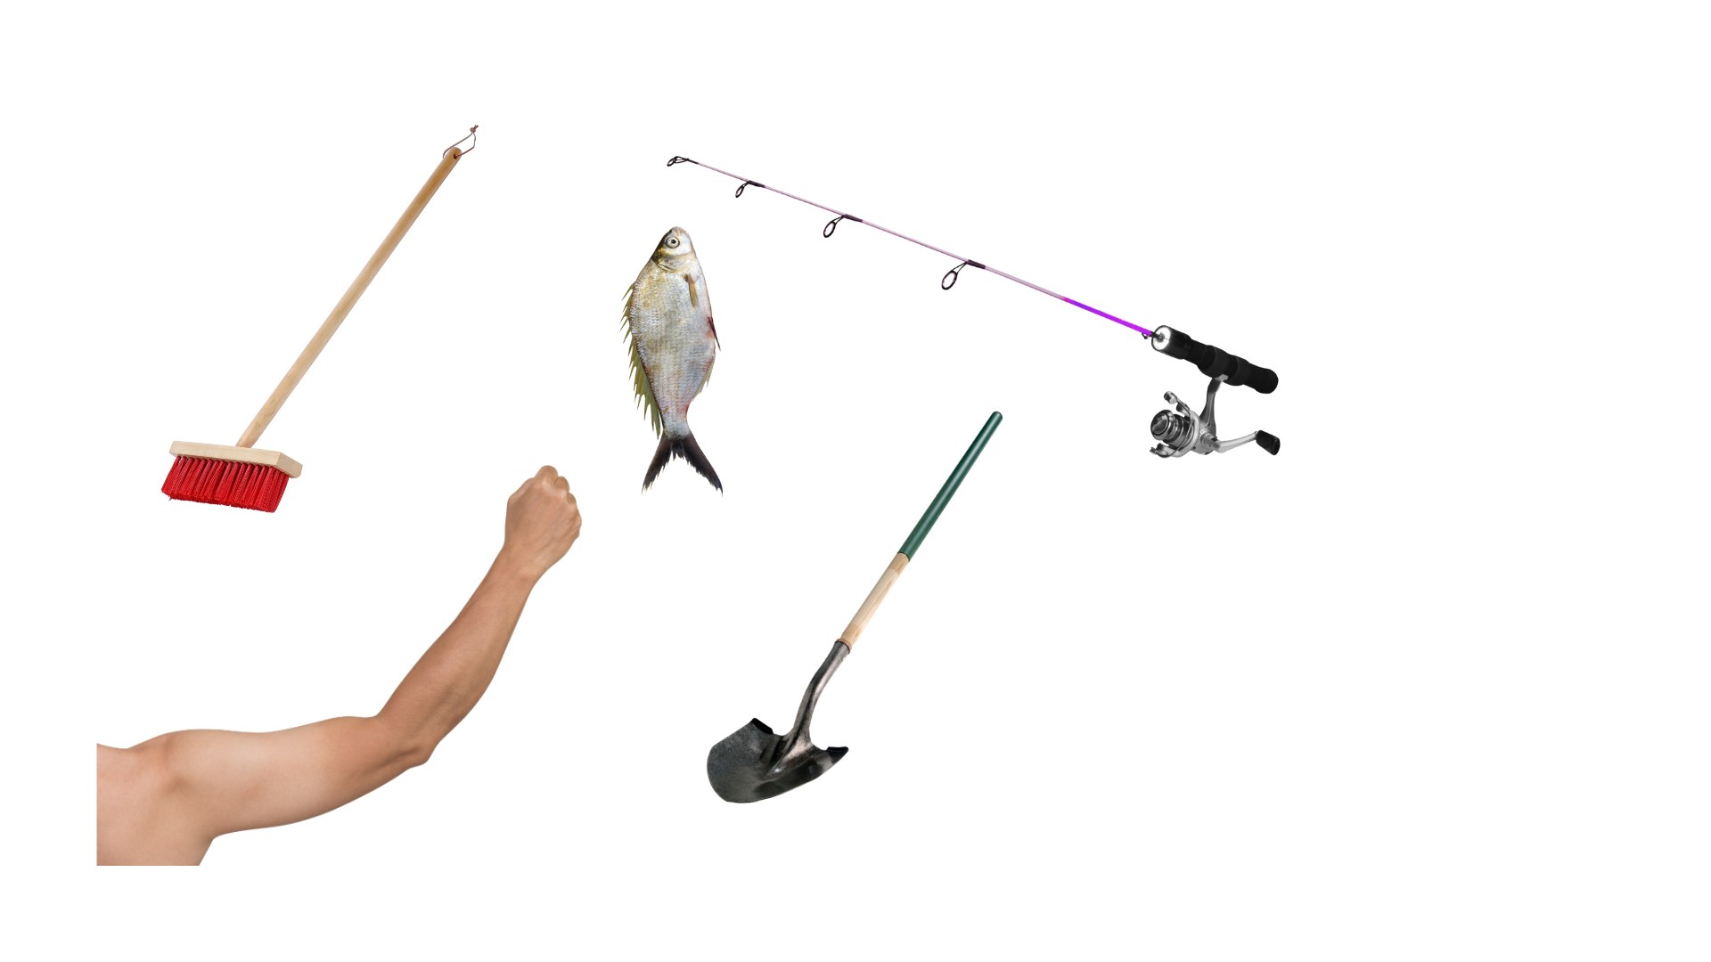
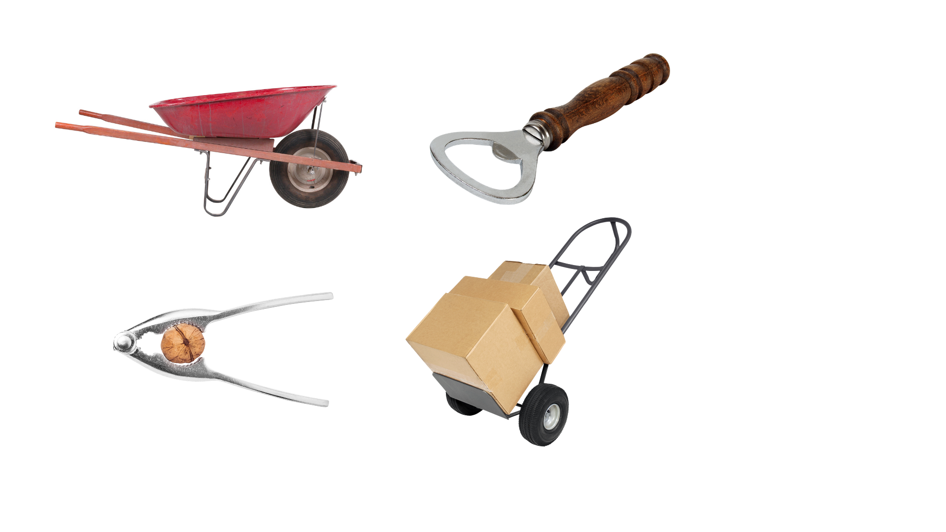
Warm Up
What do these items have in common?
Notes:
*This slide contains animations. CLICK to reveal content.
Instructional Activity: Gain Attention
Instructional Time: 5 min.
Do: Facilitate a short discussion.
Talking Points:
Take a look at these everyday objects.
Before we begin today's lesson, I'd like you to think about one question: What do these items have in common?
Call on learners to respond.
There may be several good observations, but they all share one important characteristic—they all use leverage to make work easier.
Some help lift heavy loads, while others help cut, pry, or move objects. Although they look very different, each one uses the same basic mechanical principle.
Throughout this lesson, we'll explore how levers work, why they make tasks easier, and how these same principles are applied every day in transportation maintenance.

Slide 7

1.1 – The Mechanical Lever
In this section, we’ll review what a lever is and how they make work easier.
Notes:
Instructional Activity: Direction
Instructional Time: 2 min.
Do: Introduce the section.
Talking Points: In this section, we’ll review what a lever is and how they make work easier.

Slide 8
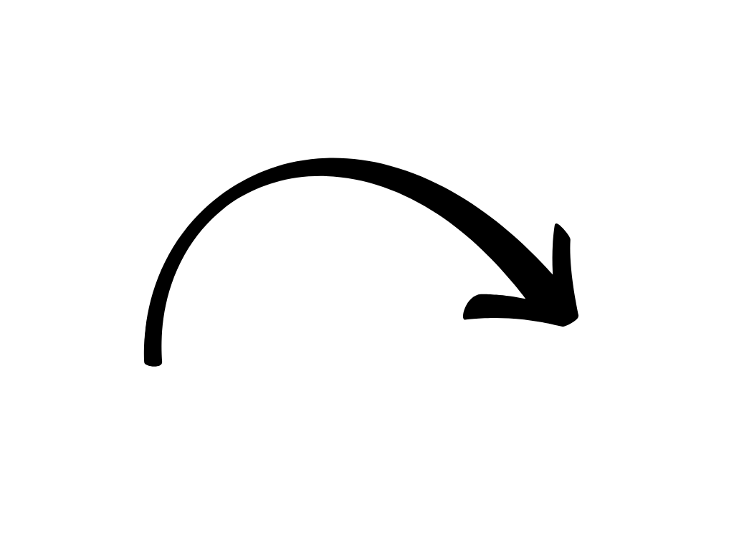

What is a lever?
Lever - A simple machine made of a rigid beam that pivots on a fulcrum to help move or lift a load with less effort.
Fulcrum - The fixed pivot point that a lever rotates around.
Beam
Load
Fulcrum
Notes:
Instructional Activity: Present Content
Instructional Time: 2 min.
Talking Points:
Levers are one of the oldest and simplest machines ever created, but they are still used every day in transportation maintenance.
A mechanical lever consists of a rigid beam that rotates around a fixed point called the fulcrum.
The beam transfers force from one end of the lever to the other, allowing us to lift, move, or pry objects with less effort.
You'll see levers built into many common hand tools, making difficult jobs easier and safer.
Now let's look at exactly how a lever works.

Slide 9
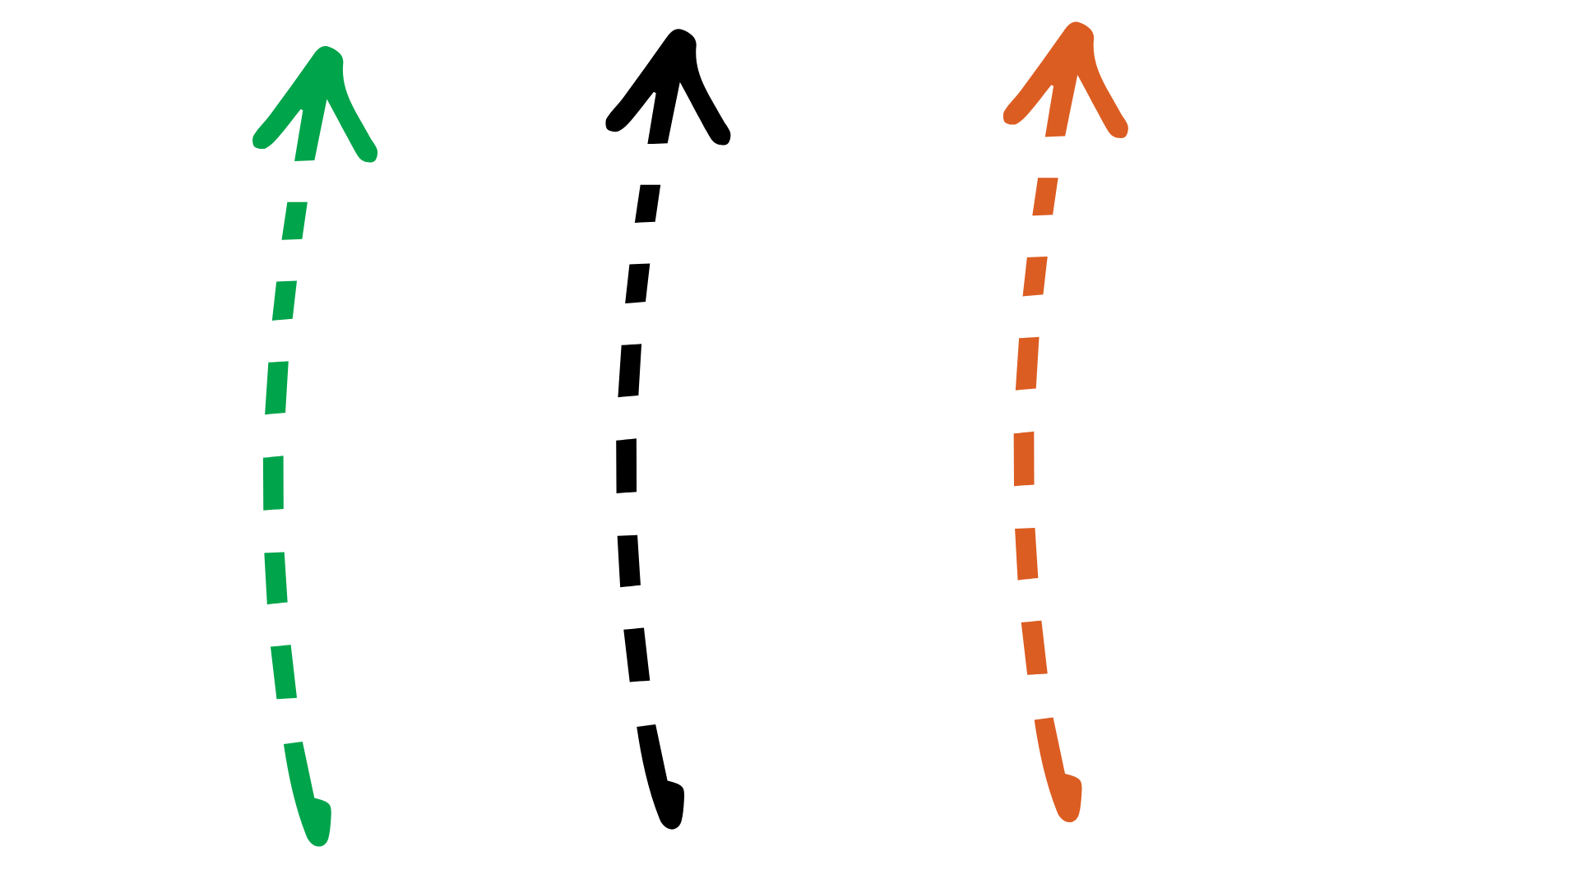
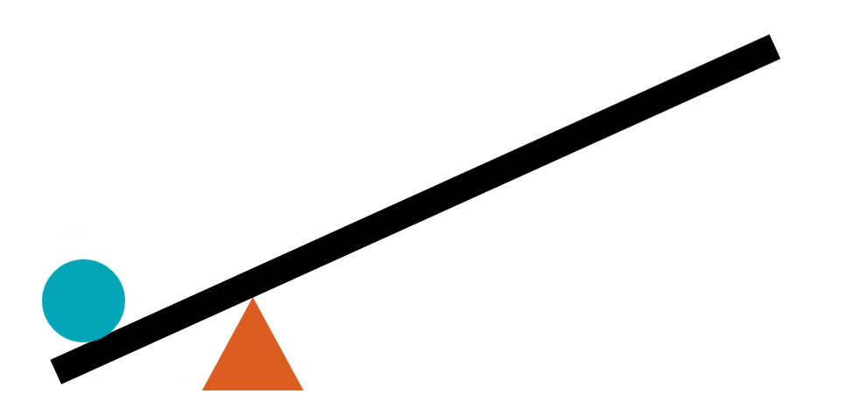


How Does a Lever Work?
A lever pivots around a fulcrum to transfer and multiply force, making heavy loads easier to move.
Effort
(Input Force)
Load
(Output Force)
Notes:
Instructional Activity: Present Content
Instructional Time: 2 min.
Talking Points:
A lever works by rotating around the fulcrum.
When you apply force, called the effort or input force, to one end of the lever, the beam pivots around the fulcrum and transfers that force to the opposite end.
The object being moved is called the load, sometimes referred to as the output force.
Because of the way the lever is designed, it can multiply the force you apply. This allows a smaller effort to move or lift a much heavier load.
Think about using a long pry bar to lift a heavy cover or a breaker bar to loosen a tight bolt. Instead of relying on brute strength, the lever helps you do the work more efficiently.
The amount of force the lever can multiply depends on where the fulcrum, effort, and load are positioned. We'll look at that next when we discuss mechanical advantage.

Slide 10
Mechanical Advantage
Mechanical Advantage – The ability of a simple machine to multiply the force you apply, making work easier and more efficient.
Fulcrum close to the load =
Less effort
Fulcrum farther from load =
More effort
Notes:
Instructional Activity: Present Content
Instructional Time: 2 min.
Talking Points:
Mechanical advantage is one of the main reasons we use simple machines like levers.
Mechanical advantage refers to a machine's ability to multiply the force you apply. In other words, it allows you to move or lift an object using less effort than would be required without the machine.
With a lever, mechanical advantage depends on several factors, including the location of the fulcrum, where the effort is applied, and the weight of the load.
When the fulcrum is positioned closer to the load, the lever provides greater mechanical advantage. This means you can lift the same load using less effort.
Choosing the right lever and using it correctly makes the job safer, easier, and more efficient.
As we continue, we'll see how different lever designs create different types of mechanical advantage.

Slide 11
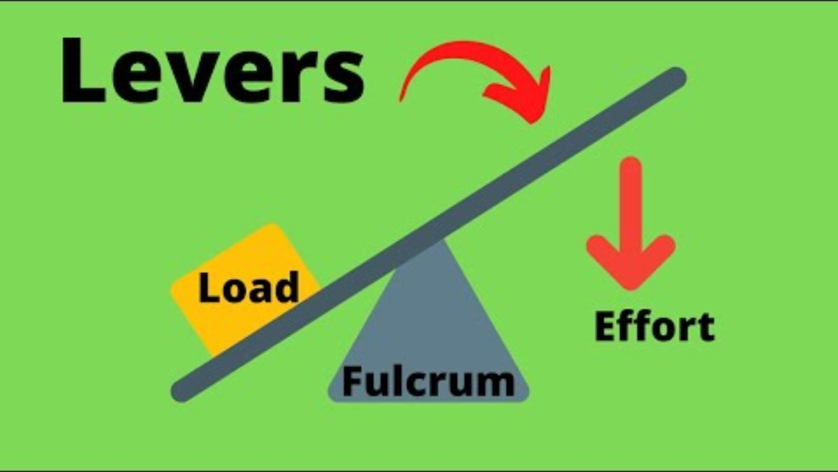
Simple Machines: The Lever
Notes:
Instructional Activity: Provide Learning Guidance
Instructional Time: 6 min
Do:
Play the video
Video Link: https://www.youtube.com/watch?v=fzljPiPy9nw

Slide 12
Video Debrief
Describe one lever you could find in your home. Identify each part of the lever.
What is one way a lever exists in the human body? Identify each part of the lever.
What does FLE 123 mean?
Notes:
*This slide contains animations. CLICK to reveal content.
Instructional Activity: Provide Learning Guidance, Recall
Instructional Time: 5 min
Do: Use the questions on the slide to facilitate a debrief discussion.
Answer Key:
1.) Wheelbarrow, scissors, pliers, etc.
2.) Jaw, Arm, Leg, etc.
3.) Fulcrum, Load, Effort; The 123 describes the location of the fulcrum in each type of lever

Slide 13
Knowledge Check
Label each of the three parts of a lever.
Beam
Load
Fulcrum
Notes:
*This slide contains animations. CLICK to reveal content.
Instructional Activity: Evaluate/Assess Performance, Provide Feedback
Instructional Time: 3 min.
Learning Objective: Explain how leverage helps move or lift a load with less effort.
Do: Review the knowledge check question. Call on learners to share their responses.
Answer:
Ball = Load
Triangle = Fulcrum
Rectangle = Beam

Slide 14
Knowledge Check
The term effort can also be defined as _____________.
(A). Mechanical Advantage
(B). Input Force
(B). Input Force
(C). Load Force
(D). Output Force
Notes:
*This slide contains animations. CLICK to reveal content.
Instructional Activity: Evaluate/Assess Performance, Provide Feedback
Instructional Time: 3 min.
Learning Objective: Explain how leverage helps move or lift a load with less effort.
Do: Review the knowledge check question. Call on learners to share their responses.
Answer:
B

Slide 15
Knowledge Check
A lever pivots around a fulcrum to __________ and _________ force, making heavy loads easier to move.
(A). Create, balance
(B). Measure, control
(C). Transfer, multiply
(D). Reduce, duplicate
(C). Transfer, multiply
Notes:
*This slide contains animations. CLICK to reveal content.
Instructional Activity: Evaluate/Assess Performance, Provide Feedback
Instructional Time: 3 min.
Learning Objective: Explain how leverage helps move or lift a load with less effort.
Do: Review the knowledge check question. Call on learners to share their responses.
Answer:
C - A lever pivots around a fulcrum to transfer and multiply force, making it easier to move or lift heavy loads.

Slide 16
Summary and What’s Next
A lever is a simple machine.
A lever consists of a beam and a fulcrum.
Levers reduce the effort needed to move a load.
Mechanical advantage depends on lever design.
Now that you understand the basic parts of a lever and how leverage works, it's time to look at the different types of levers.
Notes:
*This slide contains animations. CLICK to reveal content.
Instructional Activity: Enhance Retention and Transfer, Recall
Instructional Time: 5 min.
Do:
Ask learners to share what they think is the most important information from this section.
Review the key takeaways from this section of the module.
Clearly explain how to connects to the next section of the module.
Talking Points:
What are the most key takeaways from this part of our lesson?
Call on leaners to respond.
Nice work – let’s recap. We've covered the basic concepts behind how a mechanical lever works.
CLICK - Remember that a lever is a simple machine made of a rigid beam that pivots around a fulcrum.
CLICK - When force is applied to one end of the lever, it is transferred through the beam to move or lift a load with less effort.
CLICK - We also introduced the idea of mechanical advantage, which explains why the design of a lever affects how much effort is needed to do the job.
Next, we'll explore the three classes of levers and see how the positions of the fulcrum, effort, and load change the way each type of lever works. We'll also look at common tools and maintenance tasks that use each class of lever.

Slide 17
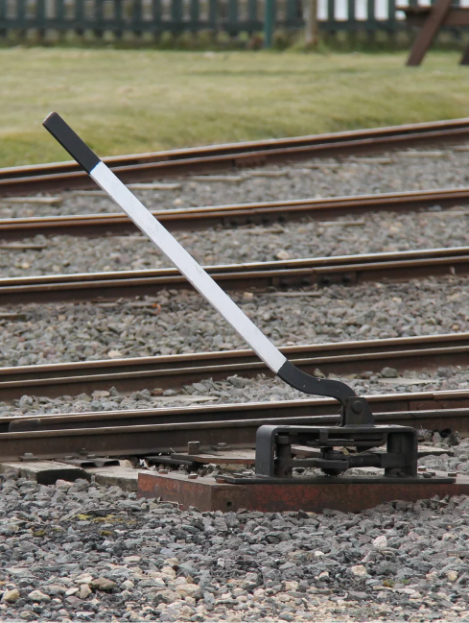
1.2 – Classes of Levers
This section will discuss the different classes of levers and their real-life applications.
Notes:
Instructional Activity: Direction
Instructional Time: 2 min.
Do: Introduce the section.
Talking Points: This section will discuss the different classes of levers and their real-life applications.

Slide 18
First Class Lever
The fulcrum is located between the effort and the load.
Input Force
Notes:
Instructional Activity: Present Content
Instructional Time: 2 min.
Talking Points:
A first-class lever has the fulcrum positioned between the effort and the load.
When you apply effort to one side of the fulcrum, the opposite side moves the load.
One of the biggest advantages of a first-class lever is that it can change the direction of the applied force. For example, pushing down on one end of a crowbar lifts the load on the other end.
Transportation maintenance workers often use pry bars and crowbars to lift covers, separate components, or align heavy parts during repairs.
Other familiar examples include scissors, a car jack, and pliers.

Slide 19

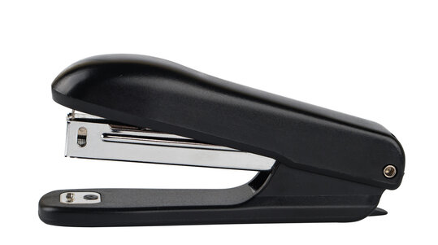
Second Class Lever
The load is located between the fulcrum and the effort.
Input Force
Notes:
Instructional Activity: Present Content
Instructional Time: 2 min.
Talking Points:
In a second-class lever, the load is positioned between the fulcrum and the effort.
This arrangement provides a large mechanical advantage, allowing heavy loads to be moved with relatively little effort.
A wheelbarrow is a common example. The wheel acts as the fulcrum, the load sits in the middle, and the effort is applied by lifting the handles.
A hand truck, or dolly, works in a similar way when transporting heavy equipment or materials.
Second-class levers are designed to maximize lifting force, making them useful whenever heavy loads need to be moved efficiently.

Slide 20
Third Class Lever
The effort is located between the fulcrum and the load.
Input Force
Notes:
Instructional Activity: Present Content
Instructional Time: 2 min.
Talking Points:
A third-class lever places the effort between the fulcrum and the load.
Unlike second-class levers, these levers do not increase lifting force. Instead, they increase the speed and distance that the load moves.
A broom is a good example. One hand acts as the fulcrum, the other hand applies the effort, and the brush at the end moves the load.
A shovel works in a similar way when lifting dirt or gravel.
Your own forearm is also a third-class lever. Your elbow acts as the fulcrum, your bicep provides the effort, and your hand moves the load.
Third-class levers are common in both everyday activities and maintenance work because they provide greater control and movement.

Slide 21
Activity: Clever Lever
Your instructor will place a heavy object on the floor with a block of wood to serve as the fulcrum.
Take turns using different tools as levers to determine which lever allows you to lift the object with the least amount of effort.
    Predict: Which lever do you think will be the most efficient?
Notes:
Instructional Activity: Provide Guided Learning, Elicit Performance, Provide Feedback
Instructional Time: 20 min.
Materials:
One per small group:
Block of wood to use as a fulcrum
A heavy rock or object to use as the load
12" pry bar
24" pry bar
36" pry bar
Do:
5 min.
Review the directions on the slide and answer any questions learners may have.
Separate learners into small groups and distribute materials.
15 min.
Give learners time to work.
Circulate the room answering questions and providing feedback as needed.
You engage in a debrief discussion using the questions on the next slide.

Slide 22
Activity: Clever Lever
Which lever worked best? Why?
How did the length of the lever affect the amount of effort needed?
Why is it important to choose the right tool for the job? Use evidence from today's activity to support your answer.
How can selecting the correct tool help prevent workplace injuries?
Notes:
Instructional Activity: Provide Guided Learning, Elicit Performance, Provide Feedback
Instructional Time: 10 min.
Do: Use the questions on the slide to facilitate a debrief discussion.
Answer Key:
1. Which lever worked best? Why?
The longer lever worked best because it provided greater mechanical advantage, allowing the object to be lifted with less effort.
2. How did the length of the lever affect the amount of effort required?
As the lever became longer, less effort was needed to lift the load because the longer effort arm increased mechanical advantage.
3. Why is it important to choose the right tool for the job?
Choosing the correct tool makes the job easier, more efficient, and safer. In this activity, the longer lever required less force than the shorter lever to lift the same object.
4. How can selecting the correct tool help prevent workplace injuries?
Using the correct tool reduces the amount of force required, decreases physical strain and fatigue, and helps workers maintain better control. This lowers the risk of muscle strains, slips, and other injuries while completing the task.

Slide 23
Knowledge Check
A hand-dolly is an example of what class of lever?
First-Class Lever
Second-Class Lever
Third-Class Lever
Fourth-Class Lever
Force
Load
Fulcrum
Notes:
*This slide contains animations. CLICK to reveal content.
Instructional Activity: Evaluate/Assess Performance, Provide Feedback
Instructional Time: 3 min.
Learning Objective: Explain how leverage helps move or lift a load with less effort.
Do: Review the knowledge check question. Call on learners to share their responses.
Answer:
B - A second-class lever has the load positioned between the fulcrum and the effort.
Fulcrum: The axle (center) of the wheels
Load: The boxes resting on the frame
Effort: The force you apply by pulling back on the handles

Slide 24
Summary and What’s Next
First-class: Fulcrum between effort and load
Second-class: Load between fulcrum and effort
Third-class: Effort between fulcrum and load
Different lever classes are used for different tasks
You'll identify common transportation maintenance tools and recognize how leverage is applied in real-world maintenance scenarios.
Notes:
*This slide contains animations. CLICK to reveal content.
Instructional Activity: Enhance Retention and Transfer, Recall
Instructional Time: 5 min.
Do:
Ask learners to share what they think is the most important information from this section.
Review the key takeaways from this section of the module.
Clearly explain how to connects to the next section of the module.
Talking Points:
What are the most key takeaways from this part of our lesson?
Call on leaners to respond.
Let's review what you've learned about the three classes of levers.
The difference between each class is the position of the fulcrum, effort, and load.
CLICK - In a first-class lever, the fulcrum is located between the effort and the load.
CLICK - In a second-class lever, the load is between the fulcrum and the effort, providing a large mechanical advantage for lifting heavy objects.
CLICK - In a third-class lever, the effort is between the fulcrum and the load, allowing for greater speed and control.
CLICK - Understanding these lever classes helps you recognize why certain tools are designed the way they are and how they make maintenance tasks safer and more efficient.
Next, you'll apply these concepts by examining common transportation maintenance tools and identifying how leverage is used in real-world maintenance scenarios.

Slide 25
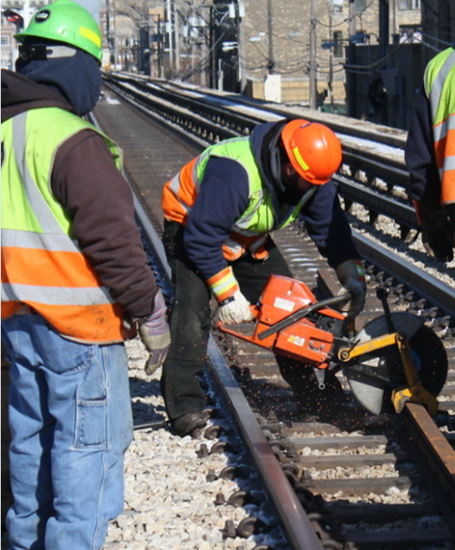
1.3 – Transit Maintenance
In this section, we’ll learn why leverage is an important part of transit maintenance.
Notes:
Instructional Event: Direction
Time: 1 minute.
Talking points: In this section, we’ll learn why leverage is an important part of transit maintenance.

Slide 26
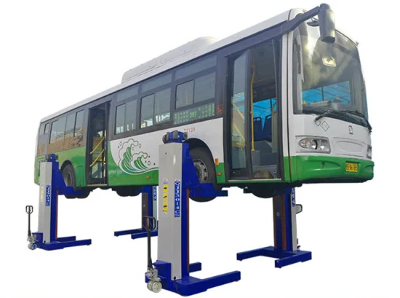
Leverage in Transit Maintenance
Leverage helps technicians perform many maintenance tasks more safely and efficiently.
Operating a hand throw lever
Lifting a bus with a jack
Loosening or tightening lug nuts
Opening stuck panels or doors
Aligning or separating components
Notes:
Instructional Activity: Present Content
Instructional Time: 2 min.
Do: Elaborate on these examples using your real-life experiences in the field.
Talking Points:
Leverage isn't just a concept found in textbooks. It's something transportation maintenance workers use every day.
Many common maintenance tasks rely on leverage to move heavy components, apply force, or make precise adjustments.
Whether you're operating a hand throw lever, lifting a vehicle with a jack, loosening lug nuts, or separating parts during a repair, leverage helps make the job easier and safer.

Slide 27
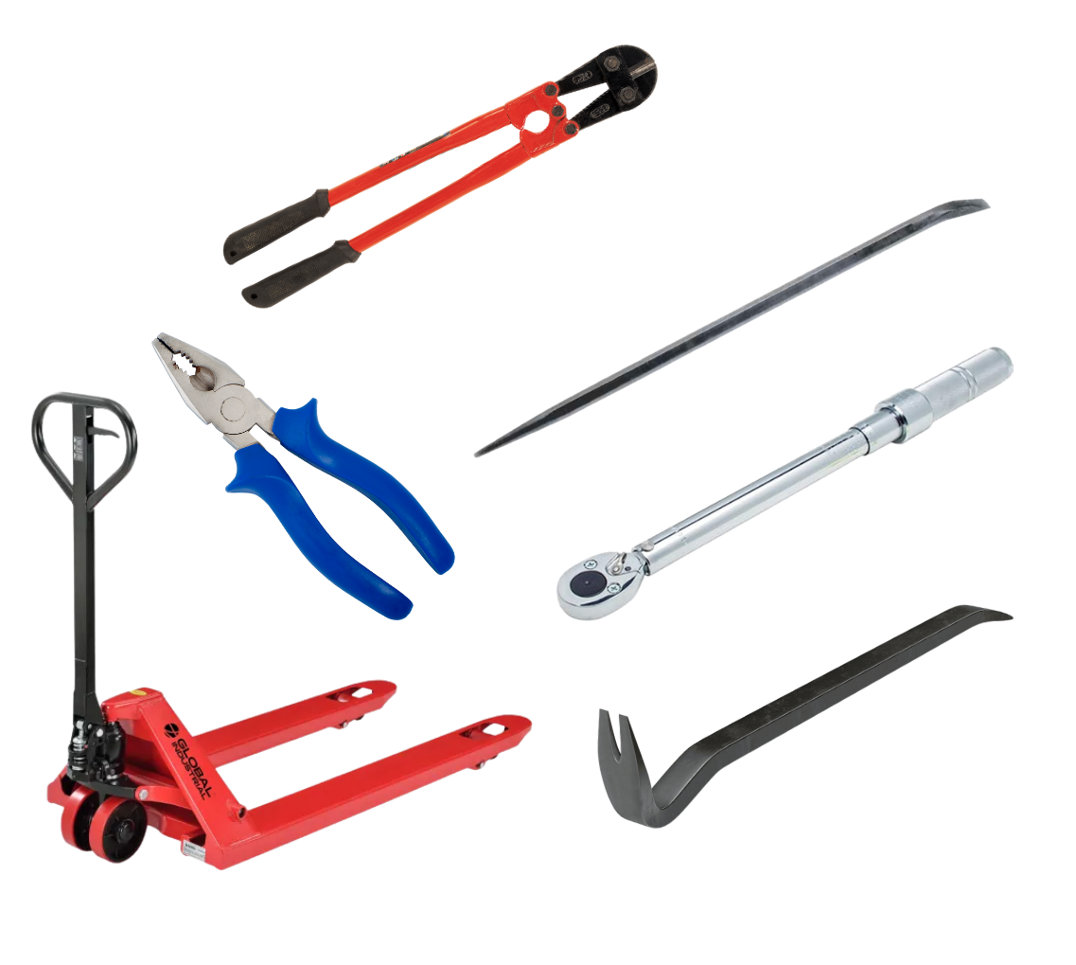
Common Leverage Tools
Common Leverage Tools
Pry bar
Crowbar
Alignment (drift) bar
Torque wrench
Pliers
Bolt cutters
Hand truck (dolly)
Hydraulic or manual jack
Notes:
Instructional Activity: Present Content
Instructional Time: 2 min.
Do: Elaborate on using these tools using your real-life experiences in the field.
Talking Points:
Many of the tools you use in transportation maintenance are designed to take advantage of leverage.
For example, pry bars and crowbars help lift or separate heavy components.
Alignment bars help position parts during assembly or repair.
Torque wrenches use leverage to apply a specific amount of torque to fasteners.
Bolt cutters use long handles to multiply force and cut through heavy materials.
Even equipment like hand trucks and jacks rely on leverage to move or lift heavy loads with less physical effort.

Slide 28
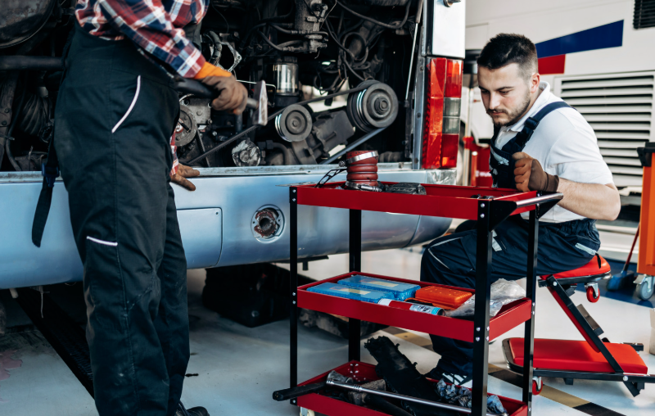
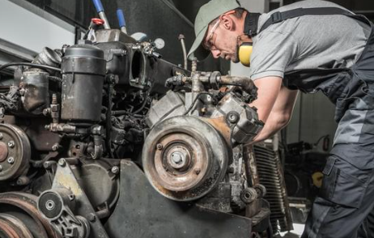
The Importance of Leverage on the Job
Understanding leverage helps you:
Work more efficiently
Reduce physical strain
Complete repairs faster
Improve problem-solving
Increase workplace safety
Notes:
Instructional Activity: Present Content
Instructional Time: 2 min.
Talking Points:
Understanding leverage is about more than knowing how a simple machine works. It directly affects your performance on the job.
Using leverage correctly allows you to complete tasks with less physical effort, reducing fatigue during the workday.
It can also improve repair times because the right tool allows the work to be completed more efficiently.
Perhaps most importantly, understanding leverage helps you work more safely by reducing unnecessary strain and encouraging proper tool selection.
Experienced technicians don't simply work harder; they work smarter by using leverage to their advantage.

Slide 29
Knowledge Check
A technician needs to remove a stuck access panel from the side of a transit bus. Which tool would provide the best leverage for the task?
(A). Torque Wrench
(B). Pry Bar
(B). Pry Bar
(C). Needle-Nose Pliers
(D). Socket Wrench
Notes:
*This slide contains animations. CLICK to reveal content.
Instructional Activity: Evaluate/Assess Performance, Provide Feedback
Instructional Time: 3 min.
Learning Objective: Recognize tools and maintenance tasks that use leverage.
Do: Review the knowledge check question. Call on learners to share their responses.
Answer:
B - A pry bar is designed to provide leverage for lifting, separating, or prying components with less effort

Slide 30
Knowledge Check
A maintenance worker chooses a longer pry bar instead of a shorter one to lift a heavy component. What is the primary benefit of using the longer tool?
(A). It increases the weight of the tool.
(B). It allows the worker to use more body weight.
(C). It provides greater mechanical advantage.
(C). It provides greater mechanical advantage.
(D). It eliminates the need for a fulcrum.
Notes:
*This slide contains animations. CLICK to reveal content.
Instructional Activity: Evaluate/Assess Performance, Provide Feedback
Instructional Time: 3 min.
Learning Objective: Describe why leverage is important for safe and efficient transit maintenance.
Do: Review the knowledge check question. Call on learners to share their responses.
Answer:
C - It provides greater mechanical advantage, reducing the effort needed to lift the load.

Slide 31

Quiz
Time for a quiz! Let’s see what you have learned from today’s lesson.
Notes:
Instructional Activity: Direction, Evaluate/Assess Performance
Instructional Time: 20 min.
Materials: Quiz_Leverage
Do:
Ask learners if they have any lingering questions. Address them before distributing the quiz.
Pass out the quiz and review the directions.
Talking Points:
Time for a quiz! Let’s see what you have retained from today’s lesson.

Slide 32
Revisiting Objectives
Explain how leverage helps move or lift a load with less effort.
Recognize tools and maintenance tasks that use leverage.
Describe why leverage is important for safe and efficient transit maintenance.
Notes:
Instructional Activity: Enhance Transfer and Retention
Instructional Time: 5 min.
Do: Facilitate a short discussion to review the key topics in the lesson.
Talking Points:
If you were explaining today’s objectives to someone else, how would you summarize what they mean and why they matter?
Which of today’s objectives do you feel most confident about? Which were most challenging? Explain your reasoning.
Can you give an example of how you could apply one of today’s objectives in a real-world situation?
After Discussion:
This conclude this section of the module. Thank you for your participation.

Slide 33
Thank you!
Notes:
Instructional Activity: Enhance Transfer and Retention
Instructional Time: 2 min.
Do:
Thank learners for their participation.
If possible, stay after class to answer any lingering questions learners may have.

