Slide 1


Instructor Guide Snapshot
Icon Key
Activity:
Video:
Instructor Demo:
Knowledge Check:
Instructional Time: 2.5 Hrs
Preparation before class:
  Review all materials – Review all slides, talking points, and handouts before class to understand the structure and flow of the lesson. Pay special attention to animations within the slides.
Provided Course Materials:
  +Hydraulics and Pneumatics_Mech Foundations.pptx
  +Instructor Facilitation Toolkit_Hydraulics and Pneumatics.docx - For Instructor use only.
  +Participant Resource Guide_Fasteners.docx - Print one copy for each learner. All handouts that leaners need for activities are embedded in the Participant Resource Guide.
  Quiz_Hydraulics and Pneumatics.docx - Print one copy for each learner.

Slide 2
Pacing Guide
Times have been rounded to the nearest .25 hours.
Total Time: 2.5 Hours
  (<.25 Hrs) Welcome and Warm Up
  (<.25 Hrs) 1.1 Fluid Dynamics
  (.75 Hrs) 1.2 Hydraulics
  (.75 Hrs) 1.3 Pneumatics
  (<.25 Hrs) 1.4 Hydraulics and Pneumatics in Transit Maintenance
  (.5 Hrs) Quiz and Wrap Up

Slide 3
Hydraulics and Pneumatics
Mechanical Foundations
Transit Core Competencies Curriculum (TC3)
Notes:
Instructional Activity: Direction
Instructional Time: 1 min.
Do: Welcome learners to class. Introduce the course and module.

Slide 4
Objectives
Define fluid dynamics and explain how it relates to hydraulic and pneumatic systems.
Define and differentiate hydraulics and pneumatics.
Identify mechanisms that use hydraulic and pneumatic systems.
Explain the importance of hydraulics and pneumatics in transit maintenance.
Compare the advantages and disadvantages of hydraulic and pneumatic systems.
Notes:
Instructional Activity: Direction
Instructional Time: 2 min.
Do: Review the module objectives.

Slide 5
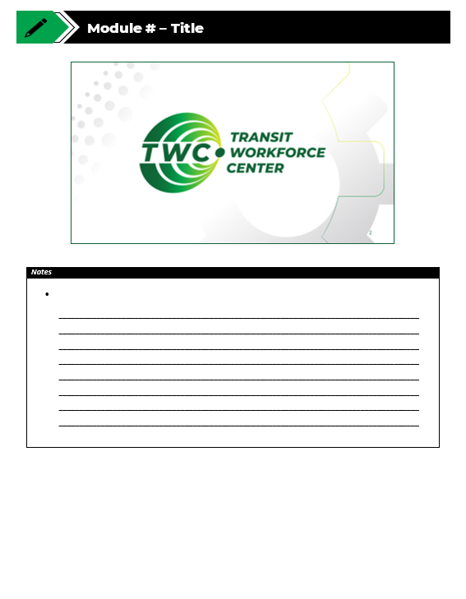
Agenda
Welcome and Warm-Up
1.1 Fluid Dynamics
1.2 Hydraulics
1.3 Pneumatics
1.4 Hydraulics and Pneumatics in Transit Maintenance
Quiz and Wrap-Up
Notes:
Instructional Activity: Direction
Instructional Time: 1 min.
Do: Review the module agenda.

Slide 6
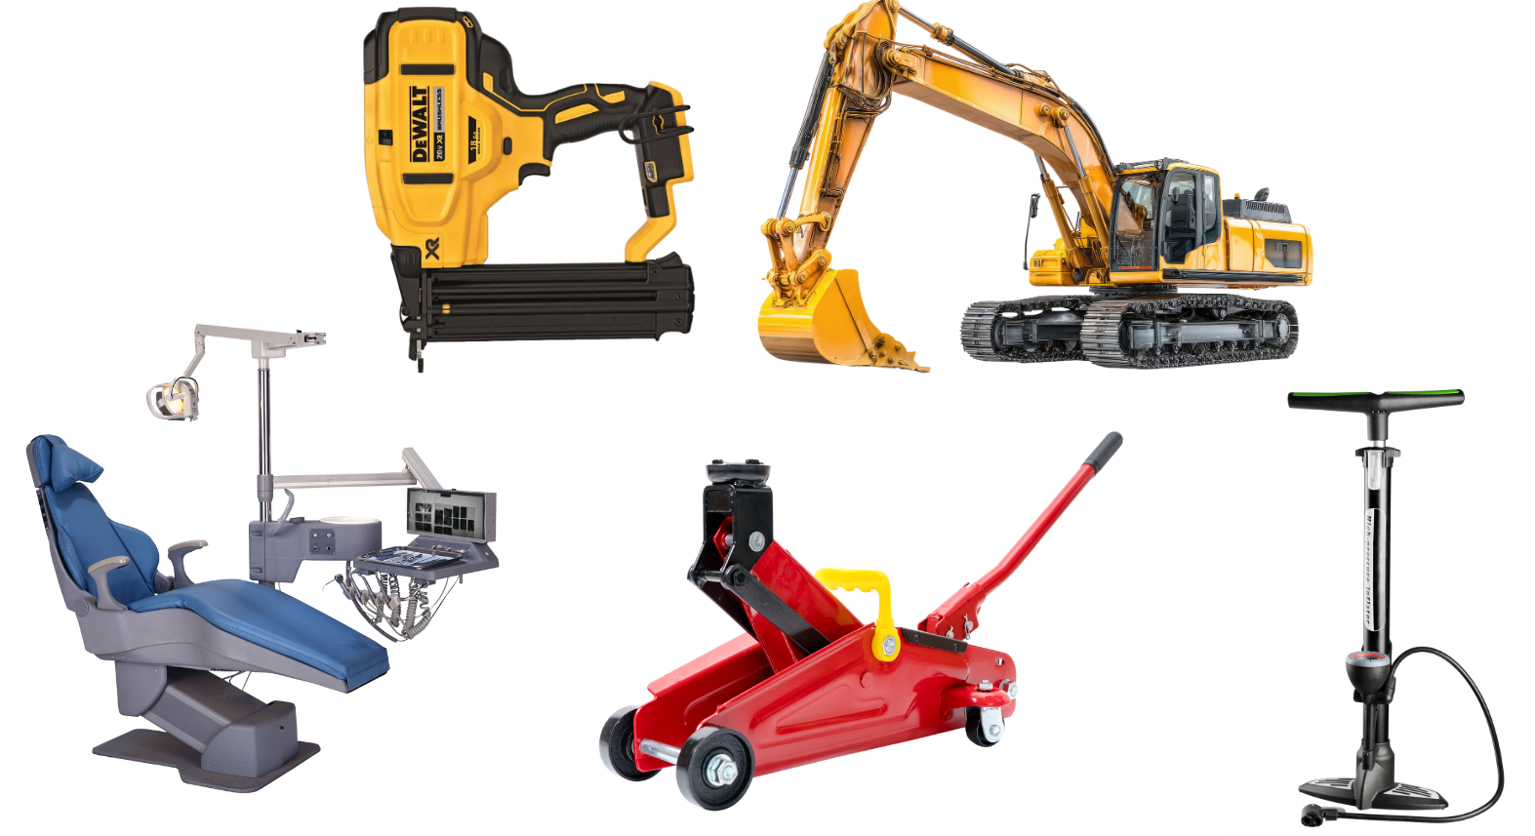
Warm Up
What do these items have in common?
Nail Gun
Excavator
Bike Pump
Dentist Chair
Floor Jack
Notes:
*This slide contains animations. CLICK to reveal content.
Instructional Activity: Gain Attention
Instructional Time: 5 min.
Do: Read the question on the slide and call on learners to share their responses.
Talking Points:
Let's begin with a quick activity.
Take a look at the images on the screen. They represent a variety of tools, machines, and equipment that you may have seen in everyday life or in the workplace.
ASK: What do these items have in common?
Take about a minute to discuss your ideas with a partner. Don't worry about finding the "right" answer, just think about what these items might share.
Allow time for discussion.
Let's hear a few ideas. What similarities did you notice?
Facilitate a brief discussion.
These items may look very different and perform different jobs, but they all have one important thing in common: they use fluid power to create force and motion.
By the end of this module, you'll be able to explain how each system works, recognize where they're used in transit maintenance, and understand why one system is often chosen over the other depending on the job.

Slide 7
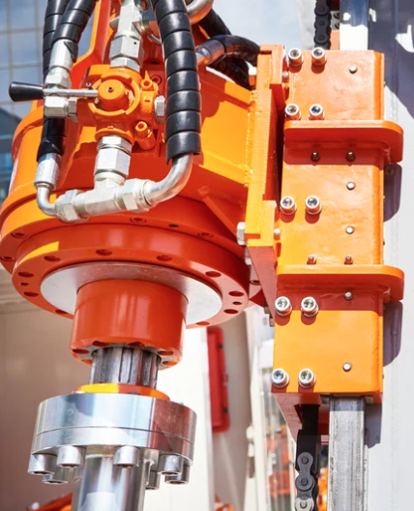
1.1 – Fluid Dynamics
In this section, you will explore the basics of fluid mechanics and fluid dynamics and how moving fluids are used to transmit power and create mechanical motion.
Notes:
Instructional Activity: Direction
Instructional Time: 1 min.
Do: Introduce the section.
Talking Points: In this section, you will explore the basics of fluid mechanics and fluid dynamics and how moving fluids are used to transmit power and create mechanical motion.

Slide 8
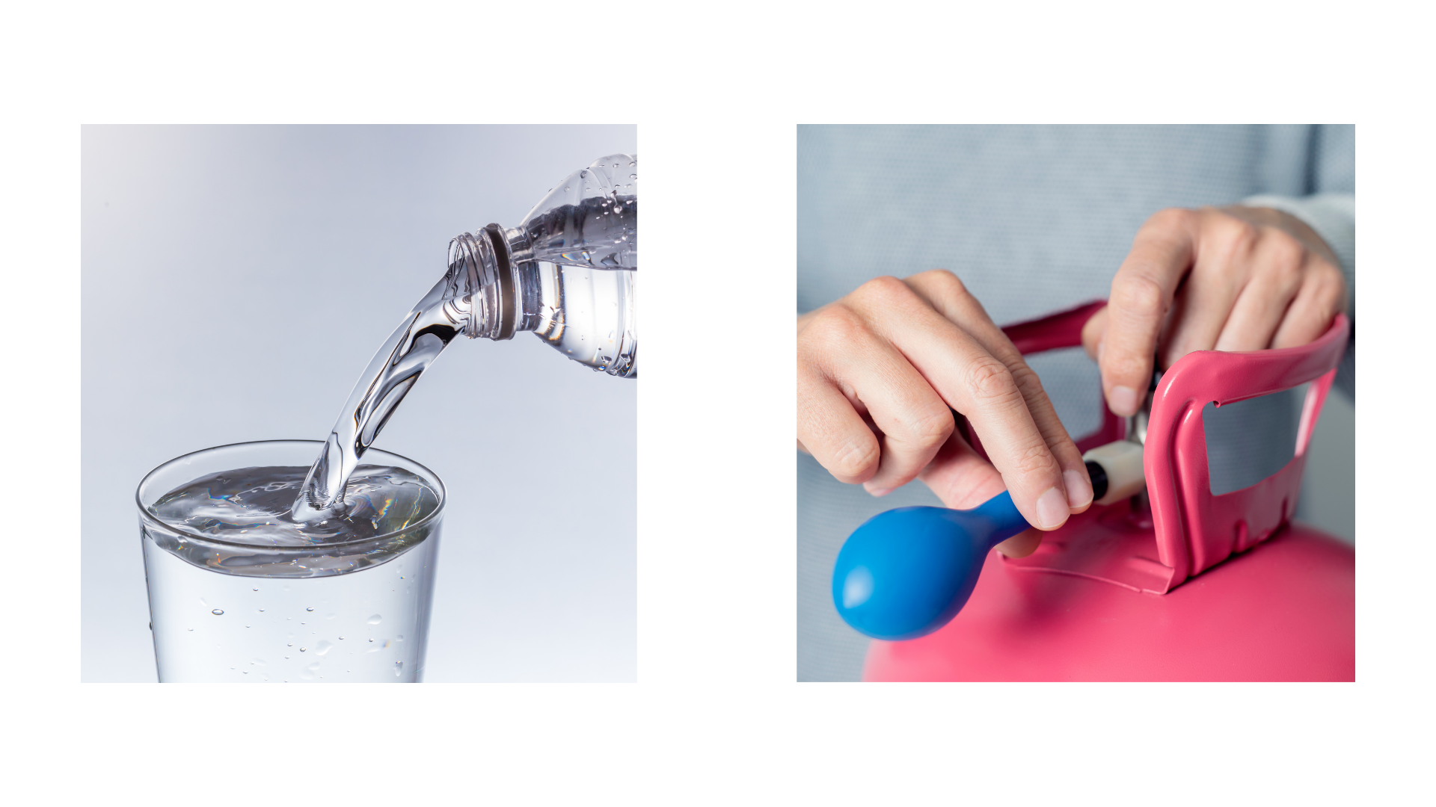
What is a fluid?
Fluid – A substance that flows when force is applied and takes the shape of its container.
Liquids (Water, oil, fuel, etc.)
Gases (Air, steam, natural gas, etc.)
Notes:
Instructional Activity: Present Content
Instructional Time: 2 min.
Talking Points:
When you hear the word fluid, you may immediately think of a liquid, like water or oil. But in physics, the term has a broader meaning.
A fluid is a substance that can flow when a force is applied and takes the shape of its container.
Liquids are fluids. Think about pouring water into a glass, the water flows and takes the shape of the glass.
But gases are also fluids. Air, for example, flows and takes the shape of whatever space or container it occupies. Think about filling a balloon or an air compressor tank.
This is important for our course because transportation systems use both types of fluids to perform work.
Next, we'll look at the science used to study fluids: fluid mechanics.
Source:
LibreTexts. (n.d.). What is a fluid? Physics LibreTexts. Physics LibreTexts
National Aeronautics and Space Administration. (n.d.). Fluid physics. NASA Science. NASA Science

Slide 9
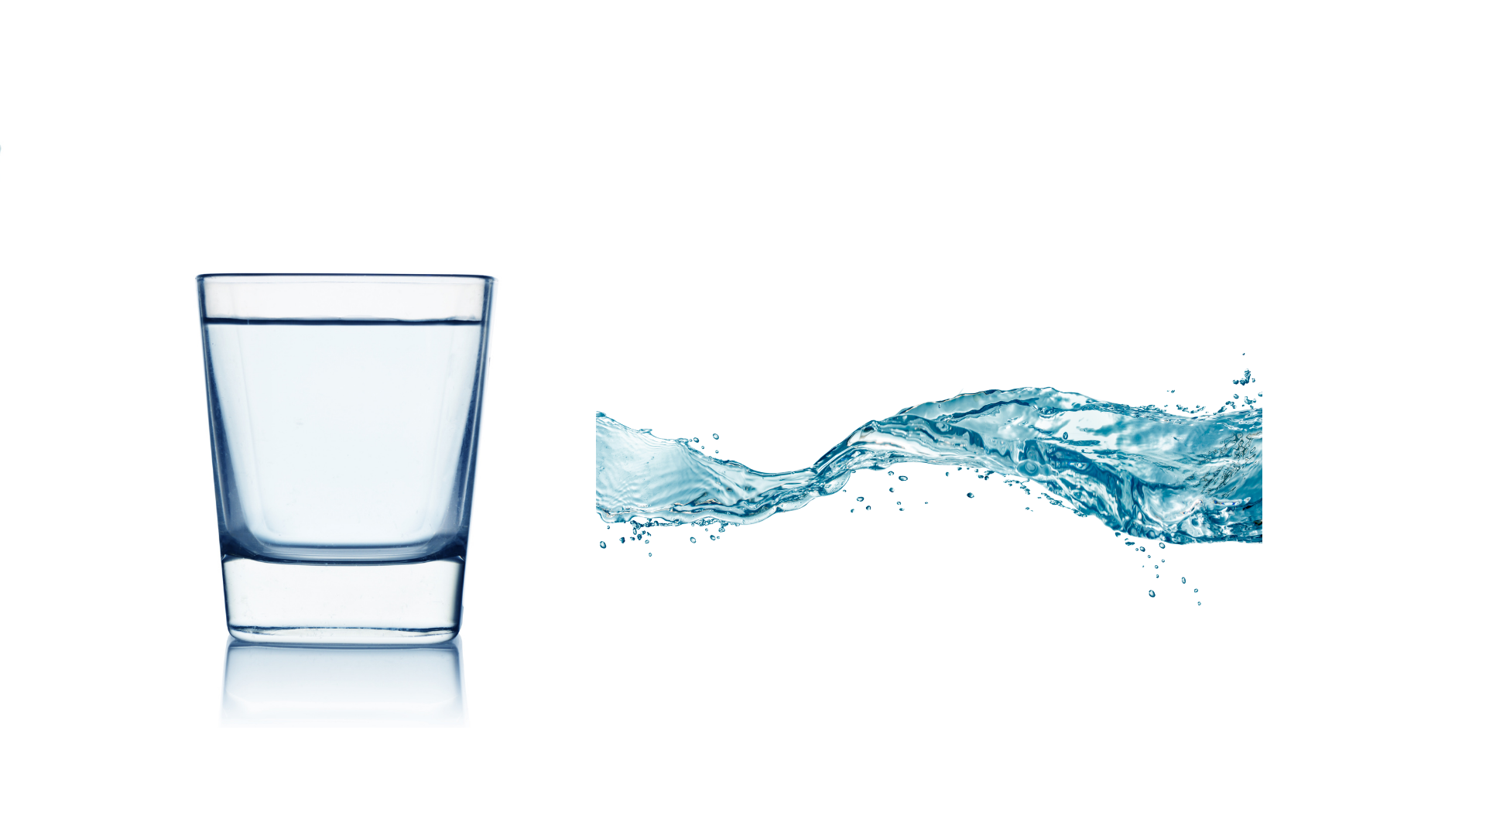
Fluid Mechanics
Fluid Mechanics
The study of fluids and how forces affect their behavior.
Fluid Statics
The study of fluids at rest.
Fluid Dynamics
The study of fluids in motion.
Notes:
Instructional Activity: Present Content
Instructional Time: 2 min.
Talking Points:
Now that we know what a fluid is, let's look at fluid mechanics.
Fluid mechanics is the study of fluids and how forces affect their behavior. Remember, when we say fluids, we're talking about both liquids and gases.
Fluid mechanics can be divided into two main areas: fluid statics and fluid dynamics.
Fluid statics looks at fluids that are at rest. For example, think about the hydraulic fluid sitting inside a reservoir when the system is not operating.
Fluid dynamics looks at fluids in motion. Water moving through a pipe or compressed air flowing through an air line are examples of fluid dynamics.
For this course, we'll focus primarily on fluid dynamics because hydraulic and pneumatic systems depend on controlling the movement of liquids and gases to transmit power and perform work.

Slide 10
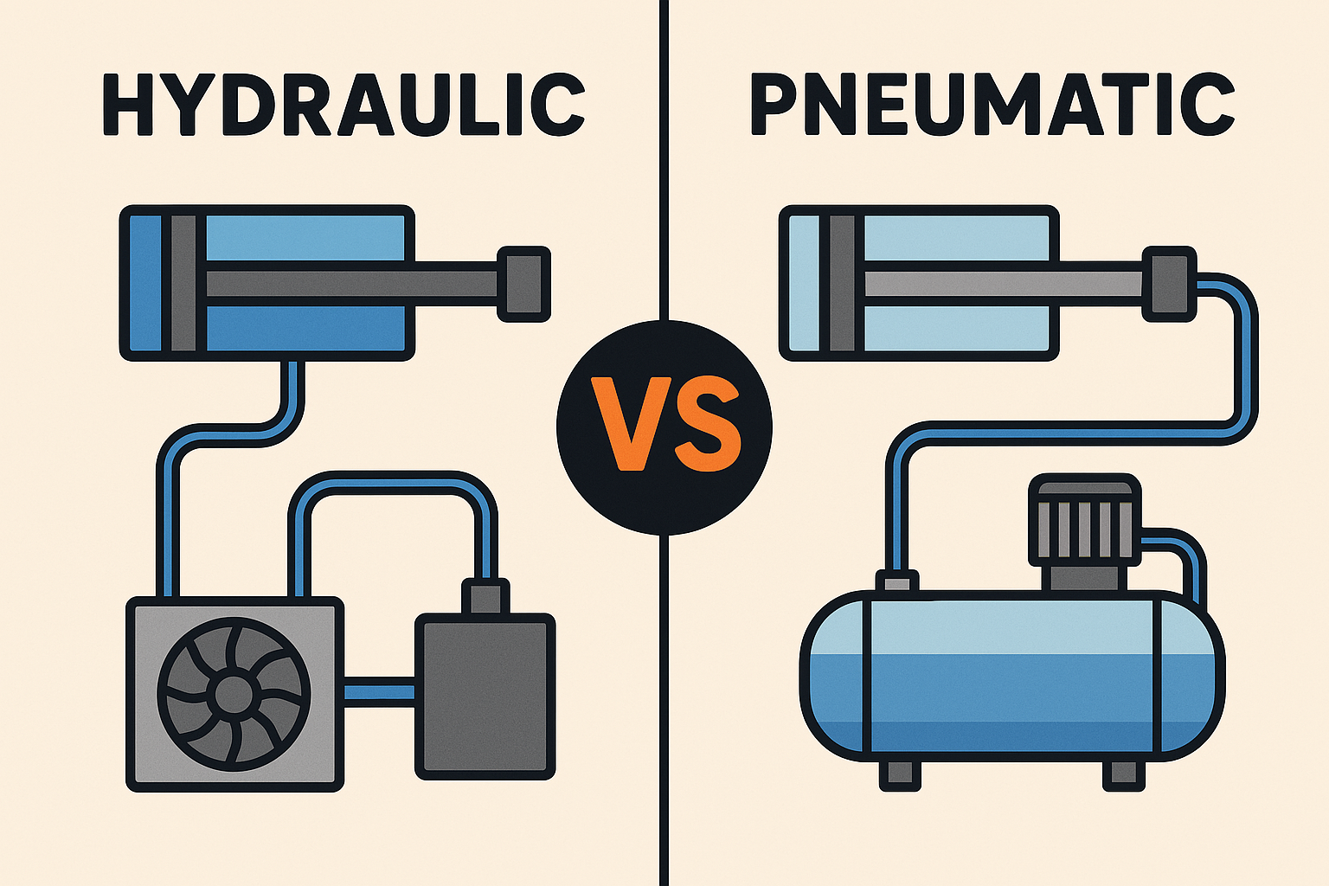
From Fluid Dynamics to Fluid Power
Fluid Power occurs when moving fluids can transmit force and energy to perform mechanical work.
Hydraulics – pressurized liquid
Pneumatics – compressed air or gas
Pressure and flow allow fluid power systems to transmit energy and produce force and motion.
Notes:
Instructional Activity: Present Content
Instructional Time: 2 min.
Talking Points:
Now that we've introduced fluid dynamics, let's connect it to fluid power.
Moving fluids can carry energy through a system and help create mechanical work, such as lifting, pushing, pulling, or moving a component.
In fluid power systems, there are two main types we'll focus on: hydraulics and pneumatics.
Hydraulic systems use pressurized liquid, while pneumatic systems use compressed air or gas.
Although they use different fluids, both systems rely on the same basic ideas of pressure and flow to transmit energy through the system.
When that energy reaches an actuator or another working component, it can produce force and motion.
As we move into the next section, we'll look more closely at hydraulics and see how pressurized liquid is used to perform work in transportation maintenance.
Image Source: Delanges Industries. (n.d.). Hydraulic vs. pneumatic: Which system saves more energy and costs? Delanges Industries

Slide 11
Hydraulics and Pneumatics Safety Considerations
Hydraulic and pneumatic systems can contain high-pressure fluids or air that can cause serious injury.
Wear appropriate PPE
Follow LOTO procedures
Never use your hands to check for leaks
Follow all agency safety procedures
Ex: Leak Check - Use an approved method, such as cardboard, to help locate suspected hydraulic leaks while keeping hands clear
Notes:
Instructional Activity: Present Content
Instructional Time: 2 min.
Talking Points:
Hydraulic and pneumatic systems operate under high pressure, so following proper safety procedures is extremely important.
Always wear the appropriate personal protective equipment, or PPE, for the work you are performing.
Before beginning work on a hydraulic or pneumatic system, use the required lockout/tagout, or LOTO, procedures.
Finally, always follow your agency’s specific safety protocols. Procedures and requirements may vary depending on the equipment and work being performed.
For example, when checking for a leak, never use your hand. Instead, use a piece of cardboard to help locate the leak. High-pressure fluid can penetrate the skin and cause a serious injection injury.
These basic precautions can help protect you and others when working with hydraulic and pneumatic systems.

Slide 12

1.2 - Hydraulics
This section introduces hydraulic systems, including how they work, their key components, advantages and disadvantages, and common applications.
Notes:
Instructional Activity: Direction
Instructional Time: 1 min.
Do: Introduce the section.
Talking Points: This section introduces hydraulic systems, including how they work, their key components, advantages and disadvantages, and common applications.

Slide 13
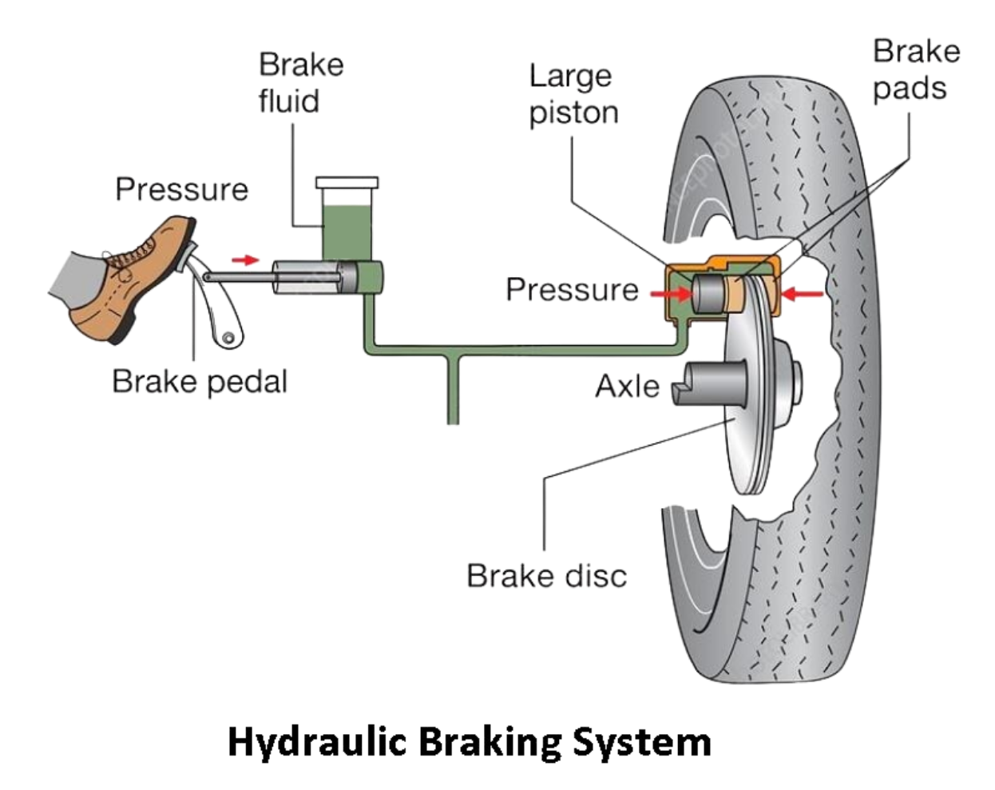
What Are Hydraulics?
Hydraulics – The use of pressurized liquid to transmit power and perform mechanical work.
Typically uses oil or other hydraulic fluids
Transmits power through a confined liquid
Produces force and motion
Notes:
Instructional Activity: Present Content
Instructional Time: 2 min.
Talking Points:
Hydraulics is a type of fluid power that uses pressurized liquid to transmit power and perform mechanical work.
Hydraulic systems can use different types of liquids, but specially formulated hydraulic oils are commonly used because they provide properties needed for reliable system operation.
You've probably used a hydraulic system without thinking about it. A common example is the braking system in many vehicles.
When you press the brake pedal, force is transmitted through pressurized brake fluid to components at the wheels, which apply the brakes and slow or stop the vehicle.
In transportation maintenance, you'll encounter hydraulics in many different systems and pieces of equipment.
Image Source: Moorthi, M. (2017, July 27). Hydraulic braking system. LinkedIn. LinkedIn article

Slide 14
How Does a Hydraulic System Work?
A hydraulic system uses fluid flow and pressure to transmit power and create motion.
Pump
A pump moves hydraulic fluid
Flow
Resistance to flow creates pressure
Pressure
Pressurized fluid transmits energy
Movement
Actuator converts energy into force and motion
Key Takeaway: The pump creates flow; resistance to flow creates pressure.
Notes:
Instructional Activity: Present Content
Instructional Time: 2 min.
Do: Emphasize the importance of resistance.
Talking Points:
Let's take a look at the basic process that makes a hydraulic system work.
First, a pump moves hydraulic fluid through the system.
The pump causes the liquid to flow.
As that fluid encounters resistance in the system, pressure builds which can then transmit energy through the hydraulic system.
The fluid eventually reaches an actuator, such as a hydraulic cylinder, which converts that hydraulic energy into mechanical force and motion.
So, remember this basic sequence: the pump creates flow, resistance creates pressure, and the system uses that pressurized fluid to produce force and motion.

Slide 15
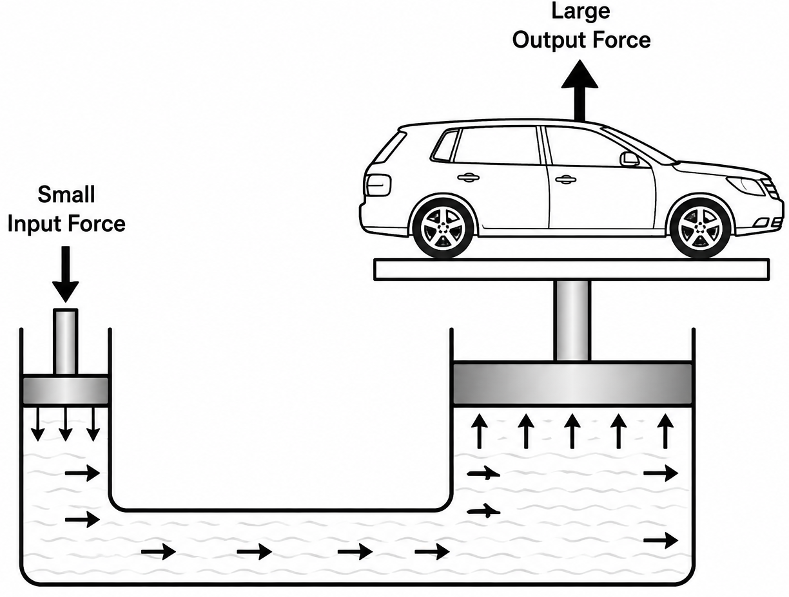
Pascal’s Law
Pascal's Law states that pressure applied to a confined liquid is transmitted equally throughout the liquid.
As a result, a small input force can produce a larger output force.
Notes:
Instructional Activity: Present Content
Instructional Time: 2 min.
Talking Points:
One of the most important principles behind hydraulic systems is Pascal's Law.
Pascal's Law states that when pressure is applied to a confined liquid, that pressure is transmitted equally throughout the liquid.
This means the pressure created at one point in the system is carried through the hydraulic fluid to other parts of the system.
When that pressure acts on a larger piston or cylinder, it can produce a much greater output force than the force originally applied.
This is why hydraulic systems are able to lift buses, operate heavy equipment, and move large components with relatively little input effort.
Keep in mind that the system isn't creating energy, it is using pressure to transfer force efficiently through the hydraulic fluid.
Image Source: Encyclopaedia Britannica. (n.d.). Pascal's principle. Encyclopaedia Britannica. Encyclopaedia Britannica – Pascal's principle

Slide 16
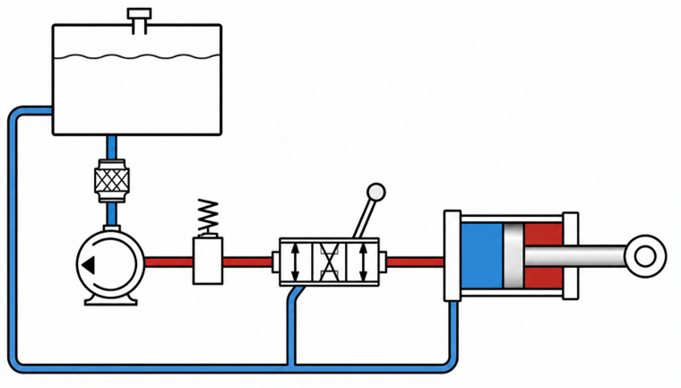
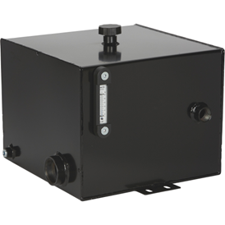
Basic Hydraulic System Components
Reservoir
Stores the hydraulic fluid and supplies it to the pump as the system operates
Reservoir
Pump
Hydraulic Fluid
Pipes
Valves
Actuator
Piston
Notes:
Instructional Activity: Present Content
Instructional Time: 1 min.
Talking Points:
Now that we've seen how a hydraulic system works, let's look at the main components that make it possible.
First, we have the Reservoir which stores the hydraulic fluid and supplies it to the pump as the system operates.

Slide 17
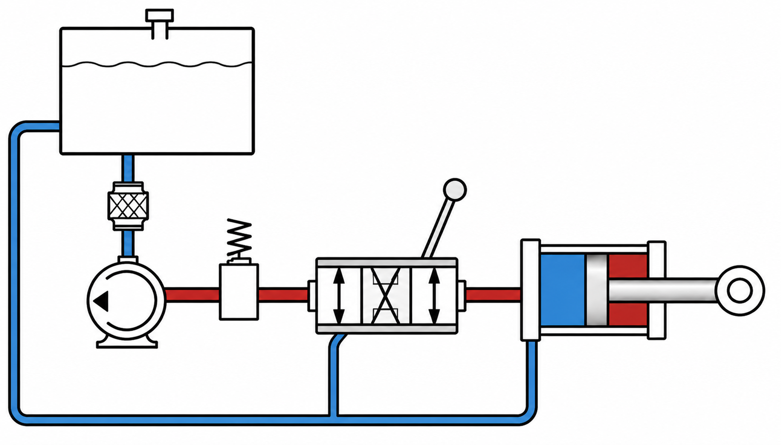
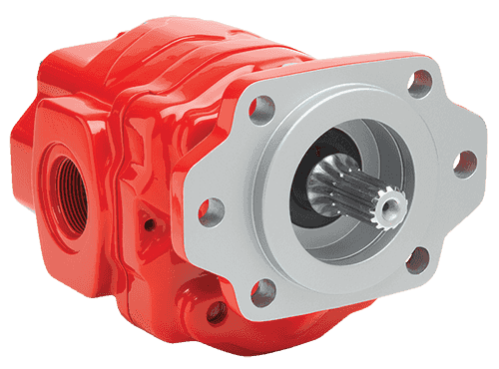
Basic Hydraulic System Components
Pump
Draws hydraulic fluid from the reservoir and moves it through the system, creating the flow needed for the system to operate
Reservoir
Pump
Hydraulic Fluid
Pipes
Valves
Actuator
Piston
Notes:
Instructional Activity: Present Content
Instructional Time: 1 min.
Talking Points:
Next, we have the pump, which draws hydraulic fluid from the reservoir and moves it through the system, creating the flow needed for the system to operate.

Slide 18
Basic Hydraulic System Components
Hydraulic Fluid
carries energy through the system while also helping lubricate and cool system components. It is nearly incompressible and can efficiently transmit pressure.
Reservoir
Pump
Hydraulic Fluid
Pipes
Valves
Actuator
Piston
Notes:
Instructional Activity: Present Content
Instructional Time: 1 min.
Talking Points:
The pump moves hydraulic fluid through the system. The fluid transmits energy while also helping lubricate and cool system components.
Because it is nearly incompressible, hydraulic fluid can efficiently transmit pressure.

Slide 19
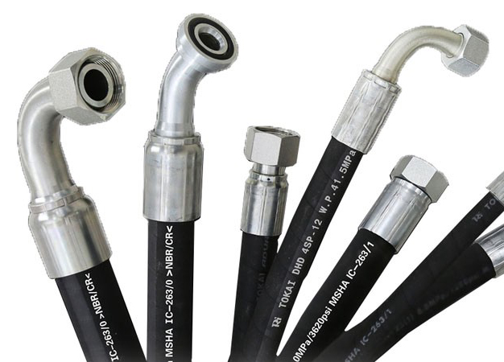
Basic Hydraulic System Components
Pipes and Hoses
provide pathways for hydraulic fluid to travel between components throughout the system.
Reservoir
Pump
Hydraulic Fluid
Pipes
Valves
Actuator
Piston
Notes:
Instructional Activity: Present Content
Instructional Time: 1 min.
Talking Points:
The pipes and hoses provide pathways for hydraulic fluid to travel between components throughout the system.

Slide 20
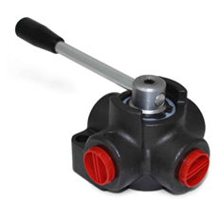
Basic Hydraulic System Components
Valves
control the direction, pressure, and flow of hydraulic fluid to regulate how the system operates.
Reservoir
Pump
Hydraulic Fluid
Pipes
Valves
Actuator
Piston
Notes:
Instructional Activity: Present Content
Instructional Time: 1 min.
Talking Points:
The valves control the direction, pressure, and flow of hydraulic fluid to regulate how the system operates.

Slide 21
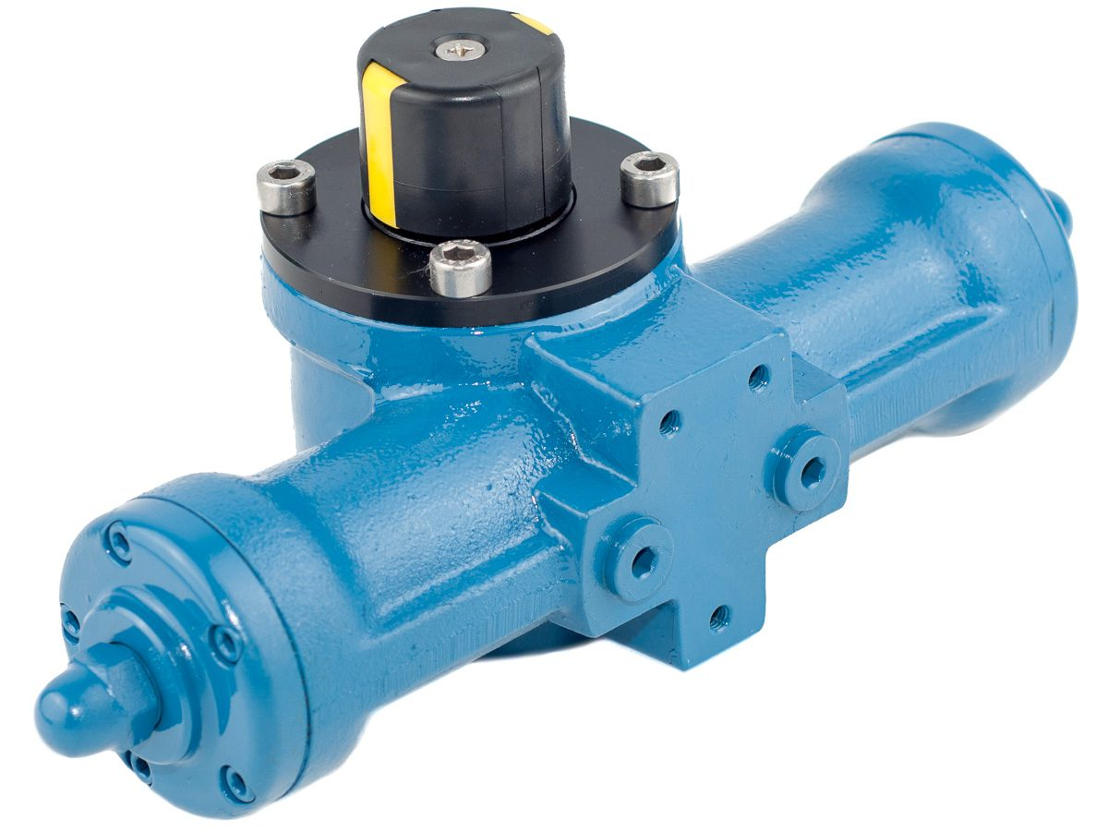
Basic Hydraulic System Components
Actuator
Converts hydraulic energy into mechanical force and motion to lift, push, pull, or hold a load
Reservoir
Pump
Hydraulic Fluid
Pipes
Valves
Actuator
Piston
Notes:
Instructional Activity: Present Content
Instructional Time: 1 min.
Talking Points:
The actuator converts hydraulic energy into mechanical force and motion. A hydraulic cylinder is a type of actuator that produces linear motion to lift, push, pull, or hold a load.

Slide 22
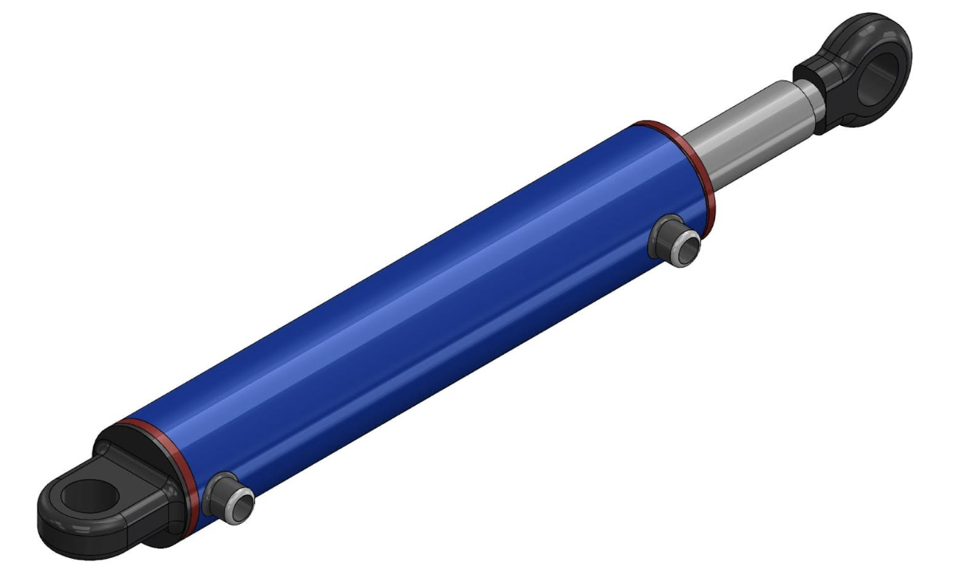
Basic Hydraulic System Components
Piston
A movable component inside a hydraulic cylinder. Pressurized fluid acts on the piston, causing it to move and produce force.
Reservoir
Pump
Hydraulic Fluid
Pipes
Valves
Actuator
Piston
Notes:
Instructional Activity: Present Content
Instructional Time: 1 min.
Talking Points:
The piston is a movable component inside an actuator (hydraulic cylinder). Pressurized fluid acts on the piston, causing it to move and produce force.

Slide 23
Basic Hydraulic System Components
Reservoir
Hydraulic Fluid
Valves
Actuator
Pump
Piston
Pipes
Notes:
Instructional Activity: Recall
Instructional Time: 1 min.
Do: Review by asking learners to explain how a basic hydraulic system functions from start to finish.
Talking Points:
Let’s Review. Who can explain how a basic hydraulic system functions from start to finish?
Call on learners to response. Provide feedback and address learning gaps as needed.

Slide 24
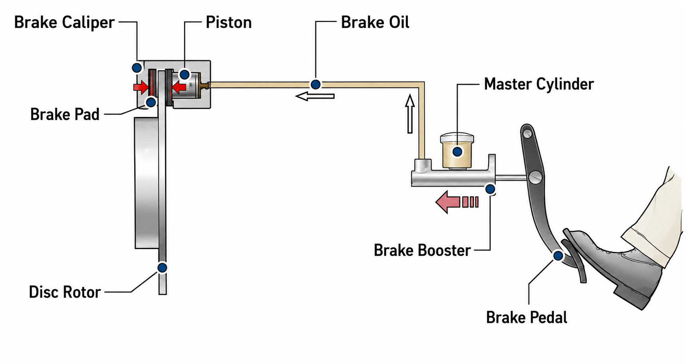
Example: Break Pedal
Notes:
INSTRUCTIONAL ACTIVITY: Present Content
TIME: 2 minutes.
Do:
Walk learners through the example.
Explain how each part of the hydraulic system is present including the reservoir, pump, hydraulic fluid, pipes, valves, actuator, and pistons.
TALKING POINTS:
Now that we have a better understanding of how hydraulic systems work, let’s return to this break pedal graphic we saw earlier in the presentation.
In a car's braking system, the driver pressing the brake pedal applies a force to the brake fluid, creating pressure.
This pressure is then transmitted to the brake caliper and pad, which presses against the rotor to apply the brakes.
Image Source: Moorthi, M. (2017, July 27). Hydraulic braking system. LinkedIn. LinkedIn article

Slide 25
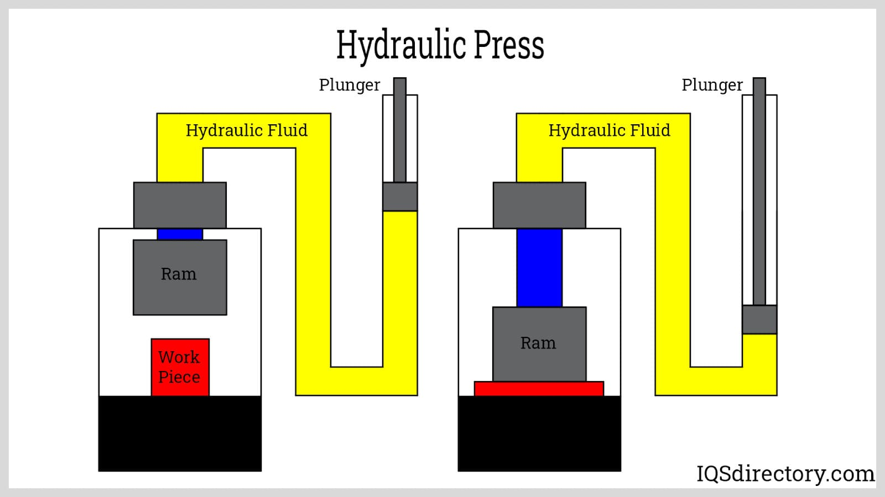
Example: Hydraulic Press
Notes:
INSTRUCTIONAL ACTIVITY: Present Content
TIME: 2 minutes.
Do:
Walk learners through the example.
Explain how each part of the hydraulic system is present including the reservoir, pump, hydraulic fluid, pipes, valves, actuator, and pistons.
TALKING POINTS:
In a hydraulic press, a force is applied to a small piston (plunger), generating pressure.
When this pressure is then transmitted to a larger piston, the force is multiplied, which allows the press to exert a large force on the work piece.
Image Source: IQS Directory Editorial Team. (2026, May 14). Hydraulic press: Types, uses and functions. IQS Directory. IQS Directory – Hydraulic Press

Slide 26
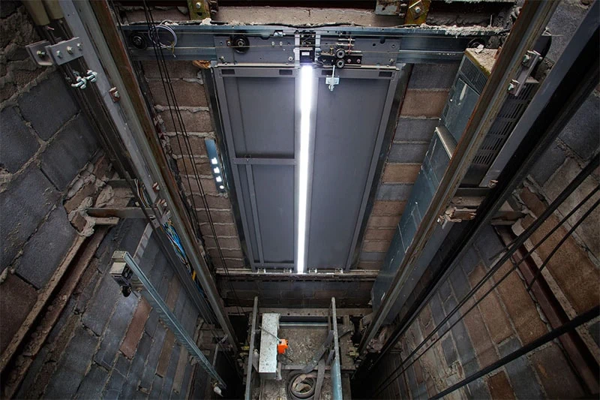
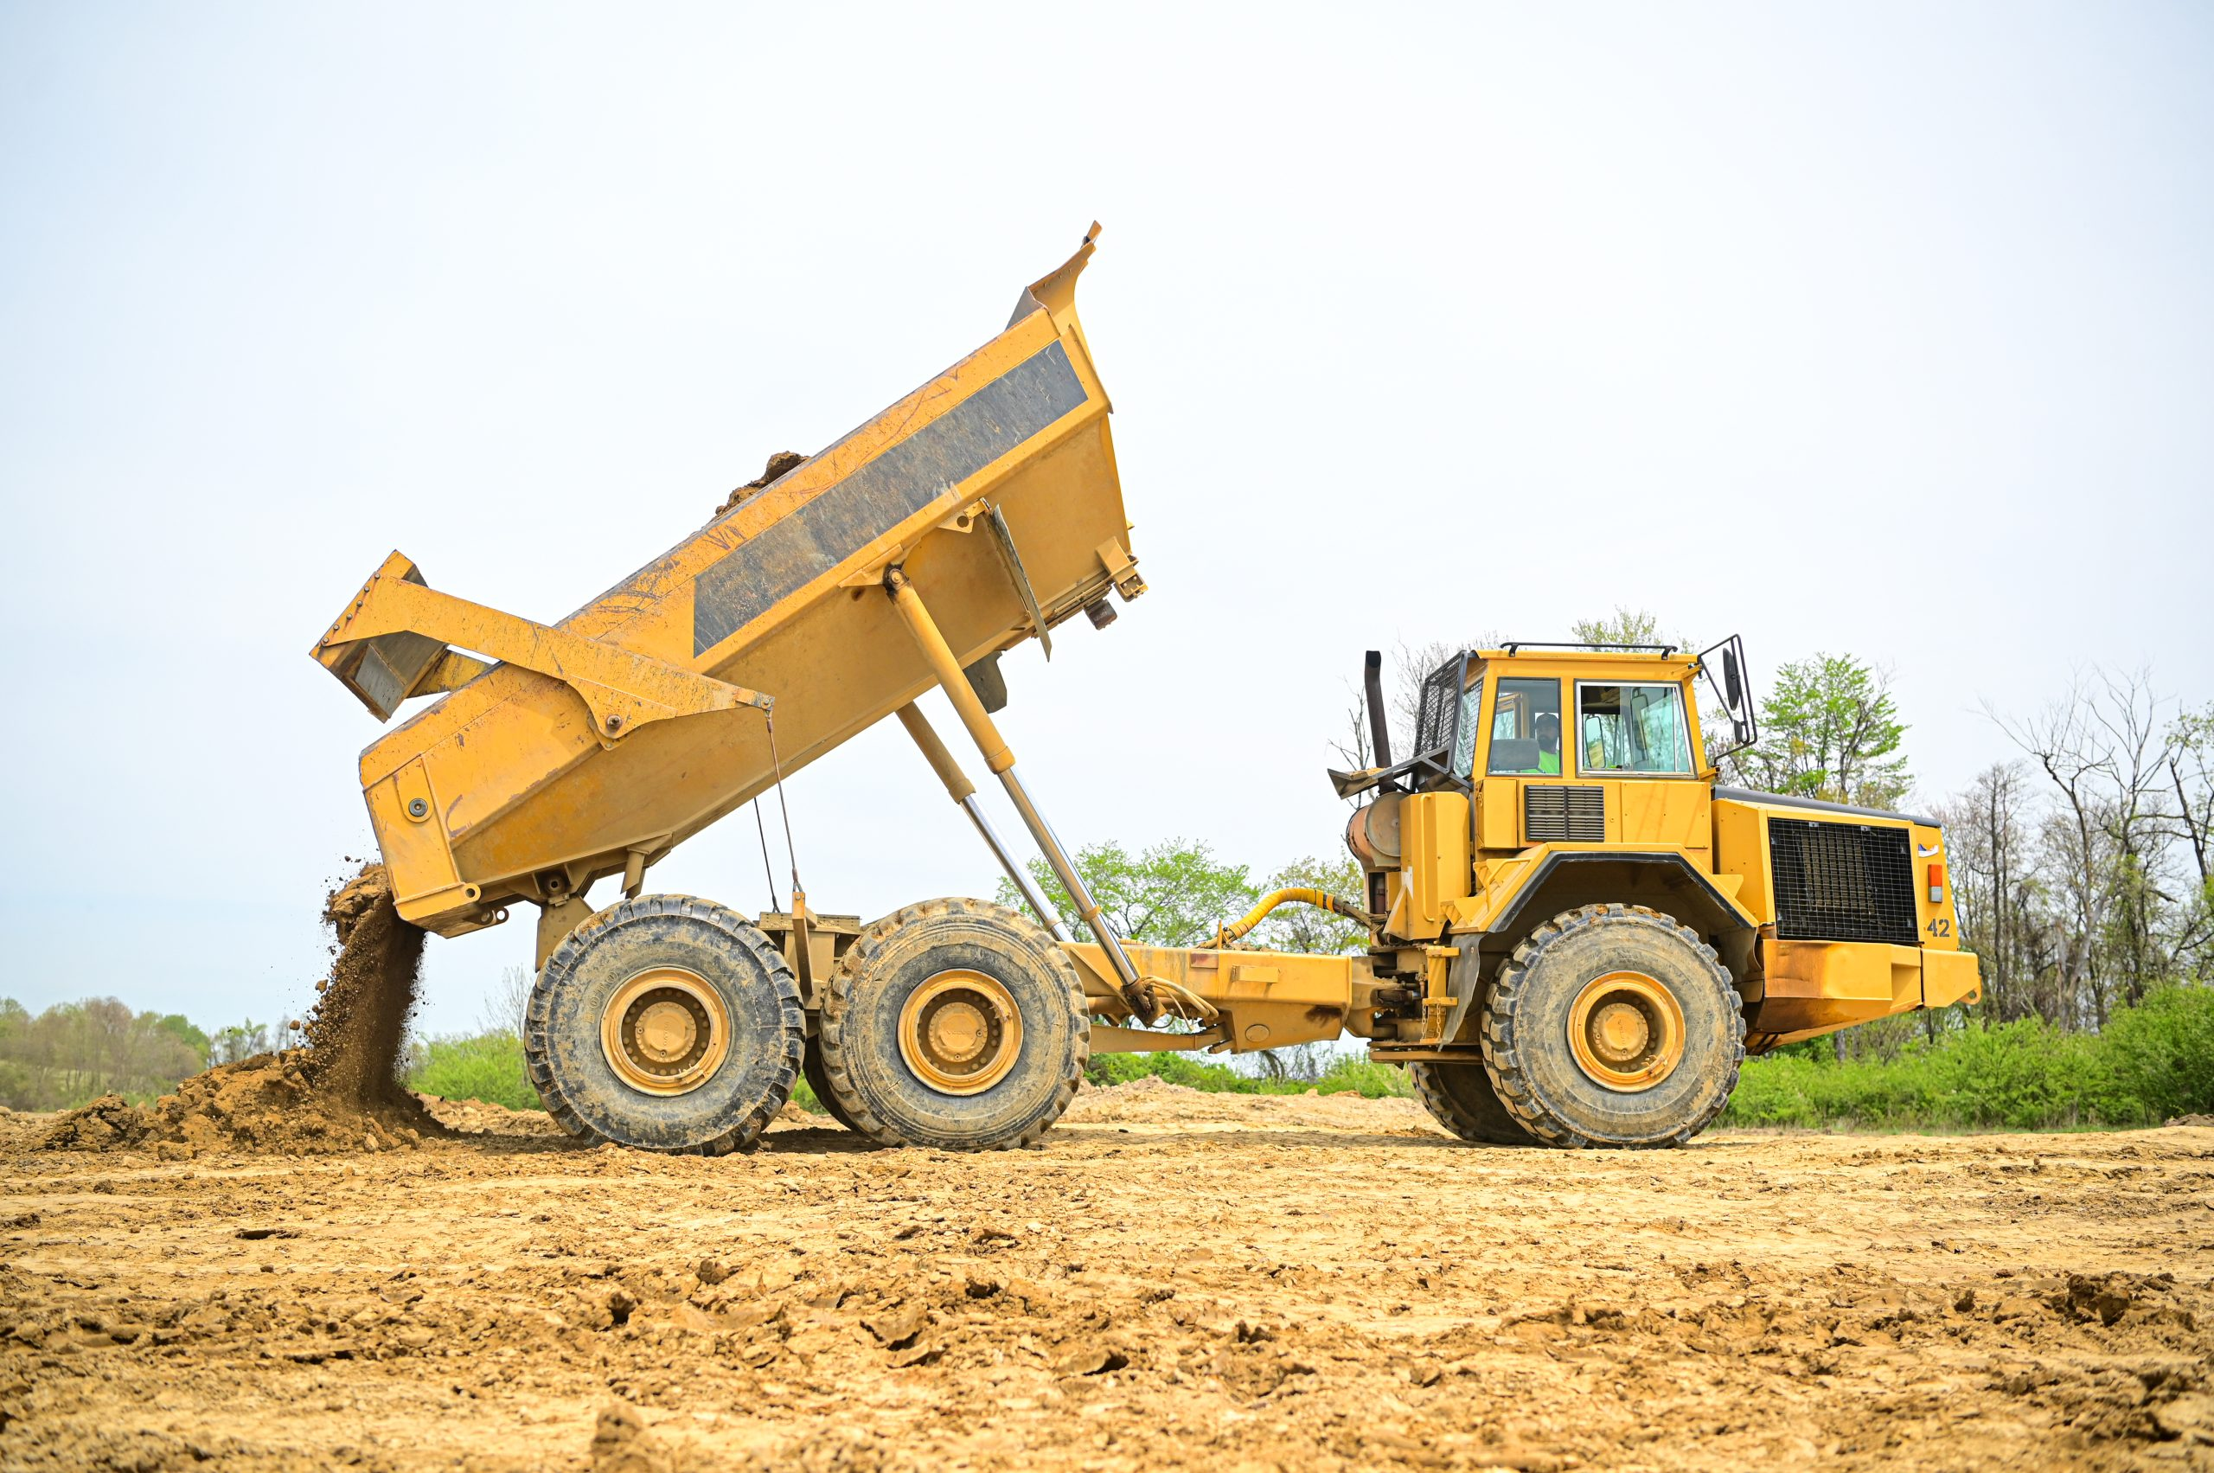
Common Hydraulic Systems
Elevators
Dump trucks (lifting mechanism)
Wheelchair lift
Hydraulic braking system (bus and trains)
Power Steering systems
Hydraulic lift
Notes:
INSTRUCTIONAL ACTIVITY: Present Content
TIME: 2 minutes.
TALKING POINTS:
Hydraulic systems are used in many different types of equipment because they can produce a large amount of force to move or lift heavy loads.
You may be familiar with hydraulic systems in elevators and dump trucks, where hydraulic force is used to lift heavy loads.
In transit, wheelchair lifts are a common example. Hydraulics can provide the controlled lifting force needed to raise and lower the platform.
Hydraulics are also used in braking and power steering systems on some transit vehicles. These systems use pressurized fluid to help control vehicle movement.
Maintenance facilities also use hydraulic lifts to raise vehicles so technicians can safely access components underneath.
The specific application may change, but the basic principle remains the same: hydraulic fluid transmits power to produce force and motion.
Next, we'll look at some of the advantages and disadvantages of using hydraulic systems.

Slide 27
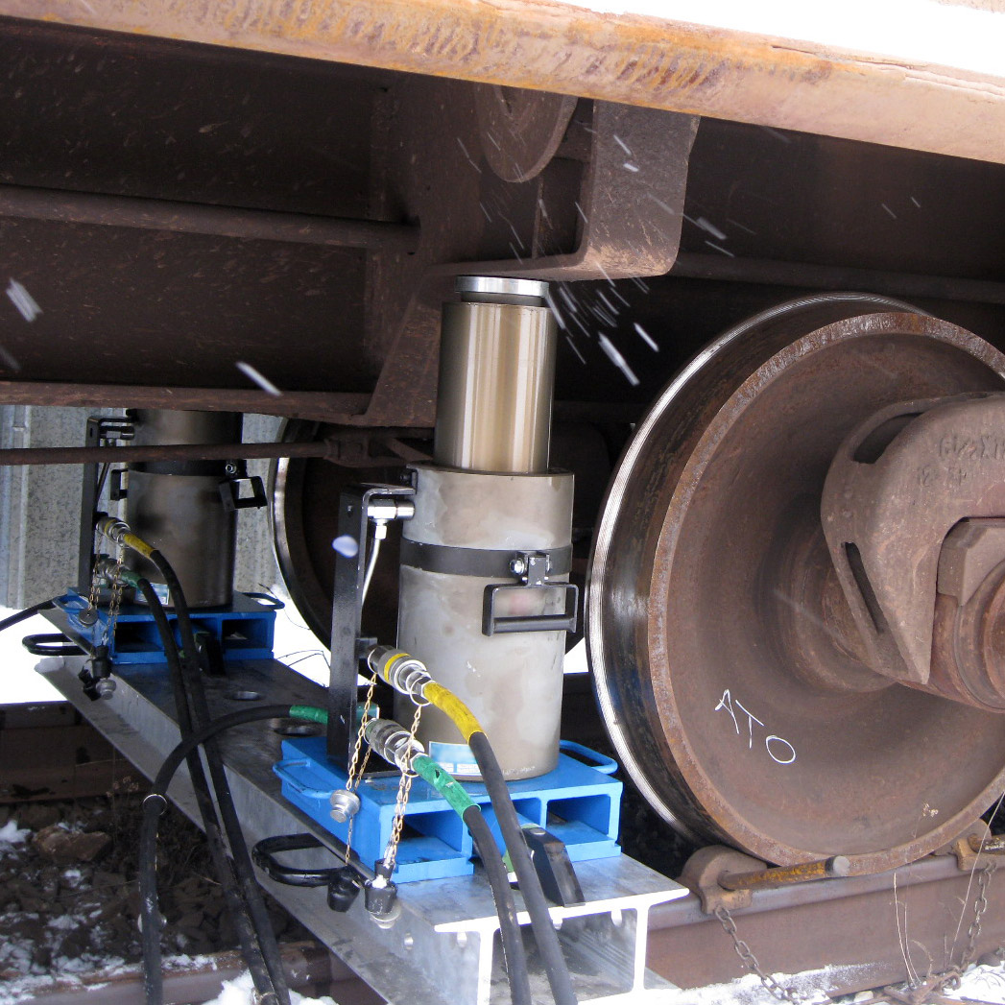
Advantages of Hydraulic Systems
Hydraulic systems are well suited for applications requiring high force and heavy loads.
Produce high amounts of force
Move and lift heavy loads
Generate high force with smaller actuators
Fluid provides power, lubrication, and cooling
Typically operate more quietly than pneumatic systems
Notes:
INSTRUCTIONAL ACTIVITY: Present Content
TIME: 2 minutes.
TALKING POINTS:
Hydraulic systems have several advantages that make them useful in transportation and other heavy-duty applications.
One of their biggest advantages is their ability to produce large amounts of force. Compared with pneumatic systems, hydraulics typically operate at higher pressures and can produce greater force.
This makes hydraulics especially useful when equipment needs to lift or move a heavy load, such as raising a vehicle on a hydraulic lift.
Higher operating pressures also allow hydraulic systems to produce significant force from relatively compact actuators.
Hydraulic fluid also performs several jobs within the system. In addition to transmitting power, it can help lubricate components and carry away heat.
Hydraulic systems also tend to operate more quietly than pneumatic systems, particularly because they do not have the same compressed-air exhaust noise.
These advantages help explain why hydraulics are commonly used for heavy-duty applications where high force and controlled movement are important.

Slide 28
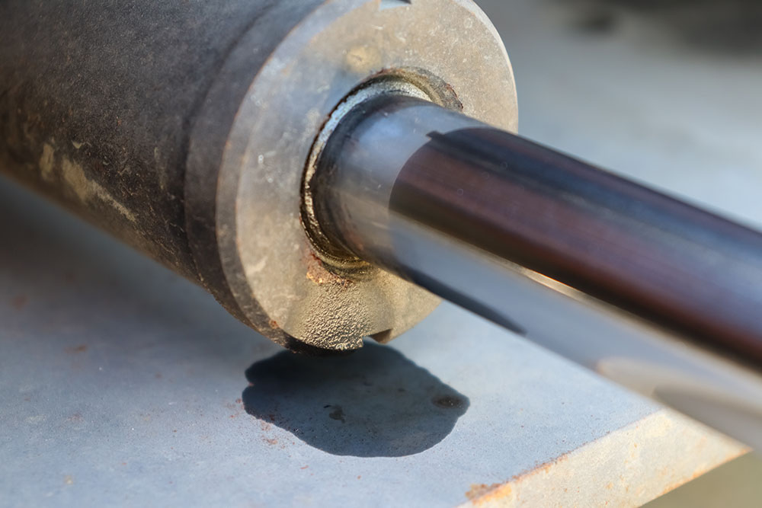
Disadvantages of Hydraulic Systems
Hydraulic systems also have limitations that must be considered.
Can be large and complex
May require more installation space
Often have higher costs
May operate more slowly in some applications
High-pressure fluid can create safety hazards
Safety Reminder: Always wear appropriate PPE and follow agency safety procedures.
Notes:
INSTRUCTIONAL ACTIVITY: Present Content
TIME: 2 minutes.
TALKING POINTS:
Although hydraulic systems can produce a lot of force, there are also some disadvantages.
Hydraulic systems can be relatively large and complex because they may require pumps, reservoirs, valves, hoses, fluid, actuators, and other components.
All of those components require space, which can be an important consideration when designing or maintaining equipment.
Hydraulic systems can also be more expensive because of their components, installation, and maintenance requirements.
In some applications, hydraulic systems may operate more slowly than pneumatic systems. Hydraulic fluid is more viscous than air and moving it through the system requires energy.
Safety is another important consideration. Hydraulic systems can operate under very high pressure, and a high-pressure fluid leak can cause a serious injury.
As we discussed earlier, always wear the appropriate PPE and follow your agency's procedures when working with hydraulic equipment.
Understanding both the advantages and disadvantages helps technicians recognize why hydraulics are appropriate for some applications but not necessarily the best choice for every application.

Slide 29
Knowledge Check
Match the term with the correct definition.
(A.) The study of fluids in motion.
(B.) The study of fluids and how forces affect their behavior.
(C.) The study of fluids at rest.
(1.) Fluid Mechanics
(2.) Fluid Dynamics
(3.) Fluid Statics
Notes:
*This slide contains animations. CLICK to reveal content.
Instructional Activity: Evaluate/Assess Performance, Provide Feedback
Instructional Time: 3 min.
Learning Objective: Define fluid dynamics and explain how it relates to hydraulic and pneumatic systems.
Do: Review the knowledge check question. Call on learners to share their responses.
Answer:
B - Fluid Mechanics - The study of fluids and how forces affect their behavior.
A - Fluid Dynamics - The study of fluids in motion.
C - Fluid Statics - The study of fluids at rest.

Slide 30
Knowledge Check
What are hydraulics?
  The use of compressed air to transmit power
  The use of pressurized liquid to transmit power
  The use of electrical energy to transmit power
  The use of mechanical gears to transmit power
Notes:
*This slide contains animations. CLICK to reveal content.
Instructional Activity: Evaluate/Assess Performance, Provide Feedback
Instructional Time: 3 min.
Learning Objective: Define and differentiate hydraulics and pneumatics.
Do: Review the knowledge check question. Call on learners to share their responses.
Answer:
B - The use of pressurized liquid to transmit power

Slide 31
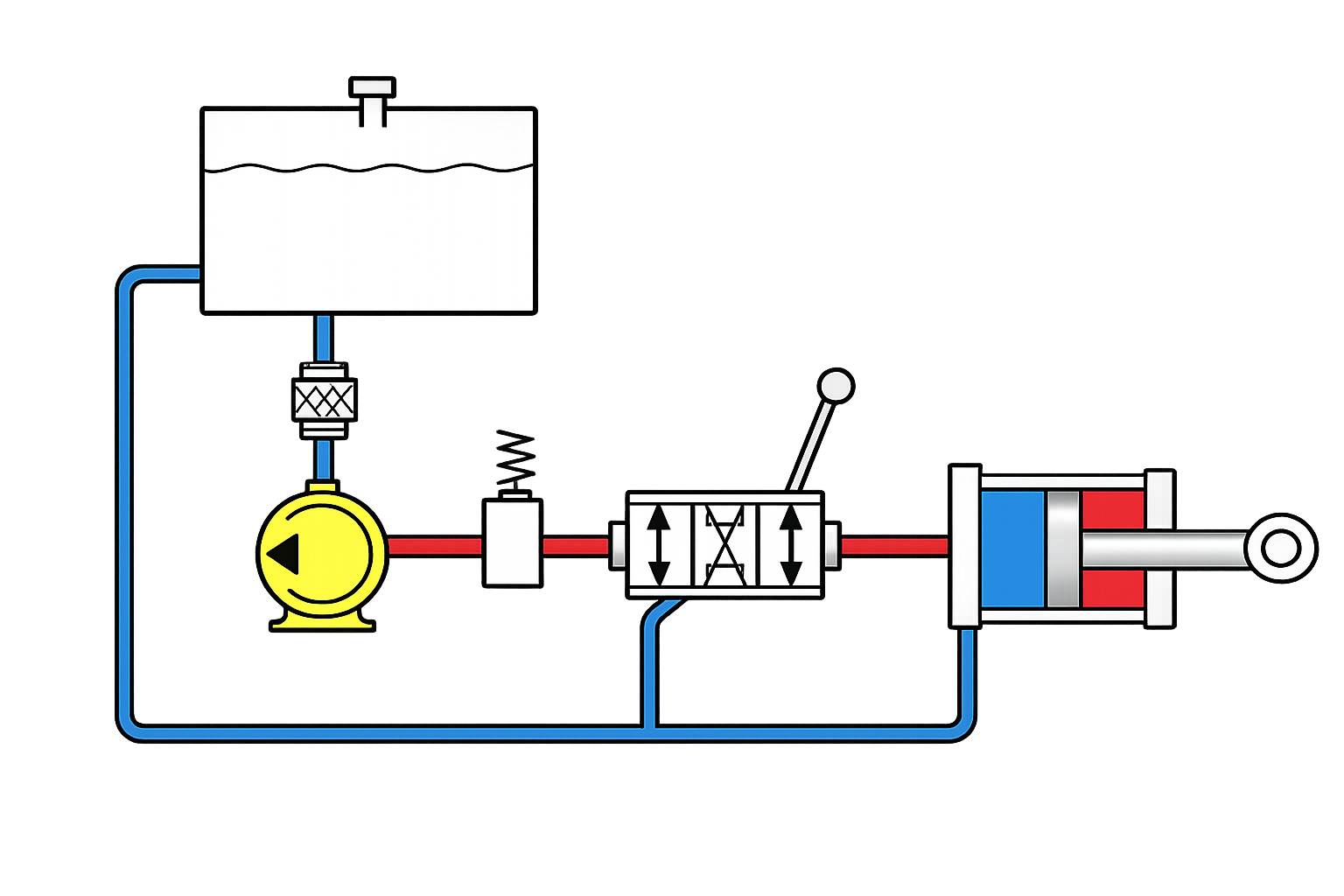
Knowledge Check
What is the function of a pump (highlighted) in a hydraulic system?
Pump - Draws hydraulic fluid from the reservoir and moves it through the system, creating the flow needed for the system to operate.
Notes:
*This slide contains animations. CLICK to reveal content.
Instructional Activity: Evaluate/Assess Performance, Provide Feedback
Instructional Time: 3 min.
Learning Objective:
Do: Review the knowledge check question. Call on learners to share their responses.
Answer:
Pump - Draws hydraulic fluid from the reservoir and moves it through the system, creating the flow needed for the system to operate.

Slide 32
Knowledge Check
Explain one way hydraulics are used the transit industry.
Notes:
Instructional Activity: Evaluate/Assess Performance, Provide Feedback
Instructional Time: 3 min.
Learning Objective: Explain the importance of hydraulics and pneumatics in transit maintenance.
Do: Review the knowledge check question. Call on learners to share their responses.
Answer:
Answers will vary (Ex: Hydraulic lift, Hydraulic breaks, Wheelchair lift, etc.)

Slide 33
Summary and What’s Next
Hydraulics use pressurized liquid to transmit power.
Hydraulic systems produce high force for heavy loads.
Pumps, valves, cylinders, and fluid work together to create motion.
Hydraulics are common in transit vehicles and maintenance equipment.
Now that you understand how hydraulic systems work, it's time to explore pneumatic systems and compare how they differ from hydraulics.
Notes:
*This slide contains animations. CLICK to reveal content.
Instructional Activity: Enhance Retention and Transfer, Recall
Instructional Time: 5 min.
Do:
Ask learners to share what they think is the most important information from this section.
Review the key takeaways from this section of the module.
Clearly explain how to connects to the next section of the module.
Talking Points:
What are the most key takeaways from this part of our lesson?
Call on leaners to respond.
Let's review what we've covered about hydraulics.
CLICK - Hydraulic systems use pressurized liquid to transmit power and create motion.
Because liquids are nearly incompressible, hydraulic systems can generate a large amount of force, making them ideal for lifting and moving heavy loads.
CLICK - We also learned about the major components of a hydraulic system including the pump, reservoir, valves, hydraulic fluid, and actuator. We learned how they work together to perform mechanical work.
CLICK - Finally, we explored common transit applications, along with the advantages and disadvantages of hydraulic systems.
Now that you understand how hydraulic systems operate, we'll shift our focus to pneumatic systems and see how compressed air can also be used to perform mechanical work.

Slide 34
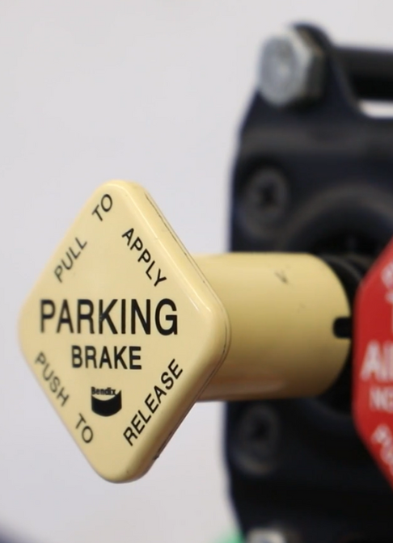
1.3 - Pneumatics
This section introduces pneumatic systems, including how they work, their key components, advantages and disadvantages, and common applications.
Notes:
Instructional Activity: Direction
Instructional Time: 1 min.
Do: Introduce the section.
Talking Points: This section introduces pneumatic systems, including how they work, their key components, advantages and disadvantages, and common applications.

Slide 35
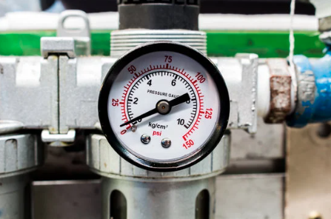
What Are Pneumatics?
Pneumatics – The use of pressurized air or gas to transmit power and perform mechanical work.
air pressure produces force and motion
Common transportation systems
Example: Pneumatic air brakes
Notes:
Instructional Activity: Present Content
Instructional Time: 2 min.
Talking Points:
The word pneumatic comes from the Greek word pneuma, which is associated with breath, wind, and air. That gives us a good clue about how pneumatic systems operate.
Pneumatics involves using pressurized air or another gas to transmit power and perform mechanical work.
A familiar transit example is an air brake system on a bus. The system stores and controls compressed air so it can be used as part of the braking process.
Remember the basic distinction we've established: hydraulics use liquid, while pneumatics use air or gas.

Slide 36
How Does a Pneumatic System Work?
A pneumatic system uses compressed air and pressure to transmit power and create motion.
Compress
Compressor draws in and compresses air
Store
Compressed air is stored in a receiver tank
Airflow
Hoses carry compressed air through the system
Control
Valves control pressure, direction, and airflow
Key Takeaway: The compressor compresses and supplies the air; the system stores, controls, and directs it to produce motion.
Notes:
Instructional Activity: Present Content
Instructional Time: 2 min.
Talking Points:
Just like we did with hydraulics, let's break a pneumatic system down into a basic sequence.
First, the compressor draws in air and compresses it. This increases the air pressure and provides the system with its source of compressed air.
The compressed air is typically held in a receiver tank, where it is stored until needed.
When the system operates, compressed air travels through hoses or lines to where it is needed.
Valves control the pressure, direction, and flow of the compressed air.
Finally, the compressed air reaches an actuator, such as a pneumatic cylinder. The actuator converts pneumatic energy into mechanical force and motion.
So, think of the process as compress → store → move → control → work.
As we continue, we'll look more closely at the individual components that make each of these steps possible.

Slide 37
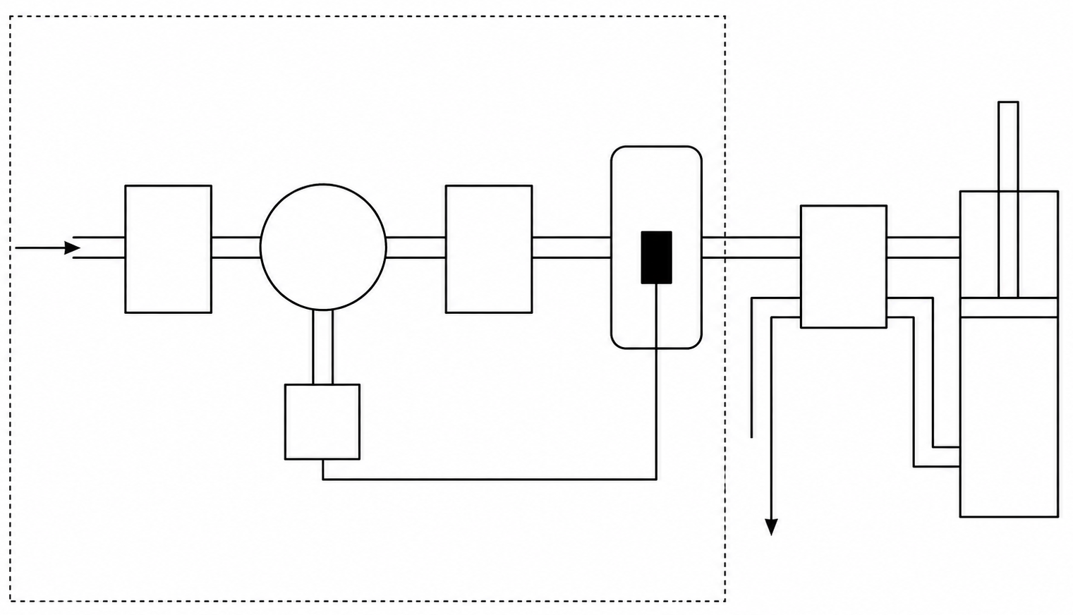
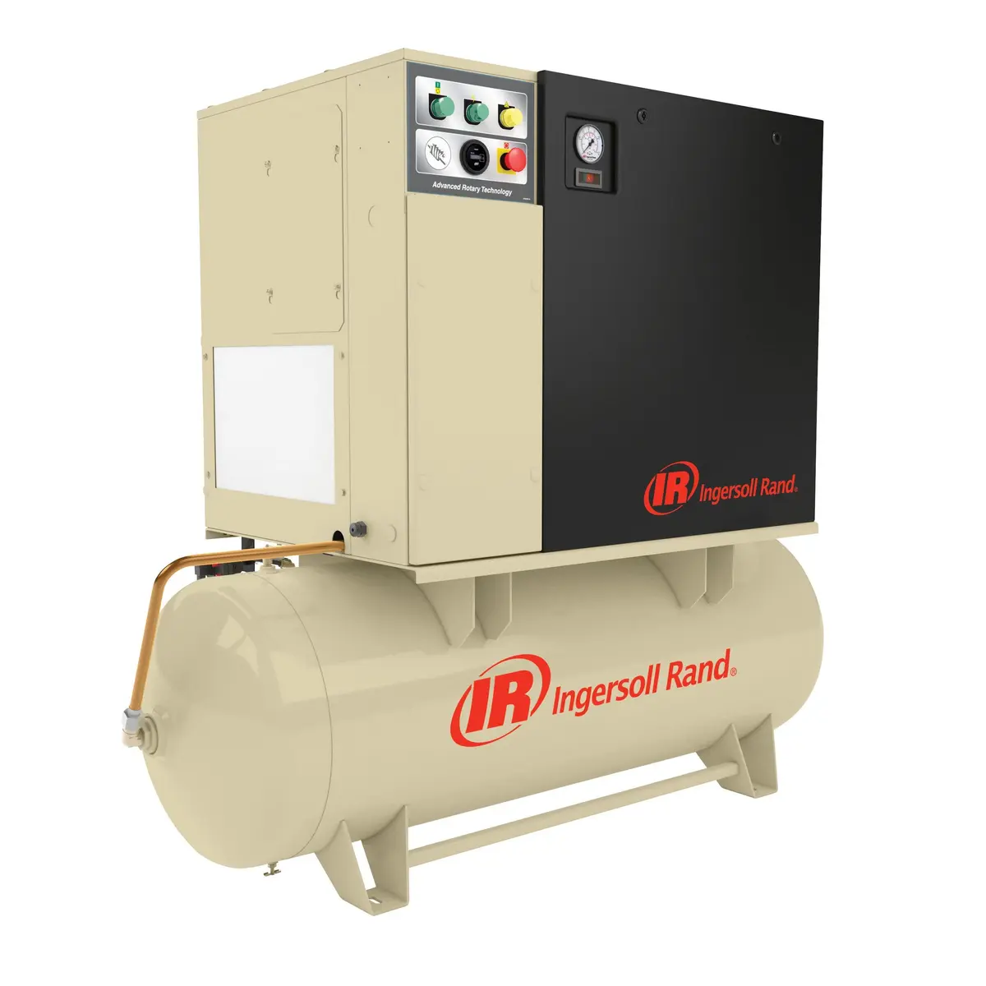
Basic Pneumatic System Components
Compressor
Draws in and compresses air to create pressurized air
Compressor
Air Receiver (Tank)
Pipes/Hoses
Valves
Actuator (Cylinder)
Notes:
Instructional Activity: Present Content
Instructional Time: 1 min.
Talking Points:
Just like hydraulic systems, pneumatic systems rely on several components working together to produce force and motion.
The process begins with the compressor.
It draws in air from the atmosphere and compresses it, creating the pressurized air needed to power the system.

Slide 38
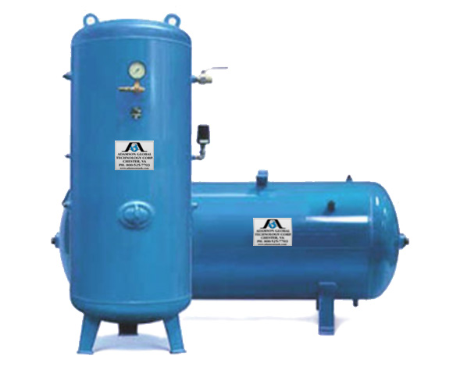
Basic Pneumatic System Components
Air Receiver Tank
Stores compressed air until it is needed
Compressor
Air Receiver (Tank)
Pipes/Hoses
Valves
Actuator (Cylinder)
Notes:
Instructional Activity: Present Content
Instructional Time: 1 min.
Talking Points:
The compressed air is then stored in an air receiver, sometimes called a receiver tank.
This provides a supply of compressed air that is ready when the system needs it.

Slide 39
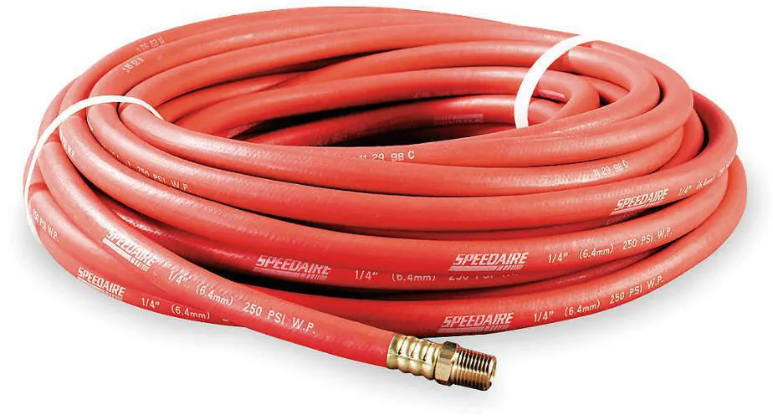
Basic Pneumatic System Components
Pipes and Hoses
Carry compressed air throughout the system
Compressor
Air Receiver (Tank)
Pipes/Hoses
Valves
Actuator (Cylinder)
Notes:
Instructional Activity: Present Content
Instructional Time: 1 min.
Talking Points:
Next, pipes and hoses carry the compressed air throughout the system, connecting the different components.

Slide 40
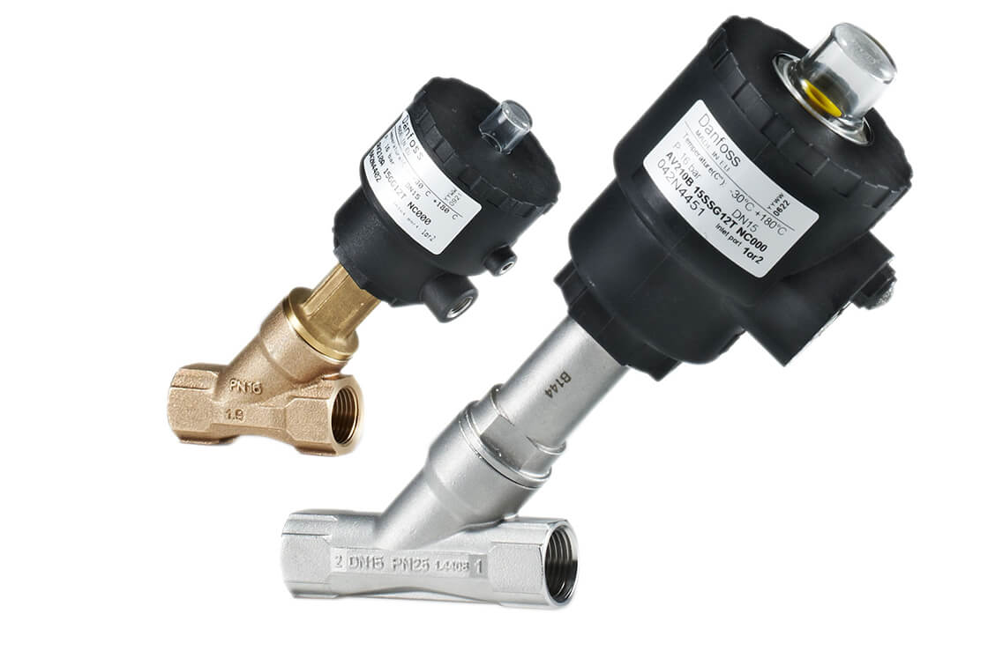
Basic Pneumatic System Components
Valves
Control the direction, pressure, and flow of compressed air
Compressor
Air Receiver (Tank)
Pipes/Hoses
Valves
Actuator (Cylinder)
Notes:
Instructional Activity: Present Content
Instructional Time: 1 min.
Talking Points:
Valves control where the compressed air goes and regulate its pressure and flow.
Depending on the application, valves may be operated manually or automatically.

Slide 41
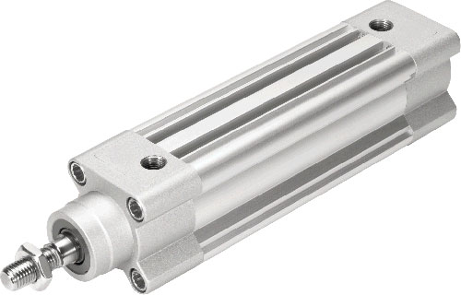
Basic Pneumatic System Components
Actuator (Cylinder)
Converts compressed air into mechanical force and motion
Compressor
Air Receiver (Tank)
Pipes/Hoses
Valves
Actuator (Cylinder)
Notes:
Instructional Activity: Present Content
Instructional Time: 1 min.
Talking Points:
Finally, the compressed air reaches an actuator, such as a pneumatic cylinder.
The actuator converts the energy of the compressed air into mechanical force and motion to perform work.

Slide 42
Basic Pneumatic System Components
Air Receiver (Tank)
Compressor
Actuator (Cylinder)
Pipes/Hoses
Valves
Notes:
Instructional Activity: Recall
Instructional Time: 1 min.
Do: Review by asking learners to explain how a basic pneumatic system functions from start to finish.
Talking Points:
Let’s Review. Who can explain how a basic pneumatic system functions from start to finish?
Call on learners to response. Provide feedback and address learning gaps as needed.

Slide 43
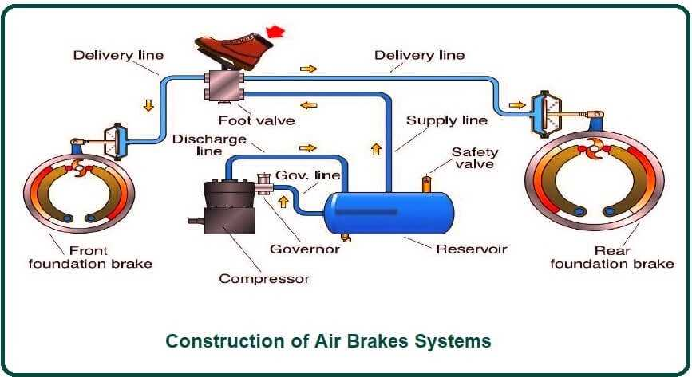
Example: Dump Truck Air Brakes
Notes:
INSTRUCTIONAL ACTIVITY: Present Content
TIME: 2 minutes.
TALKING POINTS:
Let's look at a real-world example of a pneumatic system: an air brake system used on heavy vehicles, including buses and trains.
Pneumatic braking systems use compressed air to actuate the brake shoes or brake pads, applying the force needed to slow or stop the vehicle.
As you look at the diagram, notice several of the components we just discussed.
The air compressor draws in air from the atmosphere, compresses it, and sends it to the air reservoir, where the compressed air is stored until it is needed.
The air commonly comes from the engine’s main air intake or air filter housing, which helps provide cleaner air to the system. Some systems may draw air directly from the atmosphere.
When the driver presses the brake pedal, the brake valve opens and regulates the flow of compressed air from the storage tank to the brake chambers.
The pressurized air then actuates the braking mechanism, applying the brakes to slow or stop the vehicle.
In actual transit vehicles, you'll also find relay control circuits in the delivery lines. These help deliver compressed air more quickly and efficiently to the brakes, improving braking response.
Although air brake systems can vary in design, they all rely on the same basic principles: compress the air, store it, control its flow, and use it to create mechanical braking force.

Slide 44
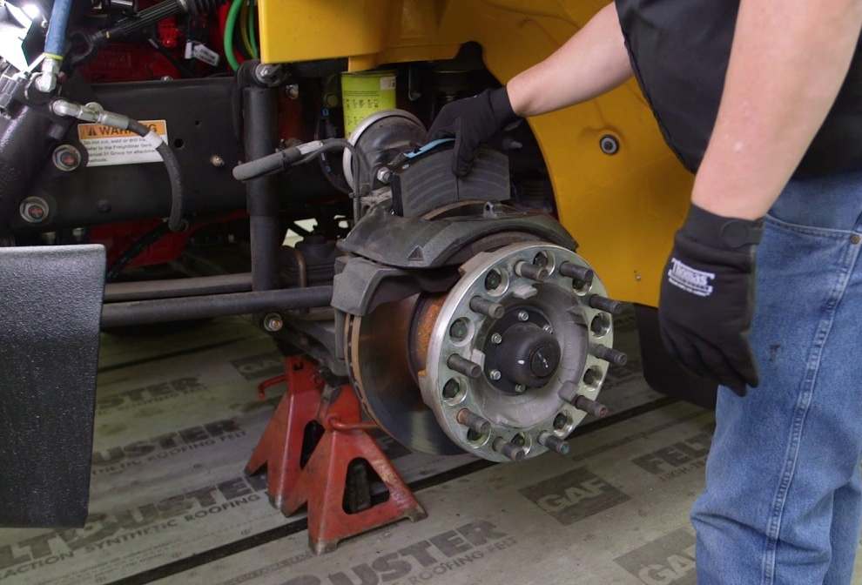
Common Pneumatic Systems
Pneumatic systems are commonly used where fast, reliable, and repetitive motion is needed.
Air brakes on buses, trucks, and trains
Air suspension systems
Pneumatic tools
Manufacturing and assembly lines
Bus and train door systems
Pneumatic windshield wipers
Train horns
Rail sander systems
Notes:
INSTRUCTIONAL ACTIVITY: Present Content
TIME: 2 minutes.
TALKING POINTS:
One of the most familiar examples is air brakes, which are used on buses, trucks, and trains to safely stop heavy vehicles.
Many transit vehicles also use air suspension systems to improve ride quality and help maintain a consistent vehicle height, regardless of passenger load.
In maintenance shops, you'll often find pneumatic tools, such as impact wrenches and air ratchets, because they are lightweight, durable, and provide consistent power.
Outside of transit, pneumatics are widely used in manufacturing and assembly lines, where compressed air powers equipment that performs fast, repetitive tasks.
Transit vehicles also use pneumatic systems to open and close passenger doors, providing reliable operation throughout the day.
Other common applications include pneumatic windshield wipers, train horns, and rail sander systems, which use compressed air to improve wheel traction during poor weather or low-traction conditions.

Slide 45
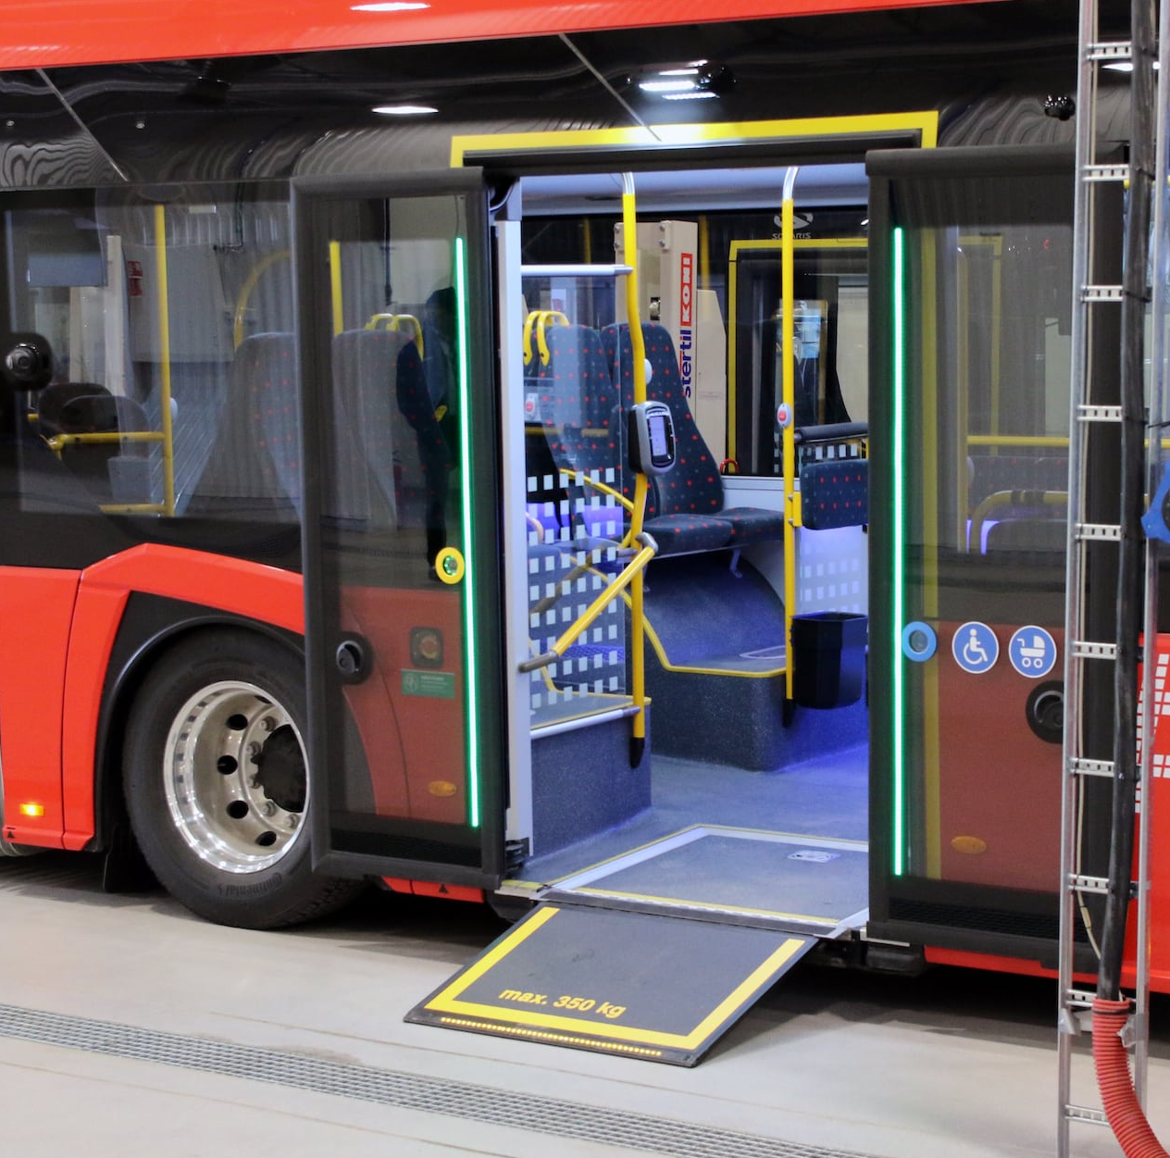
Advantages of Pneumatic Systems
Pneumatic systems are ideal for applications requiring fast, reliable motion.
Lower installation and operating costs
Require less space than hydraulic systems
Lower fire and explosion hazards
Air flows quickly for fast operation
Simpler design and easier maintenance
Reliable for repetitive tasks
Notes:
INSTRUCTIONAL ACTIVITY: Present Content
TIME: 2 minutes.
TALKING POINTS:
Pneumatic systems offer several advantages that make them a popular choice for many transit and industrial applications.
One advantage is their lower installation cost. Pneumatic systems are often less expensive to install than hydraulic systems because they typically require fewer components.
They also require less space, making them a good option when equipment size is limited.
Since pneumatic systems use compressed air instead of hydraulic fluid, they generally present a lower risk of fires and explosions.
Air also moves through the system very quickly, allowing pneumatic systems to respond rapidly. This makes them well suited for applications that require fast, repetitive motion, such as opening and closing bus doors.
Finally, pneumatic systems tend to have a simpler design, making them easier to maintain and troubleshoot than many hydraulic systems.

Slide 46
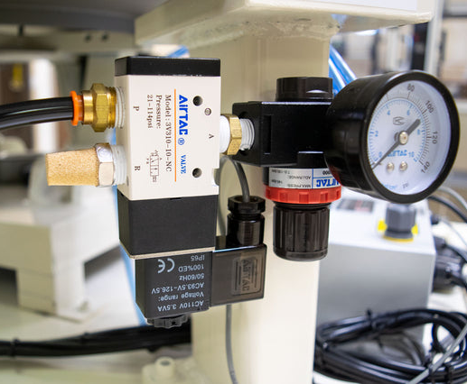
Disadvantages of Pneumatic Systems
Pneumatic systems also have limitations.
Produce less force than hydraulic systems
Air pressure fluctuations can affect performance
Require larger cylinders for the same force
Lose energy during air compression
Can be noisy during operation
Moisture can reduce system performance
Time is required to build air pressure
Notes:
INSTRUCTIONAL ACTIVITY: Present Content
TIME: 2 minutes.
TALKING POINTS:
Although pneumatic systems have many advantages, they also have several limitations.
Compared to hydraulics, pneumatic systems generally produce less force. For that reason, hydraulics are often preferred for lifting or moving very heavy loads.
Because air is compressible, pressure can fluctuate, making movement less precise than in hydraulic systems.
To produce the same amount of force as a hydraulic cylinder, a pneumatic system typically requires a larger actuator.
Another disadvantage is efficiency. Compressing air generates heat, which means some of the input energy is lost during the compression process.
Pneumatic systems can also be loud, particularly when compressed air is exhausted from valves and actuators.
Moisture is another concern. Air compressors naturally draw moisture from the atmosphere, and if that moisture isn't removed, it can reduce system performance or damage components.
Finally, pneumatic systems require time to build pressure before they are ready to operate, which can introduce a short delay in some applications.

Slide 47
Hydraulics vs. Pneumatic
 | Hydraulics | Pneumatics
Pressure | Higher operating pressure | Lower operating pressure
Force Produced | High force; ideal for heavy loads | Lower force; best for lighter loads
Speed | Generally slower, controlled movement | Faster response and movement
Precision | More precise because liquids are nearly incompressible | Less precise because air is compressible
Maintenance | More complex; requires monitoring for leaks and fluid condition | Simpler; requires moisture control and air system maintenance
Safety Concerns | High-pressure fluid leaks and injection hazards | High-pressure air, noise, and stored energy hazards
Notes:
INSTRUCTIONAL ACTIVITY: Present Content
TIME: 2 minutes.
TALKING POINTS:
We've now explored both hydraulics and pneumatics individually. This chart summarizes the key differences between the two systems.
One of the biggest differences is pressure. Hydraulic systems operate at much higher pressures than pneumatic systems, allowing them to generate significantly more force.
Because of that higher pressure, hydraulics are better suited for lifting and moving heavy loads, while pneumatics are typically used for lighter-duty applications that require fast, repetitive movement.
Another important difference is speed and precision. Hydraulic systems generally provide slower, more controlled, and more precise movement because liquids are nearly incompressible. Pneumatic systems respond more quickly, but because air can be compressed, they are typically less precise.
The two systems also differ in their maintenance requirements. Hydraulic systems require regular monitoring for fluid leaks and fluid condition, while pneumatic systems are generally simpler but require moisture control and maintenance of the compressed air system.
Finally, both systems have unique safety considerations. Hydraulic systems operate under extremely high fluid pressures, creating hazards such as injection injuries. Pneumatic systems store compressed air, which introduces hazards related to high-pressure air, noise, and stored energy.
Neither system is inherently better than the other. Instead, each is designed for different applications. Understanding the strengths and limitations of both helps maintenance technicians choose the right system for the job and work with it safely and effectively.

Slide 48
Discussion
Read the scenario and decide whether the company should use a hydraulic system or a pneumatic system. Be prepared to explain your reasoning.
A transit maintenance facility is installing a new railcar wheel press to remove and install wheelsets. The equipment must generate extremely high force, move slowly and precisely, and operate safely under heavy loads. The facility has enough space and budget for a larger, more complex system.
A transit agency is installing an automated parts sorting system in its maintenance warehouse. The system must repeatedly push, sort, and position lightweight parts at high speed throughout the day. The equipment should be simple to maintain and inexpensive to install.
A manufacturing company has several applications that require high force, precision, controlled movements, and heavy loads. The company is on a large plot of land far away from neighbors who could complain about noise. Last quarter produced higher than normal profits for the company, so set-up costs for the selected system will not be a problem.
Notes:
Instructional Activity: Provide Learning Guidance, Elicit Performance
Instructional Time: 10 min.
Do:
Click to reveal three scenarios.
Read each scenario aloud to the class.
Facilitate a short discussion.
Answer:
Hydraulics - Scenario 1 emphasizes high force, precision, and heavy loads.
Hydraulics - Scenario 2 emphasizes high force, precision, and heavy loads.
Pneumatics - Scenario 3 emphasizes speed, repetitive motion, lighter loads, and lower cost.

Slide 49
Knowledge Check
What are pneumatics?
  The use of compressed air or gas to transmit power
  The use of pressurized liquid to transmit power
  The use of electrical energy to transmit power
  The use of mechanical gears to transmit power
Notes:
*This slide contains animations. CLICK to reveal content.
Instructional Activity: Evaluate/Assess Performance, Provide Feedback
Instructional Time: 3 min.
Learning Objective: Define and differentiate hydraulics and pneumatics.
Do: Review the knowledge check question. Call on learners to share their responses.
Answer:
A - The use of compressed air or gas to transmit power

Slide 50
Knowledge Check
Which system would you choose? Why?
Lifting a 35,000-pound transit bus onto a maintenance lift
Hydraulic System
Hydraulic System
Pneumatic System
Notes:
*This slide contains animations. CLICK to reveal content.
Instructional Activity: Evaluate/Assess Performance, Provide Feedback
Instructional Time: 3 min.
Learning Objective:
Compare the advantages and disadvantages of hydraulic and pneumatic systems.
Identify mechanisms that use hydraulic and pneumatic systems.
Do: Review the knowledge check question. Call on learners to share their responses.
Answer:
Hydraulic System - Hydraulic systems operate at high pressures and use nearly incompressible fluid to generate large amounts of force. This makes them ideal for lifting and supporting extremely heavy loads safely and with precise control.

Slide 51
Knowledge Check
Which system would you choose? Why
Opening and closing bus passenger doors hundreds of times each day
Hydraulic System
Pneumatic System
Pneumatic System
Notes:
*This slide contains animations. CLICK to reveal content.
Instructional Activity: Evaluate/Assess Performance, Provide Feedback
Instructional Time: 3 min.
Learning Objective:
Compare the advantages and disadvantages of hydraulic and pneumatic systems.
Identify mechanisms that use hydraulic and pneumatic systems.
Do: Review the knowledge check question. Call on learners to share their responses.
Answer:
Pneumatic System - Pneumatic systems use compressed air to provide fast, reliable, and repetitive motion. They are well suited for applications like bus doors, where quick operation and frequent cycling are more important than producing high force.

Slide 52
Knowledge Check
It is important for transit maintenance technicians to understand both hydraulic and pneumatic systems so they can __________________.
replace all pneumatic systems with hydraulic systems
operate every transit vehicle without additional training
eliminate the need for preventive maintenance
identify the correct system, work safely, and perform maintenance effectively
Notes:
*This slide contains animations. CLICK to reveal content.
Instructional Activity: Evaluate/Assess Performance, Provide Feedback
Instructional Time: 3 min.
Learning Objective: Explain the importance of hydraulics and pneumatics in transit maintenance.
Do: Review the knowledge check question. Call on learners to share their responses.
Answer:
D - It is important for transit maintenance technicians to understand both hydraulic and pneumatic systems so they can identify the correct system, work safely, and perform maintenance effectively.

Slide 53
Summary and What’s Next
Pneumatics use compressed air or gas to transmit power.
Pneumatic systems provide fast, reliable motion.
Compressors, air receivers, valves, and actuators work together.
Pneumatics are commonly used for air brakes, doors, and pneumatic tools.
Next, we’ll look at the role of hydraulics and pneumatics in transit maintenance
Notes:
*This slide contains animations. CLICK to reveal content.
Instructional Activity: Enhance Retention and Transfer, Recall
Instructional Time: 5 min.
Do:
Ask learners to share what they think is the most important information from this section.
Review the key takeaways from this section of the module.
Clearly explain how to connects to the next section of the module.
Talking Points:
What are the most key takeaways from this part of our lesson?
Call on leaners to respond.
CLICK - Pneumatic systems use compressed air or gas to transmit power and create motion.
While they generally produce less force than hydraulic systems, they are well suited for applications that require quick, reliable, and repetitive movement.
CLICK - We also examined the major components of a pneumatic system—including the compressor, air receiver, valves, pipes and hoses, and actuator—and saw how they work together to produce mechanical motion.
CLICK - Finally, we explored common transit applications, as well as the advantages and disadvantages of pneumatic systems.
Next, we'll bring the role of hydraulics and pneumatics in transit maintenance

Slide 54

1.4 – Applications for Hydraulics and Pneumatics in Transit Maintenance
This section examines the role of hydraulics and pneumatics in transit vehicle maintenance.
Notes:
INSTRUCTIONAL ACTIVITY: Give Direction
TIME: 1 minute.
TALKING POINTS: This section examines the role of hydraulics and pneumatics in transit vehicle maintenance.

Slide 55
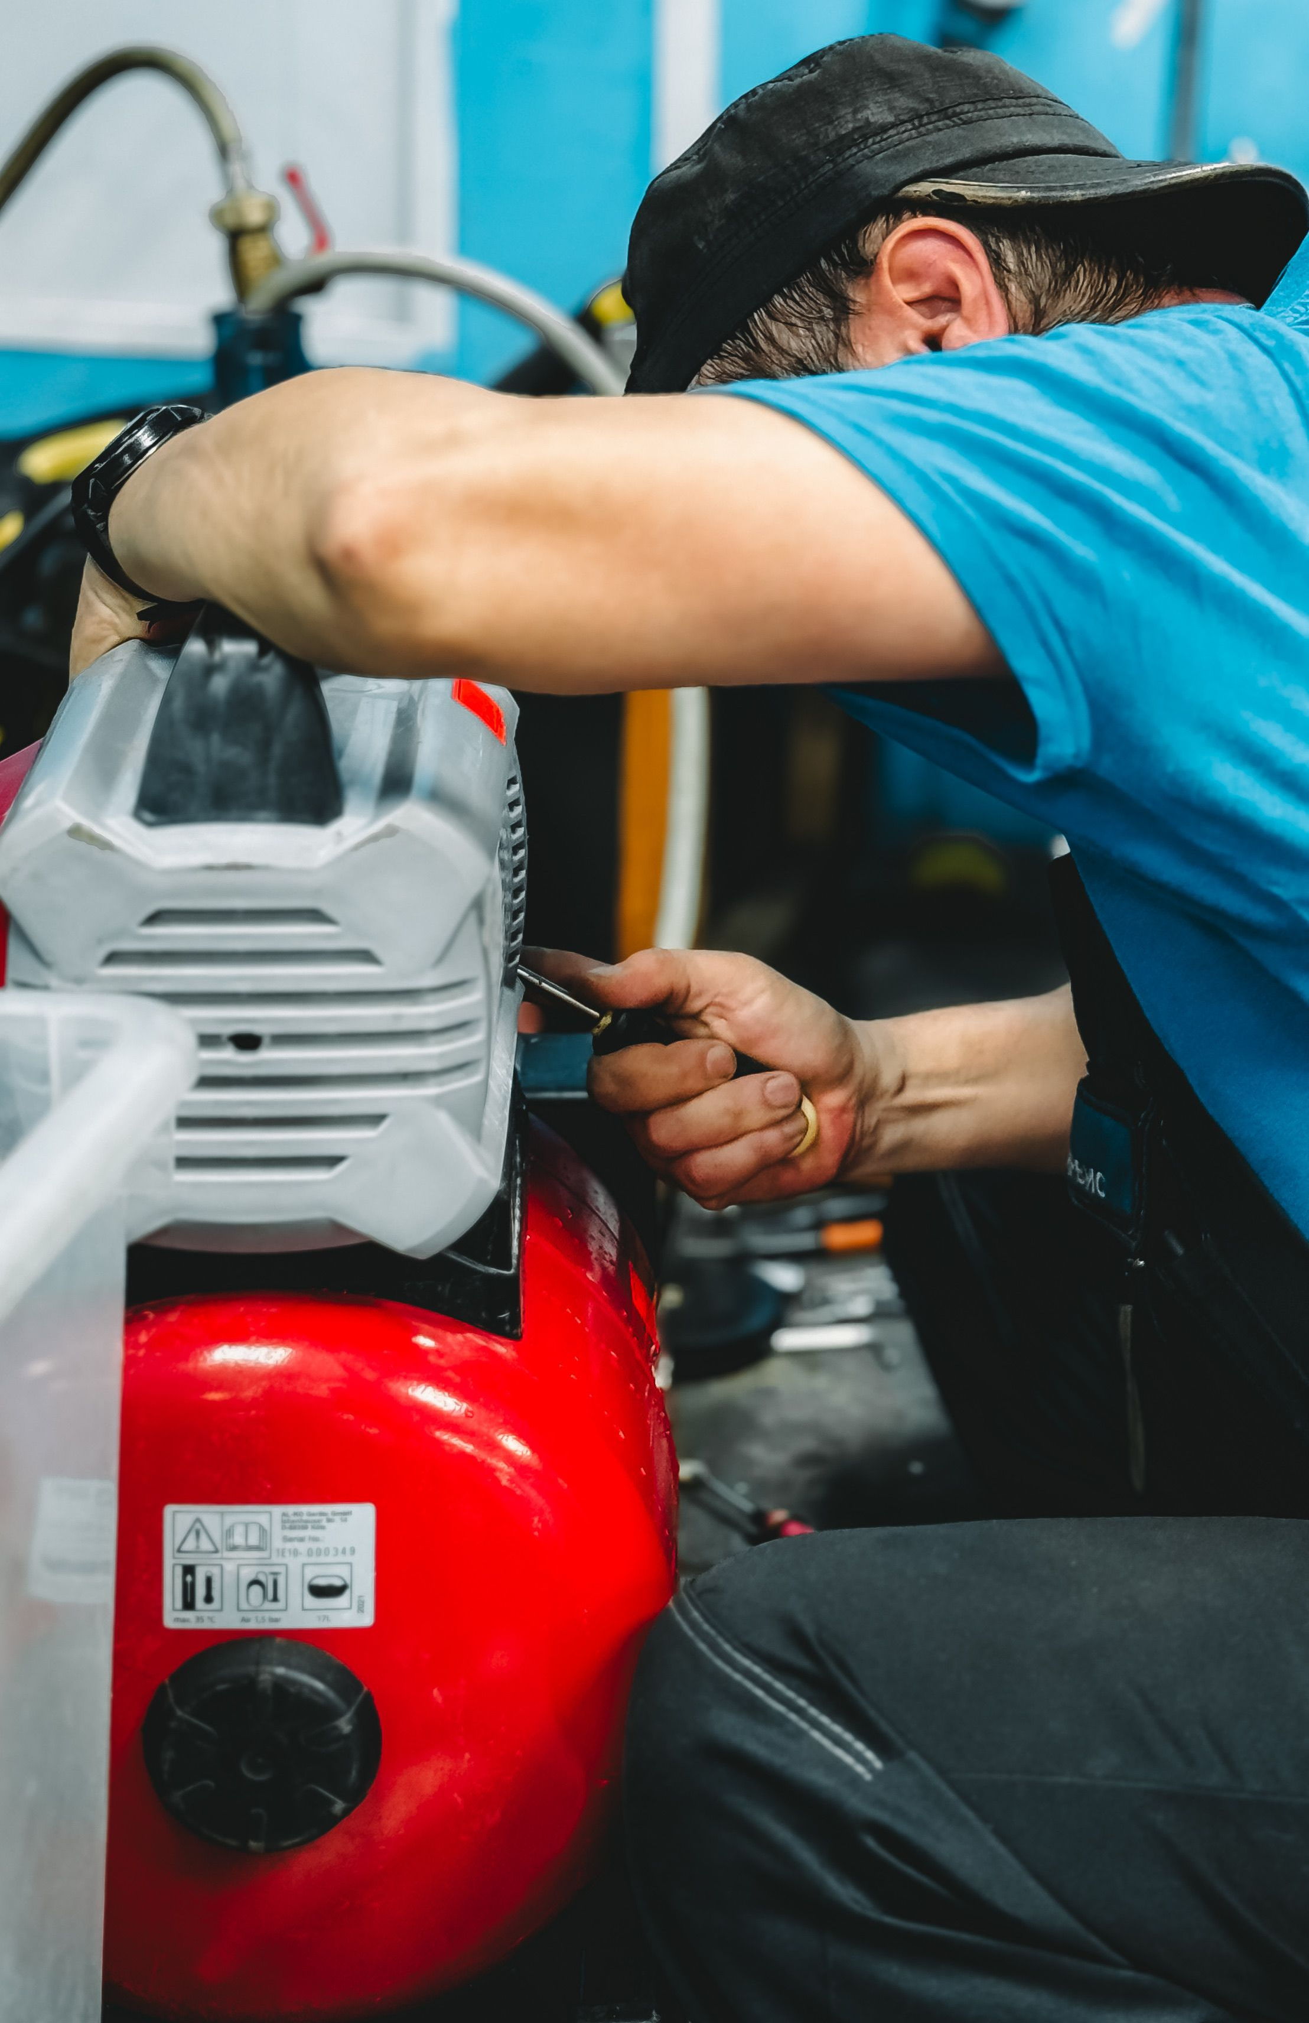
Hydraulics and Pneumatics in Transit Maintenance
Understanding hydraulic and pneumatic systems helps technicians:
Diagnose and troubleshoot equipment problems
Perform repairs safely and efficiently
Select the right system and tool for the job
Recognize hazards and follow safe work practices
Notes:
INSTRUCTIONAL ACTIVITY: Present Content
TIME: 2 minutes.
TALKING POINTS:
Hydraulic and pneumatic systems are found throughout transit vehicles and maintenance facilities. As a technician, understanding how these systems operate is an important part of your job.
First, this knowledge helps you diagnose and troubleshoot problems more effectively. When you understand how a system is supposed to work, it's much easier to identify when something isn't working correctly.
It also helps you perform repairs safely and efficiently. Knowing how pressure is generated and stored allows you to follow the proper procedures before working on a system.
Understanding the differences between hydraulic and pneumatic systems also helps you select the right system and tool for the application.
As we've discussed, hydraulics are typically used when high force is needed, while pneumatics are often chosen for fast, repetitive motion.
Finally, understanding these systems helps you recognize potential hazards, such as high-pressure fluid or compressed air, and follow the appropriate safety practices to protect yourself and those around you.

Slide 56

Quiz
Time for a quiz! Let’s see what you have learned from today’s lesson.
Notes:
Instructional Activity: Direction, Evaluate/Assess Performance
Instructional Time: 20 min.
Materials: Quiz_Hydraulics and Pneumantics
Do:
Ask learners if they have any lingering questions. Address them before distributing the quiz.
Pass out the quiz and review the directions.
Talking Points:
Time for a quiz! Let’s see what you have retained from today’s lesson.

Slide 57
Revisiting Objectives
Define fluid dynamics and explain how it relates to hydraulic and pneumatic systems.
Define and differentiate hydraulics and pneumatics.
Identify mechanisms that use hydraulic and pneumatic systems.
Explain the importance of hydraulics and pneumatics in transit maintenance.
Compare the advantages and disadvantages of hydraulic and pneumatic systems.
Notes:
Instructional Activity: Enhance Transfer and Retention
Instructional Time: 5 min.
Do: Facilitate a short discussion to review the key topics in the lesson.
Talking Points:
If you were explaining today’s objectives to someone else, how would you summarize what they mean and why they matter?
Which of today’s objectives do you feel most confident about? Which were most challenging? Explain your reasoning.
Can you give an example of how you could apply one of today’s objectives in a real-world situation?
After Discussion:
This conclude this section of the module. Thank you for your participation.

Slide 58
Thank you!
Notes:
Instructional Activity: Enhance Transfer and Retention
Instructional Time: 2 min.
Do:
Thank learners for their participation.
If possible, stay after class to answer any lingering questions learners may have.

