Slide 1


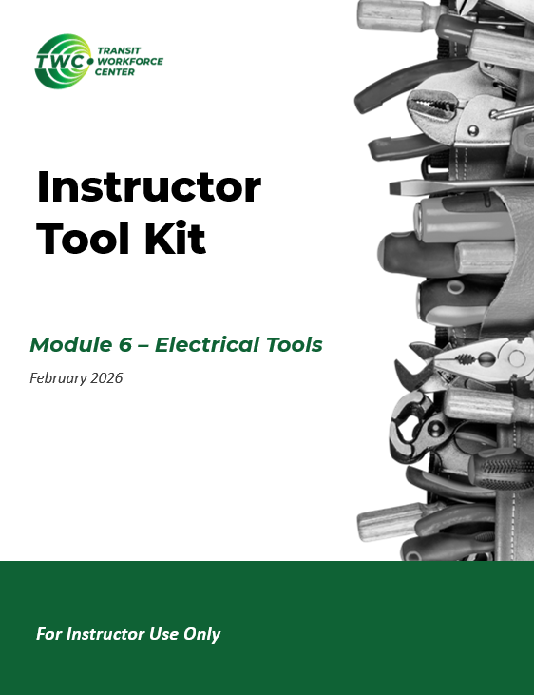
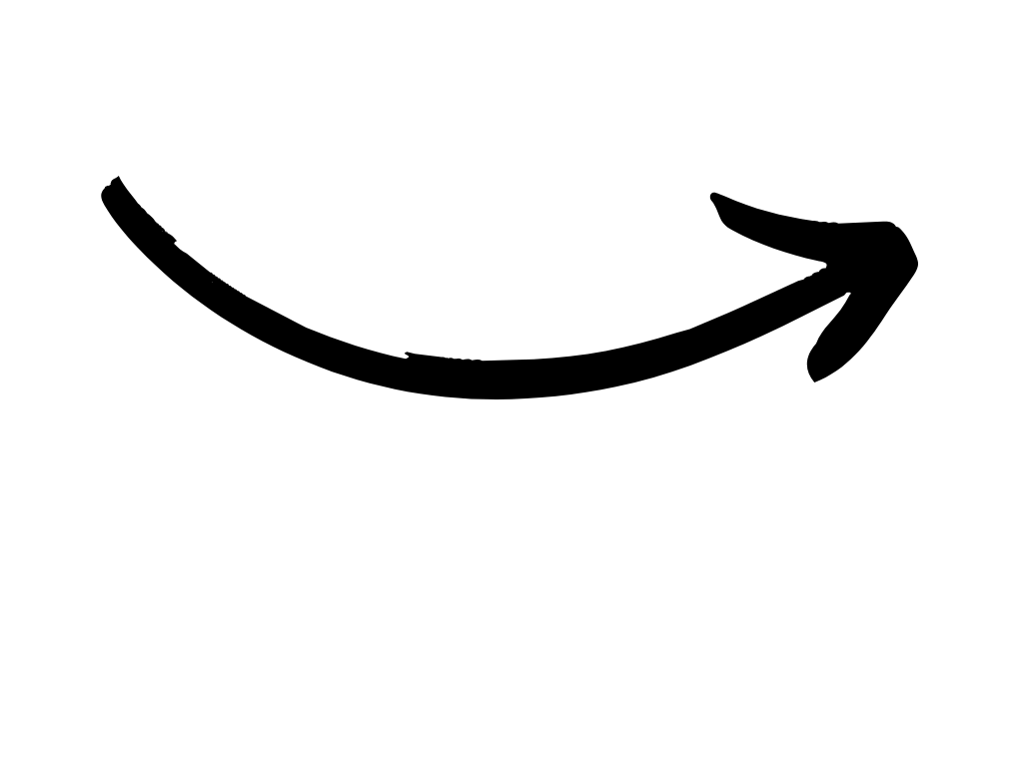
Instructor Guide Snapshot
Icon Key
Activity:
Video:
Instructor Demo:
Knowledge Check:
Instructional Time: 4.5 Hrs.
Preparation before class:
  Review all materials – Review all slides, talking points, and handouts before class to understand the structure and flow of the lesson. Pay special attention to animations within the slides.
  Prep for demos and activities – Review the full list of “Additional Materials” located in the Instructor Facilitation Toolkit. Gather and prepare all necessary materials.
Provided Course Materials:
  +Fasteners_Mechanical Foundations.pptx
  +Instructor Facilitation Toolkit_Fasteners.docx - For Instructor use only.
  +Participant Resource Guide_Fasteners.docx - Print one copy for each learner. All handouts that leaners need for activities are embedded in the Participant Resource Guide.
    Bolt Grade Marking Chart_Fasteners
    Fastener Application_Fasteners
    Fastener Identification_Fasteners
  +Safety Wire Video.mov
  Quiz_Fasteners.docx - Print one copy for each learner.
Additional Materials:
A list of additional materials needed for demonstrations and activities can be found in the Instructor Facilitation Toolkit on page 4.

Slide 2
Pacing Guide
Times have been rounded to the nearest .25 hours.
Total Time: 4.5 Hours
  (.25 Hrs) – Welcome and Warm Up
  (.25 Hrs) – 1.1 - Fasteners for Metal and Wood
  (.5 Hrs) – 1.2 - Screws
  (1.5 Hrs) – 1.3 - Nuts and Bolts
  (1 Hrs) – 1.4 - Washers, Retaining Hardware, and Staples
  (.5 Hrs) – 1.5 - Applications for Fasteners in Transit
  (.5 Hrs) – Quiz and Wrap Up

Slide 3
Fasteners
Mechanical Foundations
Transit Core Competencies Curriculum (TC3)
Notes:
Instructional Activity: Direction
Instructional Time: 1 min.
Do: Welcome learners to class. Introduce the course and module.

Slide 4
Objectives
Identify the various types of fasteners and explain their purpose, including screws, nuts, bolts, washers, staples, retaining hardware, and miscellaneous hardware.
Explain the advantages and disadvantages of fastener materials.
Recognize common applications for fasteners.
Notes:
Instructional Activity: Direction
Instructional Time: 2 min.
Do: Review the module objectives.

Slide 5
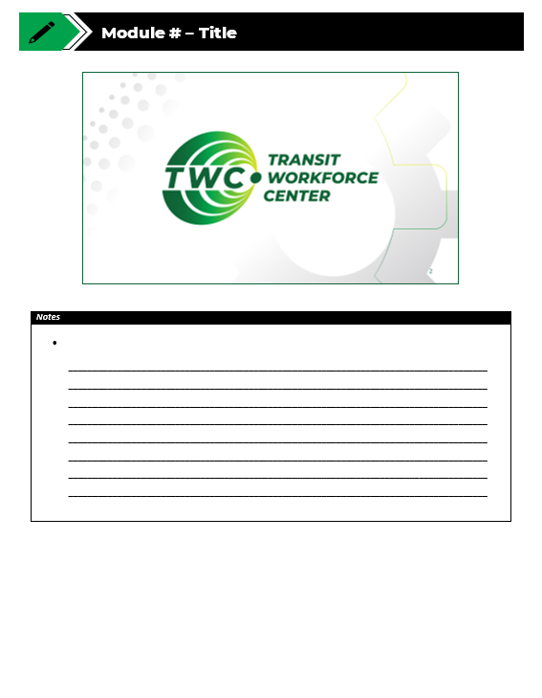
Agenda
Welcome and Introduction
1.1 – Introduction to Fasteners
1.2 - Screws
1.3 – Nuts and Bolts
1.4 - Washers, Retaining Hardware, and Staples
1.5 - Applications for Fasteners in Transit
Quiz
Notes:
Instructional Activity: Direction
Instructional Time: 2 min.
Do: Review the module agenda.

Slide 6
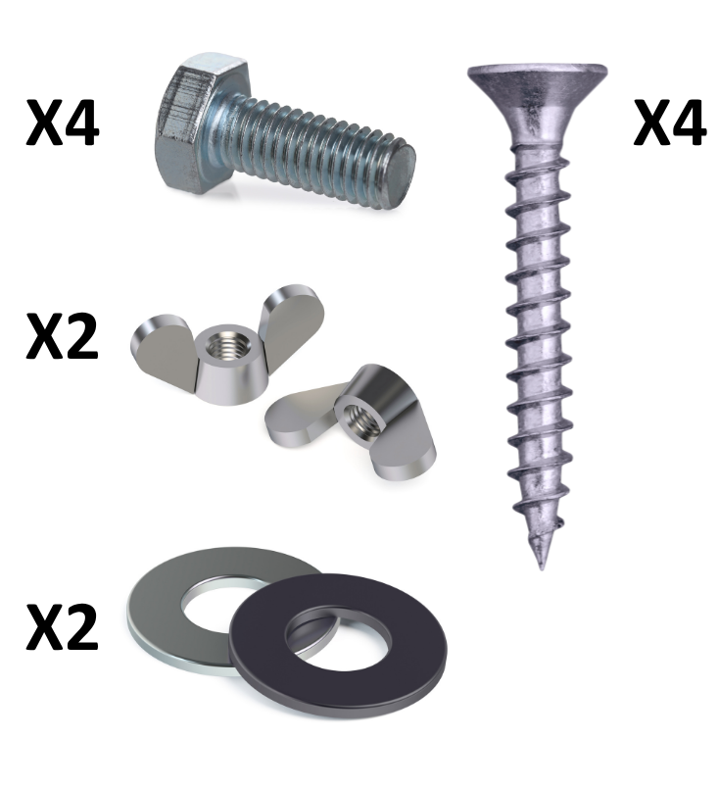
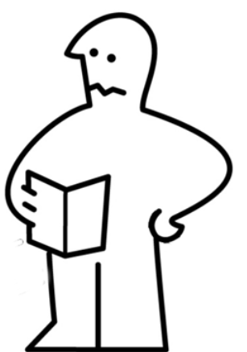
Warm Up
Scenario: You've just opened a new piece of furniture that requires assembly. Inside the hardware bag, you find a variety of fasteners and hardware.
Why do you think the manufacturer included so many different pieces?
What do you think some of these fasteners are designed to do?
Which ones do you recognize?
Notes:
Instructional Activity: Gain Attention, Recall
Instructional Time: 5 min.
Do:
Read the scenario to the group.
Facilitate a short discussion using the questions on the slide.
Encourage learners to share their real-world experiences working with types of fasteners.

Slide 7
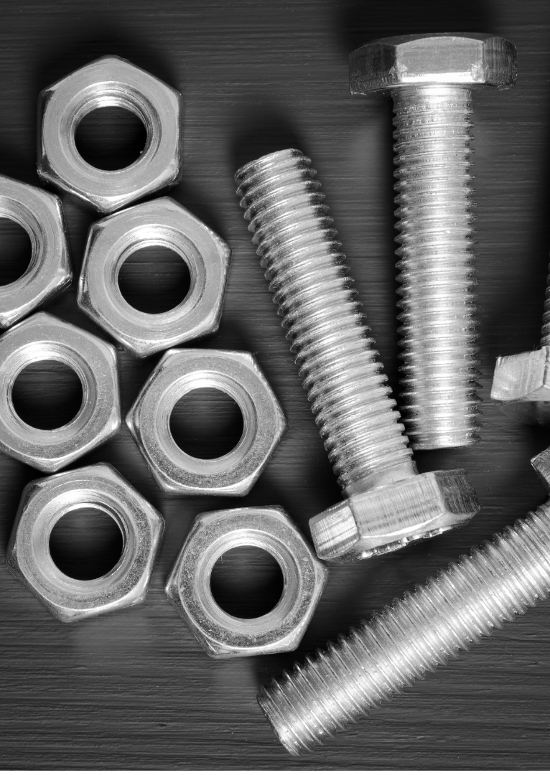
1.1 – Introduction to Fasteners
This section will introduce a variety of fasteners and their various applications.
Notes:
Instructional Activity: Direction
Instructional Time: 1 min.
Do:
Transition from warm up to section 1.1.
Introduce the section.
Talking Points:
Based on our warm-up discission, you may already have some experience with fasteners.
We’ll build on any existing knowledge in this section and introduce a variety of fasteners and their various applications.

Slide 8
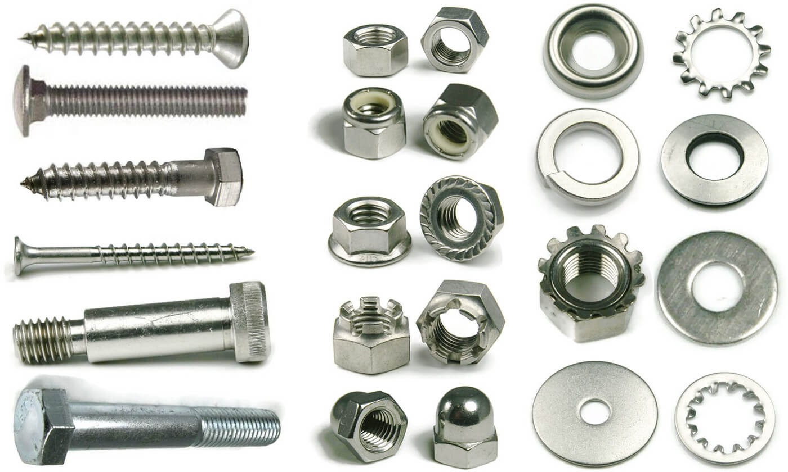
What are fasteners?
A category of hardware that is used to secure parts or objects together.
Common types:
  Screws
  Nuts
  Bolts
  Washers
  Staples
Notes:
Instructional Activity: Present Content
Instructional Time: 2 min.
Talking Points:
The term fasteners refers to a category of hardware that is used to secure parts or objects together.
Typical fasteners include screws, nuts, blots, washers, and staples.
Today we will learn about types of fasteners, their use, and how to select the right fastener for the job.

Slide 9
Common Fastener Materials
Material | Common Characteristics
Aluminum | Lightweight; commonly used in transportation applications
Steel | Strong and durable; available in a variety of strength grades
Stainless Steel | Excellent corrosion resistance; commonly used in harsh environments
Brass | Corrosion resistant; softer than steel and often used in specialty applications
Magnesium | Extremely lightweight; requires protection in corrosive environments
Copper | Excellent electrical conductivity; used for specialized electrical applications
Notes:
Instructional Activity: Present Content
Instructional Time: 3 min.
Do:
Review the common characteristics of each materials.
Provide real-world examples of situations where each material might be used.
Talking Points:
Fasteners are made from different materials because no single material is ideal for every application.
Each material has its own strengths and limitations.
For example, aluminum is valued for its light weight, while steel is commonly selected for its strength.
Stainless steel is often used where corrosion resistance is important.
Material selection depends on the job the fastener needs to perform.
In fact, some fasteners are manufactured to break under stress. This typically occurs when breaking a cheaper part is a fail safe for breaking a more expensive part.

Slide 10
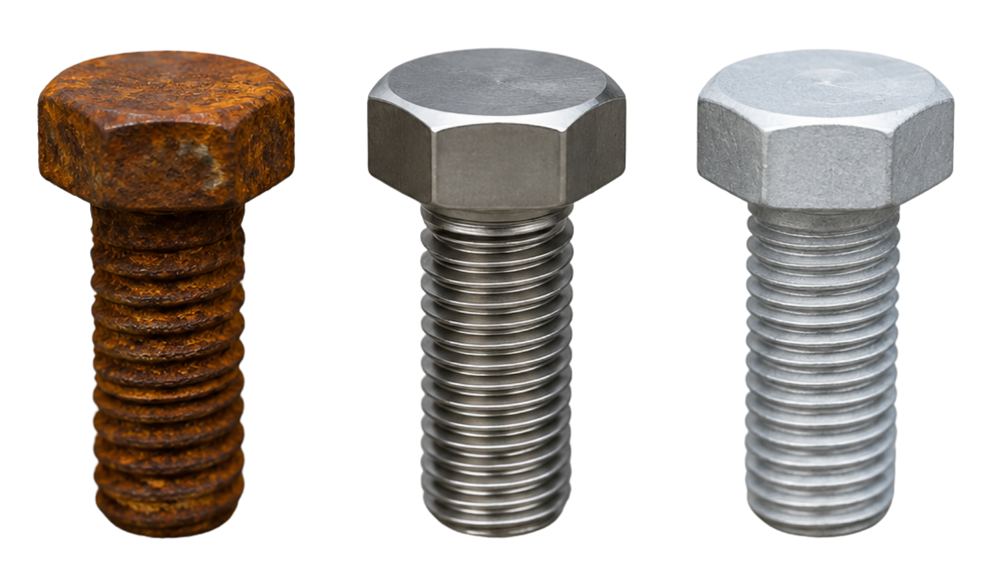
Selecting the Right Fastener Material
When selecting a fastener material, consider factors such as:
Strength
Corrosion resistance
Flexibility
Ability to withstand pressure
Long-term durability
Compatibility with other metals
Weight
Cost
Availability
Rusty Steel Bolt
Stainless Steel Bolt
Aluminum Bolt
Notes:
Instructional Activity: Present Content
Instructional Time: 2 min.
Talking Points:
Selecting the right fastener involves more than choosing the correct size or type.
The material directly affects how the fastener performs over time.
Strength and corrosion resistance are often the primary considerations.
Other factors, such as weight, cost, and compatibility with surrounding materials, may also influence the selection.
The best material depends on the application and operating environment.
Note – Image Ai enhanced for clarity by authoring graphic designer.

Slide 11
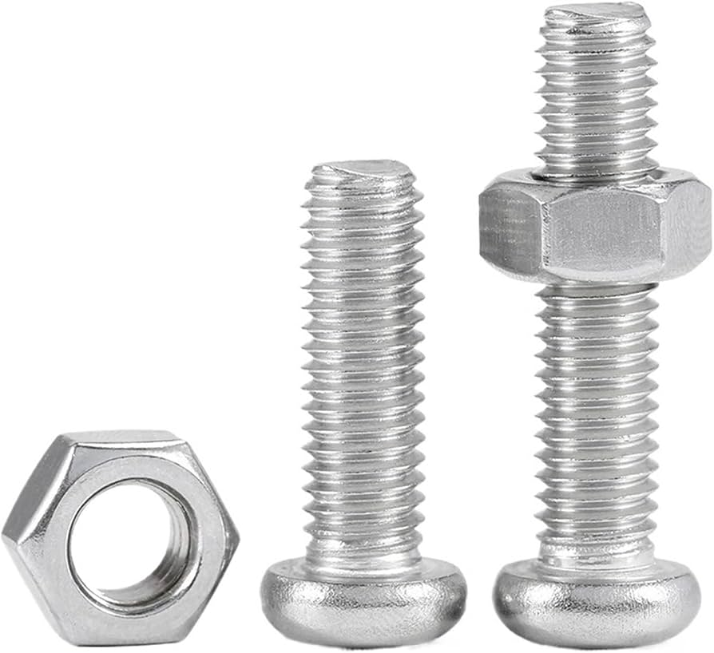
Using Compatible Materials
When selecting screws, bolts, nuts, and washers, use compatible materials whenever possible to help prevent:
Galvanic corrosion
Uneven strength
Thermal expansion issues
Compatibility problems
Maintenance challenges
Notes:
Instructional Activity: Present Content
Instructional Time: 2 min.
Talking Points:
When selecting screws, bolts, nuts, and washers, use compatible materials whenever possible to help prevent:
Galvanic corrosion – Dissimilar metals can corrode when exposed to moisture.
Uneven strength – Different material strengths can create uneven load distribution.
Thermal expansion issues – Materials expand and contract at different rates, which can loosen connections.
Compatibility problems – Some materials are not designed to be used together and may fail under stress.
Maintenance challenges – Mixed materials can make inspection, maintenance, and replacement more difficult.

Slide 12
Knowledge Check
In your own words, what is a fastener?
Notes:
*This slide contains animations. CLICK to reveal content.
Instructional Activity: Evaluate/Assess Performance, Provide Feedback
Learning Objective: Identify the various types of fasteners and explain their purpose, including screws, nuts, bolts, washers, staples, retaining hardware, and miscellaneous hardware.
Instructional Time: 3 min.
Do: Review the knowledge check questions. Call on learners to share their responses.
Answer Key:
A category of hardware that is used to secure parts or objects together.

Slide 13
Knowledge Check
Which of the following fastener materials would be best for a situation where corrosion resistance is needed?
(A). Stainless Steel
(A). Stainless Steel
(B). Aluminum
(C). Magnesium
(D). Wood
Notes:
*This slide contains animations. CLICK to reveal content.
Instructional Activity: Evaluate/Assess Performance, Provide Feedback
Instructional Time: 3 min.
Learning Objective: Explain the advantages and disadvantages of fastener materials.
Do: Review the knowledge check question. Call on learners to share their responses.
Answer:
A - Stainless steel is commonly used in environments where corrosion resistance is important because it resists rust and corrosion better than many other fastener materials. It is often the preferred choice for outdoor, marine, and other harsh environments.

Slide 14
Knowledge Check
A technician replaces a stainless-steel bolt with a different metal that is not compatible with the original hardware. What is one potential consequence?
(B). The assembly may experience corrosion or reduced reliability.
(A). The fastener will be easier to remove.
(B). The assembly may experience corrosion or reduced reliability.
(C). The bolt will automatically become stronger.
(D). The assembly will require fewer inspections.
(C). Magnesium
Notes:
*This slide contains animations. CLICK to reveal content.
Instructional Activity: Evaluate/Assess Performance, Provide Feedback
Instructional Time: 3 min.
Do: Review the knowledge check question. Call on learners to share their responses.
Answer:
B - Using incompatible materials can lead to corrosion, uneven strength, and other issues that reduce the reliability of the assembly.

Slide 15
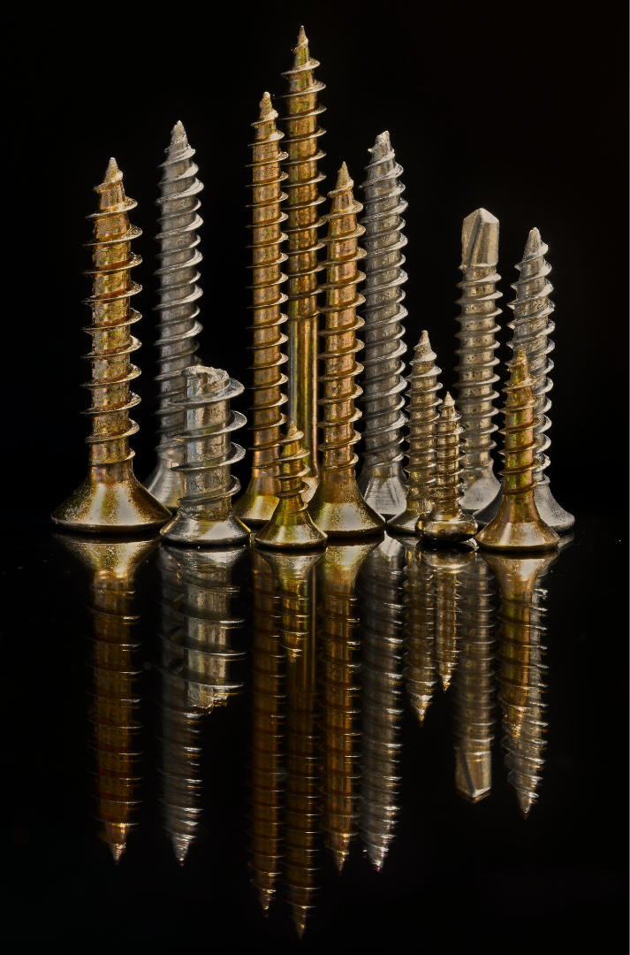
1.2 - Screws
This section will discuss different types of screws along with their characteristics and uses.
Notes:
Instructional Activity: Direction
Instructional Time: 1 min.
Do: Introduce the section.
Talking Points:
This section will discuss different types of screws along with their characteristics and uses.

Slide 16
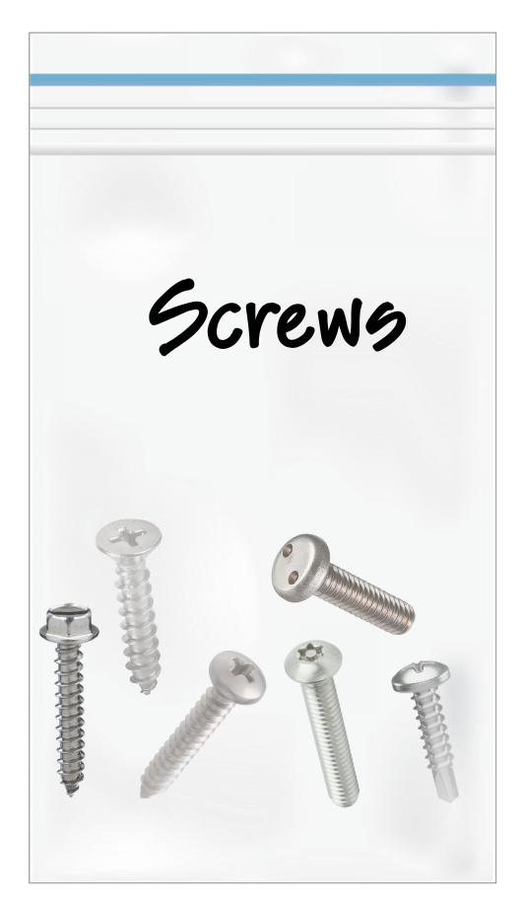
As we review this section, please take a look at these screws as they are passed around the room.
Notes:
Instructional Activity: Provide Learning Guidance
Instructional Time: 1 min.
Materials:
A plastic bag labeled “Screws” that contains one of each of the following: Machine Screw, Self-Tapping Screw, Sheet Metal Screw, Self-Drilling Screw, Hex Washer Screw, Anti-Tampering Screw
Do:
Pass the bag of screws around the room for learners to examine.
Talking Points:
While we review, take a look at the screws I am passing around the room.

Slide 17
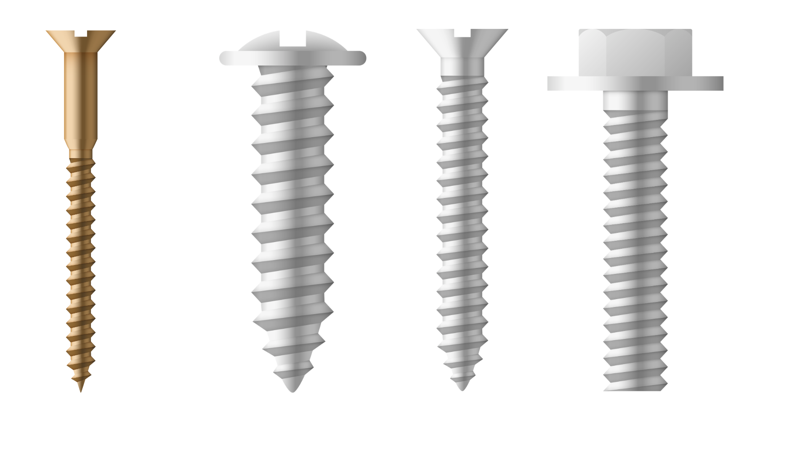
What is a screw?
A screw is a cylindrical fastener with threads used to secure objects together.
Threads - Engage with a matching threaded hole or nut to create a secure connection
Used for fastening, assembly, positioning, and adjustment
Available in a variety of materials and strength levels for different applications
Notes:
Instructional Activity: Present Content
Instructional Time: 2 min.
Talking Points:
Screws are one of the most commonly used fasteners in mechanical systems. They are found in everything from electrical enclosures and vehicle components to track equipment and shop fixtures.
The threads are what allow the screw to hold materials together. As the screw is tightened, the threads grip the material or engage with a threaded hole or nut to create a secure connection.
Some screws, like wood screws and sheet metal screws, create their own threads as they are installed.
Others, such as machine screws, require an existing threaded hole or a matching nut.
Screws are used in a variety of applications for fastening, assembly, and positioning.
Because screws are manufactured in different materials and strength levels, it's important to select the right screw for the application.

Slide 18
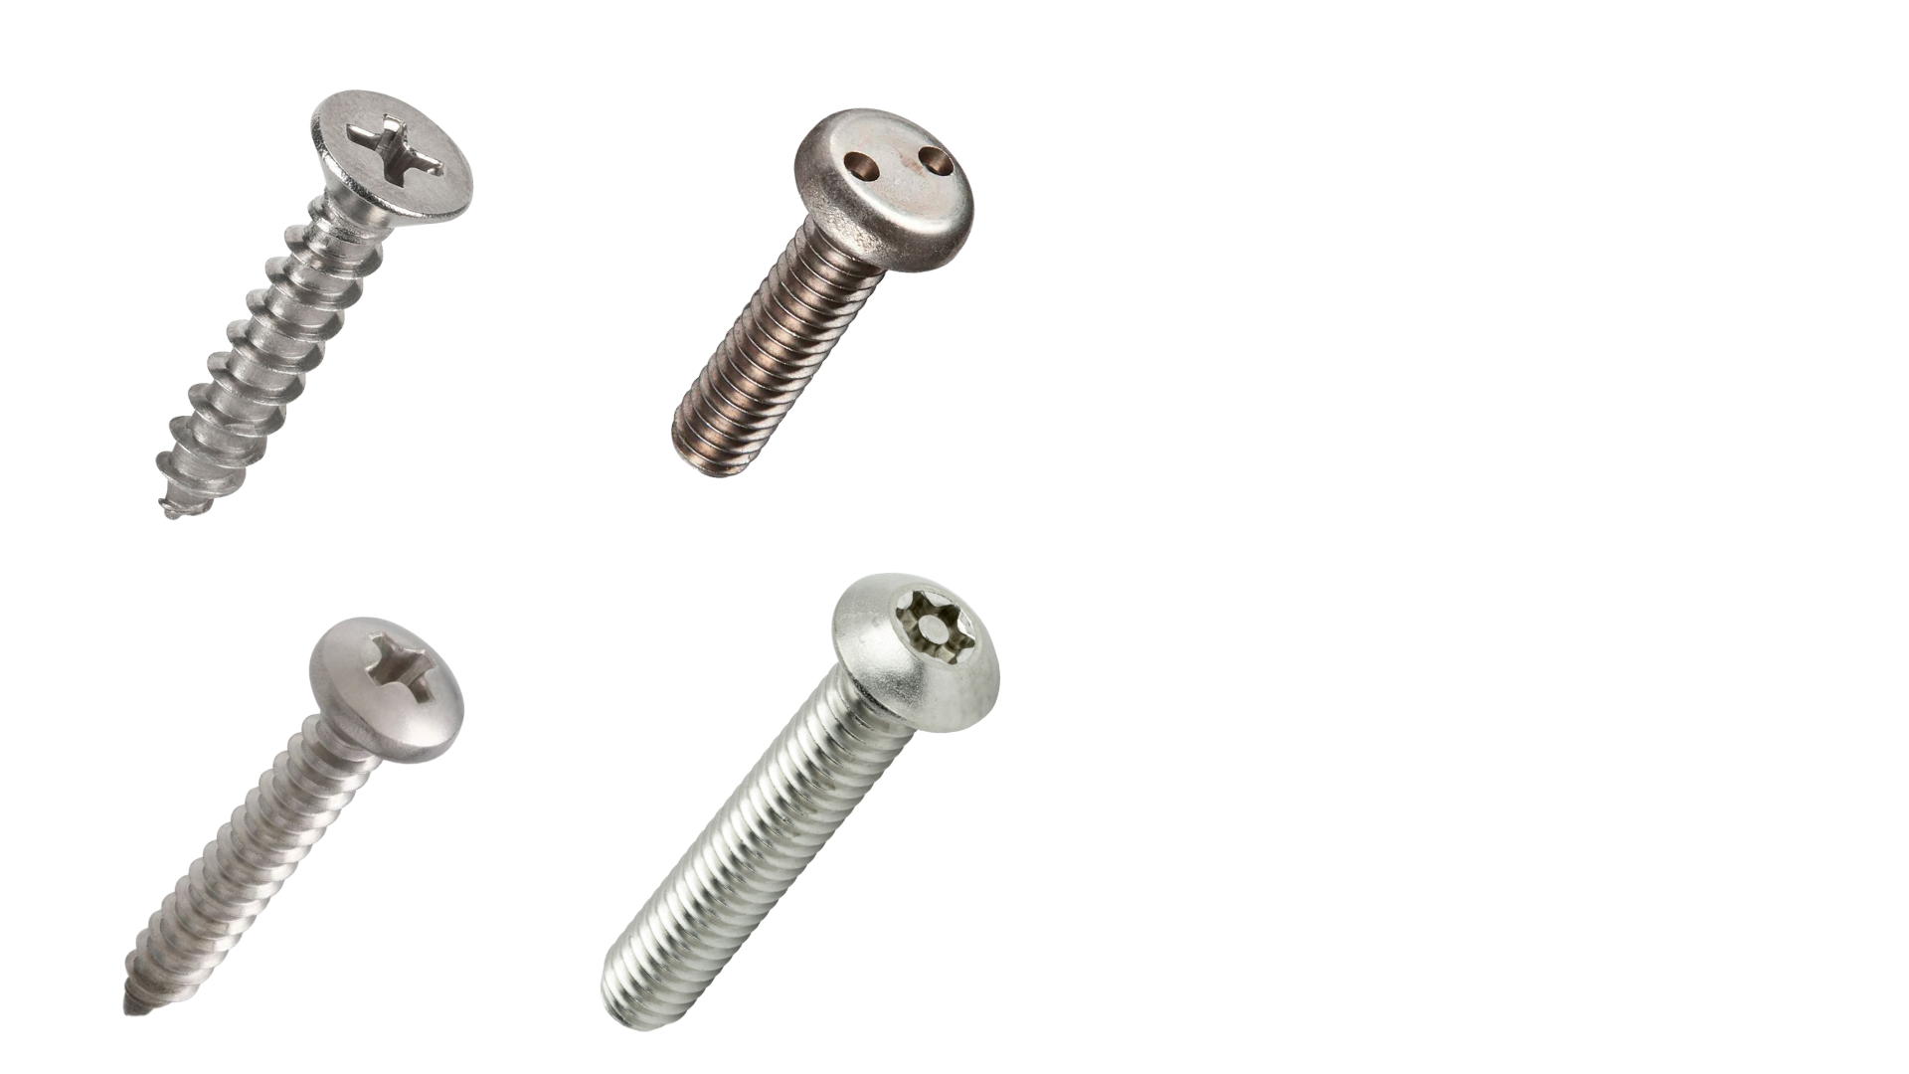
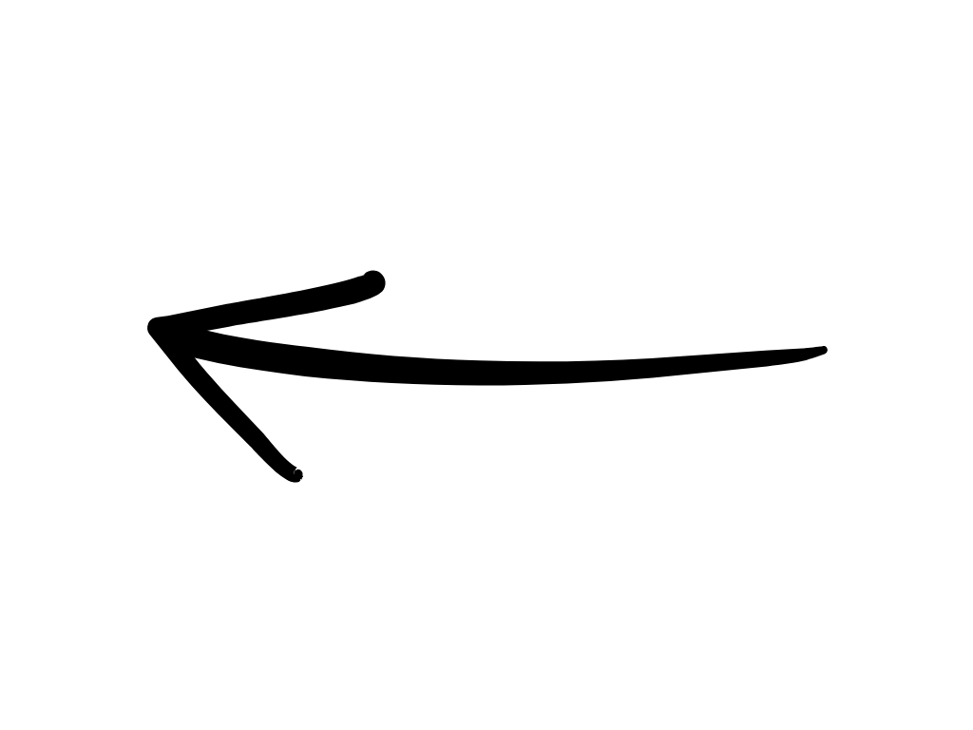
Parts of a Screw
Types of Heads
Flat Head | Anti-Tamper
Phillips | Torx
Head
Shank
Thread
Notes:
*This slide contains animations. CLICK to reveal content.
Instructional Activity: Present Content
Instructional Time: 2 min.
Talking Points:
Although there are many types of screws, they all share the same basic parts. Understanding this terminology will make it easier to identify screws and communicate about them on the job.
The head is the top portion of the screw. It provides the surface that the tool engages to drive or remove the screw. Different head designs are used depending on the application and the tool required.
The shank is the smooth section between the head and the threads. Not every screw has a visible shank, but when present, it helps align the materials being fastened and can improve the strength of the connection.
The threads are the ridges that run along the body of the screw. As the screw is turned, the threads grip the material or engage with a threaded hole or nut to create a secure connection.
CLICK - On the right are examples of several common head types you may encounter. Different head designs are selected based on factors such as the tool being used, the amount of torque required, accessibility, or the need to discourage unauthorized removal.
Flat Head: Designed to sit flush with the surface of the material after installation, creating a smooth, finished appearance.
Anti-Tamper: Includes a specialized drive that requires a matching security tool, helping prevent unauthorized removal.
Phillips: Uses a cross-shaped recess and is one of the most common drive types for general-purpose fastening.
Torx: Uses a six-point star-shaped recess that provides better torque transfer and reduces the chance of the driver slipping or stripping the screw.

Slide 19
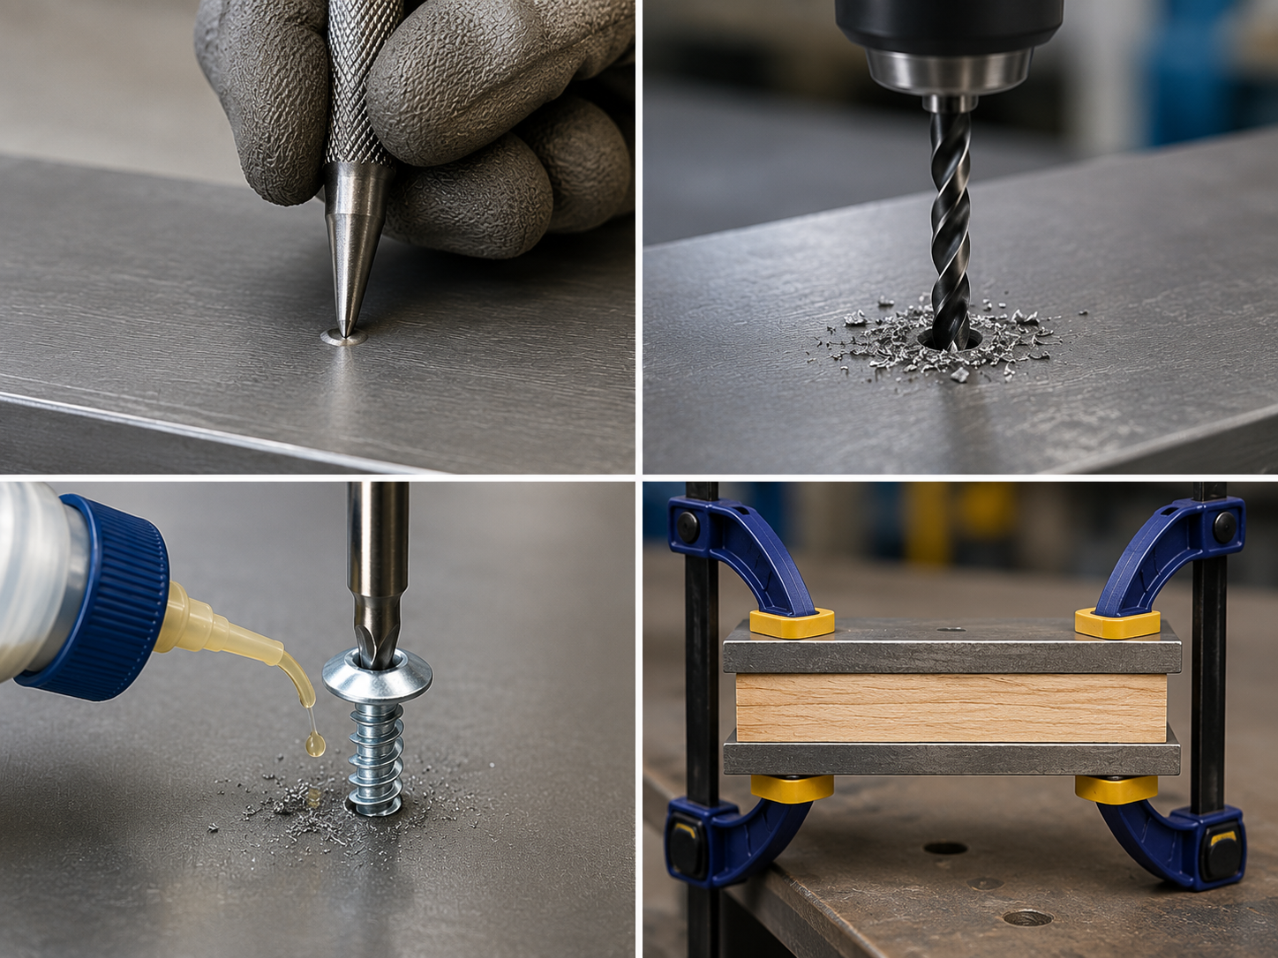
Installation Best Practices
Mark the hole location with a center punch
Drill a pilot hole when required
Use cutting fluid or oil when installing self-tapping screws to reduce friction and heat.
Clamp materials securely using the sandwich technique
Notes:
Instructional Activity: Present Content
Instructional Time: 3 min.
Talking Points:
Proper installation helps create a stronger, more reliable connection while reducing the risk of damaging the fastener or the material.
A center punch creates a small indentation that helps keep the drill bit from wandering when starting the hole.
A pilot hole makes it easier to install the screw and reduces the chance of splitting the material or damaging the fastener. Not every screw requires a pilot hole, so always follow the manufacturer's recommendations.
Cutting fluid or oil reduces friction and heat during drilling and installation. This helps extend tool life and can improve thread quality when working with metal.
The sandwich technique uses clamps to hold materials tightly together before drilling or fastening. This helps keep the pieces aligned and prevents movement during installation.
These simple practices improve the quality of the installation and reduce the likelihood of rework or premature fastener failure.
Now that we've covered how screws are installed, let's examine the different types of screws and where each is commonly used.
Note – Image Ai enhanced for clarity by authoring graphic designer.

Slide 20
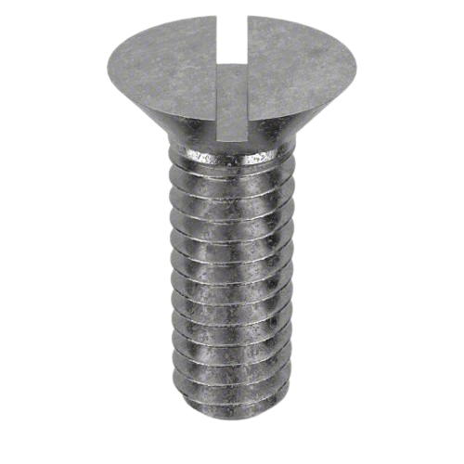
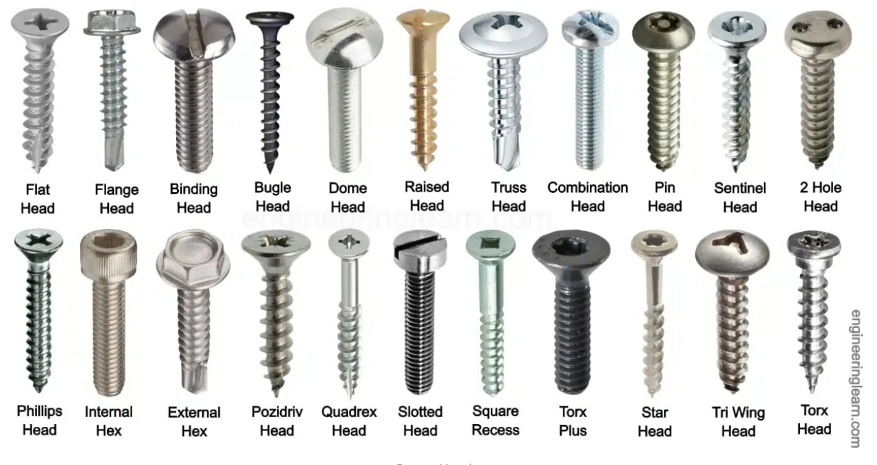
Types of Screws
Notes:
Instructional Activity: Present Content
Instructional Time: 1 min.
Talking Points:
The type of screw selected will depend on the thickness of the metal, the type of fastening that is recommended or required, and the desired appearance.
In the next few slides, we’ll review screws that are commonly used for metal work.
This includes machine screws, self-tapping screws, self-drilling screws, sheet metal screws, hex washer head screws, and anti-tamper screws
Image Source: Engineering Learn. (n.d.). Types of screw heads and their uses (with pictures). https://engineeringlearn.com/types-of-screw-heads-and-their-uses-with-pictures

Slide 21
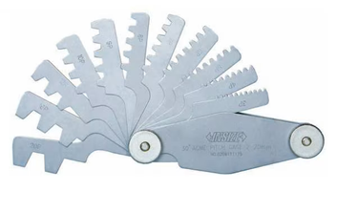
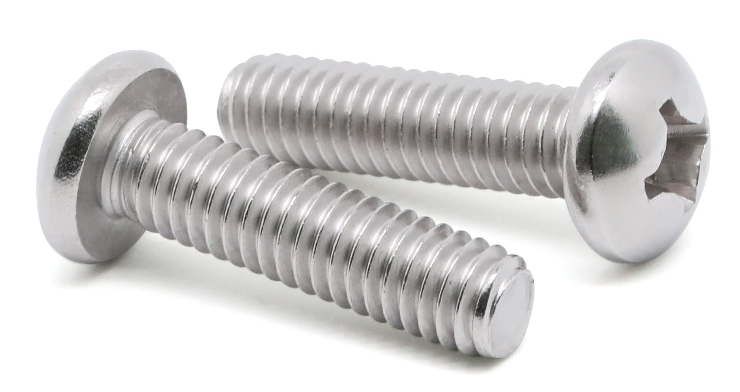
Machine Screw
Used in mechanical and electrical assemblies
Designed to be installed into a pre-threaded hole or matching nut and washer
Fine thread for greater clamping force
Notes:
Instructional Activity: Present Content
Instructional Time: 2 min.
Talking Points:
Machine screws are commonly used in mechanical and electrical assemblies where a precise, secure connection is needed.
Machine screws differ from wood and sheet metal screws because they do not create their own threads. Instead, they are designed to be installed into a pre-threaded hole or used with a matching nut and washer.
They typically have fine threads, which are spaced closer together than those on wood or sheet metal screws.
Fine threads provide greater clamping force, allow for more precise adjustments, and generally have higher tensile strength than coarse-thread fasteners of the same size.
A thread pitch gauge is used to identify the spacing between threads so the correct replacement fastener can be selected.
Machine screws are commonly found in electrical equipment, control panels, brackets, instrumentation, and other transit components requiring secure, precise fastening.

Slide 22
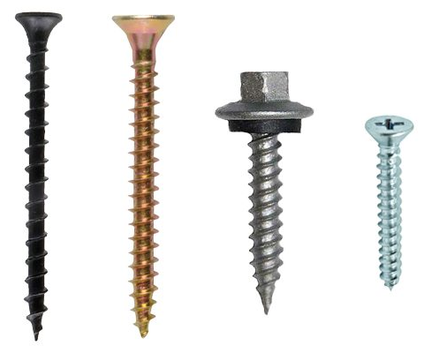
Self-Tapping Screw
Form their own threads as they are installed
Typically installed in a pre-drilled pilot hole
Pilot holes are slightly smaller than the screw diameter
Commonly used when fastening metal, plastic, and other materials
Notes:
Instructional Activity: Present Content
Instructional Time: 2 min.
Talking Points:
Unlike machine screws, self-tapping screws create their own threads as they are driven into the material. This eliminates the need for a pre-threaded hole or matching nut.
Self-tapping screws are usually installed into a pilot hole that is slightly smaller than the screw's diameter. As the screw is turned, its threads cut or form matching threads in the material.
Keep in mind that self-tapping does not mean self-drilling. Most self-tapping screws still require a pilot hole before installation.
Using the correct pilot hole size is important. If the hole is too small, installation can be difficult or damage the screw. If it's too large, the screw may not hold securely.
Self-tapping screws are commonly used with sheet metal, plastics, and other materials where creating threads during installation is practical.

Slide 23
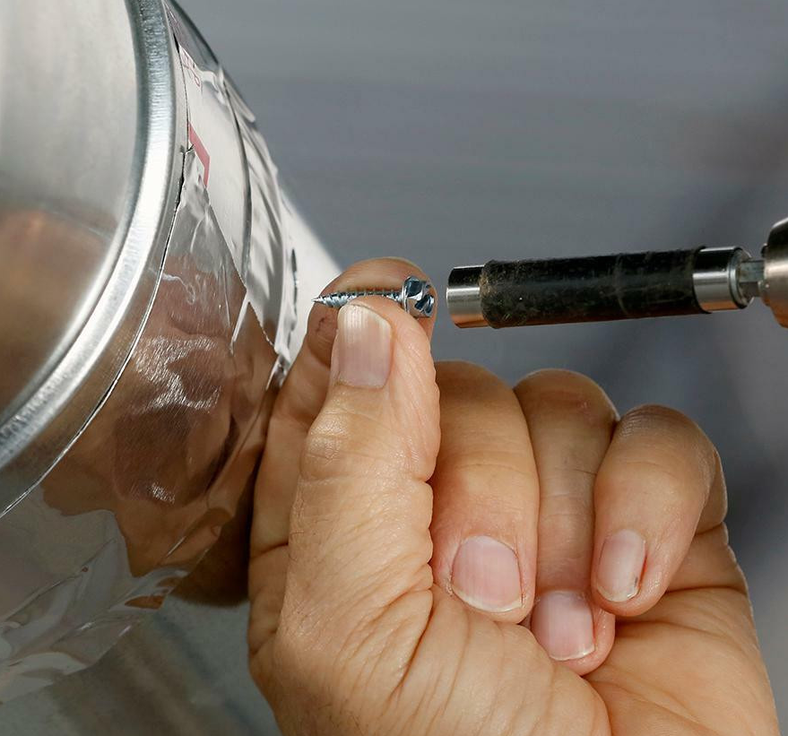
Sheet Metal Screw
Designed for fastening thin sheet metal
Can also be used with plastic and other materials
Typically have a fully threaded shank with sharp, aggressive threads
Provides a secure grip by forming threads during installation
Notes:
Instructional Activity: Present Content
Instructional Time: 2 min.
Talking Points:
Sheet metal screws are specifically designed to fasten thin pieces of metal together, but they are also commonly used with plastic, fiberglass, and other materials.
These screws usually have a fully threaded shank with sharp, aggressive threads that provide excellent holding power by cutting or forming threads as they are installed.
Because sheet metal screws are typically self-tapping, they create their own mating threads in the material. In most metal applications, a pilot hole is drilled first to make installation easier and improve accuracy.
Sheet metal screws are widely used throughout transit vehicles and facilities to secure access panels, covers, brackets, electrical enclosures, HVAC components, and other light-gauge metal assemblies.
Selecting the correct length, diameter, and thread style helps ensure a strong, reliable connection without damaging the material.
Image Source: Mobile Home Outfitters. (n.d.). #8 hex head zinc plated sheet metal screw (1 lb.). https://mobilehomeoutfitters.com/building-materials/8-hex-head-zinc-plated-sheet-metal-screw-1-lb/

Slide 24
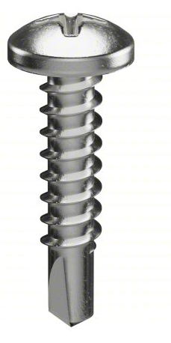
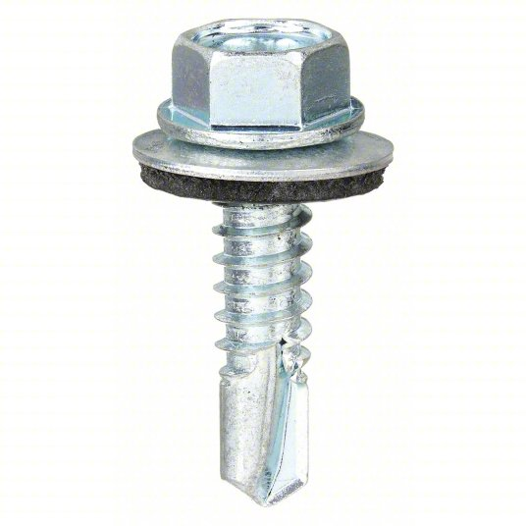
Self-Drilling Screw
Have a drill bit-shaped tip that drills its own pilot hole
Eliminate the need to pre-drill most metal applications
Drill, tap, and fasten in a single operation
Commonly used for fastening sheet metal and light-gauge steel
Notes:
Instructional Activity: Present Content
Instructional Time: 2 min.
Talking Points:
Self-drilling screws are designed to save time by combining three steps into one.
As they are installed, they drill the hole, create the mating threads, and fasten the material—all in a single operation.
The key feature is the drill bit-shaped tip. Unlike a self-tapping screw, which usually requires a pilot hole, a self-drilling screw creates its own pilot hole as it is driven into the material.
These screws are most often used to fasten sheet metal, light-gauge steel, and similar materials, making them a common choice for equipment housings, electrical enclosures, brackets, and metal panels.
Although self-drilling screws simplify installation, it's still important to select the correct screw size and use the appropriate driver to avoid damaging the fastener or the material.

Slide 25
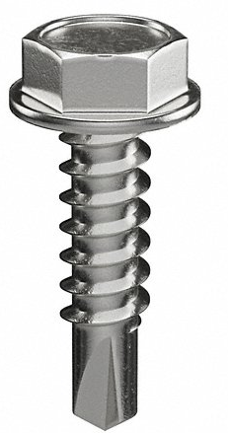
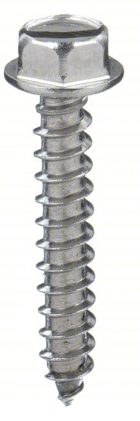
Hex-Washer Screw
Feature a hexagonal head with a built-in washer
The built-in washer helps distribute the clamping force over a larger surface
Installed using a socket or nut driver for a secure connection
Available in self-tapping and self-drilling versions
Notes:
Instructional Activity: Present Content
Instructional Time: 2 min.
Talking Points:
Hex washer screws are easy to recognize by their hexagonal head and the built-in washer located beneath it.
The integrated washer helps distribute the clamping force over a larger area. This helps protect the material from damage and creates a more secure connection.
These screws are installed using a socket or nut driver, allowing technicians to apply more torque than many traditional screwdriver drive types. This makes them a popular choice for fastening metal components.
Hex washer screws are commonly used in transit maintenance, construction, and manufacturing to secure sheet metal, brackets, equipment housings, and other metal assemblies.
You'll find two common versions:
Self-tapping hex washer screws require a pilot hole but create their own mating threads during installation.
Self-drilling hex washer screws have a drill-point tip that drills the hole, forms the threads, and fastens the material in one operation.

Slide 26
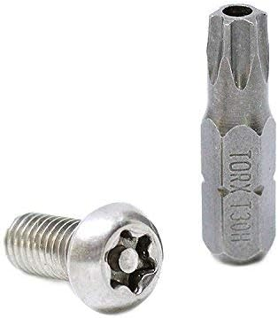
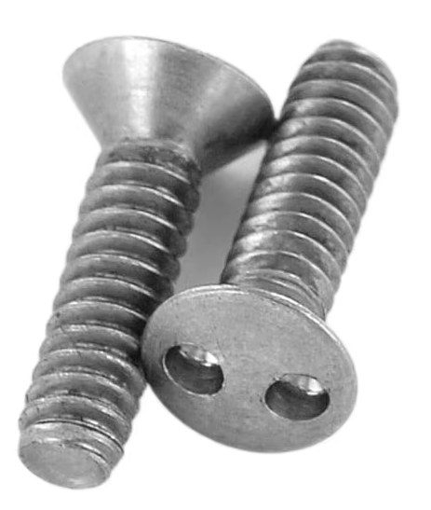
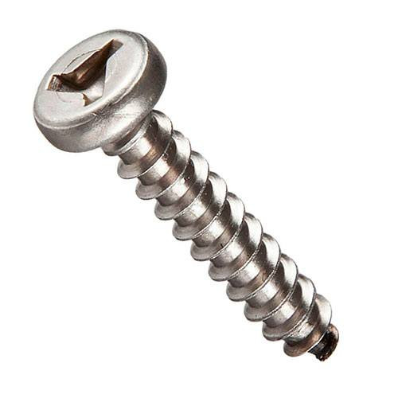
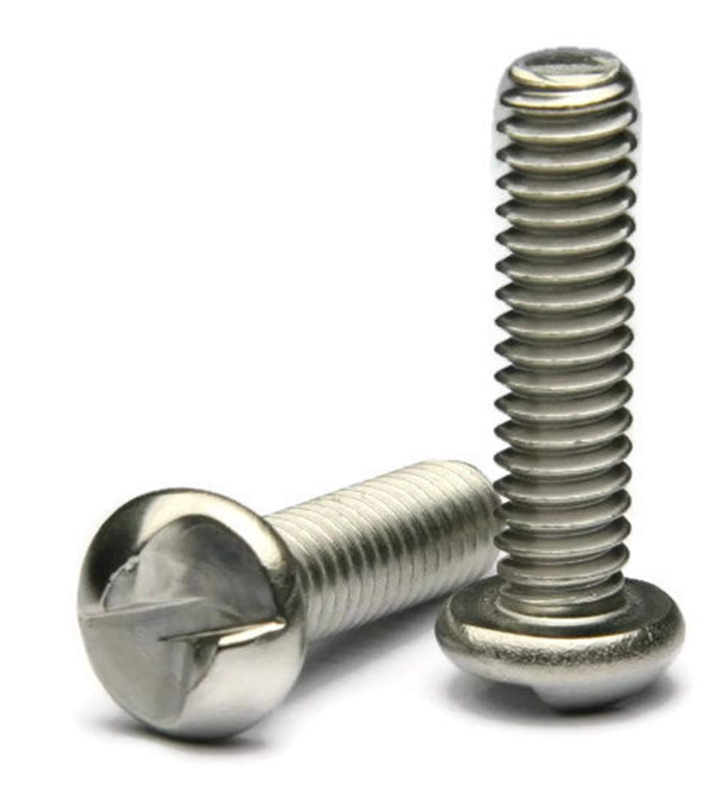
Anti-Tampering Screw
Designed to discourage unauthorized removal by requiring specialized tools.
Require a matching security driver for installation and removal.
Available in a variety of security drive designs such as
  Pin-in Torx
  Spanner ("Snake Eyes")
  Tri-Wing
  One-Way
Notes:
Instructional Activity: Present Content
Instructional Time: 2 min.
Talking Points:
Anti-tamper screws are designed to help prevent unauthorized access to equipment, panels, or components.
Unlike standard screws, they require a specialized driver for installation and removal.
In transit systems, you may find them on fare equipment, electrical enclosures, signal equipment, control cabinets, and other components that should only be accessed by authorized personnel.
Some common examples include:
Pin-in Torx, which has a small pin in the center of the drive recess.
Spanner, often called "Snake Eyes," which uses two small holes in the screw head.
Tri-Wing, which has a three-lobed drive pattern.
One-Way screws, which are designed to tighten normally but are difficult to remove using conventional tools.
Although these screws improve security, they are not theft-proof. Their purpose is to discourage tampering and limit access to trained personnel with the proper tools.

Slide 27
Summary and What’s Next
Screws are threaded fasteners used to join materials together.
Different screw types are designed for specific materials, applications, and installation methods.
Selecting the correct screw helps ensure a safe, secure, and reliable connection.
Next, we'll learn about nuts and bolts and how they work together to create strong mechanical connections.
Notes:
*This slide contains animations. CLICK to reveal content
Instructional Activity: Recall, Enhance Retention and Transfer
Instructional Time: 5 min.
Do:
Review the key takeaways from this section of the module.
Clearly explain how to connects to the next section of the module.
Talking Points:
Ask: What are the most important things we learned about screws in this section?
Call on learners to respond.
Great ideas. Let's review a few more key ideas from this section.
CLICK - First, screws are threaded fasteners used to join materials together. While they all share the same basic purpose, they come in many different designs to meet different fastening needs.
CLICK - Second, different screw types are designed for different applications. We looked at machine screws, self-tapping screws, sheet metal screws, self-drilling screws, hex washer screws, and anti-tamper screws. Each has features that make it better suited for certain materials or installation methods.
CLICK - Finally, choosing the correct screw is essential. Selecting the right screw improves strength, reliability, ease of installation, and long-term performance while reducing the risk of damage or fastener failure.
CLICK - In the next section, we'll shift our focus to nuts and bolts and learn how they work together to create strong mechanical connections in transit equipment and infrastructure.

Slide 28
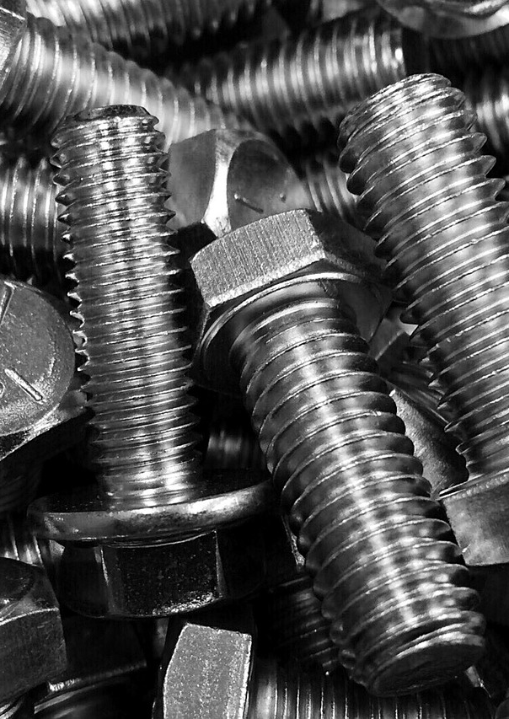
1.3 – Nuts and Bolts
In this section, we’ll review the purpose, function, and characteristics of nuts and bolts.
Notes:
Instructional Activity: Direction
Instructional Time: 1 min.
Do: Introduce the section.
Talking Points:
In this section, we’ll review the purpose, function, and characteristics of nuts and bolts.

Slide 29
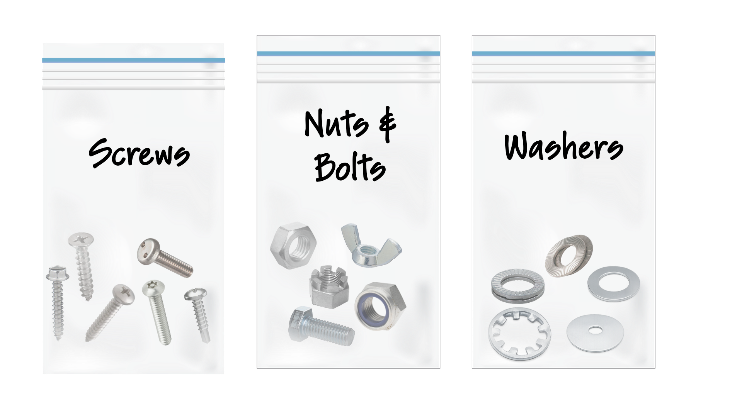
As we review this section, please take a look at these nuts and bolts as they are passed around the room.
Notes:
Instructional Activity: Provide Learning Guidance
Instructional Time: 1 min.
Materials:
A plastic bag labeled “Nuts and Bolts” that contains one of each of the following: Standard Bolts, Torque-to-Yield (TTY) Bolts, Hex Nut, wing Nut, Castle Nut, Lock Nut (Nylock®)
Do:
Pass the bag of nuts and bolts around the room for learners to examine.
Talking Points:
While we review, take a look at the nuts and bolts I am passing around the room.

Slide 30
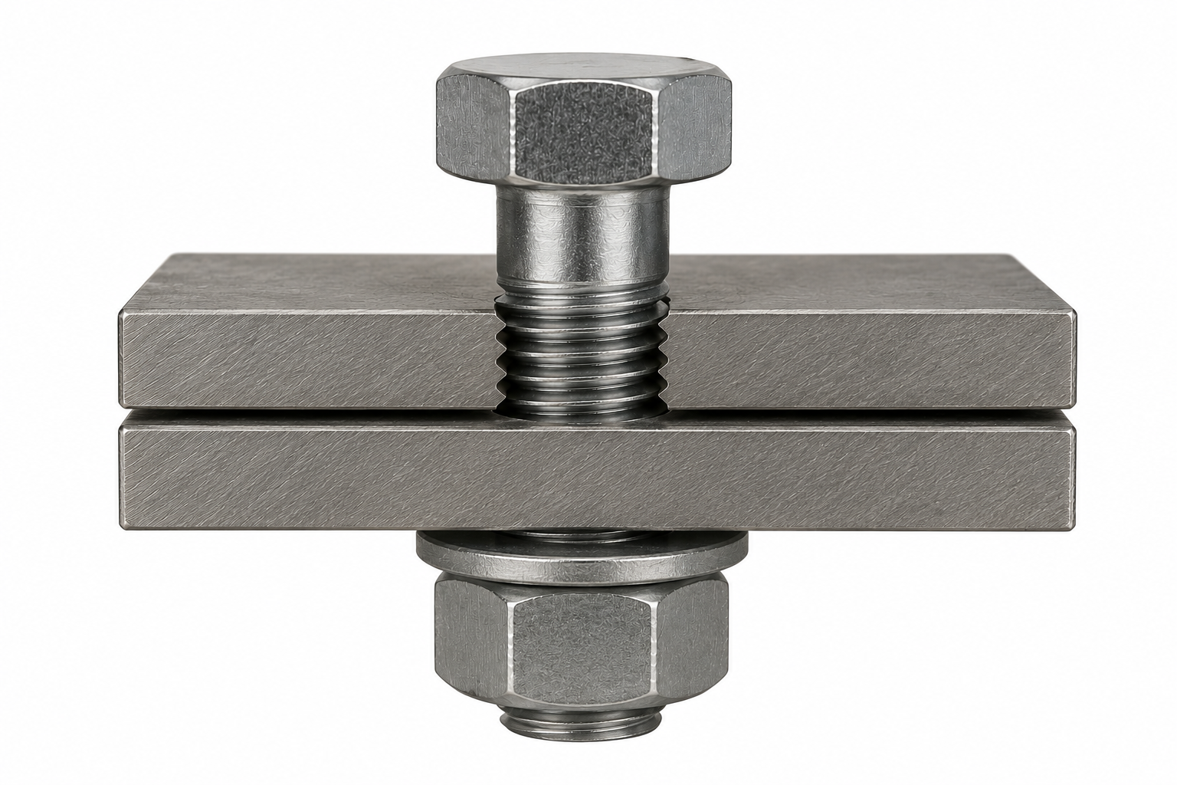
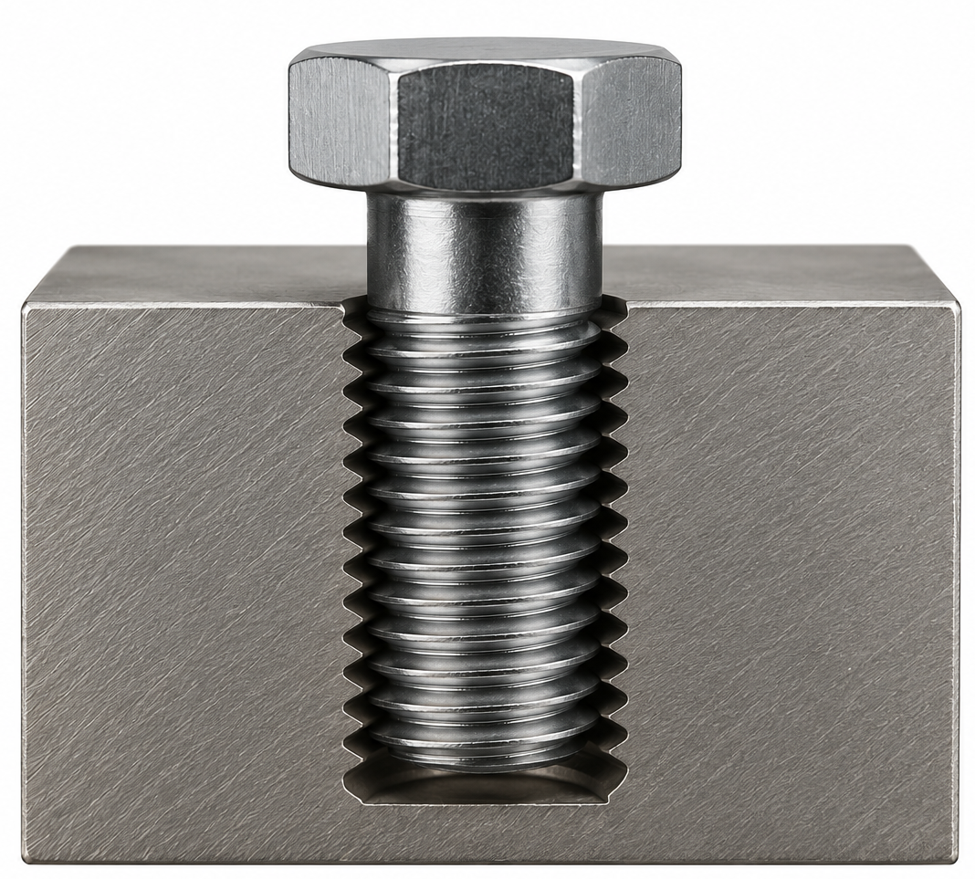
What is a bolt?
A bolt is a threaded fastener used to join two or more parts together.
Used with a matching nut or installed into a tapped hole
Typically have a head, shank, and threaded end
Create strong, secure connections that can be easily assembled, adjusted, and disassembled.
Notes:
Instructional Activity: Present Content
Instructional Time: 2 min.
Talking Points:
A bolt is a threaded fastener used to join two or more parts together.
While bolts are most commonly paired with a matching nut, they can also be installed into a tapped hole when the component already has internal threads.
Most bolts share the same basic design. They have a head, a shank, and a threaded end that engages with a nut or threaded hole to secure the connection.
Depending on the application, a bolt may have a partially threaded shank or be fully threaded.
The amount of smooth shank and threaded length is selected based on the strength and function required for the joint.
One of the key advantages of a bolted connection is that it can be assembled, adjusted, disassembled, and reassembled without damaging the components being joined. This makes bolts a popular choice for equipment that requires maintenance or periodic replacement.
Bolts are commonly used throughout transit vehicles, maintenance facilities, and infrastructure to secure brackets, equipment, structural components, and mechanical assemblies.
Now that we've defined what a bolt is, let's identify the basic parts of a bolt and learn how each contributes to the fastener's function.
Note – Image Ai enhanced for clarity by authoring graphic designer.

Slide 31
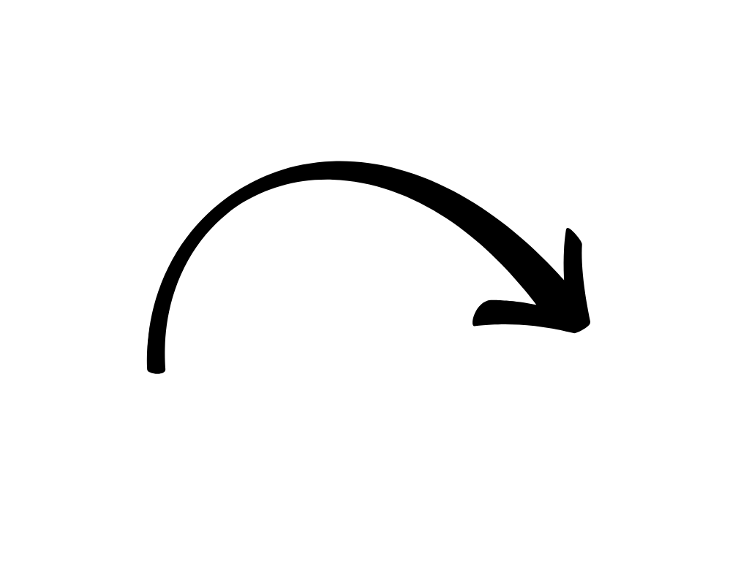
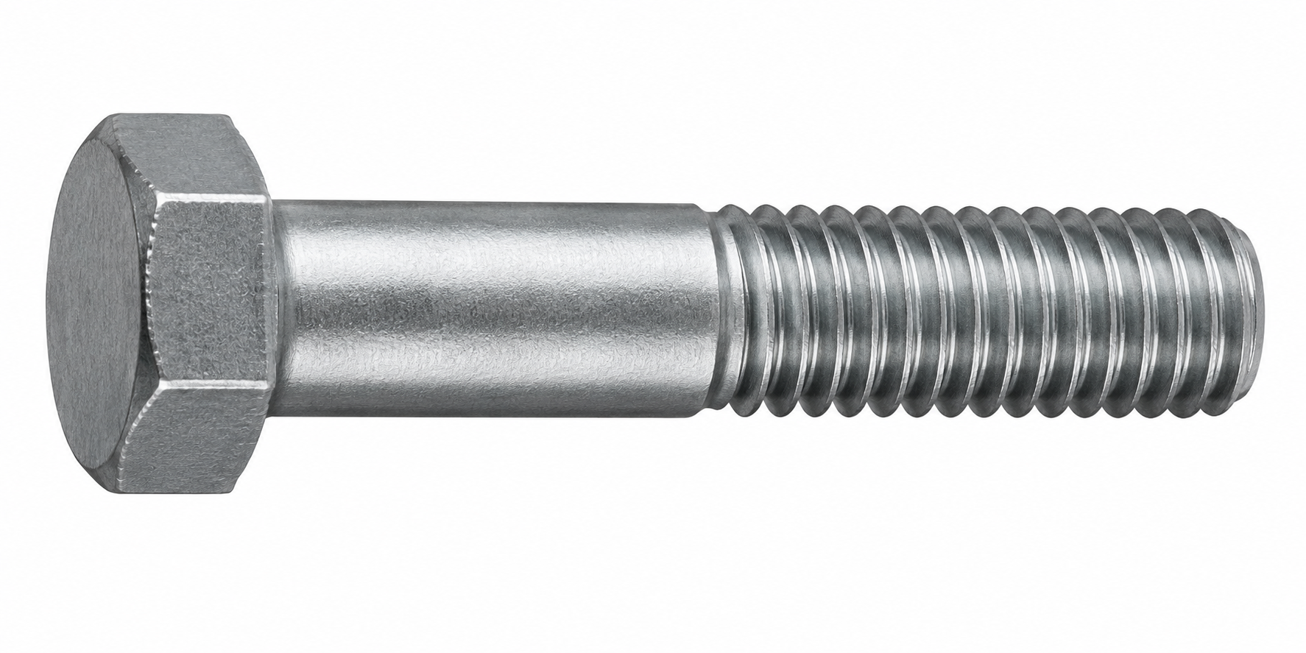
Parts of a Bolt
Thread - Engage with a nut or tapped hole to secure the connection.
Head - Surface used to tighten or loosen the bolt.
Shank - Main body of the bolt between the head and the threads.
Notes:
Instructional Activity: Present Content
Instructional Time: 2 min.
Talking Points:
Understanding the parts of a bolt will make it easier to identify, select, and communicate about bolts on the job.
The head is the portion of the bolt that a wrench or socket grips to tighten or loosen the fastener.
Bolts are available with several head styles, but the hex head is one of the most common.
The shank is the main body of the bolt between the head and the threads.
Some bolts have a long smooth shank, while others are threaded almost their entire length.
The amount of shank depends on the bolt's intended application.
The threads engage with a matching nut or a tapped hole to create a secure connection.
The threaded portion is responsible for developing the clamping force that holds the joint together.
While bolts may vary in length, diameter, head style, and thread length, they all share these same basic parts.

Slide 32
Bolt Threads
Coarse threads
Further apart, less likely to cross-thread
Faster to install/remove
More forgiving if damaged
Fine threads
Closer together, stronger clamping force
More adjustments
Higher tensile strength (max pulling force)
Notes:
Instructional Activity: Present Content
Instructional Time: 2 min.
Talking Points:
Bolt threads are generally classified as coarse or fine. The difference is the spacing between the threads, and each type is designed for different applications.
Coarse threads have wider spacing between the threads.
This makes them quicker to install and remove, less likely to cross-thread during assembly, and more tolerant of dirt, debris, or minor damage.
They're commonly used for general-purpose fastening.
Fine threads are spaced closer together.
Because more threads engage over the same length, they can provide greater clamping force and higher tensile strength.
They also allow for finer adjustments during assembly.
Neither thread type is "better" than the other. The correct choice depends on the application and the manufacturer's specifications.

Slide 33
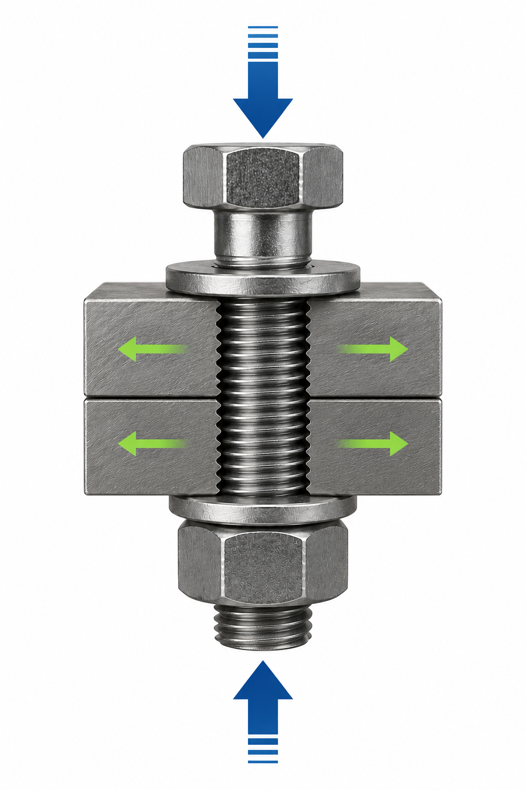
How a Bolted Joint Works
A bolt and nut clamp materials together.
Tightening the bolt creates tension, causing the bolt to stretch slightly.
The stretched bolt acts like a spring, creating clamping force.
Clamping force and friction help keep the joint secure.
Notes:
Instructional Activity: Present Content
Instructional Time: 2 min.
Talking Points:
A bolt and nut don't simply hold materials together by filling a hole. They work together to create clamping force.
As the bolt is tightened, it stretches a very small amount. Although the stretch is not visible, it places the bolt under tension.
That slight stretch allows the bolt to behave much like a spring.
As it tries to return to its original length, it continuously pulls the joint together and maintains pressure on the connected materials.
This pressure, called clamping force, creates friction between the materials. That friction is what helps keep the joint from loosening during normal operation and vibration.
Applying the correct amount of tightening force is important.
Too little torque may not produce enough clamping force, allowing the joint to loosen over time.
Too much torque can overstretch or damage the bolt and the connected components.
Technicians should always follow the manufacturer's torque specifications.
Using the specified torque helps achieve the proper clamping force without damaging the fastener or the assembly.
Note – Image Ai enhanced for clarity by authoring graphic designer.

Slide 34
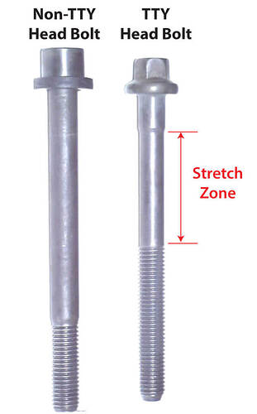
Torque-to-Yield (TTY) Bolts
Designed to stretch permanently during installation
Tightened using a specified torque and angle procedure
Commonly used in critical, high-load applications
Replace after removal unless the manufacturer specifies otherwise.
Notes:
Instructional Activity: Present Content
Instructional Time: 2 min.
Talking Points:
Most of the bolts we've discussed can be reused if they're in good condition and the manufacturer's procedures allow it. However, torque-to-yield, or TTY, bolts are an important exception.
A torque-to-yield bolt is designed to stretch beyond its elastic limit during installation. This permanent stretch allows the bolt to produce a very consistent clamping force across the joint.
Because the bolt has permanently stretched, it generally cannot provide the same clamping force a second time. For that reason, TTY bolts are typically replaced whenever they're removed.
Technicians often tighten these bolts using a torque-plus-angle procedure. Instead of stopping at a torque value alone, the bolt is tightened to an initial torque and then turned an additional number of degrees to achieve the required stretch.
In transit maintenance, you may encounter torque-to-yield bolts on engines, transmissions, drive systems, suspension components, or other critical assemblies where maintaining a precise clamping force is essential.
Image Source: Car Talk Community. (2023, July 15). What has torque-to-yield bolts really done for us? https://community.cartalk.com/t/what-has-torque-to-yield-bolts-really-done-for-us/204392

Slide 35
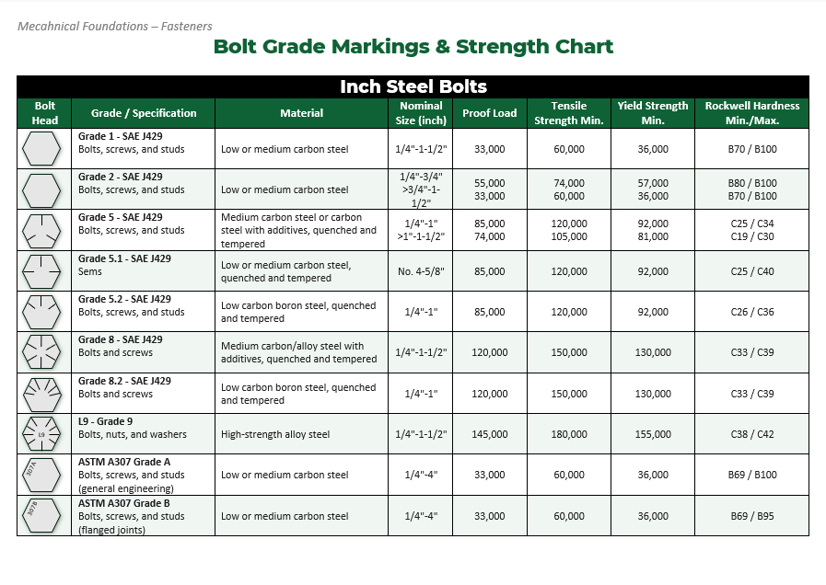
Metric vs. Standard Bolts
Metric Bolt
Uses metric system for diameter
Thread pitch is in millimeters
Grade designation is on top of head
Standard Bolt (Inch Bolts)
Uses imperial system for diameter
Threads Per Inch (TPI)
Grade designation is on top of head
Notes:
Instructional Activity: Provide Guided Learning
Instructional Time: 5 min.
Materials:
Grades of Bolts_Fasteners handout
Do:
Refer learners to the “Grades of Bolts” handout embedded in the Participant Resource Guide.
Talking Points:
Bolts are generally classified using either the standard (inch) system or the metric system.
The two systems use different methods for measuring bolt size and thread spacing, so they are not interchangeable.
Standard, or inch, bolts use the imperial measurement system.
Their diameter is measured in inches, and the thread spacing is described as Threads Per Inch (TPI).
Metric bolts use the metric system.
Their diameter is measured in millimeters, and the distance between threads is identified by the thread pitch, which is also measured in millimeters.
In addition to size, bolts are also identified by their grade, which indicates the bolt's strength and hardness.
The grade is typically stamped on the head of the bolt.
If a bolt needs to be replaced, always use the grade specified by the manufacturer. Never replace it with a lower-grade bolt, as it may not provide sufficient strength for the application and could lead to joint failure.
Higher property classes are designed for applications requiring greater strength and clamping force.
Source: AFT Fasteners. (n.d.). Grades of bolts: Bolt grade markings & bolt strength chart. https://www.aftfasteners.com/grades-of-bolts-bolt-grade-markings-bolt-strength-chart/

Slide 36
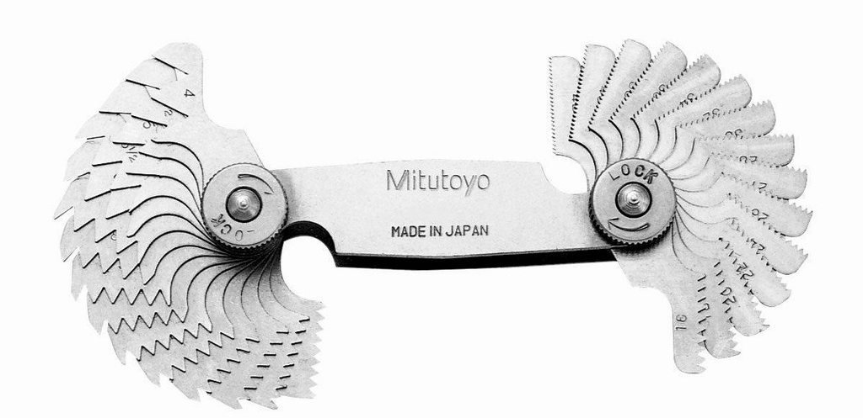
Measuring Thread Pitch on Bolts
Used to identify an unknown thread
Different gauges for metric pitch and imperial pitch
Includes several leaves with stamped pitch numbers
Notes:
Instructional Activity: Present Content
Instructional Time: 2 min.
Talking Points:
Measuring thread pitch is necessary to identify an unknown thread.
To measure pitch, you will need to use a thread pitch gauge.
One gauge is used to measure metric pitch, another to measure imperial pitch
Having both gauges is important as a metric pitch gauge may appear to match some imperial threads (or visa versa)
A pitch gauge has several leaves with a number stamped on it – this number indicates the pitch.

Slide 37
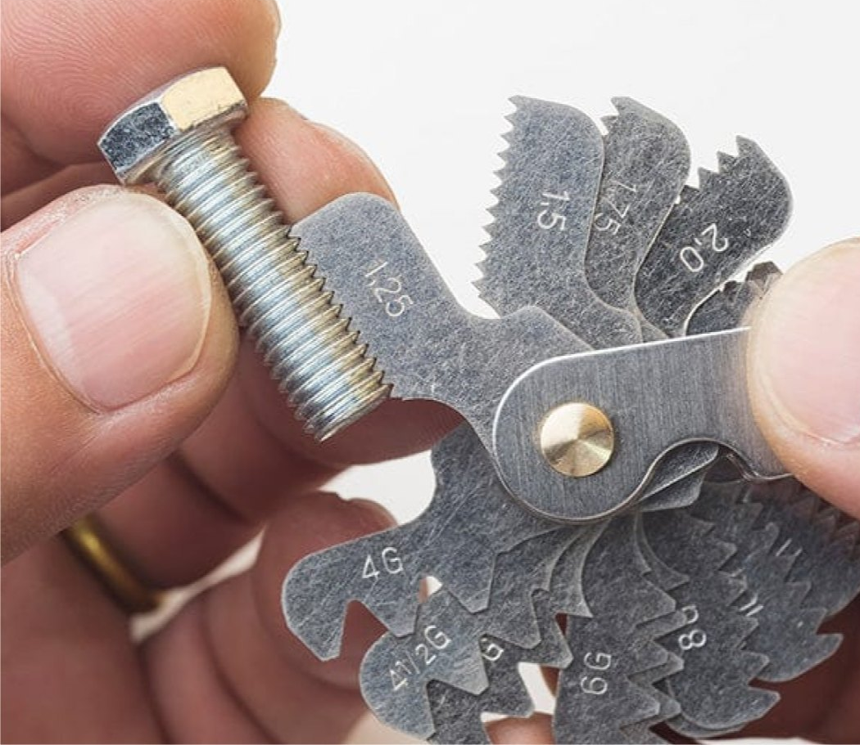
Measuring Thread Pitch on Bolts
Determine whether you need a metric or imperial gauge.
Select a thread pitch gauge and choose a blade with a likely pitch.
Match the gauge teeth to the bolt threads until they fit perfectly with no gaps.
Read the pitch value stamped on the gauge.
Metric Pitch Example: M8-1.25 (8mm dia. bolt with 1.25 pitch)
Notes:
Instructional Activity: Gain Attention, Provide Learning Guidance
Instructional Time: 15 min.
Materials:
Metric thread pitch gauge
Imperial thread pitch gauge
2-3 Bolts with varying pitches
Do:
Review the steps for measuring thread pitch on the slide.
Show learners how to measure bolt threads using both a metric and imperial thread pitch gauge.
Show several examples using bolts with different thread pitches.

Slide 38

Optional Video
Click the image to watch the video about British Airways Flight 5390 .
Discussion:
How does using the wrong size bolt impact the clamping force?
Notes:
Note to Instructors – This is an optional video.
Instructional Activity: Recall, Present Content
Time: 10 min.
Do:
Click the image to watch the video about British Airways Flight 5390 .
Use the questions on the slide to facilitate a discussion.

Slide 39
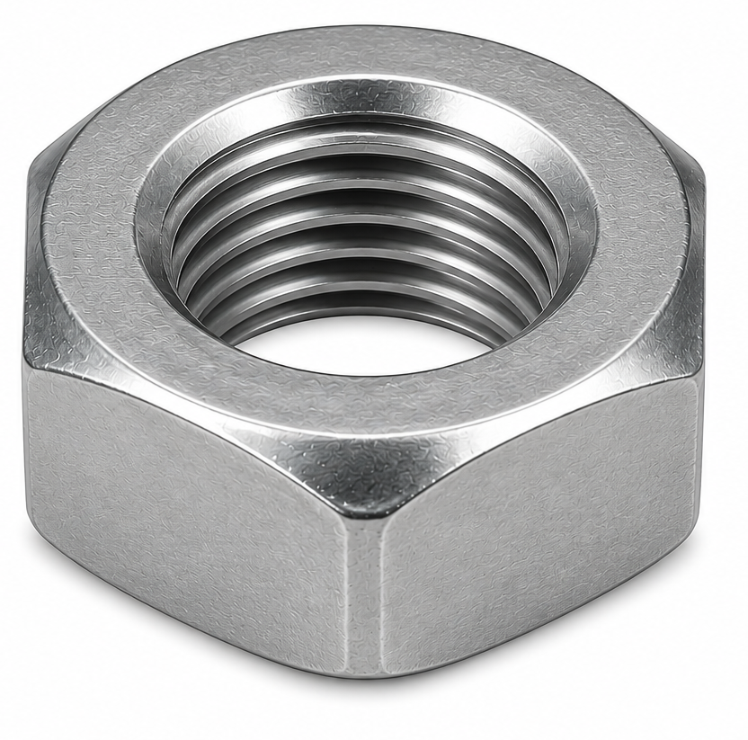
What is a nut?
Threads
A nut is a fastener with internal threads that is used with a matching bolt to join two or more parts together.
Create strong, removable and adjustable connections
Typically have internal threads, flats, and corners for tightening
Available in a variety of designs for different applications.
Flat
Corner
Notes:
Instructional Activity: Present Content
Instructional Time: 2 min.
Talking Points:
A nut is a fastener with internal threads that works together with a matching bolt to securely join two or more parts.
Unlike a bolt, a nut has internal threads that engage with the bolt's external threads to create a secure mechanical connection.
Most nuts have flats and corners that allow a wrench or socket to grip and tighten them.
One of the advantages of a bolted connection is that it can be assembled, adjusted, disassembled, and reassembled when maintenance or repairs are needed.
In some applications, vibration or repeated movement can cause a nut to loosen over time.
To help prevent this, nuts may be used with washers, cotter pins, nylon inserts, or thread-locking compounds such as Loctite®, depending on the application.
Nuts are manufactured in several different designs, each intended for a specific purpose.

Slide 40
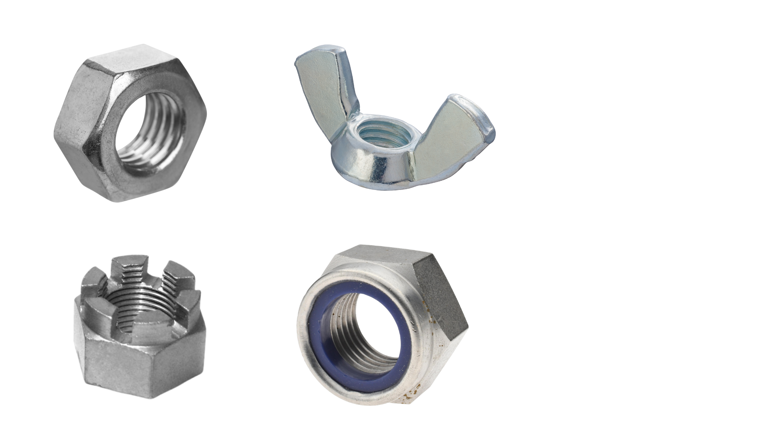
Types of Nuts
Hex Nut
General-purpose fastening
Wing Nut
Hand tightening and
frequent adjustments
Castle Nut
Secured with a cotter pin to resist loosening
Lock Nut (Nylock®) Nylon insert helps resist loosening from vibration
Notes:
Instructional Activity: Present Content
Instructional Time: 3 min.
Do:
Pass the bag of nuts around the room for learners to examine.
Talking Points:
Let's look at some of the most common nut types you'll encounter in transit maintenance.
Hex nuts are the most common type of nut and are used in a wide variety of fastening applications.
They're typically tightened with a wrench or socket and paired with a standard bolt.
Wing nuts have two wings that allow them to be tightened or loosened by hand without tools.
They're commonly used when a connection needs to be adjusted or removed frequently.
Castle, or castellated, nuts have slots cut into the top of the nut.
After the nut is tightened, a cotter pin is inserted through the slots and a hole in the bolt to help prevent the nut from loosening due to vibration.
These are commonly used in safety-critical applications where accidental loosening could cause damage or injury.
Lock nuts, often called Nylock® nuts, contain a nylon insert that increases friction between the nut and the bolt threads, helping resist loosening caused by vibration.
Many lock nuts are intended for limited reuse because the nylon insert loses effectiveness after repeated installations.
The type of nut selected depends on the application, the amount of vibration, how often the assembly will be removed, and the level of security required.

Slide 41
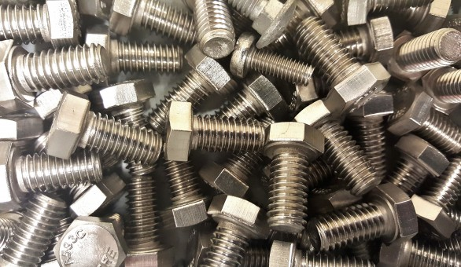
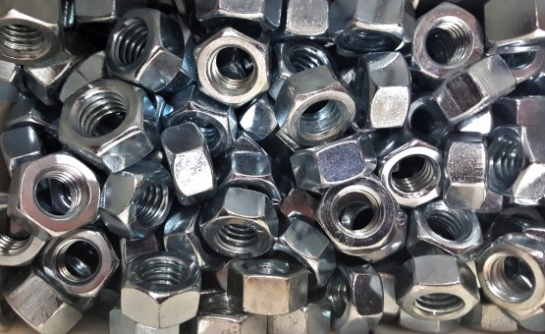
Matching and Measuring
Materials: A variety of metric and standard, fine and coarse thread nuts and bolts available for you to inspect.
Match the appropriate bolt with its counterpart nut (size and thread)
Use a thread pitch gage to measure the pitch of one metric and one imperial (inch) bolt.
Notes:
Instructional Activity: Provide Guided Learning, Elicit Performance, Provide Feedback
Instructional Time: 15 min.
Materials:
For each small group or pair:
A variety of metric and standard, fine and coarse thread nuts and bolts
Metric pitch gage
Imperial pitch gage
Do:
Review the directions on the slide and answer any questions learners may have.
Distribute materials and give learners time to work.
Circulate the room checking in with each small group or pair.
Visit each group or pair to provide feedback and assess learner understanding.
If needed, revisit topics to clarify content.

Slide 42
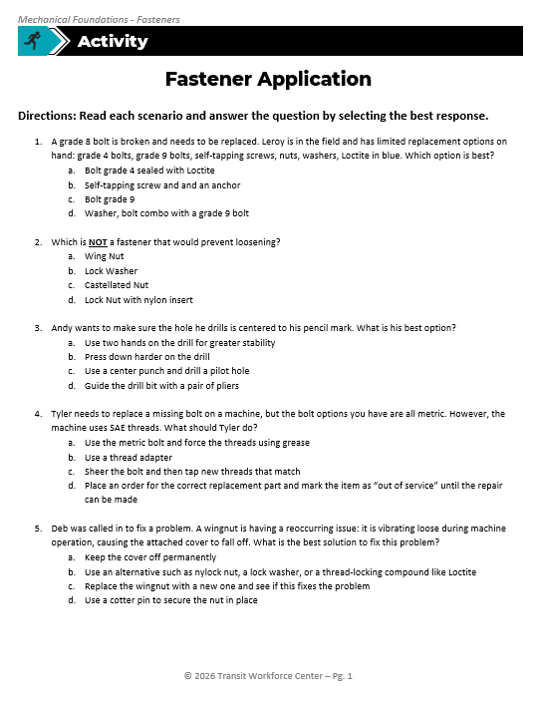
Fastener Application
Directions: Read each scenario and answer the question by selecting the best response.
Answer Key:
1.) C
2.) A
3.) C
4.) D
5.) B
Notes:
*This slide contains animations. CLICK to reveal content.
Instructional Activity: Provide Guided Learning, Elicit Performance, Provide Feedback
Instructional Time: 15 min.
Materials:
Fastener Application_Fasteners
Do:
(3 min.)
Refer learners to the “Fastener Application” handout embedded in the Participant Resource Guide.
Review the directions and answer any questions learners may have.
(10 min.)
Give learners time to answer the questions.
Circulate the classroom to answer questions, provide feedback, and assess learner understanding.
(7 min.) Review and Discussion
Regroup as a class and all on learners to share their answers.
CLICK to reveal the answers on the slide.
Answer Key:
C
A
C
D
B

Slide 43
Knowledge Check
What are some similarities between screws and bolts?
Notes:
*This slide contains animations. CLICK to reveal content.
Instructional Activity: Evaluate/Assess Performance, Provide Feedback
Learning Objective: Identify the various types of fasteners and explain their purpose, including screws, nuts, bolts, washers, staples, retaining hardware, and miscellaneous hardware.
Instructional Time: 3 min.
Do: Review the knowledge check questions. Call on learners to share their responses.
Answer Key:
Answers will vary but may include…
Similarities:
They both have common features such as heads and threads
They are both used to secure two or more parts
They are both can be used to secure metal and wood
Etc.
Differences:
Screws have a point and can be used to start a pilot hole
Different heads
Different strength charts
Etc.

Slide 44
Knowledge Check
What kind of screw would be best for the following scenario?
Scenario: A technician is fastening a metal bracket to a steel support beam. The material has not been pre-drilled, and the technician wants to complete the installation in a single step.
(A). Machine Screw
(B). Sheet Metal Screw
(C). Self-Drilling Screw
(C). Self-Drilling Screw
(D). Anti-Tamper Screw
Notes:
*This slide contains animations. CLICK to reveal content.
Instructional Activity: Evaluate/Assess Performance, Provide Feedback
Instructional Time: 3 min.
Learning Objective: Identify the various types of fasteners and explain their purpose, including screws, nuts, bolts, washers, staples, retaining hardware, and miscellaneous hardware.
Do: Review the knowledge check question. Call on learners to share their responses.
Answer:
C - Self-drilling screws have a drill-bit tip that drills, taps, and fastens in one operation, eliminating the need to pre-drill a pilot hole.

Slide 45
Knowledge Check
What kind of nut would be best for the following scenario?
Scenario: A technician is securing a component that experiences constant vibration during normal operation. The connection should resist loosening without using a cotter pin.
(A). Wing nut
(B). Lock (Nylock®) nut
(B). Lock (Nylock®) nut
(C). Hex nut
(D). Castle nut
Notes:
*This slide contains animations. CLICK to reveal content.
Instructional Activity: Evaluate/Assess Performance, Provide Feedback
Instructional Time: 3 min.
Learning Objective: Identify the various types of fasteners and explain their purpose, including screws, nuts, bolts, washers, staples, retaining hardware, and miscellaneous hardware.
Do: Review the knowledge check question. Call on learners to share their responses.
Answer:
B - Lock nuts contain a nylon insert that increases friction between the nut and bolt threads, helping resist loosening caused by vibration.

Slide 46
Summary and What’s Next
Bolts and nuts work together to create strong, removable mechanical connections.
Select the correct bolt type, thread, and grade based on the application and manufacturer specifications.
Different nut types are designed for specific purposes, such as resisting vibration or allowing quick adjustments.
Next, we'll learn about washers and other fastening hardware that help improve the performance and reliability of fastened joints.
Notes:
*This slide contains animations. CLICK to reveal content
Instructional Activity: Enhance Retention and Transfer
Instructional Time: 5 min.
Do:
Review the key takeaways from this section of the module.
Clearly explain how to connects to the next section of the module.
Talking Points:
Ask: What are the most important things we learned about nuts and bolts in this section?
Call on learners to respond.
CLICK - In this section, we learned that bolts and nuts work together to create secure, reusable connections that can be assembled, adjusted, and disassembled when maintenance is required.
CLICK - We also discussed how to identify bolt characteristics, including thread type, grade, and standard versus metric sizing, and why it's important to follow the manufacturer's specifications when selecting replacement fasteners.
CLICK - We explored several common nut types and learned that each is designed for a specific purpose, whether it's general fastening, quick hand adjustments, or preventing loosening caused by vibration.
Remember that selecting the correct bolt and nut helps ensure a strong, reliable connection and contributes to the safe operation of equipment.
CLICK - Next, we'll look at washers and other fastening hardware. Although they may seem like small components, they play an important role in distributing load, protecting surfaces, and improving the performance and reliability of fastened joints.

Slide 47
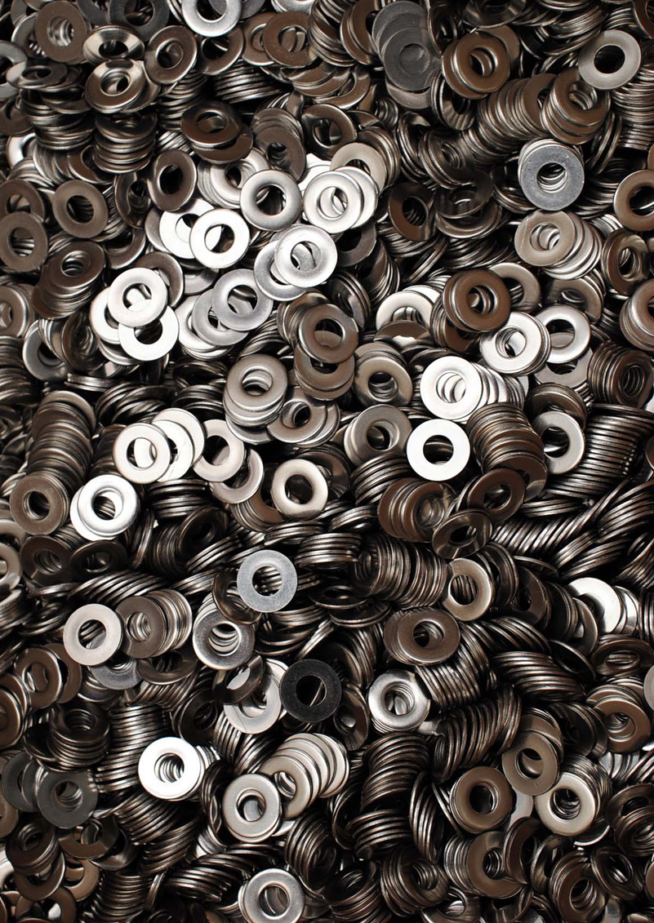
1.4 - Washers, Retaining Hardware, and Staples
In this section we’ll review what washers are, what retaining hardware is and does, and briefly review staples.
Notes:
INSTRUCTIONAL ACTIVITY: Give Direction
TIME: 1 min.
TALKING POINTS: In this section we’ll review what washers are, what retaining hardware is and does, and briefly review staples.

Slide 48
As we review this section, please take a look at these washers as they are passed around the room.
Notes:
Instructional Activity: Provide Learning Guidance
Instructional Time: 1 min.
Materials:
A plastic bag labeled “Washers” that contains one of each of the following: Flat, Fender, Star, Nord-Lock
Do:
Pass the bag of washers around the room for learners to examine.
Talking Points:
While we review, take a look at the washers I am passing around the room.

Slide 49
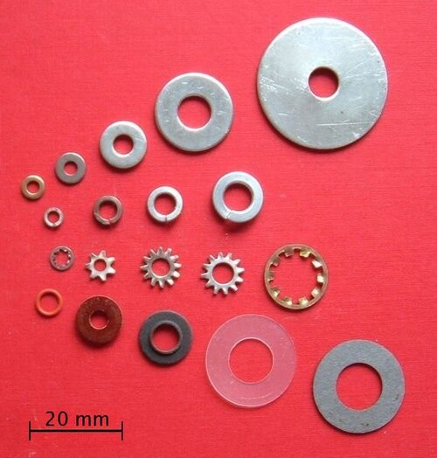
Washers
A washer is a thin plate with a hole in the center that is used with bolts, screws, and nuts.
Help distribute clamping force across a larger surface area
Designed to help resist loosening caused by vibration.
Available in a variety of materials to meet different strengths
Notes:
Instructional Activity: Present Content
Instructional Time: 2 min.
Talking Points:
A washer is a simple but important fastener component that is typically used with a bolt, screw, or nut.
One of its primary functions is to distribute the clamping force over a larger surface area. This helps reduce damage to the material being fastened and creates a more secure connection.
Depending on the application, some washers are also designed to help resist loosening caused by vibration or movement.
Washers are manufactured from a variety of materials, including steel, brass, silicon bronze, stainless steel, and alloy steel.
The material is selected based on the strength required and the environment in which the fastener will be used.
To improve performance, some washers are heat treated, coated, or specially treated to increase durability or provide additional protection against corrosion in environments such as fresh water or salt water.
Now that we've discussed the purpose of washers, let's look at some of the most common washer types and when each should be used.

Slide 50
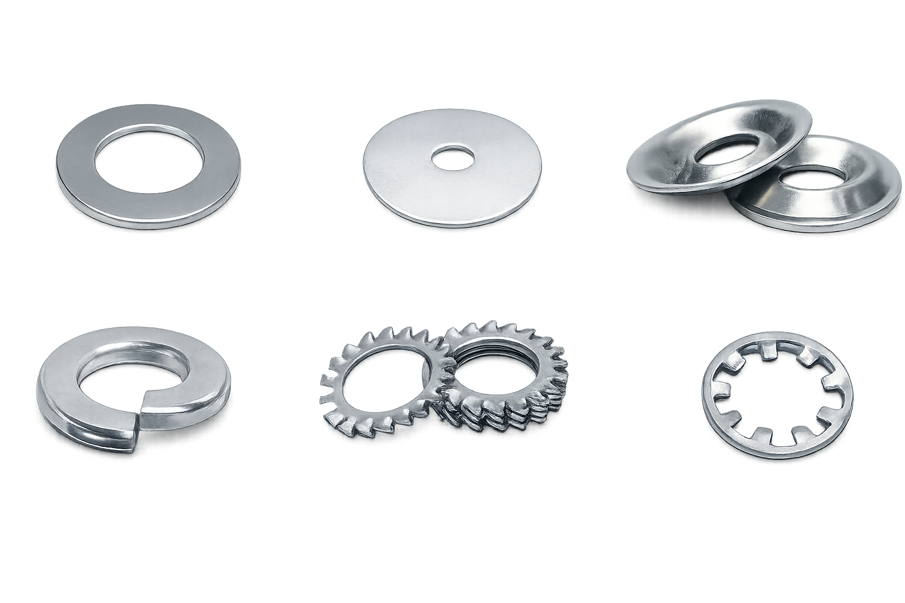
Flat Washers
Flat Washers
Evenly distribute the load beyond the diameter of the bolt head
Prevents bolt from slipping through hole
Fender Washer
An oversized flat washer
Distributes load even further
Good for soft materials
Notes:
Instructional Activity: Present Content
Instructional Time: 2 min.
Talking Points:
Now that we've discussed the purpose of washers, let's look at some of the most common washer types and when each should be used.
Flat washers are the most commonly used type of washer.
Their primary purpose is to distribute the clamping force over a larger surface area, helping protect the material being fastened and creating a more secure connection.
Flat washers can also help prevent the bolt or nut from pulling through oversized or worn holes, especially when fastening thinner materials.
Fender washers are a type of flat washer with a much larger outside diameter. The larger surface area distributes the load even farther than a standard flat washer.
Because they spread the force over a wider area, fender washers are commonly used with soft or thin materials, such as sheet metal, plastic, fiberglass, or wood, where additional support is needed.
Selecting the appropriate washer helps improve the strength, durability, and reliability of the fastened joint.

Slide 51
Split Lock Washers
Helical shape helps maintain tension in a fastened joint
Helps resist loosening caused by vibration
Helps maintain clamping force during minor thermal expansion and contraction
Notes:
Instructional Activity: Present Content
Instructional Time: 2 min.
Talking Points:
Split lock washers have a unique helical shape that acts like a spring when compressed between the bolt head or nut and the material being fastened.
As the bolt is tightened, the washer helps maintain tension in the joint, making it more resistant to loosening.
Split lock washers are commonly used in applications where vibration could cause a bolt or nut to gradually back off over time.
They can also help maintain clamping force when materials expand and contract due to normal temperature changes.
While split lock washers can improve the reliability of a fastened joint, they should always be used in accordance with the manufacturer's specifications and are not a substitute for proper bolt torque.

Slide 52
Star Washers
Also known as serrated or toothed washers.
Toothed edges increase grip by biting into the mating surface.
Help resist loosening caused by vibration.
Available with internal or external teeth.
Notes:
Instructional Activity: Present Content
Instructional Time: 2 min.
Talking Points:
Star washers are another type of lock washer designed to help resist fastener loosening caused by vibration.
They're also commonly referred to as serrated washers or toothed washers because of the teeth around their edge.
As the bolt or nut is tightened, the teeth bite into the mating surface. This increases friction and grip, helping the fastener resist loosening during normal operation.
Star washers are available with either internal teeth, which are located around the inside diameter of the washer, or external teeth, which extend around the outside edge.
The choice between internal and external teeth depends on the application, the amount of gripping force needed, and whether the washer should remain less visible after installation.

Slide 53
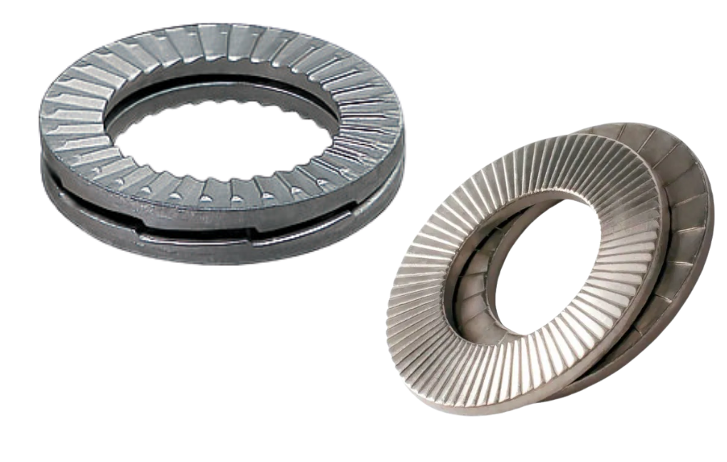
Nord-Lock Washers
Also known as serrated or toothed washers.
Toothed edges increase grip by biting into the mating surface.
Help resist loosening caused by vibration.
Available with internal or external teeth.
Notes:
Instructional Activity: Present Content
Instructional Time: 2 min.
Talking Points:
Nord-Lock washers are designed for applications where vibration, dynamic loads, or movement could cause a bolted joint to loosen.
Unlike traditional lock washers, Nord-Lock washers help maintain the tension in the bolted joint rather than relying only on friction to keep the fastener secure.
The system consists of two washers that are used together. One side of each washer has cams, while the opposite side has radial teeth.
When the bolt is tightened, the radial teeth grip the mating surfaces while the cams work together to help maintain bolt tension if the joint begins to loosen.
Because they are highly effective in demanding environments, Nord-Lock washers are commonly used in heavy equipment, rail applications, and other industries where maintaining a secure bolted joint is critical.

Slide 54
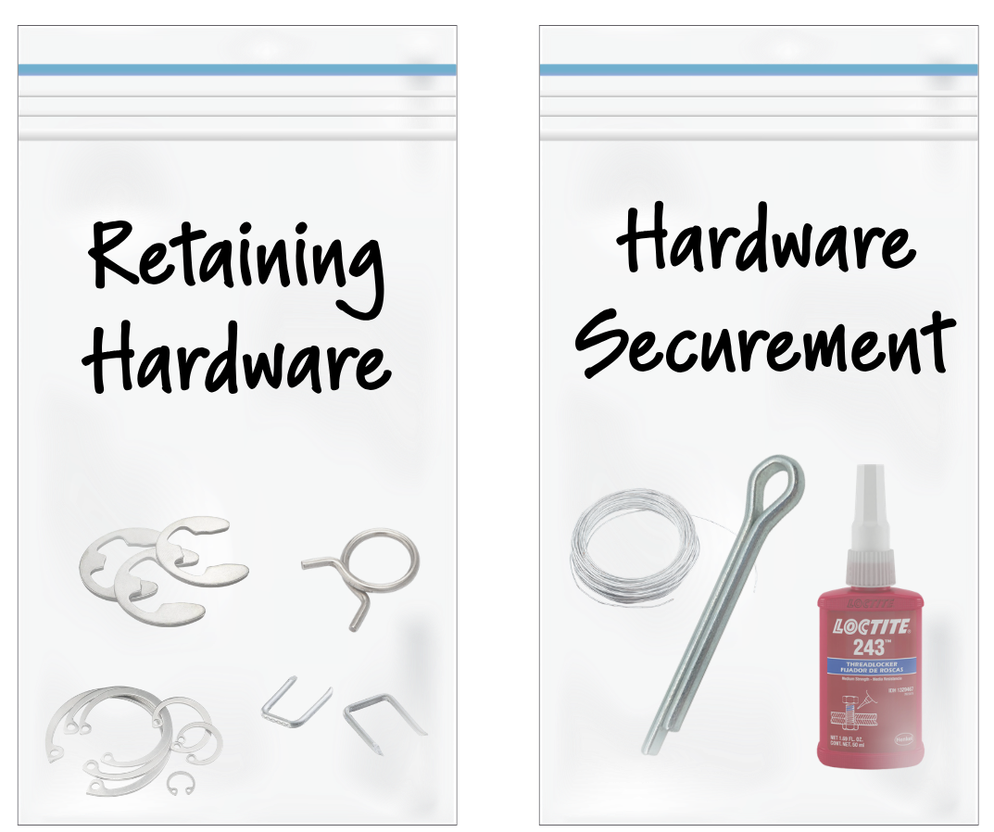
As we review this section, please take a look at these washers as they are passed around the room.
Notes:
Instructional Activity: Provide Learning Guidance
Instructional Time: 1 min.
Materials:
A plastic bag labeled “Retaining Hardware” that contains one of each of the following: Spring Clips, E-Clips/C-Clips, Snap Rings, Staples
A plastic bag labeled “Hardware Securement” that contains one of each of the following: Cotter Pins, Safety Wire, Thread Locker
Do:
Pass each bag around the room for learners to examine.
Talking Points:
Next, we’ll talk about a variety of retaining hardware and hardware securement options.
While we review, take a look at the washers I am passing around the room.

Slide 55


Hardware Securement: Cotter Pins
Used with a castellated nut and a drilled bolt or shaft
Inserted through the nut slots and the hole in the bolt or shaft
Ends are bent to create a secure mechanical lock
Helps prevent the nut from loosening in critical applications.
Cotter Pin
Hairpin Cotter
Notes:
Instructional Activity: Present Content
Instructional Time: 2 min.
Talking Points:
Cotter pins are used in applications where a nut coming loose could create a serious safety hazard.
They're typically used with a castellated nut and a bolt or threaded shaft that has a hole drilled through it.
After the nut is tightened, the cotter pin is inserted through the slots in the nut and the hole in the bolt or shaft.
The ends of the cotter pin are then bent in opposite directions to create a simple mechanical locking system that helps keep the nut from rotating or backing off.
A hair-pin cotter does not require a bending too and uses a spring tension design for fast, tool-free removal and reuse.
Cotter pins are inexpensive, reliable, and commonly found on components such as tie rod ends, wheel spindles, axles, and other safety-critical mechanical assemblies.

Slide 56

Hardware Securement: Safety Wire
Used to help prevent fasteners from loosening in safety-critical applications
Installed through a pre-drilled hole in a bolt or nut
Twisted wire creates a secondary mechanical restraint
Commonly used where vibration is expected.
Notes:
Instructional Activity: Present Content
Instructional Time: 2 min.
Talking Points:
Safety wire is another method of preventing fasteners from loosening in critical applications.
Instead of relying on friction or spring tension, safety wire creates a physical restraint that helps prevent the bolt or nut from rotating.
The wire is threaded through a pre-drilled hole in the bolt head or nut and then twisted securely before being anchored to another fastener or a fixed point.
If the fastener begins to rotate, the wire immediately resists that movement, helping keep the assembly secure.
Safety wire is commonly used in aviation, motorsports, heavy equipment, and other industries where fastener failure could have serious consequences.

Slide 57

Video
Click the image to watch a demonstration of a safety wire installation.
Notes:
Instructional Activity: Provide Guided Learning
Instructional Time: 5 min.
Do: Click the image to play the video demonstration.
Talking Points:
In this video, we’ll see how safety wire is installed.
Video Link: https://vimeo.com/1231646556/10118150fd?share=copy&fl=sv&fe=ci

Slide 58

Hardware Securement: Thread Locker
Liquid adhesive applied to fastener threads before assembly
Hardens after installation to help resist loosening
Available in different strength grades identified by color
Cure time ranges from 10 minutes to 24 hours, depending on the product.
Notes:
Instructional Activity: Present Content
Instructional Time: 2 min.
Talking Points:
Thread locker is a liquid adhesive that's applied to the threads of bolts, screws, and other threaded fasteners before assembly.
After the fastener is installed, the material cures and hardens, helping resist loosening caused by vibration while also sealing the threads against moisture and corrosion.
Loctite® is one of the best-known brands of thread locker, and the brand name is often used generically throughout the industry to describe thread-locking compounds.
Thread lockers are available in several strength grades. Keep in mind that the color of the bottle or tube does not always indicate the color or strength of the thread locker inside, so always verify the product number and specifications before use.
Depending on the product, curing can take anywhere from about 10 minutes to 24 hours.
The chart on this slide shows how thread locker strength affects the torque required to loosen a fastener after it has cured. It lists the fastener size, the breakaway torque required to start loosening the fastener, and the prevail torque required to continue turning it after it begins to move.
Transition: Cotter pins, safety wire, and thread lockers are all examples of secondary retention methods that help keep critical fasteners secure in demanding operating conditions.
Source: Henkel Adhesives Technologies. (n.d.). LOCTITE® threadlocker product range. Try Loctite India. https://www.tryloctite.in/infographics/product-category/loctite-threadlocker-product-range

Slide 59

Retaining Hardware
Holds components together when nuts and bolts are not practical
Often allows parts to rotate or pivot while secured
Uses spring tension, grooves, or locking features
Common types include: Spring Clips, C-Clips (E-Clips), Snap Rings, Staples
Notes:
Instructional Activity: Present Content
Instructional Time: 2 min.
Talking Points:
Retaining hardware serves a different purpose than threaded fasteners.
Instead of clamping two parts together with a bolt and nut, retaining hardware keeps components from sliding apart while still allowing movement when needed.
Many retaining devices rely on spring tension, grooves, or specially designed locking features to hold components securely in place.
You'll commonly find retaining hardware in bearings, shafts, wheels, linkages, and other assemblies where components need to rotate or pivot.
Throughout this section, we'll look at several common types of retaining hardware and discuss where each is used.

Slide 60

Spring Clips
Broad family of retaining hardware
Bent metal fasteners with spring tension
Holds components without threaded fasteners
Common applications include:
  Hoses
  Body panels
  Upholstery
Notes:
Instructional Activity: Present Content
Instructional Time: 2 min.
Talking Points:
Spring clips are not one specific fastener—they're a broad family of retaining hardware designed for different applications.
They're made from spring steel and use the natural spring force of the metal to grip or retain a component.
You'll commonly find them securing hoses, body panels, trim pieces, upholstery, wiring, and other components that may need to be removed for maintenance.
Spring clips provide a simple, reliable fastening method without requiring threads, nuts, or bolts.

Slide 61
C-Clip/E-Clip
A specialized Spring Clip that snaps into a groove on a shaft
Compact design for limited-space applications
Allows parts to rotate or pivot while remaining retained
Installed and removed using retaining clip pliers
Notes:
Instructional Activity: Present Content
Instructional Time: 2 min.
Talking Points:
One specialized type of spring clip is the C-clip, which is designed to retain parts on a shaft.
C-clips, often called E-clips because of their shape, are designed to snap into a groove machined into a shaft.
Once installed, they prevent components from sliding off the shaft while still allowing them to rotate or pivot freely.
Their compact design makes them a good choice when space is limited, and a low-profile retaining device is needed.
Because they're spring-loaded, special retaining clip pliers or removal tools are typically used to install and remove them safely.
You'll commonly find C-clips on linkages, control mechanisms, and other assemblies where lightweight component retention is required.

Slide 62
Snap Ring
Designed for higher-load retaining applications
Installed in grooves on shafts or inside housings
Available as internal or external snap rings
Installed and removed using snap ring pliers
Notes:
Instructional Activity: Present Content
Instructional Time: 2 min.
Talking Points:
Snap rings perform the same basic function as C-clips by preventing components from sliding off a shaft or out of a housing.
However, they're generally used in applications that require greater holding strength or where more space is available for installation.
Snap rings are available in two common styles. External snap rings fit into grooves on the outside of a shaft, while internal snap rings fit into grooves inside a bore or housing.
Like C-clips, they're installed and removed with special snap ring pliers designed to safely expand or compress the ring.
You'll commonly find snap rings in bearings, transmissions, gearboxes, electric motors, and axle assemblies where reliable component retention is essential.
We've now covered several common types of retaining hardware. Next, we'll look at staples and other specialized fastening components used in mechanical applications.

Slide 63

Staples
U-shaped fasteners with squared corners
Driven into materials using a staple gun
Available in various sizes, lengths, and wire gauges
Commonly used to secure non-structural materials, such as upholstery, fabric, insulation, and trim
Notes:
Instructional Activity: Present Content
Instructional Time: 2 min.
Talking Points:
Most people are familiar with staples from office staplers, but mechanical staples are much larger and stronger.
A staple is a thin piece of metal bent into a U-shape with pointed legs that are driven into a material to hold it securely in place.
Staples are available in a variety of sizes, lengths, and wire gauges to match different materials and applications.
They're commonly used to attach upholstery, carpeting, insulation, fabric, and other non-structural materials to wood or composite surfaces.
A staple gun drives the staple into the material with enough force to securely anchor it. Staple guns may be manual, electric, battery-powered, or pneumatic, depending on the application.
Although staples are quick and effective for securing lightweight materials, they are not intended for structural or load-bearing applications.

Slide 64
Knowledge Check
What is the primary purpose of a flat washer?
(B). To distribute the clamping force over a larger surface area
(A). To permanently lock a bolt in place
(B). To distribute the clamping force over a larger surface area
(C). To increase the length of the bolt
(D). To replace a lock nut and increase tension
Notes:
*This slide contains animations. CLICK to reveal content.
Instructional Activity: Evaluate/Assess Performance, Provide Feedback
Instructional Time: 3 min.
Learning Objective: Identify the various types of fasteners and explain their purpose, including screws, nuts, bolts, washers, staples, retaining hardware, and miscellaneous hardware.
Do: Review the knowledge check question. Call on learners to share their responses.
Answer:
B - Flat washers spread the clamping force over a larger area, helping protect the material and create a more secure connection.

Slide 65
Knowledge Check
Which type of retaining hardware is installed in a groove on a shaft to keep a component from sliding off while still allowing it to rotate?
(A). Spring Clip
(B). Staple
(C). C-Clip
(D). Split-Lock Washer
(C). C-Clip
Notes:
*This slide contains animations. CLICK to reveal content.
Instructional Activity: Evaluate/Assess Performance, Provide Feedback
Instructional Time: 3 min.
Learning Objective: Identify the various types of fasteners and explain their purpose, including screws, nuts, bolts, washers, staples, retaining hardware, and miscellaneous hardware.
Do: Review the knowledge check question. Call on learners to share their responses.
Answer:
C - C-clips (E-clips) fit into a groove on a shaft to retain components while allowing them to rotate or pivot.

Slide 66
Knowledge Check
A mechanic is replacing a fastener on equipment that is regularly exposed to rain and road salt. Which fastener material would be the best choice?
(A). Plain Carbon Steel
(B). Magnesium
(C). Stainless Steel
(C). Stainless Steel
(D). Copper
Notes:
*This slide contains animations. CLICK to reveal content.
Instructional Activity: Evaluate/Assess Performance, Provide Feedback
Instructional Time: 3 min.
Learning Objective: Explain the advantages and disadvantages of fastener materials.
Do: Review the knowledge check question. Call on learners to share their responses.
Answer:
C – Stainless steel offers excellent corrosion resistance, making it a good choice for outdoor or wet environments. Material selection should always consider the application's strength, weight, and environmental conditions.

Slide 67
Knowledge Check
A mechanic needs to secure vehicle upholstery to a wooden seat frame. Which fastener is the best choice?
(A). Snap Ring
(B). Thread Locker
(C). Star Washer
(D). Staple
(D). Staple
Notes:
*This slide contains animations. CLICK to reveal content.
Instructional Activity: Evaluate/Assess Performance, Provide Feedback
Instructional Time: 3 min.
Learning Objective: Identify the various types of fasteners and explain their purpose, including screws, nuts, bolts, washers, staples, retaining hardware, and miscellaneous hardware.
Do: Review the knowledge check question. Call on learners to share their responses.
Answer:
D - Staples are commonly used to attach upholstery, fabric, insulation, and other non-structural materials to wood or composite surfaces.

Slide 68
Summary and What’s Next
Washers improve fastener performance by distributing load and helping resist loosening.
Retaining hardware secures components while allowing movement when needed.
Staples provide a quick method for fastening non-structural materials.
Selecting the appropriate hardware improves the safety, reliability, and performance of a mechanical assembly.
Next, we’ll explore fastener applications in transit maintenance.
Notes:
*This slide contains animations. CLICK to reveal content
Instructional Activity: Enhance Retention and Transfer
Instructional Time: 5 min.
Do:
Review the key takeaways from this section of the module.
Clearly explain how to connects to the next section of the module.
Talking Points:
Ask: What are the most important things we learned in this section?
Call on learners to respond.
In this section, we explored several types of hardware that support or enhance traditional fasteners.
CLICK - We learned that washers perform a variety of functions, including distributing clamping force, helping resist loosening, and maintaining bolt tension in demanding applications.
CLICK - We also discussed retaining hardware, such as spring clips, C-clips, snap rings, cotter pins, safety wire, and thread lockers, which are used to keep components securely in place when threaded fasteners alone aren't sufficient.
CLICK - Finally, we looked at staples, which provide a quick and effective method for attaching non-structural materials like upholstery, insulation, and trim.
One of the key takeaways from this section is that the right hardware depends on the application. Understanding the purpose of each component helps ensure fasteners remain secure, reliable, and easy to maintain.
CLICK - Next, we’ll take a look at how fasteners are used specifically in transit maintenance.

Slide 69

1.5 – Applications for Fasteners in Transit Maintenance
This section examines the role of fasteners in transit vehicle maintenance.
Notes:
INSTRUCTIONAL ACTIVITY: Give Direction
TIME: 1 min.
TALKING POINTS: This section examines the role of fasteners in transit vehicle maintenance.

Slide 70
Common Fasteners and Their Use
Fastener | Purpose | Example
Screw | Join parts | Secure interior panels
Nut & Bolt | Clamp components | Secure flooring, brackets, and equipment (e.g., heat exchangers)
Washer | Distribute load | Distribute load in wheel assemblies
Cotter Pin | Prevent nut rotation | Lock tie rod ends and axle components
Spring Clip | Retain components | Secure fuel lines and wiring
E-Clip | Retain shafts/pins | Retain door linkage and pivot pins
Notes:
Instructional Activity: Present Content
Instructional Time: 2 min.
Talking Points:
This table brings together some common examples and shows where you might encounter them in bus and rail maintenance.
Note that there isn't a single fastener that's used for every job. Each application has its own requirements based on factors like strength, vibration, movement, accessibility, and the materials being joined.
For example, you may remove screws to access interior panels during routine inspections, replace nuts and bolts when installing flooring or mounting equipment, or work with washers anytime a bolted connection requires proper load distribution.
You'll also encounter retaining hardware during maintenance tasks. Cotter pins are commonly found on steering and axle components, spring clips are used to secure fuel lines and wiring, and E-clips are often used to retain door linkage and other pivoting components.
As you gain experience in the shop, you'll begin to recognize these fasteners and understand why each one was selected for a particular application.

Slide 71
Selecting the Right Fastener
Selecting the correct fastener helps ensure a safe, reliable, and long-lasting repair.
Consider the following when choosing a fastener:
  Strength
  Torque Requirements
  Thread Locker
  Replacement Options
Notes:
Instructional Activity: Present Content
Instructional Time: 2 min.
Talking Points:
Choosing the right fastener is just as important as installing it correctly.
Using the wrong fastener can lead to premature wear, corrosion, loose components, or even mechanical failure.
When selecting a fastener, first consider its strength. Using a lower-grade fastener than specified can cause it to break under load.
Next, think about material compatibility. Some metals react with one another and can accelerate corrosion, while others may not provide the durability needed for the environment.
It's also important to understand the torque requirements for the fastener. Some fasteners are designed to be tightened to a specific torque, while others may have torque-to-yield specifications that require replacement after removal.
If a thread-locking compound is required, select the correct strength for the application. Keep in mind that some thread lockers are designed to be removable, while others create a much more permanent bond.
Finally, if the original fastener is unavailable, only use an approved replacement or alternative that meets the manufacturer's requirements. Substituting the wrong fastener can compromise the safety and reliability of the repair.

Slide 72

Fastener Identification
Directions – Label the following fasteners using the word bank below.
Try to complete this activity without looking back at your notes.
Notes:
Instructional Activity: Provide Guided Learning, Elicit Performance, Provide Feedback
Instructional Time: 10 min.
Materials:
Fastener Identification_Fasteners
Do:
(2 min.)
Refer learners to the “Fastener Identification” handout embedded in the Participant Resource Guide.
Review the directions and answer any questions learners may have.
(8 min.)
Give learners time to answer the questions.
Circulate the classroom to answer questions, provide feedback, and assess learner understanding.
Note – You will review the answers as a class on the next two slides.

Slide 73


Fastener Identification
3. ) Flat Washer
) Hex Nut
5. ) Self-Drilling Screw
2. ) Bolt
4. ) Anti-Tamper Screw
Notes:
*This slide contains animations. CLICK to reveal content.
Instructional Activity: Provide Guided Learning, Elicit Performance, Provide Feedback
Instructional Time: 5 min.
Materials:
Fastener Identification_Fasteners
Do:
Call on learners to share their answer AND provide an example of how this fastener could be used on the job.
CLICK to reveal the answers on the slide.
Provide feedback and revisit topics to clarify understanding if needed.
Answer Key:
Hex Nut
Bolt
Flat Washer
Anti-Tamper Screw
Self-Drilling Screw

Slide 74



Fastener Identification
6. ) Torx Screw
8. ) Phillips Head Screw
10. ) Cotter Pin
7. ) Castellated Nut
9. ) Snap Ring
Notes:
*This slide contains animations. CLICK to reveal content.
Instructional Activity: Provide Guided Learning, Elicit Performance, Provide Feedback
Instructional Time: 5 min.
Materials:
Fastener Identification_Fasteners
Do:
Call on learners to share their answer AND provide an example of how this fastener could be used on the job.
CLICK to reveal the answers on the slide.
Provide feedback and revisit topics to clarify understanding if needed.
Answer Key:
6.Torx-Screw
7. Castellated Nut
8. Phillips Head Screw
9. Snap Ring
10. Cotter Pin

Slide 75
Knowledge Check
A transit mechanic is reinstalling an interior access panel after performing routine maintenance. Which fastener is most commonly used for this application?
(A). Machine Screw
(A). Machine Screw
(B). Spring Pin
(C). Cotter Pin
(D). Snap Ring
Notes:
*This slide contains animations. CLICK to reveal content.
Instructional Activity: Evaluate/Assess Performance, Provide Feedback
Instructional Time: 3 min.
Learning Objective: Recognize common applications for fasteners.
Do: Review the knowledge check question. Call on learners to share their responses.
Answer:
A - Machine screws are commonly used to secure interior panels and covers because they provide a reliable, removable connection for routine inspection and maintenance.

Slide 76
Knowledge Check
During an inspection, a mechanic removes a cotter pin from a tie rod end to replace the steering component. Why is the cotter pin used in this application?
(A). To distribute the load across the joint
(B). To increase the bolt’s strength
(C). To prevent the castellated nut from loosening or rotating
(C). To prevent the castellated nut from loosening or rotating
(D). To seal the threads from moisture
Notes:
*This slide contains animations. CLICK to reveal content.
Instructional Activity: Evaluate/Assess Performance, Provide Feedback
Instructional Time: 3 min.
Learning Objective: Recognize common applications for fasteners.
Do: Review the knowledge check question. Call on learners to share their responses.
Answer:
C - Cotter pins are commonly used on steering and axle components to help prevent a castellated nut from loosening due to vibration, helping maintain a safe and secure connection.

Slide 77

Quiz
Time for a quiz! Let’s see what you have learned from today’s lesson.
Notes:
Instructional Activity: Direction, Evaluate/Assess Performance
Instructional Time: 20 min.
Materials: Quiz_Fasteners
Do:
Ask learners if they have any lingering questions. Address them before distributing the quiz.
Pass out the quiz and review the directions.
Talking Points:
Time for a quiz! Let’s see what you have retained from today’s lesson.

Slide 78
Revisiting Objectives
Identify the various types of fasteners and explain their purpose, including screws, nuts, bolts, washers, staples, retaining hardware, and miscellaneous hardware.
Explain the advantages and disadvantages of fastener materials.
Recognize common applications for fasteners.
Notes:
Instructional Activity: Enhance Transfer and Retention
Instructional Time: 5 min.
Do: Facilitate a short discussion to review the key topics in the lesson.
Talking Points:
If you were explaining today’s objectives to someone else, how would you summarize what they mean and why they matter?
Which of today’s objectives do you feel most confident about? Which were most challenging? Explain your reasoning.
Can you give an example of how you could apply one of today’s objectives in a real-world situation?
After Discussion:
This conclude this section of the module. Thank you for your participation.

Slide 79
Thank you!
Notes:
Instructional Activity: Enhance Transfer and Retention
Instructional Time: 2 min.
Do:
Thank learners for their participation.
If possible, stay after class to answer any lingering questions learners may have.

