Slide 1


Instructor Guide Snapshot
Icon Key
Activity:
Video:
Instructor Demo:
Knowledge Check:
Instructional Time: 3 Hrs.
Preparation before class:
  Review all materials - Review all slides, talking points, and handouts before class to understand the structure and flow of the lesson. Pay special attention to animations within the slides.
  Slide 10 – Fill in slide to reflect your agency’s policies on use of calculator or personal device on the job.
Provided Course Materials:
  +Decimals_M3
  Place Value + Conversion Resource_M3
  Solving Equations with Decimals_M3
  Solving Equations with Decimals_Answer Key_M3
  Quiz_M3
  Quiz_Answer Key_M3
Additional Materials:
  One standard calculator per learner

Slide 2
Pacing Guide
Times have been rounded to the nearest .25 hours.
Total Time: 3 Hours
  (.5 Hrs.) Welcome and Warm Up
  (.5 Hrs.) 3.1 - Fundamentals of Decimals
  (.5 Hrs.) 3.2 – Adding and Subtracting Decimals
  (.5 Hrs.) 3.3 – Multiplying and Dividing Decimals
  (.5 Hrs.) 3.4 - Combine Operations with Decimal
  (.5 Hrs.) Quiz and Wrap Up

Slide 3
Decimals
Shop Math
Transit Core Competencies Curriculum (TC3)
Notes:
Instructional Activity: Direction
Instructional Time: 1 min.
Do: Welcome learners to class. Introduce the course and module.

Slide 4
Objectives
Demonstrate the ability to solve mathematics problems involving decimals.
  Convert between decimals and fractions to represent values in different forms.
  Solve addition and subtraction problems involving decimals.
  Solve multiplication and division problems involving decimals.
  Apply order of operations to solve multi-step problems involving decimals.
Notes:
Instructional Activity: Direction
Instructional Time: 1 min.
Do: Review the module objectives.

Slide 5

Agenda
Welcome and Intro
3.1 - Fundamentals of Decimals
3.2 – Adding and Subtracting Decimals
3.3 – Multiplying and Dividing Decimals
3.4 - Combine Operations with Decimal
Quiz and Wrap Up
Notes:
Instructional Activity: Direction
Instructional Time: 1 min.
Do:
Review the module agenda.
Remind learners that they have a Participant Guide Resource which they can use for optional notetaking.

Slide 6
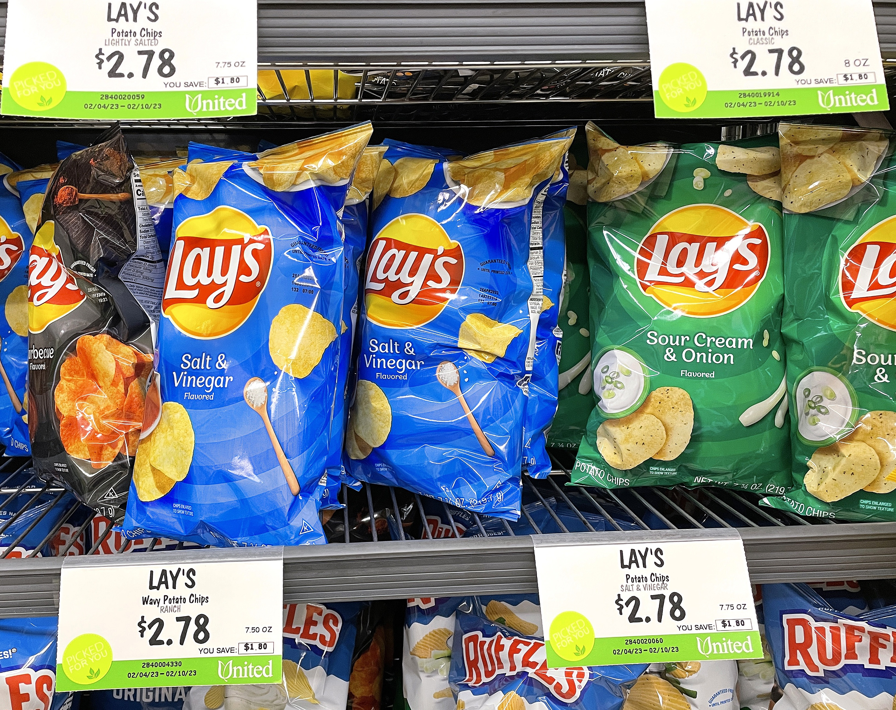
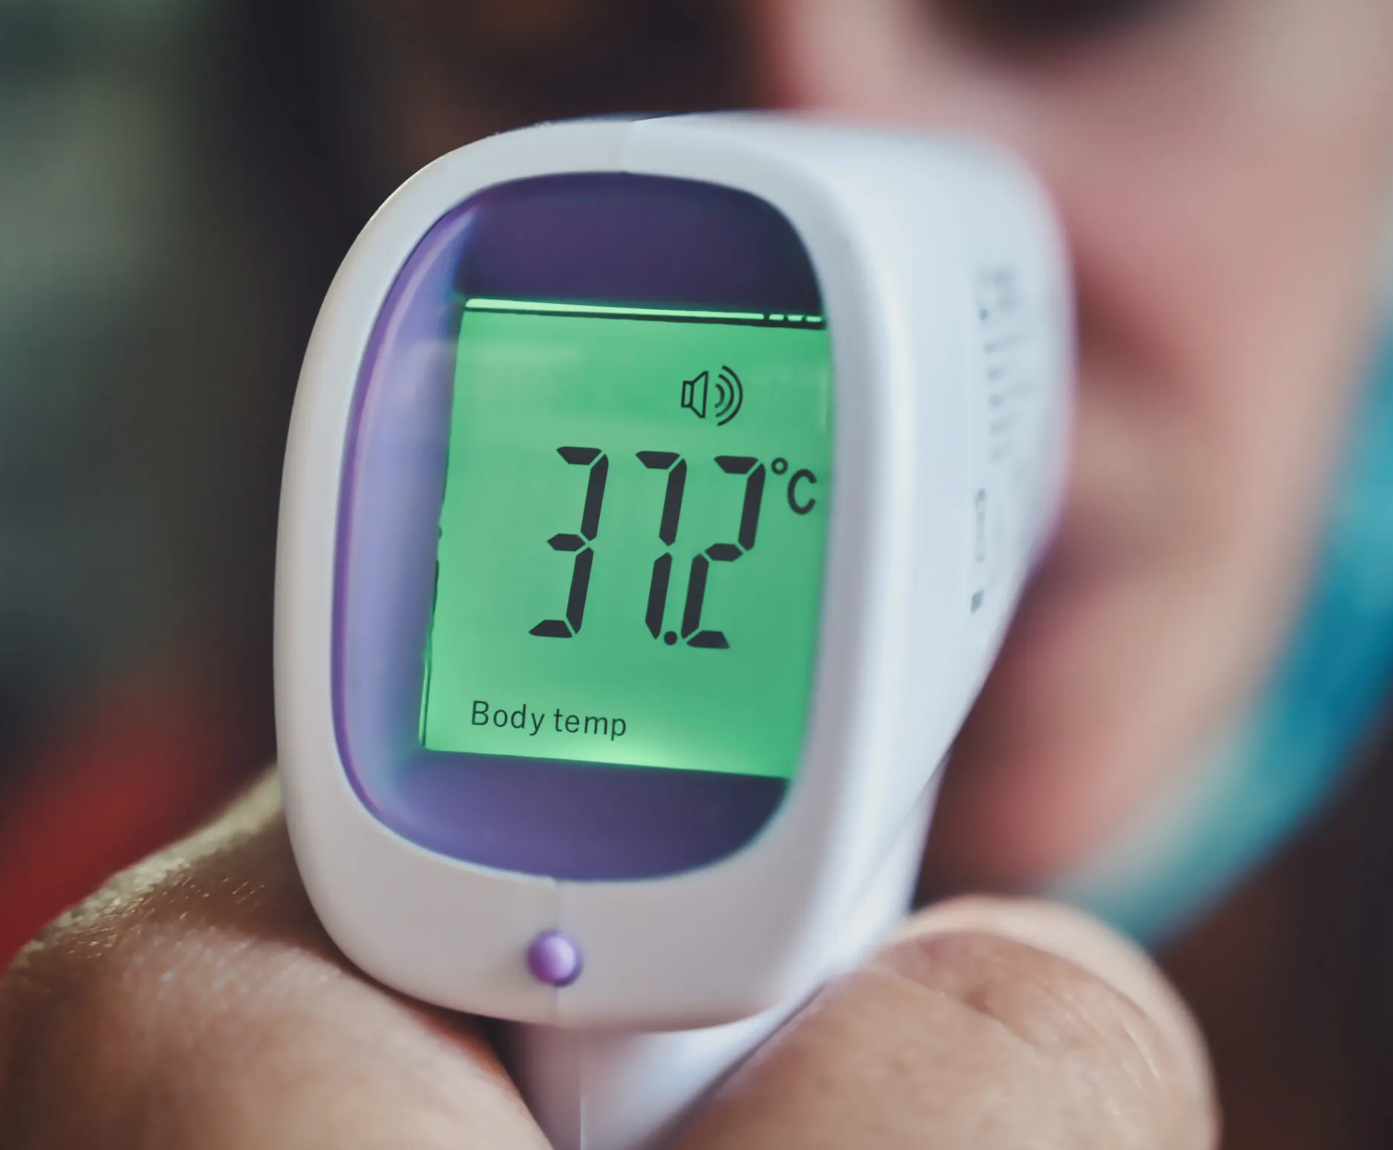
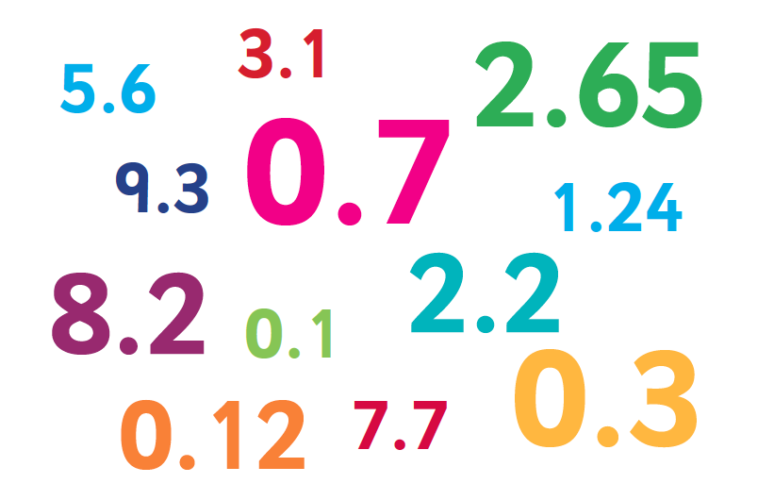
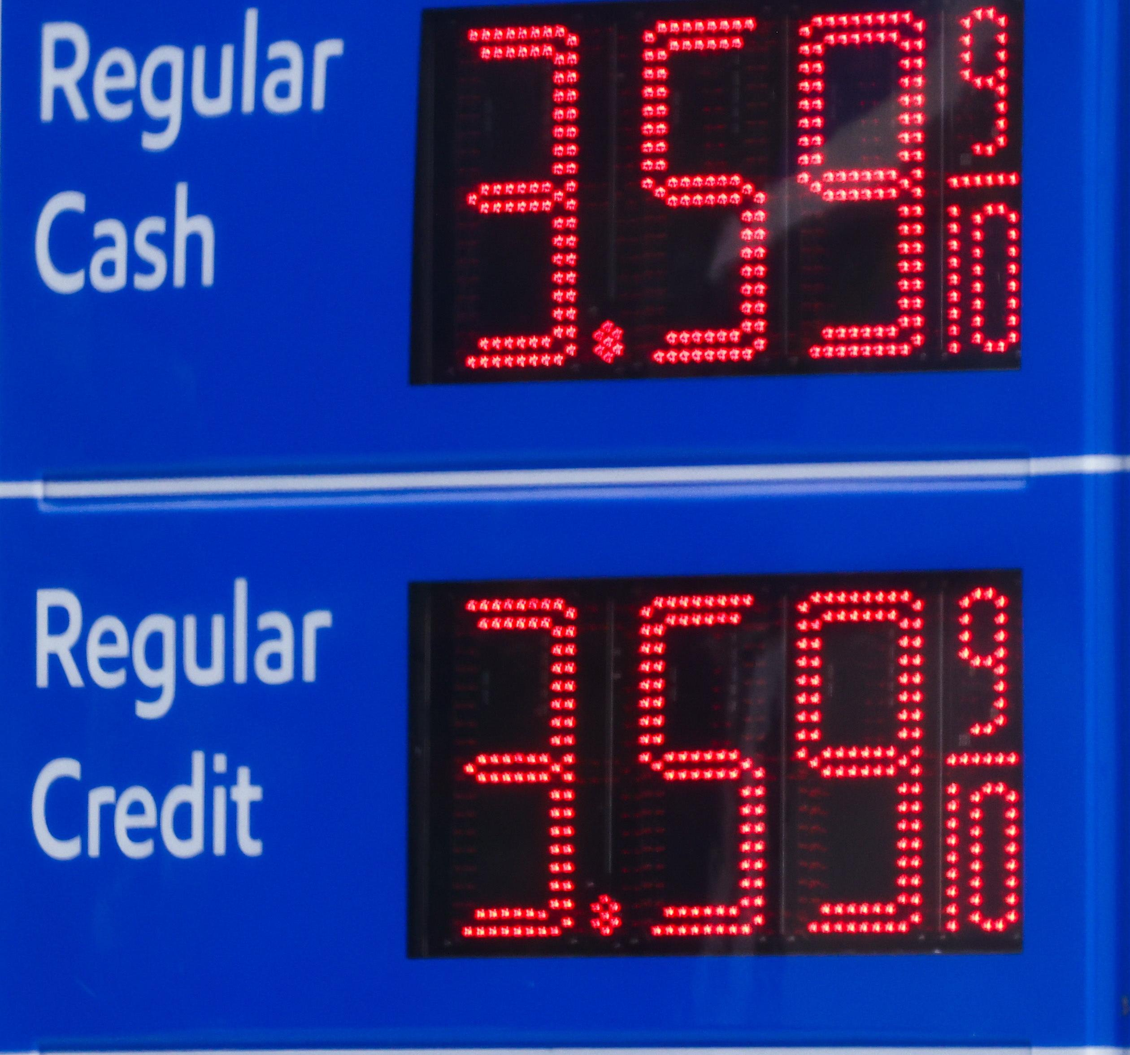
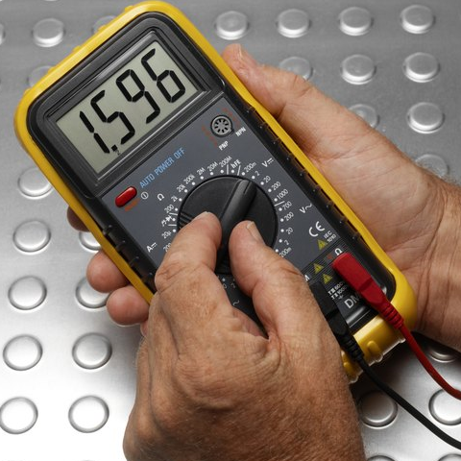
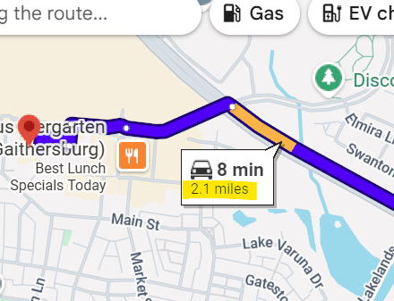
Warm Up
Where do you see decimals in everyday life?
Notes:
*This slide contains animations. CLICK to reveal content.
Instructional Activity: Gain Attention, Recall
Instructional Time: 5 min.
Talking Points:
Today we’ll be exploring decimals and how you will work with decimals on the job.
But decimals are all around us, not just in math problems
ASK: Where do you see decimals in everyday life?
Call on learners to respond.
CLICK – You may see decimals in the form of prices, like at the gas station or grocery store.
They are also used when expressing different kinds of measurements, like temperature or distance.
Many tools you will see in the shop also express measurements in decimals, such as the multimeter here showing a voltage reading.

Slide 7
The Importance of Decimals in the Shop
Accuracy
Precision
Decision Making
Notes:
*This slide contains animations. CLICK to reveal content.
Instructional Activity: Gain Attention
Instructional Time: 2 min.
Talking Points:
Decimals help us work with accuracy and precision on the job as we can be as exact as possible.
Even small decimal differences can lead to big issues, especially in measurements or electrical readings.
For example, a reading of 1.596 on a meter gives much more precise information than just rounding to 1.6.
Decimals also support better decision-making.
Technicians rely on precise values to determine if equipment is operating correctly or needs adjustment.
As you work, decimals help you measure correctly, troubleshoot problems, and make informed decisions

Slide 8
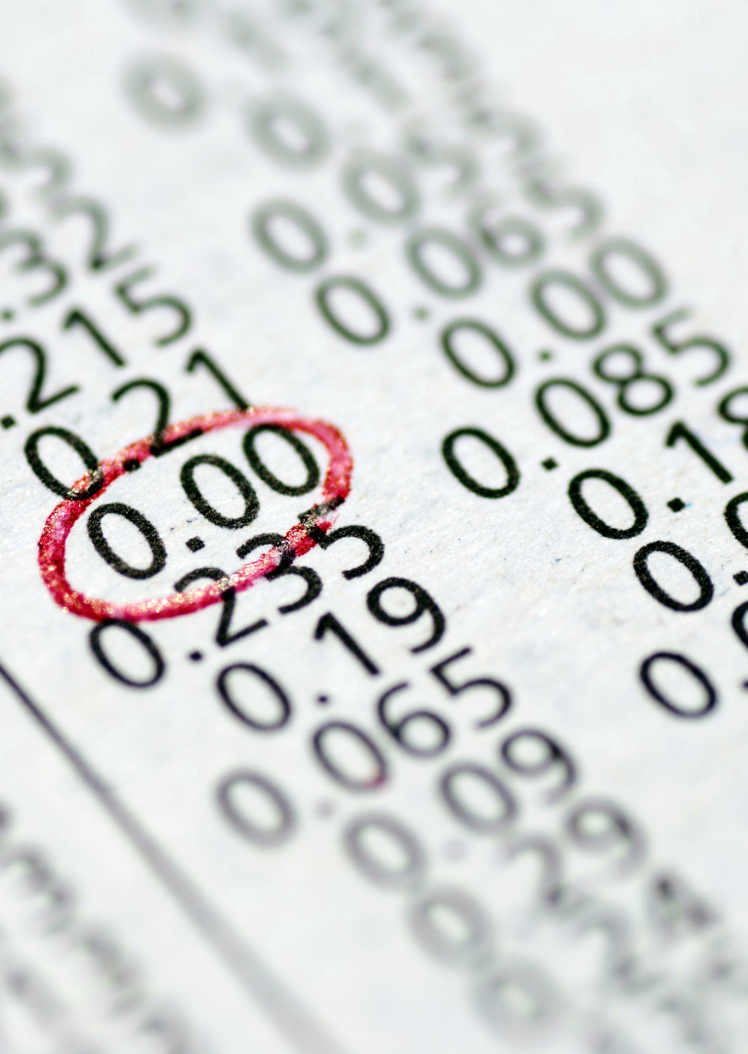
3.1 - Fundamentals of Decimals
In this section, we’ll review the basics of decimals including key terms, conversions, and real-life examples.
Notes:
Instructional Activity: Direction
Instructional Time: 1 min.
Do: Introduce the section.
Talking Points: In this section, we’ll review the basics of decimal fractions including key terms, conversions, and real-life examples.

Slide 9
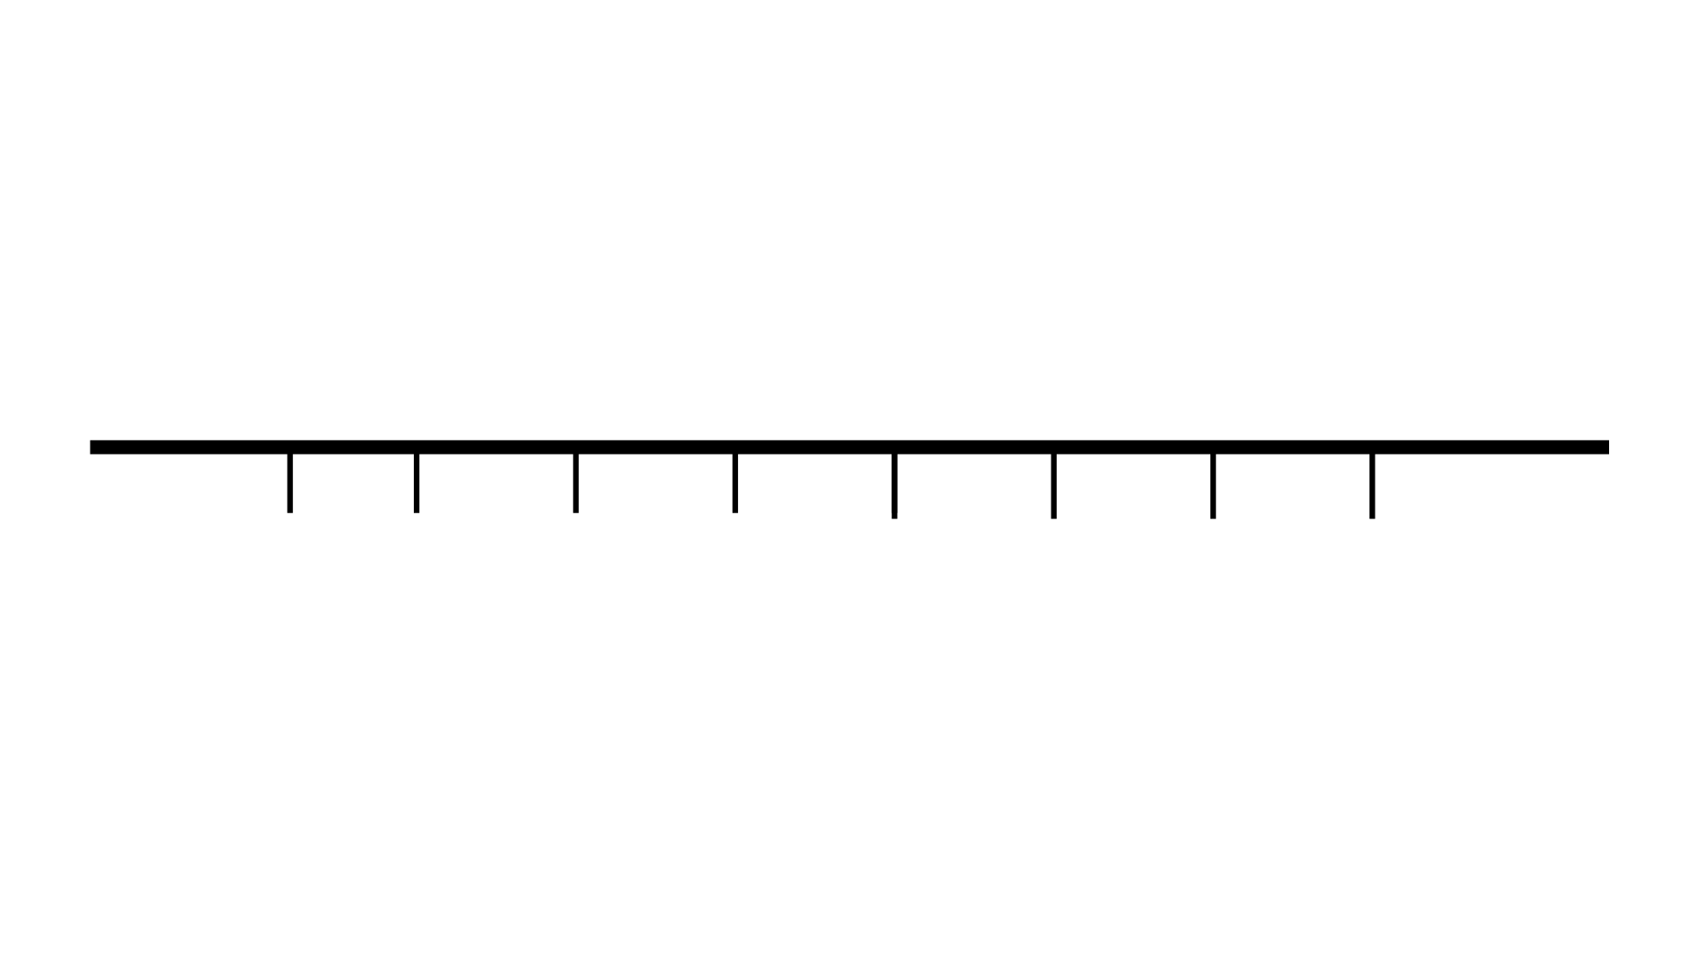
What is a Decimal?
A decimal is a number written with a decimal point where each digit has a place value.
These place values represent parts of a whole.
Decimal Point
Whole Numbers
Fractional Parts
1 2 5
Ten
Ones
Tenths
Thousand
Hundred
Hundredths
Thousandths
Notes:
*This slide contains animations. CLICK to reveal content.
Instructional Activity: Present Content
Instructional Time: 2 min.
Materials: Place Value + Conversion Resource_M3
Do:
Direct learners to the “Place Value + Conversion Resource_M3” embedded in their Participant Resource Guide. This will serve as a useful reference throughout the lesson.
Talking Points:
A decimal is a number written with a decimal point where each digit has a place value.
These place values represent parts of a whole.
The decimal point separates whole numbers from fractional parts.
CLICK - Everything to the left of the decimal is a whole number.
In the number 12.5, 12 is a whole number. The one is in the “Tenths” place value, while the 2 is the in “Ones” place value.
CLICK - Everything to the right represents smaller parts of a whole. Each position after the decimal gets smaller as you move to the right.
For example, in 12.5, 5 represents part of a whole.
This is how we show values that are not whole numbers, like measurements or readings.

Slide 10
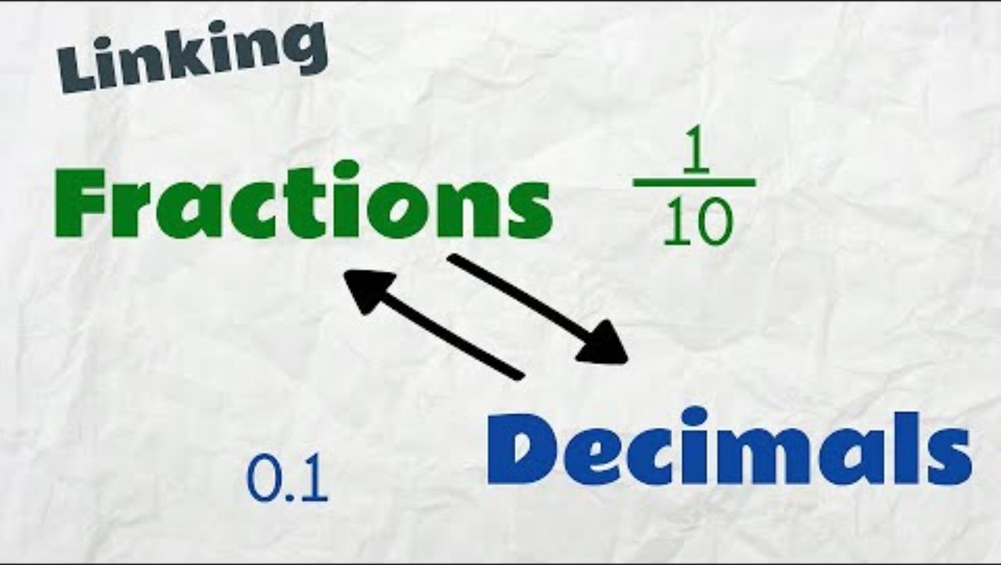
Linking Fractions and Decimals
Notes:
Instructional Activity: Present Content, Provide Learning Guidance
Instructional Time: 6 min.
Materials:
Video Link: https://www.youtube.com/watch?v=mDh1M4bEIbA
Do:
Play the video.
Pause at 4:02 – Complete the practice problems as a group.
Pause at 4:54 – Complete the practice problems as a group.
Talking Points:
Let’s take a closer look at the relationship between fractions and decimals to better understand the meaning of place values.

Slide 11

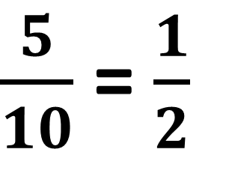



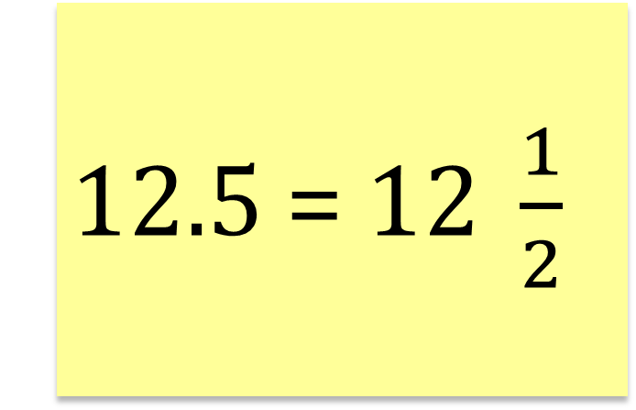
Linking Fractions and Decimals
$\frac{5}{10}$ = $\frac{1}{2}$
12.5 = $12 \frac{1}{2}$
1 2 5
Ten
Ones
Tenths
Hundred
Hundredths
Thousand
$$\frac{1}{10}$$
Thousandths
$$\frac{1}{100}$$
$$\frac{1}{1000}$$
Notes:
Instructional Activity: Present Content
Instructional Time: 2 min.
Talking Points:
Let’s return to our 12.5 example where the 5 sits in the tenths place value.
As we learned in the video, the tenths place value means $\frac{1}{10}$.
CLICK - So, the 5 is actually equal to $\frac{5}{10}$ which can be simplified to $\frac{1}{5}$.
CLICK - The decimal 12.5 is the same as saying 12 $\frac{1}{2} .$

Slide 12
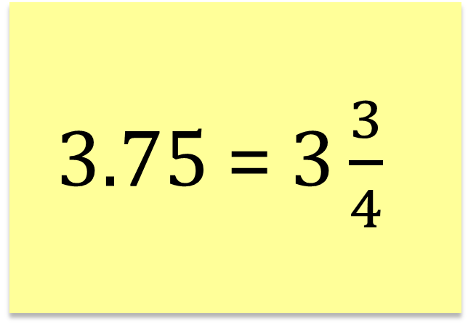



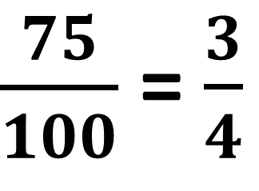
Example 1
A technician cuts 3.75 feet of cable. What does this look like as a fraction?
$\frac{75}{100}$ = $\frac{3}{4}$
3 75
3.75 = $3\frac{3}{4}$
Ten
Ones
Tenths
Hundred
Hundredths
Thousand
$$\frac{1}{10}$$
Thousandths
$$\frac{1}{100}$$
$$\frac{1}{1000}$$
Notes:
Instructional Activity: Provide Guided Learning
Instructional Time: 2 min.
Talking Points:
Let’s put things into context with some real-world examples.
A technician cuts 3.75 feet of cable.
What does that look like as a fraction?
75 goes all the way to the hundredths place, so 75 = $\frac{75}{100}$.
ASK: How can this fraction be simplified?
Call on learners to respond. CLICK to reveal the answer: Each of those numbers can be simplified by dividing them by 25, so it can be reduced to $\frac{3}{4}$ .
ASK: What does 3.75 look like as a fraction?
Call on learners to respond. CLICK to reveal the answer: 3.75 is equal to $3\frac{3}{4}$

Slide 13
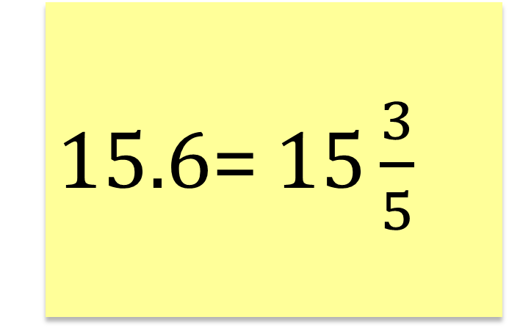
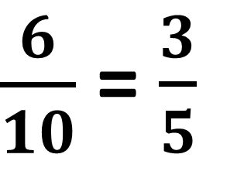
Example 2
A technician reads 15.6 volts on a meter. What does this look like as a fraction?
$\frac{6}{10}$ = $\frac{3}{5}$
15 6
15.6= $15\frac{3}{5}$
Ten
Ones
Tenths
Hundred
Hundredths
Thousand
$$\frac{1}{10}$$
Thousandths
$$\frac{1}{100}$$
$$\frac{1}{1000}$$
Notes:
Instructional Activity: Provide Guided Learning
Instructional Time: 2 min.
Talking Points:
How about this one: A technician reads 15.6 volts on a meter. What does this look like as a fraction?
The 6 is in the tenths place, so 6 = $\frac{6}{10}.$
ASK: How can this fraction be simplified?
Call on learners to respond. CLICK to reveal the answer: Each of those numbers can be simplified by dividing them by 2, so it can be reduced to $\frac{3}{5}$ .
ASK: What does 15.6 look like as a fraction?
Call on learners to respond. CLICK to reveal the answer: 15.6 is equal to $15\frac{3}{5}$

Slide 14
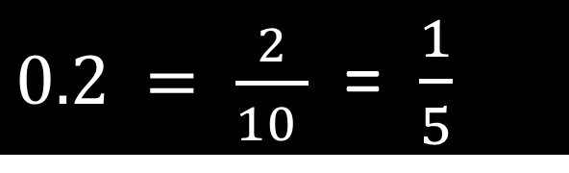
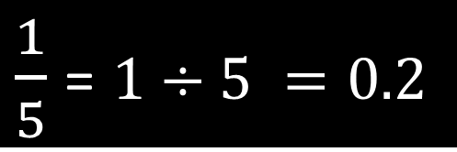
Converting Decimals & Fractions
Converting Decimals to Fractions
Write the decimal as a fraction by using the place value:
  - 10 (if 1 decimal place)
  - 100 (if 2 decimal places)
  - 1000 (if 3 decimal places), etc.
Simplify
Converting Fractions to Decimals
Turn the fraction into a division problem.
Solve
$0.2 = \frac{2}{10 }$ = $\frac{1}{5}$
$\frac{1}{5}$ = $1÷5 =0.2$
Notes:
*This slide contains animations. CLICK to reveal content.
Instructional Activity: Present Content
Instructional Time: 4 min.
Materials: Place Value + Conversion Resource_M3
Do:
Direct learners to the “Place Value + Conversion Resource_M3” embedded in their Participant Resource Guide. This will serve as a useful reference throughout the lesson.
Talking Points:
Let’s briefly summarize how to convert decimals into fractions and fractions into decimals.
CLICK – To convert decimals into fractions, start by writing the decimal as a fraction by using the place value.
To do this, you will place the number over 10, 100, 1000, or whatever the place value of the decimal is.
In this case 0.2 goes to the tenths place value, so we’ll write 2/10.
Next, we simplify to get 1/5. That’s it!
CLICK – To convert fractions into decimals, start by writing the fraction as a division problem.
In this case, $\frac{1}{5}$ will become $1÷5.$
Next, we solve the equation. $1÷5. =0.2.$

Slide 15
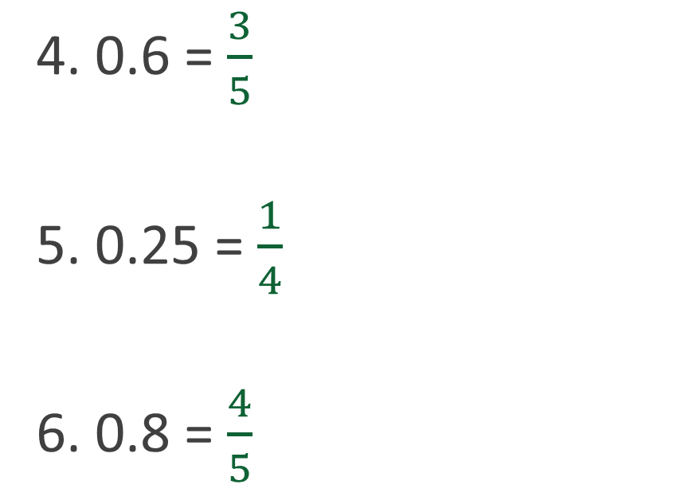
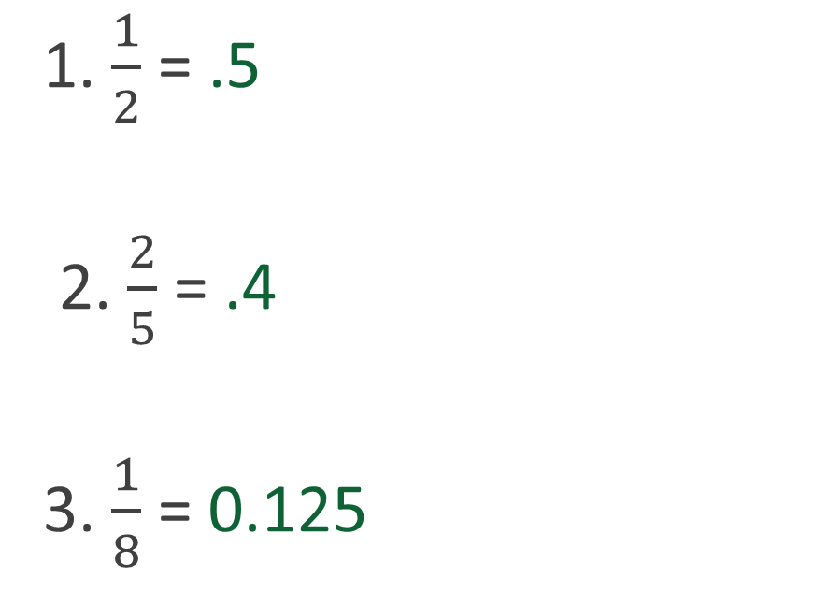
QUICK PRACTICE - Conversions
Convert the following fractions to decimals or decimals to fractions.
1. $\frac{1}{2}$ = .5
2. $\frac{2}{5}$ = .4
3. $\frac{1}{8}$ = 0.125
4. 0.6 = $\frac{3}{5}$
5. 0.25 = $\frac{1}{4}$
6. 0.8 = $\frac{4}{5}$
Notes:
*This slide contains animations. CLICK to reveal content.
Instructional Activity: Provide Learning Guidance, Elicit Performance, Provide Feedback
Instructional Time: 6 min.
Do:
Lead learners through a quick practice of converting fractions to decimals and decimals to fractions.
Read the equation, give learners time to calculate, and call on a learner to give the answer.
CLICK to reveal the answer. Provide feedback as needed.

Slide 16
Summary and What’s Next
A decimal is a number written with a decimal point where each digit has a place value. These place values represent parts of a whole.
Fractions and decimals are two different ways to show parts of a whole. They can represent the same value
Next, we’ll learn how to add and subtract decimals to get accurate results on the job.
Example
0.5 = 1/2
0.1 = 1/10
Notes:
Instructional Activity: Enhance Retention and Transfer
Instructional Time: 3 min.
Do:
Review the key takeaways from this section of the module.
Clearly explain how they connect to the next section of the module.

Slide 17

3.2 – Adding and Subtracting Decimals
In this section, we’ll review how to add and subtract decimals.
Notes:
Instructional Activity: Direction
Instructional Time: 1 min.
Do: Introduce the section.
Talking Points: In this section, we’ll review how to add and subtract decimals.

Slide 18
Adding & Subtracting Decimal Fractions
Write the problem vertically and line up the decimal points.
Add additional zeros if necessary so the numbers have the same number of decimal places.
Add or subtract from right to left as if the numbers are whole numbers. Bring the decimal point straight down.
18.70 – 10.3 = ?
18.70
– 10.3
0
8.4
Notes:
*This slide contains animations. CLICK to reveal content.
Instructional Activity: Present Content, Provide Learning Guidance
Instructional Time: 3 min.
Do: Walk learners through each step of the practice problem using the slide animations.
Talking Points:
Adding and subtracting can be done in three simple steps.
CLICK – First, write the problem vertically and line up the decimal points.
CLICK – Next, add additional zeros (if necessary) so the numbers have the same number of decimal places.
CLICK – Lastly, add or subtract from right to left as if the numbers are whole numbers. Bring the decimal point straight down.
Source: ASAP After School Activities Partnerships (2024). 6th grade review summer packet. https://asaphila.org/wp-content/uploads/2024/07/6th-grade-review-Summer-Packet.pdf

Slide 19
Group Practice 1
Write the problem vertically and line up the decimal points.
Add additional zeros if necessary so the numbers have the same number of decimal places.
Add or subtract from right to left as if the numbers are whole numbers. Bring the decimal point straight down.
24.2 + 8.5 = ?
24.2
+ 8.5
32.7
Notes:
*This slide contains animations. CLICK to reveal content.
Instructional Activity: Provide Learning Guidance
Instructional Time: 3 min.
Do: Walk learners through each step of the practice problem using the slide animations.
Talking Points:
Let’s try with an addition problem.
CLICK – First, write the problem vertically and line up the decimal points.
Next, add additional zeros (if necessary) so the numbers have the same number of decimal places.
ASK: Do we need to add additional zeros here?
Call on learners to respond. Answer: No
CLICK – Lastly, add or subtract as if the numbers are whole numbers. Bring the decimal point straight down.
ASK:
What is 5 + 2? Call on learners to respond. Answer: 7
What is 4 + 8? Call on learners to respond. Answer: 10, so we’ll carry one over to the tens place value.
What is 2 + 1? Call on learners to respond. Answer: 13
After bringing our decimal point straight down, we will have our final answer: 32.7.

Slide 20
Group Practice 2
Write the problem vertically and line up the decimal points.
Add additional zeros if necessary so the numbers have the same number of decimal places.
Add or subtract from right to left as if the numbers are whole numbers. Bring the decimal point straight down.
14.2 – 7.934
13
11
9
0
3
1
10
10
14.2
– 7.9 3 4
0
0
6.
6 6
2
Notes:
*This slide contains animations. CLICK to reveal content.
Instructional Activity: Provide Learning Guidance
Instructional Time: 4 min.
Do: Walk learners through each step of the practice problem using the slide animations.
Talking Points:
Let’s try with a more complex problem.
CLICK – First, write the problem vertically and line up the decimal points.
Next, add additional zeros (if necessary) so the numbers have the same number of decimal places.
ASK: Where do we need to add zeros?
Call on learners to respond. CLICK to reveal the answer: Add two zeros to the top number in the hundredths and thousandths place values.
Lastly, we will subtract the numbers as if they are whole numbers.
Things are a little tricky here because we can’t subtract 4 from 0, so we need to borrow from the 2.
CLICK - That will turn the 2 into a 1, the first 0 into a 9, and the second 0 into a 10.
ASK: If we subtract straight down in the thousandths and hundredths place value columns, what is our answer?
Call on learners to respond. CLICK to reveal the answer: In both columns, the answer is 6.
When we get to the tenths column, we run into the same problem again. We can’t subtract 9 from 1, so we need to borrow from the 4.
CLICK - This will turn the 4 into a 3 and give us 11 – 9 in the tenths column.
ASK: What is 11- 9?
Call on learners to respond. CLICK to reveal the answer: 2
We’re almost there!
CLICK - Once again, we can’t subtract 7 from 3 so we need to borrow a number.
We’ll take 1 from the tenths column which will give us 13 in the ones column.
ASK: What is 13 – 7?
Call on learners to respond. CLICK to reveal the answer: 6
We’ll bring our decimal point straight down to give us a final answer of 6.266.
Source: . ASAP After School Activities Partnerships (2024). 6th grade review summer packet. https://asaphila.org/wp-content/uploads/2024/07/6th-grade-review-Summer-Packet.pdf

Slide 21
Group Practice 3 and 4
26.7 – 4.92
120.7 + 49.1
16
5
6
10
26.7
– 4.92
120.7
+ 49.1
0
21.78
169.8
Notes:
*This slide contains animations. CLICK to reveal content.
Instructional Activity: Provide Learning Guidance
Instructional Time: 4 min.
Do:
Ask learners to complete the following two practice problems on their own.
Go through each problem one at a time. Call on learners to share their responses. You may choose to have learners write their responses on the board.
Make sure learners show their work and explain each step in the they used to solve the equation.
CLICK to reveal the answer.

Slide 22
Knowledge Check
Solve the equation: 4.75 – 2.25 =
(A). 2.5
(A). 2.5
(B). 7
(C). 1.5
(D). 2.25
Notes:
*This slide contains animations. CLICK to reveal content.
Instructional Activity: Evaluate/Assess Performance, Provide Feedback
Instructional Time: 3 min.
Learning Objective: Solve addition and subtraction problems involving decimals.
Do: Review the knowledge check question. Call on learners to share their responses.
Answer: A

Slide 23
Knowledge Check
Convert the solution to a fraction: 2.5
(A). 2/5
(B). 1/7
(C). 7/2 or 3 ½
(D). 5/2
(D). 5/2 or 2 ½
Notes:
*This slide contains animations. CLICK to reveal content.
Instructional Activity: Evaluate/Assess Performance, Provide Feedback
Instructional Time: 3 min.
Learning Objective: Convert between decimals and fractions to represent values in different forms.
Do: Review the knowledge check question. Call on learners to share their responses.
Answer: D
The answer can be the fraction 5/2 or the mixed number 2 ½.

Slide 24
Summary and What’s Next
When adding and subtracting, line up the decimal points.
Always add and subtract from right to left.
Accuracy matters — small mistakes can lead to incorrect results.
Next, we’ll learn how to multiply and divide decimals to solve more complex problems on the job
Notes:
Instructional Activity: Enhance Retention and Transfer
Instructional Time: 3 min.
Do:
Review the key takeaways from this section of the module.
Clearly explain how they connect to the next section of the module.

Slide 25
3.3 – Multiplying and Dividing Decimals
In this section, we’ll review how to multiply and divide decimals.
Notes:
Instructional Activity: Direction
Instructional Time: 1 min.
Do: Introduce the section.
Talking Points: In this section, we’ll review how to multiply and divide decimals.

Slide 26
Multiplying Decimals
Ignore the decimal points and multiply the numbers like whole numbers.
Count the total number of digits after the decimal point in both numbers.
Put the decimal point in the answer so it has the same total number of decimal places.
2.5 X 1.2
+1
+1
25
X 12
3 00
+2
Notes:
*This slide contains animations. CLICK to reveal content.
Instructional Activity: Present Content, Provide Learning Guidance
Instructional Time: 3 min.
Materials: One standard calculator per learner
Do: Walk learners through each step of the practice problem using the slide animations.
Talking Points:
Multiplication can also be done in three simple steps.
CLICK – First, ignore the decimal points and multiply the numbers like whole numbers.
We’ll use a calculator to do some quick multiplication. 25 x 12 = 300
CLICK – Next, count the total number of digits after the decimal point in both numbers.
CLICK – Lastly, put the decimal point in the answer so it has the same total number of decimal places.
Source: . ASAP After School Activities Partnerships (2024). 6th grade review summer packet. https://asaphila.org/wp-content/uploads/2024/07/6th-grade-review-Summer-Packet.pdf

Slide 27
Group Practice 1
Ignore the decimal points and multiply the numbers like whole numbers.
Count the total number of digits after the decimal point in both numbers.
Put the decimal point in the answer so it has the same total number of decimal places.
18.7 X 3.24
+1
+2
187
X 324
60588
+3
Notes:
*This slide contains animations. CLICK to reveal content.
Instructional Activity: Provide Learning Guidance
Instructional Time: 3 min.
Materials: One standard calculator per learner
Do: Walk learners through each step of the practice problem using the slide animations.
Talking Points:
Ok, let’s try one together.
First, we’ll ignore the decimal points and multiply the numbers like whole numbers.
ASK: What is 187 x 324? Call on learners to respond. CLICK to reveal the answer: 60588
Next, we’ll count the total number of digits after the decimal point in both numbers.
ASK: How many numbers appear after the decimal point? Call on learners to respond. CLICK to reveal the answer: 3
Finally, we’ll move the decimal point in the answer so it has the same total number of decimal places.
ASK: What will our final answer be? Call on learners to respond. CLICK to reveal the answer: 60.588

Slide 28
Group Practice 2
Ignore the decimal points and multiply the numbers like whole numbers.
Count the total number of digits after the decimal point in both numbers.
Put the decimal point in the answer so it has the same total number of decimal places.
28.2 X 2.58
+1
+2
282
X 258
72756
+3
Notes:
*This slide contains animations. CLICK to reveal content.
Instructional Activity: Provide Learning Guidance
Instructional Time: 3 min.
Materials: One standard calculator per learner
Do: Walk learners through each step of the practice problem using the slide animations.
Talking Points:
Ok, let’s try one together.
First, we’ll ignore the decimal points and multiply the numbers like whole numbers.
ASK: What is 282 X 258? Call on learners to respond. CLICK to reveal the answer: 72756
Next, we’ll count the total number of digits after the decimal point in both numbers.
ASK: How many numbers appear after the decimal point? Call on learners to respond. CLICK to reveal the answer: 3
Finally, we’ll move the decimal point in the answer so it has the same total number of decimal places.
ASK: What will our final answer be? Call on learners to respond. CLICK to reveal the answer: 72.756

Slide 29
Group Practice 3 and 4
7.75 X 4.5
12.7 X 49.1
7.75
X 4.5
12.7
X 49.1
34.875
623.57
Notes:
*This slide contains animations. CLICK to reveal content.
Instructional Activity: Provide Learning Guidance
Instructional Time: 4 min.
Materials: One standard calculator per learner
Do:
Ask learners to complete the following two practice problems on their own.
Go through each problem one at a time. Call on learners to share their responses. You may choose to have learners write their responses on the board.
Make sure learners show their work and explain each step in the they used to solve the equation.
CLICK to reveal the answer.

Slide 30
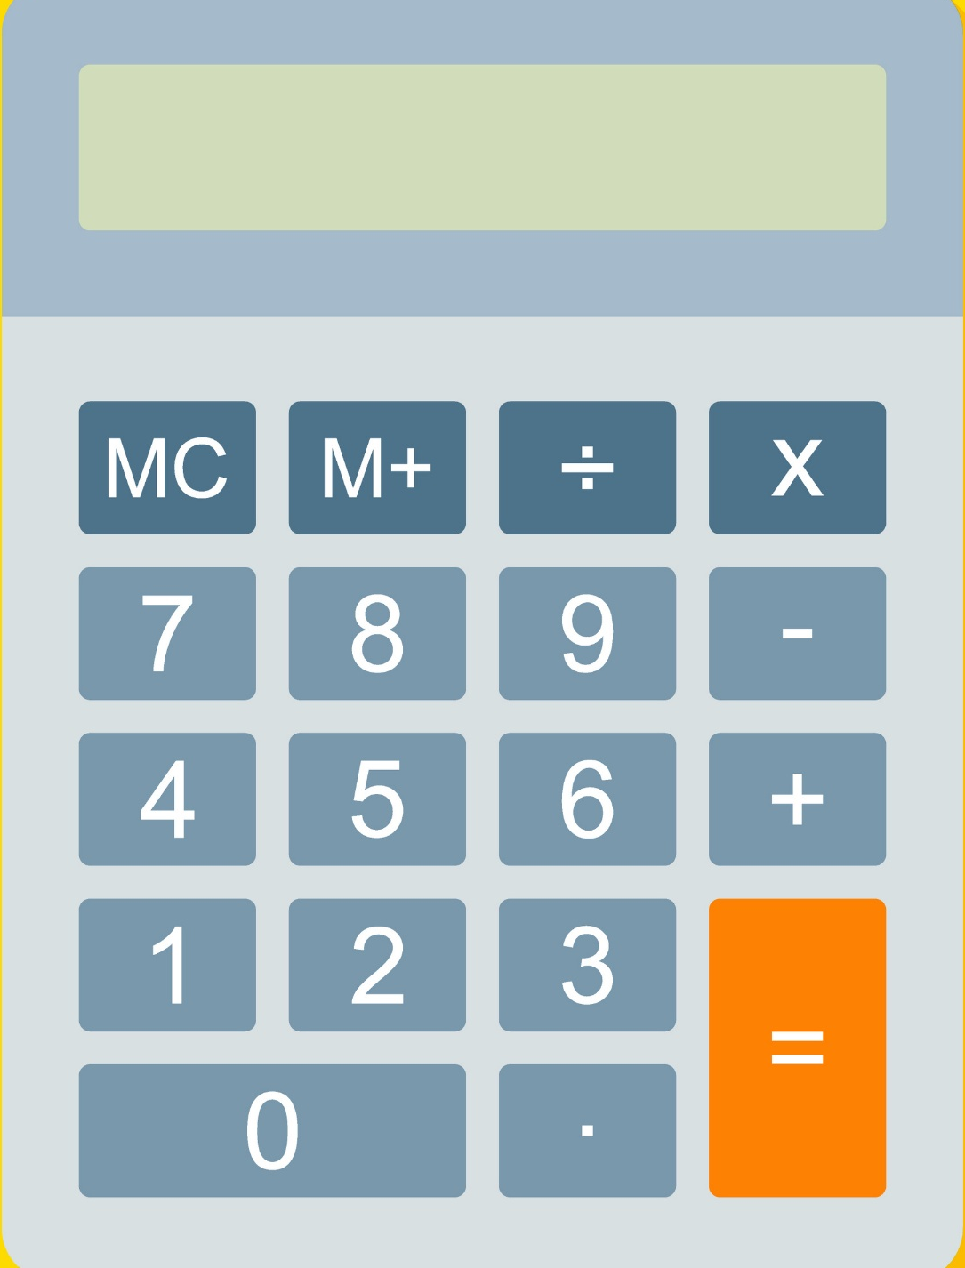
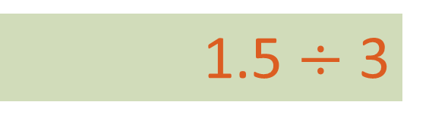
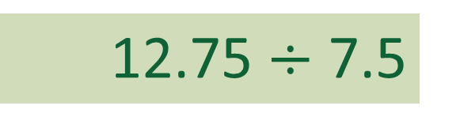
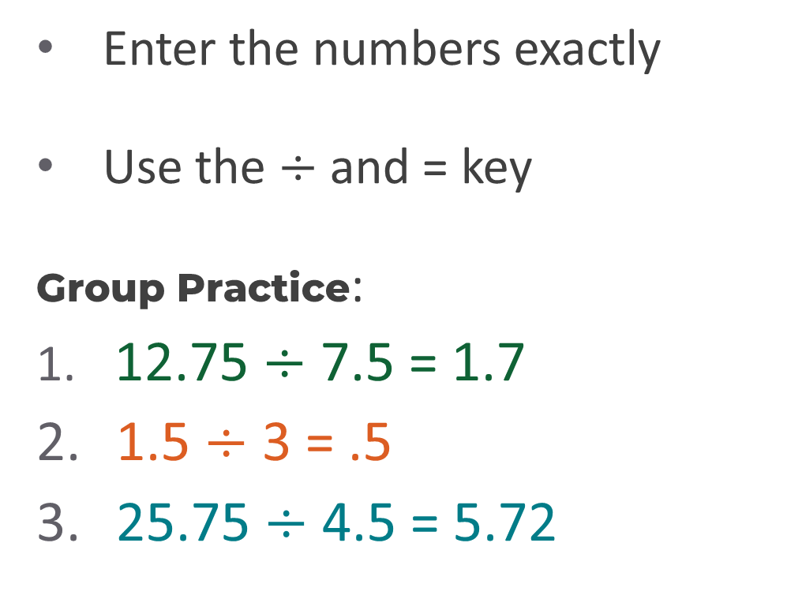
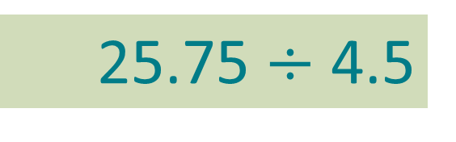
Dividing Decimals
Enter the numbers exactly
Use the $÷$ and = key
Group Practice:
12.75 $÷$ 7.5 = 1.7
1.5 $÷$ 3 = .5
25.75 $÷$ 4.5 = 5.72
5.72
.5
12.75 $÷$ 7.5
1.7
1.5 $÷$ 3
25.75 $÷$ 4.5
Notes:
*This slide contains animations. CLICK to reveal content.
Instructional Activity: Present Content, Provide Learning Guidance
Instructional Time: 4 min.
Materials: One standard calculator per learner
Do: Walk learners through each step of the practice problem using the slide animations.
Talking Points:
When it comes to dividing fractions, the most efficient way to perform calculations is with a calculator.
If possible, keep a standard calculator with you on the job.
Remember - If you want to use the calculator on your cell phone or personal device, always check and follow your agency’s policies as they relate to use of a personal device on the job.
To divide decimals with a fraction, be sure to:
First, enter the numbers exactly into the calculator.
Use the $÷$ and = key to solve the equation.
Let’s try a few practice problems as a group.
CLICK to reveal practice problems.
Call on learners to share their answers.
CLICK again to reveal the answer.

Slide 31
Dividing Decimals
Divide – How many times does the divisor go into the first number?
Multiply – Multiply your answer by the divisor.
Subtract – Subtract to find what is left.
Bring Down – Bring down the next digit.
Repeat – Continue until there are no digits left.
2
.
2
5
3
6. 7 5
6
0
7
6
1
5
1
5
0
Notes:
*This slide contains animations. CLICK to reveal content.
Instructional Activity: Present Content, Provide Learning Guidance
Instructional Time: 4 min.
Do: Walk learners through each step of the practice problem using the slide animations.
Talking Points:
When a calculator is not available, you’ll need to know how to complete long division by hand.
We’ll use the same process each time: divide, multiply, subtract, bring down, and repeat.
For now, we will completely ignore the decimal point. We’ll return to where the decimal point goes shortly.
Let’s walk through an example using 6.75 divided by 3.
CLICK
First, Divide. How many times does 3 go into 6? Two times, so write 2 above the 6.
Next, Multiply. Two times 3 is 6. Then Subtract: 6 minus 6 is 0.
CLICK -
Then Bring Down the 7.
Now Repeat the process. Divide: 3 goes into 7 two times. Multiply: 2 times 3 is 6. Subtract: 7 minus 6 is 1.
CLICK -
Bring down the 5 to make 15.
Repeat again. Divide: 3 goes into 15 five times. Multiply: 5 times 3 is 15. Subtract: 15 minus 15 is 0.
Now there are no more digits to bring down – we’re nearly done!
CLICK -
Let’s return to the decimal point.
Bring the decimal point straight up into the answer.
Now we’re finished. 6.75 divided by 3 equals 2.25.

Slide 32
Group Practice 2
Divide – How many times does the divisor go into the first number?
Multiply – Multiply your answer by the divisor.
Subtract – Subtract to find what is left.
Bring Down – Bring down the next digit.
Repeat – Continue until there are no digits left.
2
.
3
4
4
9. 3 6
8
1
3
1
2
1
6
1
6
0
Notes:
*This slide contains animations. CLICK to reveal content.
Instructional Activity: Present Content, Provide Learning Guidance
Instructional Time: 4 min.
Do:
Ask learners to complete the following practice problem on their own.
Go through each problem one at a time. Call on learners to share their responses. You may choose to have learners write their responses on the board.
Make sure learners show their work and explain each step in the they used to solve the equation.
CLICK to reveal the answer.

Slide 33
Knowledge Check
Solve the equation: 3.75 x 0.4 =
(A). 4.14
(B). 9.4
(C). 1.5
(D). 15
(C). 1.5
Notes:
*This slide contains animations. CLICK to reveal content.
Instructional Activity: Evaluate/Assess Performance, Provide Feedback
Instructional Time: 2 min.
Learning Objective: Solve multiplication and division problems involving decimals.
Do: Review the knowledge check question. Call on learners to share their responses.
Answer:
C

Slide 34
Knowledge Check
Convert the solution to a fraction: 3.75 x 0.4 = 1.5
(A). 5/6
(B). 3/2
(B). 3/2
(C). 1/5
(D). 2/3
Notes:
*This slide contains animations. CLICK to reveal content.
Instructional Activity: Evaluate/Assess Performance, Provide Feedback
Instructional Time: 3 min.
Learning Objective: Convert between decimals and fractions to represent values in different forms.
Do: Review the knowledge check question. Call on learners to share their responses.
Answer:
B

Slide 35
Summary and What’s Next
Multiplying decimals requires counting decimal places.
If permitted, use a calculator for quick and efficient problem solving with multiplication and division.
Next, we’ll combine all decimal operations to solve multi-step problems using order of operations.
Notes:
Instructional Activity: Enhance Retention and Transfer
Instructional Time: 3 min.
Do:
Review the key takeaways from this section of the module.
Clearly explain how they connect to the next section of the module.

Slide 36

3.4 – Combining Operations with Decimals
Next, we’ll learn how to combine operations with fractions.
Notes:
Instructional Activity: Direction
Instructional Time: 2 min.
Do: Introduce the section.
Talking Points: Next, we’ll learn how to combine operations with fractions.

Slide 37
Quick Review
What is the purpose of PEMDAS?
PEMDAS is an acronym that reminds us of the sequence of steps to follow when solving mathematical expressions with multiple operations.
It stands for parentheses, exponents, multiplication, division, addition, and subtraction.
What does PEMDAS stand for?
Notes:
Instructional Activity: Recall
Instructional Time: 2 min.
Talking Points:
ASK: What is the purpose of PEMDAS?
Call on learners to respond. CLICK to reveal the answer: PEMDAS is an acronym that reminds us of the sequence of steps to follow when solving mathematical expressions with multiple operations.
ASK: What does PEMDAS stand for?
Call on learners to respond. CLICK to reveal the answer: It stands for parentheses, exponents, division, addition, and subtraction.

Slide 38
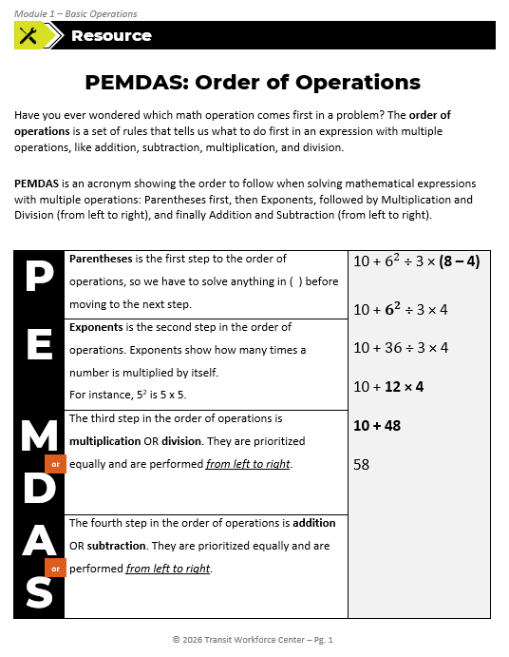
PEMDAS: Order of Operations
This resource from Module 1 – Basic Operations will be useful in this part of our lesson.
Notes:
Instructional Activity: Direction
Instructional Time: 1 min.
Materials: PEMDAS Order of Operations_M1
Do: Ask learners to take out the “PEMDAS Order of Operations_M1” resource from Module 1. This will be a useful resource for this part of the lesson.
Talking Points:
In this section of our lesson, we’ll be building off what we learned about basic operations in Module 1.
You may want to have the “PEMDAS Order of Operations” handout from Module 1 in front of you.
It should be embedded in your Participant Resource Guide and will be a useful reference for this part of our lesson.

Slide 39
Combining Operations with Decimals
Solve items in parentheses.
Solve items with exponents.
Solve items with multiplication or division from left to right.
Solve items with addition or subtraction from left to right.
Reminder – If applicable, solve the TOP of the fraction bar first.
(2.5 + 1.75) × 2 + 1.5 =
4.25 × 2 + 1.5 =
8.5 + 1.5 =
10
Notes:
*This slide contains animations. CLICK to reveal content.
Instructional Activity: Present Content, Provide Learning Guidance
Instructional Time: 3 min.
Materials: One standard calculator per learner
Do: Walk learners through each step of the practice problem using the slide animations.
Talking Points:
Solving equations with multiple operations with decimals is no different than if we are using whole numbers.
We start with solving any items in parenthesis.
ASK: In this example equation, what comes first? What is the solution?
Call on learners to respond. CLICK to reveal the answer: parentheses; 2.5 + 1.75 = 4.75
Next, we’ll solve any exponents in the equation. This example doesn’t have any exponents, so we can keep going.
Now it’s time for multiplication and division. Remember, we always solve in order from left to right.
ASK: What is the next step in our example equation? What is the solution?
Call on learners to respond. CLICK to reveal the answer: multiplication; 8.5 + 1.5
Lastly, we solve any items with addition or subtraction from left to right.
ASK: What is our final answer?
Call on learners to respond. CLICK to reveal the answer: 10

Slide 40



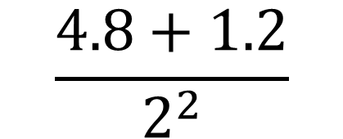
Group Practice 1
Solve items in parentheses.
Solve items with exponents.
Solve items with multiplication or division from left to right.
Solve items with addition or subtraction from left to right.
Reminder – If applicable, solve the TOP of the fraction bar first.
$$\frac{4.8+1.2}{2^{2}}$$
$$\frac{6}{2^{2}}$$
$$\frac{6}{4}$$
$$\frac{3}{2}$$
=
Notes:
*This slide contains animations. CLICK to reveal content.
Instructional Activity: Provide Learning Guidance
Instructional Time: 3 min.
Materials: One standard calculator per learner
Do: Walk learners through each step of the practice problem using the slide animations.
Talking Points:
Let’s try again. Remember that with division problems, we always solve what is on TOP of the fraction bar first.
ASK: Starting with the top bar, what do we need to solve?
Call on learners to respond. CLICK to reveal the answer: addition; 4.8 + 1.2 = 6
Moving to the bottom bar, what do we need to solve?
Call on learners to respond. CLICK to reveal the answer: addition; $2^{2}=4$
This will give us $\frac{6}{4}$which can be simplified to $\frac{3}{2}$

Slide 41
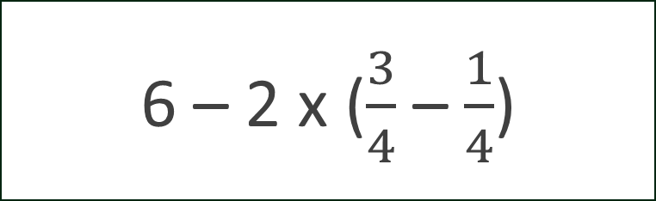
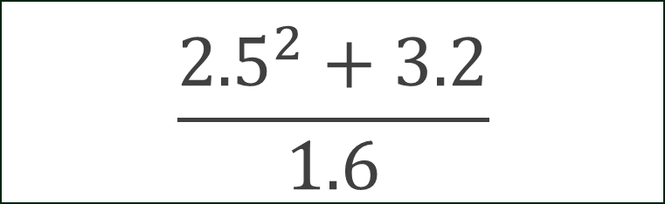
Group Practice 2 and 3
$$\frac{{2.5}^{2}+3.2}{1.6}$$
6 – 2 x ($\frac{3}{4}$ – $\frac{1}{4}$)
6.25 + 3.2
1.6
6 – 2 x 1
6 – 2
9.45
1.6
4
5.91
Notes:
*This slide contains animations. CLICK to reveal content.
Instructional Activity: Provide Learning Guidance
Instructional Time: 4 min.
Materials: One standard calculator per learner
Do:
Ask learners to complete the follow two practice problems on their own.
Go through each problem one at a time. Call on learners to share their responses. You may choose to have learners write their responses on the board.
Make sure learners show their work and explain each step in the they used to solve the equation.
CLICK to reveal the answer.

Slide 42
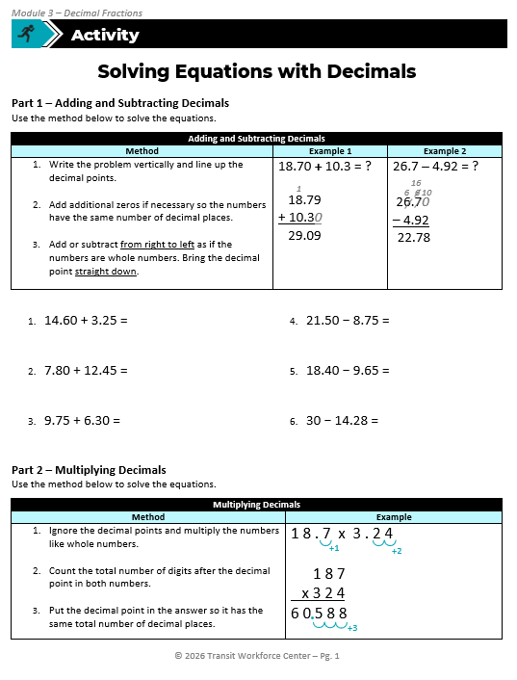
Solving Equations with Decimals
Part 1 – Adding and Subtracting Decimals
Part 2 – Multiplying Decimals
Part 3 –Dividing Decimals
Part 4 – Solving Mixed Operation Equations with Decimals
Notes:
Instructional Activity: Provide Guided Learning, Elicit Performance, Provide Feedback
Instructional Time: 35 min.
Materials:
Solving Equations with Decimals_M3
Solving Equations with Decimals_Answer Key_M3
Do:
3 min.
Refer learners to the “Solving Equations with Decimals_M3” handout embedded in the Participant Resource Guide.
Review the directions and answer any questions learners may have.
17 min.
Give learners time to work. You may have them work with partners or groups if you choose.
Circulate the room answering questions and providing feedback as needed.
15 min.
Call on 5 learners to write the answers to 1-5 on the front board. Use the answer key to confirm the accuracy of the answers. Allow the class to check their work.
Call on 5 learners to write the answers to 6-10 on the front board. Use the answer key to confirm the accuracy of the answers. Allow the class to check their work.
Call on 5 learners to write the answers to 11-15 on the front board. Use the answer key to confirm the accuracy of the answers. Allow the class to check their work.

Slide 43

Knowledge Check
Solve the equation: $\frac{{6^{2} − 4}^{}}{{72}^{}+ 2^{3}}$
(A). 0.5
(B). 0.4
(B). 0.4
(C). 0.6
(D). 0.8
Notes:
*This slide contains animations. CLICK to reveal content.
Instructional Activity: Evaluate/Assess Performance, Provide Feedback
Instructional Time: 2 min.
Learning Objective: Apply order of operations to solve multi-step problems involving decimals.
Do: Review the knowledge check question. Call on learners to share their responses.
Answer:
B

Slide 44
Knowledge Check
Convert the solution to a fraction: 0.4
(A). 4/10 simplified to 2/5
(B). 5/10 simplified to 1/2
(A). 4/10
(C). 18/45
(D). 3/5
Notes:
*This slide contains animations. CLICK to reveal content.
Instructional Activity: Evaluate/Assess Performance, Provide Feedback
Instructional Time: 3 min.
Learning Objective: Convert between decimals and fractions to represent values in different forms.
Do: Review the knowledge check question. Call on learners to share their responses.
Answer:
A

Slide 45

Quiz
Time for a quiz! Let’s see what you have learned from today’s lesson.
Notes:
Instructional Activity: Direction, Evaluate/Assess Performance
Instructional Time: 20 min.
Materials: Quiz_M4
Do:
Ask learners if they have any lingering questions. Address them before distributing the quiz.
Pass out the quiz and review the directions.
Talking Points:
Time for a quiz! Let’s see what you have retained from today’s lesson.

Slide 46
Revisiting Objectives
Demonstrate the ability to solve mathematics problems involving decimals.
  Convert between decimals and fractions to represent values in different forms.
  Solve addition and subtraction problems involving decimals.
  Solve multiplication and division problems involving decimal fractions.
  Apply order of operations to solve multi-step problems involving decimals.
Notes:
Instructional Activity: Enhance Transfer and Retention
Instructional Time: 5 min.
Do: Facilitate a short discussion to review the key topics in the lesson.
Talking Points:
If you were explaining today’s objectives to someone else, how would you summarize what they mean and why they matter?
Which of today’s objectives do you feel most confident about? Which were most challenging? Explain your reasoning.
Can you give an example of how you could apply one of today’s objectives in a real-world situation?
After Discussion:
This conclude this section of the module. Thank you for your participation.

Slide 47
Thank you!
Notes:
Instructional Activity: Enhance Transfer and Retention
Instructional Time: 2 min.
Do:
Thank learners for their participation.
If possible, stay after class to answer any lingering questions learners may have.

