Slide 1


Instructor Guide Snapshot
Icon Key
Activity:
Video:
Instructor Demo:
Knowledge Check:
Instructional Time: 4.25
Preparation before class:
  Review all materials - Review all slides, talking points, and handouts before class to understand the structure and flow of the lesson. Pay special attention to animations within the slides.
Provided Course Materials:
  +Common Fractions_M2
  Multiplying and Dividing Fractions_M2
  Multiplying and Dividing Fractions_Answer Key_M2
  Adding and Subtracting Fractions_M2
  Adding and Subtracting Fractions_Answer Key_M2
  Combining Operations with Fractions_M2
  Combining Operations with Fractions_Answer Key_M2
  Quiz_M2
  Quiz_Answer Key_M2

Slide 2
Pacing Guide
Times have been rounded to the nearest .25 hours.
Total Time: 4.25 Hours
  ( .5 Hrs.) Warm Up and Introduction
  ( 1.5 Hrs.) 2.1 - Multiplying and Dividing Fractions
  ( .75 Hrs.) 2.2 - Adding and Subtracting Fractions
  ( 1 Hr. Hrs) 2.3 - Combining Operations with Fractions
  ( .5 Hrs.) Quiz and Wrap Up

Slide 3
Common Fractions
Shop Math
Transit Core Competencies Curriculum (TC3)
Notes:
Instructional Activity: Direction
Instructional Time: 1 min.
Do: Welcome learners to class. Introduce the course and module.

Slide 4
Objectives
Demonstrate the ability to solve mathematics problems involving fractions.
  Solve multiplication and division problems involving fractions.
  Solve addition and subtraction problems involving fractions.
  Use the order of operations to solve problems involving fractions accurately.
Notes:
Instructional Activity: Direction
Instructional Time: 2 min.
Do: Review the module objectives.

Slide 5
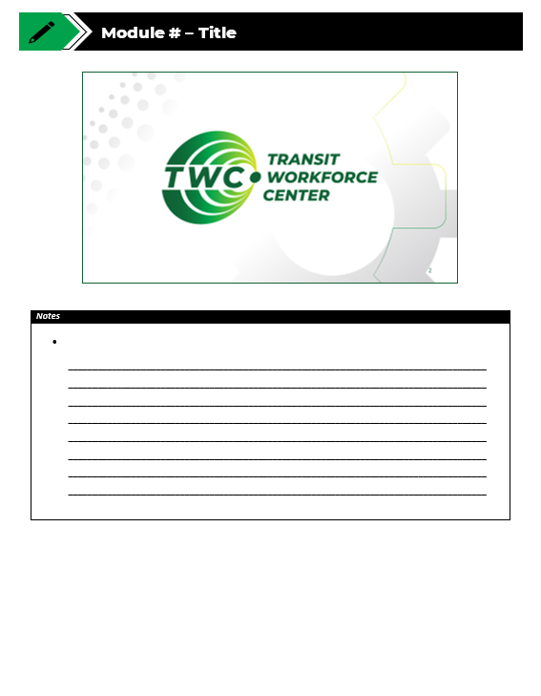
Agenda
Warm Up and Introduction
2.1 - Multiplying and Dividing Fractions
2.2 - Adding and Subtracting Fractions
2.3 - Combing Operations with Fractions
Quiz and Wrap Up
Notes:
Instructional Activity: Direction
Instructional Time: 1 min.
Do:
Review the module agenda.
Remind learners that they have a Participant Resource Guide which they can use for optional notetaking.

Slide 6
Warm Up
Let’s see what you recall from Module 1 – Basic Operations.
What are the 4 basic operations?
Addition, subtraction, multiplication, and division
What does PEMDAS stand for?
Parentheses, Exponents, Multiplication, Division,
Addition, Subtraction
Why does order matter when solving a math problems on the job?
Doing steps out of order can lead to incorrect measurements, wasted materials, or even safety issues.
Notes:
*This slide contains animations. CLICK to reveal content.
Instructional Activity: Gain Attention, Recall
Instructional Time: 6 min.
Do: Call on learners to answer the questions and recall key information from Module 1.
Talking Points:
Let’s start with a quick review to get our brains warmed up.
What are the four basic math operations we’ve worked with before?
Call on learners to respond. CLICK to reveal the answer: Addition, subtraction, multiplication, division
Now, who remembers what PEMDAS stands for?
Call on learners to respond. CLICK to reveal the answer: Parentheses, Exponents, Multiplication, Division, Addition, Subtraction
Why does order matter when solving a problem? What could happen if we just solved left to right without a plan?
Call on learners to respond. CLICK to reveal the answer: In the shop, doing steps out of order can lead to incorrect measurements, wasted materials, or even safety issues.
Keep these three important ideas in mind during our lesson today. We’ll be building on our knowledge of basic operations to solve equations involving fractions.

Slide 7
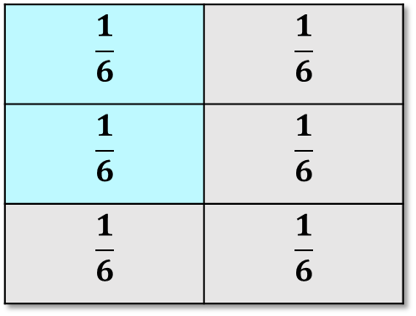
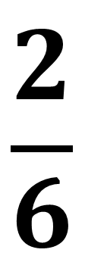
What is a common fraction?
A common fraction is number that represents a part of a whole.
They are written with one number over another, separated by a line called a fraction bar.
  Numerator (Top) – the number of equal parts being counted.
  Denominator (Bottom) – The number of equal parts in one whole.
$$\frac{1}{6}$$ | $$\frac{1}{6}$$
$$\frac{1}{6}$$ | $$\frac{1}{6}$$
$$\frac{1}{6}$$ | $$\frac{1}{6}$$
$$\frac{2}{6}$$
Notes:
*This slide contains animations. CLICK to reveal content.
Instructional Activity: Present Content
Instructional Time: 2 min.
Do:
Talking Points:
Let’s start with the basics—what is a fraction?
A fraction is a number that represents part of a whole. You’ll see these all the time in the shop when measuring, cutting, or dividing materials.
Fractions are written with one number over another, separated by a line called a fraction bar. That line just means division.
CLICK - Now let’s break down the parts of a fraction.
The top number is called the numerator. This tells us how many parts are being counted.
The bottom number is called the denominator. This tells us how many equal parts are in a whole.
Take a look at this box.
ASK: How many parts are in the whole? This will be our denominator.
Call on learners to respond. CLICK to reveal the answer: 6.
ASK: How many parts are being counted in blue? This will be our numerator.
Call on learners to respond. CLICK to reveal the answer: 2.
CLICK - What we’re really saying here is that each box within the whole is 1/6th of the total. So, the blue boxes represent 2/6th
Understanding these two parts is key, because everything we do with fractions builds from this idea.
Source: Khan Academy. (n.d.). All about fractions. Khan Academy. https://www.khanacademy.org/math/cc-sixth-grade-math/x0267d782:khan-for-families/x0267d782:fractions/a/all-about-fractions

Slide 8
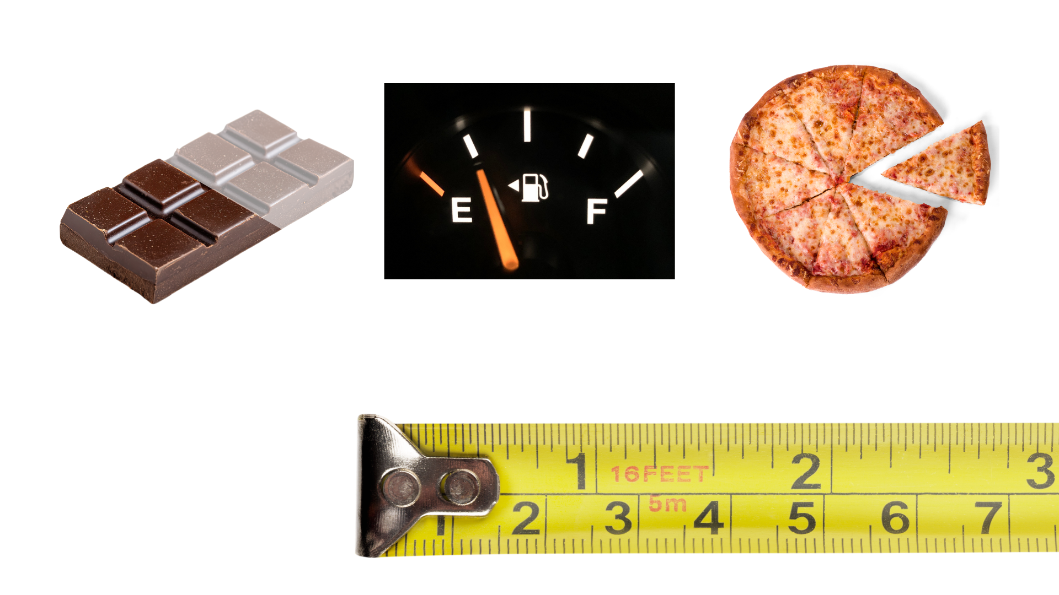
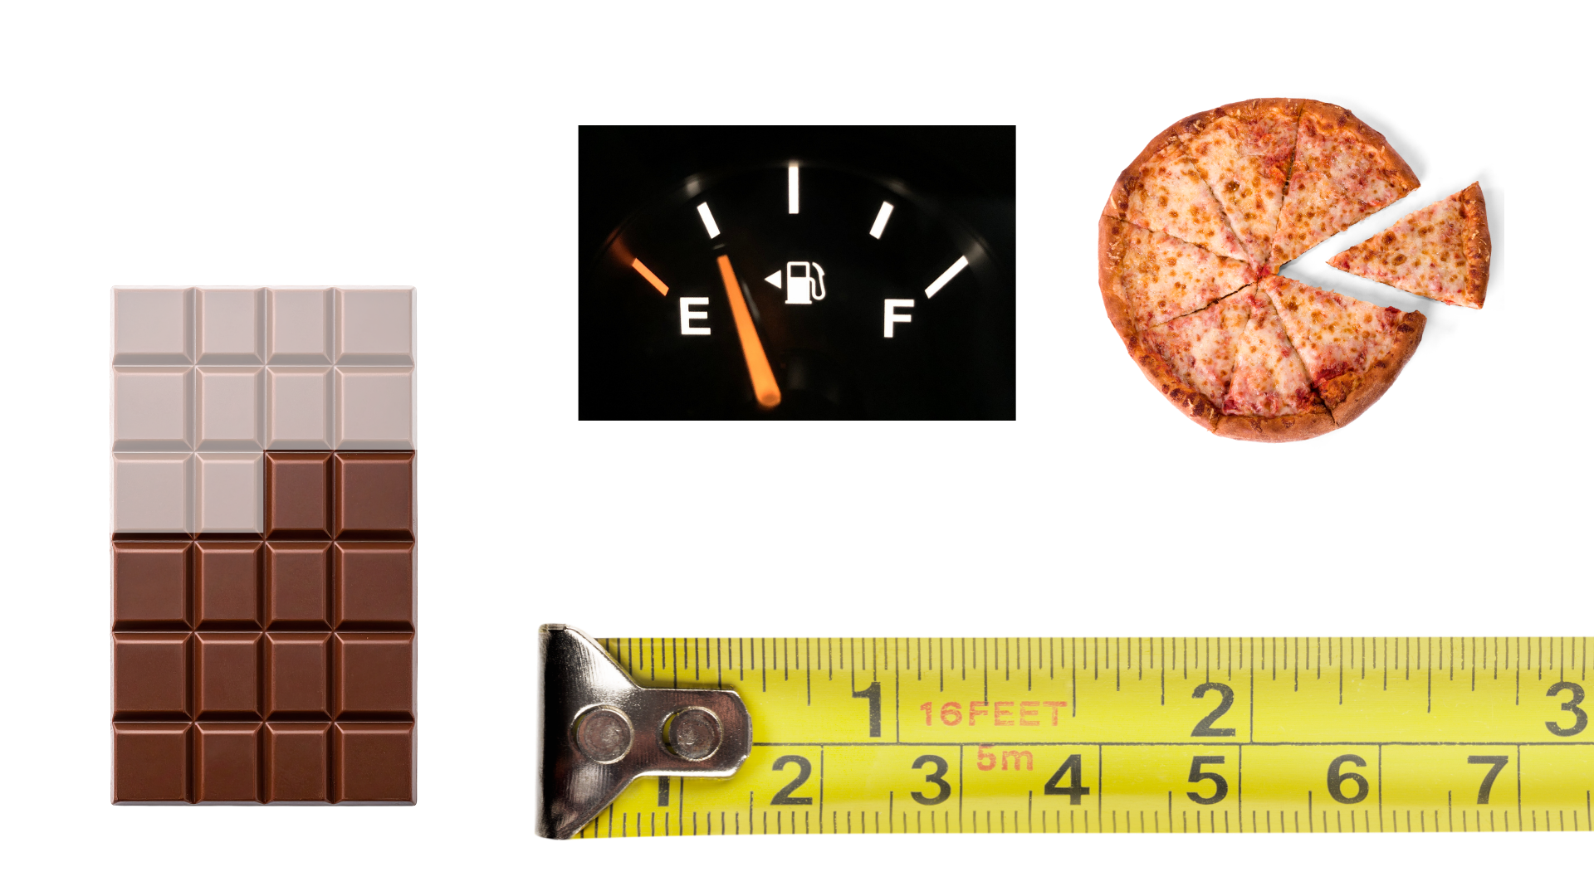
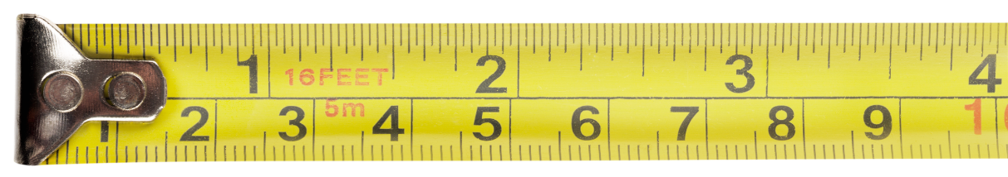
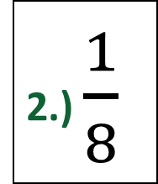
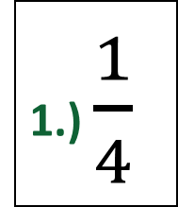
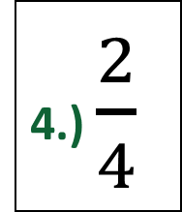
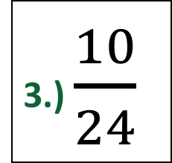
How are fractions represented?
parts counted
whole
1.) $\frac{1}{4}$
2.) $\frac{1}{8}$
3.) $\frac{10}{24}$
4.) $\frac{2}{4}$
Notes:
*This slide contains animations. CLICK to reveal content.
Instructional Activity: Provide Learning Guidance
Instructional Time: 5 min.
Do:
Call on learners to determine the fractions for numbers 1-4.
CLICK to reveal the answer.
Talking Points:
Fractions can be represented in a variety of ways such as piece of a whole, parts of a group, or even portions of a number line.
Let’s try writing fractions for each of these examples.
Remember the total number of parts goes on the bottom and it called the denominator. The parts being counted go on top and are called numerators.
Answer Key:
1/4
1/8
10/24
2/4

Slide 9
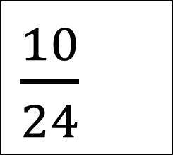


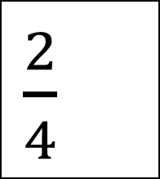
What does “Simplest Form” mean?
A fraction in simplest form cannot be reduced further. The numerator and denominator have no common factors (except 1).
How can these fractions be reduced to simplest form?
$\frac{5}{12}$
$\frac{1}{2}$
$\frac{10}{24}$
$\frac{2}{4}$
Notes:
*This slide contains animations. CLICK to reveal content.
Instructional Activity: Present Content, Provide Learning Guidance
Instructional Time: 3 min.
Talking Points:
Let’s talk about what “simplest form” means.
A fraction is in simplest form when it cannot be reduced any further. That means the numerator and denominator do not share any common factors other than 1.
In our first example, the numbers 10 and 24 can both be divided by 2. So, what is our fraction in simplest form?
Call on learners to respond. CLICK to reveal answer: 5/12
What about our second example? What is the simplest form?
Call on learners to respond. CLICK to reveal answer: 1/2
Even though these fractions look different, they represent the same amount.
Simplifying helps us write fractions in a cleaner, easier-to-use form when solving problems.

Slide 10

Why do fractions matter on the job?
Measure materials accurately
Cut and fit parts correctly
Follow specifications and diagrams
Reduce waste and rework
Support safe and efficient work
Notes:
*This slide contains animations. CLICK to reveal content.
Instructional Activity: Present Content
Instructional Time: 2 min.
Talking Points:
Fractions are something you will use regularly on the job, even if you don’t always think about them that way.
You use fractions any time you measure materials, whether that’s wire, conduit, or other components. Accuracy matters, because even small measurement errors can cause parts not to fit correctly.
Fractions also help you cut and install parts properly.
If a measurement is off, it can lead to wasted material or extra work to fix the mistake.
You’ll also see fractions when reading specifications, diagrams, or instructions. Being able to understand and work with them helps you follow those directions correctly.
At the end of the day, using fractions correctly helps you work more efficiently, reduce mistakes, and maintain a safe work environment.

Slide 11
Key Terms
Common Fraction - A number that represents a part of a whole. The numerator is the number on top, and the denominator is the number on the bottom.
Simplest Form – The process of reducing the fraction so the numerator and denominator have no common factors except 1.
Reciprocal – A fraction created by flipping the numerator and denominator of another fraction (Ex: 2/3 is 3/2). Reciprocals are used when dividing fractions.
Least Common Denominator (LCD) – The smallest number that two or more denominators can all divide into evenly. It is used to rewrite fractions so they have the same denominator, which makes them easier to add or subtract.
Improper fraction - A number greater than one whole. The numerator of the fraction (top number) is, therefore, greater than the denominator of the fraction (bottom number).
Mixed Number – A whole number and a fraction (Ex: 1 ½ )
Notes:
Instructional Activity: Present Content
Instructional Time: 3 min.
Talking Points:
There are a few key terms to keep in mind as we work through this lesson.
You can find these in the glossary of the course, but I recommend bookmarking this page in your Participant Resource Guide so you can quickly and easily refer to these terms as needed.
In addition to common fraction, numerator, and denominator, it’s also important to know reciprocal and least common denominator.
A reciprocal is a fraction created by flipping the numerator and denominator of another fraction. For example, the reciprocal of 2/3 is 3/2.
We’ll use this term when we discuss dividing fractions.
The least common denominator (LCD) is the he smallest number that two or more denominators can all divide into evenly. It is used to rewrite fractions so they have the same denominator, which makes them easier to add, or subtract.
An improper fraction is a number greater than one whole. The numerator of the fraction (top number) is, therefore, greater than the denominator of the fraction (bottom number).
Lastly, a mixed number is a whole number and a fraction (Ex: 1 ½ ).
Source:
Khan Academy. (n.d.). All about fractions. Khan Academy. https://www.khanacademy.org/math/cc-sixth-grade-math/x0267d782:khan-for-families/x0267d782:fractions/a/all-about-fractions
Bartlett, S. (2025, October 21). What is an improper fraction? explained for Elementary School. Third Space Learning. https://thirdspacelearning.com/us/blog/what-is-improper-fraction/

Slide 12
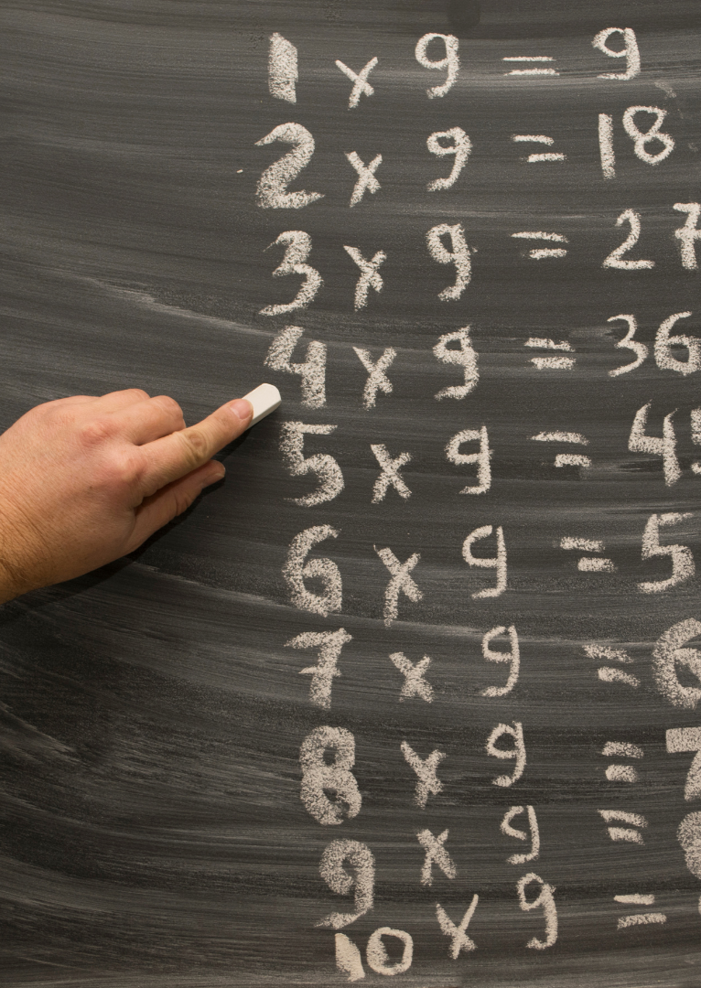
2.1 – Multiplying and Dividing Fractions
In this section, we’ll learn how to accurately multiply and divide fractions.
Notes:
Instructional Activity: Direction
Instructional Time: 1 min.
Do: Introduce the section.
Talking Points: In this section, we’ll learn how to accurately multiply and divide fractions.

Slide 13
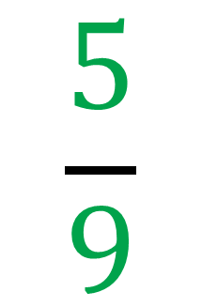
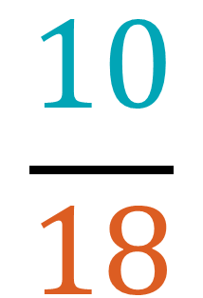
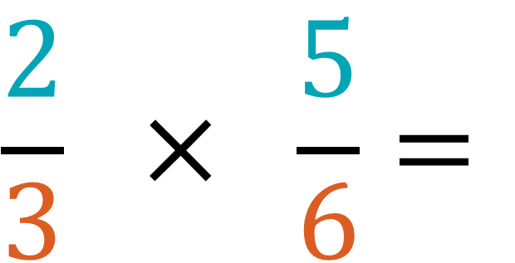
Multiplying Fractions
Multiply the numerators.
Multiply the denominators.
Reduce the fraction to simplest form, if possible.
$$\frac{2}{3} × \frac{5}{6}=$$
$$\frac{10}{18}$$
$$\frac{5}{9}$$
Notes:
*This slide contains animations. CLICK to reveal content.
Instructional Activity: Present Content, Provide Learning Guidance
Instructional Time: 3 min.
Do:
Talking Points:
Multiplying fractions is a three-step process.
First, we multiply the numerators, which are the top numbers.
CLICK - In this example, we multiply 2 times 5 to get 10.
Next, we multiply the denominators, which are the bottom numbers.
CLICK - So, we multiply 3 times 6 to get 18. At this point, we have the fraction 10/18.
The last step is to reduce the fraction to simplest form, if possible. Both 10 and 18 can be divided by 2.
CLICK - When we divide 10 by 2, we get 5.
CLICK – When we divide 18 by 2, we get 9.
So, our final answer is 5/9.
Multiplying fractions is straightforward. We multiply straight across, then simplify if we can.

Slide 14
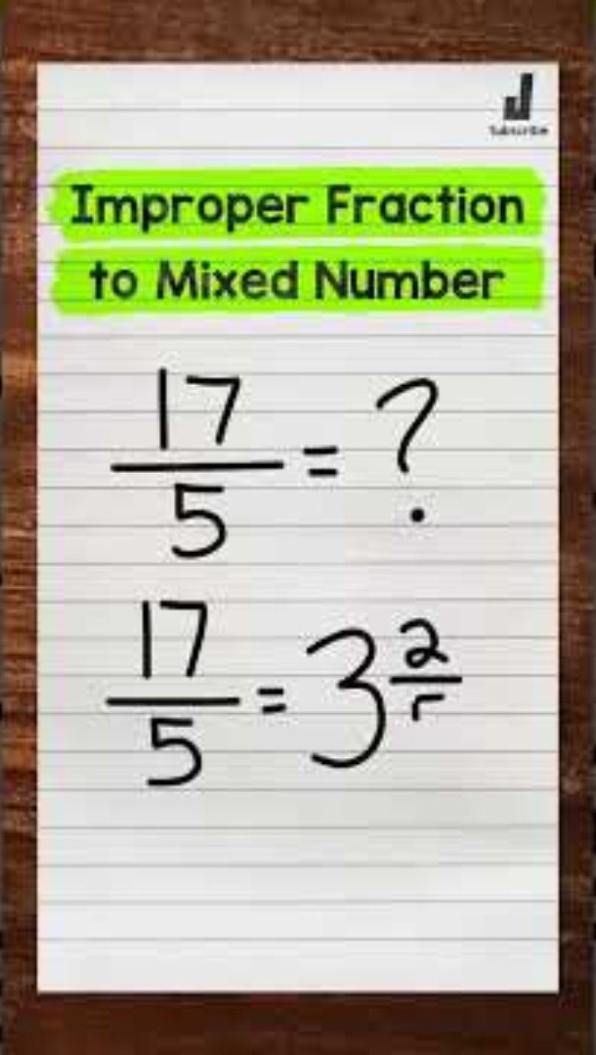


Converting Improper Fractions
Improper fraction: The numerator is larger than the denominator.
Mixed number: A whole number and a fraction.
Example
How many times does 3 go into 7? How much is left over?
$$\frac{7}{3}$$
$$\frac{1}{3}$$
2
Notes:
Instructional Activity: Present Content, Recall, Provide Learning Guidance
Instructional Time: 4 min.
Talking Points:
Sometimes the solution to a math problem results in an improper fraction.
Remember, an improper fraction has a numerator that is larger than the denominator.
It can be helpful to convert improper fractions to a mixed number, which combines a whole number and a fraction.
Take a moment to watch this short video. It will show you how to convert an improper fraction into a mixed number.
CLICK to start the video.
After Video
CLICK - Let’s walk through an example using 7/3.
CLICK - ASK: To convert 7/3, we need to ask ourselves, how many times does 3 go into 7?
Call on learners to respond. Answer: Three goes into 7 two whole times, so 2 becomes our whole number.
Next, ask: How much is left over?
Call on learners to respond. Answer: After taking 6 out of 7, we have a remainder of 1.
CLICK - We place that remainder over our original denominator, 3. So 7/3 becomes 2 1/3.
The value hasn’t changed. We’ve simply written the same amount in a different form.

Slide 15
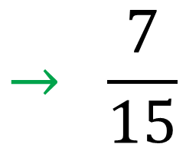
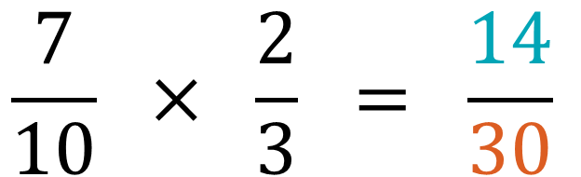
Multiplying Fractions – Group Practice 1
Method:
Multiply the numerators.
Multiply the denominators .
Reduce the fraction to simplest form, if possible.
$$\frac{7}{10} × \frac{2}{3} = \frac{14}{30}$$
Divide each by 2 to simplify
$$→ \frac{7}{15}$$
Notes:
*This slide contains animations. CLICK to reveal content.
Instructional Activity: Provide Learning Guidance
Instructional Time: 3 min.
Do:
Work through steps 1, 2, and 3 in order by calling on learners to share their response.
CLICK to reveal the answer.
Answer questions and provide feedback as needed.
Answer Key:
7 x 2 = 14
10 x 3 = 30
Divide each by 2 to simplify
Final Answer = 7/15

Slide 16

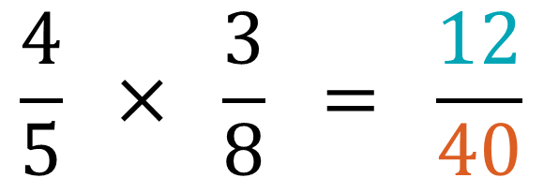
Multiplying Fractions – Group Practice 2
Method:
Multiply the numerators.
Multiply the denominators.
Reduce the fraction to simplest form, if possible.
$$\frac{4}{5} × \frac{3}{8} = \frac{12}{40}$$
Divide each by 4 to simplify
$$→ \frac{3}{10}$$
Notes:
*This slide contains animations. CLICK to reveal content.
Instructional Activity: Provide Learning Guidance
Instructional Time: 3 min.
Do:
Work through steps 1, 2, and 3 in order by calling on learners to share their response.
CLICK to reveal the answer.
Answer questions and provide feedback as needed.
Answer Key:
4 x 3 = 12
5 x 8 = 40
Divide each by 4 to simplify
Final Answer = 3/10

Slide 17
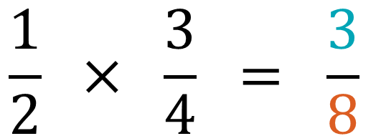
Multiplying Fractions – Group Practice 3
Method:
Multiply the numerators.
Multiply the denominators.
Reduce the fraction to simplest form, if possible.
$$\frac{1}{2} × \frac{3}{4} = \frac{3}{8}$$
This fraction is already in simplest form.
Notes:
*This slide contains animations. CLICK to reveal content.
Instructional Activity: Provide Learning Guidance
Instructional Time: 3 min.
Do:
Work through steps 1, 2, and 3 in order by calling on learners to share their response.
CLICK to reveal the answer.
Answer questions and provide feedback as needed.
Answer Key:
1 x 3 = 3
2 x 4 = 8
This fraction is already in simplest form.
Final Answer = 3/8

Slide 18
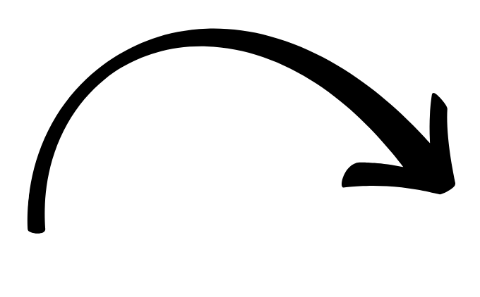
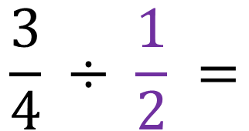


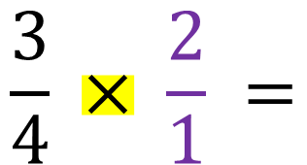
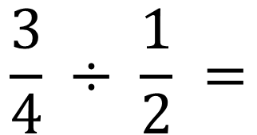
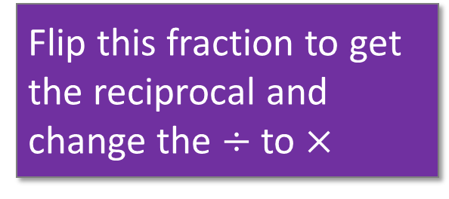
Dividing Fractions
$$\frac{3}{4} ÷ \frac{1}{2} =$$
Method
Rewrite the problem with multiplication using the reciprocal of the second fraction.
Multiply the numerators and denominators.
Reduce the fraction to simplest form, if possible.
$$\frac{3}{4} ÷ \frac{1}{2} =$$
Flip this fraction to get the reciprocal and change the $÷$ to $×$
$$\frac{3}{4} × \frac{2}{1} =$$
$$\frac{6}{4}$$
Divide each by 2 to simplify
$$\frac{3}{2}$$
Notes:
*This slide contains animations. CLICK to reveal content.
Instructional Activity: Present Content, Recall, Provide Learning Guidance
Instructional Time: 4 min.
Talking Points:
Dividing fractions is very similar to multiplying fractions.
In fact, we are going to change the equation from division to multiplication by adding one simple step.
ASK: Who remember what a reciprocal is?
Call on learners to respond. Answer: A fraction created by flipping the numerator and denominator of another fraction.
That’s right. To get the reciprocal all we have to do is flip it! That’s our first step.
We only flip the fraction we are dividing by which is the second one. The first fraction stays exactly the same.
CLICK - First, we’ll rewrite the problem with multiplication using the reciprocal of the second fraction.
In this example, that means we will have ¾ multiplied by 2/1.
Next, we’ll multiply our numerators and denominators.
CLICK – In this example, we multiply 3 x 2 to get 6 as our numerator
CLICK – and 4 x 1 to get 4 as our denominator.
Finally, we’ll reduce our fraction to simplest form.
CLICK – In this example, we can divide each number by 2.
Our final answer is 3/2.
Source: TabletClass Math. (2023, December 6). Learn fractions in 9 minutes! [Video]. YouTube. https://www.youtube.com/watch?v=GvPB9B9fG04

Slide 19

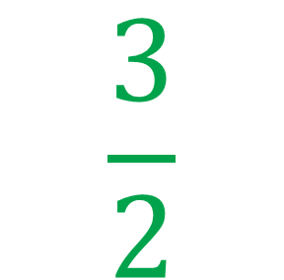
Converting Improper Fractions to Mixed Numbers
Improper Fraction
Mixed Number
$$\frac{3}{2}$$
How many times does 2 go into 3? How much is left over?
$$\frac{1}{2}$$
1
Notes:
*This slide contains animations. CLICK to reveal content.
Instructional Activity: Present Content, Recall, Provide Learning Guidance
Instructional Time: 4 min.
Talking Points:
Let’s stick with the fraction 3/2 for a moment.
Since this is an improper fraction, let’s convert it to a mixed number.
CLICK - How many times does How many times does 2 go into 3? How much is left over?
Call on learners to respond. Answer: 2 goes into 3 one time and there is one left over.
CLICK - Great! That makes our mixed number 1 ½.

Slide 20
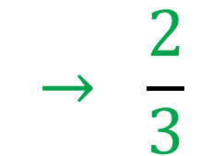
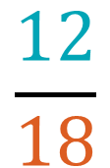
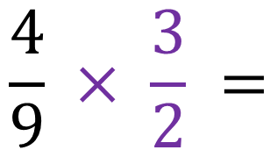
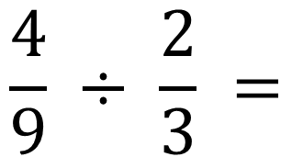
Dividing Fractions – Group Practice 1
Method
Rewrite the problem with multiplication using the reciprocal of the second fraction.
Multiply the numerators and denominators.
Reduce the fraction to simplest form, if possible.
$$\frac{4}{9} ÷ \frac{2}{3} =$$
$$\frac{4}{9} × \frac{3}{2} =$$
$$\frac{12}{18}$$
Divide each by 6 to simplify
$$→ \frac{2}{3}$$
Notes:
*This slide contains animations. CLICK to reveal content.
Instructional Activity: Provide Learning Guidance
Instructional Time: 3 min.
Do:
Work through steps 1, 2, and 3 in order by calling on learners to share their response.
CLICK to reveal the answer.
Answer questions and provide feedback as needed.
Answer Key:
Filp the fraction 2/3 to be 3/2 and change the division sign to multiplication.
Multiply the numerators 4 x 3 to get 12. Multiply the denominators 9 x 2 to get 18.
Divide each by 6 to reduce the fraction to simplest form.
Final Answer = 2/3

Slide 21
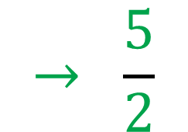
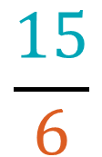
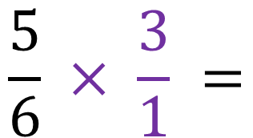
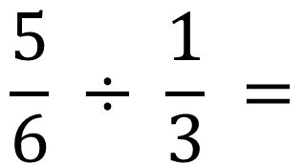
Dividing Fractions – Group Practice 2
Method
Rewrite the problem with multiplication using the reciprocal of the second fraction.
Multiply the numerators and denominators.
Reduce the fraction to simplest form, if possible.
$$\frac{5}{6} ÷ \frac{1}{3} =$$
$$\frac{5}{6} × \frac{3}{1} =$$
$$\frac{15}{6}$$
Divide each by 3 to simplify
$$→ \frac{5}{2}$$
Notes:
*This slide contains animations. CLICK to reveal content.
Instructional Activity: Provide Learning Guidance
Instructional Time: 3 min.
Do:
Work through steps 1, 2, and 3 in order by calling on learners to share their response.
CLICK to reveal the answer.
Answer questions and provide feedback as needed.
Answer Key:
Filp the fraction 1/3 to be 3/1 and change the division sign to multiplication.
Multiply the numerators 5 x 3 to get 15. Multiply the denominators 6 x 1 to get 6.
Divide each by 3 to reduce the fraction to simplest form.
Final Answer = 5/2

Slide 22
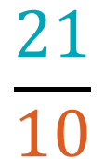
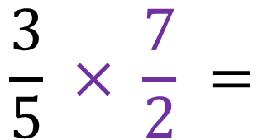
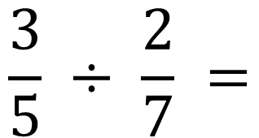
Dividing Fractions – Group Practice 3
Method
Rewrite the problem with multiplication using the reciprocal of the second fraction.
Multiply the numerators and denominators.
Reduce the fraction to simplest form, if possible.
$$\frac{3}{5} ÷ \frac{2}{7} =$$
$$\frac{3}{5} × \frac{7}{2} =$$
$$\frac{21}{10}$$
This fraction is already in simplest form.
Notes:
*This slide contains animations. CLICK to reveal content.
Instructional Activity: Provide Learning Guidance
Instructional Time: 3 min.
Do:
Work through steps 1, 2, and 3 in order by calling on learners to share their response.
CLICK to reveal the answer.
Answer questions and provide feedback as needed.
Answer Key:
Filp the fraction 2/7 to be 7/2 and change the division sign to multiplication.
Multiply the numerators 3 x 7 to get 21. Multiply the denominators 5 x 2 to get 10.
This fraction is already in simplest form.
Final Answer = 21/10

Slide 23
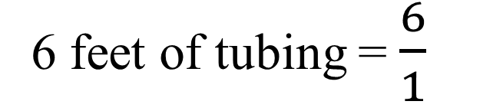
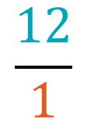
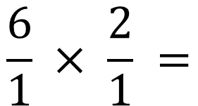
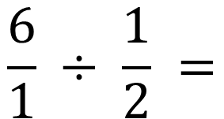
Real-World Word Example
A technician has 6 feet of tubing and needs to cut it into pieces that are each 1/2 foot long.
What operation do we need?
What is the equation?
How many pieces of tubing will the technician get from the 6 feet of tubing?
6 feet of tubing = $\frac{6}{1}$
$$\frac{6}{1} ÷ \frac{1}{2} =$$
$$\frac{6}{1} × \frac{2}{1} =$$
$$\frac{12}{1}$$
12 pieces of tubing.
Notes:
*This slide contains animations. CLICK to reveal content.
Instructional Activity: Present Content, Recall, Provide Learning Guidance
Instructional Time: 3 min.
Talking Points:
Let’s put things in context by reviewing a real-world scenario.
For instance, “A technician has 6 feet of tubing and needs to cut it into pieces that are each 1/2 foot long.”
ASK: What operation do we need to solve this equation? Multiplication or division?
Call on learners to respond. Answer: Division
CLICK - When we say, “6 feet”, we can write this as a fraction 6/1.
ASK: What would our equation be?
Call on learners to respond. CLICK to reveal answer: $\frac{6}{1} ÷ \frac{1}{2}$
Who can solve this equation for us? Remember that we need to change the equation from division to multiplication by using the reciprocal.
Call on learners to respond. CLICK to reveal answer:$\frac{6}{1} × \frac{2}{1}= \frac{12}{1}$
The fraction 12/1 is the same as simply saying 12.
This makes our final answer 12 pieces of tubing.

Slide 24
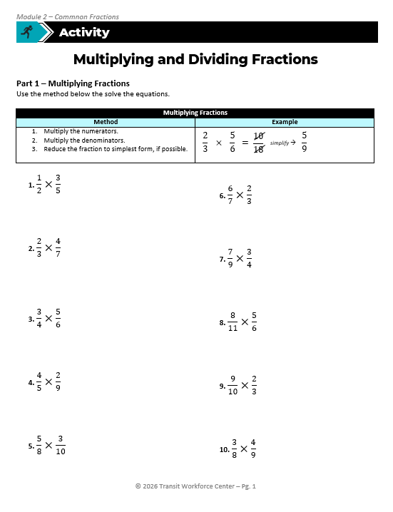
Multiplying and Dividing Fractions
Part 1 – Multiplying Fractions
Use the multiplying fractions method the solve the equations.
Part 2 – Dividing Fractions
Use the dividing fractions method the solve the equations.
Notes:
Instructional Activity: Provide Guided Learning, Elicit Performance, Provide Feedback
Instructional Time: 45 min.
Materials:
Multiplying and Dividing Fractions_M2
Multiplying and Dividing Fractions_Answer Key_M2
White board
Markers
Optional Engagement Strategy: Place participants into pairs and have each pair work through the practice problems together. Assign each pair one or more specific problems to solve on flip charts placed around the room. Have each pair present their solution to the group, explaining the process they used and how they arrived at their answer. Encourage questions and discussion.
Do:
5 min.
Refer learners to the “Multiplying and Dividing Fractions” handout embedded in the Participant Resource Guide.
Review the directions and answer any questions learners may have.
25 min.
Give learners time to work. You may have them work with partners or groups if you choose.
Circulate the room answering questions and providing feedback as needed.
15 min.
Review answers together and ask volunteers to explain their reasoning.
Consider having leaners write their answers and equations on the white board. They can then review the answer and explain their work to the class.

Slide 25
Knowledge Check
Q: Define numerator and denominator.
A: The numerator is the top number on the fraction that represents the parts being counted while the denominator is the bottom number that represents the whole.
Notes:
*This slide contains animations. CLICK to reveal content.
Instructional Activity: Evaluate/Assess Performance, Provide Feedback
Instructional Time: 2 min.
Learning Objective: Demonstrate the ability to solve mathematics problems involving fractions.
Do: Review the knowledge check question. Call on learners to share their responses.
Answer:
The numerator is the top number on the fraction that represents the parts being counted while the denominator is the bottom number that represents the whole.

Slide 26
Knowledge Check
Q: What does it mean to put a fraction in simplest form?
A: A fraction is in simplest form when it cannot be reduced any further. This means the numerator and denominator have no common factors other than 1.
Notes:
*This slide contains animations. CLICK to reveal content.
Instructional Activity: Evaluate/Assess Performance, Provide Feedback
Instructional Time: 2 min.
Learning Objective: Demonstrate the ability to solve mathematics problems involving fractions.
Do: Review the knowledge check question. Call on learners to share their responses.
Answer:
A fraction is in simplest form when it cannot be reduced any further. This means the numerator and denominator have no common factors other than 1.

Slide 27
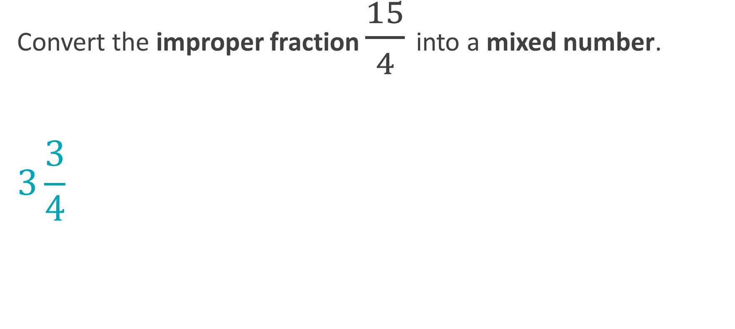
Knowledge Check
Convert the improper fraction $\frac{15}{4}$ into a mixed number.
$$3\frac{3}{4}$$
Notes:
*This slide contains animations. CLICK to reveal content.
Instructional Activity: Evaluate/Assess Performance, Provide Feedback
Instructional Time: 2 min.
Learning Objective: Demonstrate the ability to solve mathematics problems involving fractions.
Do: Review the knowledge check question. Call on learners to share their responses.
Answer:
$$3\frac{3}{4}$$

Slide 28








Knowledge Check
A maintenance worker has 4 sheets of insulation that are 3 feet long. The worker needs strips that are 1 ½ feet long for repairs. Using all the sheets how many repairs can be made?
(1.) What is the total amount of insulation?
4 sheets x 3 feet long = 12 feet
(2.) What is the equation?
(3.) What is the solution?
12
$$÷$$
1
$$\frac{1}{2}$$
Convert the mixed number to an improper fraction
$$÷$$
$$\frac{3}{2}$$
12
Rewrite division as multiplication
$$\frac{12}{1}$$
$$×$$
$$\frac{2}{3}$$
Solve and simplify
$$\frac{24}{3}$$
= 8
Notes:
*This slide contains animations. CLICK to reveal content.
Instructional Activity: Evaluate/Assess Performance, Provide Feedback
Instructional Time: 3 min.
Learning Objective: Solve multiplication and division problems involving fractions.
Do: Review the knowledge check question. Call on learners to share their responses.
Answer:
4 x 3 = 12
12 $÷1\frac{1}{2}$
CLICK to reveal the steps below on the slide…
Equation: 12 $÷1\frac{1}{2}$
Step 1: 12$÷ \frac{3}{2}$
Step 2: $\frac{12}{1} ÷ \frac{2}{3}$
Step 3: $\frac{24}{3} =8 repairs for each worker$

Slide 29
Summary and What’s Next
Multiply: Multiply across, then simplify
Divide: Flip the fraction to get the reciprocal, then multiply
Always check if your answer can be simplified
Next, we’ll learn about adding and subtracting fractions.
Notes:
Instructional Activity: Enhance Retention and Transfer
Instructional Time: 3 min.
Do:
Review the key takeaways from this section of the module.
Clearly explain how to connects to the next section of the module.
Talking Points:
When multiplying fractions, we multiply straight across the top numbers and bottom numbers. Then simplify if possible.
When dividing fractions, we keep the first fraction as it is but change division to multiplication by using the reciprocal of the second fraction. Then we multiply and simplify.
Remember – reciprocal means flip it!
In both cases, it’s important to check your final answer and reduce it to simplest form when you can.
Now, we’re going to build on our new learning by looking at adding and subtracting fractions.
Unlike multiplying and dividing, we can’t just go straight across. We need to make sure the fractions have a common denominator first.

Slide 30

2.2 – Adding and Subtracting fractions
In this section, we’ll learn how to cross multiply to add and subtract fractions.
Notes:
Instructional Activity: Direction
Instructional Time: 1 min.
Do: Introduce the section.
Talking Points: In this section, we’ll learn how to cross multiply to add and subtract fractions.

Slide 31
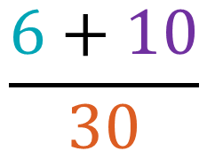
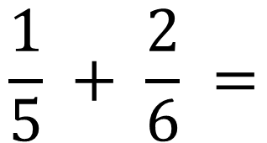
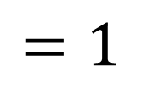


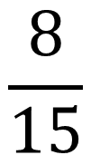
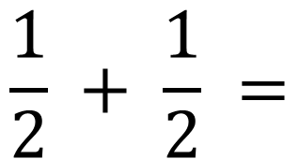
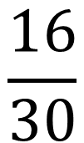
Adding and Subtracting Fractions
Method
If the denominators are the same, add/subtract the numerators.
If the denominators are not the same, create a common denominator by cross multiplying. Then and add/subtract the numerators.
Solve the equation and reduce the fraction to simplest form, if possible.
$$\frac{1}{2} + \frac{1}{2} =$$
$$\frac{2}{2}$$
$$=1$$
$$\frac{1}{5} + \frac{2}{6} =$$
$$\frac{6+10}{30}$$
$$\frac{16}{30}$$
$$\frac{8}{15}$$
$$=$$
Notes:
*This slide contains animations. CLICK to reveal content.
Instructional Activity: Present Content, Provide Learning Guidance
Instructional Time: 4 min.
Talking Points:
Adding and subtracting fraction can be a little trickier than multiplying and dividing fractions.
However, If the denominators are the same, the process is straightforward. We keep the denominator the same and just add or subtract the numerators. Keep the denominators the same.
CLICK - For example, one-half plus one-half equals two-halves, which simplifies to one.
If the denominators are different, we need to create a common denominator before we can combine the fractions.
A common denominator is the smallest number that two or more denominators can all divide into evenly.
One way to do this is by cross multiplying. That means we multiply each numerator by the opposite denominator.
Once the denominators match, we can add or subtract the numerators.
CLICK - For example, 5 x 6 gives us a common denominator of 30.
If we cross multiply 6 x 1 and 5 x 2 we get 6 + 10 as our numerator.
Adding 6 + 10 will give us our new fraction of 16/30.
Finally, just like before, we simplify the fraction if possible.
CLICK – In this case, 16/30 can be reduced to 8/15.
This process is important because, unlike multiplying and dividing, we cannot combine fractions unless they represent equal-sized parts.
Source: TabletClass Math. (2023, December 6). Learn fractions in 9 minutes! [Video]. YouTube. https://www.youtube.com/watch?v=GvPB9B9fG04

Slide 32





Adding and Subtracting Fractions –Practice 1
Method
If the denominators are the same, add/subtract the numerators.
If the denominators are not the same, create a common denominator by cross multiplying. Then and add/subtract the numerators.
Solve the equation and reduce the fraction to simplest form, if possible.
$$\frac{5}{6} − \frac{1}{3} =$$
$$\frac{15−6}{18}$$
$$\frac{9}{18}$$
$$\frac{1}{2}$$
$$=$$
Notes:
*This slide contains animations. CLICK to reveal content.
Instructional Activity: Provide Learning Guidance
Instructional Time: 3 min.
Do:
Work through steps 1, 2, and 3 in order by calling on learners to share their response.
CLICK to reveal the answer.
Answer questions and provide feedback as needed.
Answer Key:
The denominators are not the same, we so need to cross multiply.
Cross multiply to find a common denominator.
Denominator: 6 X 3 = 18
Numerator: 15 – 6
The fraction 9/18 can be reduced to 1/2.

Slide 33





Adding and Subtracting Fractions –Practice 2
Method
If the denominators are the same, add/subtract the numerators.
If the denominators are not the same, create a common denominator by cross multiplying. Then and add/subtract the numerators.
Solve the equation and reduce the fraction to simplest form, if possible.
$$\frac{1}{6}+ \frac{3}{8} =$$
$$\frac{18+8}{48}$$
$$\frac{26}{48}$$
$$\frac{13}{24}$$
$$=$$
Notes:
*This slide contains animations. CLICK to reveal content.
Instructional Activity: Provide Learning Guidance
Instructional Time: 3 min.
Do:
Work through steps 1, 2, and 3 in order by calling on learners to share their response.
CLICK to reveal the answer.
Answer questions and provide feedback as needed.
Answer Key:
The denominators are not the same, we so need to cross multiply.
Cross multiply to find a common denominator.
Denominator: 6 X 8 = 48
Numerator: 18 + 8
The fraction 26/48 can be reduced to 13/24.

Slide 34


Adding and Subtracting Fractions –Practice 3
Method
If the denominators are the same, add/subtract the numerators.
If the denominators are not the same, create a common denominator by cross multiplying. Then and add/subtract the numerators.
Solve the equation and reduce the fraction to simplest form, if possible.
$$\frac{9}{16} − \frac{6}{16}=$$
$$\frac{3}{16}$$
Notes:
*This slide contains animations. CLICK to reveal content.
Instructional Activity: Provide Learning Guidance
Instructional Time: 2 min.
Do:
Work through steps 1, 2, and 3 in order by calling on learners to share their response.
CLICK to reveal the answer.
Answer questions and provide feedback as needed.
Answer Key:
The denominators are the same, so we keep 16 as our denominator. Then we subtract 9 - 6.
We don’t need to cross multiply to find a common denominator.
The final answer is 3/16. This fraction is already in its simplest form.

Slide 35

Adding and Subtracting Fractions
Directions: Use the method below the solve the equations.
Method:
If the denominators are the same, add/subtract the numerators.
If the denominators are not the same, create a common denominator by cross multiplying. Then and add/subtract the numerators.
Solve the equation and reduce the fraction to simplest form, if possible
Notes:
Instructional Activity: Provide Guided Learning, Elicit Performance, Provide Feedback
Instructional Time: 30 min.
Materials:
Adding and Subtracting Fractions_M2
Adding and Subtracting Fractions_Answer Key_M2
White board
Markers
Do:
2 min.
Refer learners to the “Adding and Subtracting Fractions” handout embedded in the Participant Resource Guide.
Review the directions and answer any questions learners may have.
15 min.
Give learners time to work. You may have them work with partners or groups if you choose.
Circulate the room answering questions and providing feedback as needed.
13 min.
Review answers together and ask volunteers to explain their reasoning.
Consider having leaners write their answers and equations on the white board. They can then review the answer and explain their work to the class.

Slide 36
Knowledge Check
Q: When is cross multiplication needed?
A: We need to cross multiply when the denominators in an addition or subtraction problem are not the same.
Notes:
*This slide contains animations. CLICK to reveal content.
Instructional Activity: Evaluate/Assess Performance, Provide Feedback
Instructional Time: 2 min.
Learning Objective: Solve addition and subtraction problems involving fractions.
Do: Review the knowledge check question. Call on learners to share their responses.
Answer:
We need to cross multiply when the denominators in an addition or subtraction problem are not the same.

Slide 37
Summary and What’s Next
When the denominators are the same - add/subtract the numerators
When the denominators are different – cross multiply to find a common denominator
Always simply your final answer
Next, we’ll learn about combining operations with fractions.
Notes:
Instructional Activity: Enhance Retention and Transfer
Instructional Time: 3 min.
Do:
Review the key takeaways from this section of the module.
Clearly explain how to connects to the next section of the module.
Talking Points:
Let’s wrap up what we’ve learned about adding and subtracting fractions.
When the denominators are the same, we can simply add or subtract the numerators and keep the denominator the same.
When the denominators are different, we need to create a common denominator first. One way to do that is by cross multiplying so the fractions represent equal-sized parts.
We should always check our final answer and simplify it if possible.
Now that we can add and subtract fractions, we’re ready to take the next step.
Next, we’ll learn how to combine multiple operations with fractions, which brings together everything we’ve practiced so far.

Slide 38

2.3 – Combining Operations with Fractions
Next, we’ll learn how to combine operations with fractions.
Notes:
Instructional Activity: Direction
Instructional Time: 2 min.
Do: Introduce the section.
Talking Points: Next, we’ll learn how to combine operations with fractions.

Slide 39

PEMDAS: Order of Operations
This resource from Module 1 – Basic Operations will be useful in this part of our lesson.
Notes:
Instructional Activity: Direction
Instructional Time: 1 min.
Materials: PEMDAS Order of Operations_M1
Do: Ask learners to take out the “PEMDAS Order of Operations_M1” resource from Module 1. This will be a useful resource for this part of the lesson.
Talking Points:
In this section of our lesson, we’ll be building off what we learned about basic operations in Module 1.
You may want to have the “PEMDAS Order of Operations” handout from Module 1 in front of you.
It should be embedded in your Participant Resource Guide and will be a useful reference for this part of our lesson.

Slide 40

Video Link: https://www.youtube.com/watch?v=hfVKWJxGYE8
Notes:
*This slide contains animations. CLICK to reveal content.
Instructional Activity: Provide Learning Guidance, Present Content
Instructional Time: 8 min.
Materials:
Video Link: https://www.youtube.com/watch?v=hfVKWJxGYE8
Note taking space in Participant Resource Guide
Do: Play the video.
Talking Points:
Use the note taking space in your Participant Resource Guide to follow along with the video.
Record the examples as the instructor in the video work through the equations.
Source: Math with Mr. J. (2023, July 23). Order of operations with fractions [Video]. YouTube. https://www.youtube.com/watch?v=hfVKWJxGYE8

Slide 41





Combining Operations with Fractions
Method:
Use PEMDAS to solve the equation on the top of the division bar.
Use PEMDAS to solve the equation on the bottom of the division bar.
Reduce the fraction to simplest form, if possible.
$$\frac{8+4 ×3}{10÷2}$$
Always work from LEFT to RIGHT
$$\frac{8+12}{10÷2}$$
$$\frac{20}{10÷2}$$
$$\frac{20}{5}$$
$$\frac{4}{1}$$
=
= 4
Notes:
*This slide contains animations. CLICK to reveal content.
Instructional Activity: Provide Learning Guidance
Instructional Time: 4 min.
Do:
Review the method for solving equations that combine operations with fractions.
Work through the example problem together as a group.
Call on learners to share their responses and provide feedback as needed.
Talking Points:
When it comes to combining operations with fractions, we’ll use the following steps to solve equations.
First, use PEMDAS to solve the equation on the top of the division bar.
Next, use PEMDAS to solve the equation on the bottom of the division bar.
Remember to always work from LEFT to RIGHT.
Lastly, we’ll reduce the fraction to simplest form, if possible.
Let’s work through a practice problem together. We’ll start with the equation on top of the division bar.
ASK: What operation do we need to do first?
Call on learners to respond. CLICK to reveal the answer: Multiplication comes first, 4 x 3 = 12 so the top bar will be 8+12
ASK: Staying with the top of the division bar, what operation comes next?
Call on learners to respond. CLICK to reveal the answer: Addition comes next, so the top bar will be 8 + 12 = 20.
Great! We’re ready to move onto the bottom bar. There is only one operation here.
ASK: What is $10÷2?$
Call on learners to respond. CLICK to reveal the answer: 5
Ok, all we need to do now is reduce this fraction to its simplest form.
ASK: What is the simplest form of 12/5?
Call on learners to respond. CLICK to reveal the answer: 4/1 = 4

Slide 42







Combining Operations with Fractions
Method:
Use PEMDAS to solve the equation on the top of the division bar.
Use PEMDAS to solve the equation on the bottom of the division bar.
Reduce the fraction to simplest form, if possible.
$$\frac{24 −6+2 ×5}{\left(18 −6\right)÷(2×3)}$$
$$\frac{28}{2}$$
$$\frac{14}{1}$$
=
$$\frac{24 −6+10}{\left(18 −6\right)÷(2×3)}$$
= 14
$$\frac{28}{\left(18 −6\right)÷(2×3)}$$
$$\frac{28}{\left(18 −6\right)÷6}$$
$$\frac{28}{12÷6}$$
Notes:
*This slide contains animations. CLICK to reveal content.
Instructional Activity: Provide Learning Guidance
Instructional Time: 4 min.
Do:
Review the method for solving equations that combine operations with fractions.
Work through the example problem together as a group.
Call on learners to share their responses and provide feedback as needed.
Answer Key:
Original Equation - $\frac{24 −6+2 ×5}{\left(18 −6\right)÷(2×3)}$
CLICK - $\frac{24 −6+10}{\left(18 −6\right)÷(2×3)}$
CLICK - $\frac{28}{\left(18 −6\right)÷(2×3)}$
CLICK - $\frac{28}{\left(18 −6\right)÷6}$
CLICK - $\frac{28}{12÷6}$
CLICK - $\frac{28}{2}$
CLICK - $\frac{14}{1}$ = 14

Slide 43

Combining Operations with Fractions
Directions: Use the method below the solve the equations.
Method:
Use PEMDAS to solve the equation on the top of the division bar.
Use PEMDAS to solve the equation on the bottom of the division bar.
Reduce the fraction to simplest form, if possible.
Always work from LEFT to RIGHT
Notes:
Instructional Activity: Provide Guided Learning, Elicit Performance, Provide Feedback
Instructional Time: 30 min.
Materials:
Combining Operations with Fractions_M2
Combining Operations with Fractions_Answer Key_M2
White board
Markers
Do:
2 min.
Refer learners to the “Combining Operations with Fractions ” handout embedded in the Participant Resource Guide.
Review the directions and answer any questions learners may have.
15 min.
Give learners time to work. You may have them work with partners or groups if you choose.
Circulate the room answering questions and providing feedback as needed.
13 min.
Review answers together and ask volunteers to explain their reasoning.
Consider having leaners write their answers and equations on the white board. They can then review the answer and explain their work to the class.

Slide 44
Knowledge Check
Q: True or False: Always solve equations using PEMDAS from right to left.
True
False
False
Notes:
*This slide contains animations. CLICK to reveal content.
Instructional Activity: Evaluate/Assess Performance, Provide Feedback
Instructional Time: 2 min.
Learning Objective: Demonstrate the ability to solve mathematics problems involving fractions.
Do: Review the knowledge check question. Call on learners to share their responses.
Answer:
False – always solve from LEFT to RIGHT

Slide 45

Knowledge Check
Q: What is the solution to this equation?
$$\frac{12+3^{2 }−1}{8^{2} −24}$$
(A). 17/8
(B). 1/20
(C). 9/20
(D). 1/2
(D). 1/2
Notes:
*This slide contains animations. CLICK to reveal content.
Instructional Activity: Evaluate/Assess Performance, Provide Feedback
Instructional Time: 3 min.
Learning Objective: Use the order of operations to solve problems involving fractions accurately.
Do: Review the knowledge check question. Call on learners to share their responses.
Answer:
D.) $\frac{1}{2}$
$\frac{12+3^{2 }−1}{8^{2} −24}$ = $\frac{12+9−1}{8^{2} −24}$ = $\frac{20}{8^{2} −24}$ = $\frac{20}{64 −24}$ = $\frac{20}{40}$ = $\frac{1}{2}$

Slide 46

Quiz
Time for a quiz! Let’s see what you have learned from today’s lesson.
Notes:
Instructional Activity: Direction, Evaluate/Assess Performance
Instructional Time: 20 min.
Materials: Quiz_M2
Do:
Ask learners if they have any lingering questions. Address them before distributing the quiz.
Pass out the quiz and review the directions.
Talking Points:
Time for a quiz! Let’s see what you have retained from today’s lesson.

Slide 47
Revisiting Objectives
Demonstrate the ability to solve mathematics problems involving fractions.
  Solve multiplication and division problems involving fractions.
  Solve addition and subtraction problems involving fractions.
  Use the order of operations to solve problems involving fractions accurately.
Notes:
Instructional Activity: Enhance Transfer and Retention
Instructional Time: 5 min.
Do: Facilitate a short discussion to review the key topics in the lesson.
Talking Points:
If you were explaining today’s objectives to someone else, how would you summarize what they mean and why they matter?
Which of today’s objectives do you feel most confident about? Which were most challenging? Explain your reasoning.
Can you give an example of how you could apply one of today’s objectives in a real-world situation?
After Discussion:
This conclude this section of the module. Thank you for your participation.

Slide 48
Thank you!
Notes:
Instructional Activity: Enhance Transfer and Retention
Instructional Time: 2 min.
Do:
Thank learners for their participation.
If possible, stay after class to answer any lingering questions learners may have.

