Slide 1


Instructor Guide Snapshot
Icon Key
Activity:
Video:
Instructor Demo:
Knowledge Check:
Instructional Time: 2.5 Hrs
Preparation before class:
  Review all materials - Review all slides, talking points, and handouts before class to understand the structure and flow of the lesson. Pay special attention to animations within the slides.
  Slide 8 – Add notes about the policies and procedures around using calculators or a personal device that contains a calculator while on the job at your facility.
Provided Course Materials:
  +Basic Operations_M1
  Choosing the Right Operation_M1
  Choosing the Right Operation_Answer Key_M1
  Order of Operation Practice_M1
  Order of Operation Practice_Answer Key_M1
  PEMDAS Order of Operations_M1
  Quiz_Answer Key_M1
  Quiz_M1

Slide 2
Pacing Guide
Times have been rounded to the nearest .25 hours.
Total Time: 2.5 Hours
  (.25 Hr) Welcome and Warm Up
  (.75 Hr) 1.1 – Basic Operations
  (1 Hr) 1.2 – Order of Operations
  (.5 Hr) Quiz and Wrap Up

Slide 3
Basic Operations
Shop Math
Transit Core Competencies Curriculum (TC3)
Notes:
Instructional Activity: Direction
Instructional Time: 1 min.
Do: Welcome learners to class. Introduce the course and module.

Slide 4
Objectives
Demonstrate the ability to solve mathematics problems involving whole numbers.
  Choose the correct operation based on a given problem.
  Use the order of operations to solve problems accurately.
Notes:
Instructional Activity: Direction
Instructional Time: 1 min.
Do: Review the module objectives.

Slide 5

Agenda
Welcome and Warm Up
1.1 – Basic Operations
1.2 – Order of Operations
Quiz and Wrap Up
Notes:
Instructional Activity: Direction
Instructional Time: 1 min.
Do:
Review the module agenda.
Remind learners that they have a Participant Guide Resource which they can use for optional notetaking.

Slide 6


Warm Up
Scenario: During a busy shift, Chris and Elena need to estimate how long a job will take before the next train arrives. The job requires 5 minutes of prep time, and each component takes 4 minutes to install. There are 6 components total. The next train arrives in 30 minutes.
Discuss:
How could the wrong estimate impact service or safety?
Which math operations do they need?
Why did they get different answers?
Elena: 29 minutes
Chris: 54 minutes
5 + (4 × 6)
5 + 24
29 min.
5 + (4 × 6)
9 x 6
54 min.
Notes:
*This slide contains animations. CLICK to reveal content.
Instructional Activity: Gain Attention
Instructional Time: 10 mins.
Talking Points:
We’ll kick off today’s lesson with a brief scenario discussion.
Here is our scenario:
During a busy shift, two technicians, Chris and Elena, need to estimate how long a job will take before the next train arrives. The job requires 5 minutes of prep time, and each component takes 4 minutes to install. There are 6 components total. The next train arrives in 30 minutes.
ASK: How could the wrong estimate impact service or safety?
Call on learners to respond. Answers may include delayed service, customer frustration, supervisor accountability, safety risks if rushed, etc.
ASK: Which math operation are needed for this equation? Do they need to add, subtract, multiply, or divide?
Call on learners to respond. Answer: addition and multiplication
CLICK: Let’s see their work.
ASK: Why did they get different answers?
Call on learners to respond. Answer: Elena multiplied 4 x 6 and then added 5. Chris added 5 + 4 and then multiplied by 6.
As you can see, simple mistakes can have real-world consequences.
In our lesson today, we’ll review basic math operations and the correct order of operations for solving equations.
We will return to Elena and Chris shortly.

Slide 7
Key Terms
Equation - An equation is a mathematical statement that shows two values are equal, using an equals sign (=).
Solution - A solution is the correct answer to an equation.
Both sides of the equation have the same value
8 + 4 = 12
The value that makes the equation true
Notes:
Instructional Activity: Present Content
Instructional Time: 2 min.
Talking Points:
As we dive deeper into our lesson topic, you will hear the following terms frequently.
CLICK - An equation is a mathematical statement that shows two values are equal, using an equal sign (=). Both sides of the equation have the same value. We have 12 on the left and 12 on the right of the equal sign.
CLICK - A solution is the correct answer to an equation. A solution is the value that makes the equation true. In this case, 12.

Slide 8
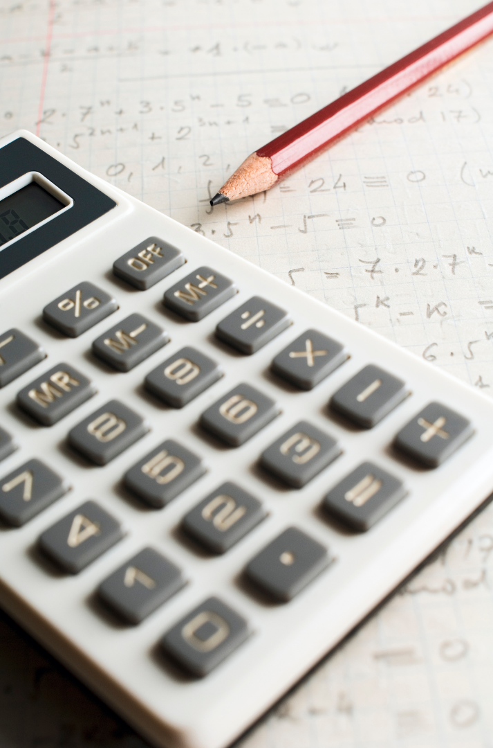
1.1 – Basic Operations
In this section we’ll review the purpose and function of the four major math operations.
Notes:
Instructional Activity: Direction
Instructional Time: 2 min.
Do: Introduce the section.
Talking Points:
In this section we’ll review the purpose and function of the four major math operations.
Note for instructors: If this section is not needed for your learners, please skip and move to the next.

Slide 9
Basic Operations
Basic operations are the four fundamental ways we work with numbers. They include addition, subtraction, multiplication, and division.
Notes:
Instructional Activity: Present Content
Instructional Time: 1 min.
Talking Points:
Basic operations are the four fundamental ways we work with numbers.
There are four basic operations in math: addition, subtraction, multiplication, and division.
Think of these as the foundational building blocks of math.

Slide 10
Basic Operations
Addition is combining values to find a total.
5,000 Morning steps
3,500 Afternoon
steps
=
8,500 Total
steps
Notes:
Instructional Activity: Present Content
Instructional Time: 2 min.
Talking Points:
Addition (+): Addition is combining values to find a total.
For example, you add the number of steps you walked in the morning and the evening to get your total for the day.

Slide 11
Basic Operations
Subtraction is finding the difference between values.
$475 Before groceries
$150
After groceries
=
$325 Remaining money
Notes:
Instructional Activity: Present Content
Instructional Time: 2 min.
Talking Points:
Subtraction (-): Subtraction is finding the difference between values or what's left over.
A common example is checking how much money you have left after buying groceries.

Slide 12
Basic Operations
Multiplication is a shortcut for repeated addition.
$5
Lunch
7
Days a week
=
$35
Cost per week
Notes:
Instructional Activity: Present Content
Instructional Time: 2 min.
Talking Points:
Multiplication (x): Multiplication is a shortcut for repeated addition.
Instead of adding $5 for lunch each day over 7 days, you multiply 5 × 7 to find the total cost for the week.

Slide 13


Basic Operations
Division is used for splitting a value into equal parts or groups.
1 8 = 1/8
of a pizza per person
Notes:
Instructional Activity: Present Content
Instructional Time: 2 min.
Talking Points:
Division is used for splitting a value into equal parts or groups.
For instance, you divide one pizza into 8 slices, so everyone gets an equal share.

Slide 14
Choosing the Right Operation
Problems won’t always tell you which operation to use
Workers must decide based on the situation
Ask Yourself:
  What am I trying to find?
  Am I combining, comparing, grouping, or splitting?
Notes:
Instructional Activity: Present Content
Instructional Time: 2 min.
Talking Points:
In real-world work environments, problems don’t come labeled as addition, subtraction, multiplication, or division.
It’s up to you to figure out which operation makes sense based on the situation.
A good starting point is to ask yourself:
What am I trying to find?
Am I combining amounts, finding a difference, working with equal groups, or splitting something evenly?
The math itself may be simple, but choosing the correct operation is where mistakes often happen.
If the wrong operation is used, the final answer will be incorrect—even if the math is done correctly.
This is why understanding the situation is just as important as knowing how to calculate.
Let’s do some practice problems to get a feel for choosing the correct operation.

Slide 15
Choose, Solve, Explain
A technician installs 6 sensors in the morning and 9 sensors in the afternoon. How many sensors were installed in total?
Which operation do we need to use?
Explain your choice.
What is the solution?
Addition
6 + 9 =
15 sensors
Notes:
*This slide contains animations. CLICK to reveal content.
Instructional Activity: Provide Learning Guidance
Instructional Time: 3 min.
Do:
Review the scenario.
Call on learners to complete questions 1-3.
CLICK to reveal the answer.

Slide 16
Choose, Solve, Explain
A crew has 36 inspection tasks to complete. There are 6 technicians on the team. How many tasks should each worker have to distribute work evenly?
Which operation do we need to use?
Explain your choice.
What is the solution?
Division
36 6 =
6 tasks each
Notes:
*This slide contains animations. CLICK to reveal content.
Instructional Activity: Provide Learning Guidance
Instructional Time: 3 min.
Do:
Review the scenario.
Call on learners to complete questions 1-3.
CLICK to reveal the answer.

Slide 17
Choose, Solve, Explain
A technician starts with 30 bolts. They use 4 bolts per panel on 5 panels. How many bolts are left on the job?
Which operations do we need to use?
Explain your choice.
What is the solution?
Multiplication
Subtraction
4 x 5 = 20
30 – 20 =
10 bolts
Notes:
*This slide contains animations. CLICK to reveal content.
Instructional Activity: Provide Learning Guidance
Instructional Time: 3 min.
Do:
Review the scenario.
Call on learners to complete questions 1-3.
CLICK to reveal the answer.
Talking Points:
Let’s make things a little more challenging.
In this scenario, you will need to use TWO operations.

Slide 18
Choose, Solve, Explain
A technician is working on 4 vehicles. Each vehicle needs 3 filters. The technician wants to bring 5 extra filters just in case. How many filters does the technician need?
Which operations do we need to use?
Explain your choice.
What is the solution?
Multiplication
Addition
4 x 3 = 12
12 + 5 =
17 filters
Notes:
*This slide contains animations. CLICK to reveal content.
Instructional Activity: Provide Learning Guidance
Instructional Time: 3 min.
Do:
Review the scenario.
Call on learners to complete questions 1-3.
CLICK to reveal the answer.
Talking Points:
Let’s make things a little more challenging.
In this scenario, you will need to use TWO operations.

Slide 19
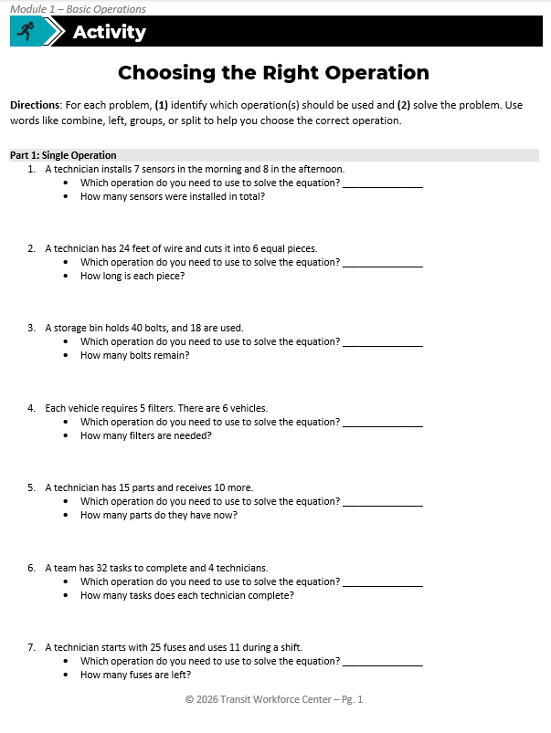
Activity: Choosing the Right Operation
Directions: For each problem, (1) identify which operation(s) should be used and (2) solve the problem.
Use the words addition, subtraction, multiplication, or division to help you choose the correct operation.
Notes:
Instructional Activity: Provide Guided Learning, Elicit Performance, Provide Feedback
Instructional Time: 22 min.
Instructor Note: Skip activity if it is too simple for your learners.
Materials:
Choosing the Right Operation_M1
Choosing the Right Operation_Answer Key_M1
White board
Markers
Do:
2 min.
Refer learners to the “Choosing the Right Operation” handout embedded in the Participant Resource Guide.
Review the directions and answer any questions learners may have.
10 min.
Give learners time to work. You may have them work with partners or groups if you choose.
Circulate the room answering questions and providing feedback as needed.
10 min.
Review answers together and ask volunteers to explain their reasoning.
Consider having leaners write their answers and equations on the white board. They can then review the answer and explain their work to the class.

Slide 20
Summary and What’s Next
Solving equations accurately is essential for a safe and efficient workplace.
Addition, subtraction, multiplication, and division are the four fundamental ways we work with numbers.
Workers must be familiar with these operations so they can choose which operations they need in real-work scenarios.
Next, we’ll learn about how to solve more complex equations in the correct order.
Notes:
Instructional Activity: Enhance Retention and Transfer, Recall
Instructional Time: 3 min.
Do:
Review the key takeaways from this section of the module.
Clearly explain how to connects to the next section of the module.
Talking Points:
Solving equations accurately is important for working safely and efficiently on the job.
Even small mistakes in math can lead to bigger problems like delays, incorrect materials, or safety risks.
We reviewed the four basic operations: addition, subtraction, multiplication, and division. These are the main ways we work with numbers in everyday tasks.
It’s not just about knowing how to do the math. It’s also about knowing which operation to use based on the situation.
On the job, no one tells you which operation to use—you have to figure that out.
Being comfortable with these operations helps you make better decisions and avoid mistakes.
Next, we’ll build on this by learning how to solve more complex equations using the correct order of operations.

Slide 21

1.2 – Order of Operations
In this section we’ll review how to solve an equation in the correct order to calculate the correct solution.
Notes:
Instructional Activity: Direction
Instructional Time: 1 min.
Do: Introduce the section.
Talking Points:
In this section we’ll review how to solve an equation in the correct order to calculate the correct solution.

Slide 22

Order of Operations
PEMDAS is an acronym that reminds us of the sequence of steps to follow when solving mathematical expressions with multiple operations.
It stands for parentheses, exponents, multiplication, division, addition, and subtraction.
The order of operations is a set of rules that tells us what math operation to do first in an expression with multiple operations.
Elena: 29 minutes
Chris: 54 minutes
5 + (4 × 6)
5 + 24
29 min.
5 + (4 × 6)
9 x 6
54 min.
Notes:
Instructional Activity: Present Content
Instructional Time: 2 min.
Talking Points:
Have you ever tried to solve a math problem, where you didn't know where to start or what to do next?
Think back to Elena and Chris from our warm up. They both solved the same equation, but they solved it in a different order and got different answers.
The order of operations is a set of rules that tells us what math operation to do first in an expression with multiple operations like addition, subtraction, multiplication, and division.
Let’s take a closer look at the order of operations so we can determine whether Elena or Chris solved the equation correctly.
Source: Mathnasium. (n.d.). Order of operations in math. https://www.mathnasium.com/blog/order-of-operations-in-math

Slide 23
PEMDAS is an acronym that reminds us of the sequence of steps to follow when solving mathematical expressions with multiple operations.
It stands for parentheses, exponents, multiplication, division, addition, and subtraction.
Notes:
Instructional Activity: Present Content
Instructional Time: 2 min.
Talking Points:
PEMDAS is an acronym that reminds us of the sequence of steps to follow when solving mathematical expressions with multiple operations.
It stands for parentheses, exponents, division, addition, and subtraction.

Slide 24
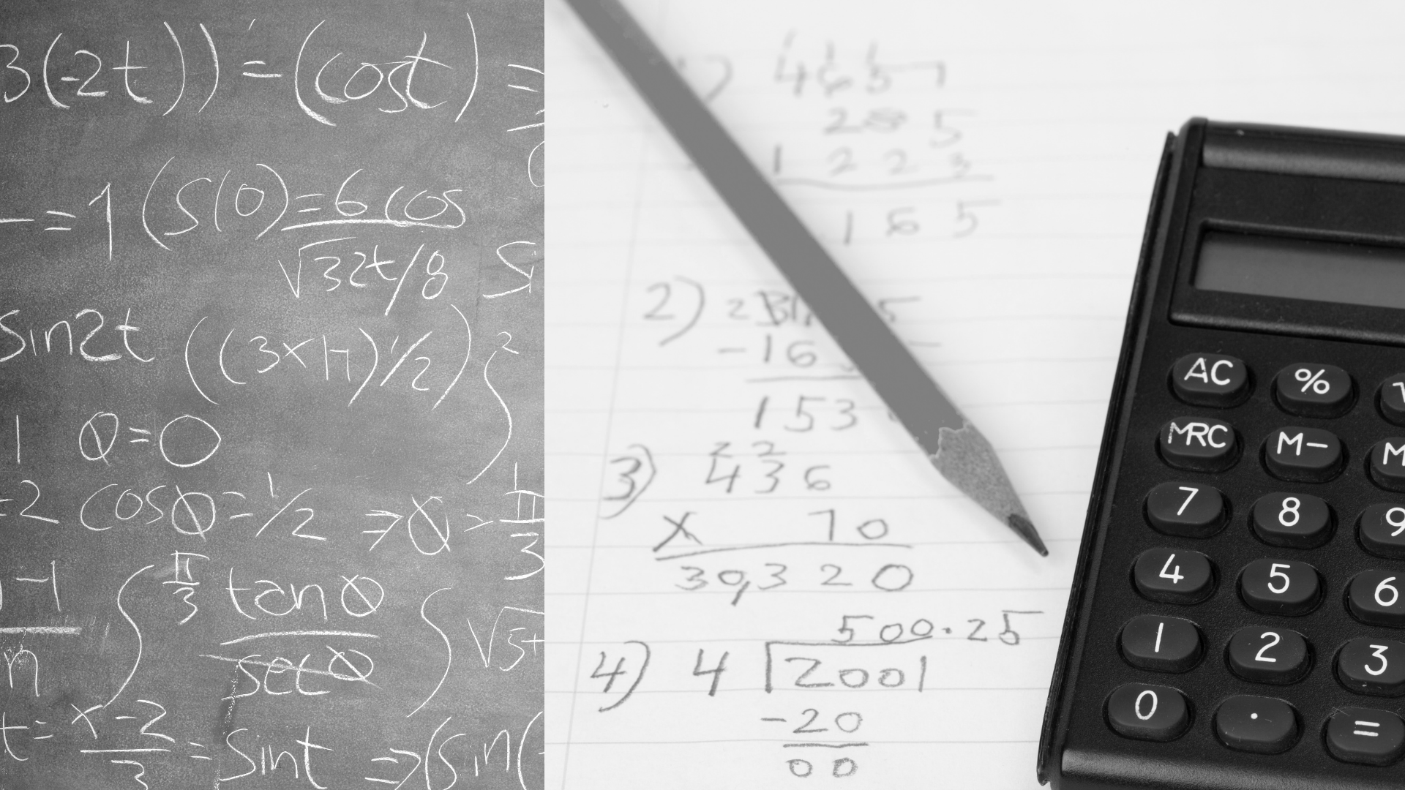
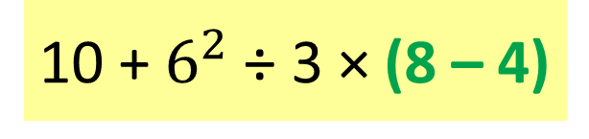
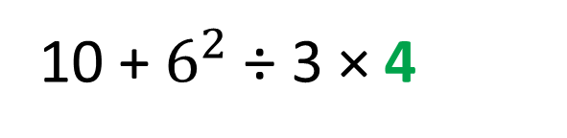
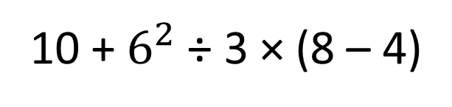
P
Parentheses
Example:
E
10 + $6^{2}$ ÷ 3 × (8 – 4)
10 + $6^{2}$ ÷ 3 × (8 – 4)
The first step to the order of operations
We must solve anything in ( ) before moving on.
10 + $6^{2}$ ÷ 3 × 4
M
or
D
A
or
S
Notes:
*This slide contains animations. CLICK to reveal content.
Instructional Activity: Present Content
Instructional Time: 2 min.
Talking Points:
Parentheses is the first step to the order of operations, so we have to solve anything in ( ) before moving to the next step.
Sometimes people call these “brackets” instead of parentheses – they mean the same thing.
ASK: Take a look at the example equation. What do we need to do first?
Call on learners to respond.
CLICK to reveal answer: (8 - 4) = 4
Source: Mathnasium. (n.d.). Order of operations in math. https://www.mathnasium.com/blog/order-of-operations-in-math

Slide 25
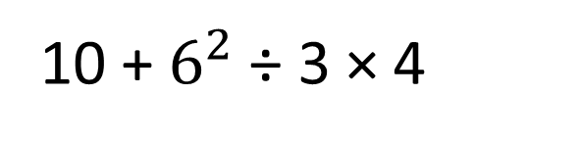
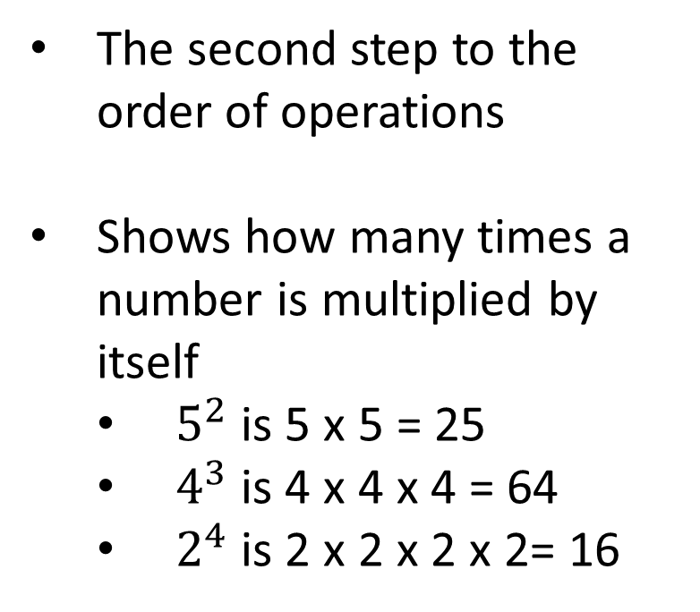
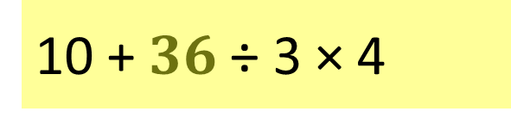
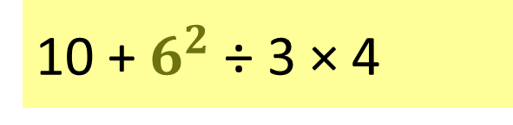
P
Exponents
Example:
E
10 + $6^{2}$ ÷ 3 × (8 – 4)
The second step to the order of operations
Shows how many times a number is multiplied by itself
  $5^{2}$ is 5 x 5 = 25
  $4^{3}$ is 4 x 4 x 4 = 64
  $2^{4}$ is 2 x 2 x 2 x 2= 16
10 + $6^{2}$ ÷ 3 × 4
10 + $6^{2}$ ÷ 3 × 4
M
or
10 + $36$ ÷ 3 × 4
D
A
or
S
Notes:
*This slide contains animations. CLICK to reveal content.
Instructional Activity: Present Content
Instructional Time: 3 min.
Talking Points:
The second step in the order of operations is exponents.
Exponents show how many times a number is multiplied by itself.
For instance, $5^{2}$ is 5 x 5.
ASK: What does 5 x 5 equal?
Call on learners to respond. CLICK to reveal answer: $5^{2}$ = 25
ASK: Take a look at $4^{3}$ which would represent 4 x 4 x 4. What does $4^{3}$ equal?
Call on learners to respond. CLICK to reveal answer: $4^{3}$ = 64
ASK: What equation does $2^{4}$ represent? What is the solution to $2^{4}$?
Call on learners to respond.
CLICK to reveal answer: 2 x 2 x 2 x 2
CLICK to reveal answer: $2^{4}$ = 16
CLICK - ASK: Take a look at the example equation. What do we need to do second?
Call on learners to respond.
CLICK to reveal answer: $6^{2}$ = 36
Source: Mathnasium. (n.d.). Order of operations in math. https://www.mathnasium.com/blog/order-of-operations-in-math

Slide 26
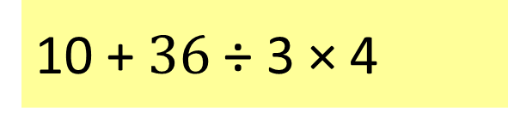
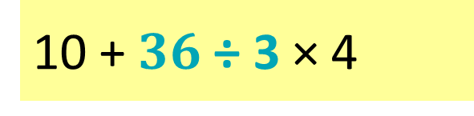
P
Multiplication or Division
Example:
E
10 + $6^{2}$ ÷ 3 × (8 – 4)
10 + $6^{2}$ ÷ 3 × 4
M
The third step to the order of operations
They are prioritized equally and are performed from left to right
10 + $36$ ÷ 3 × 4
or
10 + $36$ ÷ 3 × 4
D
10 + 12 × 4
10 + 12 × 4
10 + 48
A
or
S
Notes:
*This slide contains animations. CLICK to reveal content.
Instructional Activity: Present Content
Instructional Time: 3 min.
Talking Points:
The third step in the order of operations is multiplication OR division.
Depending on the equitation, you may have EITHER or BOTH of these operations.
They are prioritized equally and are performed from left to right.
Take a look at the example equation.
ASK: If we are reading from left to right, what equation do we need to solve first? What is the solution?
Call on learners to respond.
CLICK to reveal answer: $36$ ÷ 3 = 12
Remember that multiplication and division go together, so were not done yet.
ASK: What do we need to solve next? What is the solution?
Call on learners to respond.
CLICK to reveal answer: 12 x 4= 48
Source: Mathnasium. (n.d.). Order of operations in math. https://www.mathnasium.com/blog/order-of-operations-in-math

Slide 27
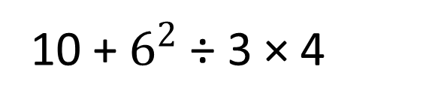
P
Addition or Subtraction
Example:
E
10 + $6^{2}$ ÷ 3 × (8 – 4)
10 + $6^{2}$ ÷ 3 × 4
M
The fourth step to the order of operations
They are prioritized equally and are performed from left to right
or
10 + $36$ ÷ 3 × 4
D
10 + 12 × 4
10 + 48
10 + 48
A
58
or
S
Notes:
*This slide contains animations. CLICK to reveal content.
Instructional Activity: Present Content
Instructional Time: 3 min.
Talking Points:
The fourth step in the order of operations is addition OR subtraction.
Depending on the equitation, you may have EITHER or BOTH of these operations.
They are prioritized equally and are performed from left to right.
Take a look at the example equation.
ASK: If we are reading from left to right, what equation do we need to solve next? What is the solution?
Call on learners to respond.
CLICK to reveal answer: 10 + 48 = 58
Remember that addition and subtraction go together.
We don’t have any subtraction left in this equation which means we have found the solution.
Source: Mathnasium. (n.d.). Order of operations in math. https://www.mathnasium.com/blog/order-of-operations-in-math

Slide 28
Common Mistakes
Not following the correct order
  Always follow P, E, M/D, A/S
Not reading from left to right
  When it comes to M/D and A/S, always do which ever operation comes first
What comes first?
8 – 2 + 3
What comes first?
6 ÷ 2 x 3
Notes:
*This slide contains animations. CLICK to reveal content.
Instructional Activity: Present Content
Instructional Time: 3 min.
Talking Points:
When it comes to the order of operations, there are a few common mistakes we need to watch out for.
One common mistake is not following the correct order.
CLICK – Always follow this order: parentheses, exponents, multiplication/division, and addition/subtraction.
This next one is a critical mistake. People often forget to read the equation from LEFT to RIGHT, like you're reading a book.
CLICK - This matters most when it comes to multiplication/division and addition/subtraction because they occur at the same time.
Take a look at these examples.
ASK: If we read from left to right in the first example, what comes first – addition or subtraction?
Call on learners to respond. Answer: subtraction.
ASK: If we read from left to right in the second example, what comes first – multiplication or division?
Call on learners to respond. Answer: division.
If we don’t read from left to right, we will not get the right solution.

Slide 29


Which worker has the correct answer?
Elena has the correct answer.
Elena: 29 minutes
5 + (4 × 6)
5 + 24
29 min.
Parentheses come first in PEMDAS.
Elena: 29 minutes
Chris: 54 minutes
5 + (4 × 6)
5 + 24
29 min.
5 + (4 × 6)
9 x 6
54 min.
Notes:
Instructional Activity: Recall, Provide Learning Guidance
Instructional Time: 2 min.
Talking Points:
Once again, we’ll return Elena and Chris.
ASK: Which workers has the correct answer?
Call on learners to respond. The answer is on the next slide.

Slide 30
Elena has the correct answer.
Elena: 29 minutes
5 + (4 × 6)
5 + 24
29 min.
Parentheses come first in PEMDAS.
Notes:
Instructional Activity: Recall, Provide Learning Guidance
Instructional Time: 2 min.
Talking Points:
Have you ever tried to solve a math problem, where you didn't know where to start or what to do next?
Think back to Elena and Chris from our warm up. They both solved the same equation, but they solved it in a different order, so they got different answers.
The order of operations is a set of rules that tells us what math operation to do first in an expression with multiple operations like addition, subtraction, multiplication, and division.
Let’s take a closer look at the order of operations so we can determine whether Elena or Chris solved the equation correctly.
Source: Mathnasium. (n.d.). Order of operations in math. https://www.mathnasium.com/blog/order-of-operations-in-math

Slide 31
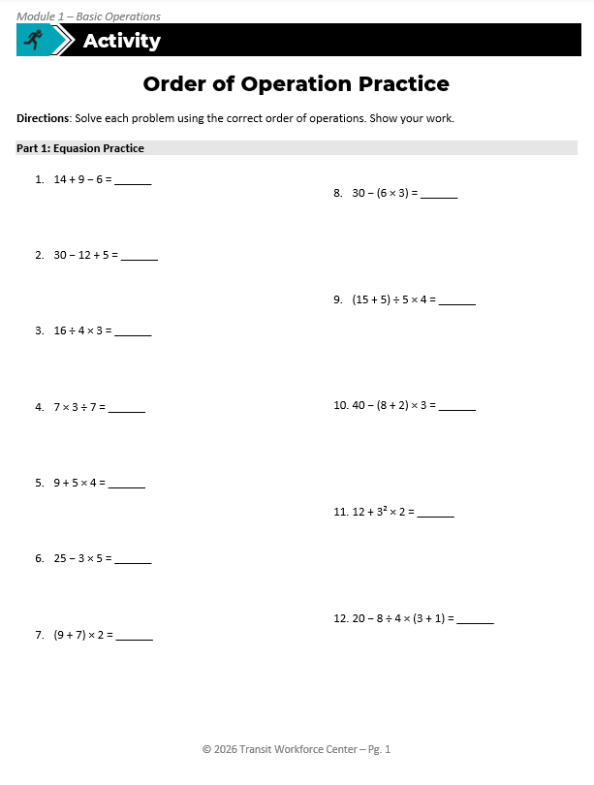
Activity: Order of Operation Practice
Directions: Solve each problem using the correct order of operations. Show your work.
Part 1: Equation Practice
Part 2: Word Problem Practice
Notes:
Instructional Activity: Provide Guided Learning, Elicit Performance, Provide Feedback
Instructional Time: 22 min.
Materials:
Order of Operation Practice_M1
Order of Operation Practice_Answer Key_M1
PEMDAS Order of Operations_M1
White board
Markers
Optional engagement strategy: Assign each learner one or more problems to solve. Place flip charts around the room and have learners work through their assigned problem(s) on the chart, then explain their process and solution to the group. This can also be done in pairs/small groups.
Do:
2 min.
Refer learners to the “Order of Operation Practice” handout embedded in the Participant Resource Guide. The “PEMDAS Order of Operations” handout will also be a useful reference for this activity.
Review the directions and answer any questions learners may have.
10 min.
Give learners time to work. You may have them work with partners or groups if you choose.
Circulate the room answering questions and providing feedback as needed.
10 min.
Review answers together and ask volunteers to explain their reasoning.
Consider having leaners write their answers and equations on the white board. They can then review the answer and explain their work to the class.

Slide 32
Knowledge Check
Q: What are the basic operations?
A: Addition, subtraction, multiplication, and division
Notes:
*This slide contains animations. CLICK to reveal content.
Instructional Activity: Evaluate/Assess Performance, Provide Feedback
Instructional Time: 3 min.
Learning Objective: Choose the correct operation based on a given problem.
Do: Review the knowledge check question. Call on learners to share their responses.
Answer:
Addition, subtraction, multiplication, and division

Slide 33
Knowledge Check
Q: Which operations does the technician need to use in this scenario: A technician installs 3 sensors on each of 5 vehicles, then installs 4 additional sensors.
A: Multiplication and Addition
Notes:
*This slide contains animations. CLICK to reveal content.
Instructional Activity: Evaluate/Assess Performance, Provide Feedback
Instructional Time: 3 min.
Learning Objective:
Do: Review the knowledge check question. Call on learners to share their responses.
Answer:
The order of operations exists to make sure everyone solves math problems the same way and gets the same answer.

Slide 34
Knowledge Check
Q: Why does the order of operations exist?
A: The order of operations exists to make sure everyone solves math problems the same way and gets the same answer.
Notes:
*This slide contains animations. CLICK to reveal content.
Instructional Activity: Evaluate/Assess Performance, Provide Feedback
Instructional Time: 3 min.
Learning Objective: Use the order of operations to solve problems accurately.
Do: Review the knowledge check question. Call on learners to share their responses.
Answer:
The order of operations exists to make sure everyone solves math problems the same way and gets the same answer.

Slide 35
Knowledge Check
Q: What is the solution to this equation?
18 − 6 ÷ 3 × (2 + 4)
(A). 6
(A). 6
(B). 12
(C). 30
(D). 24
Notes:
*This slide contains animations. CLICK to reveal content.
Instructional Activity: Evaluate/Assess Performance, Provide Feedback
Instructional Time: 3 min.
Learning Objective: Use the order of operations to solve problems accurately.
Do: Review the knowledge check question. Call on learners to share their responses.
Answer:
A.) 6

Slide 36
Knowledge Check
A technician solves the following equation: 12 ÷ 3 × 2. They write their answer as 2.
Q: Why did this person get the wrong answer?
A: They multiplied before dividing instead of working from left to right
Notes:
*This slide contains animations. CLICK to reveal content.
Instructional Activity: Evaluate/Assess Performance, Provide Feedback
Instructional Time: 3 min.
Learning Objective: Use the order of operations to solve problems accurately.
Do: Review the knowledge check question. Call on learners to share their responses.
Answer:
They multiplied before dividing instead of working from left to right

Slide 37

Quiz
Time for a quiz! Let’s see what you have learned from today’s lesson.
Notes:
Instructional Activity: Direction, Evaluate/Assess Performance
Instructional Time: 20 min.
Materials: Quiz_M1
Do:
Ask learners if they have any lingering questions. Address them before distributing the quiz.
Pass out the quiz and review the directions.
Talking Points:
Time for a quiz! Let’s see what you have retained from today’s lesson.

Slide 38
Revisiting Objectives
Demonstrate the ability to solve mathematics problems involving whole numbers.
  Choose the correct operation based on a given problem.
  Use the order of operations to solve problems accurately.
Notes:
Instructional Activity: Enhance Transfer and Retention
Instructional Time: 5 min.
Do: Facilitate a short discussion to review the key topics in the lesson.
Talking Points:
If you were explaining today’s objectives to someone else, how would you summarize what they mean and why they matter?
Which of today’s objectives do you feel most confident about? Which were most challenging? Explain your reasoning.
Can you give an example of how you could apply one of today’s objectives in a real-world situation?
After Discussion:
This conclude this section of the module. Thank you for your participation.

Slide 39
Thank you!
Notes:
Instructional Activity: Enhance Transfer and Retention
Instructional Time: 2 min.
Do:
Thank learners for their participation.
If possible, stay after class to answer any lingering questions learners may have.

