Slide 1


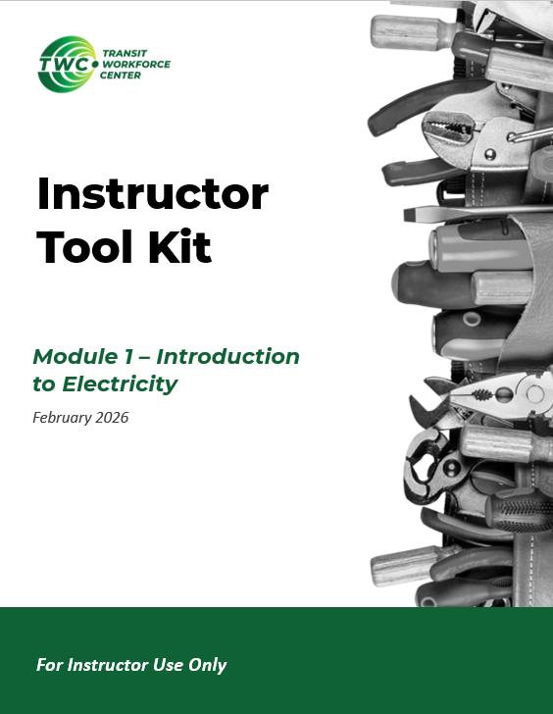

Instructor Guide Snapshot
Icon Key
Activity:
Video:
Instructor Demo:
Knowledge Check:
Instructional Time: 6 Hrs
Preparation before class:
  Review all materials - Review all slides, talking points, and handouts before class to understand the structure and flow of the lesson. Pay special attention to animations within the slides.
  Slides 70-71 – Add PPT slide notes, talking points, and images focusing on LOTO procedures are your facility.
  LOTO at Our Facility Activity – Make arrangements and gather materials needed to practice implementing lock out tag out procedures in your facility. See slides 72.
Provided Course Materials:
  Electrical Safety Overview_M7
  Electrical Safety Overview_Answer Key_M7
  OSHA Arc Flash PPE Chart_M7
  Inspect, Test, Use_M7
  Reading Arc Labels_M7
  Reading Arc Labels_Answer Key_M7
  Quiz_M7
  Quiz_Answer Key_M7
Additional Materials:
A list of additional materials needed for demonstrations and activities can be found in the Instructor Facilitation Toolkit on page _.

Slide 2
Pacing Guide
Times have been rounded to the nearest .25 hours.
Total Time: 6 Hours
  (.25 Hrs) Welcome and Warm Up
  (2.25 Hrs) 7.1 - Electrical Hazards in the Workplace
  (1.5 Hrs) 7.2 - PPE for Electrical Safety
  (1.5 Hrs) 7.3 - Procedures to Protect Workers
  (.5 Hrs) – Quiz and Wrap Up

Slide 3
Module 7 – Safety and PPE
Transit Core Competencies Curriculum (TC3)
Electrical Foundations
Notes:
Instructional Activity: Direction
Instructional Time: 1 min.
Do: Welcome learners to class. Introduce the course and module.

Slide 4
Objectives
Identify and assess electrical hazards in the workplace.
Select and utilize appropriate PPE for high voltage, low voltage, and arc flash environments.
Apply workplace safety policies and procedures to mitigate electrical hazards.
Notes:
Instructional Activity: Direction
Instructional Time: 2 min.
Do: Review the module objectives.

Slide 5
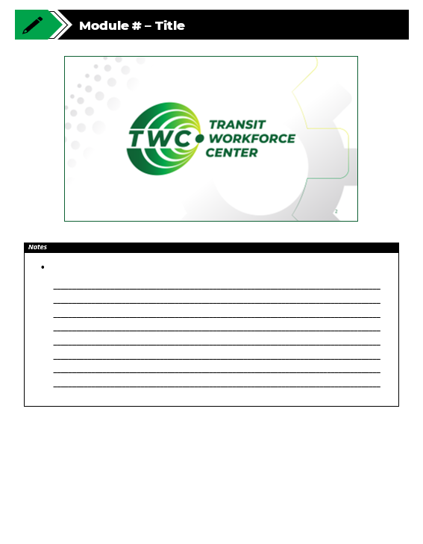
Agenda
Welcome and Warm Up
7.1 - Electrical Hazards in the Workplace
7.2 - PPE for Electrical Safety
7.3 - Procedures to Protect Workers
Quiz and Wrap Up
Notes:
Instructional Activity: Direction
Instructional Time: 2 min.
Do: Review the module agenda.

Slide 6
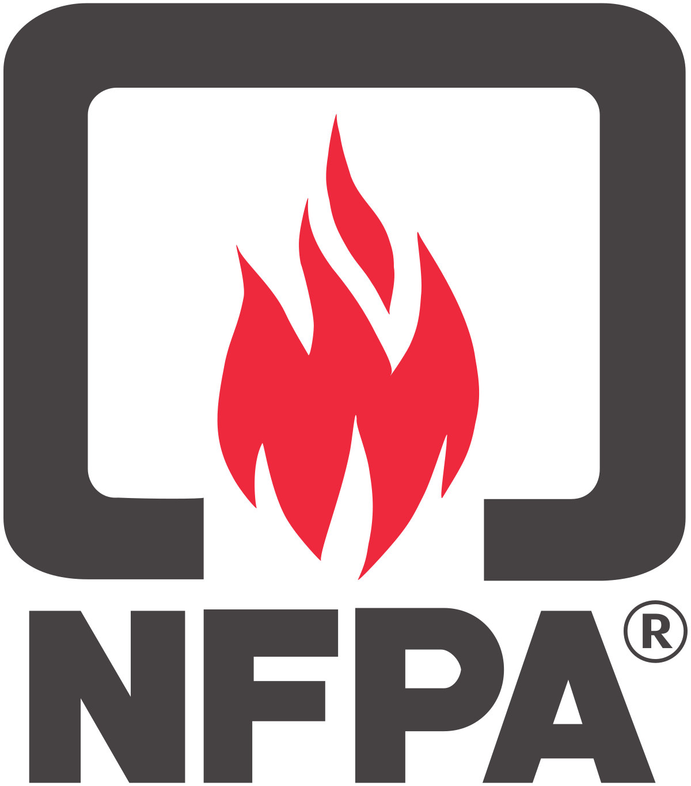
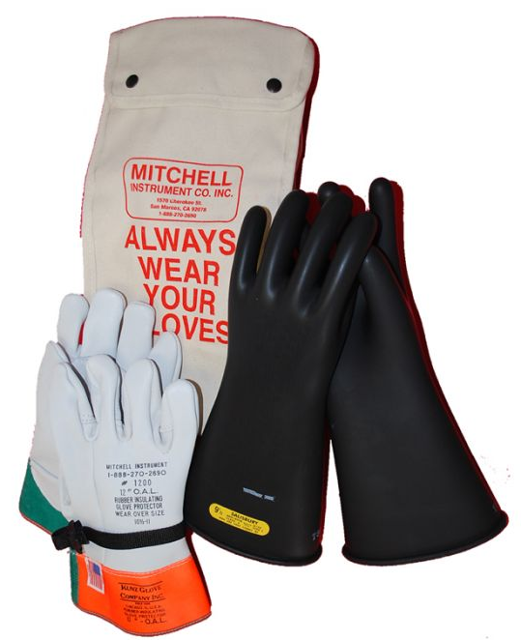
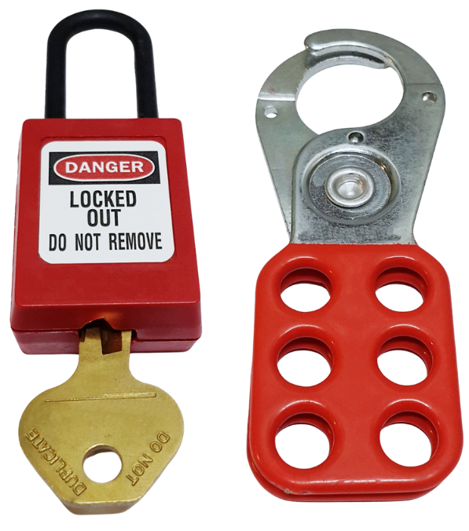
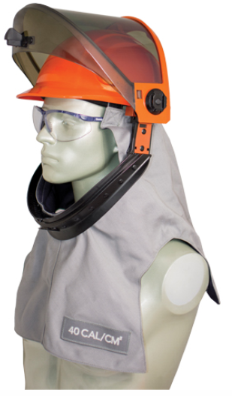
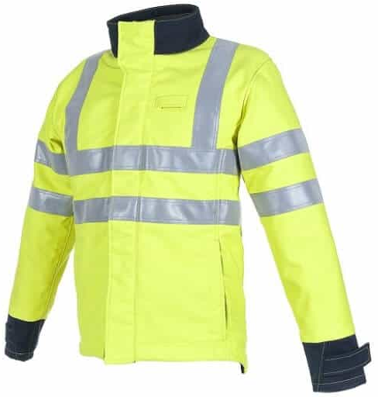
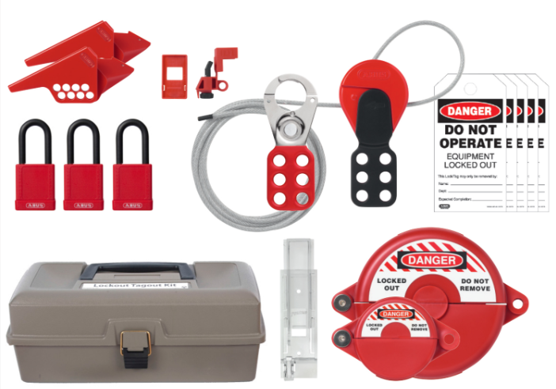
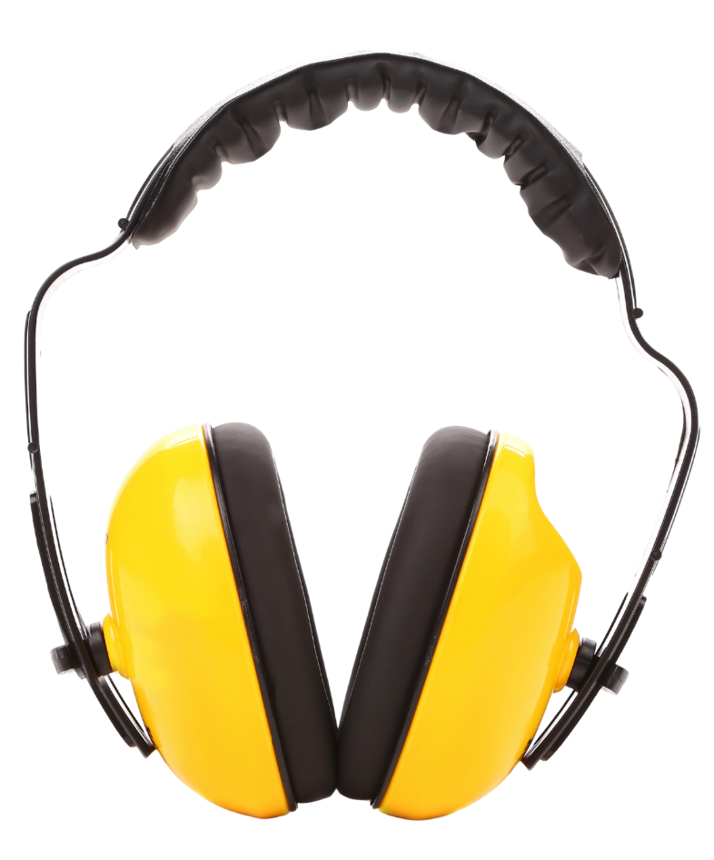

Warm Up
Take a look at these items. Does anyone recognize them? What are they used for?
Notes:
*This slide contains animations. CLICK to reveal content.
Instructional Activity: Gain Attention, Recall
Instructional Time: 5 min.
Do: Facilitate a short discussion to access prior knowledge.
Talking Points:
The images on this slide all have something to do with the topics we’ll learn about in today’s lesson.
Take a look at these items.
ASK: Does anyone recognize them? What are they used for?
Call on learners to share their responses.

Slide 7
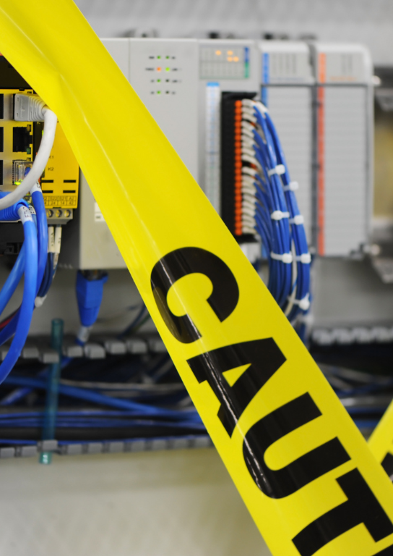
7.1 - Electrical Hazards in the Workplace
In this section, we’ll explore electrical hazards, workplace responsibilities, and safety policy.
Notes:
Instructional Activity: Direction
Instructional Time: 2 min.
Do: Introduce the section.

Slide 8
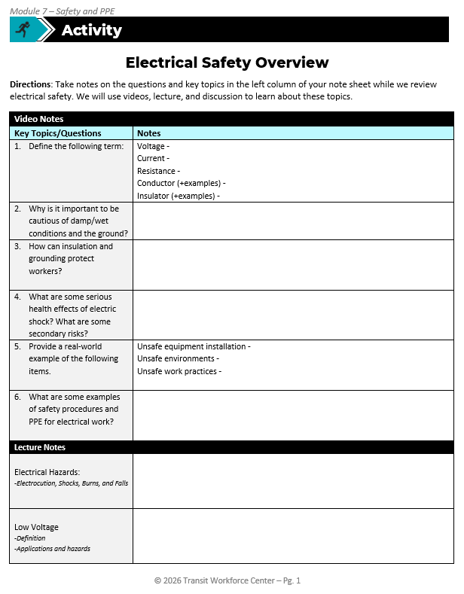
Electrical Safety Overview and Discussion
Directions: Take notes on the questions and key topics in the left column of your note sheet while we review electrical safety. We will use videos, lecture, and discussion to learn about these topics.
Notes:
Instructional Activity: Provide Guided Learning, Elicit Performance, Provide Feedback
Instructional Time: 5 min.
Materials:
Electrical Safety Overview_M7
Electrical Safety Overview_Answer Key_M7
Do:
Refer learners to the “Electrical Safety Overview and Discussion” handout embedded in the Participant Resource Guide. An answer key has also been provided for instructor use only.
Review the directions.
Talking Points:
Today we’ll start with a video, lecture, and discussion activity.
Take a look at the “Electrical Safety Overview and Discussion” handout embedded in the Participant Resource Guide.
We’ll start with a video that provides a solid overview of electrical safety.
As you watch, take notes on the questions and key topics in the left column of your note sheet while we review electrical safety.
We’ll complete the remainder of the activity with a lecture.

Slide 9
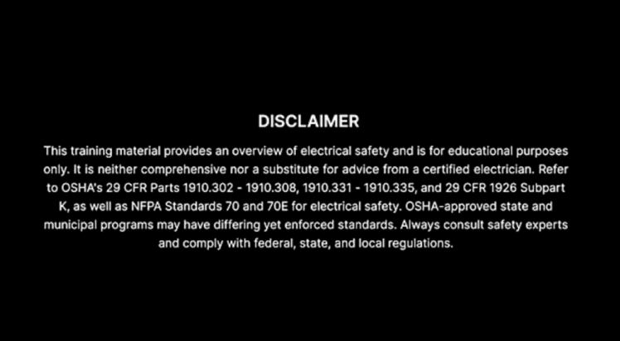

Electrical Safety Overview and Discussion
Video Link
Notes:
Instructional Activity: Provide Guided Learning, Elicit Performance, Provide Feedback
Instructional Time: 17 min.
Materials:
Electrical Safety Overview_M7
Electrical Safety Overview_Answer Key_M7
Video Link: https://www.youtube.com/watch?v=WoJBg6oEA3k – This video could not be embedded into the slide deck because of it’s size.
Do:
Play the video for learners.
You may choose to pause the video at 5 minutes to give learners time to complete questions 1 and 2.

Slide 10
Electrical Safety Overview and Discussion
Why is it important to be cautious of damp/wet conditions and the ground?
  Voltage -
  Current -
  Resistance -
  Conductor (+examples) -
  Insulator (+examples) -
How can insulation and grounding protect workers?
Notes:
Instructional Activity: Provide Guided Learning, Elicit Performance, Provide Feedback
Instructional Time: 10 min.
Materials:
Electrical Safety Overview_M7
Electrical Safety Overview_Answer Key_M7
Do:
Debrief from the discussion by reviewing the answers to the questions on the “Electrical Safety Overview and Discussion” handout. An answer key has been provided.
Questions 3-5 are on the next slide.

Slide 11
Electrical Safety Overview and Discussion
3. What are some serious health effects of electric shock? What are some secondary risks?
4. Provide a real-world example of the following items.
  Unsafe equipment installation -
  Unsafe environments -
  Unsafe work practices -
5. What are some examples of safety procedures and PPE for electrical work?
Notes:
Instructional Activity: Provide Guided Learning, Elicit Performance, Provide Feedback
Instructional Time: 10 min.
Materials:
Electrical Safety Overview_M7
Electrical Safety Overview_Answer Key_M7
Do:
Debrief from the discussion by reviewing the answers to the questions on the “Electrical Safety Overview and Discussion” handout. An answer key has been provided.

Slide 12
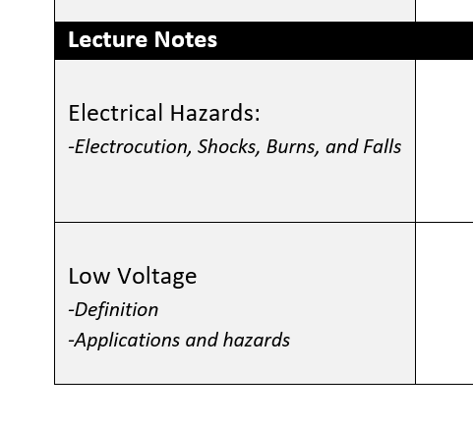



Electrical Safety Overview and Discussion
Lecture Notes
We’ll now shift from video notes to lecture notes.
Pay special attention to the suggested subtopic in each note category.
Notes:
Instructional Activity: Provide Guided Learning, Elicit Performance, Provide Feedback
Instructional Time: 1 min.
Materials: Electrical Safety Overview_M7
Talking Points:
We’ll now shift from video notes to lecture notes.
Pay special attention to the suggested subtopic in each note category.

Slide 13
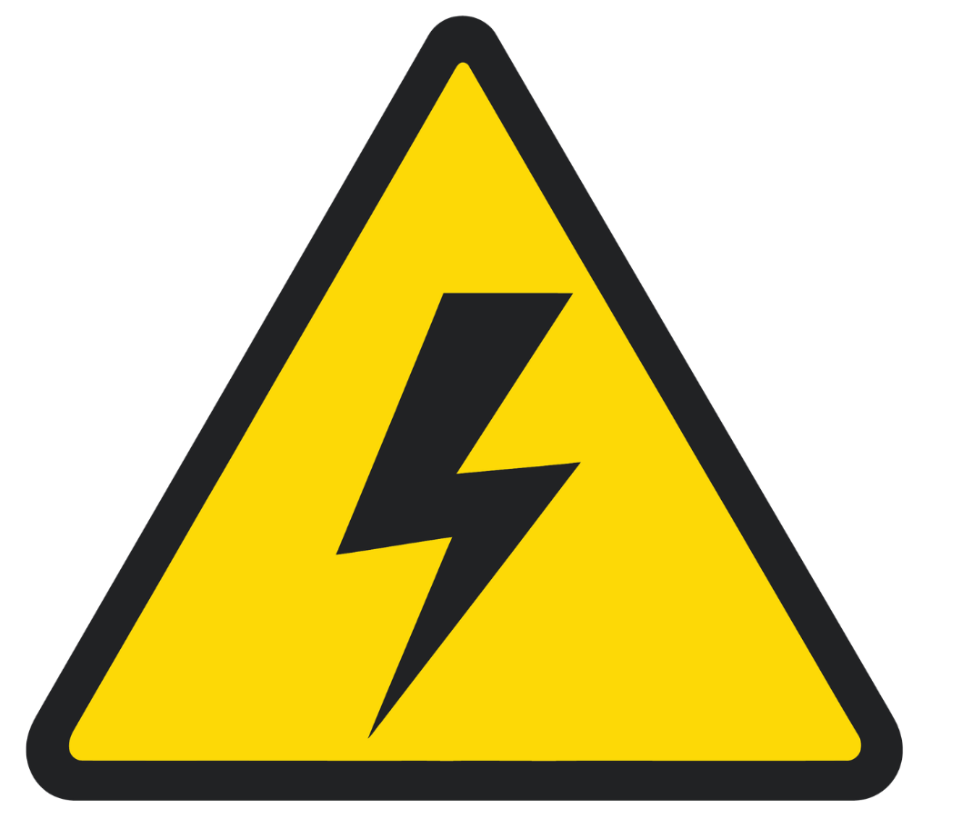
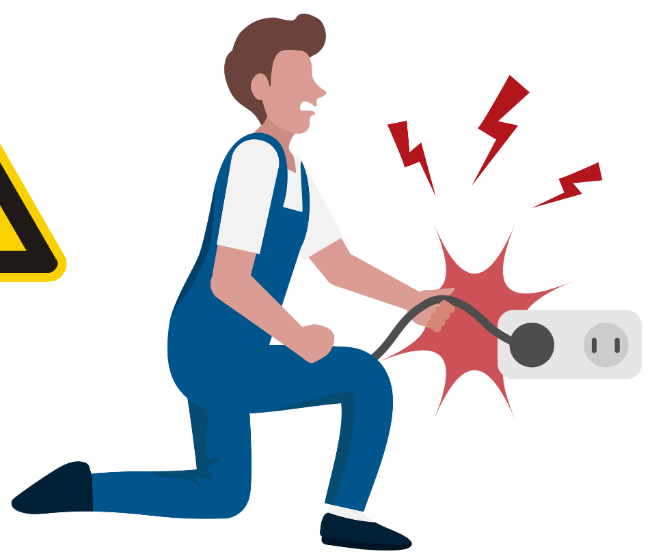

Primary Electrical Hazards
Electric Shock
About 30,000 non-fatal shocks per year
Direct injuries caused by electrical energy itself
Occur when the body becomes part of an electrical circuit or is directly exposed to electrical energy
Electrocution
Over 1,000 deaths per year due to electrical injuries
Burns
5% of all burn unit admissions are electrical injuries
Zemaitis MR, Cindass R, Lopez RA, et al. Electrical Injuries. [Updated 2025 Jan 20]. In: StatPearls [Internet]. Treasure Island (FL): StatPearls Publishing; 2025 Jan-. Available from: https://www.ncbi.nlm.nih.gov/books/NBK448087/
Notes:
*This slide contains animations. CLICK to reveal content.
Instructional Event: Present Content
Time: 2 min.
Materials: Electrical Safety Overview_M7
Talking points:
Electrical hazards are often placed in two categories: primary hazards and secondary hazards.
Primary hazards are direct injuries caused by electrical energy itself. These occur when the body becomes part of an electrical circuit or is directly exposed to electrical energy.
CLICK –
Primary electrical hazards include things like shocks, electrocution, and burns and they are are more common and more dangerous than many people realize.
Every year, over 1,000 people in the U.S. die from electrocution (across the board, not just the workplace), and around 30,000 more suffer non-fatal electric shocks that can still cause serious injuries.
Electrical burns are another major concern, accounting for 5% of all burn unit admissions in the country.
These risks highlight why electrical safety isn’t optional — it’s essential.

Slide 14

Secondary Electrical Hazards
Injuries that happen as a result of an electrical incident, but the injury itself is not caused directly by electricity
Ex: Seizures, falls, muscle damage, heart problems, psychiatric disorders (memory loss, PTSD, etc.)
Notes:
Instructional Event: Present Content
Time: 2 min.
Materials: Electrical Safety Overview_M7
Talking points:
And it doesn’t stop there - the damage can go much deeper.
Primary hazards can lead to secondary hazards, which are injuries that happen as a result of an electrical incident, but the injury itself is not caused directly by electricity.
In other words, electricity triggers another dangerous event.
Electrical incidents can lead to long-term or delayed health issues like seizures, memory loss, PTSD, and heart problems.
Victims may also experience muscle or eye damage, and many are seriously hurt by falls that happen during or after a shock.
These secondary risks make prevention and immediate medical attention just as important as avoiding the shock itself.

Slide 15

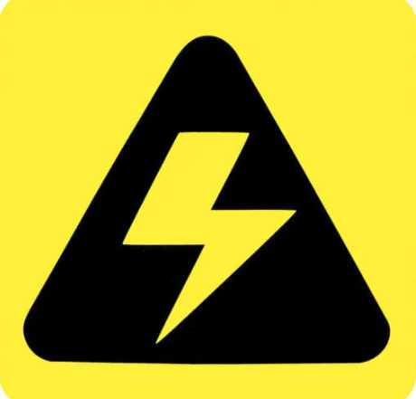
Electrical Injuries
Typical electrical injuries consist of the following:
  Electric Shock
  Electrocution
  Burns
  Falls
Notes:
Instructional Event: Present Content
Time: 2 min.
Materials: Electrical Safety Overview_M7
Talking points:
Electrical injuries can take several forms, and each one comes with serious consequences.
These injuries can happen instantly and often without warning.
Let’s take a deeper look at the most common types of electrical injuries - electrocution, electric shock, burns, and falls caused by contact with electrical energy.

Slide 16
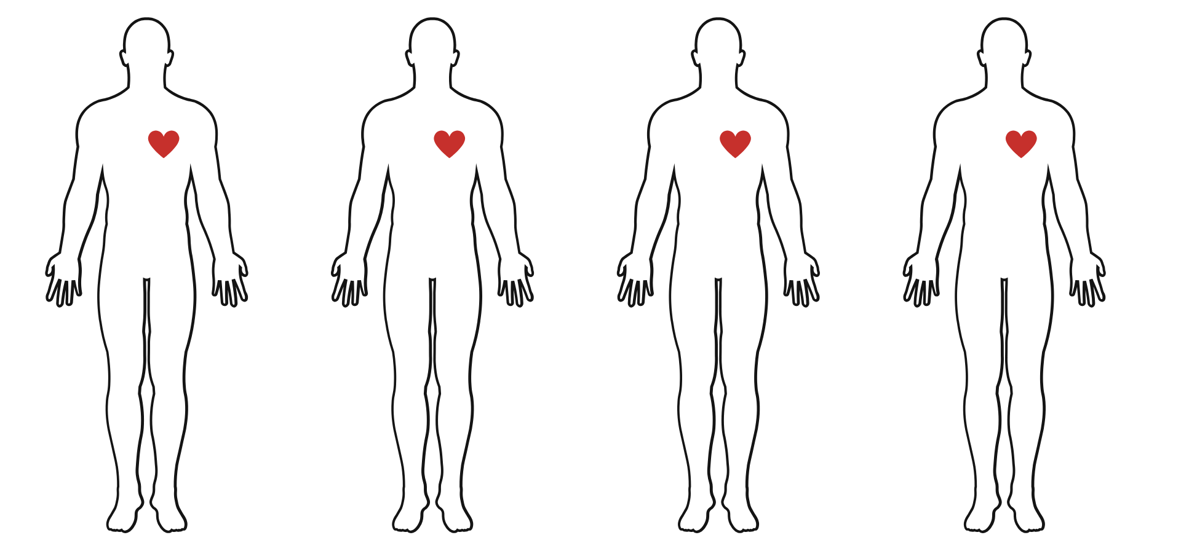
Electrocution
Exposure to a hazardous amount of electrical energy
Occurs when body becomes a part of an active electrical circuit.
Extent of injuries depends on
  Magnitude
  Pathway
  Duration of current
Hand to Hand
Hand to Arm
Hand to Foot
Hand to Head
Notes:
*This slide contains animations. CLICK to reveal content
Instructional Event: Present Content, Provide Learning Guidance
Time: 4 min.
Materials: Electrical Safety Overview_M7
DO:
Review the talking points below.
Click to review examples of electrical pathways through the human body and discuss what kind of injuries may occur with each pathway.
CLICK – Hand to hand
CLICK – Hand to arm
CLICK – Hand to foot
CLICK – Hand to head
Talking points:
Electrocution results when a human is exposed to a lethal amount of electrical energy and is subsequently killed.
For death to occur, the human body must become part of an active electrical circuit having a current capable of over stimulating the nervous system or causing damage to internal organs.
The extent of injuries received depends on the current’s magnitude, the pathway of the current through the body, and the duration of current flow through the body.

Slide 17

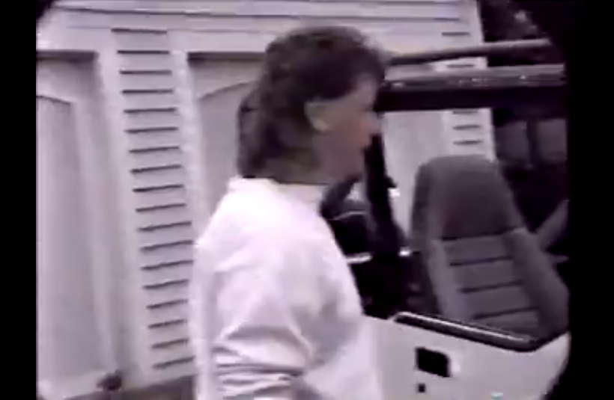
Electrocution Example
Notes:
*This slide contains animations. CLICK to reveal content
Instructional Event: Present Content, Provide Learning Guidance
Time: 2 min.
Video Link: https://tinyurl.com/ycx7dua8
Materials: Electrical Safety Overview_M7
DO:
Play the video for learner.
Emphasize how quickly and easily an electrocution can occur.

Slide 18
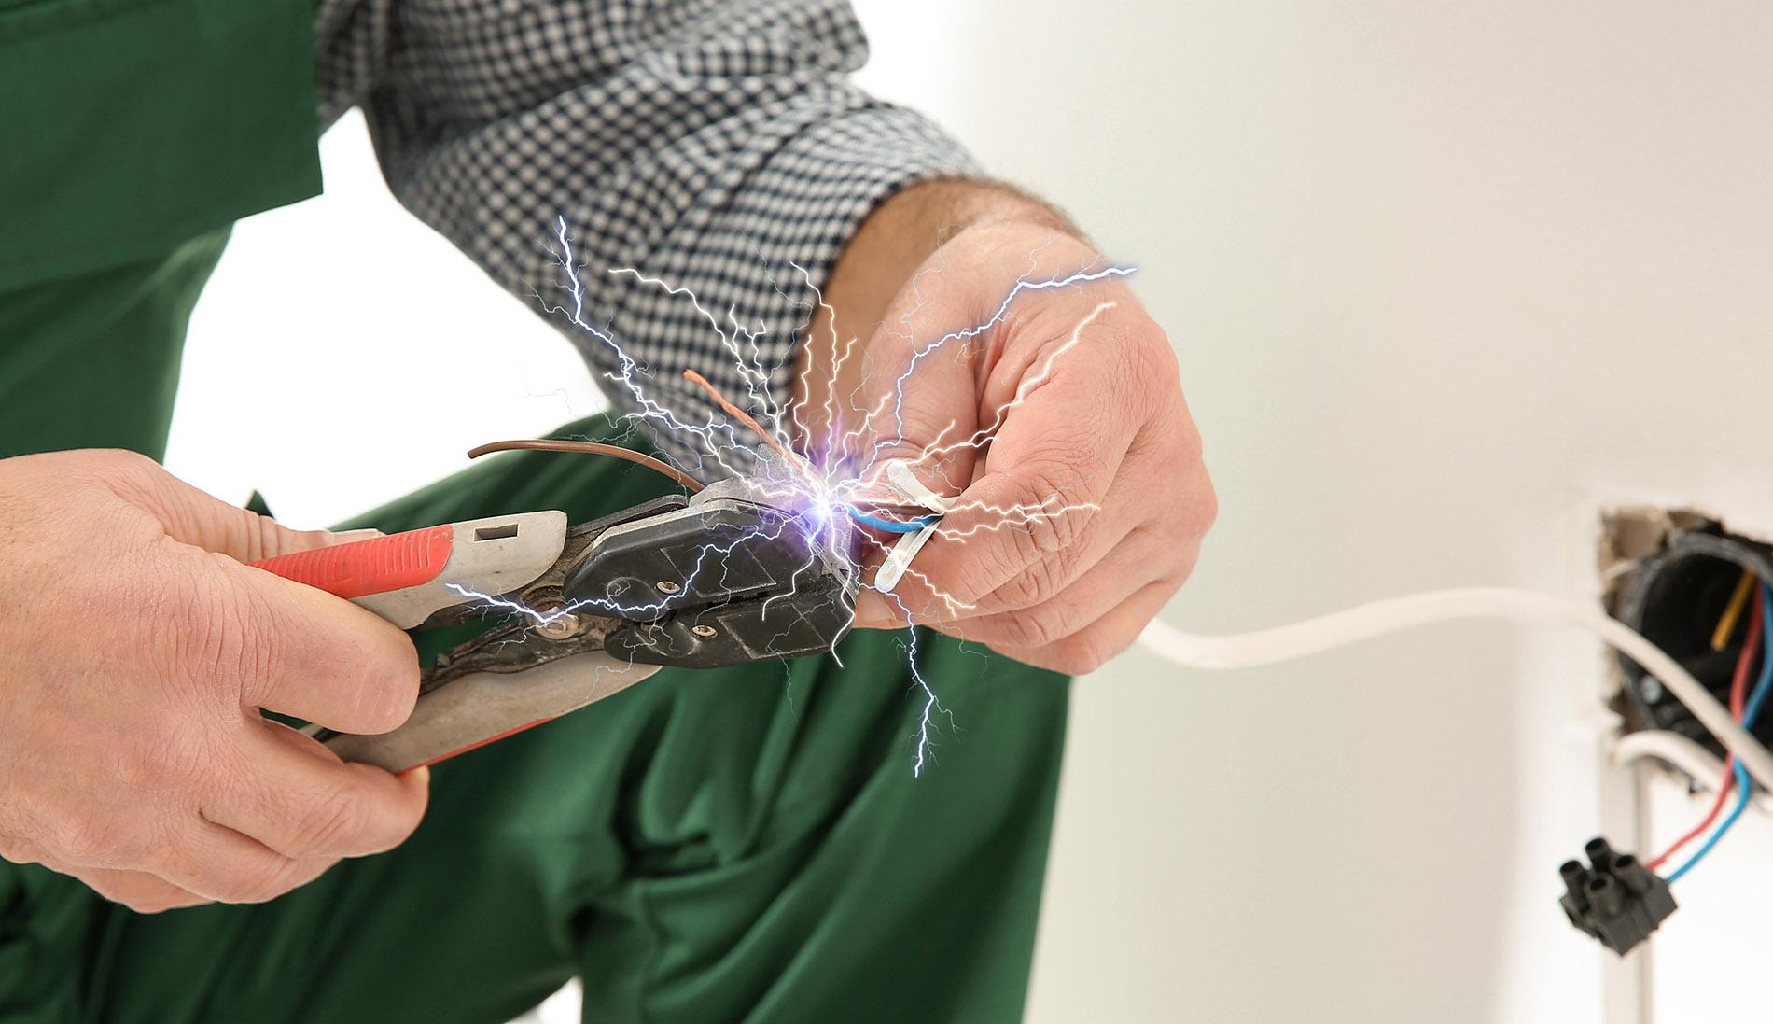
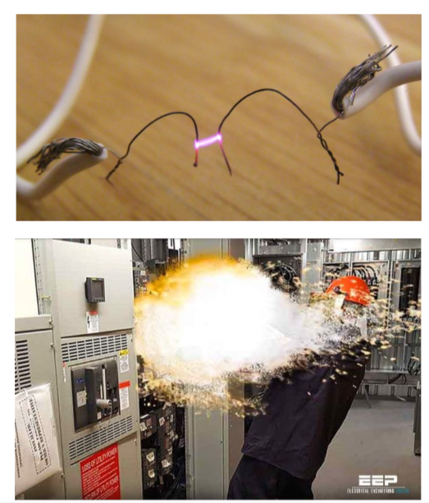
Electric Shock
Electric shock occurs when a worker makes direct contact with electrical energy and becomes part of the circuit.
Arcing happens when current jumps through the air, causing an arc flash that can lead to burns and shock injuries.
Notes:
Instructional Event: Present Content
Time: 2 min.
Materials: Electrical Safety Overview_M7
Talking points:
Electric shock happens when a worker touches live electrical parts and becomes part of the circuit, allowing current to pass through the body. This can cause serious internal injuries, even if there's no visible damage.
Arcing, on the other hand, occurs when electricity jumps through the air causing what's known as an arc flash. Arc flashes are extremely dangerous and can result in both severe burns and electric shock injuries. More on this later.

Slide 19
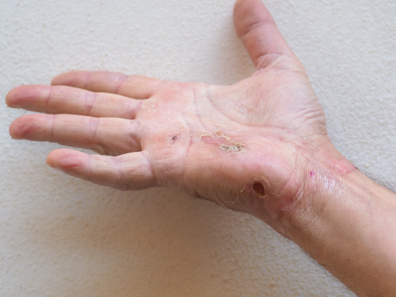
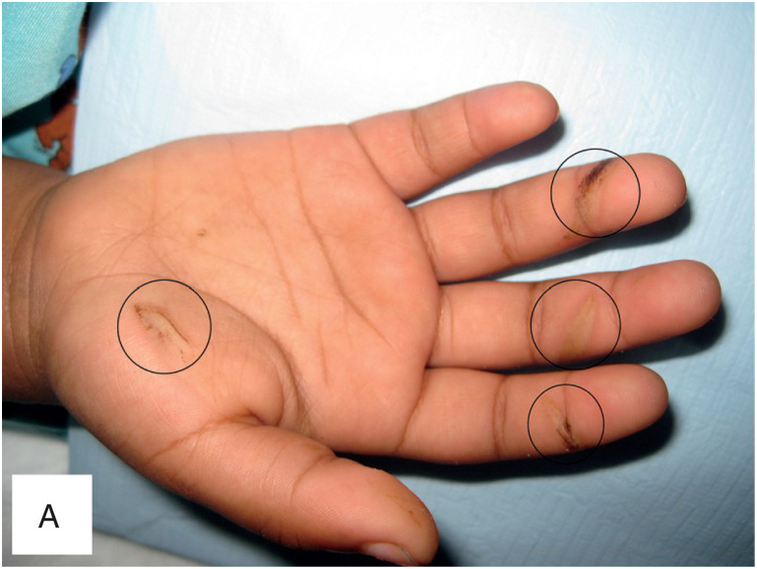
Burns
Caused when electricity touches or arcs to the body, generating intense heat
Can damage skin, internal tissues, and show entry and exit points
Ignition of flammable clothing due to arc flash
May result in deep burns, blood clots, or bone fractures
Notes:
Instructional Event: Present Content
Time: 2 min.
Materials: Electrical Safety Overview_M7
Talking points:
Electrical burns happen when electricity makes contact with your body or arcs close enough to create heat at the point of contact.
These burns can affect not just the skin, but also deep tissues, muscles, and organs which makes them especially dangerous.
With high-voltage incidents, you might see an entry and exit wound, showing where the current traveled through the body.
The damage isn’t always visible on the surface. Internally, electricity can cause clotting, nerve damage, and even break bones, especially if there’s violent muscle contraction or a fall during the shock.
That’s why any electrical burn, no matter how small it looks, should be treated seriously and evaluated by a medical professional.

Slide 20
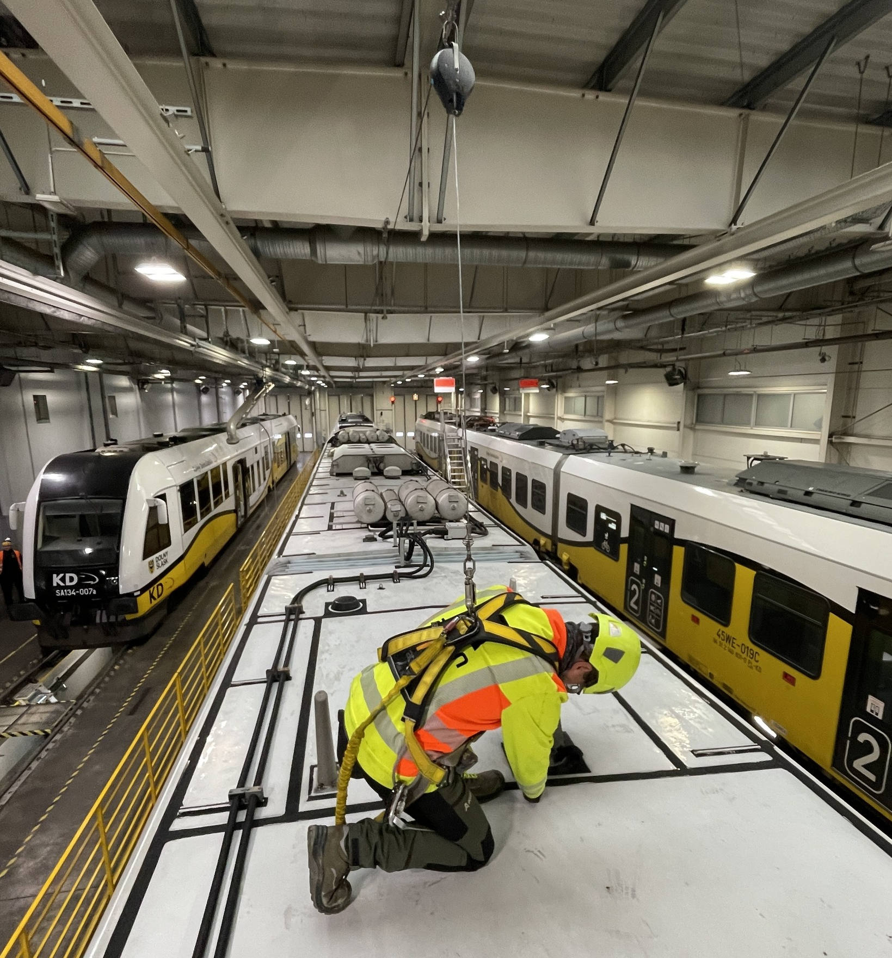
Falls
Electrical shock can cause involuntary muscle contractions, leading to loss of balance
Workers may fall from ladders, platforms, scaffolding, or other elevated work areas
Falls can cause serious injuries such as fractures, head trauma, or spinal damage
Wearing proper fall protection, such as a safety harness, can help prevent serious injury
Notes:
Instructional Event: Present Content
Time: 2 min.
Materials: Electrical Safety Overview_M7
Talking Points:
When we talk about electrical hazards, we often focus on shock or electrocution. However, falls are one of the most serious secondary hazards associated with electricity.
An electric shock can cause sudden, involuntary muscle contractions. This can cause a worker to lose their grip, balance, or control of tools.
If a worker is on a ladder, lift, or elevated platform, even a relatively small shock can lead to a dangerous fall.
These falls can cause serious injuries such as broken bones, head trauma, or spinal injuries. In some cases, the fall may be more dangerous than the electrical shock itself.
That’s why it’s important to think about the entire work environment, not just the electrical source.
When working at height, workers should always use the appropriate fall protection, such as a properly fitted safety harness.
PPE should also be inspected every time it is used. Workers should check harnesses and other fall protection equipment for tears, worn straps, damaged stitching, or weak connection points.
Regular inspection and maintenance of PPE is just as important as wearing the PPE itself.

Slide 21
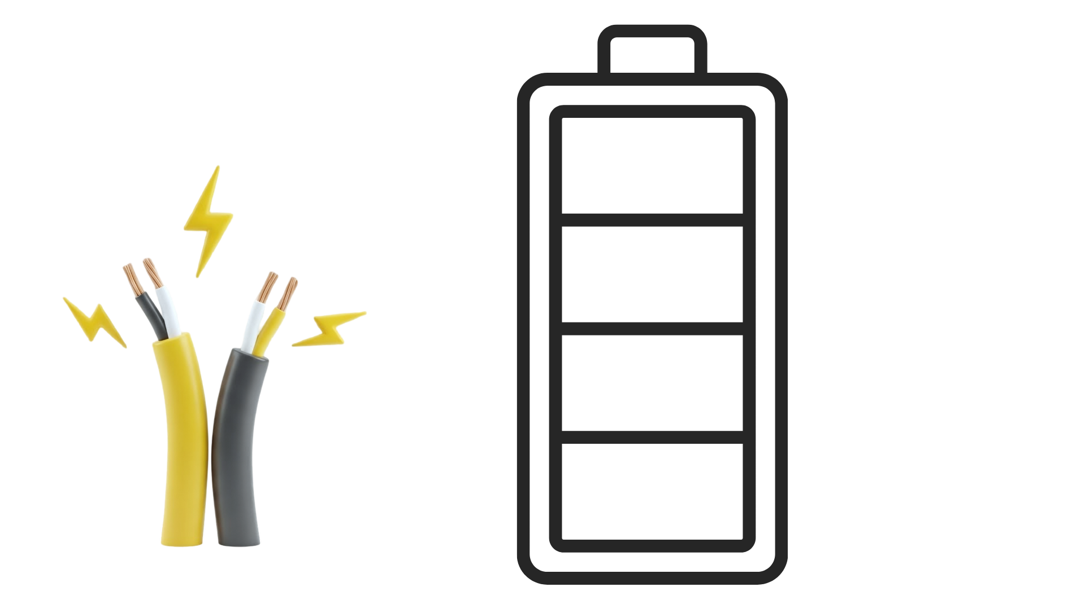
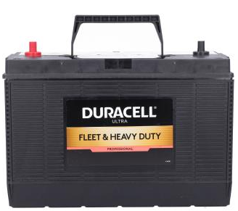
  Cars, bus batteries, communication systems, lighting systems
  Low voltage does not mean low danger
Low
50 Volts or less
Notes:
Instructional Event: Present Content
Time: 2 min.
Materials: Electrical Safety Overview_M7
Talking Points:
Low voltage refers to electrical systems operating at 50 volts or less, either AC or DC.
Many of the systems workers interact with every day fall into this category. Examples include car and bus batteries, communication systems, and some lighting systems.
For example, bus mechanics often work around 12-volt DC battery systems, which are considered low voltage.
Even though these systems operate at lower voltages, low voltage does not mean low danger. Under the right conditions, electrical current can still cause serious injury.
When working around batteries or other low-voltage systems, workers should avoid creating sparks and should wear appropriate PPE such as gloves and safety goggles. Batteries can release explosive gases, and a spark could cause a battery to explode.
Workers should also watch for hazards such as short circuits to ground, burning insulation, or overheating wires, which can lead to fires.
This course provides foundational electrical safety training, and many of the examples we discuss will focus on low-voltage DC systems commonly found in transportation equipment and facilities.

Slide 22


  Household appliances, lighting, computers, some electric buses and trains
  50 volts and above, PPE required
Intermediate
50-1,000 Volts
Low
50 Volts or less
Notes:
Instructional Event: Present Content
Time: 2 min.
Materials: Electrical Safety Overview_M7
Talking Points:
Intermediate voltage refers to electrical systems that operate above 50 volts and below 1,000 volts, either AC or DC.
At this voltage level, electricity presents a significant shock hazard, so appropriate PPE and safety procedures are required when working on or near energized equipment.
Many transportation systems operate within this range. For example, trains and battery-electric buses often use electrical systems under 1,000 volts.
Because of this, rail mechanics and transit technicians frequently work around intermediate-voltage equipment, which makes understanding electrical safety especially important.
Even though these systems are not considered high voltage, they still have enough electrical energy to cause serious injury if proper safety practices are not followed.

Slide 23
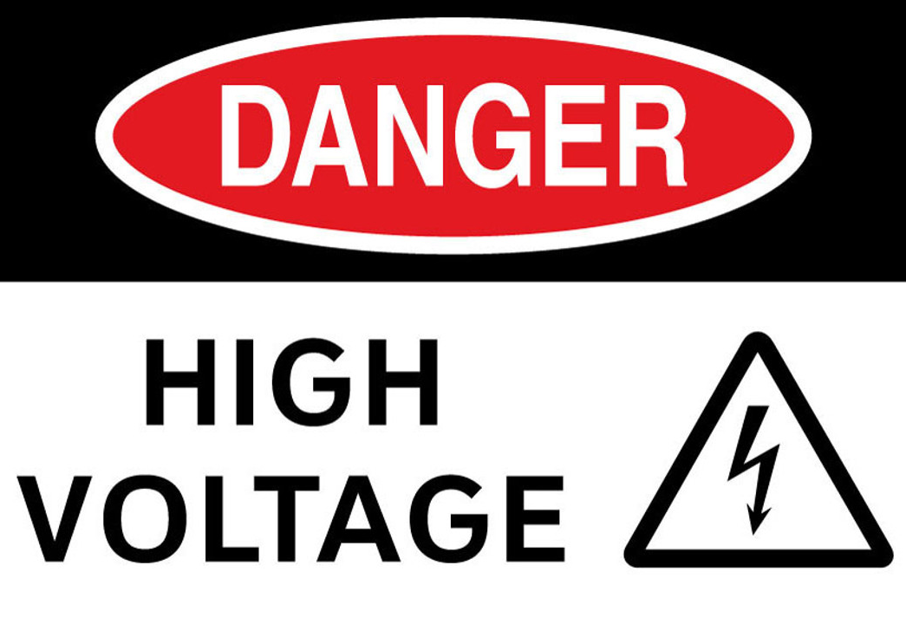
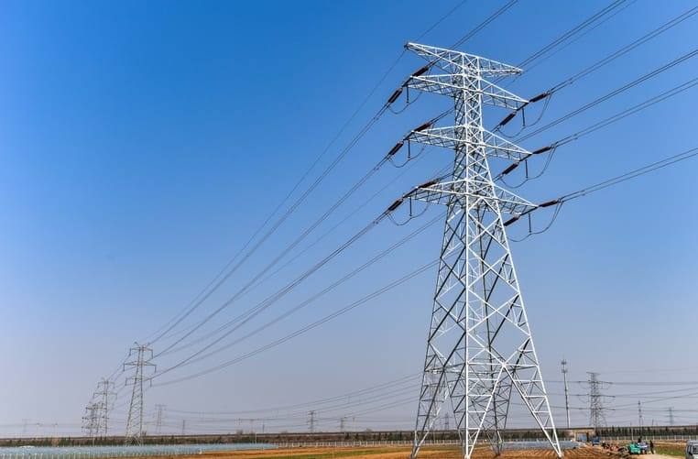
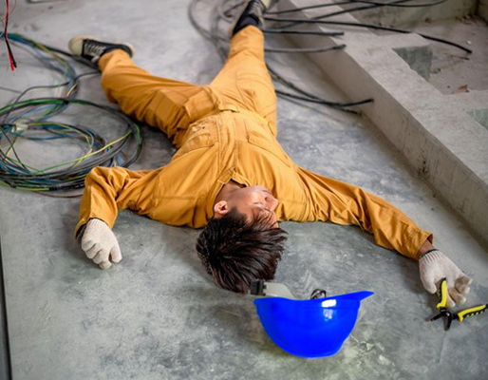
  Used in power transmission, industrial equipment, grid connection, etc.
  Electric shock, burns, arc flash incidents, and electrocution
High
50 Volts or more
Intermediate
50-1,000 Volts
Low
50 Volts or less
Notes:
Instructional Event: Present Content
Time: 2 min.
Materials: Electrical Safety Overview_M7
Talking Points:
High voltage refers to systems above 1,000 volts (1 kV).
It is used in power transmission, industrial equipment, grid connection, etc.
Hazards include electric shock, burns, arc flash, and electrocution.
At this point in training, high voltage training will be minimized. Much more training will happen if you work around high voltage equipment.
For example, someone in a rail agency’s substation department would be common to work with voltage above 1000 volts.

Slide 24

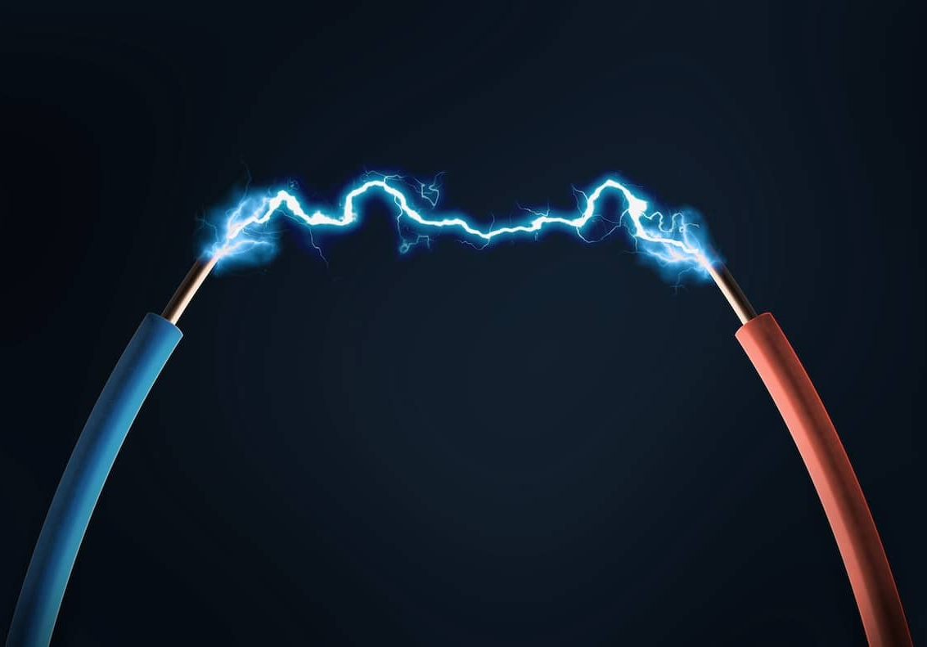
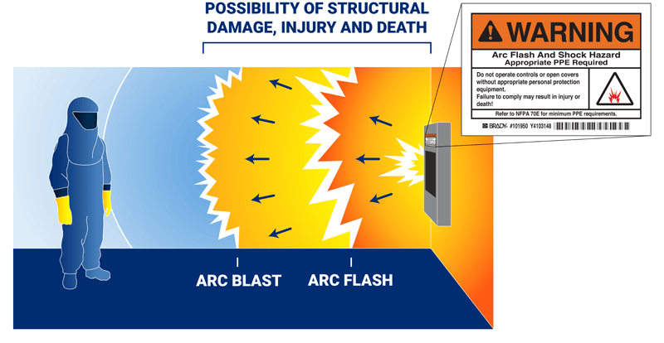
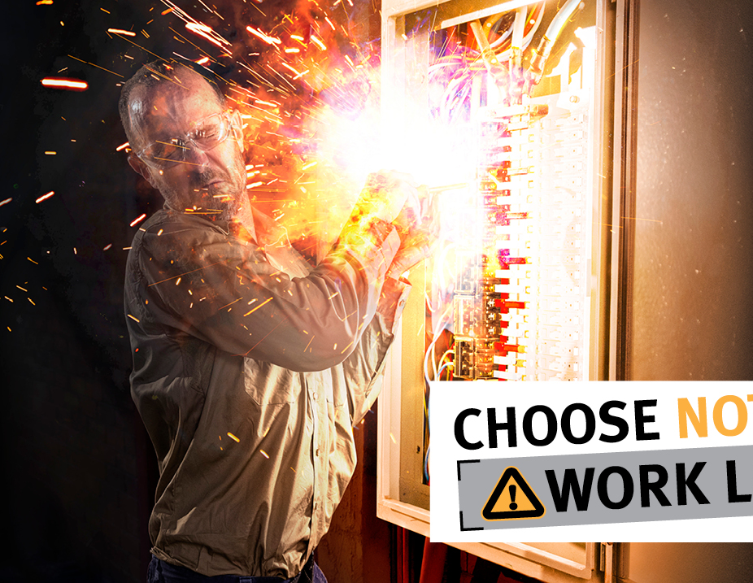
Arc Flash
Heat is 3X hotter than sun
Occurs when the air becomes ionized transforming it into a conductive plasma
Allows current to “arc” through the air which can produce a harmful flash and blast
Blast equivalent to a grenade
OSHA and NFP provide safety guidance specifically related to arc flash
Flash brighter than the sun
Notes:
*This slide has animations. CLICK to reveal content.”
Instructional Event: Present Content
Time: 2 min
Materials: Electrical Safety Overview_M7
Talking Points:
An arc flash is the result of a phenomenon known as electric arcing.
CLICK — In simple terms, an electric arc forms when electrical current leaves its intended conductive path and travels through the air.
CLICK — Normally, air acts as an insulator. However, when the air becomes ionized, its particles gain and lose electrons and it turns into a conductive gas called plasma. Electricity can then flow through this plasma, creating a powerful flash of heat and light.
Electric arcs can occur for several reasons, including high voltage or current, moisture, damaged insulation, or degraded electrical equipment.
Arc flashes can produce extreme heat, bright light, and pressure waves, which can cause serious burns and other injuries.
For this course, it is important to understand that arc flash hazards can occur in intermediate or high-voltage systems. Workers who operate around these systems receive additional training and protective equipment to ensure their safety.
National Fire Protection Association. (2024, May 1). What is arc flash and how can you stay safer? https://www.nfpa.org/news-blogs-and-articles/blogs/2024/05/01/what-is-arc-flash-and-how-can-you-stay-safer

Slide 25

The Dangers of Arc Flash
Notes:
Instructional Event: Present Content, Provide Learning Guidance
Time: 5 min.
Video Link: https://www.youtube.com/watch?v=DbqLDjXTsOM
Materials: Electrical Safety Overview_M7
Do: Use link to play the video.
Talking points:
This video shows the dangers of arc flashes. Let’s take a look.

Slide 26
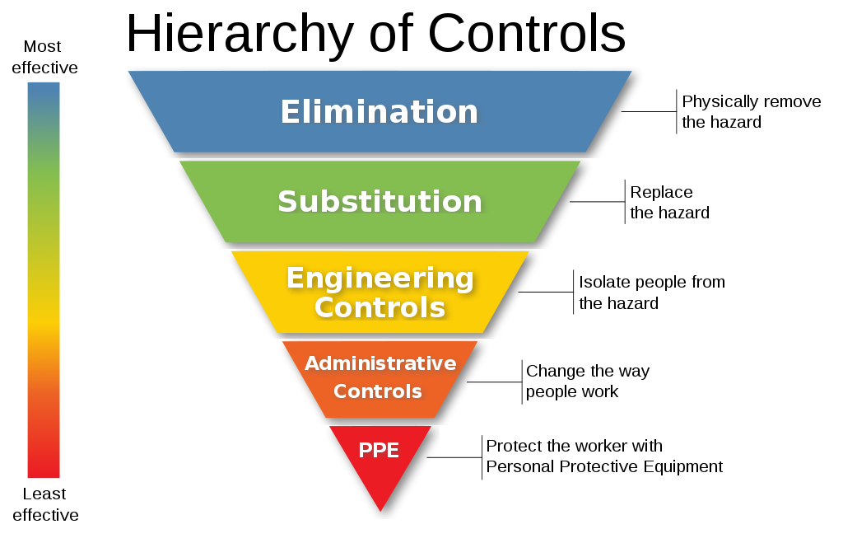
Personal Protective Equipment
Notes:
*This slide has animations. CLICK to reveal content.”
Instructional Event: Present Content, Provide Learning Guidance
Materials: Electrical Safety Overview_M7
Time: 4 min
Working with electricity can be dangerous, which is why workplaces use multiple layers of protection to keep workers safe.
One important safety concept used across many industries is called the Hierarchy of Controls. This framework helps us think about the most effective ways to reduce hazards in the workplace.
As we move down the hierarchy, the controls become less effective, which is why the goal is always to use the highest level of control possible.
CLICK — At the top of the hierarchy is Elimination, which means physically removing the hazard entirely. If the hazard no longer exists, the risk is removed.
One example of elimination is the use of automation. Some railway networks are beginning to use robotic systems that can detect defects and perform repairs such as welding or grinding. By automating these tasks, workers are removed from direct exposure to the hazard.
CLICK — The next level is Substitution, which means replacing the hazard with a safer alternative.
For example, replacing manual track switches with power-operated switch machines allows workers to control the switch remotely. The task still needs to be completed, but the worker can perform it from a safer location away from the tracks.
CLICK — Next is Engineering Controls, which isolate people from the hazard through equipment or system design.
An example of an engineering control is insulated tools. These tools are coated with rubber, nylon, or another insulating material that helps prevent electrical current from reaching the worker. The hazard still exists, but the design of the tool provides a layer of protection.
CLICK — The next level is Administrative Controls, which change how people work through policies, procedures, training, or scheduling.
A common example is a Lockout/Tagout procedure, often called LOTO. Before working on electrical equipment, workers must follow specific steps to ensure the equipment is properly shut off and cannot be accidentally re-energized.
CLICK — At the bottom of the hierarchy is Personal Protective Equipment, or PPE.
PPE includes items such as arc-rated clothing, insulated gloves, and protective face shields. PPE does not eliminate the hazard, but it helps reduce the severity of injury if an incident occurs.
This is why PPE is considered the last line of defense, used after other safety controls have been applied.
PPT is the least effective because it is subject to human error and only effective if used
Source: Robotics 24/7. (n.d.). Robel Rail Automation uses FANUC robots to repair railway lines. https://www.robotics247.com/article/robel_rail_automation_uses_fanuc_robots_repair_railway_lines

Slide 27
Personal Protective Equipment
Employer Responsibilities | Employee Responsibilities
Provide free, suitable protective equipment
Keep PPE in a good and working condition
Provide suitable training on how to use PPE
Consult with employees on if the PPE is suitable
Use all PPE provided
Follow SOPs to assess fit and inspect for damage
Report any loss or damage to the PPE
Store the PPE properly when not in use
Notes:
*This slide has animations. CLICK to reveal content.”
Instructional Event: Present Content
Time: 3 min
Materials: Electrical Safety Overview_M7
Talking Points:
For PPE to be effective, it requires both employer and employee responsibilities to be fulfilled.
CLICK - Employer responsibilities
You’ll be provided with the right PPE for the job at hand. It’s our job to keep it in good condition so you can count on it.
We’ll also train you on how to use it properly, and your feedback matters—if the gear doesn’t work for you, let us know.
CLICK - Employee responsibilities
Always use the PPE you’re given and follow the steps to check that it fits and isn’t damaged before each use.
If something’s missing or broken, report it right away—and make sure to store your gear properly so it stays in good condition.

Slide 28
Industry Standards
CFR 1910.333, .335
NFPA 70E
Mandatory for all
Not mandatory, but helps facilities meet OSHA requirements
Notes:
*This slide has animations. CLICK to reveal content.”
Instructional Event: Present Content
Time: 2 min
Materials: Electrical Safety Overview_M7
Talking Points:
Industry standards from OSHA and NFPA also protect workers from injuries related to electrical work.
CLICK - OSHA developed 1910.333 and 1910.335 which is mandatory for all.
CLICK - NFPA developed 70E which, while not mandatory, provides guidance on how to meet OSHA requirements.
Let’s take a closer look at some of these standards.

Slide 29

CFR 1910.333 –
  Follow safe work practices when working on or near electrical equipment
  Emphasizes de-energizing equipment, verifying power is off, and using safe procedures when energized work cannot be avoided
CFR 1910.333
CFR 1910.335
CFR 1910.335 –
  Requires the use of appropriate PPE and protective tools when workers may be exposed to electrical hazards
  Protective equipment must be properly maintained
Notes:
*This slide has animations. CLICK to reveal content.”
Instructional Event: Present Content
Time: 3 min
Materials: Electrical Safety Overview_M7
Talking Points:
CLICK - OSHA 29 CFR 1910.333 – Selection and Use of Work Practices
This standard requires workers to follow safe work practices when working on or near electrical equipment. It emphasizes de-energizing equipment whenever possible, verifying power is off, and using safe procedures when energized work cannot be avoided.
CLICK - OSHA 29 CFR 1910.335 – Safeguards for Personnel Protection
This standard requires the use of appropriate personal protective equipment and protective tools when workers may be exposed to electrical hazards. It also requires that protective equipment be properly maintained and used to reduce the risk of injury.
Sources:
Occupational Safety and Health Administration. (n.d.). 29 CFR § 1910.333—Selection and use of work practices. U.S. Department of Labor. https://www.osha.gov/laws-regs/regulations/standardnumber/1910/1910.333
Occupational Safety and Health Administration. (n.d.). 29 CFR § 1910.335—Safeguards for personnel protection. U.S. Department of Labor. https://www.osha.gov/laws-regs/regulations/standardnumber/1910/1910.335

Slide 30
Arc Flash Assessment: Identify hazards, energy levels, PPE, and labels
Safe Work Conditions: De-energize, Lockout/Tagout, verify zero energy
Work Boundaries: Know Limited, Restricted, and Arc Flash Boundaries
Training: Required every 3 years or when conditions change
70E
Notes:
*This slide has animations. Click to reveal content.
Instructional Event: : Present Content
Time: 4 min
Materials: Electrical Safety Overview_M7
Talking Points:
CLICK - Requires arc flash risk assessments to identify hazards, determine energy levels, and set safety boundaries with appropriate PPE and labeling.
CLICK - Outlines electrically safe work conditions including de-energizing equipment, Lockout/Tagout procedures, and verifying de-energization to protect workers.
CLICK - Defines boundaries for safe electrical work: Limited Approach (unqualified), Restricted Approach (qualified with PPE), and Arc Flash Boundary (risk of second-degree burns).
CLICK - Mandates training on safe practices, hazard identification, and PPE, updated every three years or when conditions change.

Slide 31
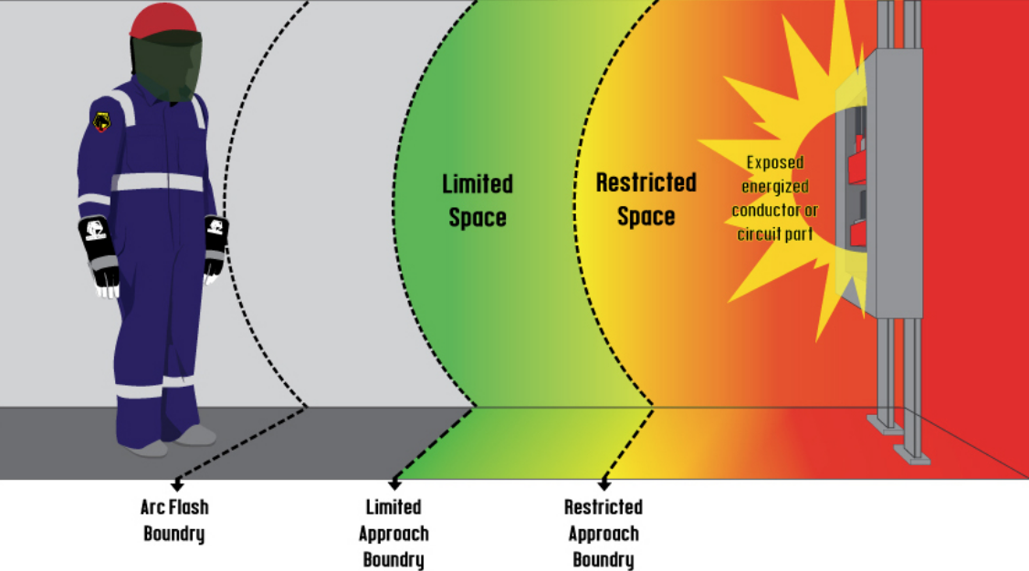
NFPA 70E and Arc Flash Boundary
Notes:
Instructional Event: Present Content
TIME: 4 min
Materials: Electrical Safety Overview_M7
Talking Points:
Explain that NFPA 70E helps electrical engineers or qualified persons calculate the arc flash boundary.
Note that this calculation takes into account fault current, arc clearing time, voltage, and software.
Review the meaning of each type of boundary (optional definitions below).
Arc Flash Boundary: The distance from energized equipment where arc flash burns may occur; anyone crossing must wear arc-rated PPE matching the incident energy level.
Limited Approach Boundary: The minimum distance an unqualified person can approach energized equipment without supervision, unless escorted by a qualified worker and additional precautions are taken.
Restricted Approach Boundary: A shock protection zone closer to live parts that only qualified workers may enter using shock-rated PPE and insulated tools.

Slide 32
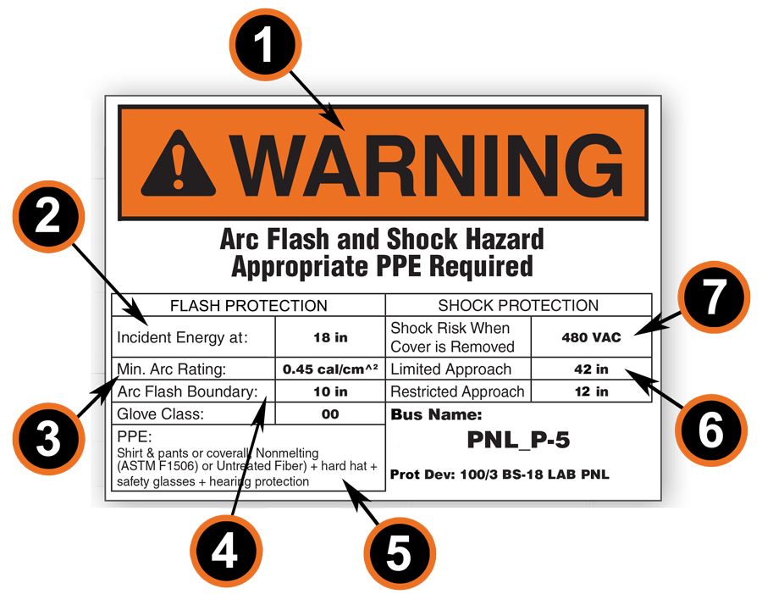
NFPA 70E and Equipment Labels
Warning Header
Incident Energy
Shock Risk
Limited and Restricted Approach
Minimum Arc Rating
Arc Flash Boundary
Appropriate PPE
Notes:
**This slide has animations. CLICK - to reveal content.
INSTRUCTIONAL ACTIVITY: Present Content
TIME: 4 min
Materials: Electrical Safety Overview_M7
Optional Video: “Questions From The Field: Explaining the Arc Flash Sticker” - https://www.youtube.com/watch?v=xRoNO2R6zlM
Do:
Use the animations to review the seven items on the label.
Remind learners to add notes to the image on page two of their Electrical Safety Overview handout.
Talking Points:
Arc flash protection also includes labels to help workers better understand the hazards and risks they are working with.
Labels may vary somewhat, but they generally contain the following:
CLICK - 1. Warning header when the voltage is over 600 or when the incident energy is over 40 cal/cm2.
CLICK - 2. Incident Energy the amount of energy that a worker could be exposed to in the event of an arc flash.
CLICK - 3. Minimum Arc Rating refers to the minimum arc rating of the required PPE.
CLICK - 4. Arc Flash Boundary: The minimum safe distance from the electrical equipment where a person could potentially receive a second-degree burn if an arc flash occurs.
CLICK - 5. Appropriate PPE: Specific types of protective gear required to protect workers from the identified electrical hazards.
CLICK - 6. Limited and Restricted approach: The minimum distance an unqualified person can approach energized equipment without supervision, unless escorted by a qualified worker and additional precautions are taken.
CLICK - 7. Shock Risk: The voltage of the equipment.

Slide 33
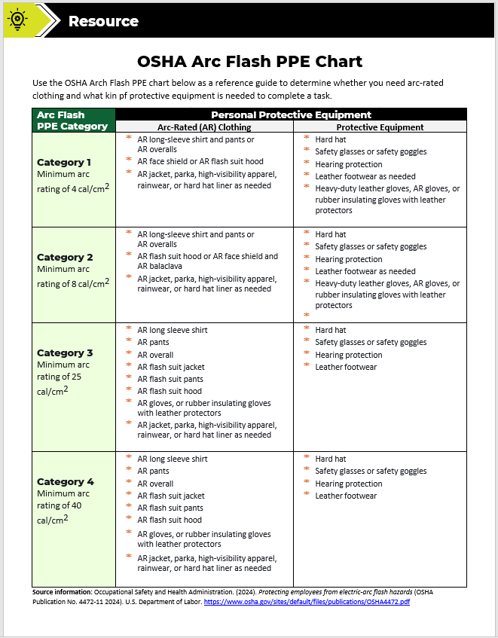
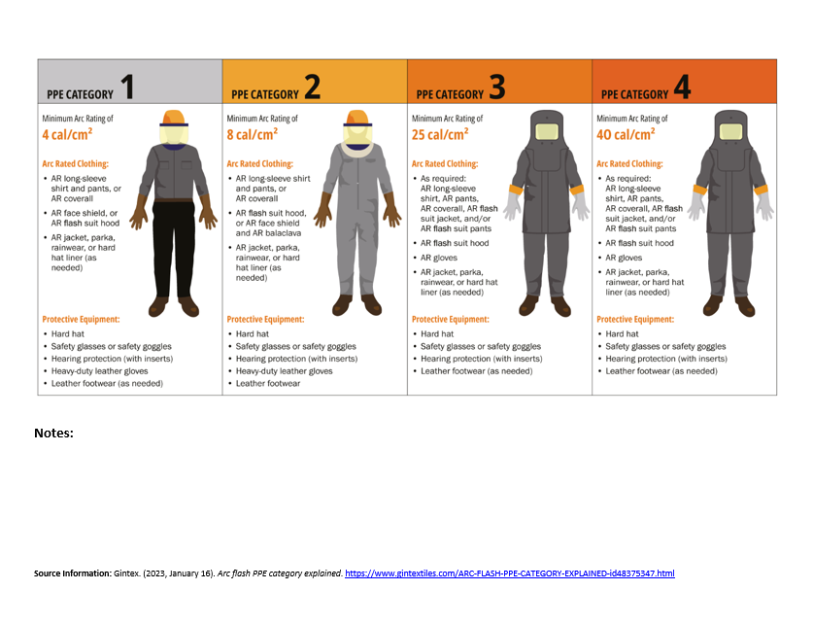
NFPA 70E and Arc Rating
Useful reference handout:
Notes:
INSTRUCTIONAL ACTIVITY: Direction
TIME: 1 min
Materials: OSHA Arc Flash PPE Chart_M7
Talking Points:
There is a lot to remember when it comes to arc flash PPE.
In your Participant Resource Guide, you will find a handout titled OSHA Arc Flash PPE Chart.
This handout outlines each arc flash PPE category and the arc-rather clothing and protective equipment associated with each.
We’ll briefly go through each category on the next slide.

Slide 34
NFPA 70E and Arc Rating
Arc Flash PPE Category | Personal Protective Equipment
 | Arc-Rated (AR) Clothing | Protective Equipment
Category 1 Minimum arc rating of 4 cal/cm2 | AR long-sleeve shirt and pants or AR overalls AR face shield or AR flash suit hood AR jacket, parka, high-visibility apparel, rainwear, or hard hat liner (AN) | Hard hat Safety glasses or safety goggles Hearing protection Leather footwear (AN) Heavy-duty leather gloves, AR gloves, or rubber insulating gloves with leather protectors
Arc Flash PPE Category | Personal Protective Equipment
 | Arc-Rated (AR) Clothing | Protective Equipment
Category 2 Minimum arc rating of 8 cal/cm2 | AR long-sleeve shirt and pants or AR overalls AR flash suit hood or AR face shield and AR balaclava AR jacket, parka, high-visibility apparel, rainwear, or hard hat liner (AN) | Hard hat Safety glasses or safety goggles Hearing protection Leather footwear (AN) Heavy-duty leather gloves, AR gloves, or rubber insulating gloves with leather protectors
Arc Flash PPE Category | Personal Protective Equipment
 | Arc-Rated (AR) Clothing | Protective Equipment
Category 3 Minimum arc rating of 25 cal/cm2 | AR long sleeve shirt AR pants AR overall AR flash suit jacket AR flash suit pants AR flash suit hood AR gloves, or rubber insulating gloves with leather protectors AR jacket, parka, high-visibility apparel, rainwear, or hard hat liner (AN) | Hard hat Safety glasses or safety goggles Hearing protection Leather footwear
Arc Flash PPE Category | Personal Protective Equipment
 | Arc-Rated (AR) Clothing | Protective Equipment
Category 4 Minimum arc rating of 40 cal/cm2 | AR long sleeve shirt AR pants AR overall AR flash suit jacket AR flash suit pants AR flash suit hood AR gloves, or rubber insulating gloves with leather protectors AR jacket, parka, high-visibility apparel, rainwear, or hard hat liner (AN) | Hard hat Safety glasses or safety goggles Hearing protection Leather footwear
Notes:
*This slide has animations. Click to reveal content.
INSTRUCTIONAL ACTIVITY: Present Content
TIME: 4 min
Materials: Electrical Safety Overview_M7
Do:
CLICK to review each category and the requires arc flash clothing and protective equipment.
Provide examples of work tasks from your line of work that fall into these categories.

Slide 35

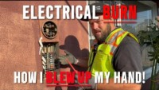
Activity: Case Study Discussion
-Was Stephan working with high, intermediate, or low voltage?
-What mistakes did Stephan make? What were the consequences?
-What factors contributed to this mistake?
-What controls are in place to prevent this type of injury?
Notes:
INSTRUCTIONAL ACTIVITY: Provide Guided Learning, Elicit Performance
TIME: 15 min
Link to Video (Time: 7:40): https://www.youtube.com/watch?v=W-d7x-S6HXs
Do:
Play the video.
Facilitate a discussion using the questions on the slide.
Talking Points:
Work through the discussion questions with the class. Call on learners to share their ideas and experiences.
Emphasize that this is the BEST case scenario. Stephan easily could have died.

Slide 36
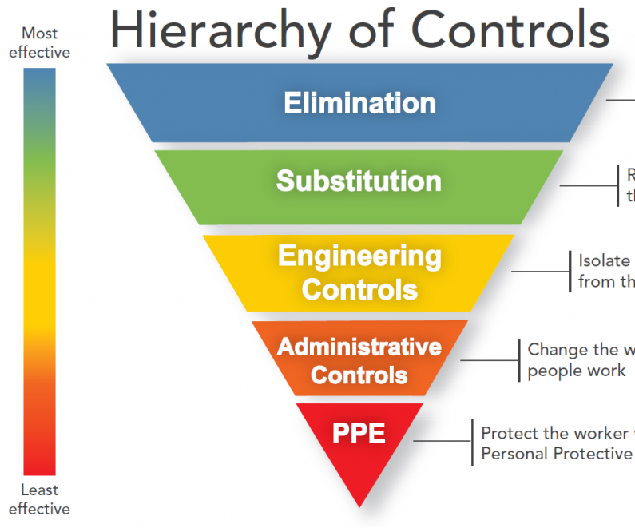
Knowledge Check
Why is PPE the least effective item on the Hierarchy of Controls?
  PPT is the least effective because it is subject to human error and only effective if used
Name two administrative controls we have discussed today.
  Policies, procedures, training, etc.
Notes:
*This slide contains animations. CLICK to reveal content.
Instructional Activity: Evaluate/Assess Performance, Provide Feedback
Instructional Time: 3 min.
Learning Objective: Apply workplace safety policies and procedures to mitigate electrical hazards.
Do: Review the knowledge check question. Call on learners to share their responses.
Answer Key:
Why is PPE the least effective item on the Hierarchy of Controls?
Answer: PPT is the least effective because it is subject to human error and only effective if used
Name two administrative controls we have discussed today.
Answer: policies, procedures, training, Lockout/Tagout, etc.

Slide 37
Knowledge Check
3. A technician needs to access electrical equipment while standing on a ladder. Which type of ladder should they choose to reduce the risk of electric shock?
(A). Metal
(B). Aluminum
(C). Wooden
(C). Wooden
(D). Extension
Notes:
*This slide contains animations. CLICK to reveal content.
Instructional Activity: Evaluate/Assess Performance, Provide Feedback
Instructional Time: 3 min.
Learning Objective: Identify and assess electrical hazards in the workplace.
Do: Review the knowledge check question. Call on learners to share their responses.
Answer Key:
C – Remind learners that metal is a conductor.

Slide 38
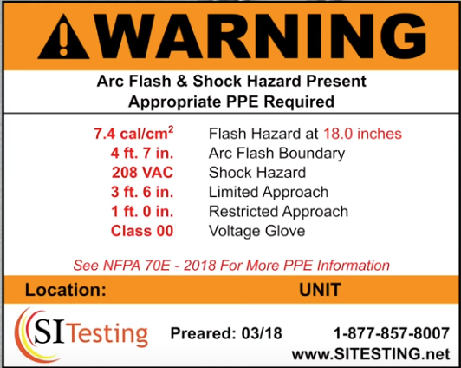
Knowledge Check
4. What kind of PPE is required when working on a device with this warning label?
Category 1 arc-rated clothing and protective equipment
Notes:
*This slide contains animations. CLICK to reveal content.
Instructional Activity: Evaluate/Assess Performance, Provide Feedback
Instructional Time: 3 min.
Learning Objective: Select and utilize appropriate PPE for high voltage, low voltage, and arc flash environments.
Do: Review the knowledge check question. Call on learners to share their responses.
Answer Key:
Category 1 arc-rated clothing and protective equipment

Slide 39
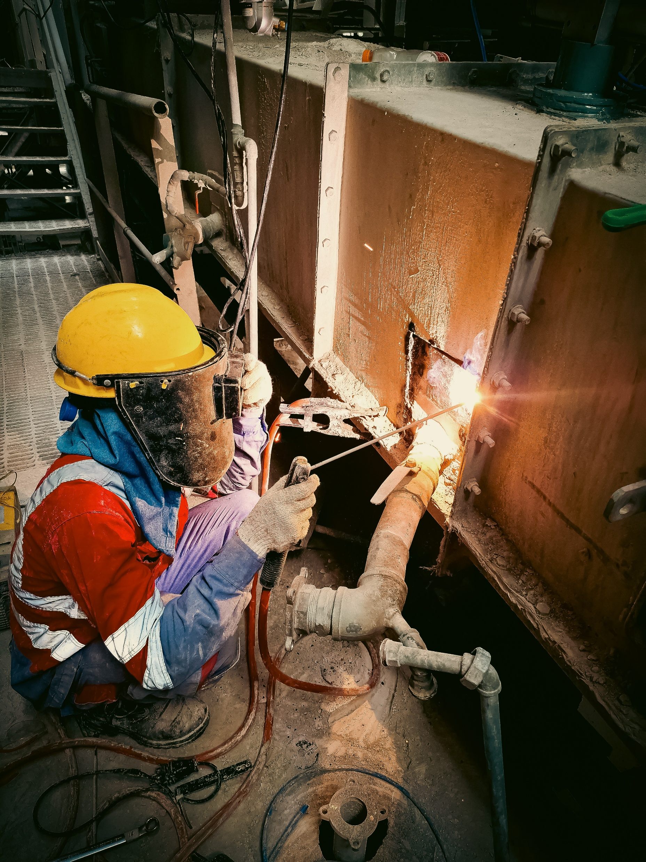
7.2 - PPE for Electrical Safety
In this section we’ll review types of PPE used in electrical work. Important note before we begin – All PPE is used at intermediate and high voltages, not just select pieces.
Notes:
INSTRUCTIONAL ACTIVITY: Direction
TIME: 1 min
DO: Introduce section.
Talking Points:
In this section we’ll review types of PPE used in electrical work.
Important note before we begin – All PPE is used at intermediate and high voltages, not just select pieces.

Slide 40
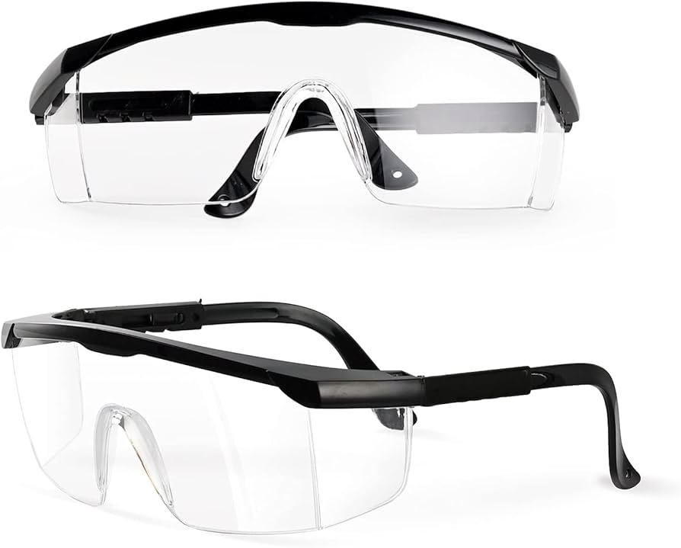
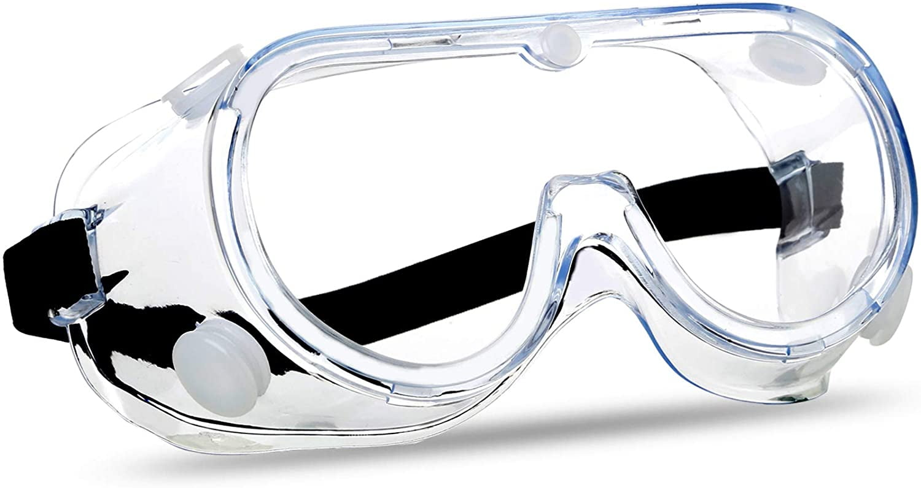
Glasses/Goggles
Purpose + Hazard Protection
ANSI Z87+ compliant eye protection
Protect eyes and face from arc flashes, sparks, and flying debris
Inspection
Check for cracks, scratches, broken parts, and lens clarity
Proper Fit and Use
Must fit securely without obstructing vision
Must fit over prescription glasses if required
Notes:
Instructional Event: Present Content, Provide Guided Learning
Materials: Safety Glasses/Goggles
Time: 2 min
Do: Model procedures for inspection, ensuring a proper, putting on, and taking off the PPE.
Talking Points:
Purpose and Hazard Protection:
Safety glasses and goggles help protect the eyes from hazards such as sparks, flying debris, and flashes of intense light that may occur during electrical work.
Many safety glasses are marked Z87+, which refers to the ANSI Z87.1 standard for eye protection. When glasses carry the Z87+ marking, it means they are impact-rated and tested to withstand high-energy impacts, not just minor hazards.
Workers can usually find the Z87+ marking on the lens, the frame, or the temple of the glasses.
Inspection
Before using eye protection, it is important to inspect the equipment. Workers should check for cracked lenses, scratches, broken parts, or anything that reduces visibility or protection.
Proper Fit and Use
Proper fit is also important. Safety glasses or goggles should fit securely and allow clear vision while staying comfortably in place.
If a worker wears prescription glasses, the safety glasses or goggles should fit properly over them without interfering with vision or protection.
For example, mechanics or technicians performing maintenance on electrical cabinets, battery systems, or equipment that may produce sparks or debris should wear approved eye protection to reduce the risk of eye injury.
Proper inspection, fit, and use of eye protection helps ensure the equipment provides the protection it was designed to deliver.

Slide 41
Hearing Protection - Earmuffs
Purpose + Hazard Protection
Protect against the high-decibel noise of arc blasts or loud environments.
Inspection
Missing or broken pieces
Proper Fit and Use
Full coverage over ears
Notes:
Instructional Event: Present Content, Provide Guided Learning
Materials: Hearing Protection/Earmuffs
Time: 2 min
Do: Model procedures for inspection, ensuring a proper, putting on, and taking off the PPE.
Talking Points:
Hearing protection such as earmuffs helps protect workers from high-decibel noise in the workplace, including loud equipment or the sudden pressure wave created by an arc blast.
Exposure to very loud noise can damage hearing, sometimes permanently, so proper hearing protection is important in high-noise environments.
Before using earmuffs, workers should inspect them for damage, such as missing parts, cracks, or worn padding that could reduce protection.
When wearing earmuffs, they must fully cover the ears and form a tight seal around them to provide effective noise reduction.

Slide 42
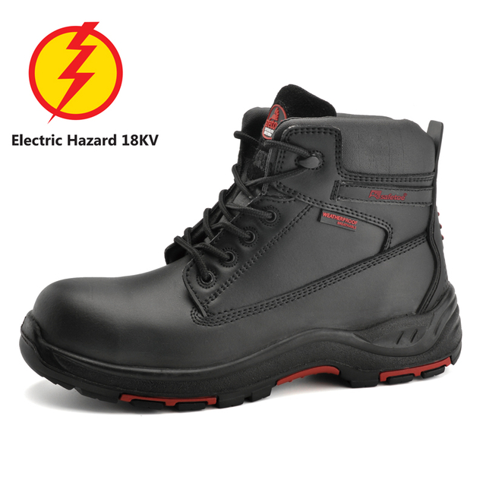
Leather Footwear
Purpose + Hazard Protection
Reduce risk of ground contact during electrical faults.
Electrical Hazed (EH) rated
Inspection
No damage to the sole, leather
Proper Fit and Use
Secure and tightly laced
Notes:
Instructional Event: Present Content, Provide Guided Learning
Materials: EH-Rated Leather Footwear
Time: 2 min
Do: Model procedures for inspection, ensuring a proper, putting on, and taking off the PPE.
Talking Points:
Leather safety boots that are EH-rated are designed to provide secondary protection against electrical shock.
EH stands for Electrical Hazard. These boots are constructed with insulating materials that help reduce the amount of electricity that can pass through the body to the ground during an electrical fault.
For example, if a worker accidentally steps on or touches something energized, EH-rated boots can help reduce the chance of electricity traveling through the feet to the ground.
However, it is important to remember that EH-rated footwear does not make a worker shock-proof. It provides an added layer of protection but must be used along with other safety controls and PPE.
Before use, workers should inspect their boots for damage, especially to the sole or leather. Cracks, holes, or excessive wear can reduce the protective qualities of the footwear.
Boots should also fit properly and be securely laced. A proper fit helps maintain stability, prevents slips or trips, and ensures the footwear provides the protection it was designed to deliver.

Slide 43
Insulating Gloves
Purpose + Hazard Protection
Protect hands from electric shock
Inspection
Inspect rubber for cracks, holes, pinholes, or other damage
Check for contamination from grease, oil, or petroleum products
Verify inspection date stamp
Limit exposure to sunlight - UV light can degrade rubber
Notes:
Instructional Event: Present Content, Provide Guided Learning
Materials: Insulating Gloves
Time: 2 min
Do: Model procedures for inspection, ensuring a proper, putting on, and taking off the PPE.
Talking Points:
Insulating gloves are designed to protect workers’ hands from electrical shock when working on or near energized electrical equipment.
These gloves are typically made from specialized rubber materials that resist the flow of electricity, helping prevent electrical current from passing through the hands.
Before use, insulating gloves must be carefully inspected. Workers should check the rubber for cracks, holes, pinholes, or other signs of damage that could reduce protection.
It is also important to check for contamination from grease, oil, or petroleum products, which can degrade the rubber and weaken the insulating properties.
Workers should also verify the inspection or test date stamp on the gloves. In many workplaces, insulating gloves are approved for six months of service after testing, and they must be retested or replaced after that period.
Because sunlight and ultraviolet light can degrade rubber, gloves should be stored properly and not left exposed to direct sunlight for long periods.

Slide 44
Insulating Gloves (Continued)
Purpose + Hazard Protection
Must be properly sized for the user
Select the correct voltage class for the task
Wear leather protector gloves over rubber insulating gloves
Store gloves in an approved glove bag when not in use
Notes:
Instructional Event: Present Content, Provide Guided Learning
Materials: Insulating Gloves
Time: 2 min
Do: Model procedures for inspection, ensuring a proper, putting on, and taking off the PPE.
Talking Points:
Insulating gloves must also be properly sized for the worker. A correct fit allows workers to safely handle tools while maintaining the protection the gloves are designed to provide.
Another important consideration is the voltage class of the glove. Insulating gloves are manufactured in different classes, and each class is rated to protect against a specific voltage range. Workers must always select gloves that match the voltage level of the task.
When using rubber insulating gloves, workers should also wear leather protector gloves over them. These protect the rubber from cuts, punctures, and abrasion that could damage the insulating material.
When the gloves are not in use, they should be stored in an approved glove bag or protective container. Proper storage helps prevent damage and keeps the gloves clean and ready for use.

Slide 45
Insulating Gloves (Continued)
Glove Class | Max AC Coverage | Max DC Coverage
Class 00 | 500 V | 750 V
Class 0 | 1,000 V | 1,500 V
Class 1 | 7,500 V | 11,250 V
Class 2 | 17,000 V | 25,500 V
Class 3 | 26,500 V | 39,750 V
Class 4 | 36,000 V | 54,000 V
Notes:
Instructional Event: Present Content, Provide Guided Learning
Materials: Insulating Gloves
Time: 2 min
Talking Points:
Insulating gloves are manufactured in different classes, and each class is rated to protect against a specific voltage level.
The class number tells you the maximum voltage the glove can safely protect against. As the class number increases, the glove is designed to protect against higher voltages.
These voltage ratings come from the ASTM D120 standard, which sets requirements for rubber insulating gloves used in electrical work.
In most transit environments, workers will typically use Class 00, Class 0, or sometimes Class 1 or Class 2 gloves, depending on the voltage of the system they are working on.
Choosing the correct glove class is important because the glove must be rated for the voltage level of the task.
ASK: If you’re not sure what voltage you’re working on, what should you do before selecting your gloves?
Call on learners to respond. Guide discussion toward the importance of verifying the voltage and following workplace procedures.
ASK: What might happen if someone chooses gloves that are rated for a much higher voltage than necessary?
Call on learners to respond. Higher-class gloves provide more protection, but they are thicker and less flexible, which can reduce dexterity and make it harder to safely handle tools and equipment.
The key takeaway is that workers should always select gloves that match the voltage level of the job while still allowing them to work safely and effectively.

Slide 46
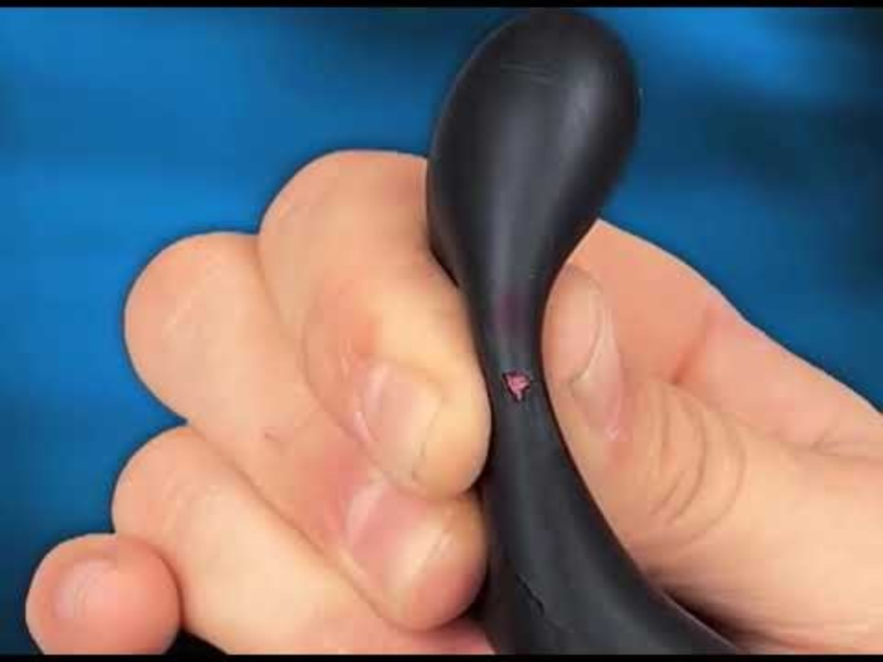
Insulated Gloves
Video Link: https://www.youtube.com/watch?v=4mpksxHgCAA
Notes:
Instructional Event: Present Content, Provide Learning Guidance
Time: 16 min.
Video Link: https://www.youtube.com/watch?v=4mpksxHgCAA
Do: Use link to play the video.
Talking points:
This video provides an overview of the purpose, use, and inspection of insulated gloves. Let’s take a look.
Source: Summit Electric Supply. (2018). Salisbury's arc flash and rubber glove safety training [Video]. YouTube. https://www.youtube.com/watch?v=4mpksxHgCAA

Slide 47
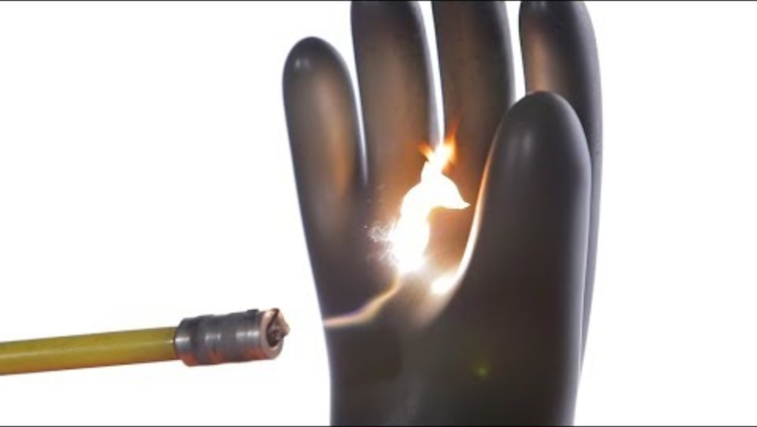
Inspecting Insulating Gloves
Video Link: https://www.youtube.com/watch?v=AnfTcccmFS4&t=142s
Notes:
Instructional Event: Present Content, Provide Learning Guidance
Time: 3 min.
Video Link: https://www.youtube.com/watch?v=AnfTcccmFS4&t=142s
Do: Use link to play the video.
Talking points:
This video dives a little deeper into inspection.
Source: Northwest Lineman College. (2018). Rubber glove inspection [Video]. YouTube. https://www.youtube.com/watch?v=AnfTcccmFS4

Slide 48
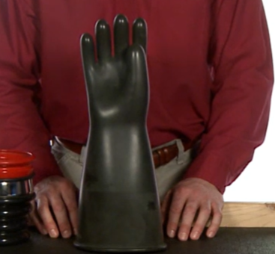
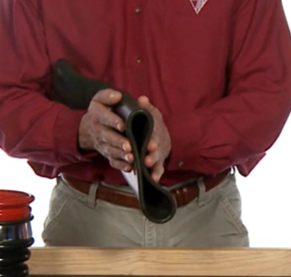
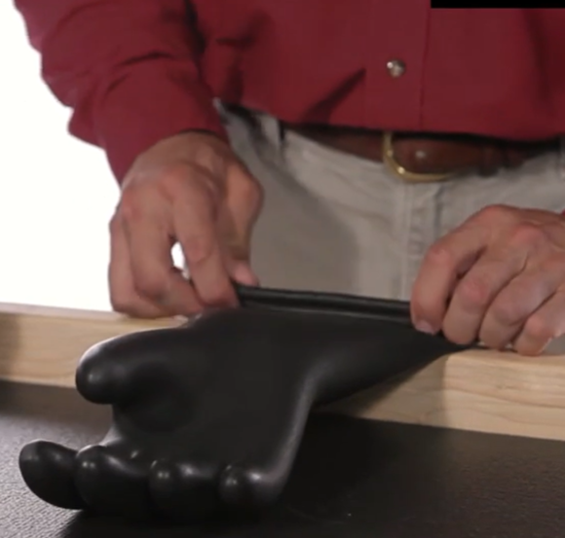
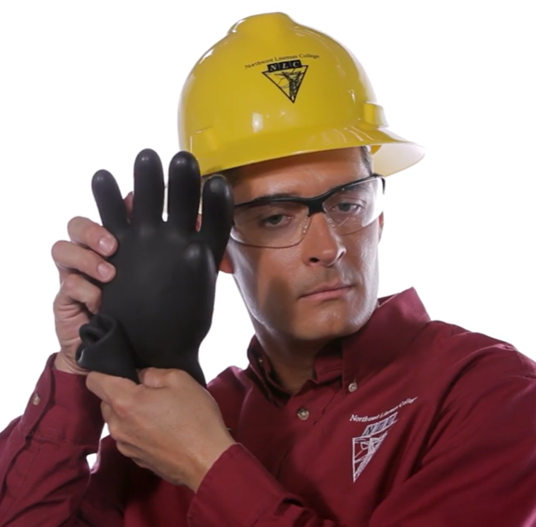
Instructor Demo: Insulating Gloves
Glove Inspection
Glove Inflation Test
Notes:
Instructional Event: Present Content, Provide Learning Guidance
Time: 5 min.
Materials: Insulated glove in good condition and Insulated glove in poor condition
Do:
Conduct a glove inspection and a glove inflation test.
Make sure you have a “bad” glove – with tiny crack, hole, oil stain or expired test date so learners know what to look for.

Slide 49
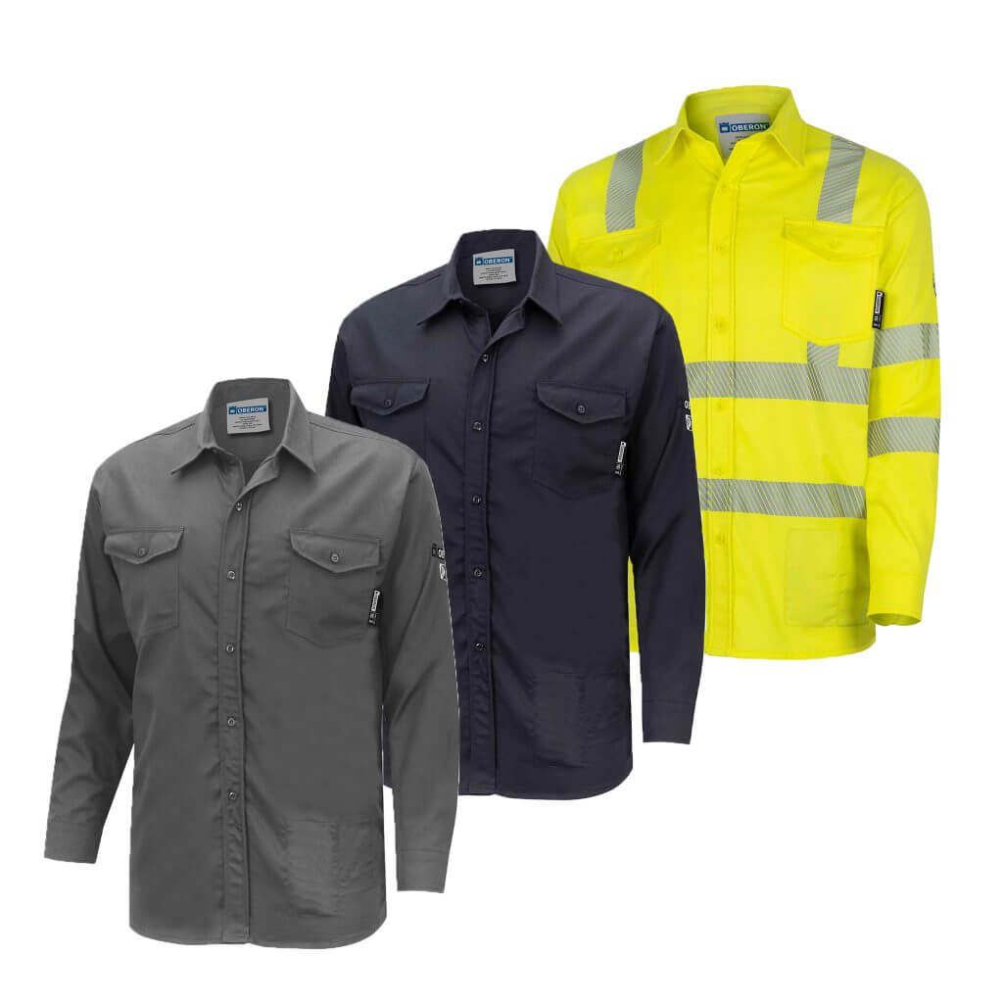

Arc Rated Uniform
Purpose + Hazard Protection
Protect the body from arc flash heat and flames
Arc-rated materials are designed not to ignite or melt during an electrical arc
Do not wear synthetic materials when working around intermediate or high voltage
Proper Use
Wear the full uniform, not just one piece
Notes:
Instructional Event: Present Content, Provide Guided Learning
Materials: Arc Rated Uniform
Time: 2 min
Do: Model procedures for inspection, ensuring a proper, putting on, and taking off the PPE.
Talking Points:
Arc-rated uniforms are designed to protect the body from the intense heat and flames produced during an arc flash event.
These garments are made from arc-rated materials that are tested to resist ignition and prevent the fabric from melting or continuing to burn when exposed to an electrical arc.
It is important to avoid wearing synthetic or man-made materials, such as polyester or nylon, when working around intermediate or high voltage. These materials can melt onto the skin when exposed to extreme heat, which can significantly worsen burn injuries.
Workers should also remember that arc-rated protection works as a system. Wearing only one piece of the uniform does not provide full protection.
For example, wearing only an arc-rated shirt while leaving other areas exposed may still allow serious burns during an arc flash event.

Slide 50
Arc Rated Uniform (Continued)
Inspection
Check for cuts, tears, or damaged fabric
Inspect for grease, oil, or other contamination
Proper Fit and Use
All buttons must be fastened
Shirts should be tucked in
Uniform must be worn correctly to maintain protection
Notes:
Instructional Event: Present Content, Provide Guided Learning
Materials: Arc Rated Uniform
Time: 2 min
Do: Model procedures for inspection, ensuring a proper, putting on, and taking off the PPE.
Talking Points:
Before wearing an arc-rated uniform, workers should inspect the clothing for damage.
Look for cuts, tears, worn fabric, or other damage that could reduce the protective performance of the garment.
Workers should also check for grease, oil, or other contamination. Contaminants can make the material more flammable, which increases the risk of injury during an arc flash.
Proper fit and use are also important. The uniform should be worn correctly and fully fastened.
All buttons should be secured, and shirts should be tucked in. This helps ensure that the arc-rated clothing provides continuous protection across the body.
Wearing the uniform properly helps ensure it performs the way it was designed and tested to protect workers during an arc flash event.

Slide 51

Arc-Rated Outerwear
Purpose + Hazard Protection
Protect the body from arc flash heat and flames
Any clothing worn over arc-rated clothing must also be arc rated
Inspection, Proper Fit, and Use
Follow the same procedures as the arc-rated uniform
Notes:
Instructional Event: Present Content, Provide Guided Learning
Materials: Arc Rated Outerwear
Time: 2 min
Do: Model procedures for inspection, ensuring a proper, putting on, and taking off the PPE.
Talking Points:
Arc-rated outerwear provides additional protection from arc flash heat and flames, especially when working outdoors or in colder environments.
Examples include arc-rated jackets, bib overalls, and other protective outer garments that are worn over the standard arc-rated uniform.
One important rule is that anything worn over arc-rated clothing must also be arc rated. Wearing non-arc-rated jackets or sweatshirts over protective clothing can reduce the effectiveness of the protection.
Outerwear should be inspected the same way as the arc-rated uniform. Workers should check for cuts, tears, damaged fabric, or contamination such as grease or oil, which can increase flammability.
The fit and use requirements are also the same as the arc-rated uniform. Outerwear should be worn correctly and fully fastened so it continues to provide the protection it was designed to deliver.

Slide 52
Arc-Rated Face Shield and Hood
Purpose + Hazard Protection
Protect the eyes, face, neck, head, and upper chest from arc flash heat, sparks, and flying debris
Inspection
Inspect for cracks, scratches, or damage
Ensure internal suspension and headgear are in good condition
Check manufacture date (typically a 5-year limit)
Verify the shield/hood is rated for electrical hazard level
Proper Fit and Use
Must fit securely and remain stable during work
Notes:
Instructional Event: Present Content, Provide Guided Learning
Materials: Arc Rated Face Sheild and Hood
Time: 2 min
Do: Model procedures for inspection, ensuring a proper, putting on, and taking off the PPE.
Talking Points:
Arc-rated face shields and hoods provide critical protection for the head and upper body during an arc flash event.
They are designed to protect the eyes, face, neck, head, and upper chest from extreme heat, sparks, and flying debris that may occur during an electrical arc.
Before use, workers should inspect the face shield or hood carefully. Look for cracks, scratches, or other damage to the visor, as this can reduce visibility or protection.
The internal suspension system and headgear should also be checked to make sure they are secure and functioning properly.
Workers should also verify the manufacture date, since many arc-rated face shields and hoods have a service life of about five years, depending on manufacturer guidance.
Another important step is confirming that the face shield or hood is rated for the electrical hazard level of the task, ensuring it provides adequate arc flash protection.
When worn, the shield or hood should fit securely and remain stable on the head, allowing the worker to maintain clear vision while staying protected.

Slide 53

Layering for Arc Protection
WARNING:
Arc protection is only as strong as the weakest layer of clothing
Wearing non–arc-rated clothing underneath can still allow burns during an arc flash event
Notes:
Instructional Event: Present Content
Time: 2 min
Talking Points:
When working in colder environments, workers may need to wear additional layers to stay warm.
If layering is necessary, it is important to make sure that all layers worn during energized electrical work are arc-rated.
Wearing non–arc-rated clothing underneath or over arc-rated PPE can reduce the overall level of protection and increase the risk of injury during an arc flash event.
Remember that arc protection is only as strong as the weakest layer, so workers should always check that each layer of clothing meets the required arc-rating standards for the task.

Slide 54

Activity: Glove Inspection
1. Inspect the gloves
2. Conduct an inflation test
3. Demonstrate putting on and taking off the glove
Notes:
Instructional Event: Provide Guided Learning, Elicit Performance, Provide Feedback
Time: 15 minutes
Materials:
One per group/pair:
Insulated glove in good condition
Insulated glove in poor condition
Leather gloves
Inspect, Test, Use_M7
Do:
(2 min.)
Refer learners to the “Inspect, Test, Use_M7” handout embedded in the Participant Resource Guide.
Review the directions and answer any questions learners may have.
Pass out the necessary materials.
(10 min.)
Give learners time to complete the activity.
Circulate the room answering questions and connecting the activity to the content taught thus far. Provide feedback as needed.
(3 min.)
Debrief by discussing question #4 as a group.

Slide 55


Activity: Reading Arc Labels
Goal: Practice reading arc-rated clothing labels to determine whether it provides sufficient protection for various electrical maintenance scenarios.
Part 1: Inspect the Clothing
Part 2: Scenario Analysis
Part 3: Discussion
Notes:
Instructional Event: Provide Guided Learning, Elicit Performance, Provide Feedback
Time: 20 minutes
Materials:
Reading Arc Labels_M7
Reading Arc Labels_Answer Key_M7
Do:
(3 min.)
Refer learners to the “Reading Arc Labels_M7” handout embedded in the Participant Resource Guide.
Review the directions for Part 1 and 2 and answer any questions learners may have.
You may have learners complete this activity in small groups if you choose.
(10 min.)
Give learners time to complete the activity.
Circulate the room answering questions and connecting the activity to the content taught thus far. Provide feedback as needed.
(12 min.)
Bring the class back together and review the answers to Part 2.
Facilitate a short discussion using the questions in Part 3.

Slide 56

7.3 - Procedures to Protect Workers
In this section, we’ll review ways to protect workers including Lock Out Tag Out.
Notes:
INSTRUCTIONAL ACTIVITY: Direction
TIME: 1 min
DO: Introduce section.
Talking Points:
In this section, we’ll review ways to protect workers including Lock Out Tag Out.

Slide 57


Lock Out Tag Out
A process by which hazardous energy is isolated by installing the following items to a machine or piece of equipment:
  lockout device
  tag out device
OSHA requires employers to have a LOTO program that includes energy control procedures, training, certification that training is up-to-date and periodic inspections
Notes:
*This slide has animations. CLICK to reveal content.”
Instructional Event: Present Content
Time: 2 min
Talking Points:
CLICK - LOTO is a safety procedure used to isolate hazardous energy during maintenance of machines and equipment.
Process involves installing a lockout device to physically prevent operation and a tagout device to communicate that the equipment must not be used.
CLICK - Employers must implement a LOTO program that includes written energy control procedures for each piece of equipment.
The program must also provide training and certification for employees, ensure training is current, and conduct periodic inspections to maintain compliance.

Slide 58

Electrical Lock Out Tag Out
Notes:
Instructional Event: Present Content, Provide Learning Guidance
Time: 4 min.
Video Link: https://www.youtube.com/watch?v=jP9HI8izPR8
Talking Points:
This video outlines the six steps in electrical lock out tag out. Let’s take a look.
Source: ASC Process Systems. (2019). Weekly safety discussion – Electrical lockout-tagout [Video]. YouTube. https://www.youtube.com/watch?v=jP9HI8izPR8

Slide 59


LOTO: Affected and Authorized Employees
Authorized Employee
Locks out or tags out equipment to do servicing or maintenance. An affected employee becomes authorized when their job includes doing that work.
Affected Employee
A person who uses or operates equipment that is being serviced under lockout/tagout or works in an area where that equipment is being serviced.
Notes:
*This slide has animations. CLICK to reveal content.”
Instructional Event: Present Content
Time: 2 min
Talking Points:
CLICK - Affected Employees operate equipment that is being serviced under lockout/tagout or work in an area where that equipment is being serviced.
CLICK - Authorized Employees lock out or tag out equipment to do servicing or maintenance. An affected employee becomes authorized when their job includes doing that work.

Slide 60
Lock Out Devices
Used to hold an energy isolating device in a safe position and prevent the energizing of a machine or equipment
Must be durable, substantial, identifiable, and subject to inspection
One key, issued to a single authorized employee
Notes:
Instructional Event: Present Content
Time: 2 min
Materials: Lock Out Devices
Do: Pass lock out devices around the room for learners to see and feel.
Talking Points:
A lockout device is used to hold an energy isolating device in a safe position and prevent the energizing of a machine or equipment.
A lock out device must be durable, substantial, identifiable, and are subject to inspect.
Note that devices come in a variety of shapes and sizes and typically use a key or combination lock to secure the device.

Slide 61

Tag Out Devices
Bright color, pattern, and bold text
Must be tag + attachment – color, pattern, bold
Indicates that the energy isolating device and controlled equipment cannot be operated until the tagout device is removed.
Includes other information such as the date and name authorized personnel
Date/Name of personnel
Notes:
*This slide has animations. CLICK to reveal content.”
Instructional Event: Present Content
Time: 2 min
Materials: Tag Out Devices
Do: Pass tag out devices around the room for learners to see and feel.
Talking Points:
CLICK - Tagout devices include both tag and attachment and must be clearly visible with a bright color, bold text, and pattern.
They indicate that the energy isolating device and controlled equipment cannot be operated until the tagout device is removed.
CLICK - Other information such as the date and name authorized personnel will also be included on the tagout device.

Slide 62

Lock Out Tag Out Placards
LOTO placards are made of durable material and state information such as:
Types of energy to be locked out
Location
Description
Method of operation
Verification method
Notes:
Instructional Event: Present Content
Time: 2 min
Materials: LOTO Placard
Do: Pass LOTO placard around the room for learners to see and feel.
Talking Points:
LOTO placards are made of durable material.
They indicate the type of energy, location, description, method of operation, and a verification of the method.

Slide 63


NFPA 70 E Article 120
6 Steps for Establishing an Electrically Safe Work Condition
Notes:
Instructional Event: : Present Content
Time: 1 min
Talking Points:
NFPA 70 E also establishes clear guidelines for Establishing an Electrically Safe Work Condition in Article 120. Let’s take a closer look.

Slide 64


(1) Determine all possible sources of electrical supply to the specific equipment. Check applicable up-to-date drawings, diagrams, and identification tags
Notes:
Instructional Event: : Present Content
Time: 2 min.
Do: Provide a real-world example.
Talking Points:
(1) Determine all possible sources of electrical supply to the specific equipment. Check applicable up-to-date drawings, diagrams, and identification tags.

Slide 65
(2) After properly interrupting the load current, open the disconnecting device(s) for each source.
Notes:
Instructional Event: : Present Content
Time: 2 min.
Do: Provide a real-world example.
Talking Points:
(2) After properly interrupting the load current, open the disconnecting device(s) for each source.

Slide 66
(3) Wherever possible, visually verify that all blades of the disconnecting devices are fully open or that drawout-type circuit breakers are withdrawn to the fully disconnected position.
Notes:
Instructional Event: : Present Content
Time: 2 min.
Do: Provide a real-world example.
Talking Points:
(3) Wherever possible, visually verify that all blades of the disconnecting devices are fully open or that drawout-type circuit breakers are withdrawn to the fully disconnected position.

Slide 67
(4) Apply lockout/tagout devices in accordance with a documented and established policy.
Notes:
Instructional Event: : Present Content
Time: 2 min.
Do: Provide a real-world example.
Talking Points:
(4) Apply lockout/tagout devices in accordance with a documented and established policy.
We’ll talk more about LOTO later in this lesson.

Slide 68
(5) Use a properly rated tester to check each phase conductor or circuit part for de-energization, both phase-to-phase and phase-to-ground. Verify the tester is working on a known voltage source before and after testing.
Notes:
Instructional Event: : Present Content
Time: 2 min.
Do: Provide a real-world example.
Talking Points:
(5) Use an adequately rated test instrument to test each phase conductor or circuit part to verify it is deenergized. Test each phase conductor or circuit part both phase-to-phase and phase-to-ground. Before and after each test, determine that the test instrument is operating satisfactorily through verification on a known voltage source.

Slide 69
(6) If induced voltage or stored energy is possible, ground phase conductors or circuit parts before contact. If contact with exposed energized parts is likely, use grounding devices rated for the available fault current.
Notes:
Instructional Event: : Present Content
Time: 2 min.
Do: Provide a real-world example.
Talking Points:
(6) Where the possibility of induced voltages or stored electrical energy exists, ground the phase conductors or circuit parts before touching them. Where it could be reasonably anticipated that the conductors or circuit parts being de-energized could contact other exposed energized conductors or circuit parts, apply ground connecting devices rated for the available fault duty.

Slide 70
LOTO at Our Facility
Notes:
Instructional Event: Present Content
Time: 10 min.
Materials: One per learner - LOTO SOPs used at your facility
Do:
Pass out a copy of the LOTO procedures used at your facility.
Review any policies or procedures related to LOTO at your facility.
Consider providing leaners with a copy of any relevant SOPs.

Slide 71

LOTO at Our Facility
Notes:
Instructional Event: Present Content
Time: 5 min
Do:
Add some photos showing examples of lock out devices and tags used in your facility.
Describe how/why they are used.

Slide 72

Activity: LOTO at Our Facility
Practice implementing lock out tag out procedures in our facility.
Notes:
Instructional Event: Provide Guided Learning, Elicit Performance, Provide Feedback
Time: 45 min
Do: Engage learners in a hands-on learning activity by practice implementing lock out tag out procedures in your facility.

Slide 73
Knowledge Check
______________ is a process by which hazardous energy is isolated and controlled during maintenance.
(A). LOTO
(A). LOTO
(B). OSHA 1910
(C). NFPA 70E
(D). Hierarchy of Controls
Notes:
*This slide contains animations. CLICK to reveal content.
Instructional Activity: Evaluate/Assess Performance, Provide Feedback
Instructional Time: 3 min.
Learning Objective: Apply workplace safety policies and procedures to mitigate electrical hazards.
Do: Review the knowledge check question. Call on learners to share their responses.
Answer Key:
A
BONUS Question – Can you describe the purpose of the other items in this question (OSHA 1910, NFPA 70E, etc.)?

Slide 74
Knowledge Check
1. Describe how to complete a glove inflation test.
  To perform a glove inflation test, trap air inside the rubber glove by rolling or folding the cuff, then gently squeeze or manually inflate it to check for leaks, cuts, or weak spots. Inspect both sides thoroughly for any signs of air escaping or damage.
2. What is the purpose of arc flash face shield and hood?
  Protect eyes, face, neck, and chest from arc flashes, sparks, and flying debris.
Notes:
*This slide contains animations. CLICK to reveal content.
Instructional Activity: Evaluate/Assess Performance, Provide Feedback
Instructional Time: 6 min.
Learning Objectives: Select and utilize appropriate PPE for high voltage, low voltage, and arc flash environments.
Do: Review the knowledge check question. Call on learners to share their responses.
Answer Key:
To perform a glove inflation test, trap air inside the rubber glove by rolling or folding the cuff, then gently squeeze or manually inflate it to check for leaks, cuts, or weak spots. Inspect both sides thoroughly for any signs of air escaping or damage.
Protect eyes, face, neck, and chest from arc flashes, sparks, and flying debris.

Slide 75

Quiz
Time for a quiz! Let’s see what you have learned from today’s lesson.
Notes:
Instructional Activity: Direction, Evaluate/Assess Performance
Instructional Time: 20 min.
Materials: Quiz_M7
Do:
Ask learners if they have any lingering questions. Address them before distributing the quiz.
Pass out the quiz and review the directions.
Talking Points:
Time for a quiz! Let’s see what you have retained from today’s lesson.

Slide 76
Revisiting Objectives
Identify and assess electrical hazards in the workplace.
Select and utilize appropriate PPE for high voltage, low voltage, and arc flash environments.
Apply workplace safety policies and procedures to mitigate electrical hazards.
Notes:
Instructional Activity: Enhance Transfer and Retention
Instructional Time: 5 min.
Do: Facilitate a short discussion to review the key topics in the lesson.
Talking Points:
If you were explaining today’s objectives to someone else, how would you summarize what they mean and why they matter?
Which of today’s objectives do you feel most confident about? Which were most challenging? Explain your reasoning.
Can you give an example of how you could apply one of today’s objectives in a real-world situation?
After Discussion:
This conclude this section of the module. Thank you for your participation.

Slide 77
Thank you!
Notes:
Instructional Activity: Enhance Transfer and Retention
Instructional Time: 2 min.
Do:
Thank learners for their participation.
If possible, stay after class to answer any lingering questions learners may have.

