Slide 1


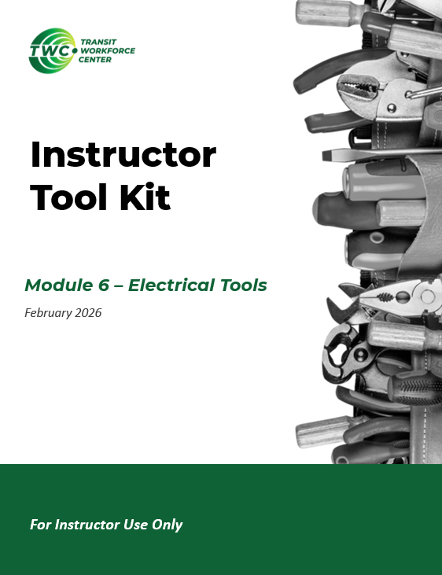

Instructor Guide Snapshot
Icon Key
Activity:
Video:
Instructor Demo:
Knowledge Check:
Instructional Time: ~8.75
Preparation before class:
  Review all materials - Review all slides, talking points, and handouts before class to understand the structure and flow of the lesson. Pay special attention to animations within the slides.
  Review any required PPE and electricity handling SOPs used at your agency
  Resistor Color Code Chart Handout - It is recommended that learners have color copies of the Resistor Color Code Chart and Reading a Resistor handouts. If color copies are limited, print and laminate 3–5 charts to use as a reusable class set.
  Slides 72-74 - Replace the placeholder images on slides 72-74 with an agency specific images of a block diagram, one-line diagram and schematic (if available).
Provided Course Materials:
  +Circuit Components & Architecture_M4.pptx
  +Instructor Facilitation Toolkit_M4.docx - For Instructor use only.
  +Participant Resource Guide_M4.docx - Print one copy for each learner. All handouts that leaners need for activities are embedded in the Participant Resource Guide.
    Drawing Circuits_M4.docx
    Kirchhoffs Laws Practice Problems_M4.docx
    Reading a Resistor_M4.docx
    Resistor Color Code Chart_M4.docx
    Symbols Chart_M4.docx
  Quiz_M4.docx - Print one copy for each learner.
Additional Materials:
A list of additional materials needed for demonstrations and activities can be found in the Instructor Facilitation Toolkit on page 4.

Slide 2
Pacing Guide
Times have been rounded to the nearest .25 hours.
Total Time: ~8.75 Hours
  (.25 Hrs.) – Welcome and Warm Up
  (1.75 Hrs.) – 4.1 Electrical Circuit Design
  (1.75 Hrs.) – 4.2 Kirchhoff’s Laws
  (2.25 Hrs.) – 4.3 Electrical Circuit Components
  (1 Hr.) – 4.4 Circuit Diagram Symbols
  (1.25 Hrs.) – 4.5 Electrical Circuit Diagrams
  (.5 Hrs.) – Quiz and Wrap Up

Slide 3
Circuit Components & Architecture
Transit Core Competencies Curriculum (TC3)
Electrical Foundations
Notes:
Instructional Activity: Gain Attention
Instructional Time: 1 min
Do: Welcome learners to the class. Introduce the topic: Circuit Components and Architecture Module 4.

Slide 4
Objectives
Define basic types of circuits and differences between them.
Draw and label a simple electrical circuit.
Define the major components of an electrical circuit and describe their functionality
Apply Kirchhoff’s Current and Voltage Laws to analyze circuits and solve for unknown electrical values.
Identify the major symbols for circuit components.
Recognize basic electrical diagrams.
Notes:
Instructional Activity: Direction
Instructional Time: 2 min.
Do: Review the module objectives.

Slide 5

Agenda
Welcome and Warm Up
Electrical Circuit Design
Kirchhoff’s Laws
Electrical Circuit Components
Circuit Diagram Symbols
Electrical Circuit Diagrams
Quiz and Wrap Up
Notes:
Instructional Activity: Direction
Instructional Time: 2 min.
Materials: Participant Guide Resource
Do:
Review module agenda.
Take a moment to review the timeline for the day, location of bathroom and emergency exits, etc.
Remind learners that they have a Participant Guide Resource which they can use for optional notetaking. This is a resource for learners to use if they choose and will not be collected.

Slide 6
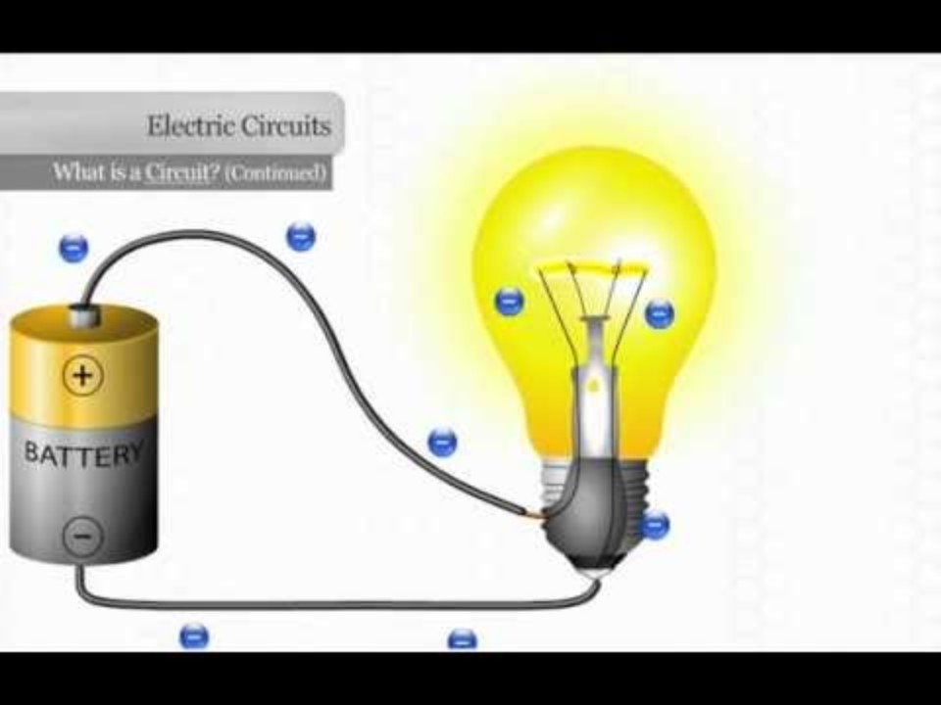
Warm Up - Review Discussion
How do the electrons form in this circuit?
Why wouldn’t the light bulb light up if electricity flow is not complete?
How does electricity flow in a circuit?
What is a short circuit?
Need a refresher? View this video from Module 1.
Notes:
Instructional Activity: Gain Attention, Recall
Instructional Time: 5 minutes total
Video Link (3 min): https://www.youtube.com/watch?v=VnnpLaKsqGU (3 min)
Do:
Watch a brief video on the basics of an electrical circuit. Video is embedded in slide but may take a minute to load.
Use the talking points below to facilitate a brief discussion.
Talking Points:
How do the electrons form in this circuit?
Why wouldn’t the light bulb light up if electricity flow is not complete?
How does electricity flow in a circuit?
What is a short circuit?
Source: Region 10 ESC. (n.d.). Explaining an electrical circuit [Video]. YouTube. https://www.youtube.com/watch?v=VnnpLaKsqGU

Slide 7
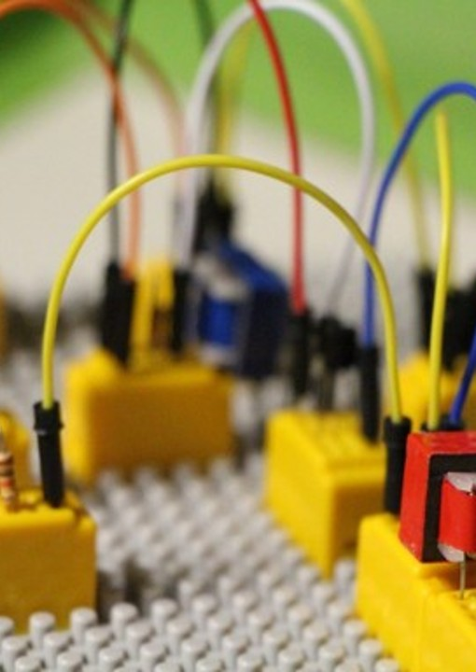
4.1 – Electrical Circuit Design
Let’s start with how electrical circuits are designed and how power flows through them.
Notes:
Instructional Event: Direction
Time: 1 minute.
Do: Review the purpose of this section of the module.
Talking Points:
In this section, we’ll learn about how electrical circuits are designed and how power flows through them.

Slide 8
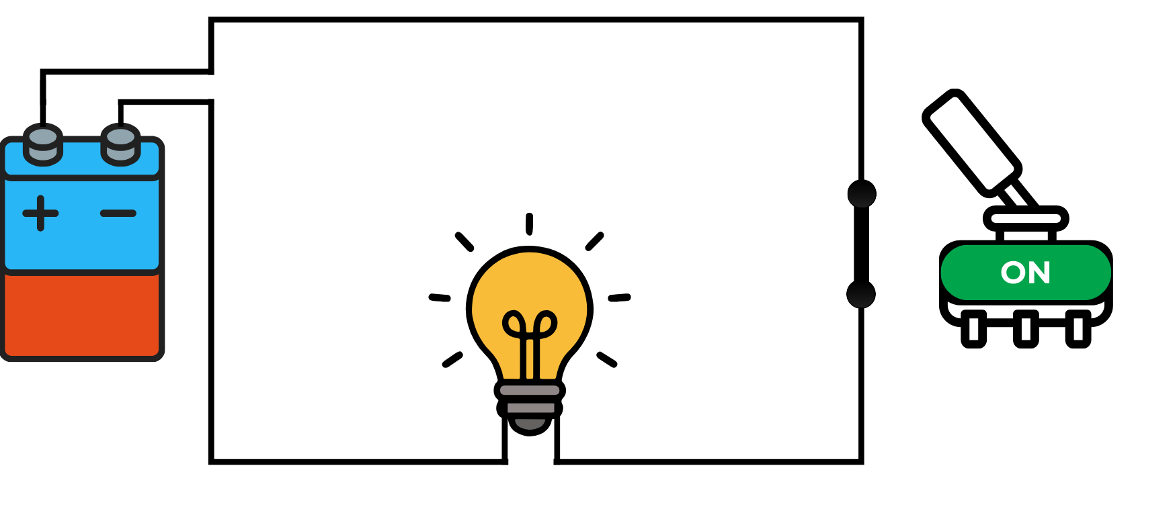
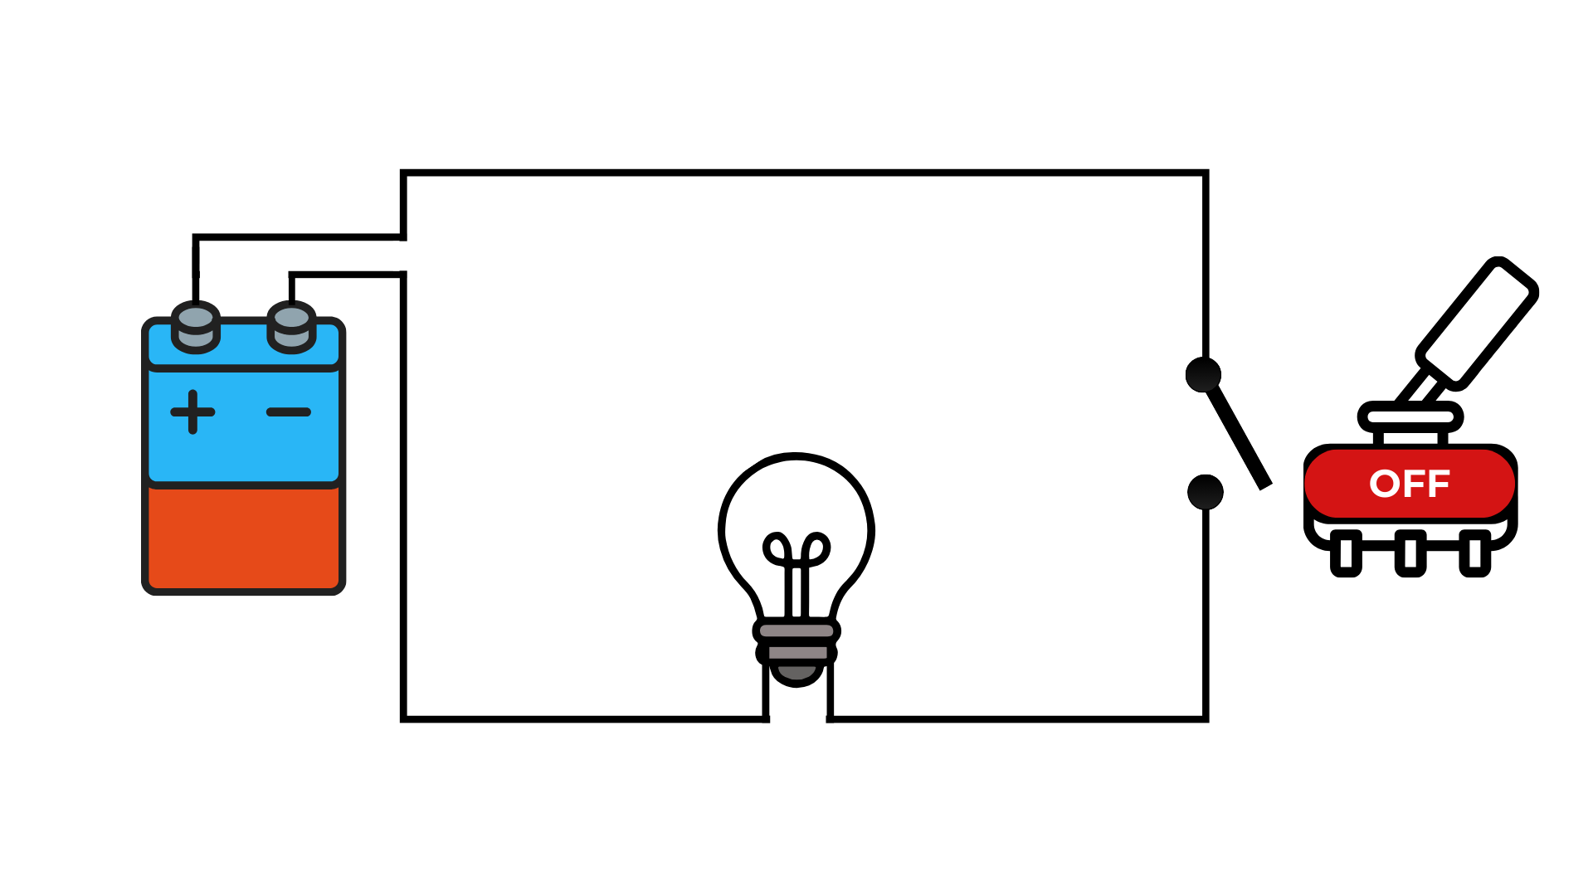
Electrical Circuit
An unbroken loop of conductive material that allows electrons to flow through the loop continuously
Circuit is closed – complete path, electrons can flow
Circuit is open – loop is broken, electrons cannot flow
Closed Circuit
Open Circuit
Series DC Circuit
Notes:
Instructional Activity: Present Content, Recall
Instructional Time: 2 minutes
Talking Points:
An electrical circuit is an unbroken loop of conductive material that allows electrons to flow through the loop continuously.
If the circuit is closed, there is a complete path meaning electrons can flow.
If the circuit is open, the loop is broken and the electrons cannot flow.
Check out the images on the right – they demonstrate the open and closed states.
ASK: This is a DC circuit. Who remembers what a DC circuit is?
Call on learners to respond. Answer: DC stands for direct current. Current flows in one direction only, from the positive side of the power source to the negative side.
You will typically see this in systems powered by batteries, DC power supplies, or rectifiers.
The voltage level in a DC circuit stays constant over time — unlike alternating current, where it changes direction periodically.
There is one more condition we need to discuss and that’s a short circuit.
In a closed circuit, current flows through the intended path — through the load, like the light bulb shown here.
A short circuit can occur when current takes an unintended low-resistance path, bypassing the load or components in the circuit. Instead of flowing through the bulb, it takes a shortcut around it.
In DC circuits, a short circuit can cause a quick increase in current because there is little to slow it down. The sudden spike can cause overheating and fire hazards.
That’s why protection devices like s and circuit breakers are critical in all electrical systems — they interrupt the circuit before damage occurs.
Basically, any time the hot wire (positive) directly make contact with the neutral/ ground wire (negative) there is a short circuit.

Slide 9
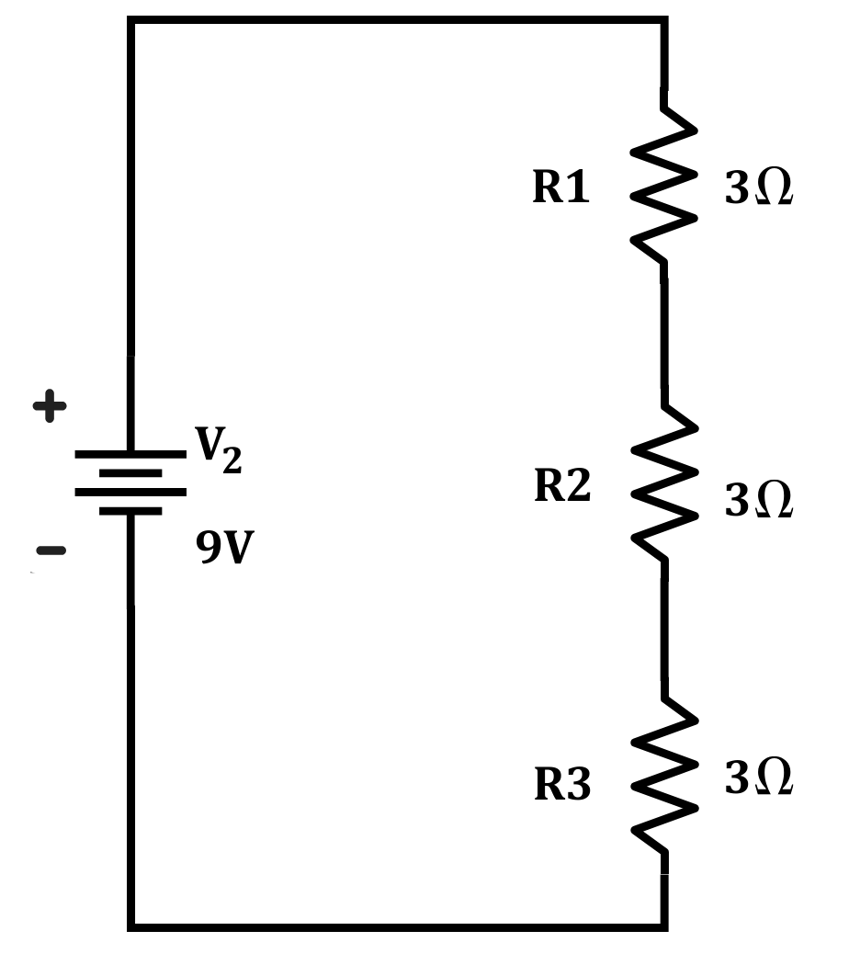
Series Circuits
One path for current to flow - components connected end-to-end in a single loop
  Current = same through all components
  Total resistance = sum of all resistances
  Voltage divides across each load
If one component fails, the entire circuit stops working
Notes:
Instructional Activity: Present Content
Instructional Time: 3 minutes
Do:
Explain how the diagram explains the division of current, resistance, and voltage across the circuit.
Offer any agency/specific examples and visuals of a series circuit.
Talking Points:
A series circuit has only one path for current to travel.
All components are connected end-to-end in a single loop, so the same current flows through each component.
In a series circuit:
Current remains constant throughout the circuit.
Total resistance is the sum of all individual resistances.
Voltage divides across each load based on its resistance.
Because there is only one path, if one component opens or fails, the entire circuit stops working.

Slide 10
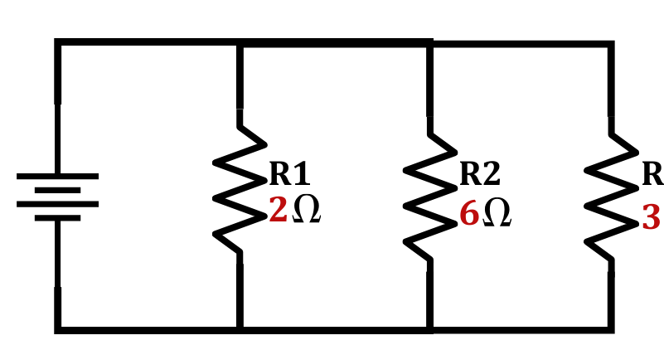
Parallel Circuits
Multiple paths for current to flow — components connected across the same voltage source
  Voltage stays the same across each branch
  Current divides among the branches
  Total resistance is less than the smallest resistor in the circuit
If one branch fails, the other branches can continue operating
Notes:
Instructional Activity: Present Content
Instructional Time: 3 minutes
Do:
Explain how the diagram explains the division of current, resistance and voltage across the circuit.
Offer any agency/specific examples and visuals of a parallel circuit.
Talking Points:
A parallel circuit has multiple paths for current to flow.
Instead of being connected end-to-end in one loop, the components are connected across the same voltage source in separate branches.
In a parallel circuit:
Voltage remains the same across each branch.
Current divides among the available paths.
Total resistance is always less than the smallest individual resistor in the circuit.
That last point is important — adding branches actually reduces overall resistance.
Because there are multiple paths, if one branch opens or a component fails, the other branches can continue operating.
This is why parallel circuits are commonly used in lighting and vehicle electrical systems — one failed component doesn’t shut everything down.
ASK: Does anyone have experience with parallel circuits used in the field?
Call on learners to respond. Connect this to vehicle lighting, accessory circuits, building lighting, etc.

Slide 11
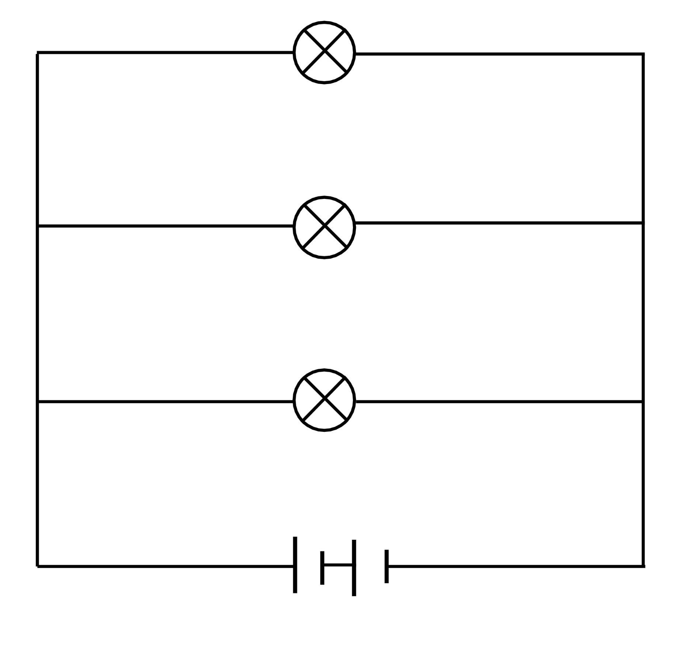

Series vs. Parallel Circuits
Series
Parallel
Only one path for current flow
Constant current, resistance adds up, divided voltage
If one components fails, whole circuit breaks and stops flow
Multiple paths for current flow
Constant voltage, resistance decreases, divided current
If one component fails, has others to continue current flow
Notes:
*This slide has animation. CLICK to reveal content.
Instructional Activity: Present Content
Instructional Time: 3 minutes
Talking Points:
Very briefly, here are the differences between series and parallel circuits.
Series:
In a series circuit, there is only one path for current to flow, so the same current moves through every component in the circuit.
As you add more components, the total resistance increases and the voltage is shared across them- and if one component fails, the entire circuit opens and current stops everywhere.
Parallel:
In a parallel circuit, there are multiple paths for current, which gives the current more than one way to flow through the system.
Each branch receives the same voltage, but the current divides between paths, and if one component fails, the rest of the circuit can continue to operate.
Image Source: Wikimedia Commons contributors. (n.d.). File: Series and parallel circuit.jpg. Wikimedia Commons. https://commons.wikimedia.org/wiki/File:Series_and_Parallel_Circuit.jpg

Slide 12
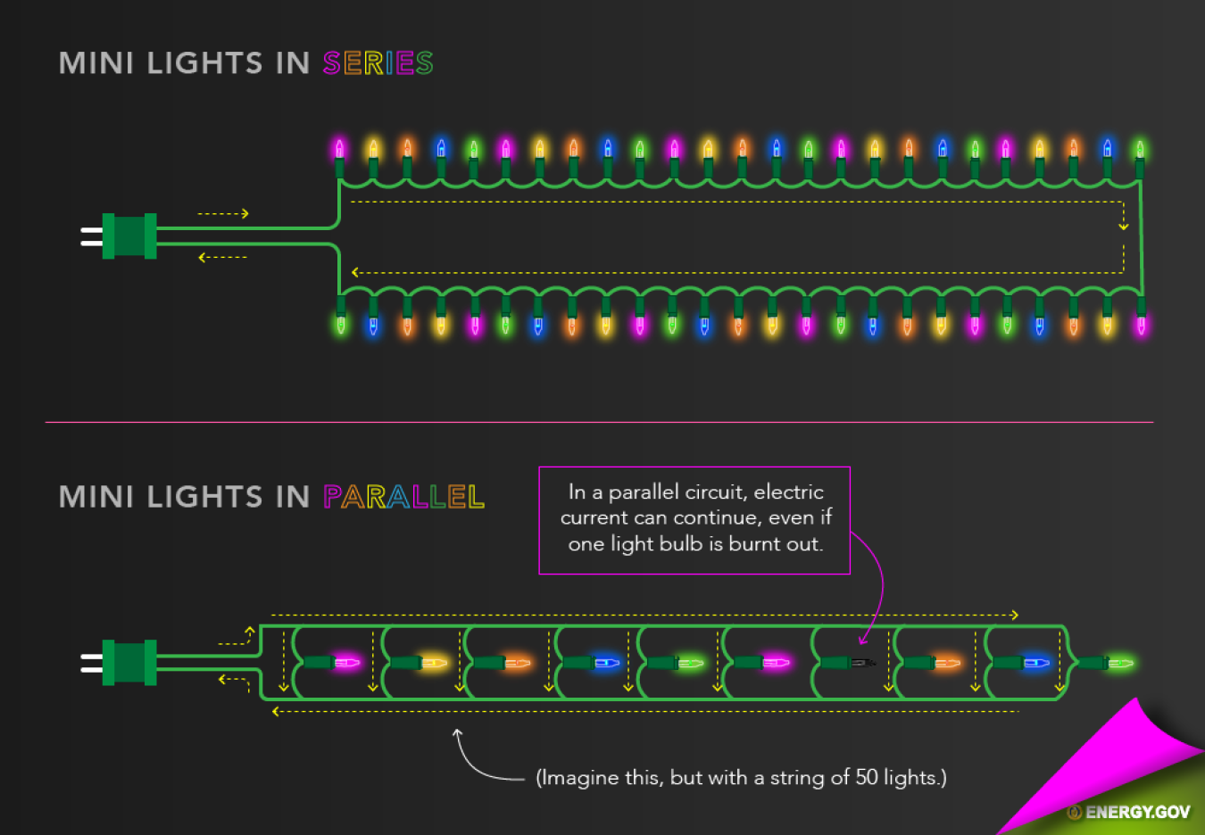
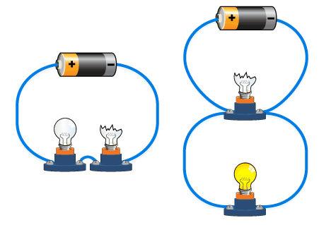
Series
Parallel
Notes:
Instructional Activity: Present Content
Instructional Time: 5 minutes
Do: Explain examples and applications of series or parallel circuits at your agency.
Talking Points:
Here are a few visual examples of series and parallel circuits.
On the top row, we have a series circuits. In the holiday light example, if one light goes out then all lights (loads) will go out.
On the bottom row, we have parallel circuits. If one light goes out the others will remain lit.
Modern holiday lights usually use a parallel circuit. This way, one light going out does not affect the rest of the string.
Other instances, as with fire alarms, the use of series circuits is needed. This way if an alarm is triggered in one room of a school for instance, they all go off, giving people time to evacuate safely.
Source:
Current Electricity & Circuits. (2024). Maggie’s Science Connection. https://maggiesscienceconnection.weebly.com/current-electricity--circuits.html
U.S. Department of Energy. (n.d.). How do holiday lights work? https://www.energy.gov/articles/how-do-holiday-lights-work

Slide 13
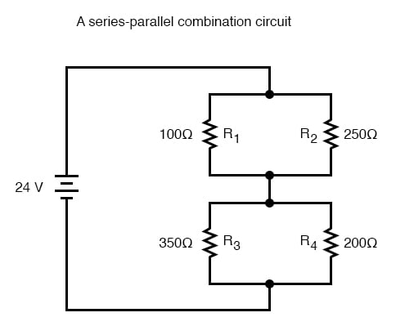
Series-Parallel Circuits
Shares elements of both series and parallel circuit configurations
Allows for complex circuit designs to optimize performance & functionality
Notes:
Instructional Activity: Present Content
Instructional Time: 3 minutes
Do:
Explain how the diagram explains the division of current, resistance and voltage across the circuit.
Offer any agency/specific examples and visuals of a series-parallel circuit.
Talking Points:
In addition to a series and parallel circuits, there is also a series-parallel circuit.
A series-parallel circuit is a combination of both series and parallel connections within the same circuit.
Some components are arranged in a single path, while others have multiple pathways for current to flow.
When examining a series-parallel circuit, it helps to look at one section at a time. Identify which portions act as a series circuit, and which parts act like parallel circuits. Then apply the same rules you know.
If a component fails, it depends on where the failure occurred. A failure in a series section can stop current to all components downstream. However, a failure in a parallel branch may only affect that path; the rest of the circuit may continue to allow current to flow.
Source: All About Circuits. (n.d.). What is a series-parallel circuit? https://www.allaboutcircuits.com/textbook/direct-current/chpt-7/what-is-a-series-parallel-circuit/

Slide 14
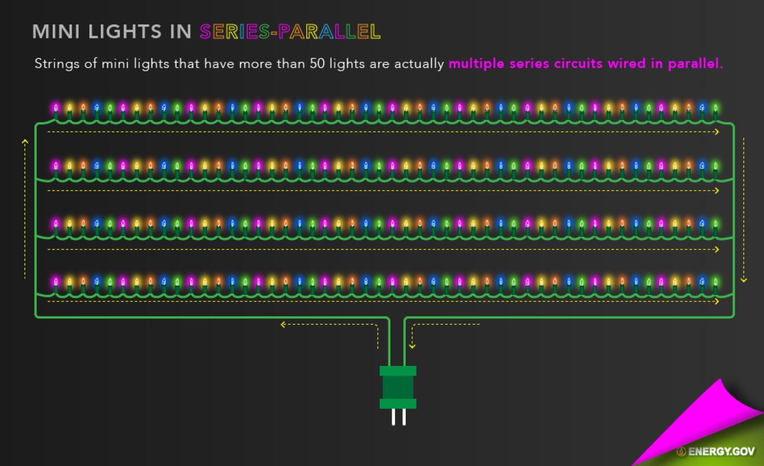
Example: Series-Parallel Circuits
Notes:
Instructional Activity: Present Content
Instructional Time: 5 minutes
Do:
Explain examples and applications of series-parallel circuits at your agency.
Talking Points:
This slide shows a real-world example of a series-parallel circuit using holiday or mini lights.
At first glance, it may look like one long string of lights. But electrically, it’s more complex.
Each individual section of lights is wired in series — meaning within that small section, current flows through each bulb one after another.
Then, those series sections are connected in parallel to each other.
So, what does that mean functionally?
Within each small section (series), voltage is divided across the bulbs.
Across the larger branches (parallel), each section receives the same source voltage.
Current divides between the parallel branches.
This design balances efficiency and reliability.
If one entire series section fails, the other parallel branches can still operate.
However, within a single series section, if one bulb opens (depending on the design) it may affect that entire section.
ASK: Why do you think manufacturers use a series-parallel design instead of all series or all parallel?
Call on learners to respond. Possible answers: cost efficiency, voltage management, reduced wiring, improved reliability, safety considerations.
Source: U.S. Department of Energy. (n.d.). How do holiday lights work? https://www.energy.gov/articles/how-do-holiday-lights-work

Slide 15
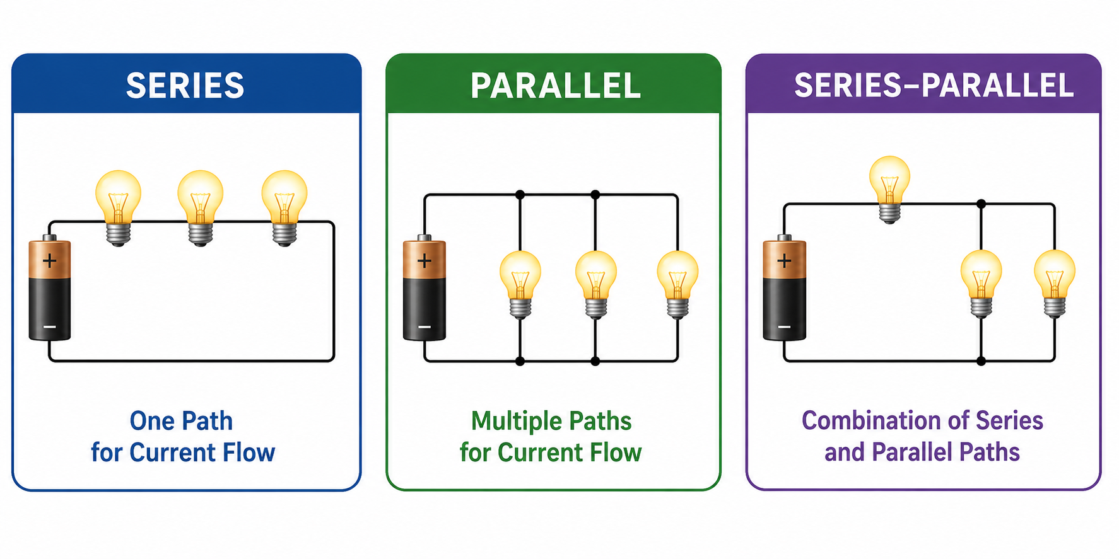
Instructor Demo: Circuit Configurations
Observe: Bulb Brightness │ Current Paths │ Effect of Removing a Bulb
Notes:
Instructional Activity: Provide Guided Learning, Elicit Performance, Provide Feedback
Instructional Time: 25 minutes
Materials:
• 9V battery
• 3 lightbulbs (3-5V max)
• Jumper wires
Do:
Purpose: This demonstration helps participants visualize the differences between series, parallel, and series-parallel circuits using common electrical components. Encourage learners to make predictions before each demonstration and discuss what they observe.
Assemble and demonstrate each circuit configuration (series, parallel, and series-parallel).
Point out that the black dots on the diagram represent junctions, where a conductor splits into two or more paths.
Explain that wires connected at a junction allow current to flow in multiple directions.
Ask learners to observe bulb brightness, current paths, and the effect of removing a bulb from the circuit.
Series Circuit Demonstration
Build a circuit with three bulbs connected in a single path.
Ask participants: "What do you think will happen when power is applied?"
Apply power and allow participants to observe.
Key observations:
• All bulbs illuminate.
• The bulbs appear dimmer than a single-bulb circuit.
• Current has only one path to follow.
Remove one bulb and ask: "What do you think will happen now?"
Demonstrate that all bulbs go out.
Emphasize: In a series circuit, current has only one path. If any component opens, the entire circuit stops working.
Parallel Circuit Demonstration
Reconfigure the circuit so each bulb is connected on its own branch across the power source.
Ask participants: "How do you think this circuit will behave differently?"
Apply power.
Key observations:
• All bulbs illuminate.
• Bulbs are brighter because each receives full source voltage.
• Current has multiple paths.
Remove one bulb.
Observe:
• The remaining bulbs stay illuminated.
Emphasize: Parallel circuits provide multiple current paths. A failure in one branch does not stop current flow through the others.
Series-Parallel Circuit Demonstration
Build a circuit with one bulb in series with two bulbs connected in parallel.
Ask participants: "Would you classify this circuit as series or parallel?"
Allow discussion before energizing the circuit.
Apply power.
Remove one bulb from the parallel section.
Observe:
• The remaining parallel bulb stays illuminated.
• The series bulb remains illuminated.
Next, remove the series bulb.
Observe:
• The entire circuit turns off.
Emphasize: Series-parallel circuits combine characteristics of both circuit types. The effect of a failure depends on where the component is located within the circuit.
Debrief Questions
• Which circuit provided only one path for current flow?
• Which circuit continued operating after a bulb was removed?
• Why are parallel circuits commonly used in electrical systems?
• How might these circuit configurations appear in transit vehicles and facilities?
Key Takeaway:
Series circuits have one path, parallel circuits have multiple paths, and series-parallel circuits combine both. Understanding these configurations helps technicians troubleshoot electrical systems more effectively.
IMPORTANT: Let participants know they will practice constructing these circuits at the end of the module.

Slide 16
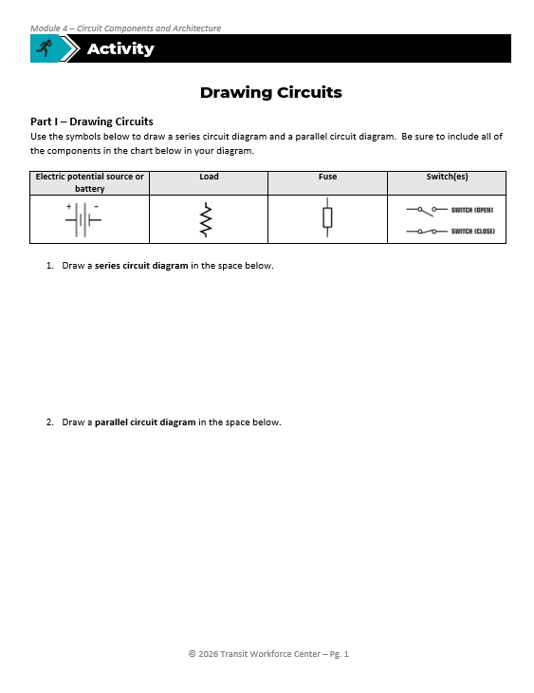
Activity: Drawing Circuits
Part I – Drawing Circuits
Use the symbols to draw a series circuit diagram and a parallel circuit diagram. Be sure to include all of the components in the chart below in your diagram.
Part II – Scenario Analysis
Read the “Simple Series Circuit Failure” scenario to (1) identify the failed component and (2) where the failure occurred in the circuit. Next, draw the circuit and label the failure.
Notes:
Instructional Activity: Provide Guided Learning, Elicit Performance, Provide Feedback
Instructional Time: 20 minutes
Materials: Drawing Circuits_M4
Do:
(5 min.)
Refer learners to the “Drawing Circuits” handout embedded in the Participant Resource Guide.
Review the directions and answer any questions learners may have.
(10 min.)
Give learners time to complete the activity.
Circulate the room answering questions and connecting the activity to the content taught thus far. Provide feedback as needed.
For Part 2, review the provided scenario on the next slide. The scenario is also on the learner handout.
(5 min.)
Debrief by reviewing the drawings and scenario answers.

Slide 17
Activity: Drawing Circuits
Scenario – Simple Series Circuit Failure
A technician is troubleshooting a small 12V lighting circuit on a vehicle. The circuit includes a battery, a switch, and three lights wired in series.
When the switch is turned on, none of the lights illuminate. The battery has been tested and is good. The switch is confirmed to be closed and functioning properly.
After inspecting the lights, the technician finds that one bulb has a broken filament.
Notes:
Instructional Activity: Provide Guided Learning, Elicit Performance, Provide Feedback
Instructional Time: 20 minutes
Materials: Drawing Circuits_M4
Do:
For Part 2 of the Drawing Circuits activity, read the scenario and have leaners identify the component and location in a circuit of failure. They should also draw and label the circuit failure in the blank space on their handout.
Answer:
Failed Component - The failed component is one of the light bulbs (the bulb with the broken filament).
Location of the Failure - The failure occurred at the light bulb in the series circuit where the filament is broken.
Explanation - The lights are wired in series, meaning there is only one path for current to flow. When the filament in one bulb breaks, it creates an open circuit, stopping current from flowing through the entire loop. As a result, none of the lights illuminate even though the battery and switch are functioning properly.

Slide 18
Knowledge Check
Identify and describe the function of each type of circuit below.
1. 2. 3.
Series-Parallel
Series
Parallel
Notes:
*This slide contains animations. CLICK to reveal content.
Instructional Activity: Evaluate/Assess Performance, Provide Feedback
Instructional Time: 3 min.
Learning Objective: Define basic types of circuits and differences between them.
Do: Review the knowledge check question. Call on learners to share their responses.
Answer Key:
Series-Parallel Circuit: An electrical circuit that contains a combination of both series and parallel connections.
Series Circuit: An electrical circuit that has only one path for current to travel. All components are connected end-to-end in a single loop, so the same current flows through each component.
Parallel Circuit: An electrical circuit which has multiple paths for current to flow. The components are connected across the same voltage source in separate branches.
Helpful information:
Series circuits are useful in alarm circuits because any break or open in the circuit stops current flow and triggers an alarm condition. In these systems, the loss of power or current is what signals the problem.
Parallel circuits are useful when multiple devices need to operate from one power source. Because current has multiple paths to flow, one device can fail while the others continue operating. This is common in house wiring and other systems where you do not want one failed load to shut down the entire circuit.
Series-parallel circuits combine features of both series and parallel circuits. These are very common in bus, shop, and signal systems because they allow electrical systems to be designed for different operating needs.

Slide 19
Summary and What’s Next
Electrical Circuits are closed paths that allow electrons to flow.
Open vs. closed circuits determine whether electricity can flow.
Series circuits have one path for current.
Parallel circuits have multiple paths for current.
Series-parallel circuits combine both types.
Next, we’ll continue our exploration of current and voltage by learning how Kirchhoff's Laws helps technicians analyze electrical circuits.
Notes:
Instructional Activity: Enhance Retention and Transfer, Recall
Instructional Time: 5 min.
Talking points:
Let’s quickly recap what we covered in this module.
An electrical circuit is a closed path that allows electrons to flow.
Whether a circuit is open or closed determines if current can move through the system.
We discussed how series circuits have only one path for current — meaning one break stops everything.
We also covered parallel circuits, which provide multiple paths — so one branch can fail without shutting down the entire system.
And finally, we looked at series-parallel circuits, which combine both configurations. These are common in real-world systems, especially in transportation and facility electrical systems.
Before we move on…
ASK: In a series circuit, what happens if one component fails?
Call on learners to respond. Answer: The entire circuit stops working.
ASK: In a parallel circuit, what electrical value stays the same across each branch?
Call on learners to respond. Answer: Voltage
The key takeaway: Understanding circuit architecture helps you predict how a system will behave — and how it will fail.
Next, we’ll continue our exploration of current and voltage by learning how Kirchhoff's Laws helps technicians analyze electrical circuits.

Slide 20
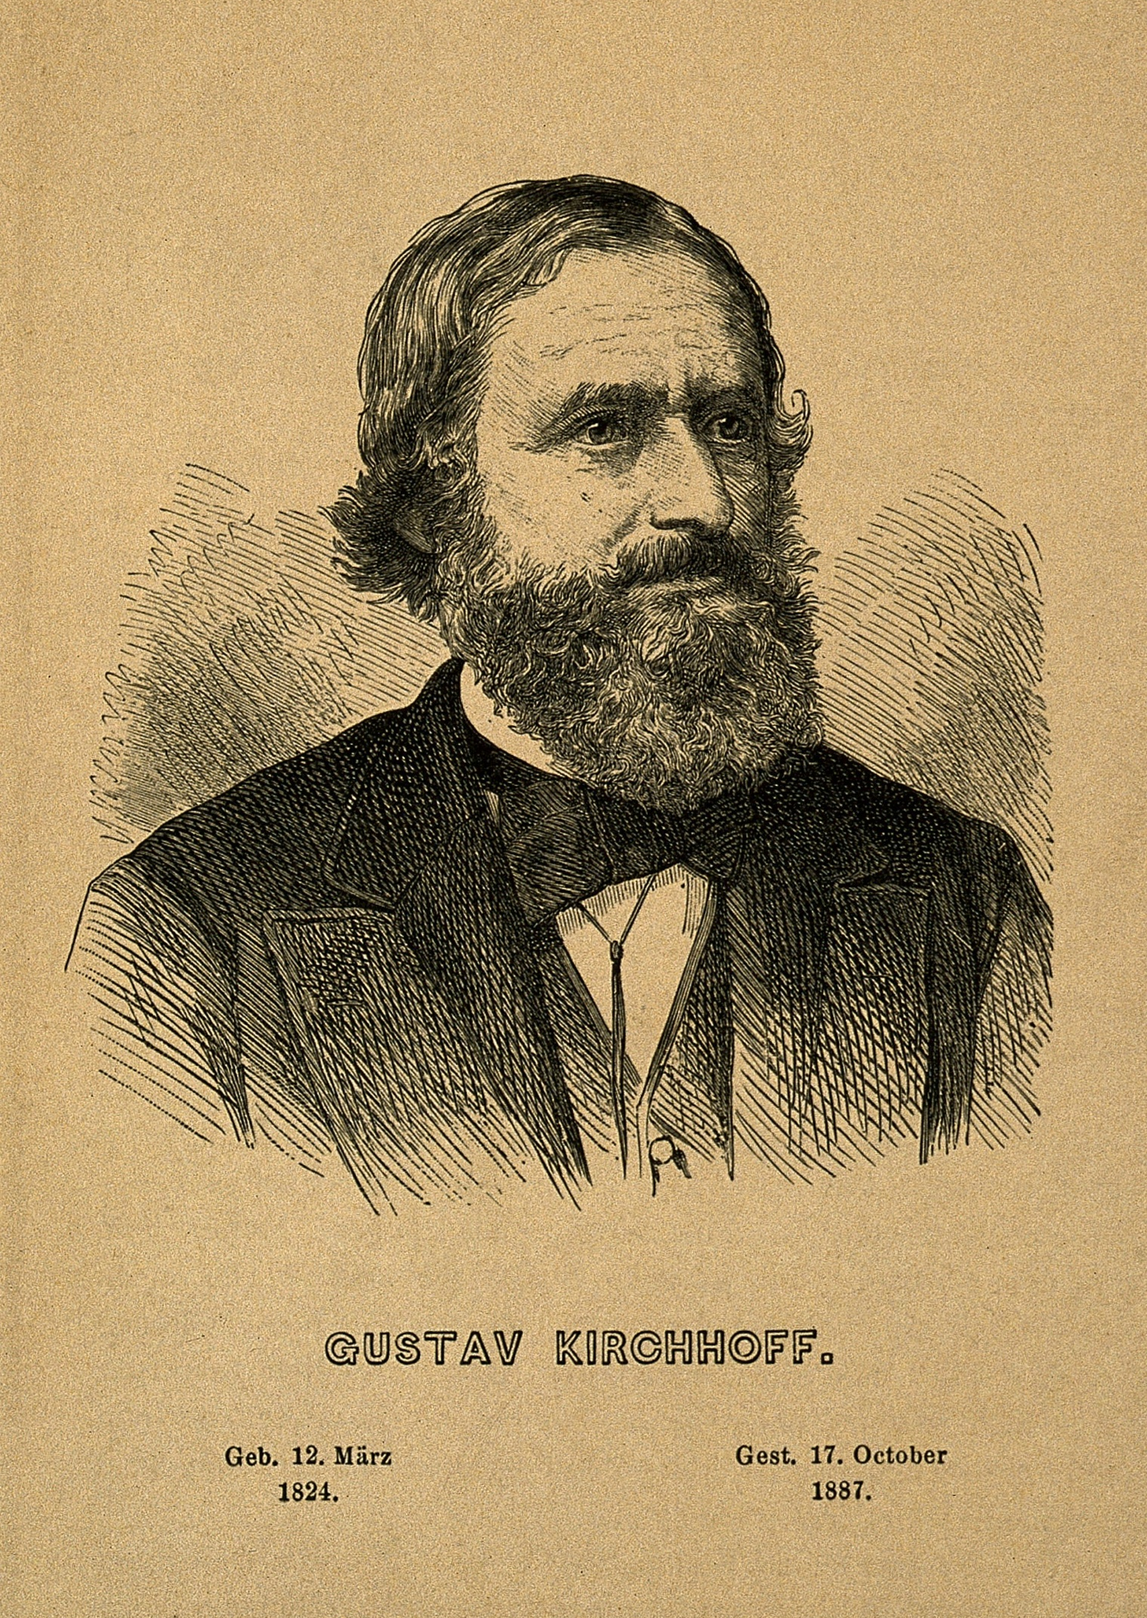
4.2 – Kirchhoff’s Laws
This section you will learn about s Kirchhoff’s Current Law and Kirchhoff’s Voltage Law which are key principles used to analyze and predict circuit behavior.
Notes:
Instructional Event: Direction
Time: 1 minute.
Do: Review the purpose of this section of the module.
Talking Points:
This section you will learn about s Kirchhoff’s Current Law and Kirchhoff’s Voltage Law which are key principles used to analyze and predict circuit behavior.
Source: Fæ, CC BY 4.0 <https://creativecommons.org/licenses/by/4.0>, via Wikimedia Commons

Slide 21
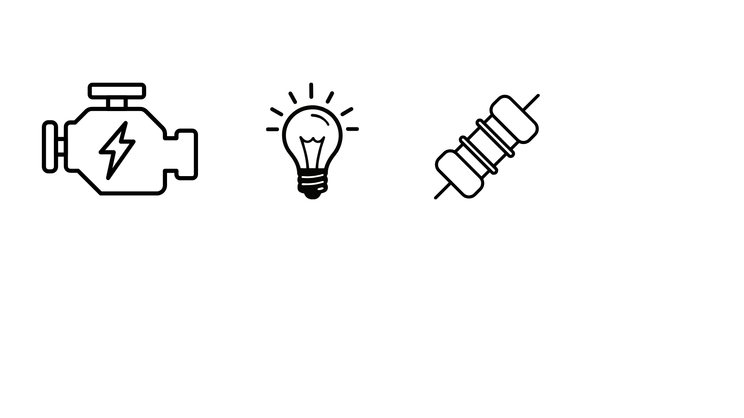
Kirchhoff’s Laws: The Rules for the Whole Circuit
Ohm’s Law
Kirchhoff’s Laws
Relationship between voltage, current, and resistance in a single part of a circuit
Explains how current and voltage behave across the entire circuit
Notes:
*This slide has animations. Click to reveal content.
Instructional Activity: Present Content
Instructional Time: 2 min.
Talking points:
We’ve learned that Ohm’s Law explains the relationship between voltage, current, and resistance in a single part of a circuit.
Think of Ohm’s Law like zooming in with a magnifying glass. We’re looking at one resistor, one light, one motor, etc.
CLICK - Kirchhoff’s Laws zoom back out. They explain how current and voltage behave across the entire circuit — how everything connects and stays balanced.
Without Kirchhoff’s Laws, we can’t analyze complex circuits, especially series-parallel systems.
So now we’re shifting from component-level thinking to system-level thinking.

Slide 22
Kirchhoff’s Laws On the Job
You use Kirchhoff’s Laws every time you:
      Check voltage drop across multiple components
      Diagnose dim lights or weak motors in a series circuit
      Look for shorts or broken wires
      Confirm system balance after a repair
Notes:
*This slide has animations. Click to reveal content.
Instructional Activity: Present Content
Instructional Time: 2 min.
Talking points:
Kirchhoff’s Laws are important because it isn’t just theory. This is exactly what you do when you troubleshoot.
You use Kirchhoff’s Laws any time you:
Check voltage drop across multiple components
Diagnose dim lights or weak motors in a series circuit
Look for shorts or open connections
Confirm the system is balanced after a repair
You might not call it “Kirchhoff’s Law” at work — but when you expect voltage to add up or current to split correctly, that’s Kirchhoff.
If voltage or current doesn’t balance, something is open, shorted, loose, or corroded.
That imbalance is your diagnostic clue.

Slide 23
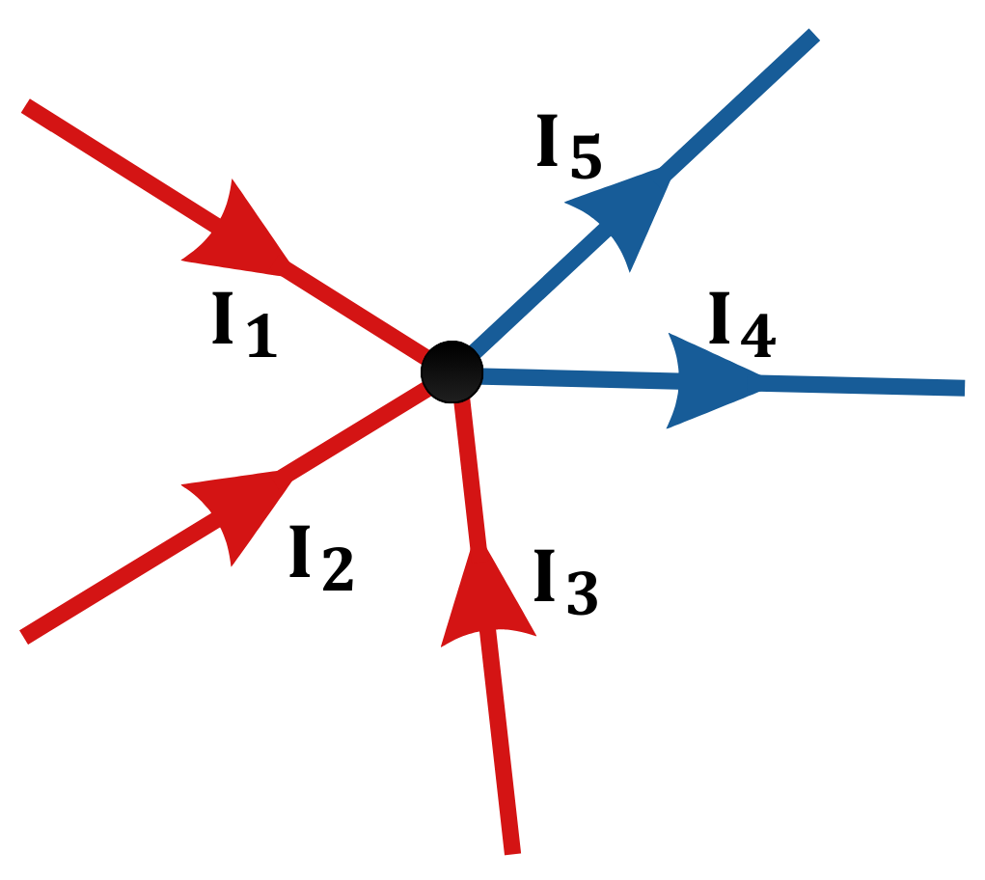
Kirchhoff’s Current Laws (KCL)
KCL: The current going into a junction is equal to the current coming out.
Formula: Iin = Iout
A junction is where two or more branches meet, allowing current to divide or rejoin
I1 + I2 + I3 = I4 +I5
Notes:
Instructional Activity: Present Content
Instructional Time: 2 min.
Talking points:
Kirchhoff’s Laws help us understand how current and voltage behave in electrical circuits, especially when things get more complex with multiple branches or loops.
Kirchhoff’s Current Law, referred to as KCL for short, states that the current going into a node (or junction) is equal to the current coming out.
In other words, the current flowing into the circuit is equal to the current flowing out of the circuit.
A junction is a point in an electrical circuit where two or more conductors or branches meet, allowing current to split into different paths or combine back together.
Think of it like traffic at an intersection- what goes in must come out.
All the current flowing into that junction point must flow out through the available paths. Current doesn’t pile up or disappear at a junction; it splits up depending on the load and circuit design.
That junction is also where different paths can lead into separate loops, and each of those loops still follows Kirchhoff’s Voltage Law.
Even though the current divides at the junction, the voltage remains constant at these junctions. Circuits design may also be a factor.
Source: Academic Fight. (2016, February 19). Simplest Explanation of KIRCHHOFF’S LAWS (kcl kvl). YouTube. https://www.youtube.com/watch?v=ZDoyIghUI44
WikiCommons Image Attribution: Philnate at German Wikipedia, Public domain, via Wikimedia Commons

Slide 24
Application: Kirchhoff’s Current Laws
KCL: The current going into a junction is equal to the current coming out.
Example:
I1 + I2 + I3 = I4 + I5
2A + 2A + 2A = 3A + I5
6A = 3A + I5
-3A -3A
3A = I5
6A coming in, 6A going out
Total = 6A
2a
?
3a
2a
2a
Notes:
*This slide has animations. CLICK to reveal content.
Instructional Activity: Present Content, Provide Guided Learning
Instructional Time: 5 min.
Do:
Review the talking points below. Consider writing out the equation on the white board.
Start by walking learners through what the equation should look like.
Red current going in should be on one side of the equal sign.
Blue current going out should be on the other side of the equal sign.
Call on learners to help you walk through the equation and solve for the final missing current.
Talking points:
What goes in must come out! Remember, KCL tells us that the total current entering a junction equals the total current leaving.
This is especially helpful when analyzing complex circuits—instead of trying to follow every path, you can focus on the junction and use KCL to find missing values.
For example, if you have five wires meeting at a node and you know the current in four of them, you can calculate the fifth by making sure the total in equals the total out.
Take a look at this example.
We know that the junction is 6A.
That means the current coming in (red arrows) equals 6A.
ASK: According to KCL, the current coming out (blue arrows) also needs to equal 6A. So, if I4 is 3A, what does I5 equal?
Call on learners to respond.
CLICK to reveal answer = 3A.
We know this is correct because we have 6A coming in and 6A going out.
Think of it like balancing the flow of traffic at an intersection.

Slide 25
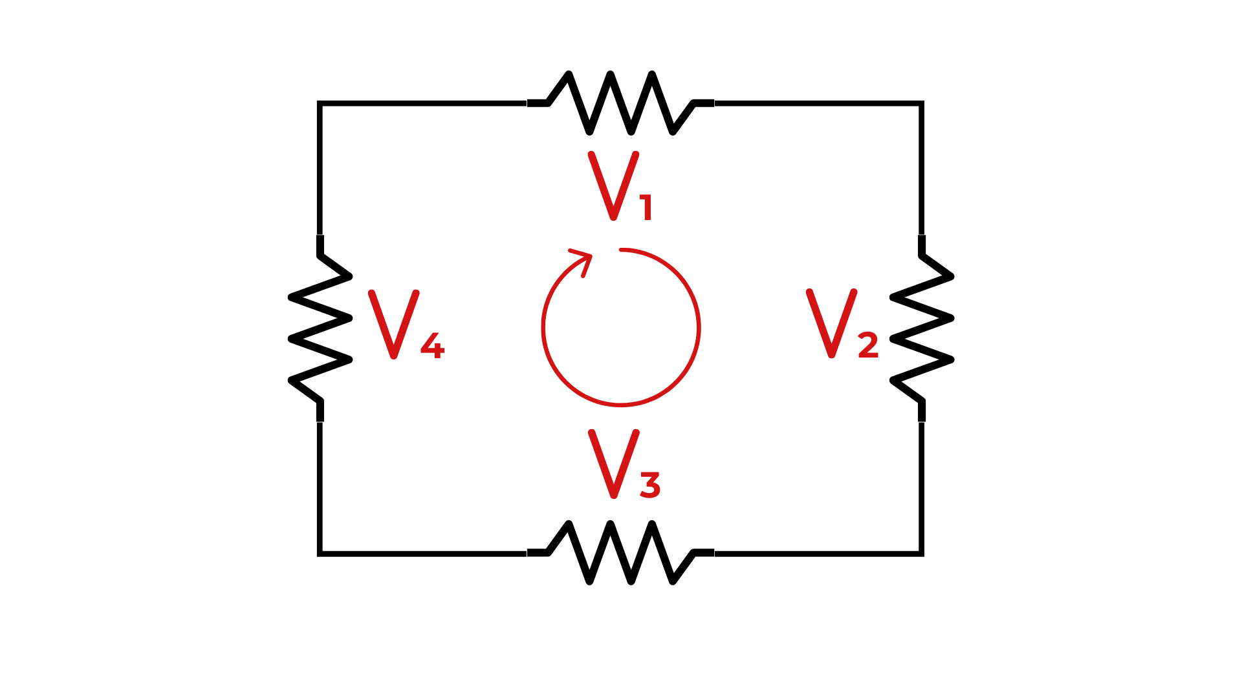
Kirchhoff’s Voltage Laws (KVL)
KVL: The sum of all voltages around a closed loop equals zero
Formula:
+Vsource ​− V1 ​− V2 ​− V3…​ = 0
All supplied voltage (Vsource) is used within the loop (V1 – V2 – V3…)
Notes:
Instructional Activity: Present Content
Instructional Time: 2 min.
Talking points:
Kirchhoff’s Voltage Law, referred to as KVL, states that the sum of all voltages around a closed loop equals zero.
What that means practically is this:
Any voltage supplied by the source must be completely accounted for within the loop.
As current moves through the circuit, each component uses some voltage. By the time you return to the source, all the voltage has been “used” or dropped across the components.
You can think of this like an energy accounting system.
Whatever energy the source provides must be fully spent across the resistors, lights, motors, or other loads in that loop.
If the numbers don’t add up, something is wrong. It could be a bad connection, incorrect measurement, or a hidden fault.
Kirchhoff’s Laws, both Voltage and Current, are foundational tools for analyzing and troubleshooting circuits, especially those with multiple loops or branches.
Once you understand the logic, they become powerful diagnostic tools in real-world systems.
Optional Video: https://www.youtube.com/watch?v=ZDoyIghUI44
Source: Academic Fight. (2016, February 19). Simplest Explanation of KIRCHHOFF’S LAWS (kcl kvl). YouTube. https://www.youtube.com/watch?v=ZDoyIghUI44

Slide 26
Application: Kirchhoff’s Voltage Laws
KVL: The sum of all voltages around a closed loop equals zero
Formula:
+Vsource ​− V1 ​− V2 ​− V3…​ = 0
Voltage Drop Example:
40V - 10V - 10V - 10V - 10V = 0
0V = 0
10V
10V
40V
10V
10V
Notes:
*This slide has animations. CLICK to reveal content.
Instructional Activity: Present Content, Provide Learning Guidance
Instructional Time: 5 min.
Do:
Review the talking points below. Consider writing out the equation on the white board.
Start by walking learners through what the equation should look like.
Call on learners to help you walk through the equation and solve for the voltage drop.
Talking points:
Again, Kirchhoff’s Voltage Law tells us that the sum of all voltages around a closed loop must equal zero.
This principle is used to find unknown voltages in a circuit by making sure that all the voltage supplied is completely used up by the components in the loop—nothing extra, nothing missing.
For example, if you have a loop with one voltage source and several resistors, KVL allows you to calculate the voltage drop across each resistor. It’s like making sure every dollar you spend adds up exactly to the amount of money you had at the start.
In any circuit, a voltage drop across a component represents the amount of voltage that component uses. (Remember voltage drops are considered negative voltage)
According to Kirchhoff’s Voltage Law, the sum of all voltage drops in a closed loop must equal the source voltage — so when we add them algebraically around the loop, the total equals zero.
In this example, we have a 40-volt source and four resistors of equal resistance connected in series.
Because the resistors are equal, the voltage divides evenly across them.
ASK: So, if 40 volts is supplied to the circuit and there are four equal resistors, how much voltage will each resistor drop?
Call on learners to respond. Answer: Each resistor will drop 10 volts.
CLICK to reveal the answer.

Slide 27
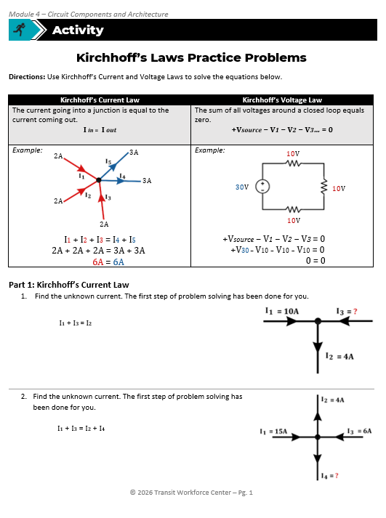
Part 1 and 2: Kirchhoff’s Laws Practice Problems
Directions: Use Kirchhoff’s Current and Voltage Laws to solve the equations below.
Part 1: Kirchhoff’s Current Law
Find the unknown current.
Part 2: Kirchhoff’s Voltage Law
Calculate the unknown voltage drop.
Please complete only Parts 1 and 2 for now.
Notes:
Instructional Activity: Provide Guided Learning, Elicit Performance, Provide Feedback
Instructional Time: 45 minutes
Materials:
Kirchhoff's Laws Practice Problems_M4
Kirchhoff's Laws Practice Problems_Answer Key_M4
White board
Markers
Do:
(5 min.) Directions
Refer learners to the “Kirchhoff's Laws Practice Problems” handout embedded in the Participant Resource Guide.
Review the directions and answer any questions learners may have.
(5 min.) Whole Group Practice
Using the white board and markers, help learning get started by completing questions 1 (KCL) and 6 (KVL) as a group.
There is an answer key for these two questions on the next two slides.
(20 min.) Work Time for Parts 1 and 2
Give learners about 20 minutes to complete Parts 1 and 2.
(15 min.) Review of Parts 1 and 2
Review the answers for parts 1 and 2 as a group.
Provide feedback and correct any thinking errors learners may have.
(10 min.)
Give learners time to complete the activity.
Circulate the room answering questions and connecting the activity to the content taught thus far.
(5 min.)
Debrief by reviewing the drawings and scenario answers.

Slide 28
Question 1
Find the unknown current. The first step of problem solving has been done for you.
Solution:
I₁ + I₃ = I₂
10A + I₃ = 4A
-10A -10A
I₃ = -6A
Check:
I₁ + I₃ = I₂
10A - 6A = 4A
4A = 4A
Notes:
*This slide has animations. CLICK to reveal content.
Instructional Activity: Provide Guided Learning, Elicit Performance, Provide Feedback
Instructional Time: See slide 25.
Materials:
Kirchhoff's Laws Practice Problems_M4
Kirchhoff's Laws Practice Problems_Answer Key_M4
White board
Markers
Do:
Help learners get started by completing question 1 (KCL) as a group.
This slide contains animations. CLICK to reveal each step in the equation.

Slide 29
Question 6
6. Calculate the unknown voltage drop across Resistor 2.
Solution:
+Vsource − V1 − V2 − V3 = 0
38V – 10V – ?V – 10V = 0
+?V +?V
38V – 10V – 10 V = ?V
18V = ?V
Check:
+Vsource − V1 − V2 − V3 = 0
38V – 10V – 18V – 10V = 0
0 = 0
Notes:
*This slide has animations. CLICK to reveal content.
Instructional Activity: Provide Guided Learning, Elicit Performance, Provide Feedback
Instructional Time: See slide 25.
Materials:
Kirchhoff's Laws Practice Problems_M4
Kirchhoff's Laws Practice Problems_Answer Key_M4
White board
Markers
Do:
Help learners get started by completing question 6 (KVL) as a group.
This slide contains animations. CLICK to reveal each step in the equation.

Slide 30
Part 3: Kirchhoff’s Laws Practice Problems
2A
Part 3: Write Your Own Equations
Using the diagrams, write two practice problems using KCL and two practice problems using KVL.
Give your paper to a partner and have them solve your equations.
Get your paper back from your partner and check their work.
2A
4A
3A
10
25
20
Notes:
Instructional Activity: Provide Guided Learning, Elicit Performance, Provide Feedback
Instructional Time: 30 minutes
Materials:
Kirchhoff's Laws Practice Problems_M4
Kirchhoff's Laws Practice Problems_Answer Key_M4
White board
Markers
Do:
(5 min.) Directions
Review the directions and Part 3.
Answer any questions learners may have.
(20 min.) Work Time for Part 3
Give learners about 20 minutes to complete Part 3.
(5 min.) Debrief Discussion
Use the following questions to debrief:
Were you able to solve your partner’s problems? If not, where did you make an error?
What was the easiest part of this activity? What was the most challenging?

Slide 31
Knowledge Check
According to Kirchhoff’s Current Law, _____________________.
  The current going into a junction is equal to the current coming out.
  Voltage across a component equals the current flowing through it multiplied by its resistance.
  The sum of all voltages around a closed loop equals zero.
  The current will be removed from the circuit.
Notes:
*This slide contains animations. CLICK to reveal content.
Instructional Activity: Evaluate/Assess Performance, Provide Feedback
Instructional Time: 3 min.
Learning Objective: Apply Kirchhoff’s Current and Voltage Laws to analyze circuits and solve for unknown electrical values.
Do: Review the knowledge check question. Call on learners to share their responses.
Answer Key:
A

Slide 32
Knowledge Check
According to Kirchhoff’s Voltage Law, the sum of all voltages around a closed loop in a circuit must be ___________.
  A. Equal to the highest voltage in the loop
  B. Greater than the battery voltage
  C. Less than the sum of voltage drops
  D. Equal to zero
Notes:
*This slide contains animations. CLICK to reveal content.
Instructional Activity: Evaluate/Assess Performance, Provide Feedback
Instructional Time: 3 min.
Learning Objective: Apply Kirchhoff’s Current and Voltage Laws to analyze circuits and solve for unknown electrical values.
Do: Review the knowledge check question. Call on learners to share their responses.
Answer Key:
D

Slide 33
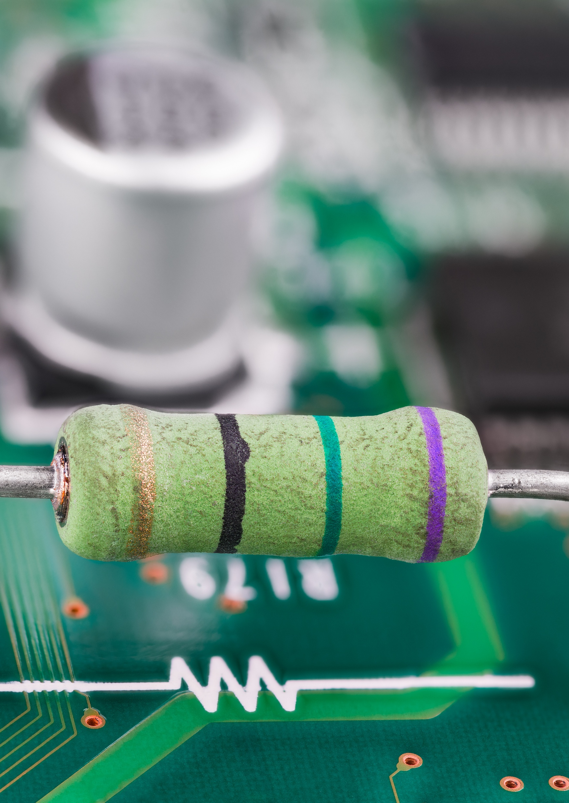
4.3 – Electrical Circuit Components
Next, we’ll explore the main parts found inside an electrical circuit.
Notes:
Instructional Event: Direction
Time: 1 minute.
Do: Review the purpose of this section of the module.
Talking Points:
Next, we’ll explore the main parts found inside an electrical circuit.

Slide 34
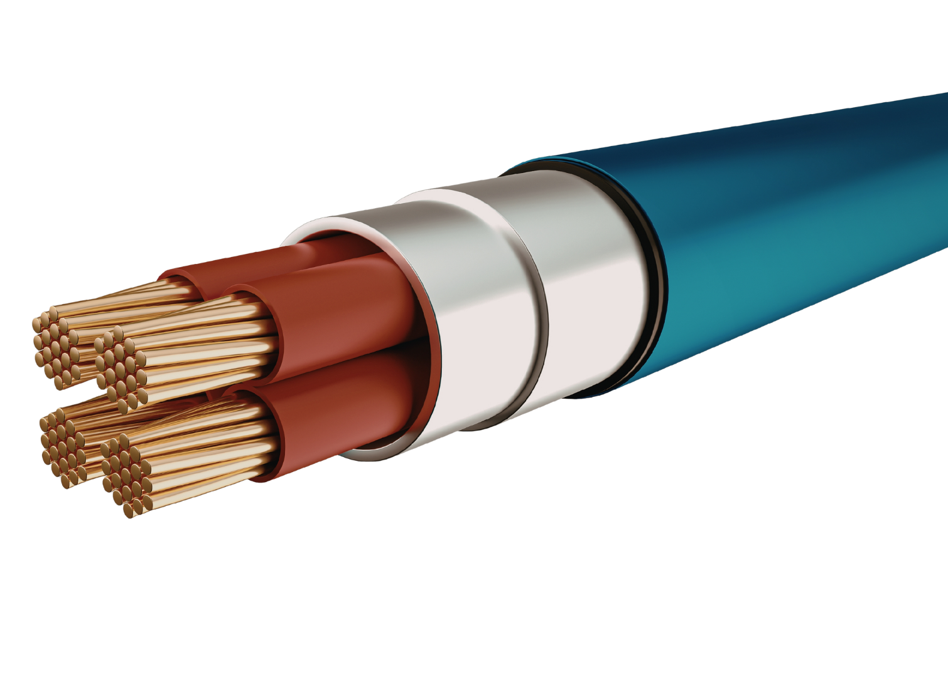
Wires
Flexible cable that carries electrical current between components in a circuit
  Conductive wires - Allow electricity to flow (copper, aluminum, etc.)
  Insulating wires - Contain the electrical current (rubber, plastic, etc. )
Protective Sleeve
Conductor
Insulator
Notes:
Instructional Activity: Present Content, Recall
Instructional Time: 2 minutes
Talking Points:
When we talk about wires, we need to discuss two terms we learned about in previous modules: conductor and insulator.
ASK: Who remembers what those terms mean?
Call on learners to respond. CLICK to reveal the answer.
A wire is a flexible cable that serves as the pathway to carry an electrical current and allows flow between components in a circuit.
If you look at the image on the slide, it shows a common cable breakdown of several parts of an individual strand of wire.
Wires can either act as either…
a conductor which allows electricity flow easily like metals like copper, aluminum, steel, and high-strength alloys.
or insulator which resists or blocks flow of electricity like rubber or plastic.
If conductors carrying electrical current were not insulated and came into contact with the ground, the electricity would take an unintended path straight to the ground.
This is because electricity always looks for the easiest path to return to its source, and the ground often provides a low-resistance route.
Image source: Teja, R. (2021, August 5). Wire Gauge Chart | American Wire Gauge (AWG) Wire Size Chart. ElectronicsHub. https://www.electronicshub.org/wire-gauge-chart/

Slide 35
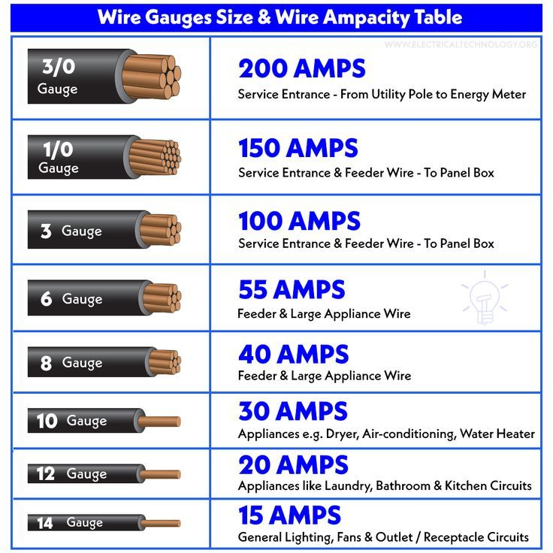
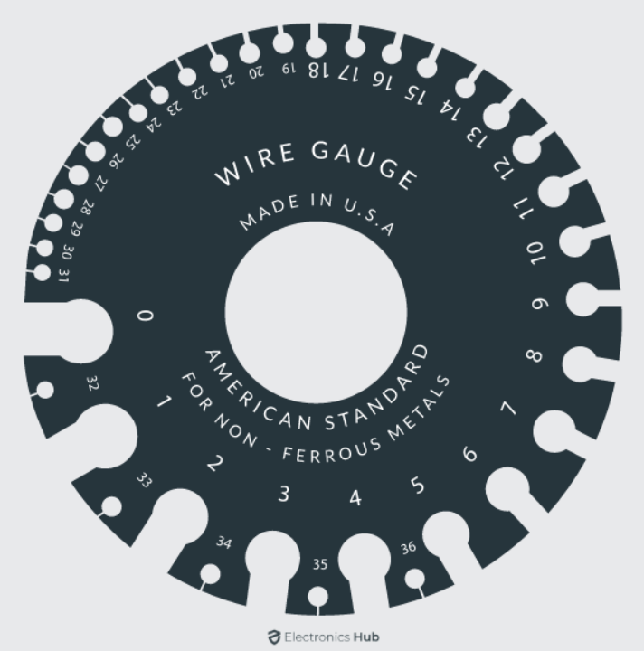
Wire Dimensions
Length – Distance of wire from one end to the other
Diameter – the cross-sectional width (or thickness) of a wire; typically measured in inches or millimeters
Gauge– Size of a wire’s diameter
Notes:
Instructional Activity: Present Content
Instructional Time: 2 minutes
Talking Points:
Wire length is the distance of wire from one end to the other.
Electrical wire can come in rolls or on spools. Lengths of wire vary from standard cuts of 50, 100, 250, 500 and 1,000 feet, but can be special ordered for specific lengths.
Wire gauge is the size of a wire’s diameter.
The size of wires affect the amount of electricity that can flow and how safely.
The smaller the number of the wire, the bigger the gauge will be.
Wire diameter is the cross-sectional width (or thickness) of a wire and is typically measured in inches or millimeters.
Source: Overview of Electrical Wire Sizes. (2024, February 13). The Spruce. https://www.thespruce.com/electrical-wire-sizes-1152851
Image source: Teja, R. (2021, August 5). Wire Gauge Chart | American Wire Gauge (AWG) Wire Size Chart. ElectronicsHub. https://www.electronicshub.org/wire-gauge-chart/

Slide 36
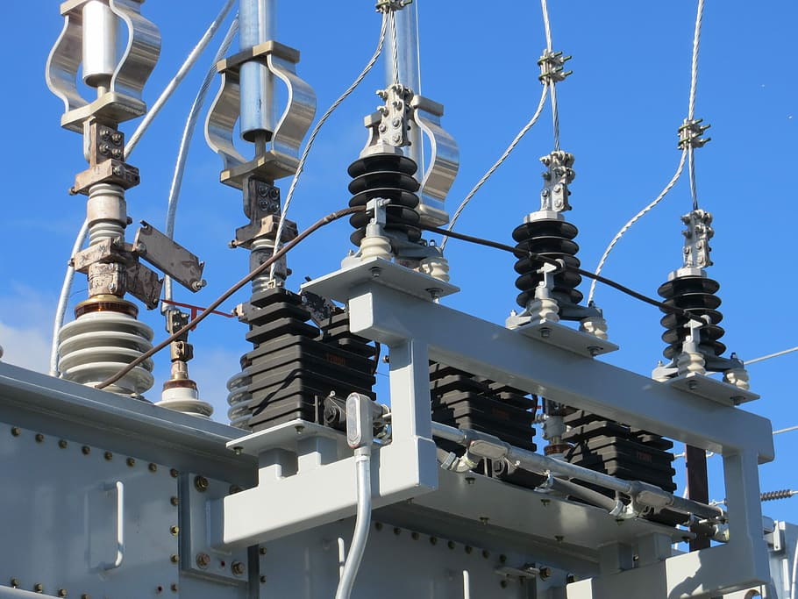


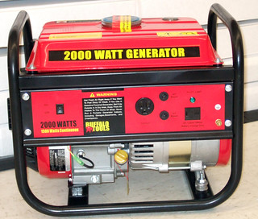
Electrical (Power) Source
Component that generates electrical energy and pushes it through a circuit
Creates the voltage that drives current flow
Voltage = Difference in electrical charge between two points
Examples: batteries, solar panels, generators, substations
Notes:
Instructional Activity: Present Content
Instructional Time: 2 minutes
Talking Points:
A power source is the component that generates electrical energy and pushes it through a circuit.
More specifically, electric current consists of free electrons moving through a conductor. As those electrons move from atom to atom, they transfer energy through the circuit.
So, what does a power source actually do?
It creates voltage — the electrical pressure that drives current through the system.
Voltage is the difference in electrical charge between two points. Without that difference in charge, electrons would not move.
As we continue through this module, you’ll see that voltage works together with two other key elements: current and resistance. Those relationships are critical to understanding circuit behavior.
Now let’s connect this to the real world.
Common power sources include:
Batteries (AA, coin cells, solar storage batteries)
Solar panels, which convert sunlight into electrical energy
Generators, often used as backup power
Electrical substations, which distribute power across larger systems
Every circuit must have a source — without it, there is no energy to move.
Source: Aresco, R. (2023, July 12). Principle of Electricity and DC & AC Power Supply: The Basics. Erie Institute of Technology. https://erieit.edu/electricity-dc-ac-power-supply-basics/

Slide 37



Load
Component or device that consumes energy in circuit
Converts energy into a functional form or task (heat, light, motion, etc.)
Example: Lightbulbs, motors, resistors, TVs, air conditioners, kitchen appliances, etc.
Notes:
Instructional Activity: Present Content, Recall
Instructional Time: 2 minutes
Talking Points:
A load is any component within a circuit that uses electricity to carry out work.
In other words, a load converts energy into a functional form or task, like producing heat, light or movement (motion).
Ask: Besides the examples shown here on the slide, can you think of any additional examples?
Call on learners to respond.
Examples include lightbulbs (incandescent, LED), motors and traction motors, resistors, TVs, air conditioners & fans, kitchen appliances, etc.

Slide 38

Circuit Protection
Safeguards built into a circuit to prevent electrical faults such as
  Overcurrent
  Short Circuit
  Overvoltage
  Ground Fault
Prevents equipment damage, fires, and system failures
Ensures system safety, reliability, and longevity
Notes:
Instructional Activity: Present Content
Instructional Time: 2 minutes
Talking Points:
Circuit protection refers to the safeguards built into an electrical system to detect and prevent faults.
Faults include things like:
Overcurrent occurs when current exceeds the rated limit of the circuit. This can overheat wires and components.
A short circuit happens when current finds an unintended low-resistance path — often bypassing the load. This can cause a rapid surge in current.
Overvoltage is a voltage spike that exceeds the system’s design limits. This can damage sensitive electronics.
A ground fault occurs when current unintentionally flows to ground, often due to damaged insulation or wiring.
Electrical systems are designed to operate within specific limits. When those limits are exceeded, damage can occur — sometimes very quickly.
Circuit protection helps prevent: Equipment damage, fires, system failures, safety hazards
It also improves system reliability and extends the life of components.

Slide 39
Circuit Protection – s
One-time devices designed to interrupt current when it exceeds a safe level
  Advantages: Simple, low cost, reliable
  Disadvantages: One-time use, must replace after blowing
Types: Blade, Cartridge, High-Speed
Notes:
Instructional Activity: Present Content
Instructional Time: 2 minutes
Talking Points:
A is a one-time safety device that breaks the circuit when the current exceeds a safe level making it a simple and effective way to protect equipment.
There are several types of s used in DC circuits, including:
Blade s – commonly found in automotive systems.
Cartridge s – used in a variety of industrial and residential settings.
High-speed s – designed to protect sensitive electronic components by reacting quickly to overcurrent.
Some of the advantages of using s are that they’re simple, low-cost, and reliable.
They also help protect with electrical damage, short circuiting, voltage, overcurrent and blow outs, reducing fire hazards/risk, wire degradation.
The main drawback is that once a blows, it has to be replaced, since it’s designed for one-time use only.

Slide 40
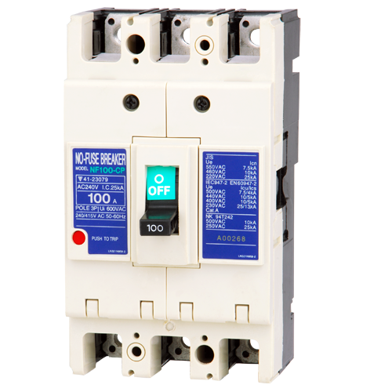
Circuit Protection – Circuit Breakers
Reusable devices that interrupts current when it exceeds a safe level
  Advantages: Reusable, easy reset, reliable
  Disadvantages: Higher cost (compared to s)
Types: Thermal, Magnetic, Hybrid
Notes:
Instructional Activity: Present Content
Instructional Time: 2 minutes
Talking Points:
Circuit breakers are devices that interrupt current when it surpasses a level that is safe.
Like s, circuit breakers offer protection against overcurrent.
However, unlike s, circuit breakers are reusable devices that stop the flow of electricity when the current exceeds safe limits—they can be reset rather than replaced.
Some key advantages of circuit breakers are that they’re reusable, easy to reset, and very reliable.
The main disadvantage is cost—they tend to be more expensive than s up front.
In DC systems, common types of circuit breakers include:
Thermal breakers – which trip when heat from excessive current builds up.
Magnetic breakers – which use a magnetic field to quickly interrupt current during a surge.
Hybrid (thermal-magnetic) breakers – combine both mechanisms for more effective protection.

Slide 41
Knowledge Check
Which of the following describes what wire gauge is?
A. A flexible cable that serves as the pathway to carry electrical current
B. Distance of the wire from one end to the other
C. Cross-sections width (thickness)of the wire
D. The size of a wire’s diameter
Notes:
*This slide contains animations. CLICK to reveal content.
Instructional Activity: Evaluate/Assess Performance, Provide Feedback
Instructional Time: 3 min.
Learning Objective: Define the major components of an electrical circuit and describe their functionality.
Do: Review the knowledge check question. Call on learners to share their responses.
Answer Key:
D

Slide 42
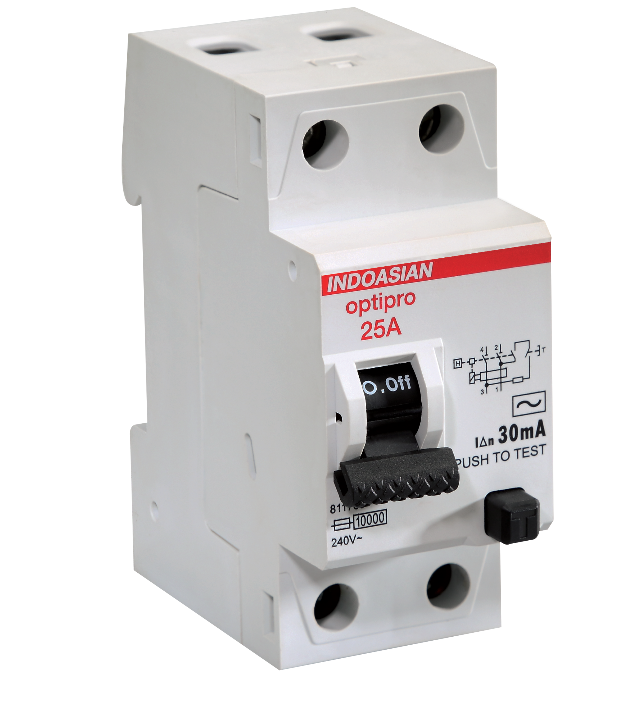
Knowledge Check
What is the main advantage of a circuit breaker over a ?
Circuit breakers are reusable and easy to reset.
Notes:
*This slide contains animations. CLICK to reveal content.
Instructional Activity: Evaluate/Assess Performance, Provide Feedback
Instructional Time: 3 min.
Learning Objective: Define the major components of an electrical circuit and describe their functionality.
Do: Review the knowledge check question. Call on learners to share their responses.
Answer Key:
Circuit breakers are reusable and easy to reset.

Slide 43
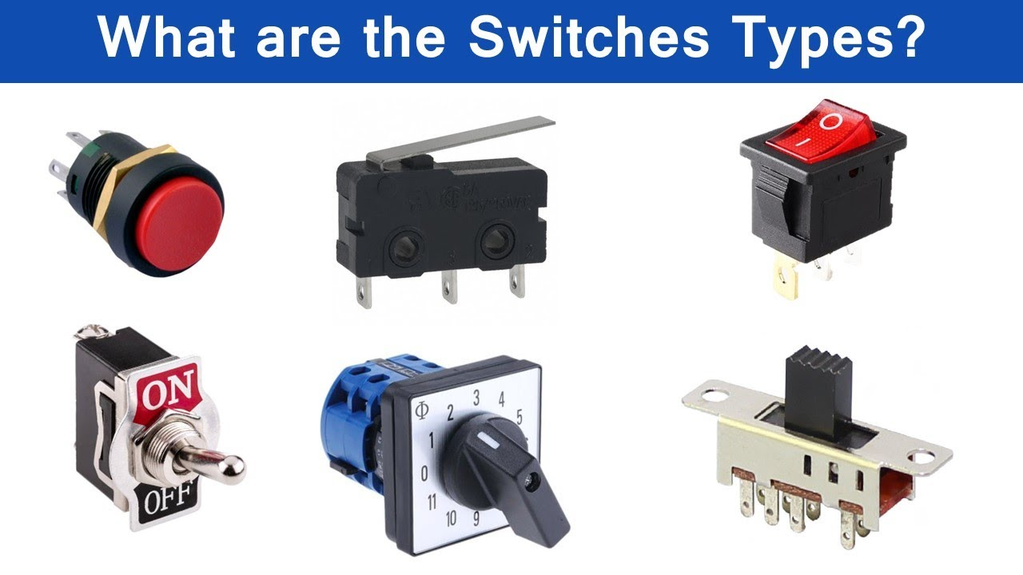
Switches
A device that completes or breaks a circuit by preventing or allowing electrical current flow to a component
When switch is “on” or “closed” this completes a circuit and allows current flow
When switch is “open” or “off”, the circuit is broken and no current flows
Notes:
Instructional Activity: Present Content, Recall
Instructional Time: 2 minutes
Talking Points
A switch is a device that completes or breaks a circuit by preventing or allowing electrical current flow to a component.
When a switch is “on” or “closed” this completes a circuit and allows current flow.
When a switch is “open” or “off”, the circuit is broken which stops the flow of current.
A switch gives us control over electricity, allowing current to flow only when it’s needed and stopping it when it is not needed.
Some of the key switches shown in the picture are:
Toggle, Push button, Rotary, etc.
Ask: Do you know any other examples of switches?
Call on learners to respond. Answers may include rocker switch, slide switch, foot switch, knife switch, joysticks, pull chain switch, etc.

Slide 44
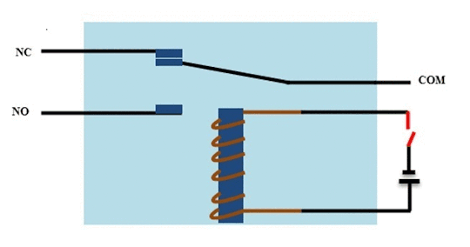
Relays
An electrical switch operated by an electromagnet
Can allow low-power circuits to control high-power circuits
Current flows through a coil generating a magnetic field that moves the switch to open or close
Notes:
Instructional Activity: Present Content
Instructional Time: 2 minutes
Talking Points
A relay is an electromechanical switch operated by an electromagnet, which can allow low-power circuits to control high-power circuits.
As current flows through a coil it generates magnetic field, and if it moves through a switch it opens or closes the circuit.
Applications of relays include:
Controlling high-current devices (motors, lights, heating elements).
Isolating low-power control systems from high-power circuits (for safety).
Automotive systems, industrial machinery, home appliances.
In transit, you may see an electromagnet at work when doors in a bus open. To open the doors, an electrical signal is sent to a relay, which in turn sends electrical current to activate lights in the stepwell to provide better illumination. When the doors close, the signal is interrupted, which then extinguishes the step lights. This is done automatically without driver intervention.
Additional/optional resource: https://www.electronicshub.org/what-is-relay-and-how-it-works/

Slide 45
Relays: Normal Open vs Normal Closed
These terms refer to a relay’s contact(s) default state when no power is being applied (Normal = De-energized)
Normal Open (NO)
Contact open; When energized, contact closes & current flows
Normal Closed (NC)
Contact closed; When energized, contact opens & current stops
Notes:
*This slide contains animations. CLICK to reveal content.
Instructional Activity: Present Content
Instructional Time: 3 minutes
Talking Points
Let’s talk about relay contact positions. The terms Normally Open (NO) and Normally Closed (NC) refer to the default state of a relay’s contacts when no power is applied to the coil.
“Normal” simply means the relay is de-energized.
When the relay’s coil becomes energized, the contacts switch from their normal state to the opposite state. That switching action allows connected circuits to open or close. So, a relay is essentially an electrically controlled switch.
CLICK
A Normally Open contact does not allow current to flow when the relay is at rest. When the coil is energized, the contact closes and allows current to pass.
Think of it like a push-button light switch that only works while you are pressing it.
No power to the coil → circuit open.
Power applied → circuit closes.
CLICK
A Normally Closed contact allows current to flow when the relay is at rest. When the coil is energized, the contact opens and interrupts current flow.
A good example is a refrigerator light switch.
The light is on by default. When the door closes (activating the switch), the circuit opens and the light turns off.
You’ll also see this logic used in emergency alarm circuits
Some relays control more than one circuit at the same time. A double-pole relay controls two separate circuits independently. A triple-pole relay controls three separate circuits.
Each circuit has its own set of contacts, but all are controlled by the same coil. This allows one control signal to switch multiple circuits simultaneously.

Slide 46
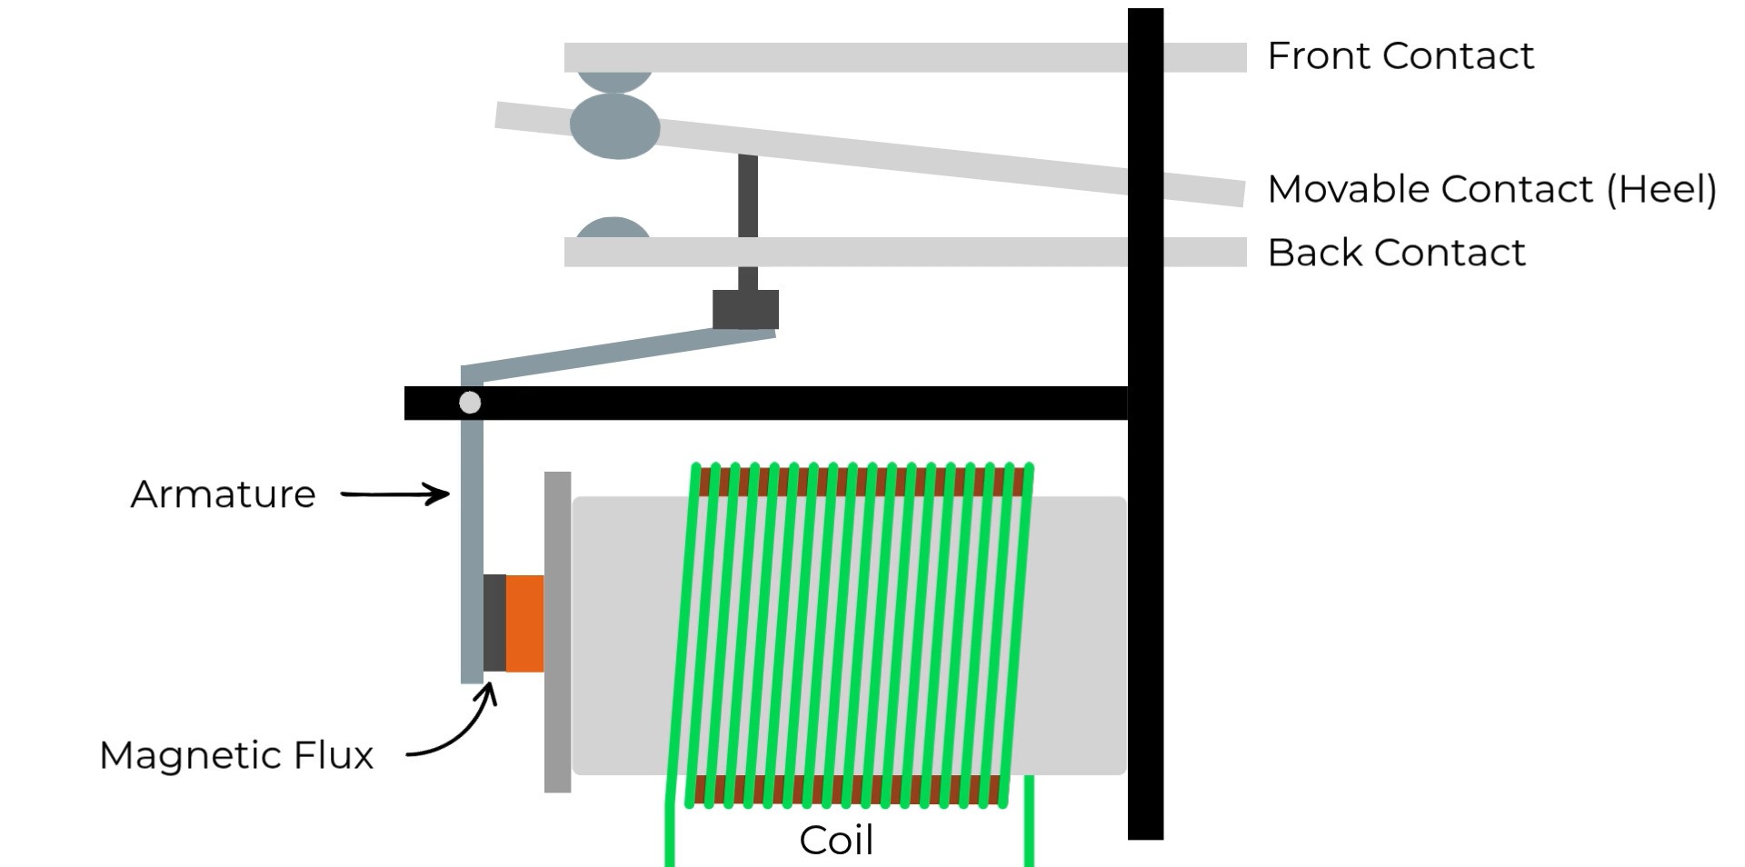
Electromechanical Relays (EMR)
Notes:
Instructional Activity: Present Content
Instructional Time: 5 minutes
Do:
Review the talking points below
Play the animation on the slide.
Consider reviewing the components of an EMR such as:
Fixed Contacts
Moveable contact
Pivot
Armature
Magnetic Flux
Yoke
Air Gap
Coil Supply Voltage
Energizing Coil
Talking Points:
There are several kinds of relays.
On the slide is a standard type Electromechanical Relays (EMRs) which uses physical moving contacts and a coil to switch circuits.
Applications for EMRs include industrial machines, automotive systems, appliances.

Slide 47
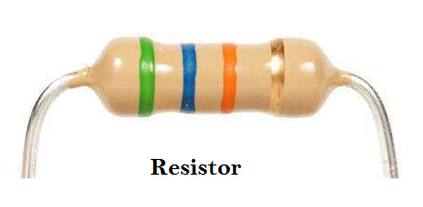
Resistors
A passive electric component that converts electrical energy into heat to control and limit current flow
Resistance measured in ohms (Ω)
Power Rating – maximum power the resistor can dissipate safely (measured in watts)
Tolerance – indicates how close resistance value is to its stated value (e.g. ± 5%)
Notes:
Instructional Activity: Present Content
Instructional Time: 3 minutes
Do: Provide examples of applications and any agency-specifics
Talking Points
A resistor is a basic, passive component with two terminals. It is designed to help control the flow of current by providing resistance.
This helps protect components, manage voltage drops, and helps to keep equipment operating smoothly.
It works by converting electrical energy into heat, which helps limit and control the flow of current.
Resistors are essential for:
Controlling current levels
Adjusting signal strength
Safely ending (terminating) transmission lines
A few key terms to know:
Resistance (R) is measured in ohms (Ω)—it tells us how much the resistor resists current.
Power rating is how much power (in watts) the resistor can handle without overheating.
Tolerance tells us how close the actual resistance value is to what’s printed on the label—like ±5%.
Source: Robocraze. (2024, January 22). How to Read a Resistor. Robocraze. https://robocraze.com/blogs/post/how-to-read-a-resistor?_pos=3&_sid=453ce3fe4&_ss=r

Slide 48
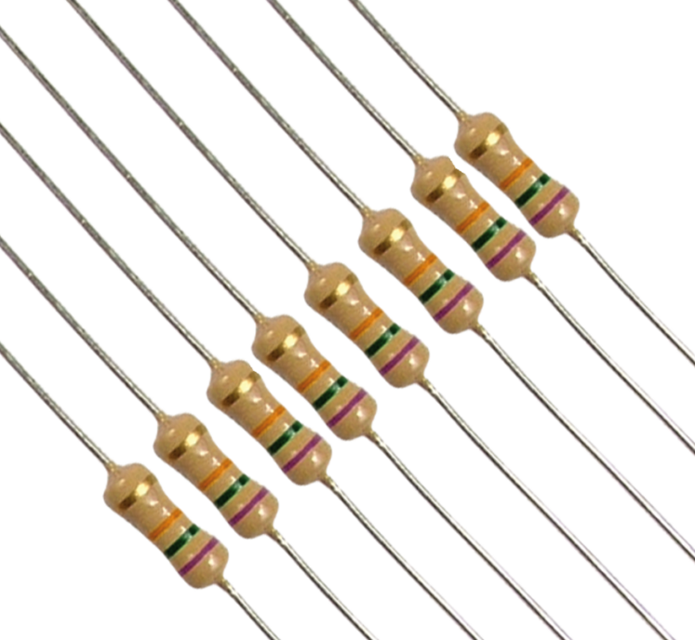
Types of Resistors
Fixed resistors – have a set or constant resistance value
  Carbon film, Metal film, Wire wound
Variable resistors – allow adjustment of resistance
  Potentiometers, Rheostats
Notes:
Instructional Activity: Present Content
Instructional Time: 2 minutes
Do: Provide agency specific examples of applications.
Talking Points:
Two common types of resistors are fixed resistors and variable resistors.
Fixed resistors have a set or constant resistance value that does not change during normal operation.
They are used when a circuit needs a consistent, predictable amount of resistance to control current.
Types include carbon film, metal film, wire wound.
Variable resistors will come with multiple terminals (or sliding terminals) and will allow for the resistance to be adjusted in the electrical circuit.
They are commonly used to fine-tune circuit behavior.
Types include potentiometers, rheostats.
Image source: Enrgtech Admin. (2022, June 1). Seven Different Types of Fixed Resistors and Their Functions. EnrgTech. https://www.enrgtech.co.uk/blog/fixed-resistors-different-types-and-their-functions/

Slide 49
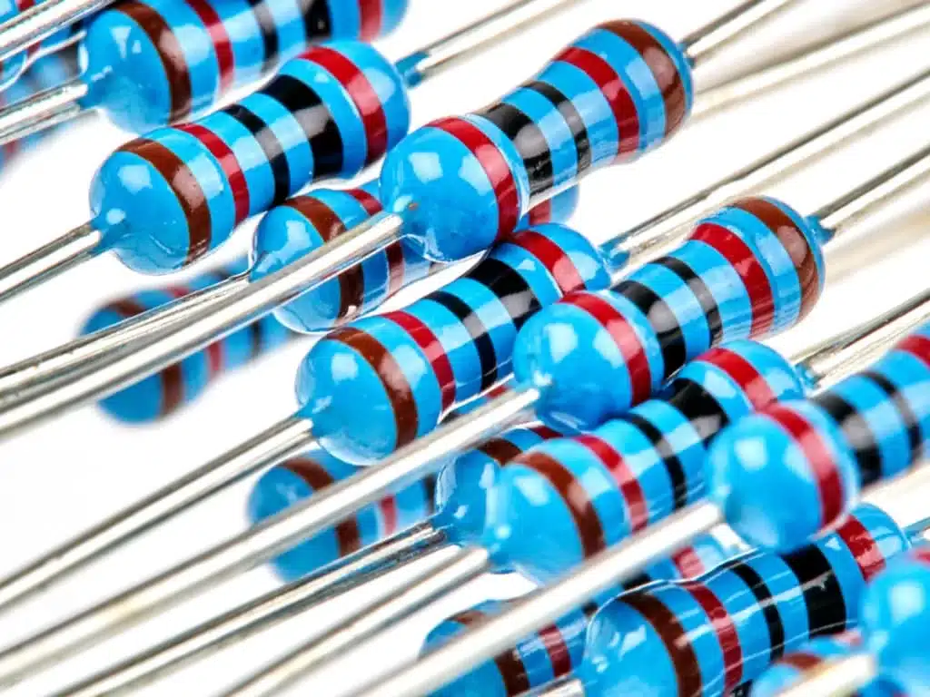
Applications of Resistors
Limit current in circuits to protect components
Voltage division in power supply circuits
Signal conditioning in audio & communication systems
Notes:
Instructional Activity: Present Content
Instructional Time: 2 minutes
Talking Points:
Applications of Resistors can include:
Limiting current in circuits to protect components
Voltage division in power supply circuits
Signal conditioning in audio & communication systems
Image source: Enrgtech Admin. (2022, June 1). Seven Different Types of Fixed Resistors and Their Functions. EnrgTech. https://www.enrgtech.co.uk/blog/fixed-resistors-different-types-and-their-functions/

Slide 50
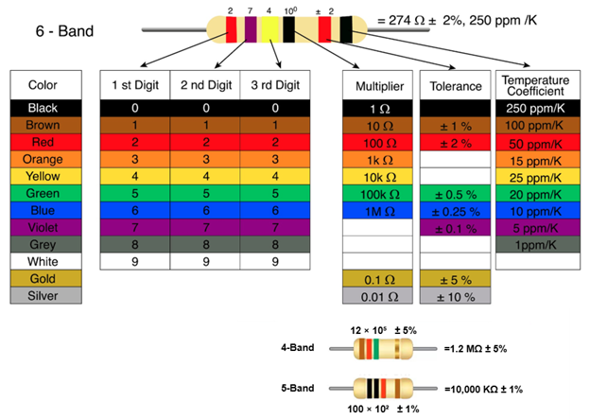

Resistor Color Codes
A standardized method for representing resistor values using colored bands.
Bands 2-3: digits
Next band is a multiplier
Final band: tolerance
  Gold = ±5%,
  Silver = ±10%
  None = ±20%
Note - Start reading from the side where the bands are closest to the edge and grouped together.
Notes:
*This slide contains animations. CLICK to reveal content.
Instructional Activity: Present Content, Provide Guided Learning,
Instructional Time: 5 minutes
Materials: Resistor Color Code Chart_M4
Do:
Refer learners to the “Resistor Color Code Chart” handout embedded in the Participant Resource Guide.
Walk learners through the resistor color code chart.
Provide examples of applications and any agency-specifics
Talking Points:
Resistor color codes are a standardized way to label resistor values without printing numbers.
Instead, resistors use colored bands to show their resistance and tolerance.
Each color stands for a number — starting with black for 0, brown for 1, all the way up to white for 9.
Most resistors have four or five bands. The first two or three bands give you the digits, the next band is a multiplier, and the final band tells you the tolerance, or how much the actual resistance might vary from the stated value.
For tolerance:
Gold means ±5%
Silver means ±10%
If there’s no tolerance band, that means ±20%
CLICK –
So, how do you know which side to start reading form?
Start reading from the side where the bands are closest to the edge and grouped together.
Source: Adobe by kadiracar

Slide 51
Resistors – Color Codes
Note - Start reading from the side where the bands are closest to the edge and grouped together.
How to Decode Resistor Color Bands
Identify the bands: 4-band, 5-band or 6-band configurations
Map colors to values: Use standardized color chart to identify digits, multipliers and tolerance
Example:
Green = 5 (1st digit)
Blue = 6 (2nd digit)
Orange = ×1,000 (multiplier)
Gold = ±5% (tolerance)
(5 × 10 + 6) × 1,000 = 56,000 ohms (or 56 kΩ)
6
X1,000
5
±5%
Notes:
Instructional Activity: Present Content, Provide Guided Learning
Instructional Time: 5 minutes
Materials: Resistor Color Code Chart_M4
Do:
Refer learners to the “Resistor Color Code Chart” handout embedded in the Participant Resource Guide.
Walk learners through the codes of the resistor on the slide using the color code chart.
Talking Points:
To decode a resistor color band, first identify the band configuration.
Next, map colors to values using the standardized color chart to identify digits, multipliers and tolerance.
Green = 5 (1st digit)
Blue = 6 (2nd digit)
Orange = ×1,000 (multiplier)
Gold = ±5% (tolerance)
(5 × 10 + 6) × 1,000 = 56,000 ohms (or 56 k Ω)

Slide 52
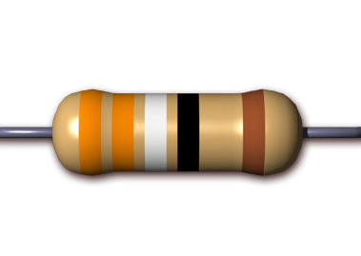
Whole Class Practice
Note - Start reading from the side where the bands are closest to the edge and grouped together.
How to Decode Resistor Color Bands
Is this a 4, 5, or 6 band configuration? 5 band configuration
What values will each color receive?
Example:
(3 × 100 + 3 × 10 + 9) × 1 =
= 339 Ω
9
3
X1
±1%
3
Notes:
Instructional Activity: Present Content, Provide Guided Learning, Elicit Performance
Instructional Time: 5 minutes
Materials: Resistor Color Code Chart_M4
Do:
Refer learners to the “Resistor Color Code Chart” handout embedded in the Participant Resource Guide.
Walk learners through the codes of the resistor on the slide using the color code chart.
Talking Points:
Let’s decode this resistor together to determine the resistance.
First, identify the bands. Is this a 4, 5, or 6 band configuration?
Call on learners and CLICK to reveal answer: 5
Next, map the color values. What number will each color receive?
Call on learners and CLICK to reveal answer: : Orange = 3, Orange = 3, White = 9, Black multiplier = ×1, Brown tolerance = ±1%
So, our equation will be…
Call on learners and CLICK to reveal answer: (3 × 100 + 3 × 10 + 9) × 1
Who can calculate our final answer?
Call on learners and CLICK to reveal answer: 339 Ω

Slide 53
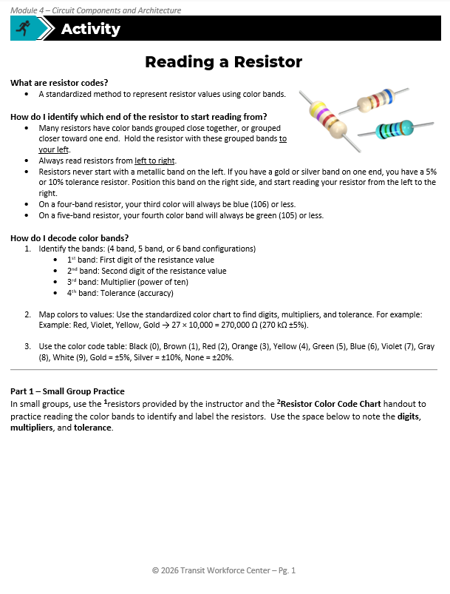
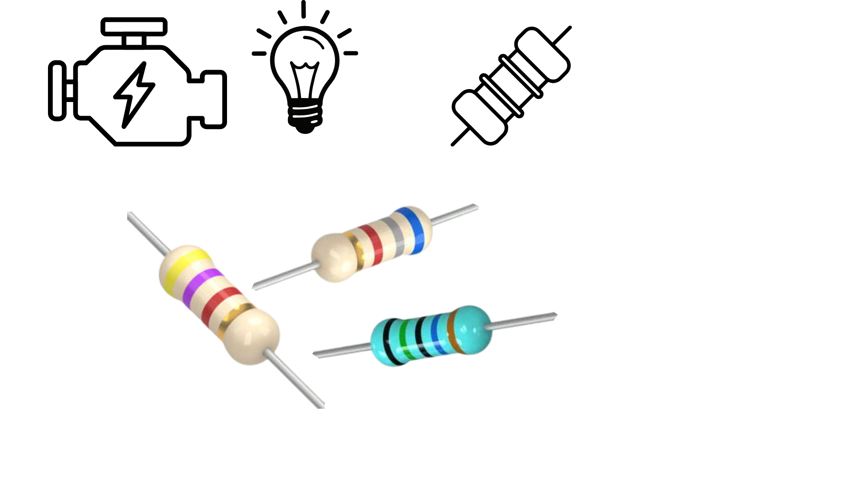
Activity: Reading a Resistor
Part 1: In small groups, use the resistors provided by the instructor and the Resistor Color Code Chart handout to identify each resistor by reading its color bands. Use the space below to record the digits, multiplier, tolerance, and final resistance value.
Part 2: On your own, read each resistor and use the space provided to note the digits, multipliers, and tolerance.
Notes:
Note – It is recommended that learners have color copies of the Resistor Color Code Chart and Reading a Resistor handouts. If color copies are limited, print and laminate 3–5 charts to use as a reusable class set.
Instructional Activity: Provide Guided Learning, Elicit Performance, Provide Feedback
Instructional Time: 35 min
Materials:
Reading a Resistor_M4 handout
Reading a Resistor_Answer Key_M4 handout
2-3 resistors per small group for Part 1
Do:
(5 min)
Refer learners to the “Reading a Resistor” handout embedded in the Participant Resource Guide.
Review the directions and answer any questions learners may have.
(10 min)
Separate learners into small groups. Give each group 2-3 resistors.
Give leaners about 10 minutes to complete Part 1.
Circulate the room answering question, checking work for accuracy, and providing feedback.
(10 min)
Transition learners into Part 2 for independent work.
Give leaners about 10 minutes to complete Part 2. Note – if color copies of the handout are not available, the resistor colors are provided on the handout.
Circulate the room answering question, checking work for accuracy, and providing feedback.
(10 min)
Debrief by reviewing the answers to the Part 2 using the provided answer key.

Slide 54
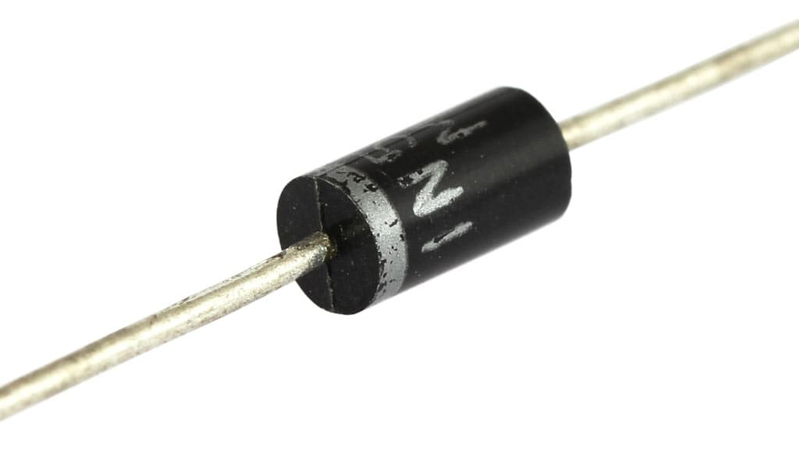
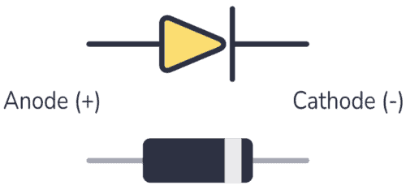
Diodes
An electrical circuit device (semiconductor) that allows current to flow in one direction only
Acts as a one-way gate for electricity
Forward-Bias:
  Anode is more positive than the cathode, current flows normally
Reverse-Bias:
  Anode is less than the cathode, diode blocks current
Diode
Diode Symbol
Notes:
Instructional Activity: Present Content
Instructional Time: 2 minute
Do: Provide examples of applications and any agency-specifics.
Talking Points:
A diode is a semiconductor device that allows current to flow in one direction only.
It acts as a one-way gate for electricity, allowing current to move through the circuit in a single direction while blocking it from flowing in the wrong direction.
When the diode is forward biased, meaning the anode is more positive than the cathode, current flows normally.
When the diode is reverse biased, meaning anode is less positive than the cathode, the diode blocks current to protect the circuit and control how electricity moves.

Slide 55
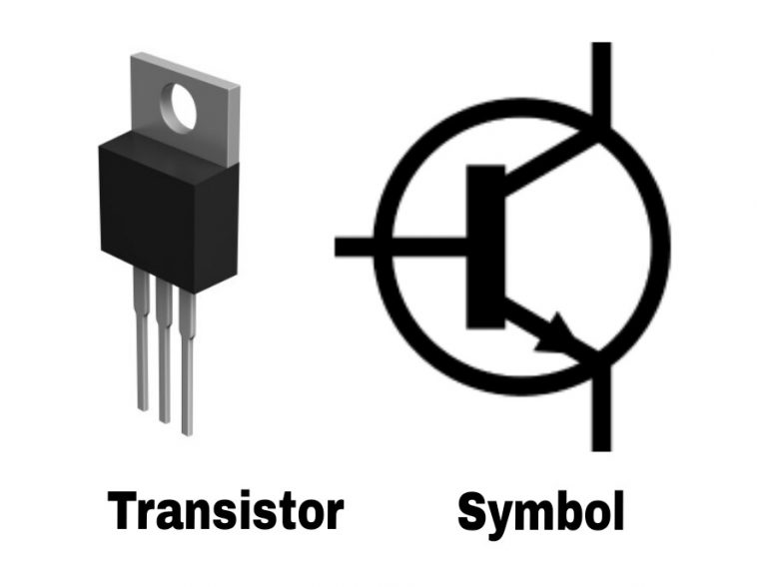
Transistors
A semiconductor device used to amplify or switch electronic signals
Acts like a relay but with no mechanical parts
Composed of three terminals - Small input current or voltage at base controls larger current between emitter and collector
Base
Collector
Emitter
Notes:
Instructional Activity: Present Content
Instructional Time: 2 minutes
Do: Provide examples of applications and any agency-specifics.
Talking Points:
A transistor is a semiconductor device used to amplify or switch electronic signals.
When you apply voltage to the base it is like operating the relay coil, then power can flow from the collector to the emitter.
Advantage is no mechanical parts so there is little to no wear.
They act as an electronic switch/signal amplifier in circuits.
Transistors are composed of three parts: Emitter, Base, and Collector.
There will be a small input current or voltage at base controls larger current between emitter and collector.
Image source: NextPCB. (n.d.). Transistor pinout. https://www.nextpcb.com/blog/transistor-pinout

Slide 56
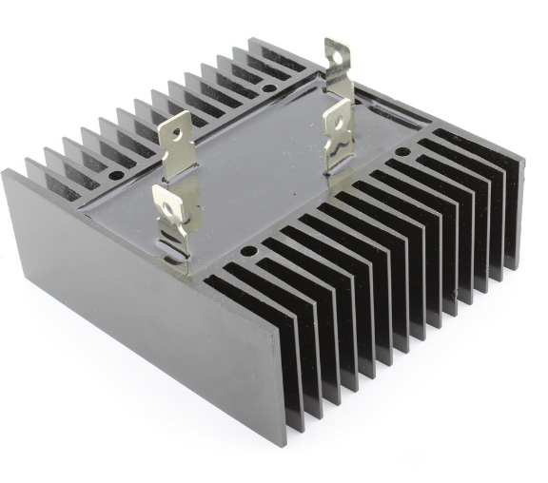
Rectifiers
A device which converts electrical current starting in AC into DC
Uses electric devices (usually diodes) to allow current to flow during a certain wave (e.g. positive and negative half-cycles)
Applications include electronics, mobile phones, radio demodulation
Notes:
Instructional Activity: Present Content
Instructional Time: 2 minutes
Do: Provide examples of applications and any agency-specifics.
Talking Points:
A rectifier is a device which converts electrical current starting in AC into DC.
They use electric devices (usually diodes) to allow current to flow during a certain wave (e.g. positive and negative half-cycles).
Applications include electronics, cell phones, and radio demodulation.
Photo source: Arrow. (2018, September 24). What is a Rectifier? Types of Rectifiers in Electronics. Arrow.com. https://www.arrow.com/en/research-and-events/articles/how-rectifiers-work-types-of-rectifiers-and-their-uses

Slide 57
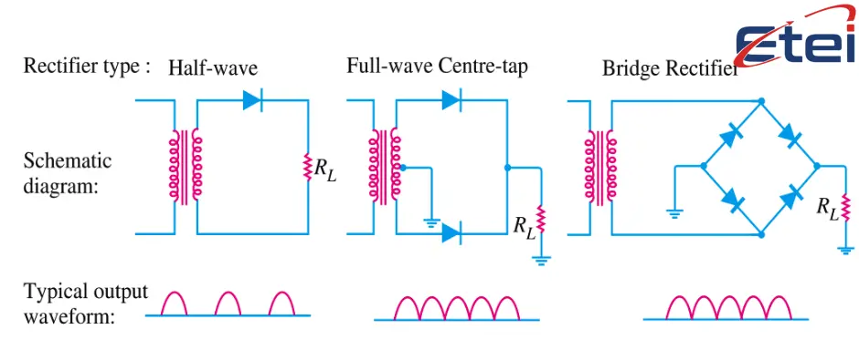
Types of Rectifiers
Three Primary Types: Half-wave, Full-wave, Full-wave bridges
Feature | Half-Wave | Full-Wave | Bridge Rectifier
Diodes | 1 | 2 | 4
Efficiency | Low | High | High
Notes:
Instructional Activity: Present Content
Instructional Time: 3 minutes
Do: Provide examples of applications and any agency-specifics.
Talking Points:
Now let’s look at the three primary types of rectifiers, which are devices used to convert alternating current (AC) into direct current (DC).
The three main types are half-wave rectifiers, full-wave rectifiers, and bridge rectifiers.
First, the half-wave rectifier.
A half-wave rectifier uses one diode. It allows only one half of the AC waveform to pass through while blocking the other half.
Because only half of the waveform is used, the output DC is less efficient and more uneven.
Next is the full-wave rectifier.
A full-wave rectifier uses two diodes and a center-tapped transformer.
Instead of using only half of the AC signal, it converts both halves of the waveform into DC, which results in higher efficiency and a smoother output than the half-wave design.
Finally, the bridge rectifier.
A bridge rectifier uses four diodes arranged in a bridge configuration.
This design also converts both halves of the AC waveform, but it does so without needing a center-tapped transformer.
Because of this configuration, bridge rectifiers are very common in power supplies and electronic devices.
Source:
Electrical Testing & Engineering Inc. (n.d.). Bridge rectifier explained: Circuit diagram, applications, and troubleshooting guide. https://www.etei.com/news/bridge-rectifier-explained-circuit-diagram-applications-and-troubleshooting-guide

Slide 58
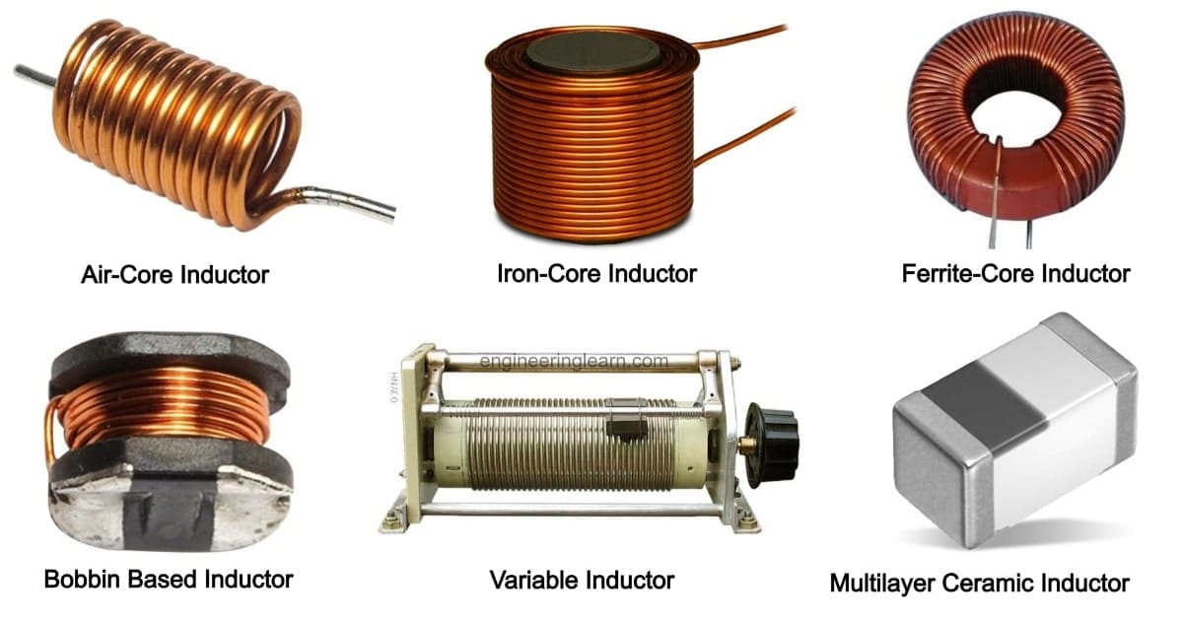
Inductors
Electrical device that stores energy in a magnetic field
Made by winding insulated wire into a coil
Also called a coil, reactor, or choke
Opposes sudden changes in current
Used to smooth signals and reduce current spikes
Notes:
Instructional Activity: Present Content
Instructional Time: 2 minute
Do: Provide examples of applications and any agency-specifics.
Talking Points:
An inductor is an electrical device that stores energy in a magnetic field.
Unlike a capacitor, which stores energy in an electric field, an inductor stores energy magnetically.
Inductors are typically made by winding insulated wire into a coil.
When current flows through that coil, it creates a magnetic field around it. That magnetic field is where the energy is temporarily stored.
You may also hear inductors referred to as a coil, a reactor, or a choke, depending on the application.
One of the most important functions of an inductor is that it resists sudden changes in current.
When current tries to increase or decrease quickly, the inductor reacts by opposing that change.
This makes inductors useful for:
Smoothing electrical signals
Reducing electrical noise
Limiting sudden current spikes
In power systems and electronics, inductors help stabilize circuits and protect components from abrupt current changes.
Inductors have little to no effect on DC and do have many functions in AC circuits.
Image source: Agrawal, K. (2024, June 25). Modeling Inductors: Non-linear Model for Circuit Analysis. Medium; Medium. https://medium.com/@karishmaagarwal2505/modeling-inductors-non-linear-model-for-circuit-analysis-b3dd61b8ab68

Slide 59
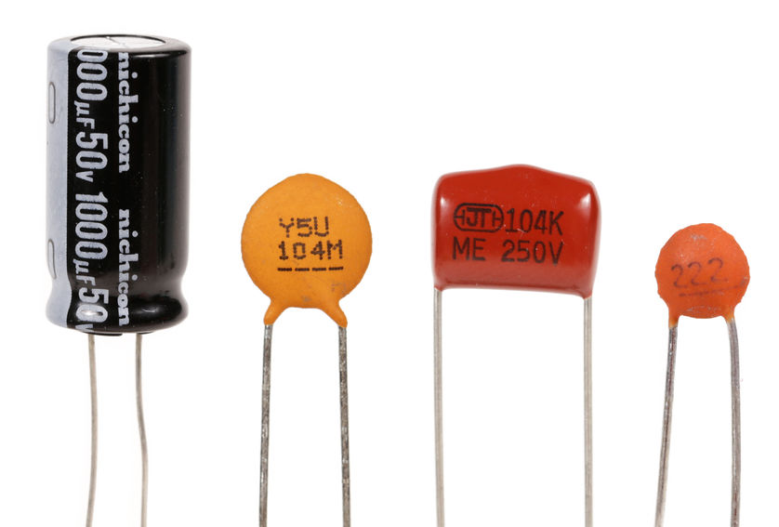
Capacitors
Electrical device that stores energy in an electric field and releases energy as needed
Made of two conductors separated by an insulating material (dielectric)
  In DC circuits: charges, then blocks further current flow
  In AC circuits: continuously charges and discharges
Notes:
Instructional Activity: Present Content
Instructional Time: 2 minutes
Do: Provide examples of applications and any agency-specifics.
Talking Points:
A capacitor is an electrical device that stores energy in an electric field.
It consists of two conductive plates separated by an insulating material called a dielectric.
When voltage is applied, the capacitor stores energy by building up an electric charge between the two plates. That stored energy can then be released back into the circuit when needed.
In a DC circuit, a capacitor will charge up to the applied voltage and then block further current flow once it is fully charged.
In an AC circuit, the voltage is constantly changing direction. Because of that, the capacitor continuously charges and discharges, allowing energy to keep moving through the circuit.
Capacitors are commonly used for:
Smoothing voltage
Filtering noise
Stabilizing power supplies
Timing and signal processing applications

Slide 60
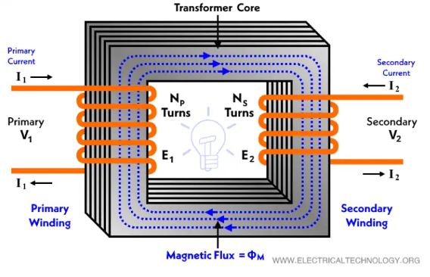
Transformers
An electrical circuit device that uses electromagnetic induction to transfer energy from one circuit to another
Types include step-up and step-down
Applications:
  Audio and radio systems
  Power Supplies
  Power Transmissions
Notes:
Instructional Activity: Present Content
Instructional Time: 2 minutes
Do: Provide examples of applications and any agency-specifics.
Talking Points:
Transformers are an electrical circuit device that uses electromagnetic induction to transfer energy from one circuit to another.
The primary types include step-up and step-down transformers.
A step-up transformer is designed to increase the voltage from primary to secondary.
A step-down transformer is designed to decrease the voltage from primary to secondary.
Applications for a transformer can include:
Audio and radio systems
Power Supplies
Power Transmissions
Source: Kuphaldt, T. R. (2015, February 12). Step-up and Step-down Transformers. Allaboutcircuits.com; All About Circuits. https://www.allaboutcircuits.com/textbook/alternating-current/chpt-9/step-up-and-step-down-transformers/
Photo source: Electrical Technology | All About Electrical & Electronics Engineering. (2015). ELECTRICAL TECHNOLOGY. https://www.electricaltechnology.org/

Slide 61
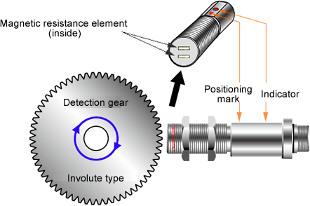
Sensors
Device that detects changes in electrical or physical conditions
Converts those changes into a usable electrical signal
Primary Types:
  Mechanical & Pressure
  Thermal
  Magnetic & Electromagnetic
  Chemical
Motor Speed Sensors
Notes:
Instructional Activity: Present Content
Instructional Time: 2 minute
Do: Provide examples of applications and any agency-specifics.
Talking Points:
A sensor is a device that detects changes in conditions — such as motion, temperature, pressure, light, or electrical fields — and converts that change into a usable electrical signal.
In simple terms, a sensor takes a physical event and turns it into information a circuit or control system can understand.
For example:
A temperature sensor detects heat and converts it into a voltage signal.
A pressure sensor detects force and converts it into an electrical output.
A magnetic sensor detects movement or position and generates a signal.
Sensors are critical in modern electrical and transportation systems because they allow systems to monitor, adjust, and respond automatically.

Slide 62
Knowledge Check
Why does circuit protection matter?
  Helps prevent damage to the circuit and/or equipment, reduces the changes of fires or system failures happening, and ensures reliability and safety of the system.
Notes:
*This slide contains animations. CLICK to reveal content.
Instructional Activity: Evaluate/Assess Performance, Provide Feedback
Instructional Time: 3 min.
Learning Objective: Define the major components of an electrical circuit and describe their functionality.
Do: Review the knowledge check question. Call on learners to share their responses.
Answer Key:
Circuit protection helps prevent damage to the circuit and/or equipment, reduces the changes of fires or system failures happening, and ensures reliability and safety of the system.

Slide 63
Knowledge Check
Match the key term with the correct description.
Relay
Switch
Diode
Transistor
Allows current to flow in only one direction.
Completes or breaks a circuit by allowing or preventing current flow.
An electromechanical device that uses a low-power signal to control a higher-power circuit.
A semiconductor device used to amplify or switch electronic signals.
Notes:
*This slide contains animations. CLICK to reveal content.
Instructional Activity: Evaluate/Assess Performance, Provide Feedback
Instructional Time: 5 min.
Learning Objective: Define the major components of an electrical circuit and describe their functionality.
Do: Review the knowledge check question. Call on learners to share their responses.
Answer Key:
1. C
2. B
3. A
4. D

Slide 64
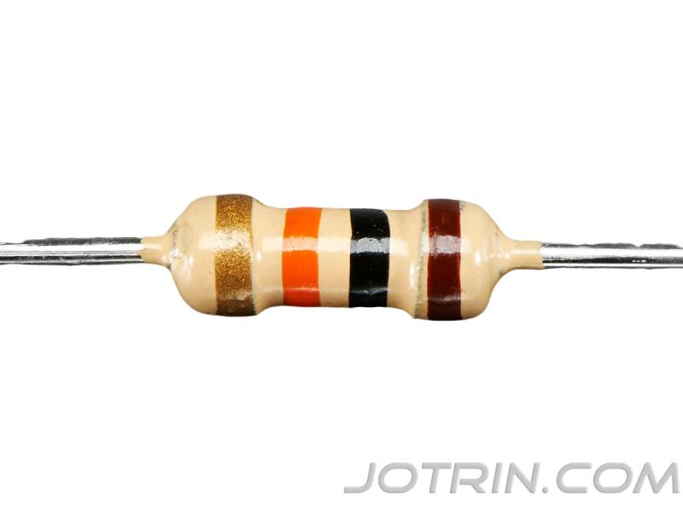
Knowledge Check
Walk us through reading a resistor using the image below. Calculate the final resistance.
Brown (1)
Black (0)
Orange (×1,000)
Gold (±5%)
  = 10kΩ ±5%
Notes:
*This slide contains animations. CLICK to reveal content.
Instructional Activity: Evaluate/Assess Performance, Provide Feedback
Instructional Time: 5 min.
Learning Objective: Define the major components of an electrical circuit and describe their functionality.
Do: Review the knowledge check question. Call on learners to share their responses.
Answer Key
Step 1: Identify the Tolerance Band
Gold is the tolerance band. That means we read from the opposite side. So, we start with Brown.
Step 2: First Two Bands = Significant Digits
Brown = 1
Black = 0
So, the first two digits are 1 0
Step 3: Third Band = Multiplier
Orange = ×1,000
Now multiply 10 x 1,000 = 10,000
Step 4: Fourth Band = Tolerance
Gold = ±5%
Final Answer: 10,000 Ohms or $10kΩ±5\%$

Slide 65
Knowledge Check
What is a capacitor?
A.) A device that converts AC current into DC current
B.) A device that transfers energy between circuits using electromagnetic induction
C.) An electrical device that stores energy in an electric field
C.) An electrical device that stores energy in an electric field
D.) A device that allows current to flow in only one direction
Notes:
*This slide contains animations. CLICK to reveal content.
Instructional Activity: Evaluate/Assess Performance, Provide Feedback
Instructional Time: 3 min.
Learning Objective: Define the major components of an electrical circuit and describe their functionality.
Do: Review the knowledge check question. Call on learners to share their responses.
Answer Key:
C

Slide 66
Knowledge Check
What is a rectifier?
A.) A device that stores energy in an electric field
B.) A device that converts electrical current from AC to DC
B.) A device that converts electrical current from AC to DC
C.) A device that transfers energy between circuits using electromagnetic induction
D.) A device that allows current to flow in only one direction
Notes:
*This slide contains animations. CLICK to reveal content.
Instructional Activity: Evaluate/Assess Performance, Provide Feedback
Instructional Time: 3 min.
Learning Objective: Define the major components of an electrical circuit and describe their functionality.
Do: Review the knowledge check question. Call on learners to share their responses.
Answer Key:
B

Slide 67
Knowledge Check
What is the difference between a step-up and step-down transformer?
  A step-up transformer is designed to increase the voltage from primary to secondary.
  A step-down transformer is designed to decrease the voltage from primary to secondary.
Notes:
*This slide contains animations. CLICK to reveal content.
Instructional Activity: Evaluate/Assess Performance, Provide Feedback
Instructional Time: 3 min.
Learning Objective: Define the major components of an electrical circuit and describe their functionality.
Do: Review the knowledge check question. Call on learners to share their responses.
Answer Key
A step-up transformer is designed to increase the voltage from primary to secondary.
A step-down transformer is designed to decrease the voltage from primary to secondary.

Slide 68
Knowledge Check
A __________ is a device that detects changes in conditions such as motion, temperature, pressure, light, or electrical fields and converts that change into a usable electrical signal.
A.) Relay
B.) Electromagnet
C.) Transformer
D.) Sensor
D.) Sensor
Notes:
*This slide contains animations. CLICK to reveal content.
Instructional Activity: Evaluate/Assess Performance, Provide Feedback
Instructional Time: 3 min.
Learning Objective: Define the major components of an electrical circuit and describe their functionality.
Do: Review the knowledge check question. Call on learners to share their responses.
Answer Key:
D

Slide 69
Summary and What’s Next
Power sources supply energy to the circuit.
Wires carry electricity between components.
Loads use electrical energy to do work.
Protection devices keep circuits and equipment safe.
Control devices turn power on and off automatically.
Electronic components change and control how electricity flows.
Next, we’ll see how circuit components are represented on electrical diagrams.
Notes:
Instructional Activity: Enhance Retention and Transfer
Instructional Time: 5 min.
Talking points:
Let’s wrap up what we covered in this section.
We started by looking at power sources, which supply the energy that moves through a circuit.
We discussed how wires act as the pathway, carrying electrical current between components.
Then we looked at loads, which use electrical energy to perform work — whether that’s producing light, motion, or heat.
We also covered protection devices, which safeguard circuits and equipment from faults like overcurrent or short circuits.
Next, we explored control devices, which allow circuits to turn on and off automatically.
And finally, we introduced electronic components that regulate and shape how electricity flows through a system.
The key takeaway is this: Every electrical system is made up of components that generate, carry, control, protect, and use electrical energy.
Now that we understand the function of these parts, the next step is learning how they are represented visually.
Next, we’ll see how circuit components are represented on electrical diagrams.

Slide 70
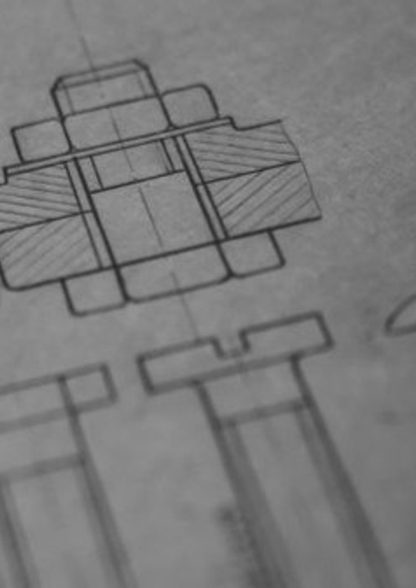
4.4 – Circuit Diagram Symbols
Next, we’ll learn the symbols that make up the language of electrical diagrams.
It’s important to note that some symbols may vary by location.
Notes:
Instructional Event: Direction
Time: 1 minute.
Do: Review the purpose of this section of the module.
Talking Points:
Next, we’ll learn the symbols that make up the language of electrical diagrams.
It’s important to note that some symbols may vary by location.

Slide 71
Why Electrical Symbols Matter
Electrical Diagrams use symbols instead of pictures.
Symbols are a shared language that technicians use to show:
  Type of component
  Connection
  How electricity moves through the system
Learning symbols allows you to read any electrical diagram, even if you’ve never seen that system before.
Notes:
Instructional Activity: Direction
Instructional Time: 2 minutes
Talking Points
Electrical Diagrams use symbols instead of pictures.
Think of symbols like road signs. You don’t need a picture of a stop sign to know what it means, the shape and color tell you what to do.
Electrical symbols work the same way. Once you know them, you can look at any diagram and understand what parts are in the circuit and how they’re connected.
Symbols are a shared language that technicians use to show the type of component, their connection within the system, and how electricity moves through the system.
Learning symbols allows you to read any electrical diagram, even if you’ve never seen that system before.

Slide 72
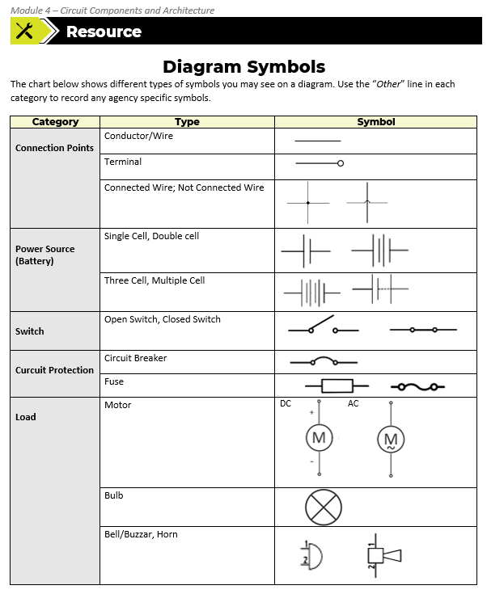
Symbols Chart Resource
This chart shows different types of symbols you may see on a diagram. We’ll use “Other” category to record any agency specific symbols.
Notes:
Instructional Activity: Present Content
Instructional Time: 1 minutes
Materials: Symbols Chart_M4
Do:
Refer learners to the “Symbols Chart” handout embedded in the Participant Resource Guide.
Talking Points:
The Symbols Chart in your Participant Resource Guide will be a useful reference in this part of the lesson as we review diagram symbols.
At times, I may ask you to add some agency specific symbols in the “Other” category on page two of the chart.

Slide 73

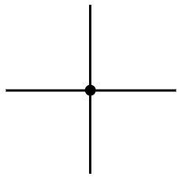

Connection points
Represented by straight and intersecting lines in a circuit diagram
Conductor/Wire Terminal
___________
Connected Wires Wires – Not Connected
Notes:
Instructional Activity: Present Content
Instructional Time: 2 minutes
Materials: Symbols Chart_M4
Do:
Explain the role in an electrical circuit diagram
Review any agency specific examples you would like learners to add to the “Symbols Chart” handout embedded in the Participant Resource Guide.
Talking Points
Let’s look at how connection points are represented on electrical diagrams.
In schematics, connections are shown using straight lines to represent conductors or wires.
A simple straight line represents a conductor — the pathway for current to travel.
A terminal is shown as a line ending in a small circle. That circle indicates a connection point where a wire connects to a device or component.
When wires are connected, you will see a solid dot at the intersection. That dot indicates an electrical connection — current can flow between those conductors.
When wires are not connected, one wire will typically “jump” over the other using a small arc. That shows the wires cross visually, but they are not electrically connected.
This distinction is critical when reading diagrams. Missing or misreading a connection dot can completely change how a circuit functions.

Slide 74

Power Source (Battery) Symbols
Represented by two parallel lines as a symbol in a circuit diagram
Single Cell Double Cell
Three Cell Multiple Cell
+
-
Notes:
Instructional Activity: Present Content
Instructional Time: 2 minutes
Materials: Symbols Chart_M4
Do:
Explain the role in an electrical circuit diagram
Review any agency specific examples you would like learners to add to the “Symbols Chart” handout embedded in the Participant Resource Guide.
Talking Points
Now let’s look at how power sources are represented on electrical diagrams.
A battery or DC power source is shown using two parallel lines.
One line is longer, and one line is shorter.
The longer line represents the positive terminal, and the shorter line represents the negative terminal.
That length difference is important — it tells you polarity.
There are a few types of batteries represented on this slide:
Single Cell - A single cell has one long line and one short line. This represents one voltage source — like a single battery cell.
Double Cell - A double cell symbol shows two sets of long and short lines. Each pair represents another cell added in series. More cells mean higher total voltage.
Three Cell - With three sets of long and short lines, you have three cells in series. Each additional cell increases the total voltage supplied to the circuit.
Multiple Cell - The multiple-cell symbol is often simplified with dashed or abbreviated lines. Instead of drawing every cell individually, the diagram shows that there are multiple cells connected in series. This keeps complex diagrams cleaner while still communicating that multiple voltage sources are present.

Slide 75

Switch Symbol
Represented by one continuous line (closed) or interrupted line (open) in a circuit diagram.
Open Switch
Closed Switch
Notes:
Instructional Activity: Present Content
Instructional Time: 2 minutes
Materials: Symbols Chart_M4
Do:
Explain the role in an electrical circuit diagram
Review any agency specific examples you would like learners to add to the “Symbols Chart” handout embedded in the Participant Resource Guide.
Talking Points
A switch is shown as either a continuous line or an interrupted line, depending on its position.
An open switch is shown with a gap in the line. That gap indicates the circuit is broken, and current cannot flow.
When a switch is open, the path is interrupted — just like turning a light switch off.
A closed switch is shown as a continuous line. This means the circuit path is complete, and current is allowed to flow.
When a switch is closed, electricity can move through the circuit and power the load.
There are other examples that may be specific depending on the setup of a circuit. On the right you will see two agency specific switch symbols used at CATS (Charlotte Area Transit System).

Slide 76


Circuit Protection Symbols
Circuit Breaker – Represented by a curved line ended with two circles
– Represented by box with line running through OR curved “S” line ended with two circles
Circuit Breaker
Notes:
Instructional Activity: Present Content
Instructional Time: 2 minutes
Materials: Symbols Chart_M4
Do:
Explain the role in an electrical circuit diagram
Review any agency specific examples you would like learners to add to the “Symbols Chart” handout embedded in the Participant Resource Guide.
Talking Points
Now let’s look at how circuit protection devices are represented on electrical diagrams.
First, the circuit breaker symbol.
A circuit breaker is typically shown as a curved line between two connection points, often ending in small circles.
This symbol represents a protective device that can open the circuit automatically if current exceeds a safe limit.
Unlike a , a circuit breaker can usually be reset after the fault is cleared.
Next, the symbol.
A may be represented in one of two common ways: A rectangular box with a line running through it or a curved “S” shaped line between two connection points
Both symbols represent a device designed to protect the circuit from overcurrent.
When excessive current flows, the element melts, permanently opening the circuit.
Unlike a breaker, a must be replaced after it operates.

Slide 77






Load Symbols
Loads are represented in a variety of way depending on what type of load is used.
LED Light/
Incandescent Lamp
Motor
Bulb
Buzzer/Horn
DC
AC
Notes:
Instructional Activity: Present Content, Recall
Instructional Time: 2 minutes
Materials: Symbols Chart_M4
Do:
Explain the role in an electrical circuit diagram
Review any agency specific examples you would like learners to add to the “Symbols Chart” handout embedded in the Participant Resource Guide.
Talking Points
Now let’s look at how loads are represented on electrical diagrams.
Loads can appear in different forms depending on what the circuit is powering.
The symbols may vary slightly depending on the agency or application, but the core representations remain consistent.
Motors (DC and AC)
The symbols shown here represent both DC motors and AC motors.
ASK: Before we move forward, let me ask: Can anyone explain the difference between AC and DC electricity?
Call on learners to respond. Answer: AC stands for alternating current, meaning the direction of current flow changes periodically. DC stands for direct current, meaning the current flows in one steady direction.
DC voltage is commonly supplied by batteries or DC power supplies.
AC voltage typically comes from wall outlets in homes and facilities.
On schematics, DC motors are usually marked clearly, and AC motors may include a small sine wave symbol to indicate alternating current.
Light Bulb
In this module, we’ll often focus on a basic load like a light bulb.
The standard symbol for a bulb is a circle with an “X” inside.
This represents a simple resistive load that converts electrical energy into light and heat.
Buzzer or Horn
The buzzer or horn symbol represents an audible load — something that produces sound. These are common in alarms, signaling systems, and warning circuits.
LED / Incandescent Lamp
LEDs have a distinct symbol showing a diode with arrows pointing outward, representing light emission.
An incandescent lamp uses the circular “X” symbol, similar to a general bulb.
The labels may indicate color, such as RD for red or CLEAR for standard incandescent.

Slide 78

Diode Symbols
Represented by a triangle pointing toward a vertical line. The vertical line represents the cathode.
Notes:
Instructional Activity: Present Content
Instructional Time: 2 minutes
Materials: Symbols Chart_M4
Do:
Explain the role in an electrical circuit diagram
Review any agency specific examples you would like learners to add to the “Symbols Chart” handout embedded in the Participant Resource Guide.
Talking Points
The symbol for a diode is a triangle pointing toward a vertical line. The triangle represents the anode, and the vertical line represents the cathode.
On a schematic, the diode symbol shows the direction conventional current is allowed to flow — from anode to cathode.
Diodes control and protect circuits by allowing current to flow in one direction while blocking reverse current.
When you see a diode symbol, pay close attention to its orientation, especially during troubleshooting, because current can only flow in one direction.

Slide 79


Relay Symbols
Represented by a spiral line next to a switch symbol.
Normally Closed
Normally Opened
Notes:
Instructional Activity: Present Content, Recall
Instructional Time: 2 minutes
Materials: Symbols Chart_M4
Do:
Explain the role in an electrical circuit diagram
Review any agency specific examples you would like learners to add to the “Symbols Chart” handout embedded in the Participant Resource Guide.
Talking Points
ASK: Before we review the relay symbol, what symbol do you see here that we have already talked about?
Call on learners to respond. Answer: Switch
A relay symbol typically consists of two main parts:
A coil, shown as a spiral or curved line.
One or more switch contacts, shown using standard switch symbols.
The coil represents the electromagnet inside the relay.
When current flows through the coil, it creates a magnetic field. That magnetic field mechanically moves the switch contacts.

Slide 80

Resistor Symbols
Represented by a zigzag line or rectangle. If it has an arrow, it is a variable resistor.
US Schematics
International Schematics
Notes:
Instructional Activity: Present Content
Instructional Time: 2 minutes
Materials: Symbols Chart_M4
Do:
Explain the role in an electrical circuit diagram
Review any agency specific examples you would like learners to add to the “Symbols Chart” handout embedded in the Participant Resource Guide.
Talking Points:
Resistors are typically shown in one of two standard formats.
The first is a zigzag line. This is the common symbol used in many U.S. schematics.
The second is a rectangle. This version is often used in international or IEC-style diagrams.
Both symbols represent the same component — a fixed resistor.
A variable resistor will have an arrow crossing the resistor symbol, which indicates it is adjustable.
The arrow represents the movable contact that changes the resistance value.
Variable resistors are used when you need to adjust current or voltage levels in a circuit — for example, in volume controls or tuning circuits.

Slide 81


Capacitor Symbols
Represented by two parallel lines or one straight and one curved line
Capacitor
Polarized Capacitor
Notes:
Instructional Activity: Present Content
Instructional Time: 2 minutes
Materials: Symbols Chart_M4
Do:
Explain the role in an electrical circuit diagram
Review any agency specific examples you would like learners to add to the “Symbols Chart” handout embedded in the Participant Resource Guide.
Talking Points
The symbol for a capacitor is shown as two parallel lines. Those lines represent the two conductive plates inside the device.
Sometimes, you’ll see one straight line and one curved line.
This typically represents a polarized capacitor, where orientation matters. The curved plate often indicates the negative side, and you may see a plus sign marking the positive terminal.
As mentioned earlier in the module, the function of a capacitor is to store and release electrical energy.
Capacitors store energy in an electric field created between those two plates.
When reading a schematic, the capacitance value listed next to the symbol tells you how much energy the capacitor can store and release at a given voltage.
Understanding this relationship helps you predict how the capacitor will behave in a circuit.

Slide 82

Inductor Symbols
Represented by coiled wire. The curved loops represent the physical coil used to create a magnetic field when current flows.
Air Core Inductor Iron Core Inductor
Ferrite Core Inductor Variable Core Inductor
Notes:
Instructional Activity: Present Content
Instructional Time: 2 minutes
Materials: Symbols Chart_M4
Do:
Explain the role in an electrical circuit diagram
Review any agency specific examples you would like learners to add to the “Symbols Chart” handout embedded in the Participant Resource Guide.
Talking Points
Now let’s look at how inductors are represented on electrical diagrams.
The symbol for an inductor is a coiled wire. The curved loops represent the physical coil used to create a magnetic field when current flows.
As mentioned earlier in the module, the primary function of an inductor is to store energy in a magnetic field.
When current flows through the coil, a magnetic field forms around it. That magnetic field is where the energy is temporarily stored.
This slide shows a few different types of inductors.
Air Core Inductor
The basic inductor symbol — just the coil — usually represents an air core inductor.
This means there is no magnetic core material inside the coil. The magnetic field is created in open air.
Air core inductors are common in high-frequency applications.
Iron Core Inductor
When you see solid parallel lines next to the coil, that indicates an iron core inductor.
The solid lines represent a ferromagnetic core placed inside the coil.
Adding an iron core increases the inductance by strengthening the magnetic field.
Ferrite Core Inductor
If the parallel lines appear dashed, that typically represents a ferrite core.
Ferrite materials are commonly used in electronics because they perform well at higher frequencies and reduce energy losses.
Variable Core Inductor
If you see an arrow crossing the coil, that indicates a variable inductor.
The arrow represents an adjustable core, which allows the inductance value to be changed.
These are often used in tuning circuits, such as radios or signal processing systems.

Slide 83



Transformer Symbols
Represented by two coils (primary and secondary) next to each other.
Notes:
Instructional Activity: Present Content
Instructional Time: 2 minutes
Do: Explain the role in an electrical circuit diagram; Review an agency specific example of component symbol/labelling on a diagram
Talking Points
A transformer symbol consists of two coils placed next to each other.
One coil represents the primary winding, and the other represents the secondary winding.
The key idea is that these two coils are magnetically coupled but not electrically connected.
Energy is transferred from the primary to the secondary through electromagnetic induction.
Sometimes you’ll see the two coils drawn without any lines between them.
Other times, you’ll see parallel vertical lines between the coils.
Those lines represent a magnetic core — usually iron — that helps strengthen and guide the magnetic field between the windings.
So:
Two coils side-by-side = transformer
Lines between them = magnetic core
Image source:
Braza, J. (2020, June 5). How Transformers Work. Circuit Basics. https://www.circuitbasics.com/what-is-a-transformer/
Electrical Technology. (2019, September 5). Electrical Transformer Symbols - Single Line Transformer Symbols. Electrical Technology. https://www.electricaltechnology.org/2019/09/transformer-symbols.html
Beard, J. (2006, June 2). File:Transformer Centre-tap Iron Core-2.svg - Wikimedia Commons. Wikimedia.org. https://commons.wikimedia.org/wiki/File:Transformer_Centre-tap_Iron_Core-2.svg

Slide 84

Activity – Circuit Symbols Practice
Working in teams, select 4-6 circuit components from the resource chart. Create a simple circuit using the correct symbols. Label each symbol.
Identify:
Power source
Load(s)
Control device
Protection device
Whether the circuit is series, parallel or series-parallel
Be prepared to explain your circuit to the class.
Notes:
Instructional Activity: Provide Guided Learning, Elicit Performance, Provide Feedback
Instructional Time: 20 min
Materials:
Flip Chart
Markers
Symbols resource chart
Do:
(5 min.) – Explain Directions
Review the directions on the slide and answer any questions learners may have.
Separate learners into small groups and provide each group with markers and flip chart paper.
Refer learners to the Symbols Chart handout for reference.
Explain that groups should create a simple circuit using the correct electrical symbols rather than pictures or component names.
(5 min.) – Provide Work Time
Give learners time to design and draw their circuit.
Remind learners to label each symbol.
Encourage learners to identify:
Power Source
Load(s)
Control Device
Protection Device
Whether the circuit is series, parallel, or series-parallel
Circulate throughout the room providing guidance and feedback.
(10 min.) – Present and Review (optional)
Have each group briefly present their circuit to the class.
Ask groups to explain:
The purpose of each component
The path of current through the circuit
Whether the circuit is series, parallel, or series-parallel
Ask the class to identify any symbols they recognize and verify that symbols are being used correctly.
Clarify misunderstandings and reinforce proper symbol usage and terminology.
Debrief Questions:
Which symbols appeared most frequently in your circuits?
How did you determine whether your circuit was series, parallel, or series-parallel?
Why is it important for technicians to use standardized symbols instead of drawings or pictures?
How do symbols make electrical diagrams easier to read and troubleshoot?
Key Takeaway:
Electrical symbols provide a standardized language that allows technicians to quickly understand, communicate, and troubleshoot electrical circuits regardless of the equipment or manufacturer.

Slide 85
Knowledge Check
What does this image represent?
  Variable resistor
  Transformer
  Inductor
  Diode
Notes:
*This slide contains animations. CLICK to reveal content.
Instructional Activity: Evaluate/Assess Performance, Provide Feedback
Instructional Time: 3 min.
Learning Objective: Identify the major symbols for circuit components.
Do: Review the knowledge check question. Call on learners to share their responses.
Answer Key:
A - Variable resistor. The diagonal arrow indicates that it is variable.

Slide 86
Knowledge Check
What does this image represent?
  Closed circuit
  Relay
  Load symbol
  Circuit protection
Notes:
*This slide contains animations. CLICK to reveal content.
Instructional Activity: Evaluate/Assess Performance, Provide Feedback
Instructional Time: 3 min.
Learning Objective: Identify the major symbols for circuit components.
Do: Review the knowledge check question. Call on learners to share their responses.
Answer Key:
B - Relay

Slide 87
Summary
Symbols are a shared language used in electrical diagrams
Each symbol represents a specific circuit component.
Symbols show how parts are connected and how power flows.
Knowing symbols lets you read any electrical diagram.
Notes:
Instructional Activity: Enhance Retention and Transfer
Instructional Time: 5 min.
Talking points: Let’s wrap up this section on electrical symbols.
Symbols are a shared language used in electrical diagrams. No matter the system, these symbols allow technicians, engineers, and electricians to communicate clearly.
Each symbol represents a specific circuit component. When you see a symbol, you should immediately recognize the type of device and its function.
Symbols don’t just show components — they show how parts are connected and how power flows through the system.
Once you understand the symbols, you can read and interpret electrical diagrams with confidence.
That ability is critical for troubleshooting, installation, and system analysis.
As we move forward, we’ll begin applying these symbols in full diagrams so you can practice identifying components and understanding how entire systems operate.

Slide 88

4.5 – Electrical Circuit Diagrams
Now that we've learned the common electrical symbols used in schematics, let's see how those symbols are combined to create electrical circuit diagrams.
Notes:
Instructional Event: Direction
Time: 1 minute.
Do: Review the purpose of this section of the module.
Talking Points:
Now that we've learned the common electrical symbols used in schematics, let's see how those symbols are combined to create electrical circuit diagrams.

Slide 89
Why Electrical Diagrams Matter
Before working on any electrical system, technicians need a way to see how it is put together.
Electrical Diagrams are like maps that show:
  Where power comes from
  Where it goes
  What components are in between
Diagrams help you understand a system before you touch it, making work safer and more accurately.
Notes:
Instructional Activity: Give Direction
Instructional Time: 2 minutes
Talking Points:
In this course you will learn how to identify and understand diagrams.
You will not yet be using diagrams to fix things, that comes later after more advanced training.
Right now, diagrams help to guide your understanding.
You will learn about where power comes from, where it goes, and what components are used in the different systems we will discuss.
A common question you might ask is: What is this system made of and how is it connected?
Understanding a system before you even tough it, will help improve your safety, communication, and understanding what you’re looking at when you open a cabinet or panel.
Electrical diagrams are similar to maps. They are a visual representation of an electrical system, usually with a map or drawing that shows a circuit’s layout of components, positions and connections.

Slide 90



Electrical Circuit Diagrams
Visual representations of an electrical system that shows a circuit’s layout of components, positions and connections
Common types :
Block Diagrams
Schematics
One Line Diagrams
Notes:
*This slide has animations. Click to reveal content.
Instructional Activity: Present Content
Instructional Time: 2 minute
Talking Points:
Before a technician works on a system, they need a way to see how it’s put together.
Electrical diagrams show where power comes from, where it goes, and what’s in between.
An electrical circuit diagrams are visual representations of an electrical system, usually with a map or drawing that shows a circuit’s layout of components, positions and connections.
CLICK - Primary types of electrical circuit diagrams can include the following:
Block diagrams
Schematics
One-line diagrams (also called single-line diagrams)
Source:
Single Line Diagram: Fuller, J. (2024). How To Read a Single Line Diagram? Eecoonline.com. https://eecoonline.com/inspire/how-to-read-a-single-line-diagram
Performance Services, Inc. (2022, December 10). Block diagrams (2 of 8 in the series): Electrical wiring diagrams. https://www.getpspt.com/blog-1/2022/12/10/blog-16-block-diagrams-2-of-8-in-the-series-electrical-wiring-diagrams

Slide 91

Block Diagrams
A diagram of a system where main parts and functions represented by blocks connected by lines to show relationships between them.
Notes:
Instructional Activity: Present Content
Instructional Time: 3 minutes
Materials: An image of an agency specific example of a block diagram (if available) for the slide.
Do:
Replace the placeholder image on this slide with an agency specific example of a block diagram (if available).
Review the components and labelling of this diagram. Note that the arrangement of the components interconnections on the diagram does not correspond to their physical locations in the finished device.
Talking Points:
A block diagram is a diagram of the system in which the principal parts or functions are represented by blocks connected by lines that show the relationships of the blocks.
You should consider the block diagram a more general, less detailed description of the electrical system that is aimed more at understanding the overall concepts and less at understanding the details of circuit operation.
Ask: What does it help you do?
Call on learners to respond. Answer: It allows you to see what exist, and how they connect. Examples: Doors, HVAC, lighting, etc.
Source: Tech Transfer. (n.d.). Intro to electrical diagrams. https://www.techtransfer.com/intro-to-electrical-diagrams/

Slide 92

One-Line Diagram
A diagram of a system where single lines and symbols are used to represent system components and connections.
Notes:
Instructional Activity: Present Content
Instructional Time: 3 minutes
Materials: An image of an agency specific example of a one-line diagram (if available) for the slide.
Do:
Replace the placeholder image on this slide with an agency specific example of a one-line diagram (if available).
Review the components and labelling of this diagram. Note that the arrangement of the components interconnections on the diagram does not correspond to their physical locations in the finished device.
Talking Points:
A one-line diagram also known as a single-line diagram is a simplified notation for representing an electrical system.
The one-line diagram is similar to a block diagram except that electrical elements such as switches, circuit breakers, transformers, and capacitors are shown by standardized schematic symbols.
A one-line diagram uses simple symbols and a single line to show how major electrical components are connected.
These diagrams focus on the overall flow of power, rather than showing detailed wiring.
You can familiarize yourself with the electrical system by using these simple, no-frills diagrams.
Ask: What does it help you do?
Call on learners to respond. Answer: See how power is distributed through the vehicle or facility.

Slide 93


Schematics
A diagram of a system that shows simplified standard symbols of the connections between devices.
Notes:
Instructional Activity: Present Content, Recall
Instructional Time: 3 minutes
Materials: An image of an agency specific example of a schematic (if available) for the slide.
Do:
Replace the placeholder image on this slide with an agency specific example of a schematic (if available).
Review the components and labelling of this diagram. Note that the arrangement of the components interconnections on the diagram does not correspond to their physical locations in the finished device.
Talking Points:
A schematic is a diagram that shows the components of the circuit as simplified standard symbols showing the connections between the devices including power and signal connections.
The arrangement of the components interconnections on the diagram does not correspond to their physical locations in the finished device.
Ask: What are schematics used for? What does it help you do?
Call on learners to respond. Answer: See what components are in a circuit and how they’re connected.
Ask: When have you seen schematics used?
Call on learners to respond. Answer: Participants answers may vary. One example could be directions for product installation such as a home AC control/monitoring device like a Nest or Honeywell thermostat.
Source: Dahl, O. N. (2020, October 8). The Most Common Schematic Symbols Used in Electronics. Build Electronic Circuits. https://www.build-electronic-circuits.com/schematic-symbols/

Slide 94

Example lighting Schematic
Notes:
Instructional Activity: Present Content, Connect to Prior Learning
Instructional Time: 5 minutes
Materials: Agency-specific lighting schematic (replace placeholder image if available)
Do:
Display the schematic and explain that this is an example of a real-world electrical diagram used in transit maintenance.
Point out the rear lighting circuits shown on the vehicle.
Help learners identify where series and parallel circuit concepts appear within the schematic.
Reinforce that technicians use the same principles they learned earlier in the module when interpreting larger, more complex diagrams.
If available, replace the example with an agency-specific schematic that learners may encounter in their work.
Talking Points:
Up to this point, we've been working with simplified circuits to learn how current flows and how components are connected.
Real-world schematics are more detailed, but they follow the same electrical principles.
This diagram shows several lighting circuits located at the rear of a bus, including tail lights, stop lights, and license plate lighting.
Notice that multiple lighting circuits are connected to the same power source while operating independently. This is an example of parallel circuit design.
Individual lamps within a branch may be connected in a way that creates a series or series-parallel arrangement.
Understanding series, parallel, and series-parallel circuits helps technicians predict how a system will behave when a component fails.
For example, if one lighting branch fails, other branches may continue to operate because they have their own current path.
Technicians use schematics like this to trace power, identify components, and troubleshoot faults efficiently.
Ask:
Can you identify any parallel branches in this diagram?
Why do you think vehicle lighting systems are commonly designed using parallel circuits?
Possible Answer: So one failed light does not disable all lighting functions.
How would this diagram help a technician troubleshoot an inoperative light?
Key Takeaway:
Although real-world schematics appear more complex than the examples we've practiced, they are built from the same series, parallel, and series-parallel circuit concepts. Understanding those foundational concepts makes larger diagrams much easier to read and troubleshoot.
Instructor Note: If possible, use a simple lighting schematic from your agency. Learners are more engaged when they can recognize a system they actually work on. A rear lighting, destination sign, door control, or HVAC control schematic works well.
*Source: Gillig Schematic provided to TWC by an agency.

Slide 95

Trace the Circuit
Directions:
Start at the battery (+)
Follow the path current takes through the circuit
Identify
  Power source
  Circuit protection device
  Switch
  Load
  Ground
Notes:
Instructional Activity: Present Content
Instructional Time: 5 minutes
Materials: optional: provide additional diagrams for participants to practice tracing power.
Do:
Display the circuit diagram.
Explain that technicians often troubleshoot electrical problems by tracing the path of current through a circuit.
Starting at the battery, walk learners through the path of current step-by-step.
Point to each component as it is discussed.
Ask learners to identify the role of each component in the circuit.
Talking Points:
Current leaves the battery positive terminal, which serves as the power source for the circuit.
Current travels through the fuse, which protects the circuit from excessive current.
Current then reaches the switch (S1).
When the switch is closed, current continues to the headlight (L1).
The headlight acts as the load, converting electrical energy into light.
Current returns through the ground path to complete the circuit.
When troubleshooting, technicians trace the flow of current from the source to the load and back to the source to identify where the circuit has been interrupted.
Ask:
Which component is the power source?
Answer: The battery.
Which component provides circuit protection?
Answer: The fuse.
Which component controls current flow?
Answer: The switch.
Which component is the load?
Answer: The headlight.
Key Takeaway:
Electrical troubleshooting begins by tracing the path of current through the circuit and identifying where that path is interrupted.

Slide 96

Trace the Circuit – Guided Practice
Directions:
Start at the battery (+)
Trace the path of current when the switch is closed
Identify
  Power source
  Circuit protection device
  Control device
  Switch
  Loads
  Return path
Notes:
Instructional Activity: Guided Practice
Instructional Time: 5–7 minutes
Materials: Slide showing parallel headlight circuit
Do:
Explain that learners will now trace a circuit together as a class.
Ask learners to identify the power source and follow the path of current through the circuit.
Call on learners to identify each component's function.
Use a pointer or cursor to physically trace the path of current on the diagram.
Encourage learners to explain what happens when current reaches the branch point.
Discuss the effect of common failures on circuit operation.
Talking Points:
Current leaves the battery positive terminal and travels through the fuse.
The fuse protects the circuit from excessive current.
Current reaches switch S1.
When S1 closes, current can flow into the circuit.
At the junction, current has two paths available.
One path supplies Headlight 1 (L1).
The second path supplies Headlight 2 (L2).
This is a parallel circuit because both loads are connected across the same source voltage.
After passing through each headlight, current returns to the battery through its ground connection.
Because the headlights are connected in parallel, each lamp can operate independently of the other.
Ask:
Where does current originate?
Answer: The battery.
What component protects the circuit?
Answer: The fuse.
What component controls current flow?
Answer: Switch S1.
What type of circuit is shown?
Answer: Parallel circuit.
Why are there two paths for current?
Answer: The circuit branches to supply two loads.
What happens when the switch closes?
Answer: Current flows to both headlights.
Key Takeaway:
In a parallel circuit, current has multiple paths. A failure in one branch does not necessarily stop current flow through the remaining branches. This is one reason many vehicle lighting circuits are designed using parallel connections.

Slide 97

Activity: Trace the Circuit
Directions:
Start at the battery (+)
Trace the path of current when switch S1 is closed
Identify
  Power source
  Circuit protection device
  Control device
  Load #1
  Load #2
  Return path
Optional troubleshooting scenarios
Notes:
Instructional Activity: Guided Practice
Instructional Time: 15 minutes
Materials: Example 3 circuit diagram
Do:
Direct learners to complete the activity independently.
Instruct learners to trace the path of current through the circuit and answer the worksheet questions.
Encourage learners to identify the power source, protection device, control device, loads, and return path.
Circulate throughout the room to answer questions and provide support as needed.
After most learners have finished, facilitate a class discussion to review answers and reinforce key concepts.
Talking Points:
Remind learners to begin tracing at the battery positive terminal.
Encourage learners to follow the complete path of current through each branch of the circuit.
Ask learners to consider how current reaches each load and how it returns to the source.
Remind learners that understanding current flow is an important troubleshooting skill.
Encourage learners to think about how a failure in one component would affect the rest of the circuit.
Ask:
Which component is the power source?
Answer: Battery.
Which component provides circuit protection?
Answer: Fuse.
Which component controls current flow?
Answer: Switch S1.
What are the two loads?
Answer: Headlight (L1) and Indicator Lamp (L2).
What type of circuit is shown?
Answer: Parallel circuit.
Why do both lamps illuminate when the switch closes?
Answer: Both loads receive power through separate branches of the circuit.
Optional Failure Scenarios:
What happens if the fuse opens?
Answer: Neither lamp receives power.
What happens if the switch remains open?
Answer: Neither lamp illuminates.
What happens if the headlight (L1) fails open?
Answer: The indicator lamp (L2) continues to operate.
What happens if the indicator lamp (L2) fails open?
Answer: The headlight (L1) continues to operate.
What happens if the ground connection to L1 is lost?
Answer: L1 will not operate, but L2 will continue to operate.
Key Takeaway:
A parallel circuit provides multiple paths for current flow. A failure in one branch does not necessarily affect the operation of the other branches.

Slide 98

Knowledge Check
What does this image represent?
A.) Schematic
B.) One-Line Diagram
C.) Block Diagram
C.) Block Diagram
D.) Tempered-Fit Diagram
Notes:
*This slide contains animations. CLICK to reveal content.
Instructional Activity: Evaluate/Assess Performance, Provide Feedback
Instructional Time: 3 min.
Learning Objective: Recognize basic electrical diagrams.
Do: Review the knowledge check question. Call on learners to share their responses.
Answer Key:
C

Slide 99
Activity: Building Circuits
Working in small groups:
Build a series circuit
Build a parallel circuit
Build a series parallel circuit
Test each circuit and observe what happens when a bulb is removed.
Record your observations on the activity sheet in your binder.
Notes:
Instructional Activity: Provide Guided Learning, Elicit Performance, Provide Feedback
Instructional Time: 30 Minutes
This activity provides participants with an opportunity to apply the circuit architecture concepts covered throughout the module. Working in small groups, participants will construct series, parallel, and series-parallel circuits and observe how current flows through each configuration. They will compare circuit behavior and reinforce the relationship between physical circuits and the diagrams used to represent them.
Facilitator Instructions
Divide participants into small groups of 2–4 learners.
Provide each group with a battery pack, wires, bulbs, and the activity worksheet.
Explain that the activity consists of three challenges:
Build a series circuit
Build a parallel circuit
Build a series-parallel circuit
Remind participants to use the instructor demonstration completed earlier in the module as a reference.
As groups work, circulate throughout the room and ask guiding questions such as:
How many paths does current have in this circuit?
What do you predict will happen if a bulb is removed?
Is this circuit wired in series, parallel, or both?
How can you tell?
Once groups have successfully built each circuit, have them test their predictions by removing a bulb or disconnecting a branch and observing the results.
Instruct participants to sketch each circuit on the worksheet and record their observations.
Bring the class back together for a debrief discussion.
Debrief Discussion
Review the following questions as a class:
What characteristics define a series circuit?
What characteristics define a parallel circuit?
What makes a circuit series-parallel?
What happened when a bulb was removed from each circuit?
Which circuit architecture provides the greatest reliability?
Why are parallel circuits commonly used in transit vehicles and equipment?
Key Takeaways
A series circuit contains a single path for current flow. If one component fails, the entire circuit is interrupted.
A parallel circuit contains multiple current paths. Components can continue operating even if one branch fails.
A series-parallel circuit combines characteristics of both configurations.
Understanding circuit architecture is critical when reading diagrams and troubleshooting electrical systems.
Many transit vehicle electrical systems utilize parallel branches to improve reliability and maintain operation of critical components.

Slide 100
Summary and What’s Next
Electrical diagrams are maps of how a system is put together.
Block diagrams show major systems and how they connect.
One-line diagrams show how power is distributed.
Schematics show how components are connected in a circuit.
Notes:
Instructional Activity: Enhance Transfer and Retention
Instructional Time: 3 minutes
Talking Points
Let’s recap what we’ve covered about electrical diagrams.
Electrical diagrams are essentially maps. They show how a system is organized and how its parts are connected.
We discussed block diagrams, which give a general, high-level view. They show major systems and how they connect to one another, but not the internal details.
We looked at one-line diagrams, which simplify how electrical power is distributed throughout a system.
And we reviewed schematics, which show the detailed connections between individual components in a circuit.
Each type of diagram serves a different purpose — from big-picture system layout to detailed troubleshooting.
The key takeaway is this: Understanding what type of diagram you’re looking at determines how you interpret the information.
Now that you understand the different diagram types, the next step is learning the language they use.
Next, we’ll focus on the symbols used to draw and read these diagrams — because being able to recognize symbols is essential for working in the field.

Slide 101

Quiz
Time for a quiz! Let’s see what you have learned from today’s lesson.
Notes:
Instructional Activity: Direction, Evaluate/Assess Performance
Instructional Time: 20 min.
Materials: Quiz_M4
Do:
Ask learners if they have any lingering questions. Address them before distributing the quiz.
Pass out the quiz and review the directions.
Talking Points:
Time for a quiz! Let’s see what you have retained from today’s lesson.

Slide 102
Revisiting the Objectives
Define basic types of circuits and differences between them.
Draw and label a simple electrical circuit.
Define the major components of an electrical circuit and describe their functionality
Apply Kirchhoff’s Current and Voltage Laws to analyze circuits and solve for unknown electrical values.
Identify the major symbols for circuit components.
Recognize basic electrical diagrams
Notes:
Instructional Activity: Enhance Transfer and Retention
Instructional Time: 5 min.
Do: Facilitate a short discussion to review the key topics in the lesson.
Talking Points:
If you were explaining today’s objectives to someone else, how would you summarize what they mean and why they matter?
Which of today’s objectives do you feel most confident about? Which were most challenging? Explain your reasoning.
Can you give an example of how you could apply one of today’s objectives in a real-world situation?
After Discussion:
This conclude this section of the module. Thank you for your participation.

Slide 103
Thank you!
Notes:
Instructional Activity: Enhance Transfer and Retention
Instructional Time: 2 min.
Do:
Thank learners for their participation.
If possible, stay after class to answer any lingering questions learners may have.

