Slide 1
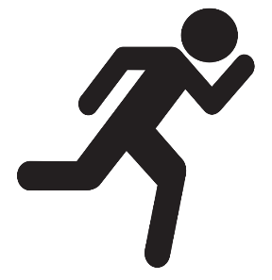

Instructor Guide Snapshot
Icon Key
Activity:
Video:
Instructor Demo:
Knowledge Check:
Instructional Time: 4 Hrs.
Preparation before class:
  Review all materials – Review all slides, talking points, and handouts before class to understand the structure and flow of the lesson. Pay special attention to animations within the slides.
  Prep for demos and activities – Review the full list of “Additional Materials” located in the Instructor Facilitation Toolkit. Gather and prepare all necessary materials.
  Schedule a field trip – The “Equipment Identification & Analysis” activity works best with a field trip to the shop floor. If a field trip is not possible, add site specific photos to slides 52-54 to simulate a field trip.
Provided Course Materials:
  +Introduction to Electricity_M3.pptx
  +Instructor Facilitation Toolkit_M3.docx - For Instructor use only.
  +Participant Resource Guide_M3.docx - Print one copy for each learner. All handouts that leaners need for activities are embedded in the Participant Resource Guide.
    What Kind of Power_M3
    What Kind of Power_Answer Key_M3
    Equipment Identification & Analysis_M3
  Quiz_M3.docx - Print one copy for each learner.
Additional Materials:
Multimeter
Wall outlet
Phone or battery charger

Slide 2
Pacing Guide
Times have been rounded to the nearest .25 hours.
Total Time: 4 Hours
  (.25 Hrs.) Welcome and Warm Up
  (.75 Hrs.) 3.1 – AC and DC Electricity
  (1 Hrs.) 3.2 – Frequency and Phase
  (1.5 Hrs.) 3.3 – Power Conversion
  (.5 Hrs.) – Quiz and Wrap Up

Slide 3
AC and DC Electricity
Transit Core Competencies Curriculum
Electrical Foundations
Notes:
Instructional Activity: Direction
Instructional Time: 1 min.
Do: Welcome learners to class.

Slide 4
Objectives
Explain the difference between AC and DC electricity.
Identify common uses of AC and DC in transit systems.
Explain the basic advantages and disadvantages of AC and DC.
Describe frequency and phase and why they matter for equipment.
Explain how power is converted between AC and DC.
Notes:
Instructional Activity: Direction
Instructional Time: 2 min.
Do: Review the module objectives.

Slide 5
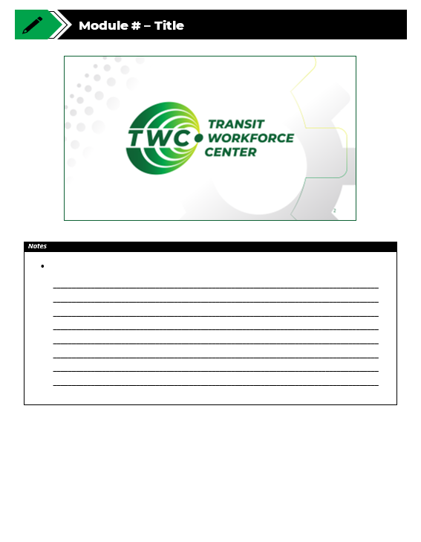
Agenda
Welcome and Warm Up
3.1 – AC and DC Electricity
3.2 – Frequency and Phase
3.3 – Power Conversion
Quiz and Wrap Up
Notes:
Instructional Activity: Direction
Instructional Time: 2 min.
Materials: Participant Guide Resource
Do:
Review the module agenda.
Remind learners that they have a Participant Guide Resource which they can use for optional notetaking.

Slide 6
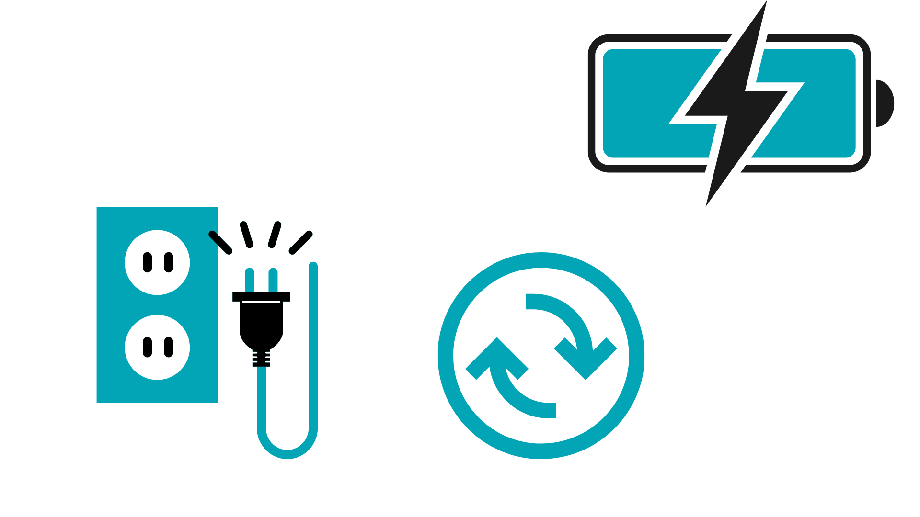
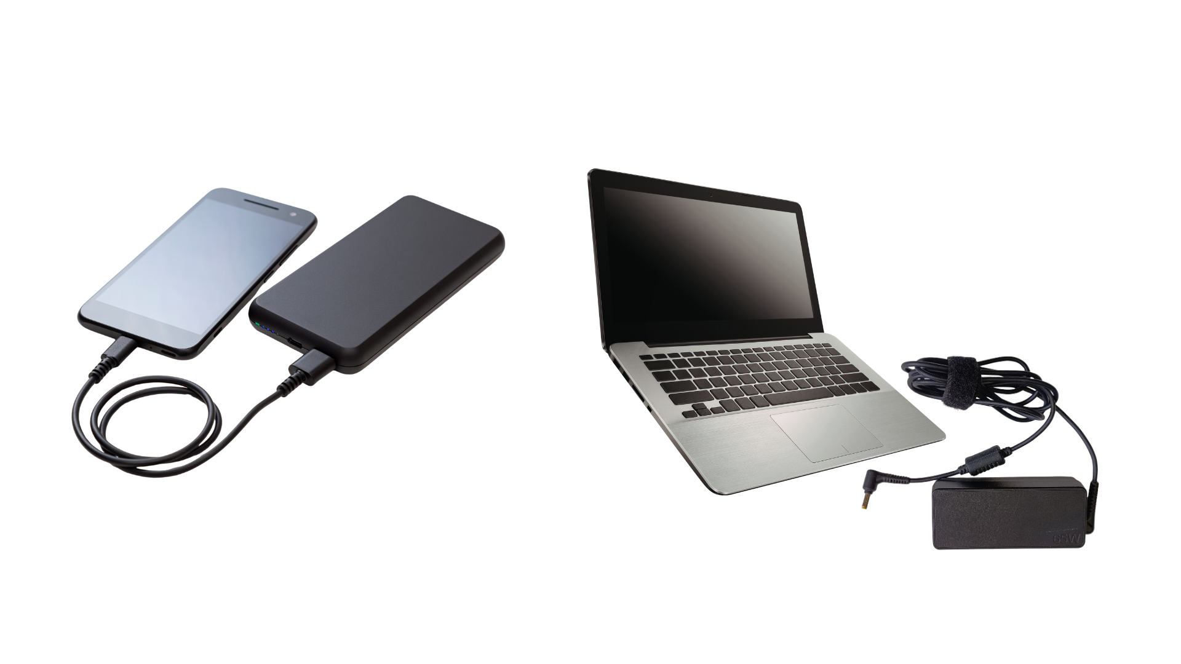
Warm Up
Have you ever noticed your charger getting warm as it charges your device?
…or wondered why your laptop needs a “power brick” to charge?
Outlet (AC)
Charger
Device (DC)
Notes:
*This slide contains animations. CLICK to reveal content.
Instructional Activity: Recall, Gain Attention
Instructional Time: 5 min.
Talking Points:
ASK:
Have you ever plugged in your phone to charge and noticed the charger gets warm?
Have you noticed the large power brick on a laptop charger?
Why do you think this happens?
Call on learners to share their responses.
When you plug a charger into a wall outlet, the electricity coming from the outlet is alternating current, or AC power.
However, most electronic devices such as phones and laptops operate using direct current, or DC power.
ASK:
Is anyone familiar with the terms AC and DC power?
Call on learners to share their background knowledge.
CLICK - Because the outlet provides AC and the device needs DC to charge, the charger must convert the incoming AC electricity into DC electricity that the device can safely use.
Inside the charger are electronic components that perform this conversion.
During this process, the system is not perfectly efficient. Some of the electrical energy is lost as it passes through the internal components.
That lost energy is released as heat, which is why the charger may feel warm when it is operating.
This is normal and happens because electrical systems rarely operate at one hundred percent efficiency.
Today we’ll learn more about AC power, DC power, and power conversion and how they impact electrical work on the job.

Slide 7
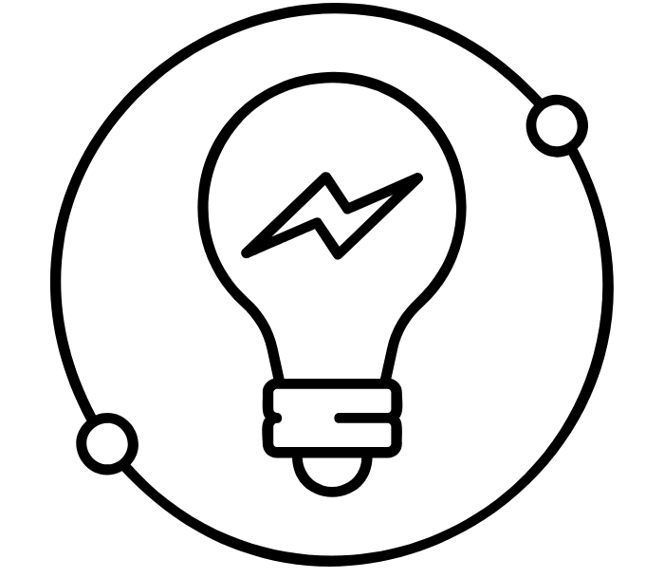
Welcome to AC and DC Electricity
Why it Matters:
Transit vehicles and facilities rely on both AC and DC electricity to power critical systems.
Understanding AC & DC power helps you diagnose:
Battery and charging problems
HVAC and power failures
Inverter/rectifier issues
Shop and field equipment power problems
Bus/train propulsion power issues
Notes:
Instructional Activity: Direction
Instructional Time: 2 min.
Talking Points:
Before we talk about what AC and DC electricity are, it helps to understand why this matters in your day-to-day work.
Many electrical problems technicians encounter involve systems that rely on either AC power, DC power, or both working together.
For example, troubleshooting might involve:
battery charging problems
HVAC power failures
inverter or rectifier issues
shop equipment that won’t power on
or propulsion power issues on vehicles.
Understanding the difference between AC and DC electricity helps you better understand how these systems are designed and where problems may occur.
In this module, we’ll build the foundational knowledge needed to recognize how AC and DC behave and where each type is used.
Icon Attribution: Created by karyative from The Noun Project

Slide 8
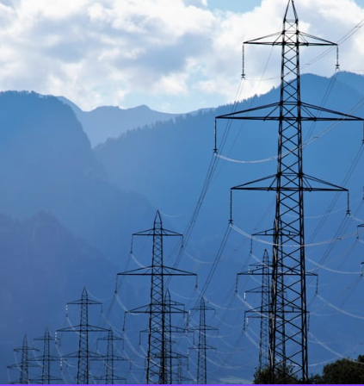
3.1 – AC and DC Electricity
Every electrical system you work on runs on either Alternative Current or Direct Current. We’ll start by understanding what those terms mean.
Notes:
Instructional Activity: Direction
Instructional Time: 1 min.
Do: Introduce the section.
Talking Points:
Every electrical system you work on runs on either Alternative Current or Direct Current. We’ll start by understanding what those terms mean.

Slide 9
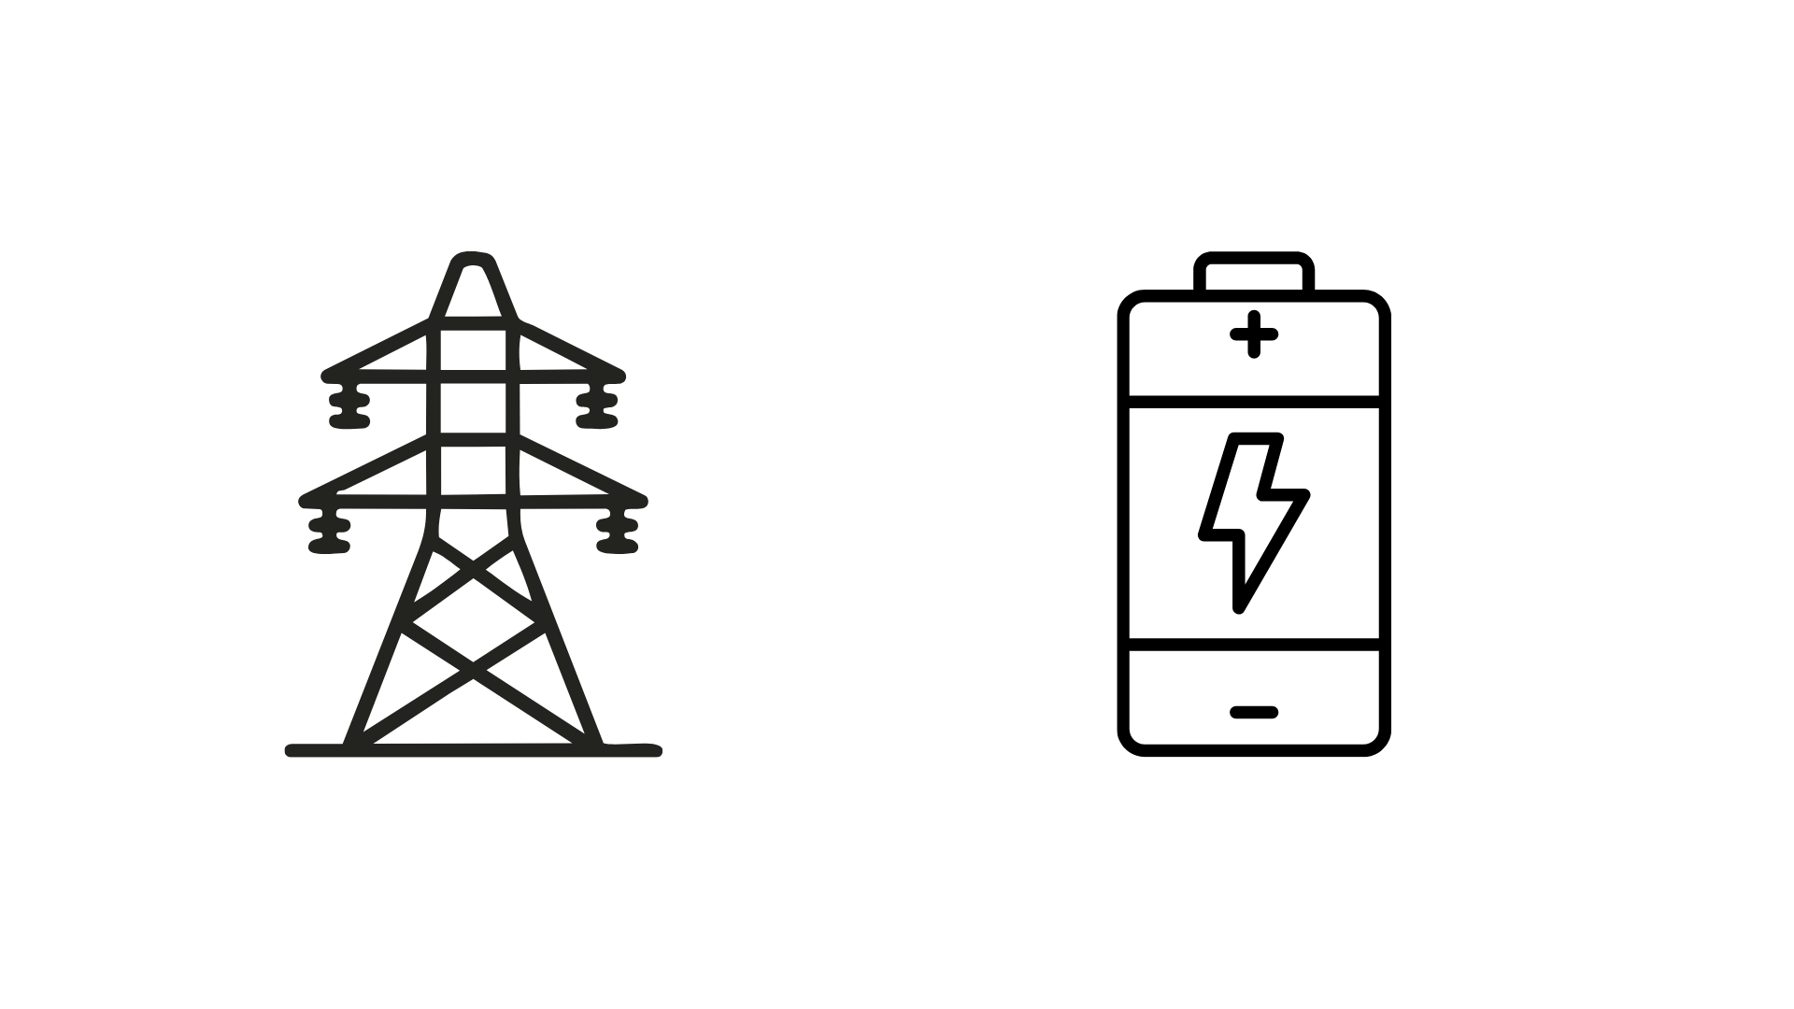
AC vs DC Electricity
AC is typically used to deliver electrical power
over long distances.
DC is typically used to power or store energy in equipment.
Building wall outlet
Most shop welders
Elevator motor
Power supplies
Bus battery
Most electric devices
Power supplies
Notes:
Instructional Activity: Present Content
Instructional Time: 2 min.
Talking Points:
For our purposes, electricity is categorized as AC or DC electricity.
AC power is typically how electricity is delivered over long distances. Power plants generate electricity and it is transmitted through the grid to buildings and facilities as AC power.
DC power is typically what equipment actually uses or stores, especially batteries and many electronic systems.
Many electrical systems use both AC and DC power together. For example, power may enter a building as AC and then be converted to DC to operate electronics or charge batteries.
That is why understanding the difference between AC and DC electricity is important for troubleshooting and maintenance.
As maintainers, one of the first things you often need to identify is whether a system is using AC power, DC power, or both.
This chart shows some common examples you may encounter in transit systems and facilities.

Slide 10
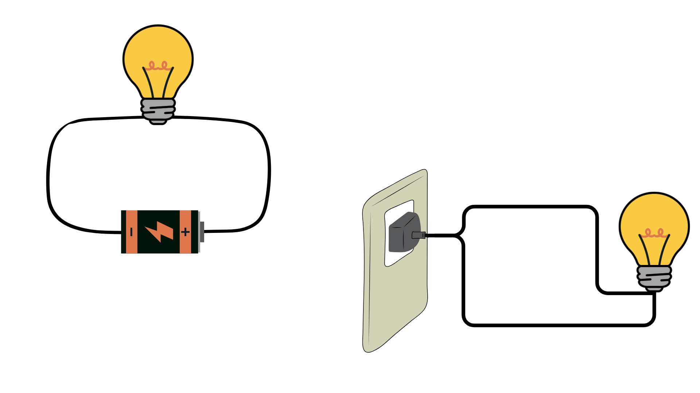
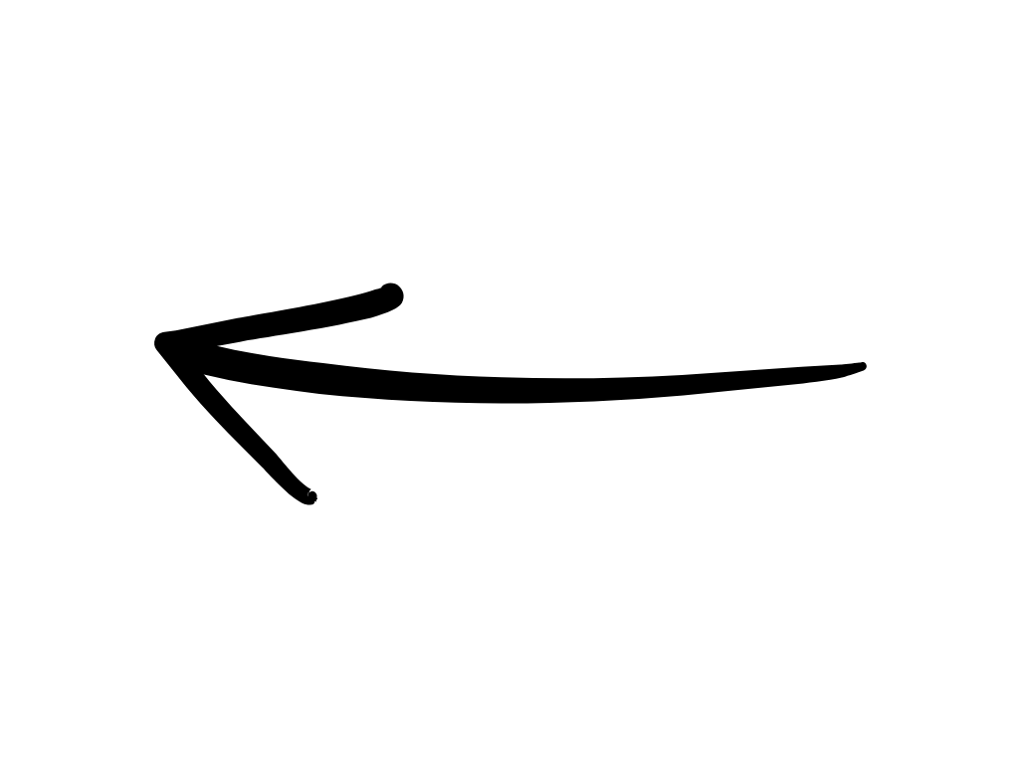
DC Electricity
DC power flows in one direction and comes from a power supply
Primary current for vehicle systems (typically 12-24 volts)
Powers onboard systems (lights, wipers, controls)
Provide stable, smooth power for electronics
e
e
e
e
e
e
Notes:
Instructional Event: Present Content
Time: 3 min.
Talking points:
When the electricity is said to be Direct Current (DC), the electrons flow in one direction, like a river. They move from the positive to the negative terminal.
Think of DC as the “steady” type of power. Batteries, lights, horns, fareboxes, GPS, radios are all DC.
Primary current for vehicle systems (typically 12-24 volts).
If DC isn’t stable, you’ll see flickering screens, slow cranking, or modules resetting.
Most electrical complaints on vehicles start as DC problems.
ASK: Name one thing on a bus or rail car that runs on DC power.
Call on learners to respond. Answer: lights, batteries, radios, cameras, door controllers, etc.
Most of what you’ll touch day-to-day on a vehicle is DC, usually 12 or 24 volts.

Slide 11
AC Electricity
Power changes direction back and forth
Used for buildings and power tools (typically 110-220 volts)
Powers larger equipment (HVAC, pumps compressors, propulsion)
AC has more dangerous shock potential
e
e
e
e
Notes:
Instructional Event: Present Content
Time: 3 min.
Talking points:
Alternating Current (AC) is when electrical power that flows back and forth in cycles. The current alternates direction, changing from positive to negative and back again.
AC is what comes out of shop wall outlets. It’s strong and travels well.
Transit vehicles turn AC into DC or DC into AC depending on the system.
Propulsion motors, HVAC compressors, and power steering pumps often use AC.
ASK: What AC-powered systems do you see on electric buses or trains?
Call on learners to respond. Answer: Electric heating elements, Wheelchair lift motors (some models), Shop/maintenance outlets on the bus, etc.

Slide 12

DC Electricity in Transit
Lighting systems
Batteries
Communication (radio, etc.)
Location Systems (GPS, etc.)
Traction Power
Power supplies
Switch machines & Signaling equipment
Notes:
Instructional Event: Present Content
Time: 2 min.
Talking points:
DC power is very common in transit systems because it provides steady and stable electrical energy.
Many systems that rely on electronics or stored energy operate on DC power.
For example, batteries store energy as DC electricity. That stored energy is used to start vehicles, power onboard systems, and support electrical equipment.
Lighting systems and many electronic components also rely on DC power because it provides consistent voltage.
Communication and location systems, such as radios and GPS units, also use DC power because electronic devices require stable power to operate correctly.
In rail systems, DC is also used for traction power in many systems to drive trains.
You will also see DC used in switch machines and signaling equipment because these systems require reliable, consistent electrical control.
Understanding where DC power is used helps technicians quickly identify the type of electrical system they are working with during maintenance and troubleshooting.

Slide 13
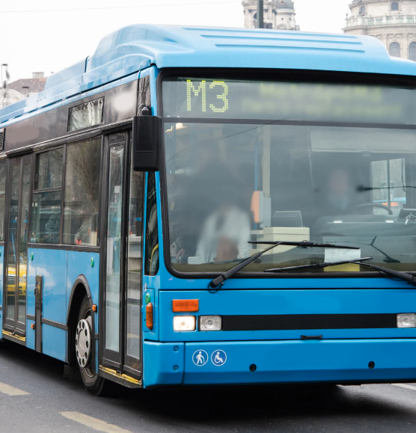
AC Electricity in Transit
HVAC systems (vehicles & buildings)
Shop tools & chargers
High-power vehicle systems (propulsion motors)
Large auxiliary systems (steering, pumps)
Notes:
Instructional Event: Present Content
Time: 2 min.
Talking points:
AC power is commonly used in transit systems when higher power levels or electric motors are required.
One common example is HVAC systems in both vehicles and buildings. Heating, ventilation, and air conditioning equipment often use AC motors to drive compressors and fans.
AC power is also commonly used for shop tools and chargers. Most maintenance equipment in facilities is designed to operate on standard AC power from building electrical systems.
High-power vehicle systems may also use AC motors, especially propulsion motors in many modern transit vehicles.
Even when the main power source is DC, an inverter may convert that power into AC so that motors can operate efficiently.
Large auxiliary systems such as steering systems or pumps may also rely on AC motors because they provide strong and reliable mechanical power.
Understanding where AC power is used helps technicians recognize how power flows through transit equipment and why certain systems require AC instead of DC.

Slide 14
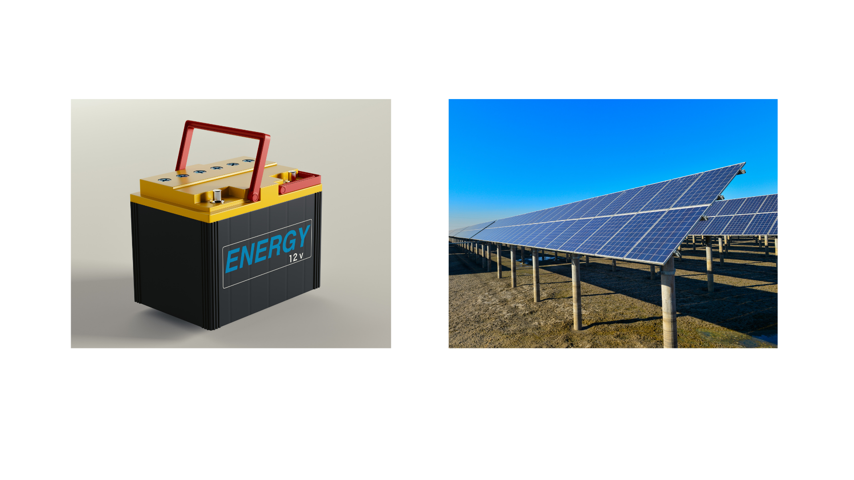
DC Power: Pros and Cons
Advantages
Easy to store (batteries)
Great for electronics
Safe, steady power
Disadvantages
Hard to send long distances
Requires inversion for AC equipment
Notes:
Instructional Event: Present Content
Time: 2 min.
Talking points:
There are both advantages and disadvantages to working with DC and AC power.
Let’s start with DC.
Advantages
DC power is easier to store and ideal when a steady, one-way flow of electricity is needed—like in batteries or electronic circuits.
It’s also easier to control the speed of DC motors, which makes them useful in transit and industrial systems.
While DC doesn’t travel far on its own, High-Voltage DC (HVDC) can extend its range and even support things like large-scale air conditioning systems.
Disadvantages
The downsides include more complex and costly voltage conversion to AC, and the need for more infrastructure, like additional transmission lines, to distribute DC effectively. Cannot use a simple transformer to change voltage levels.
DC is reliable but doesn’t travel well. If DC voltage drops even slightly, electronics can become faulty.

Slide 15
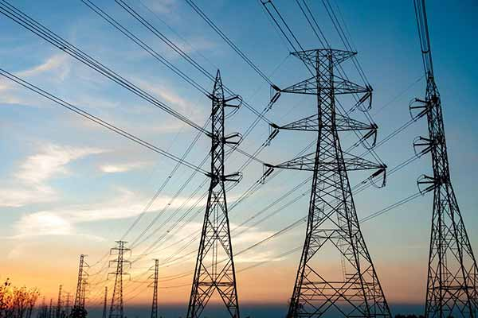
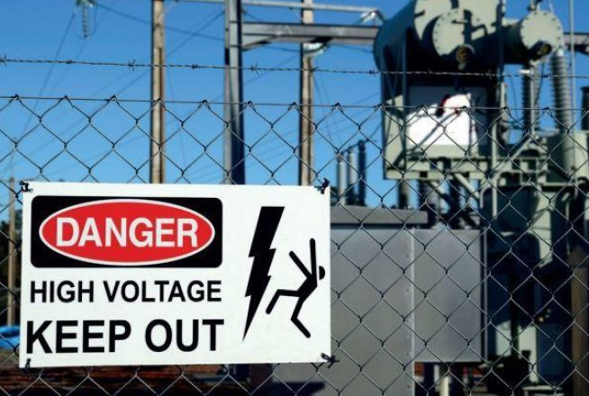
AC Power: Pros and Cons
Advantages
Travels long distances
Easy to change voltages
Great for high-power systems
Disadvantages
Higher shock risk
Requires conversion for storage
Notes:
Instructional Event: Present Content
Time: 2 min.
Talking points:
Advantages
AC is more efficient for power distribution because it can travel long distances with less energy loss, which is why it's used in the power grid.
It’s also easier to manage and convert than DC, especially when changing voltage levels.
Disadvantages
The downside is that AC can be more dangerous, especially at high voltages, which increases the risk of serious electrical shock.

Slide 16
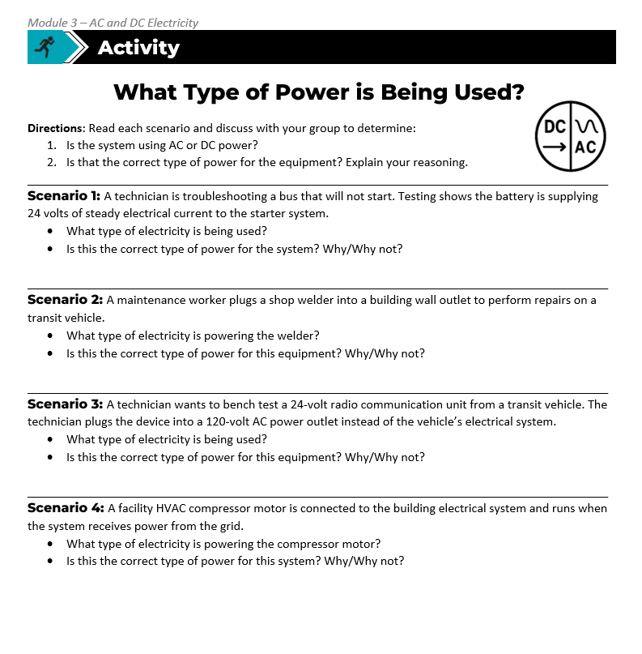
Activity: What Kind of Power is Being Used?
Directions: Read each scenario and discuss with your group to determine:
Is the system using AC or DC power?
Is that the correct type of power for the equipment? Explain your reasoning.
Scenario 1: A technician is troubleshooting a bus that will not start. Testing shows the battery is supplying 24 volts of steady electrical current to the starter system.
DC
Yes, batteries provide DC power.
Notes:
*This slide contains animations. CLICK to reveal content.
Instructional Activity: Provide Guided Learning, Elicit Performance, Provide Feedback
Instructional Time: 20 min.
Materials:
What Kind of Power_M3
What Kind of Power_Answer Key_M3
Do:
5 min.
Refer learners to the “What Kind of Power” handout embedded in the Participant Resource Guide. An answer key has also been provided for instructor use only.
Review the directions and answer any questions learners may have.
Do scenario 1 together as a group.
CLICK to reveal the scenario. Call on learners to share their ideas.
CLICK again to reveal the answer. Review and provide feedback.
10 min.
Give learners time to work.
Circulate the room answering questions and providing feedback as needed.
5 min.
Review answers together and ask volunteers to explain their reasoning.
Encourage learners to focus on why a certain type of electricity is appropriate.
Talking Points
These scenarios represent situations technicians may encounter when working on transit equipment or facilities.
When troubleshooting electrical systems, one of the first things technicians must identify is whether the system is operating on AC or DC power.
Using the correct type of electricity is important because different equipment is designed to operate with specific types of power.
In some cases, using the wrong type of electricity could prevent the system from working properly or even damage the equipment.
Discuss each scenario with your group and decide what type of electricity is being used and whether it is appropriate for that system.
Be ready to explain your reasoning.
Let’s do scenario one together as a group before we get into group work.

Slide 17
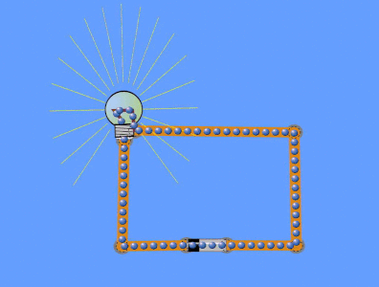
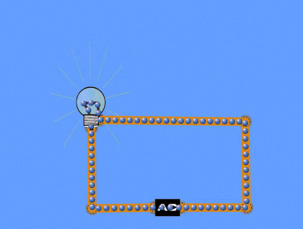
Knowledge Check
Determine which GIF shows AC and DC current. Explain your choice.
1
2
Notes:
*This slide contains animations. CLICK to reveal content.
Instructional Activity: Evaluate/Assess Performance, Provide Feedback
Instructional Time: 4 min.
Learning Objective: Explain the difference between AC and DC electricity.
Do: Review the knowledge check question. Call on learners to share their responses.
Answers:
DC, it flows in one direction.
AC, if you watch it for a moment, you can tell that it flows in two directions.
Source: Energy Education. (n.d.). AC vs DC. University of Calgary. https://energyeducation.ca/encyclopedia/AC_vs_DC

Slide 18
Knowledge Check
Why is AC commonly used for buildings and long-distance power transmission?
(A). It is easier to store.
(B). It travels well over distances.
(B). It travels well over distances.
(C). It is always safer.
(D). It never needs conversion.
Notes:
*This slide contains animations. CLICK to reveal content.
Instructional Activity: Evaluate/Assess Performance, Provide Feedback
Learning Objective: Explain basic advantages and disadvantages of AC and DC.
Instructional Time: 3 min.
Do: Review the knowledge check question. Call on learners to share their responses.
Answer:
B

Slide 19
Summary and What’s Next
DC flows in one direction and powers batteries and electronics.
AC changes direction and is used for power delivery and high-power systems.
Transit systems use both AC and DC depending on the application.
Equipment labels tell technicians what values to expect.
Knowing AC vs DC helps troubleshoot common electrical problems.
Next, we’ll look at frequency and phase and how AC behaves and why it matters for equipment performance.
Notes:
Instructional Activity: Enhance Transfer and Retention
Instructional Time: 3 min.
Talking Points:
In this module, we introduced the basic differences between AC and DC electricity.
DC electricity flows in one direction and is commonly used in batteries and many electronic systems.
AC electricity changes direction many times per second and is commonly used to deliver power over long distances and operate high-power equipment.
In transit systems, both AC and DC electricity are used depending on the type of equipment and the job the system needs to perform.
Technicians often rely on equipment labels and system information to identify the type of electricity and the electrical values they should expect to see.
Understanding whether a system uses AC or DC power is an important first step when troubleshooting electrical problems.
Next, we will look more closely at how AC electricity behaves by examining frequency and phase and why those characteristics matter for equipment performance.

Slide 20
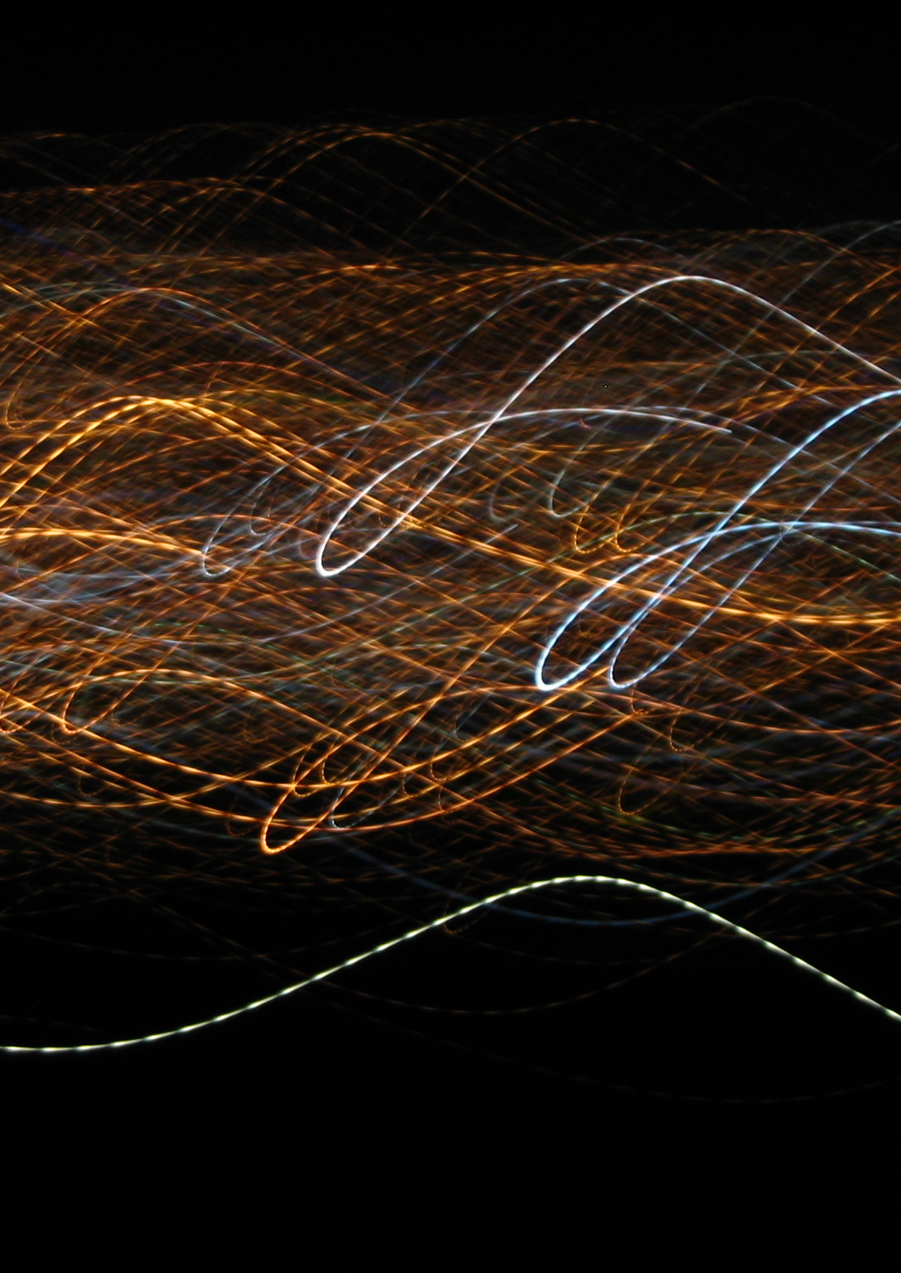
3.2 – Frequency and Phase
DC flows in one direction while AC moves in waveforms. Those waves have characteristics that are important to understand.
Notes:
Instructional Activity: Direction
Instructional Time: 1 min.
Do: Introduce the section.
Talking Points:
DC flows in one direction while AC moves in waveforms. Those waves have characteristics that are important to understand.
Image By RadRafe - Own work, Public Domain, https://commons.wikimedia.org/w/index.php?curid=210764

Slide 21
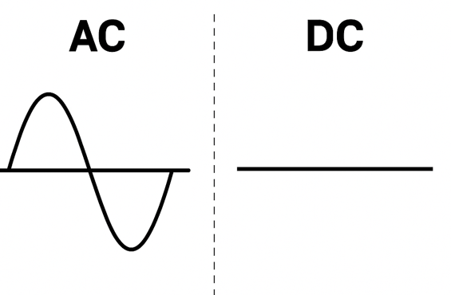
Frequency and Phase
Frequency and phase are characteristics of AC electricity
AC moves back and forth creating repeating waveforms
Wave cycle = frequency
Wave distribution = phase
DC electricity flows in one direction.
Produces a steady line
No frequency, no phase
Notes:
Instructional Activity: Present Content
Instructional Time: 2 min.
Talking Points:
Frequency and phase are characteristics that apply only to alternating current.
AC electricity moves back and forth, which creates a repeating wave pattern called a waveform.
Each time that wave completes one full cycle, it represents a unit of frequency. Frequency tells us how many times the current changes direction each second.
Phase describes how waves are positioned relative to one another. In many electrical systems, multiple AC waves may be present, and their timing relationship is called phase.
Direct current behaves differently. DC flows in only one direction and maintains a steady voltage level.
Because DC does not alternate back and forth, it does not form a waveform like AC.
Without a repeating wave pattern, DC does not have frequency or phase.
Understanding this difference helps technicians interpret electrical measurements and understand how AC systems behave in real equipment.

Slide 22

What is Frequency?
Frequency describes how many times alternating current (AC) completes a full cycle in one second.
Tells us how fast AC changes direction
Measured in Hertz (Hz)
  U.S. systems = 60 Hz
  European systems = 50 Hz
Notes:
Instructional Activity: Present Content
Instructional Time: 2 min.
Talking Points:
Now let’s look at a key concept related to alternating current called frequency.
Frequency describes how many times an AC waveform completes a full cycle in one second. A full cycle means the current flows in one direction, reverses, and then returns to its starting point.
Frequency also tells us how fast the current changes direction.
In the United States, the standard electrical frequency is 60 Hertz, or 60 cycles per second. That means the current completes 60 full wave cycles every second.
In many European countries, the standard is slightly different at 50 Hertz, meaning the current completes 50 cycles per second.
We often visualize frequency using a waveform, also called a sine wave. The more waves that occur in one second, the higher the frequency.
A simple way to think about this is to imagine waves hitting the shore at a beach.
If 60 waves reached the shore in one second, that would represent 60 Hertz.
This analogy helps show that frequency is simply measuring how often the wave repeats each second.
Frequency matters because many electrical devices are designed to operate at a specific frequency.
Motors, transformers, and other electrical equipment rely on that consistent frequency to operate properly.

Slide 23
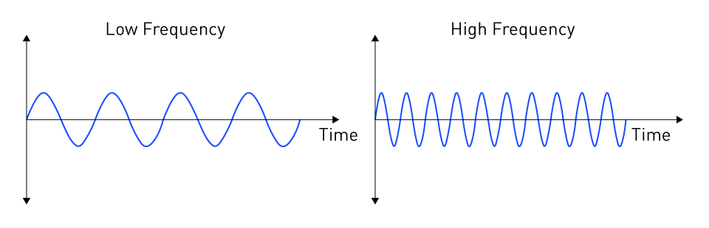
Frequency Wavelength Diagram
+
+
-
-
Notes:
Instructional Event: Present Content
Time: 3 min.
Talking points:
In AC, the power will oscillate (move back and forth) between positive and negative voltage.
On this diagram, the positive alteration of current appears above the midway line.
The negative alteration is shown below the midway line.
In the low frequency diagram…
There are four cycles are depicted during a 1 second interval of time. Therefore, the frequency is 4 Hertz.
Each positive alternation is marked with a sign that says period.
There are four complete periods during this 1 second interval.
In the high frequency diagram…
There are ten cycles are depicted during a 1 second interval of time. Therefore, the frequency is 10 Hertz.
There are ten complete periods during this 1 second interval.
Frequency is measured using a multimeter device, which we’ll learn about later in this course.
Source: Monolithic Power Systems. (n.d.). Basic concepts and importance of AC power. https://www.monolithicpower.com/en/learning/mpscholar/ac-power/introduction/basic-concepts-and-importance

Slide 24
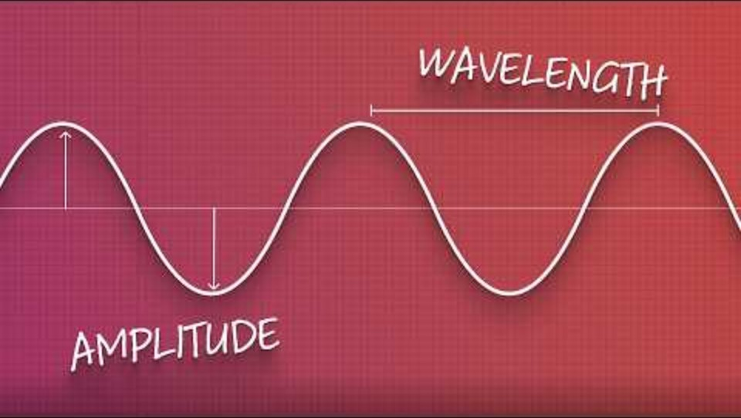
Frequency Video
Play video from 0:00 - 2:30
Notes:
Instructional Event: Present Content
Time: 3 min.
Video Link: https://youtu.be/oswC6HiqHjM
Do: Use the embedded video or link below to play the video. You can stop at 2:30 minutes (the rest of the video is not as relevant)
Source: Audio University. (2025). Audio basics: Amplitude, frequency & wavelength [Video]. YouTube. https://youtu.be/oswC6HiqHjM

Slide 25
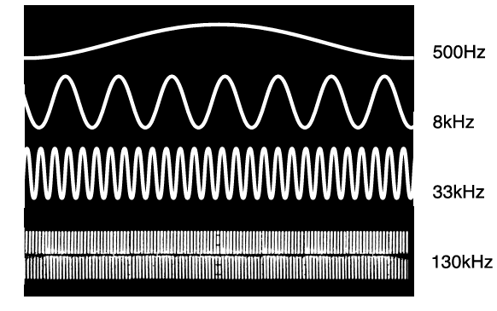
Why Frequency Matters
AC-powered equipment depends on a steady rhythm of alternating power.
If that rhythm changes:
Motors change speed
HVAC compressors struggle
Shop tools vibrate
Propulsion motors lose torque
Electronics can get damaged
Faulty equipment operation
Notes:
Instructional Activity: Present Content
Instructional Time: 2 min.
Talking Points:
Now that we understand what frequency is, let’s talk about why it matters.
AC-powered equipment depends on a steady rhythm of electrical cycles. That rhythm is the frequency.
When electrical systems operate at the correct frequency, equipment behaves the way it was designed to operate.
Many electrical devices rely on that consistent timing.
For example, electric motors depend on frequency to determine how fast they rotate. If the frequency changes, the motor speed can change as well.
HVAC compressors and other mechanical equipment may struggle to start, operate inefficiently, or shut down if the frequency is outside the expected range.
Shop tools may begin to vibrate or behave irregularly because the electrical input is not stable.
In transit systems, propulsion motors can also be affected. If the frequency is incorrect, the motor may lose torque or fail to perform as expected.
Sensitive electronics can also be damaged if electrical conditions are unstable.
The key idea is that equipment is designed to operate at a specific frequency.
When the frequency is correct, the equipment works properly.
When the frequency is incorrect, the equipment may behave unpredictably or fail.
Source: Radiodetection. (n.d.). Effects of AC frequency. https://support.radiodetection.com/hc/en-gb/articles/115005573206-Effects-of-AC-Frequency

Slide 26
Frequency HVAC Example
An HVAC compressor is built to run on 60 Hz power.
If frequency drops to 55 Hz or 50 Hz:
The motor runs slower
Pulls more current
Overheats
Trips or fails
This is why poor frequency causes HVAC units to stall or “hum” without starting.
Notes:
Instructional Activity: Present Content
Instructional Time: 2 min.
Talking Points
Let’s look at a real-world example of why frequency matters.
Many HVAC compressors are designed to operate on 60 Hertz power, which is the standard electrical frequency in the United States.
When the electrical system is operating at that correct frequency, the compressor motor runs at the proper speed and the system functions normally.
If the frequency drops below the expected level, such as to 55 Hertz or even 50 Hertz, the motor may not operate as designed.
The motor can begin to run more slowly because its speed is closely related to the electrical frequency.
As the motor struggles to maintain operation, it may start drawing more electrical current. This extra current can cause the motor to overheat.
If the problem continues, protective devices may trip, or the motor may fail.
Sometimes you may hear the motor “hum” but not start. That sound often indicates the motor is receiving power but cannot start properly due to electrical conditions or load issues.
This example shows why maintaining the correct electrical frequency is important for reliable equipment operation.

Slide 27
Knowledge Check
An HVAC motor is designed to run at 60 Hz.
If the frequency drops to 50 Hz, what might happen?
(A). The motor runs faster.
(B). The motor runs slower.
(B). The motor runs slower.
(C). Nothing changes
(D). The motor switches to DC.
Notes:
*This slide contains animations. CLICK to reveal content.
Instructional Activity: Evaluate/Assess Performance, Provide Feedback
Instructional Time: 3 min.
Learning Objective: Describe frequency and phase and why they matter for equipment.
Do: Review the knowledge check question. Call on learners to share their responses.
Answer:
B

Slide 28
Knowledge Check
Frequency applies to both AC and DC power.
True
False
False
Notes:
*This slide contains animations. CLICK to reveal content.
Instructional Activity: Evaluate/Assess Performance, Provide Feedback
Instructional Time: 3 min.
Learning Objective: Explain the difference between AC and DC electricity.
Do: Review the knowledge check questions Call on learners to share their responses.
Answer:
False

Slide 29
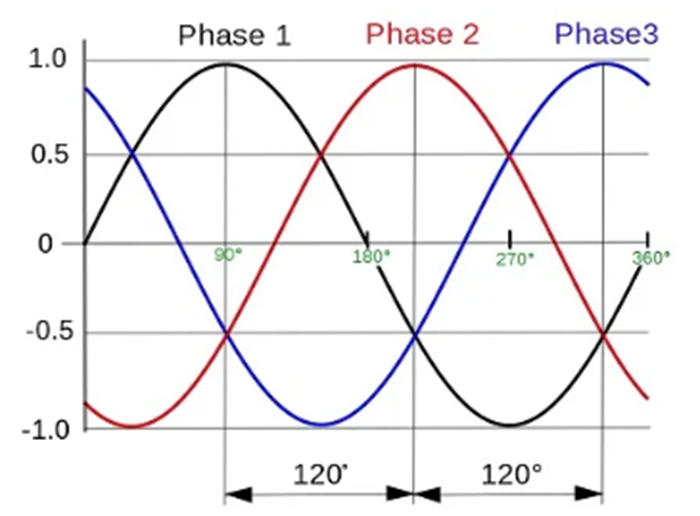
What is Phase?
Phase describes the timing and position of electrical waves as they rise and fall over time.
Single phase - small loads
Three phase - large loads
Notes:
Instructional Event: Present Content
Time: 3 min.
Talking points:
Now let’s introduce another important AC concept called phase.
When we talk about phase in electricity, we are referring to the timing and position of electrical waves as they rise and fall over time.
In AC systems, electricity moves in a repeating waveform. When multiple waves are present, phase describes how those waves are spaced or timed relative to one another.
Managing phase correctly helps keep electrical power balanced across circuits.
This becomes especially important in systems that use multiple phases, such as three-phase power systems commonly found in industrial and transit environments.
Single-phase power is typically used for smaller electrical loads, such as lighting or basic equipment.
Three-phase power is used for larger loads, especially electric motors and heavy-duty equipment, because it delivers power more smoothly and efficiently.
If phase becomes unbalanced or out of sync, several problems can occur. Circuits can become overloaded, equipment can operate inefficiently, and electrical components may be damaged.
A helpful way to think about phase is to imagine it as the rhythm of the electrical current—if it’s out of sync, everything else can fall apart.
Source: GlobalSpec. (n.d.). Single-phase vs. three-phase AC: What’s the difference? https://insights.globalspec.com/article/19377/single-phase-vs-three-phase-ac-what-s-the-difference

Slide 30
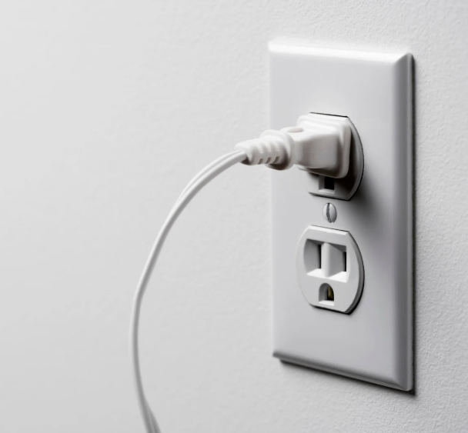
Single-Power Phase
Typically consists
  2 conductor wires
  1 ground wire
Commonly used in homes where less power is needed
  Ex: lightbulbs, TVs, radios, household appliances, etc.
Notes:
Instructional Event: Present Content
Time: 2 min.
Talking points:
Single-phase power is the most common type of electrical power used in homes and small buildings.
Because it is widely used in residential settings, it is sometimes referred to as “residential voltage.”
Single-phase systems typically include two current-carrying conductors along with a ground wire for safety.
This type of power is used where smaller amounts of electricity are needed.
Common examples include lighting, televisions, radios, phone chargers, and many household appliances.
You will also find single-phase power used in many shop outlets and light-duty equipment.
Even though the current is constantly alternating direction, the change happens extremely fast.
Single-phase power works well for everyday electrical loads, but larger equipment and motors often require a different system called three-phase power.
Source: 50Hz. (n.d.). 5 advantages of using single-phase power. https://50hz.com/5-advantages-of-using-single-phase-power/

Slide 31

Three-Phase Power
Typically consists of four wires:
  3 conductor wires
  1 ground wire
Power output remains steady, and it never drops to zero
Examples: motor to propel a rail car or electric bus, elevators, vehicle lifts, HVAC compressors
Notes:
Instructional Event: Present Content
Time: 2 min.
Talking points:
Three-Phase Power typically consists of four wires: 1 neutral wire and 3 conductor wires.
In this type of system, the power output remains steady, and it never drops to zero.
During one cycle, three-phase systems can transmit 3x as much power as a single-phase system.
It is worth mentioning that there is a second phase, but we will not be discussing it in this module.
With 3 phase power, it’s multiple phases that overlap one another. Always a positive and negative happening at the same time.
Examples of three phase power include heavy duty motors, such as motors that propel RC or drive an escalator/elevator.
Source: GlobalSpec. (n.d.). Single-phase vs. three-phase AC: What’s the difference? https://insights.globalspec.com/article/19377/single-phase-vs-three-phase-ac-what-s-the-difference

Slide 32
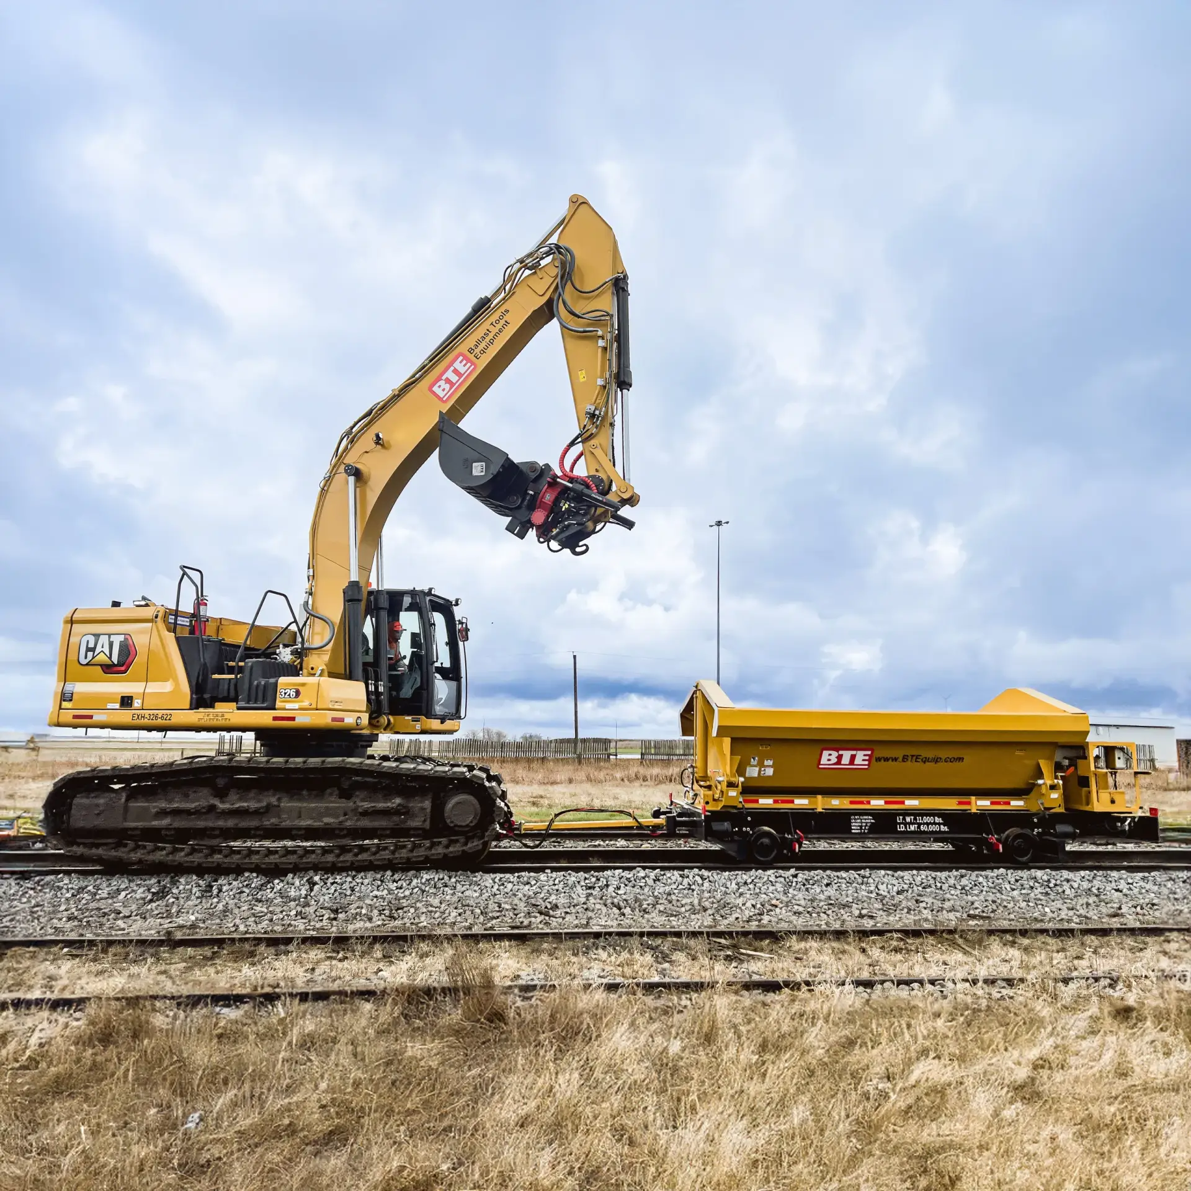
Why is Phase Important?
Phase affects how much power equipment can use
Multiple phases → more power available
Three-phase power used for: Large motors, HVAC compressors, heavy equipment, etc.
Phase imbalance can cause vibration, weak motor performance, overheating, and equipment failure
Notes:
Instructional Event: Present Content
Time: 2 min.
Talking Points
Phase is important because it affects how much electrical power equipment can safely and efficiently use.
When electrical systems use multiple phases, such as three-phase power, they can deliver more power to equipment.
More electrical power means the equipment can perform more work. This is why large motors and heavy-duty equipment often rely on three-phase power.
In industrial environments and transit systems, three-phase power is commonly used for equipment like large HVAC compressors, pumps, and high-horsepower motors.
Three-phase systems also provide smoother and more consistent power to motors, which helps them run more efficiently.
However, problems can occur if the phases become unbalanced or if one phase drops out.
When that happens, motors and other equipment may begin to vibrate, lose power, overheat, or eventually fail.

Slide 33

Phase Example: Elevator
An elevator needs three-phase power.
If one phase is missing:
The elevator may vibrate
Runs weak or slow
Might not lift at all
Motor can fail
Do you think an elevator runs on one phase or three phase power? Why?
Notes:
*This slide contains animations. CLICK to reveal content.
Instructional Event: Recall, Present Content
Time: 2 min.
Talking Points
ASK: Do you think an elevator runs on one phase or three phase power? Why?
Call on learners to share their responses.
CLICK - Elevators use large electric motors to lift and lower heavy loads. Because of the power required, these motors typically operate on three-phase electrical systems.
Three-phase power provides a steady and efficient flow of energy that allows large motors to run smoothly and produce enough torque to move the elevator.
If one of the phases is missing or drops out, the motor no longer receives balanced power.
When that happens, the elevator motor may begin to vibrate or run unevenly.
The motor may also run slower or weaker because it is not receiving the full amount of power it was designed to use.
In some cases, the elevator may not lift at all.
If the problem continues, the motor can overheat or fail due to the imbalance in electrical power.
This example shows why maintaining proper phase balance is important for large equipment that relies on three-phase power.

Slide 34
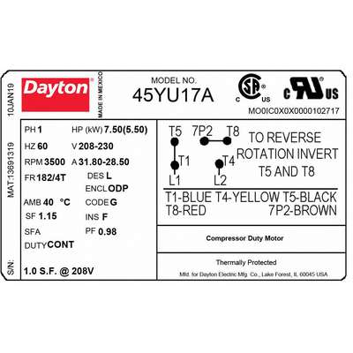
Equipment Nameplates
Voltage
Equipment nameplates tell technicians how equipment should safely operate.
Technicians should always read and verify how much electricity equipment should use.
Phase
Frequency
Notes:
Instructional Event: Present Content
Time: 2 min.
Talking Points
Talking Points
Equipment nameplates, sometimes called rating plates or labels, provide important information about how equipment is designed to operate.
These labels help technicians quickly identify what they are working on and what electrical values the equipment should normally use.
A nameplate typically lists important details such as voltage, current, frequency, and sometimes phase requirements.
When troubleshooting equipment, technicians often compare the expected values listed on the label with what they measure in the system.
Meters show what is actually happening in the circuit at that moment.
If the meter readings are close to the values listed on the equipment label, the system is likely operating normally.
If there is a large difference between the label values and the meter readings, it usually means something in the circuit has changed or a problem may be present.

Slide 35
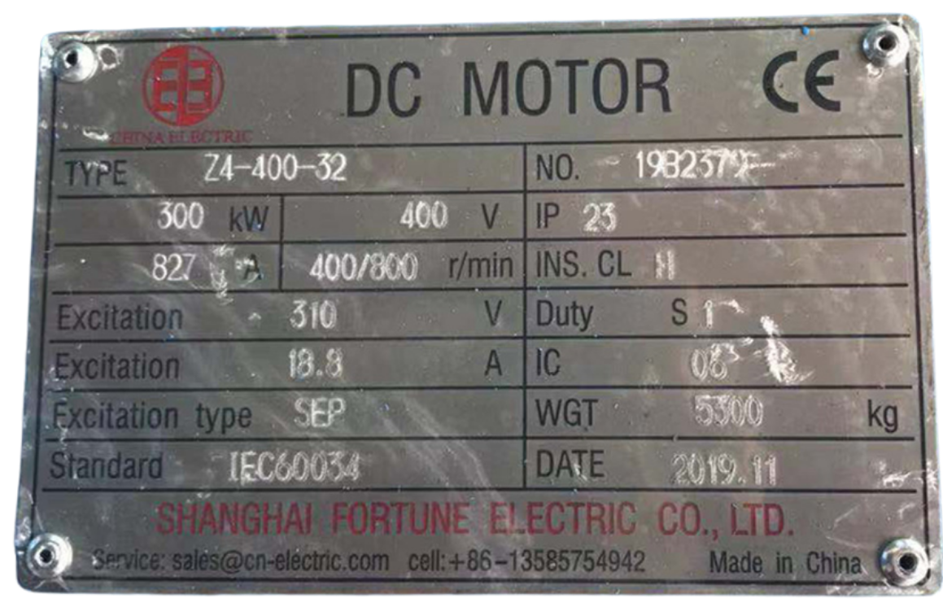
AC vs. DC Nameplates
Feature | AC Nameplate | DC Nameplate
Voltage | Listed as AC voltage | Listed as DC voltage
Frequency | Includes frequency (ex: 60 Hz or 50 Hz) | No frequency listed
Phase | May list or three-phase | Phase not listed
Current | May show amps at a specific voltage and phase | Shows current draw at DC voltage
Notes:
Instructional Event: Provide Learning Guidance
Time: 5 min.
Do: Use the chart to review the differences between DC and AC nameplates.

Slide 36
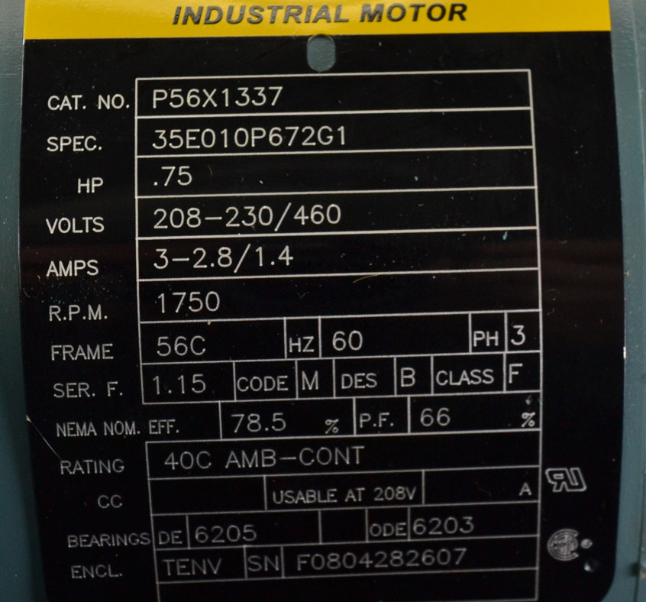
What to Look For on Equipment Nameplates
Voltage
  Required voltage?
  AC or DC?
Current
  How much current does it draw?
Phase & Frequency (AC only)
  Single-phase or three-phase?
Notes:
Instructional Event: Provide Learning Guidance
Time: 5 min.
Do:
Review the questions on the slide to practice finding voltage, current, phase, and frequency on nameplates as a group.
Call on learners to share their responses.
Answer questions and provide feedback as needed.

Slide 37
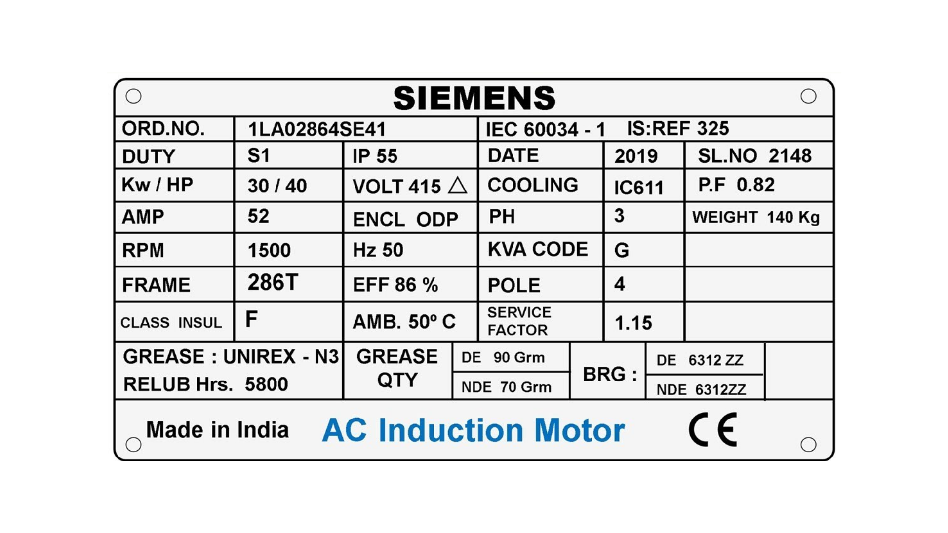
Activity: Reading Nameplates
Review the nameplate to determine the following:
Does this equipment run on AC or DC?
What is the voltage?
What is the current?
What is the frequency? (if applicable)
What is the phase? (if applicable)
Notes:
Instructional Activity: Provide Guided Learning, Elicit Performance, Provide Feedback
Instructional Time: 5 min.
Do:
Review the directions on the slide.
Ask learners:
Does this equipment run on AC or DC?
What is the voltage?
What is the current?
What is the frequency? (if applicable)
What is the phase?
Answer questions and provide feedback as needed.
Talking Points:
The next three slides contain images of different name plates.
Review the nameplate to answer the following questions.

Slide 38
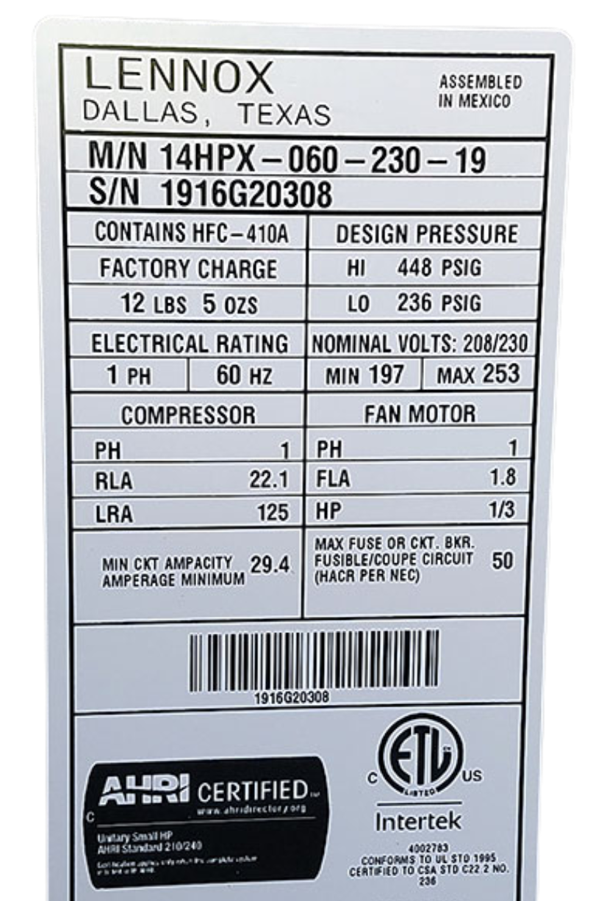
Activity: Reading Nameplates
Review the nameplate to determine the following:
Does this equipment run on AC or DC?
What is the voltage?
What is the current?
What is the frequency? (if applicable)
What is the phase? (if applicable)
Notes:
Instructional Activity: Provide Guided Learning, Elicit Performance, Provide Feedback
Instructional Time: 5 min.
Do:
Review the directions on the slide.
Ask the questions on the slide and call on learners to respond.
Answer questions and provide feedback as needed.

Slide 39
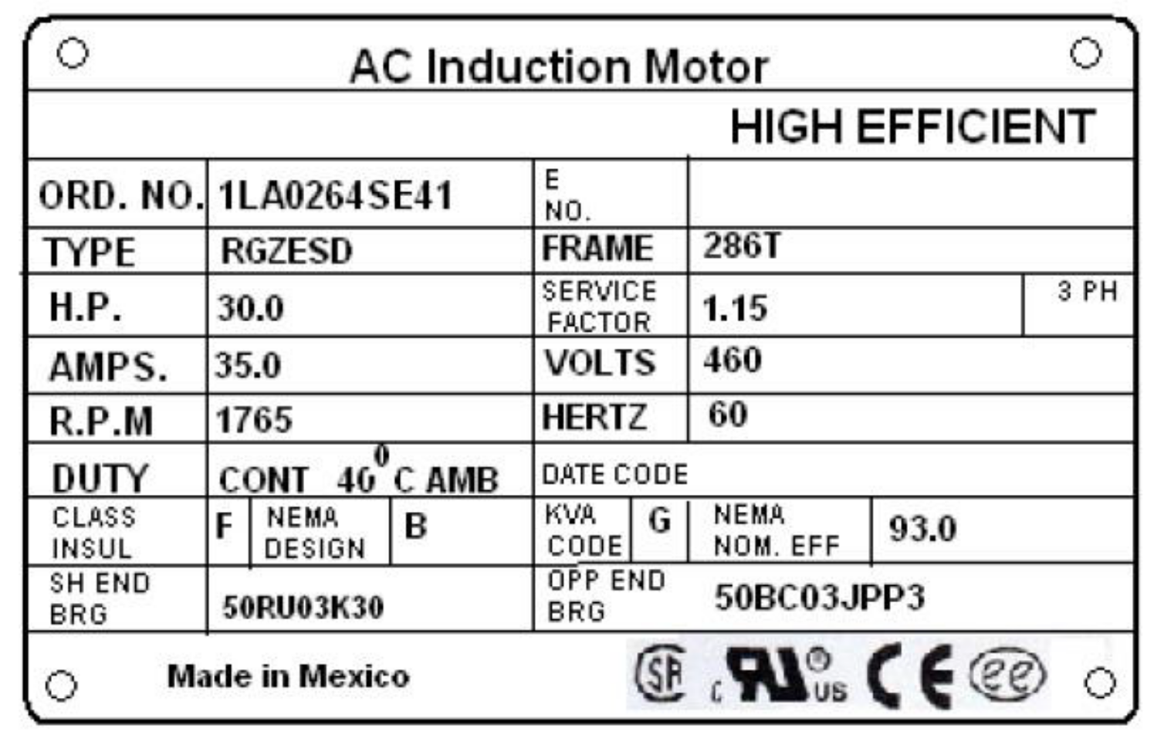
Activity: Reading Nameplates
Review the nameplate to determine the following:
Does this equipment run on AC or DC?
What is the voltage?
What is the current?
What is the frequency? (if applicable)
What is the phase? (if applicable)
Notes:
Instructional Activity: Provide Guided Learning, Elicit Performance, Provide Feedback
Instructional Time: 5 min.
Do:
Review the directions on the slide.
Ask the questions on the slide and call on learners to respond.
Answer questions and provide feedback as needed.

Slide 40
Knowledge Check
Which type of power is typically used for large motors?
(A). Zero Phase
(B). Single Phase
(C). Double Phase
(D). Three Phase
(D). Three Phase
Notes:
*This slide contains animations. CLICK to reveal content.
Instructional Activity: Evaluate/Assess Performance, Provide Feedback
Instructional Time: 3 min.
Learning Objective: Describe frequency and phase and why they matter for equipment.
Do: Review the knowledge check question. Call on learners to share their responses.
Answer:
D

Slide 41
Knowledge Check
If one phase drops out of a three-phase system, what might you observe?
(A). Equipment runs smoother
(B). The motor runs slower.
(B). Equipment shuts off permanently
(C). There would be faulty equipment operation
(C). There would be faulty equipment operation
(D). It switches to DC automatically
Notes:
*This slide contains animations. CLICK to reveal content.
Instructional Activity: Evaluate/Assess Performance, Provide Feedback
Instructional Time: 3 min.
Learning Objective: Describe frequency and phase and why they matter for equipment.
Do: Review the knowledge check question. Call on learners to share their responses.
Answer:
C

Slide 42
Summary and What’s Next
Frequency describes how fast AC changes direction.
Phase explains how AC power is distributed for different loads.
Single-phase supports lighter loads; three-phase supports heavy equipment.
Frequency or phase problems can cause weak or faulty operation.
Next, we’ll explore power conversion and how systems change AC and DC to run transit equipment.
Notes:
Instructional Activity: Enhance Transfer and Retention
Instructional Time: 3 min.
Talking Points:
Let’s quickly review the key ideas we covered.
Frequency describes how fast alternating current changes direction. In the United States, most electrical systems operate at a frequency of 60 Hertz.
Phase explains how AC power is distributed across electrical circuits, especially in systems that use multiple phases.
Single-phase power is typically used for lighter electrical loads, such as household equipment and smaller devices.
Three-phase power is used for larger equipment, especially motors and heavy-duty systems that require more power.
When frequency or phase conditions are incorrect, equipment may run weak, operate inefficiently, or fail.
Understanding these concepts helps technicians recognize electrical problems and understand how power systems support transit equipment.
Next, we will look at power conversion and explore how electrical systems change AC power to DC power and DC power to AC power to operate different types of equipment.

Slide 43
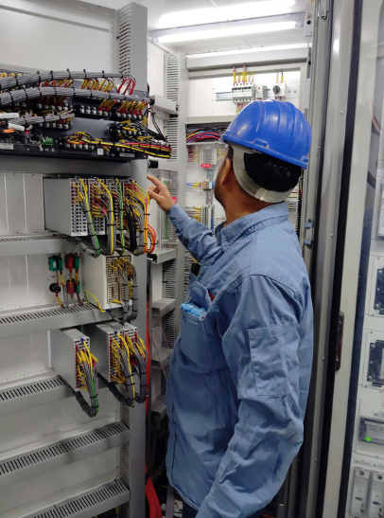
3.3 – Power Conversion
Most systems don’t run on just AC or just DC, they need both. That’s where power conversion comes in.
Notes:
Instructional Activity: Direction
Instructional Time: 1 min.
Do: Introduce the section.
Talking Points:
Most systems don’t run on just AC or just DC, they need both. That’s where power conversion comes in.

Slide 44
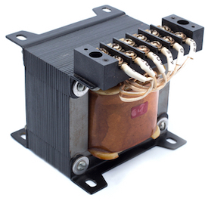
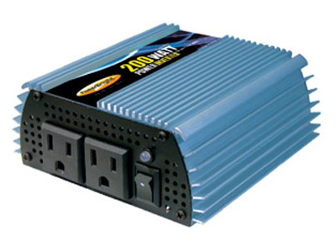
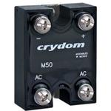
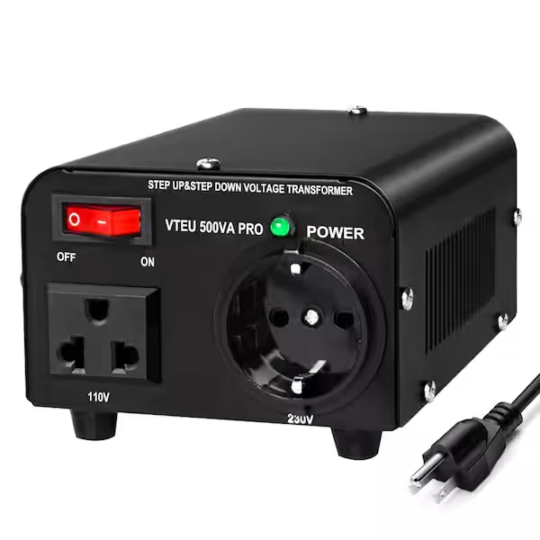
What is Power Conversion?
Power conversion = changing electricity to what the system needs
Common types of conversion:
  AC → DC (and vice versa)
  Voltage level changes (step-up/step-down)
Devices used in power conversion: Transformers, Inverters, Rectifiers, Converters
Notes:
Instructional Event: Present Content
Time: 3 min.
Talking points:
Electrical power conversion is all about adapting electricity to fit a specific purpose, whether that’s powering a small device, running a motor, or charging a battery.
We often convert AC to DC when charging things like phones or powering electric buses.
Sometimes we need to raise or lower voltage levels, and that’s where transformers come in.
Each of the devices listed, transformers, inverters, rectifiers, and converters, plays a unique role in making sure power is delivered in the right form, at the right level, and to the right place.
You’ll see conversion happening everywhere: chargers, substations, inverters, DC-DC converters, propulsion systems. If a converter fails, whole systems shut down.
If conversion fails, equipment operation and systems like HVAC, propulsion, or charging may stop working.

Slide 45
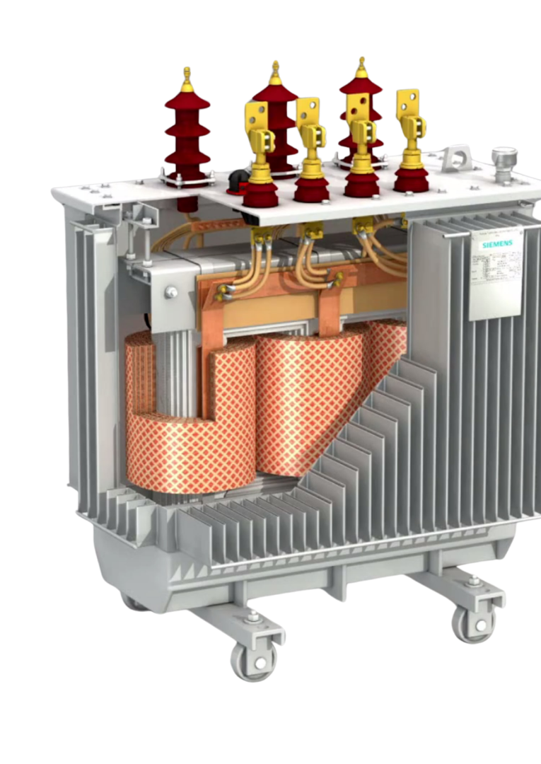
Transformers
Transformers let us adjust the voltage to match the system’s needs.
Transit substations transformers step AC down to levels needed for shop and signaling system equipment.
Notes:
Instructional Event: Present Content
Time: 2 min.
Talking points:
Transformers let us adjust the voltage to match the system’s needs.
You’ve probably seen them in your neighborhood—those gray cans on utility poles or large green boxes on the ground are transformers.
They step down the high-voltage electricity from power lines to a safer level for homes and businesses.
In transit systems, transformers are used at substations, where power from the utility company is delivered in bulk.
The substation steps it down to levels that are safe and usable for rail vehicles, station systems, and onboard equipment.
Transformers can be on poles and other locations and are not limited to substations.
Source: Seably. (n.d.). Electrical 3-phase power transformers fundamentals. https://www.seably.com/courses/electrical-3-phase-power-transformers-fundamentals

Slide 46
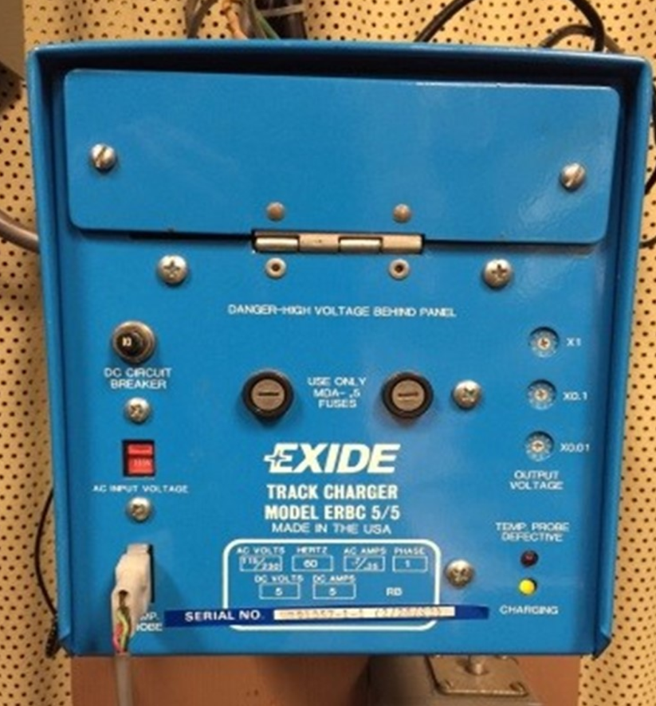
Rectifier
Rectifiers convert AC into DC
Common in these systems:
Battery charges
Onboard electronics
Rail power systems
Power supplies
Switch machine power circuits
Notes:
Instructional Event: Present Content
Time: 2 min.
Talking points:
A rectifier does the opposite of what an inverter does—it converts AC power into DC power.
This is important because many systems, especially those involving batteries or sensitive electronics, require DC power to function properly.
In transit applications, rectifiers are used in substations to take AC power from the grid and convert it to DC for use by trains, buses, or control systems.
You’ll also see rectifiers in battery chargers—like the ones used in electric vehicles—or inside power supplies that run electronics like radios or fare machines.
The goal is to deliver smooth, unidirectional current that can be stored in batteries or used directly by DC-based equipment.

Slide 47
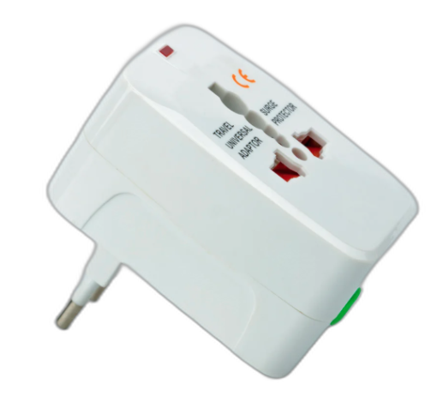
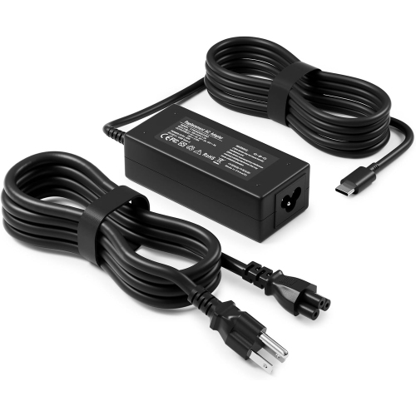
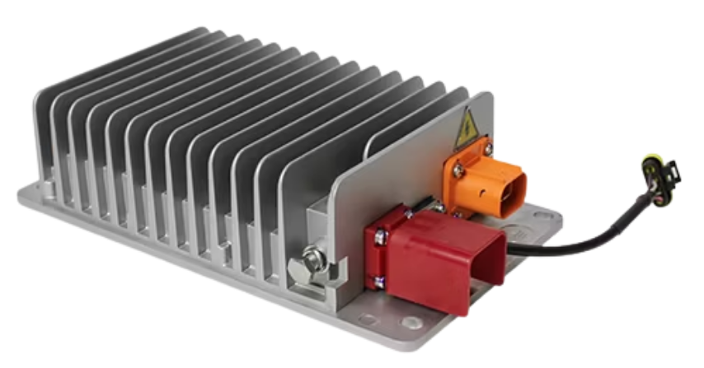
Converters
Converters can adjust voltage
Convert AC to DC
Convert DC to DC
Found in both industrial and everyday household applications
When a converter fails, electronics lose stable voltage
Notes:
Instructional Event: Present Content
Time: 2 min.
Talking points:
Converters are versatile tools in electrical systems. They allow us to adjust how electricity behaves so it can safely and efficiently power different types of equipment.
You’ll find converters in everything from electric buses and rail vehicles to solar power systems and charging stations.
Converters aren’t just found in big machines or transit systems—they’re all around us at home, too.
That little power brick on your laptop charger? It’s a converter. It takes in high-voltage AC from the wall and changes it into safe, low-voltage DC for your device.
So even though converters can seem like high-tech tools, they’re actually working behind the scenes in your home every day to make sure electricity is safe, stable, and usable.

Slide 48
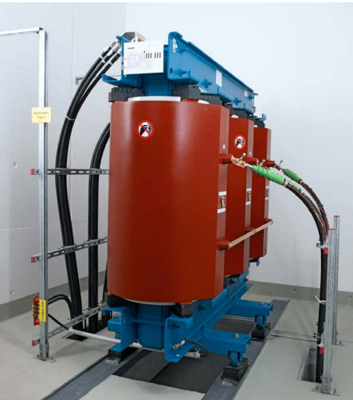
AC Rectifier Transformer
Converts utility AC power → DC power
Supports systems that require stable DC power
Works with other components:
  Transformer → adjusts voltage
  Rectifier → converts AC to DC
  Smoothing capacitor → stabilizes DC output
Provides DC power for: Traction systems, shop and field equipment, rail power distribution
Rectifier transformer by Siemens.
Notes:
Instructional Event: Present Content
Time: 3 min.
Talking points:
Many transit systems receive electricity from the utility grid as alternating current, or AC power. However, some rail systems and equipment require direct current, or DC power, to operate properly.
To make this possible, the electrical system must convert AC power into DC power.
This conversion often happens at a traction power substation using equipment that includes a transformer, a rectifier, and other supporting components.
Here’s how it works:
The transformer first adjusts the voltage level coming from the electrical grid, so it matches what the rail system requires.
Next, a rectifier converts the AC electricity into DC electricity.
After that, smoothing capacitors help stabilize the DC output by reducing electrical ripple and fluctuations in the current.
Together, these components provide stable and reliable DC power for systems that require it.

Slide 49
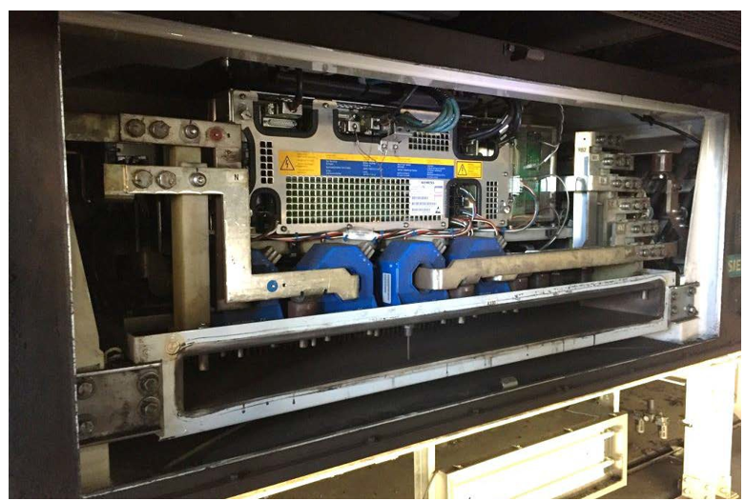
Inverters
Inverters convert DC to AC
Used for: HVAC, AC loads on hybrid/electric vehicles, rail car propulsion systems
Example: DC traction power is changed to AC by the inverter on the rail car
Inverter Installed on a Train Courtesy of MBTA.
Notes:
Instructional Event: Present Content
Time: 3 min.
Talking points:
As we have learned, DC and AC are different types of power. Technology exists to change power from one form to another for our needs.
Inverters are devices used to convert DC input voltage to AC voltage for output.
In electric transit vehicles, the battery stores power as DC, but the traction motor, air compressor, and HVAC system often need AC.
The inverter acts like a bridge, converting the battery's power into something those systems can use.
This photograph, courtesy of MBTA, depicts a propulsion inverter installed on a train. It is used to convert incoming DC high voltage power to AC power which is used to drive the traction motors.

Slide 50
Example: Battery Electric Bus
Main Power Source
(DC Batteries)
DC/DC Converter
(adjusts to different DC voltages)
Inverter
(converts DC to AC)
High Voltage Junction Box
(distributes high voltage)
Notes:
Instructional Event: Present Content
Time: 2 min.
Do: Review the block diagram.
Talking points:
This diagram illustrates a bus power system in which energy undergoes conversion.
The charger/discharger power converter assists in regulating the DC bus voltage and interfaces with the battery.

Slide 51
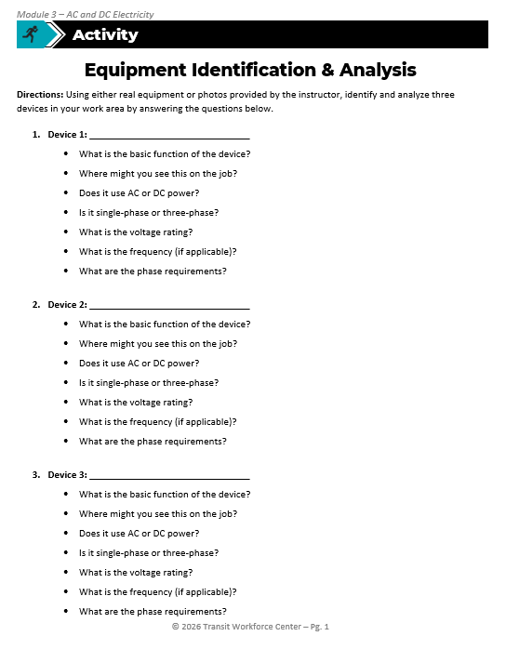
Activity: Equipment Identification
Directions: Using either real equipment or photos provided by the instructor, identify and analyze three devices in your work area by answering the questions below.
Review and Discussion:
Share your answers for one of your devices.
Where does the power come from?
Is the power transformed or converted before reaching the equipment?
What might happen if the power source is lost?
Notes:
*Note to Instructors – The goal here is to have learners accurately identify and analyze equipment on their own or in small groups/pairs.
*This slide contains animations. CLICK to reveal content.
Instructional Activity: Provide Guided Learning, Elicit Performance, Provide Feedback
Instructional Time: 50 min.
Materials: Equipment Identification & Analysis_M3 handout
Do:
(5 min.) Refer learners to the “Equipment Identification & Analysis” handout embedded in the Participant Resource Guide.
(25 min.) Field Trip
Take a field trip to your work environment to visit different pieces of equipment (rectifier, transformer, inverter, capacitor, etc.). If you are not able to take a field trip, add photos of three devices and the nameplate on the device to slides 52-54.
Ask learners to work in pairs or small groups to answer the questions on their handout for each device.
Encourage learners to reference equipment nameplates or labels if available.
CLICK - (20 min.) Review and Discussion
Regroup back in the classroom or in a place suitable for discussion.
Call on learners to share their answers for one of the devices they analyzed.
For each piece of equipment, facilitate a discussion using the questions provided in Part 2 of the handout.
Talking Points
This activity helps connect the electrical concepts we’ve discussed to real equipment you may encounter on the job.
We are going to take a brief fieldtrip to the shop floor to analyze a few pieces of equipment.
Work with a partner or small group to answer the questions on your handout for three different devices.
Use the nameplate on the devices to help you answer the questions.
After you have had some time to work, we’ll regroup to review and discuss.

Slide 52

Device 1
Note to Instructors - Use this slide if you are unable to take a fieldtrip to the shop floor.
Image of device
Image of device nameplate
Notes:
Instructional Activity: Provide Guided Learning, Elicit Performance, Provide Feedback
Instructional Time: 5 min.
Do: If you are not able to take a field trip, add a photo of a piece of equipment and nameplates/labels for learners to analyze.

Slide 53
Device 2
Note to Instructors - Use this slide if you are unable to take a fieldtrip to the shop floor.
Image of device
Image of device nameplate
Notes:
Instructional Activity: Provide Guided Learning, Elicit Performance, Provide Feedback
Instructional Time: 5 min.
Do: If you are not able to take a field trip, add a photo of a piece of equipment and nameplates/labels for learners to analyze.

Slide 54
Device 3
Note to Instructors - Use this slide if you are unable to take a fieldtrip to the shop floor.
Image of device
Image of device nameplate
Notes:
Instructional Activity: Provide Guided Learning, Elicit Performance, Provide Feedback
Instructional Time: 5 min.
Do: If you are not able to take a field trip, add a photo of a piece of equipment and nameplates/labels for learners to analyze.

Slide 55
Knowledge Check
Scenario: A vehicle plugs into a wall outlet to charge.
The outlet is AC
The battery is DC
What must happen in between for the vehicle to charge?
The power must be converted.
Notes:
*This slide contains animations. CLICK to reveal content.
Instructional Activity: Evaluate/Assess Performance, Provide Feedback
Instructional Time: 3 min.
Learning Objective: Explain how power is converted between AC and DC.
Do: Review the knowledge check question. Call on learners to share their responses.
Answer:
The power must be converted.

Slide 56
Knowledge Check
Which device converts AC into DC?
(A). Inverter
(B). The motor runs slower.
(B). Transformer
(C). Rectifier
(C). Rectifier
(D). Alternator
(D). Three Phase
Notes:
*This slide contains animations. CLICK to reveal content.
Instructional Activity: Evaluate/Assess Performance, Provide Feedback
Instructional Time: 3 min.
Learning Objective: Explain how power is converted between AC and DC.
Do: Review the knowledge check question. Call on learners to share their responses.
Answer:
C

Slide 57
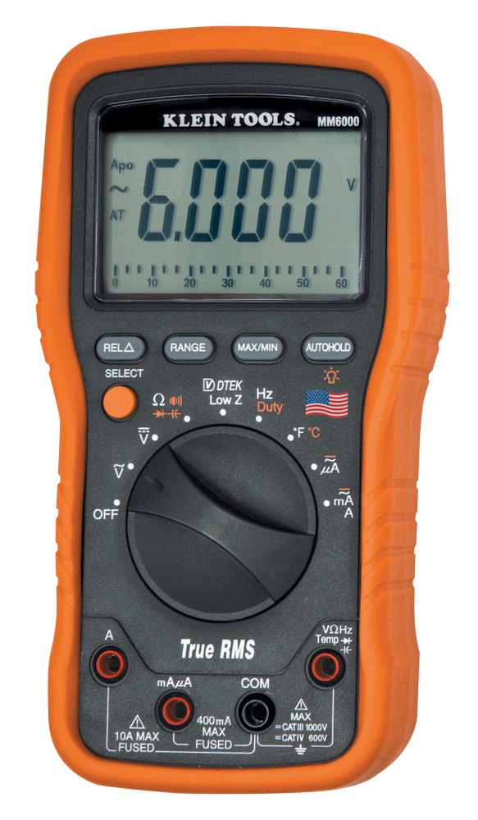
Instructor Demo: AC → DC Conversion
Measure voltage at two points:
Step 1 - Wall outlet
Step 2 - Charger output
Discuss:
Is the outlet AC or DC?
Is the charger output AC or DC?
What happened to the electricity between these two points?
Notes:
Instructional Activity: Provide Learning Guidance
Instructional Time: 10 min.
Materials:
Multimeter
Wall outlet
Phone or battery charger
Do
Briefly review the purpose of a multimeter, which you will use in this demonstration.
Demonstrate how to measure voltage using a multimeter.
Step 1 - Measure voltage at the wall outlet using the AC voltage setting.
Step 2 - Measure voltage at the charger output using the DC voltage setting.
Show learners the difference in the meter readings.
Remind learners to always confirm the correct meter mode before taking measurements.
Emphasize proper safety practices when working with energized equipment.
Talking Points:
This demonstration shows how AC electricity can be converted into DC electricity.
For this demonstration we will use a multimeter.
A multimeter is a handheld instrument used to measure key electrical properties in a circuit including voltage, current, and resistance.
We’ll learn about this tool in more detail in Module 6 – Electrical Tools.
First, we measure the voltage at the wall outlet. In most buildings, the electrical outlet provides alternating current, or AC power.
Next, we measure the voltage at the charger output.
You should see that the charger output is direct current, or DC power.
The charger contains electronic components that convert the incoming AC power into DC power.
This type of conversion is very common in electrical systems.
Many devices, including electronics, battery chargers, and vehicle systems, require DC power even though electricity is delivered from the grid as AC power.
Answer Key:
Wall outlet → AC power
Charger output → DC power
What happened in between → The charger converted AC power to DC power

Slide 58
Summary
Power conversion changes electricity to match system needs.
Transformers adjust AC voltage levels.
Rectifiers convert AC to DC.
Inverters convert DC to AC.
Conversion allows transit systems to power different equipment safely.
Notes:
Instructional Activity: Enhance Transfer and Retention
Instructional Time: 3 min.
Talking Points:
Let’s review the key ideas from this section.
Power conversion allows electrical systems to change electricity, so it matches the needs of different equipment.
In many cases, the electricity coming from the grid must be adjusted or converted before it can be used by a device.
Transformers are used to adjust AC voltage levels so that the power delivered matches what equipment requires.
Rectifiers convert alternating current into direct current.
Inverters do the opposite by converting direct current into alternating current.
These different types of conversion allow transit systems to safely power a wide range of equipment, including electronics, motors, batteries, and traction systems.
Understanding how electricity is converted helps technicians understand how power moves through electrical systems and where problems may occur.

Slide 59

Quiz
Time for a quiz! Let’s see what you have learned from today’s lesson.
Notes:
Instructional Activity: Direction, Evaluate/Assess Performance
Instructional Time: 20 min.
Materials: Quiz_M3
Do:
Ask learners if they have any lingering questions. Address them before distributing the quiz.
Pass out the quiz and review the directions.
Talking Points:
Time for a quiz! Let’s see what you have retained from today’s lesson.

Slide 60
Revisiting Objectives
Explain the difference between AC and DC electricity.
Identify common uses of AC and DC in transit systems.
Explain the basic advantages and disadvantages of AC and DC.
Describe frequency and phase and why they matter for equipment.
Explain how power is converted between AC and DC.
Notes:
Instructional Activity: Enhance Transfer and Retention
Instructional Time: 5 min.
Do: Facilitate a short discussion to review the key topics in the lesson.
Talking Points:
If you were explaining today’s objectives to someone else, how would you summarize what they mean and why they matter?
Which of today’s objectives do you feel most confident about? Which were most challenging? Explain your reasoning.
Can you give an example of how you could apply one of today’s objectives in a real-world situation?
After Discussion:
This conclude this section of the module. Thank you for your participation.

Slide 61
Thank you!
Notes:
Instructional Activity: Enhance Transfer and Retention
Instructional Time: 2 min.
Do:
Thank learners for their participation.
If possible, stay after class to answer any lingering questions learners may have.

