Slide 1
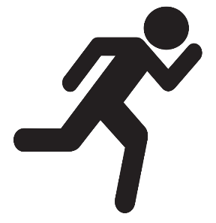

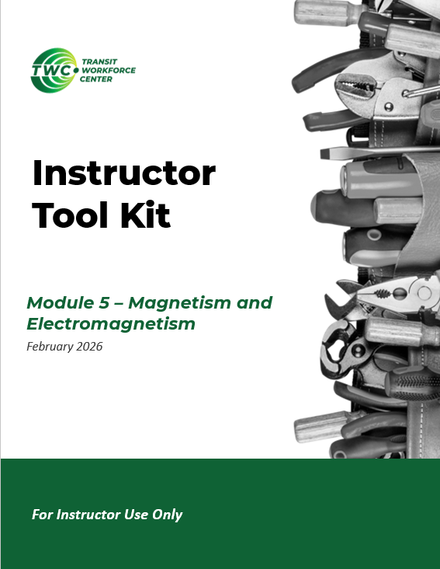
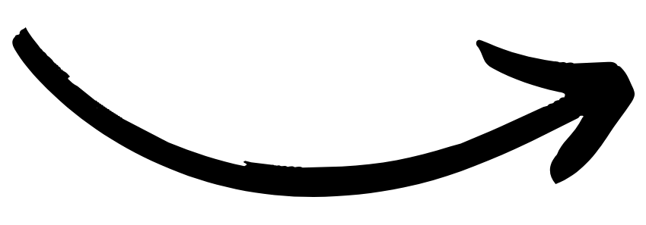
Instructor Guide Snapshot
Icon Key
Activity:
Video:
Instructor Demo:
Knowledge Check:
Instructional Time: 3.25 Hrs.
Preparation before class:
Review all materials - Review all slides, talking points, and handouts before class to understand the structure and flow of the lesson. Pay special attention to animations within the slides.
Review slide 10 - Decide whether this will be a whole-class demonstration or a small-group activity, based on the number of magnets available and time constraints.
Review slide 14 - View this video to prepare of the Visualizing Magnetic Fields activity.
Review Slide 27 – View this video from 1:28-3:47 to prepare for the Build a Simple Motor activity.
Provided Materials:
+Magnetism and Electromagnetism_M5.pptx
+Instructor Facilitation Toolkit_M5.docx - For Instructor use only.
+Participant Resource Guide_M5.docx - Print one copy for each learner. All handouts that leaners need for activities are embedded in the Participant Resource Guide.
  Visualizing Magnetic Fields_M5.docx
  Build an Electromagnet_M5.docx
  Build a Simple Motor_M5.docx
Quiz_M5.docx - Print one copy for each learner.
Additional Materials:
A list of additional materials needed for demonstrations and activities can be found in the Instructor Facilitation Toolkit on page 4.
Notes:
*This slide contains animations. CLICK to reveal content.
Instructional Activity:
Instructional Time:
Materials:
Do:
Talking Points:

Slide 2
Pacing Guide
Times have been rounded to the nearest .25 hours.
Total Time: 3.25 Hours
  (.25 Hrs.) – Welcome and Warm Up
  (1 Hr.) – 5.1 Magnetism
  (1.5 Hrs.) – 5.2 Electromagnetism
  (.5 Hrs.) – 5.3 How Magnetism Creates Electricity
  (.5 Hrs.) – Quiz and Wrap Up

Slide 3
Module 5- Magnetism and Electromagnetism
Transit Core Competencies Curriculum (TC3)
Electrical Foundations
Notes:
Instructional Activity: Direction
Instructional Time: 1 min.
Do: Welcome learners to class. Introduce the course and module.

Slide 4
Objectives
Explain basic magnetism, including magnetic fields, poles, and magnetic materials.
Explain how electromagnetism works and describe how electricity and magnetism are related.
Describe how an electromagnet works and what affects its strength.
Explain how electromagnetism is used in transit systems such as relays, motors, and generators.
Explain Faraday’s Law of induction and how changing magnetic fields are used to generate electricity in real-world systems.
Notes:
Instructional Activity: Direction
Instructional Time: 2 min.
Do: Review the module objectives.

Slide 5
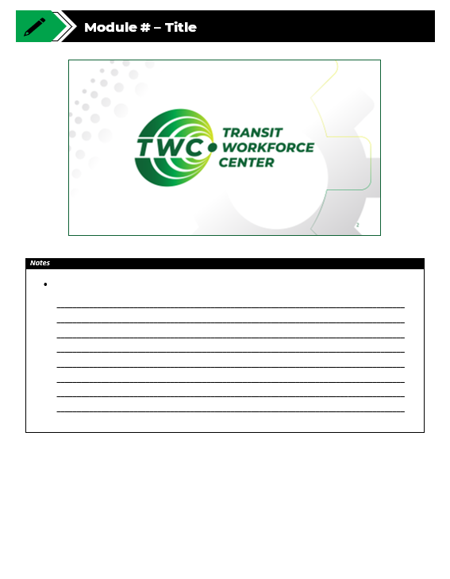
Agenda
Welcome and Warm Up
5.1 Magnetism
5.2 Electromagnetism
5.3 How Magnetism Creates Electricity
Quiz and Wrap Up
Notes:
Instructional Activity: Direction
Instructional Time: 2 min.
Materials: Participant Guide Resource
Do:
Review the module agenda.
Remind learners that they have a Participant Guide Resource which they can use for optional notetaking.

Slide 6

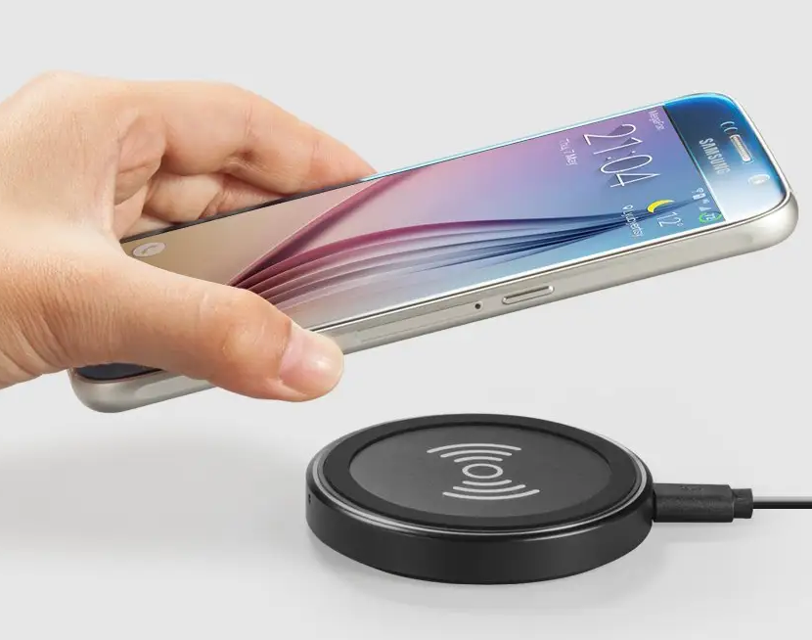


Warm Up
Have you ever used something that worked without touching it?
What do you think is happening?
What kind of force might be involved?
Notes:
Instructional Activity: Gain Attention, Recall
Instructional Time: 5 min.
Do:
Review the talking points below.
Call on learners to respond to the questions.
Facilitate a short discussion to connect real life experiences to magnetism.
Talking Points:
Before we get into today’s topic, I want you to think about something familiar.
Have you ever used something that worked without actually touching it?
Things like automatic doors, wireless chargers, or tapping a card to unlock a door – Nothing is physically pushing or pulling, but something is clearly causing an action
What do you think is happening behind the scenes?
What kind of force do you think might be involved here?

Slide 7

5.1 – Magnetism
We’ve seen magnets all around us. Let’s look at what makes something magnetic.
Notes:
Instructional Activity: Direction
Instructional Time: 2 min.
Do: Introduce the section.
Talking Points: We’ve seen magnets all around us. Let’s look at what makes something magnetic.
Image Source: Magnet Poles by Mischelle - stock.adobe.com

Slide 8
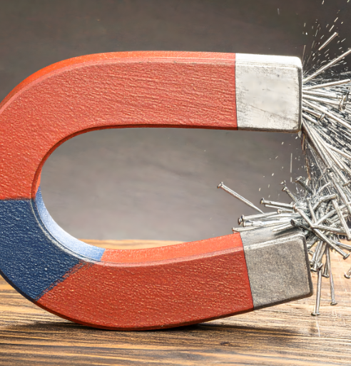
Magnetism
A force that makes some materials pull together or push apart
When electrons move, they create a magnetic field, that can pull or push on other materials
Ex: Motors turn, Relays activate, Sensors detect movement, etc.
Notes:
*This slide contains animations. CLICK to reveal content.
INSTRUCTIONAL ACTIVITY: Present Content, Recall
TIME: 2 min.
Talking points:
Magnetism is one of the fundamental forces of nature — like gravity — it’s what causes certain materials to attract or repel each other.
It all starts with the motion of electric charges.
ASK: Think back to our lessons on electricity. What part of an atom moves to create an electric charge?
Call on learners to respond. Answer: Electrons.
CLICK - That’s right, electrons.
When electrons move, they create an electric charge. They also create a magnetic field that can pull or push on other materials.
We see magnetism in natural magnets, like iron and lodestone, but it also shows up around electric currents, which means it plays a big role in electrical systems too.
Magnets and electricity are connected, when electric charges move, they create magnetic force. Which is why we see magnetism in motors, relays, and coils.

Slide 9
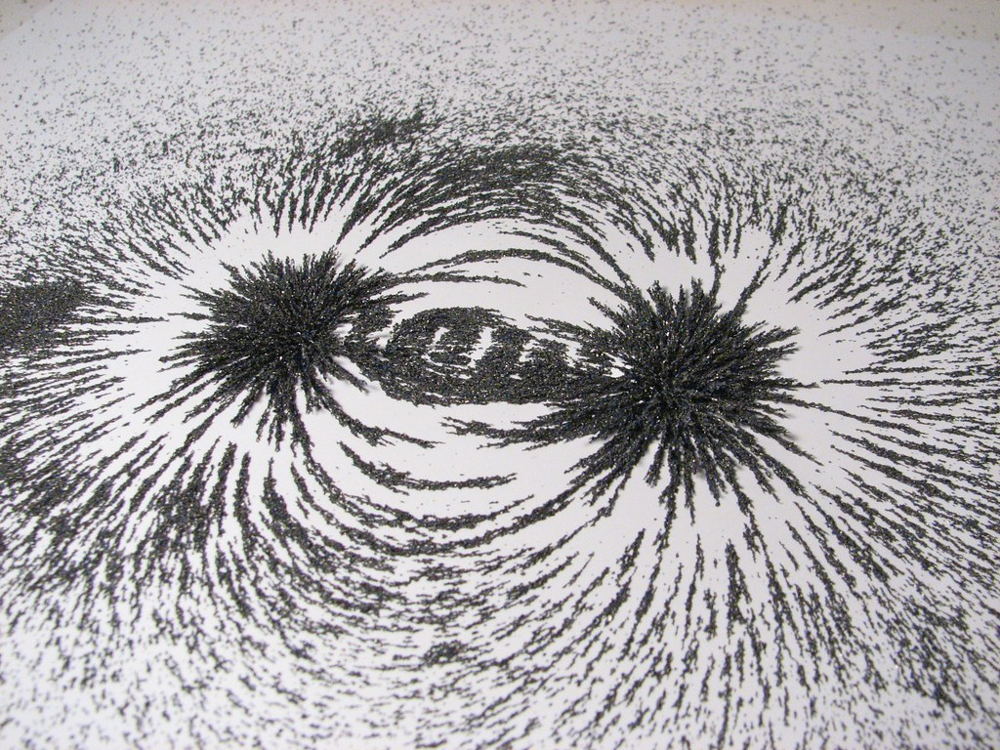
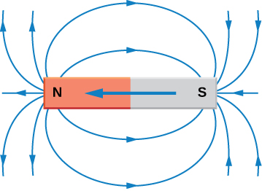
Magnetic Fields
What is a Magnetic Field?
Invisible area around a magnet where magnetic force can pull or push on objects
Show the direction and strength of magnetic force
How Can We See It?
Using iron powder, we can see the pattern of field lines that flow from the north to south pole of a magnet
Notes:
*This slide contains animations. CLICK to reveal content.
INSTRUCTIONAL ACTIVITY: Present Content
TIME: 2 min.
Talking points:
A magnetic field is an invisible area of influence around a magnet or current-carrying wire. It applies a magnetic force on materials that are sensitive to magnetism—like iron or steel.
Field lines are not real objects — they just show the direction and strength of the magnetic force.
We can visualize magnetic fields using field lines. These lines show the direction the magnetic force flows—from the north pole to the south pole of a magnet.
CLICK - You might not see the field, but you can observe its effects—like when iron filings line up around a bar magnet. That’s the magnetic field in action.
Notice how the metal fillings in this image surround the magnet. That’s the magnetic field.

Slide 10
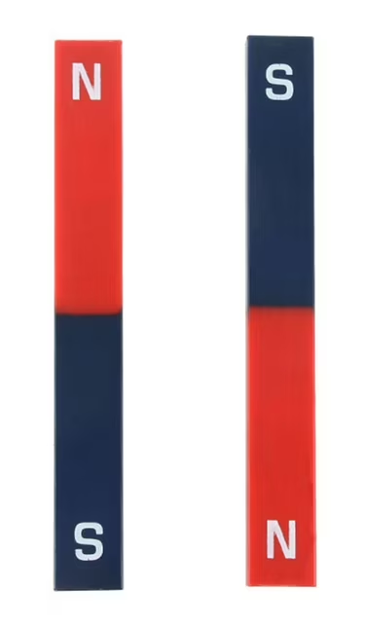
Instructor Demo: Polarity
All magnets have two poles: North and South
Watch and Observe:
What happens when magnets with the same polarity meet? What happens when opposite polarities meet?
What did you observe about polarity?
Like poles repel (push) while opposite poles attract (pull)
Polarity explains why magnets push or pull
Notes:
Note to Instructor: Decide whether this will be a whole-class demonstration or a small-group activity, based on the number of magnets available and time constraints.
*This slide contains animations. CLICK to reveal content.
INSTRUCTIONAL ACTIVITY: Present Content
TIME: 10 min.
Materials: at least two bar magnets
Do:
Place a bar magnet on a flat surface and ask the class to gather around.
Point out the north and south poles of the magnet.
Bring the second magnet close — north to north or south to south — and show how they push away.
Flip the second magnet — north to south — and show how they pull together.
If time allows, give learners some bar magnets and let them try out the experiment.
CLICK to reveal a debrief question. Call on learners to respond.
CLICK to reveal the answers.
Answer Key:
What did you observe about polarity?
Like poles repel (push) while opposite poles attract (pull)
Polarity explains why magnets push or pull

Slide 11
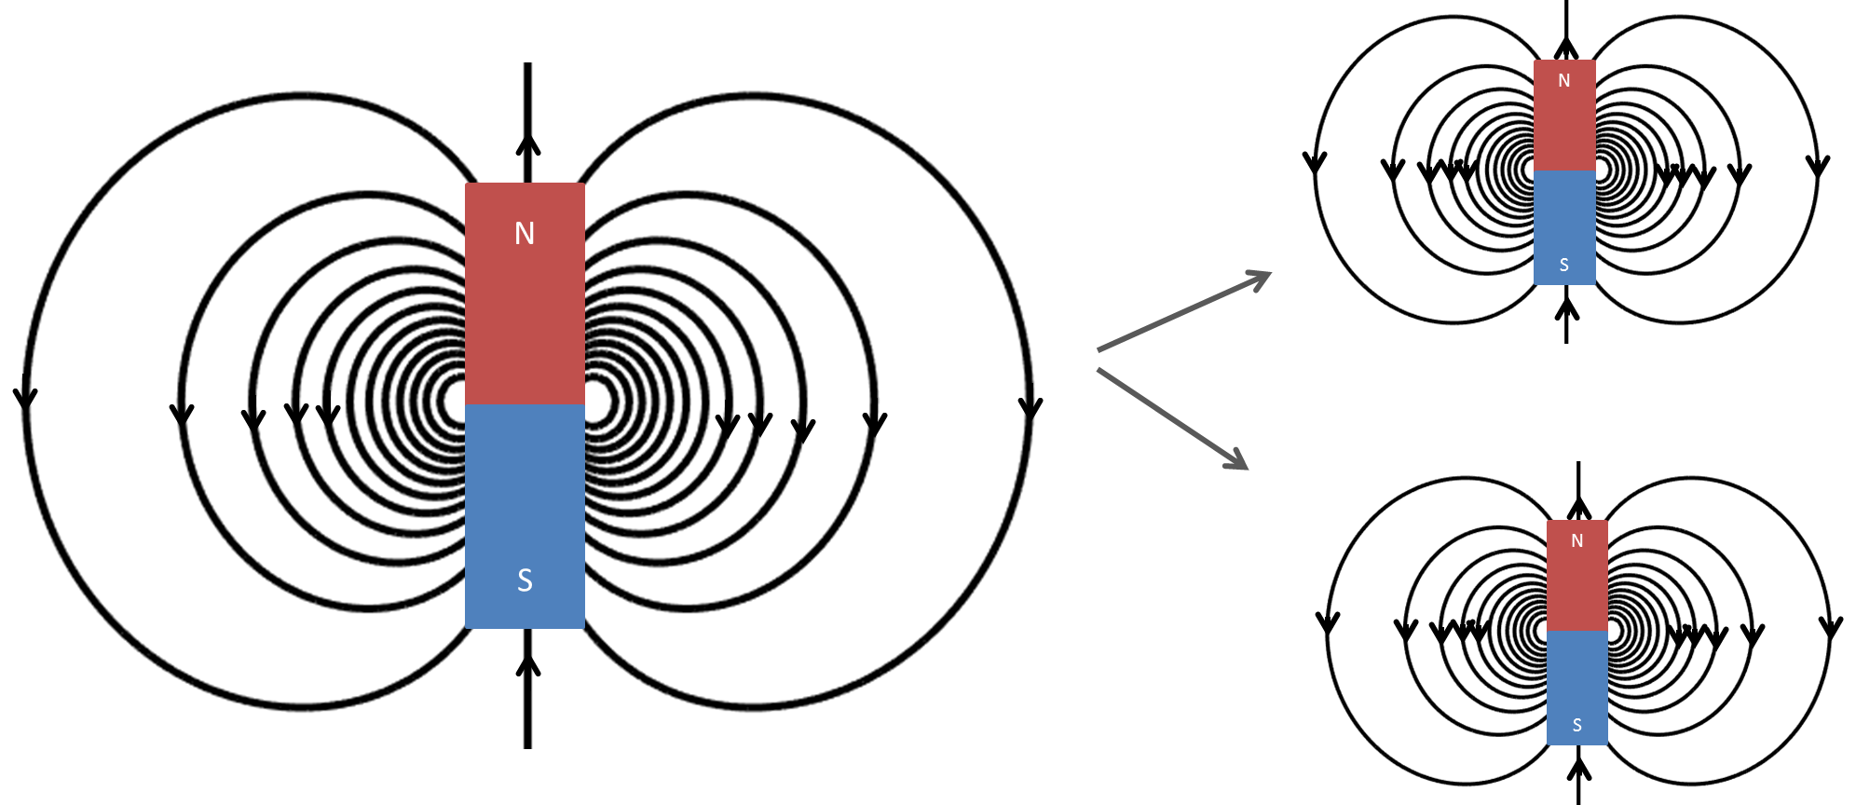
Magnetic Field Strength and Distance
Make a prediction: Based on the polarity demonstration, where do you think the magnetic field is strongest?
Magnetic field strength gets weaker as you move farther from the source.
Field strength is strongest close to the poles of the magnet.
Notes:
*This slide contains animations. CLICK to reveal content.
INSTRUCTIONAL ACTIVITY: Recall, Present Content
TIME: 2 min
Talking Points:
While our demonstration is fresh in your mind, I would like you to make a prediction: Based on the polarity demonstration, where do you think the magnetic field is strongest?
Call on learners to respond. Lead them to understand that the magnetic field is strongest where the magnets meet.
CLICK - Magnetic field strength decreases with distance—the farther you move from the magnet, the weaker the magnetic force becomes.
The field is strongest near the poles, where the magnetic lines are most concentrated. That’s why the attraction or repulsion is easiest to feel at those points.

Slide 12
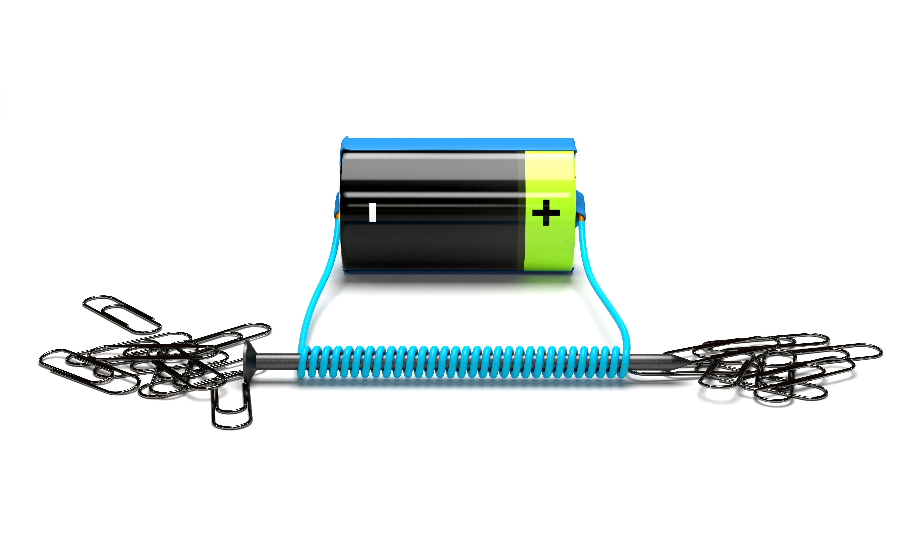
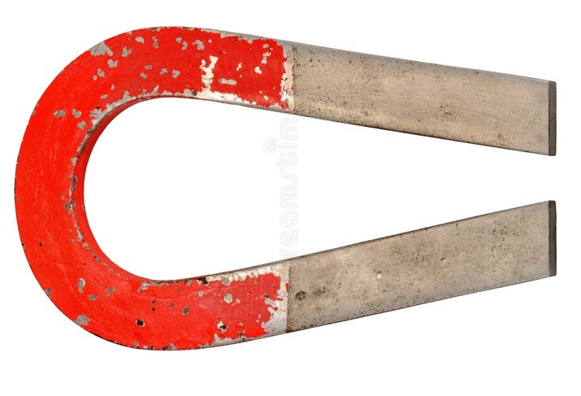
Sources of Magnetism
Permanent magnets (e.g., iron, cobalt, nickel)
Electromagnets
(coils with electric current)
Notes:
INSTRUCTIONAL ACTIVITY: Present Content
TIME: 2 min
Talking points:
Magnetism can come from a few different sources, and each one behaves a little differently:
Permanent magnets, like those made from iron, cobalt, or nickel, create a constant magnetic field—they don’t need electricity to work.
Electromagnets are created when electric current flows through a wire coil—the magnetism only exists while the current is flowing, which makes them useful in things like motors, relays, and magnetic locks.
Understanding these different sources helps explain how magnetism is used in everyday technology.

Slide 13
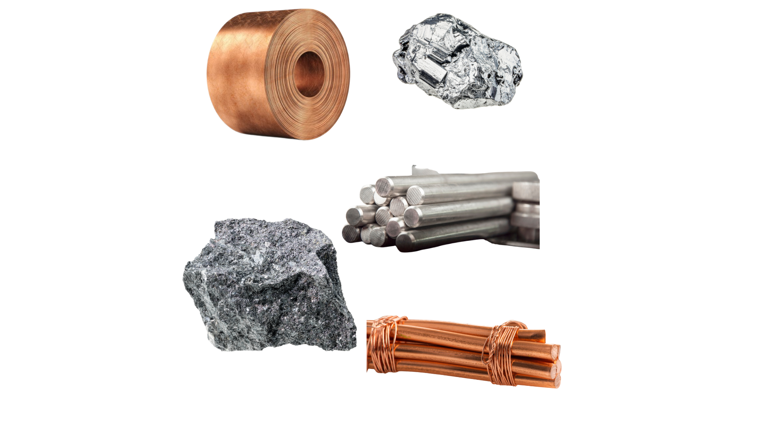
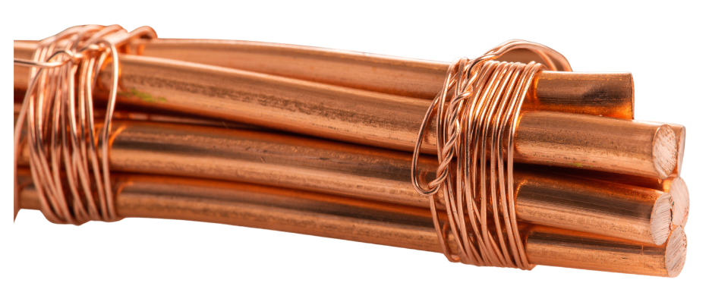
Magnetic Materials
STRONG
Some materials are pulled strongly by magnets, others aren’t.
Strong: iron, steel, nickel, cobalt. Stick tightly to magnets and are used in motors and tools
Weak: aluminum, stainless steel. May move slightly toward a magnet but not much
Non-magnetic: Copper, gold, plastic. Do not react to magnets at all.
Iron
Steel
Aluminum
Copper
WEAK
Notes:
INSTRUCTIONAL ACTIVITY: Present Content
TIME: 2 min
Talking point:
Not all materials react to magnets the same way—some are strongly attracted, some are barely affected, and others are actually pushed away.
There are three main categories of magnetic materials:
Strongly magnetic materials, like iron, nickel, and cobalt, are strongly attracted to magnets. These are the materials used to make permanent magnets.
Weakly magnetic materials, such as aluminum and platinum, are weakly attracted to magnetic fields—but the effect is so slight, you usually don’t notice it without special equipment.
Non-magnetic materials, like copper and gold, are actually slightly repelled by magnetic fields.
Understanding these differences is key when choosing materials for electrical tools, shielding, or magnetic components in circuits.

Slide 14
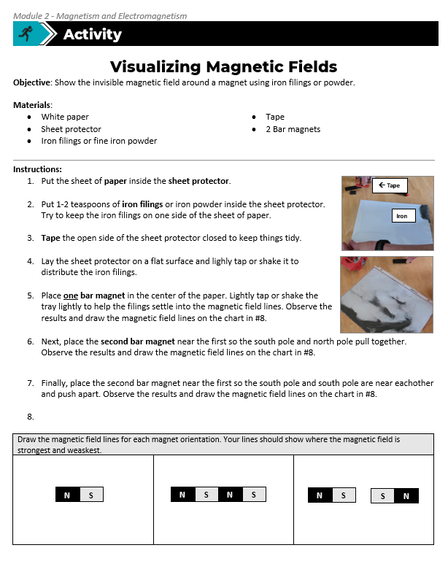
Activity: Visualizing Magnetic Fields
Objective: Show the invisible magnetic field around a magnet using iron filings or powder.
Materials:
White paper
Sheet protector
Iron filings or fine iron powder
Tape
2 Bar magnets
Notes:
Instructional Activity: Provide Guided Learning, Elicit Performance, Provide Feedback
Instructional Time: 20 minutes
Video Overview of Activity: https://www.youtube.com/watch?v=QzMaDS_nvcw
Materials:
Visualizing Magnetic Fields_M5
One per group or pair: White paper, Sheet protector, Iron filings or fine iron powder, Tape, 2 Bar magnets
Do:
(5 min.)
Refer learners to the “Visualizing Magnetic Fields” handout embedded in the Participant Resource Guide.
Review the directions.
Separate learners into groups or pairs and materials.
(10 min.)
Give learners time to complete the activity.
Circulate the room answering questions and connecting the activity to the content taught thus far.
(5 min.)
Debrief by calling on learners to share what they observed.
Ask learners to share what their magnetic field drawings look like for question #8.
Use the activity and debrief to review magnetism, magnetic fields, polarity, and magnet strength.
Source: Virtual Science Teachers. (2024, March). Magnetic field lines: Iron filings activity [PDF]. https://virtualscienceteachers.org/wp-content/uploads/2024/03/VST_Magnetic-Field-Lines-Iron-Filings-Activity.pdf

Slide 15
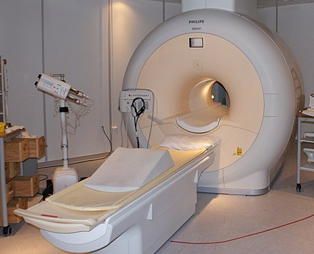
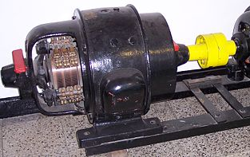
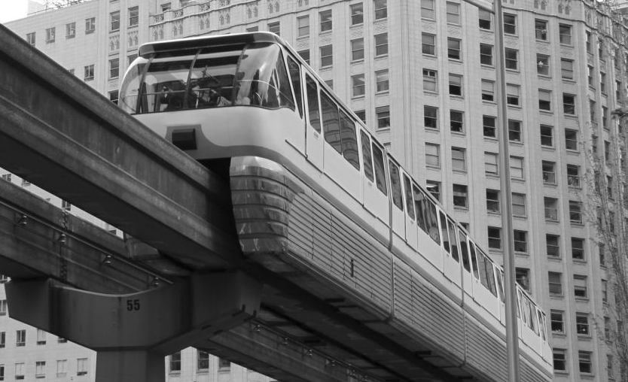

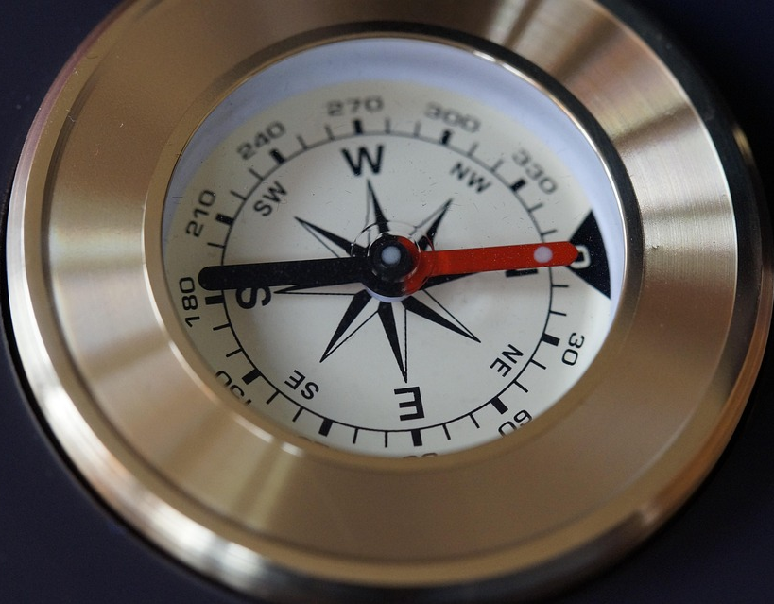

Applications
Everyday Uses:
Magnetic resonance imaging (MRI)
Electric motors and generators
Magnetic levitation trains and sensors
Compasses for navigation
Magnetic strips in credit cards
On the Job:
What applications do you see where you work?
Notes:
This slide contains animations. CLICK to add pictures to the slide.
INSTRUCTIONAL ACTIVITY: Present Content, Recall, Enhance Transfer and Retention
TIME: 4 min
Talking point:
Thus far we have reviewed what a magnet is and how it works. We’ve also talk about sources of magnetism and magnetic materials. But what about applications?
Magnetism isn’t just something you learn about in theory—it’s all around us in everyday life and technology.
In medicine, MRI machines use strong magnetic fields to create detailed images of the body.
Electric motors and generators rely on electromagnetism to convert energy between electrical and mechanical forms.
Maglev trains float above tracks using magnetic repulsion—eliminating friction and enabling high-speed travel.
Compasses use the Earth’s magnetic field for navigation—still critical in outdoor settings and aviation.
And the magnetic strips on credit cards store data using tiny magnetic fields, making digital transactions possible.
Cell phones use small but powerful magnets in components like speakers, microphones, vibration motors, wireless charging systems, and camera stabilization mechanisms.
These are just a few examples of how magnetism powers the systems we depend on every day.
ASK: What applications do you see where you work?
Call on learners to respond.

Slide 16
Knowledge Check
What does a magnetic force do?
(A.) It produces electricity on its own
B.) It creates a force that pulls or pushes certain materials
(B). It creates a force that pulls or pushes certain materials
C.) It causes movement within a device
D.) It only works when heated
Notes:
*This slide has animations. Click to reveal content.
Instructional Event: Evaluate Performance, Provide Feedback
Learning Objective: Explain basic magnetism, including magnetic fields, poles, and magnetic materials.
Time: 2 min
Do:
Review the knowledge check questions.
Call on learners to share their responses.
CLICK to reveal the answers. Provide feedback by correcting any thinking errors learners may have.
Answer Key:
B

Slide 17
Knowledge Check
Which statement correctly describes how magnetic poles behave?
A.) Magnetic force is strongest in the middle of the magnet
B.) A magnet can have more than one north pole
D.) Opposite poles attract, and like poles repel
C.) North and North poles attract each other
D.) Opposite poles attract, and like poles repel
Notes:
*This slide has animations. Click to reveal content.
Instructional Event: Evaluate Performance, Provide Feedback
Learning Objective: Explain basic magnetism, including magnetic fields, poles, and magnetic materials.
Time: 2 min
Do:
Review the knowledge check questions.
Call on learners to share their responses.
CLICK to reveal the answers. Provide feedback by correcting any thinking errors learners may have.
Answer Key:
D - Opposite poles attract, and like poles repel

Slide 18

Summary and What’s Next
Magnetism: A force that pushes or pulls certain materials.
Magnetic Field: Invisible forces around a magnet, strongest at the poles
Poles: Every magnet has North/South; opposites attract, likes repel
Sources: Permanent magnets and electromagnets
Applications: Motors, generators, locks, sensors, credit cards
Now that we understand magnetism, we’ll explore how adding electricity creates electromagnetism.
Notes:
INSTRUCTIONAL ACTIVITY: Enhance Transfer and Retention
TIME: 2 min
DO: Review key points.
Talking point: Understanding magnetism sets the stage for learning how electric currents and magnetic fields interact, leading to electromagnetism.

Slide 19
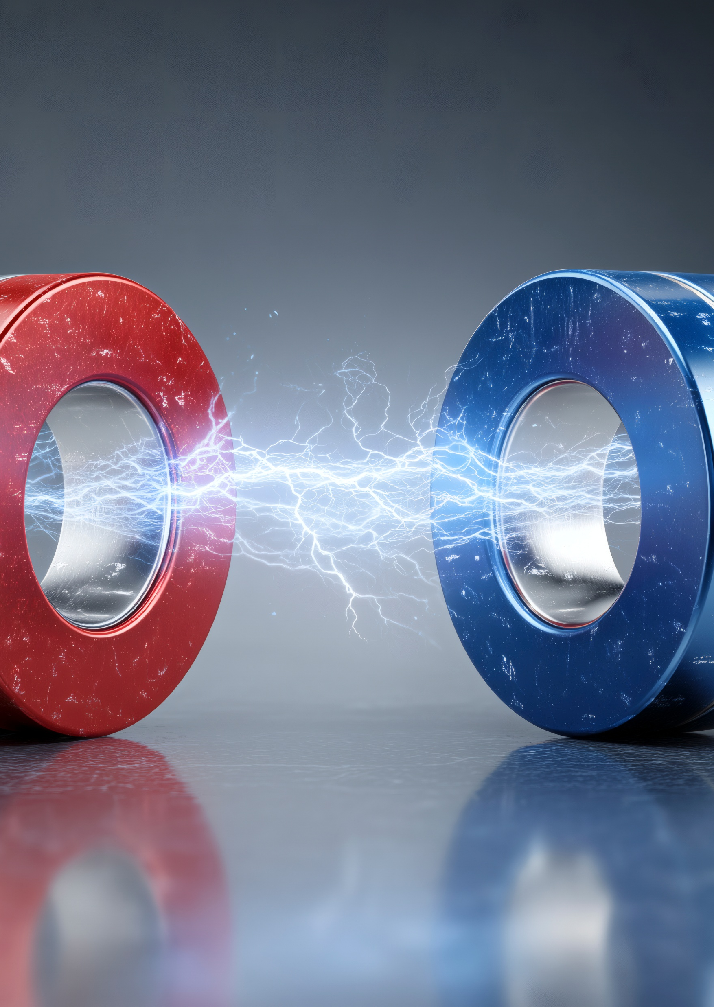
5.2 – Electromagnetism
We’ve talked about permanent magnets. In most transit systems, we use electromagnets which are magnets that come alive only when electricity flows.
Notes:
INSTRUCTIONAL ACTIVITY: Direction
TIME: 1 min
DO: Introduce section.
Talking Points: We’ve talked about permanent magnets. In most transit systems, we use electromagnets which are magnets that come alive only when electricity flows.
Image Source: heerim studio - stock.adobe.com

Slide 20
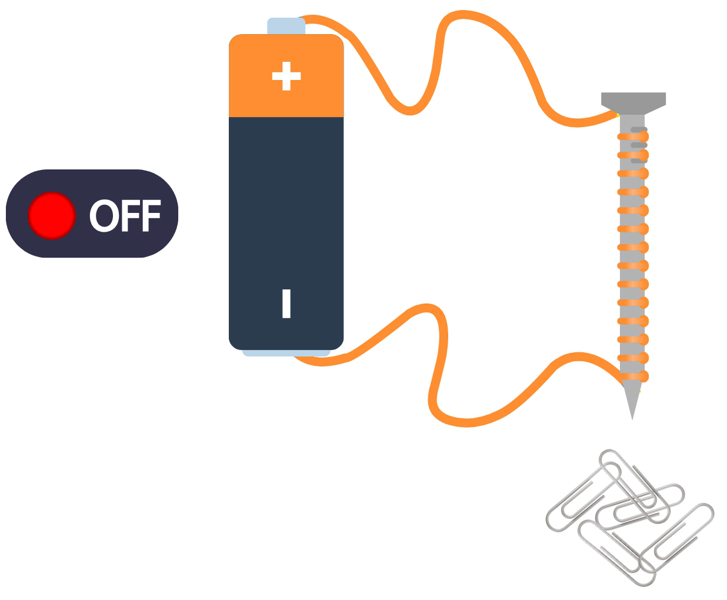
Introduction to Electromagnetism
Happens when electricity and magnetism work together to affect charged particles
When electricity moves through a wire, it creates a magnetic field around it.
Used where electric current makes things move (motors, relays, etc.)
Notes:
INSTRUCTIONAL ACTIVITY: Present Content
TIME: 2 min
Talking points:
Electromagnetism is one of the fundamental forces of nature, it happens when electricity and magnetism work together to affect charged particles.
When electricity moves through a wire, it creates a magnetic field in circles around the wire – kind of like the ripples in a pond.
When that field is used to move something, like turning a motor shaft or closing a switch, that’s electromagnetism in action.
Electromagnetism a core part of how modern electrical systems work.

Slide 21
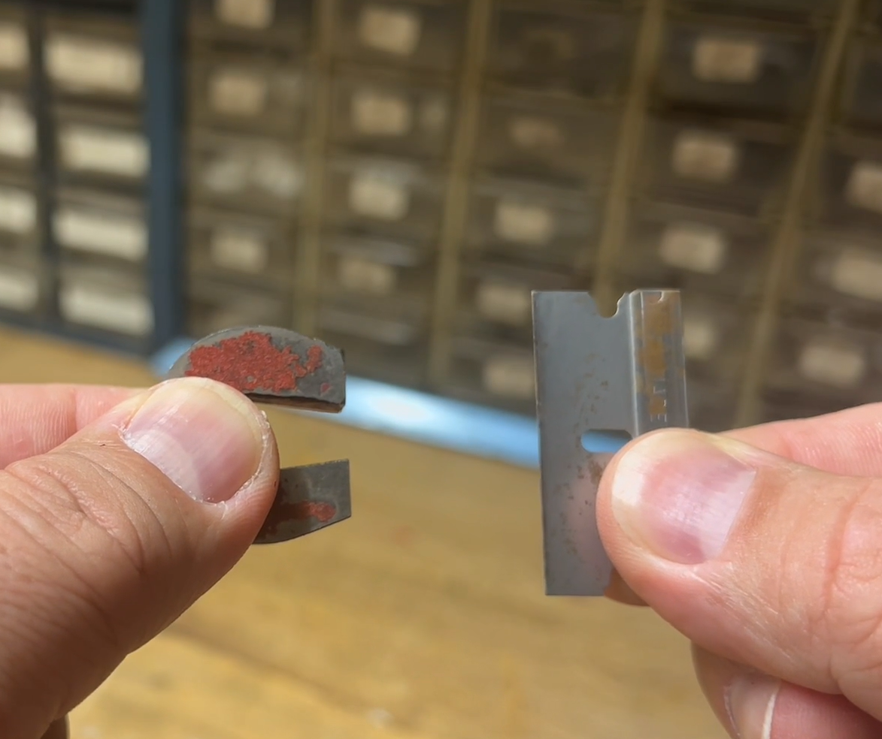
Electromagnetism in Action
Click the image to view the video.
Notes:
INSTRUCTIONAL ACTIVITY: Present Content, Recall
TIME: 10 min
Do:
Read the talking points below and play the video.
Call on learners to share their interesting facts and questions.
Facilitate a short discussion.
Talking points:
Let’s take a closer look at this process.
As you watch the video, jot down two interesting facts or one question you have about this process.
After the video…
What interesting facts did you hear in the video?
What questions do you have so far?
Video Link - https://vimeo.com/1161149792/5404c11636

Slide 22
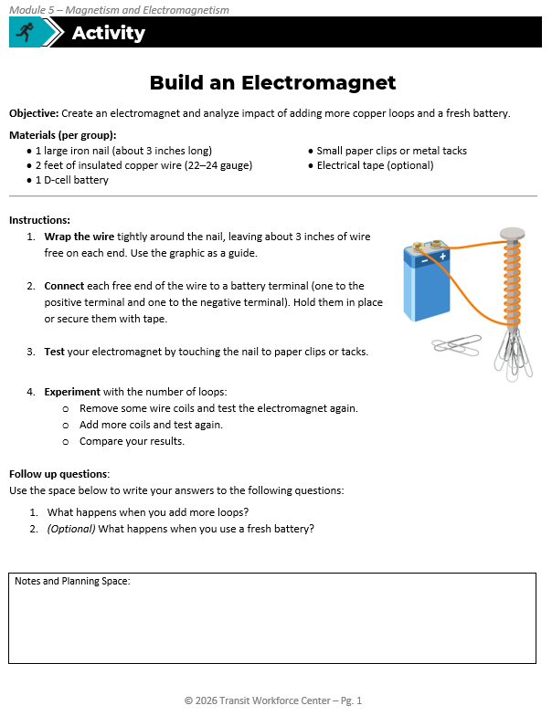
Activity: Build an Electromagnet
Objective: Create an electromagnet and analyze impact of adding more copper loops and a fresh battery.
Materials (per group):
1 large iron nail (about 3 inches long)
2 feet of insulated copper wire (22–24 gauge)
1 D-cell battery
Small paper clips or metal tacks
Electrical tape (optional)
Notes:
Instructional Activity: Provide Guided Learning, Elicit Performance, Provide Feedback
Instructional Time: 20 minutes
Materials:
Build an Electromagnet_M5
One per group or pair: 1 large iron nail (about 3 inches long), 2 feet of insulated copper wire (22–24 gauge), 1 D-cell battery, Small paper clips or metal tacks, Electrical tape (optional)
Do:
(5 min.)
Refer learners to the “Electromagnet” handout embedded in the Participant Resource Guide.
Review the directions.
Separate learners into groups or pairs and materials.
(10 min.)
Give learners time to complete the activity.
Circulate the room answering questions and connecting the activity to the content taught thus far.
(5 min.)
Debrief by calling on learners to share what they observed, particularly when adding/removing copper loops.
Use the activity and debrief to review how electromagnetism works.

Slide 23
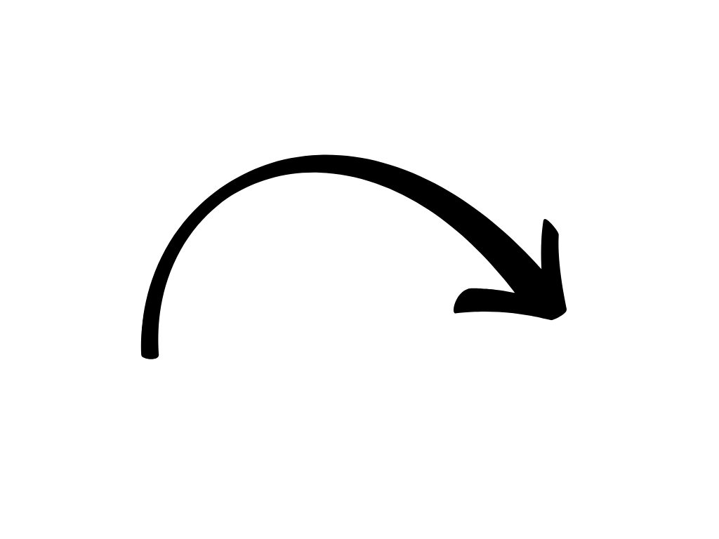
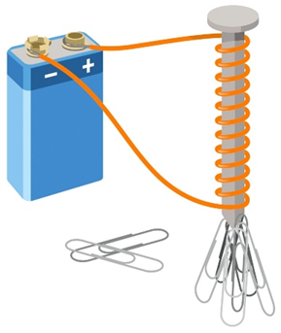
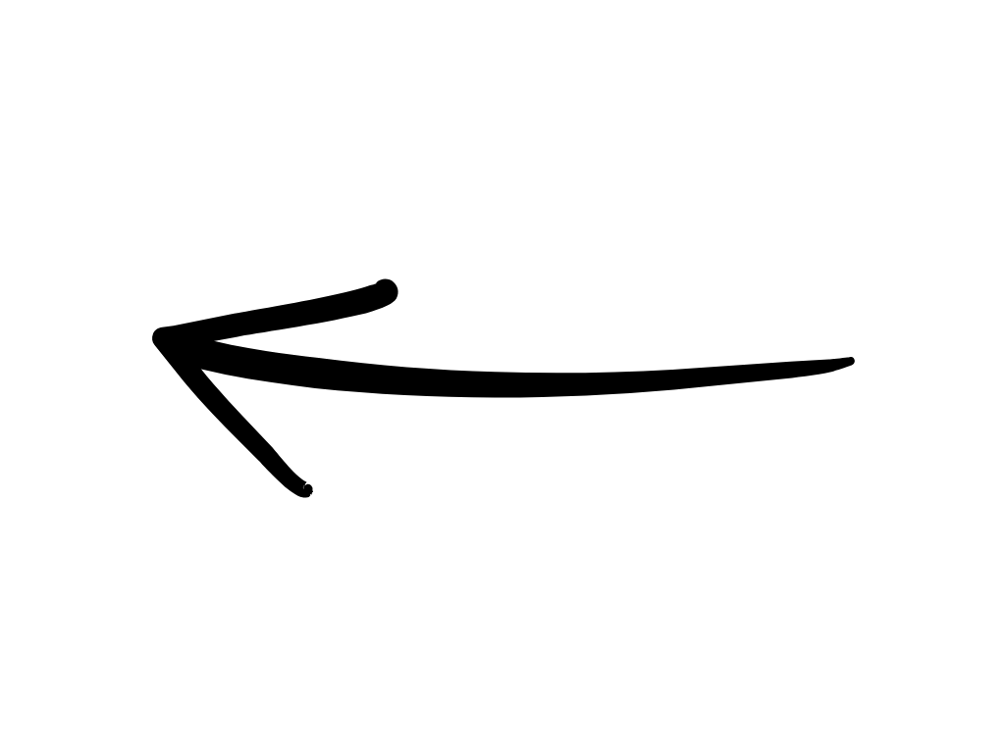
Review: What Makes an Electromagnet Stronger?
Iron core material amplifies the magnetic field
More current (voltage/power source) creates a stronger magnetic field
More coil turns (Loops) creates a more concentrated magnetic field
Tight, even windings improve magnetic efficiency
Notes:
*This slide contains animations. CLICK to reveal content.
INSTRUCTIONAL ACTIVITY: Present Content
TIME: 4 min
Talking points:
Let’s review some key takeaways from our electromagnet activity.
Several key factors determine how strong an electromagnet will be. If you increase any of these correctly, the magnetic field becomes stronger.
CLICK - First, current. The more electric current flowing through the coil, the stronger the magnetic field it produces. If voltage drops, magnetic strength drops.
CLICK - Second, the core material. Using iron inside the coil boosts the magnetic field because the iron itself becomes magnetized.
CLICK - Third, the number of coil turns. More loops mean the magnetic field becomes more concentrated and powerful.
CLICK - Fourth, the quality of the winding. Tightly wrapped, evenly spaced coils work more efficiently. Loose or damaged windings reduce magnetic strength.
In real equipment like relays or solenoids, this matters.
Low voltage equals a weak coil. A damaged or loose winding means poor magnetism.
And weak magnetism can prevent the device from operating properly.
So, remember: more power, more loops, and better core material equal a stronger electromagnet.

Slide 24
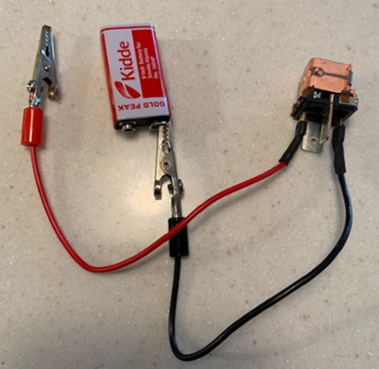
Demo: Electromagnets and Relays
Goal: Demonstrate how an electromagnet activates a relay.
Demonstration Steps
Connect wires to relay terminals 85 and 86.
Connect one wire to the battery.
Tap the second wire to the other battery terminal to make and break the circuit.
Observe the relay armature:
  Energized → Armature pulls down
  De-energized → Armature springs back
Notes:
INSTRUCTIONAL ACTIVITY: Present Content
TIME: 10 min.
Materials:
Two wire leads with terminals or alligator clips
Electro-mechanical relay (cover removed)
9V battery
Instructor Note: For this activity, the relay cover should be removed so participants can observe the armature moving. If the movement is not visible, participants should still be able to hear the relay operate. Use any relay type that is available at your location or commonly used in your work environment.
Do:
Find a flat surface to conduct the demonstration here everyone can see.
Follow the demonstration steps
Connect wires to relay terminals 85 and 86.
Connect one wire to the battery.
Tap the second wire to the other battery terminal to make and break the circuit.
Observe the relay armature:
Energized → Armature pulls down
De-energized → Armature springs back
Optional – Use the animated graphic on the next slide to illustrate key points.
Talking Points:
Let’s build off of our activity by seeing how electromagnetism activates a relay — this is not just theory; this is how real equipment works.
First, I’ll connect the two wires to terminals 85 and 86 on the relay. These are the coil terminals.
Now I’ll connect one wire to the battery. When I tap the second wire to the other battery terminal, I complete the circuit and allow current to flow.
Watch the armature closely. When current flows, the coil becomes an electromagnet and pulls the armature down.
When I disconnect the wire, the magnetic field collapses immediately. The armature springs back to its original position.
That movement is what makes or breaks the electrical contact inside the relay.
So, what we’re seeing here is simple: Current creates a magnetic field. The magnetic field creates motion. No current means no magnetism.
This is exactly why low voltage, or a weak coil can cause a relay to chatter, fail to pull in, or drop out unexpectedly.

Slide 25
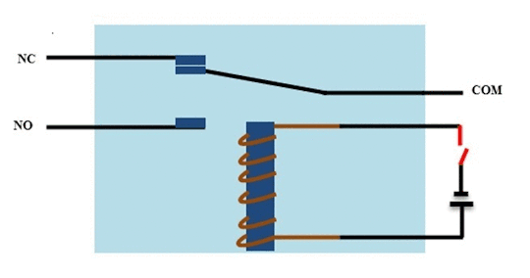
Demo: Electromagnets and Relays
Notes:
*OPTIONAL SLIDE
INSTRUCTIONAL ACTIVITY: Present Content
TIME: 2 min.
Do: Use the graphic, which learners first saw in Module 4, to illustrate key points in the Electromagnets and Relays demonstration.

Slide 26
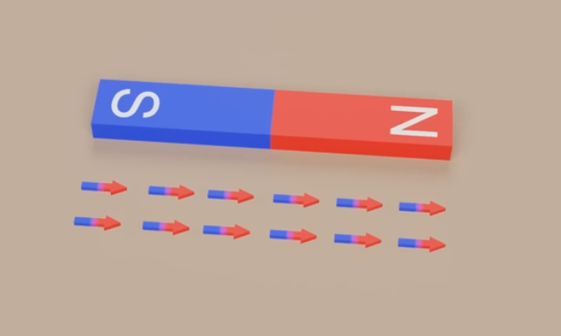
Electromagnets and Motors
Notes:
INSTRUCTIONAL ACTIVITY: Present Content, Recall
TIME: 10 min.
Do:
This video will show us how electromagnets are used in motors.
It starts with an overview of a simple circuit.
ASK: Who remembers the three essential pieces of a simple circuit?
Call on learners to respond. Answer: Power Source, Wire, Load
Nice work.
Let’s watch the video. You’ll be building your own motors in our next activity, so pay close attention.

Slide 27
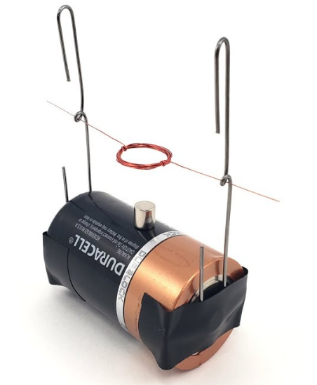
Activity: Build a Simple Motor
Directions: Create a simple motor that shows how electricity and magnetism interact. When you are finished building your motor, answer the following questions on pg. 2.
Materials:
1 C-cell battery
Insulated copper wire
2 paper clips
Sandpaper
2 small neodymium magnets
Pencil or marker for wrapping wire
Electrical tape
Notes:
Instructional Activity: Provide Guided Learning, Elicit Performance, Provide Feedback
Instructional Time: 20 minutes
Activity Overview Video: See 1:28-3:47 - https://www.youtube.com/watch?v=q9VpXz01msM
Materials:
Build a Simple motor_M5
One per pair: 1 C-cell battery, Insulated copper wire (magnet wire), 2 paper clips, Sandpaper, 2 small neodymium magnets, Pencil or marker for wrapping wire, Electrical tape
Do:
(5 min.)
Refer learners to the “Simple Motors” handout embedded in the Participant Resource Guide.
Review the directions.
Separate learners into pairs and materials.
(10 min.)
Give learners time to complete the activity.
Circulate the room answering questions and connecting the activity to the content taught thus far.
(5 min.)
Debrief by reviewing the Follow Up Questions on page 2 of the handout.
Calling on learners to share their responses.
Use the activity and debrief to review how electromagnetism works.
Source: Science Buddies. (2024, January). 3 simple DIY motor experiments [Video]. YouTube. https://www.youtube.com/watch?v=q9VpXz01msM

Slide 28

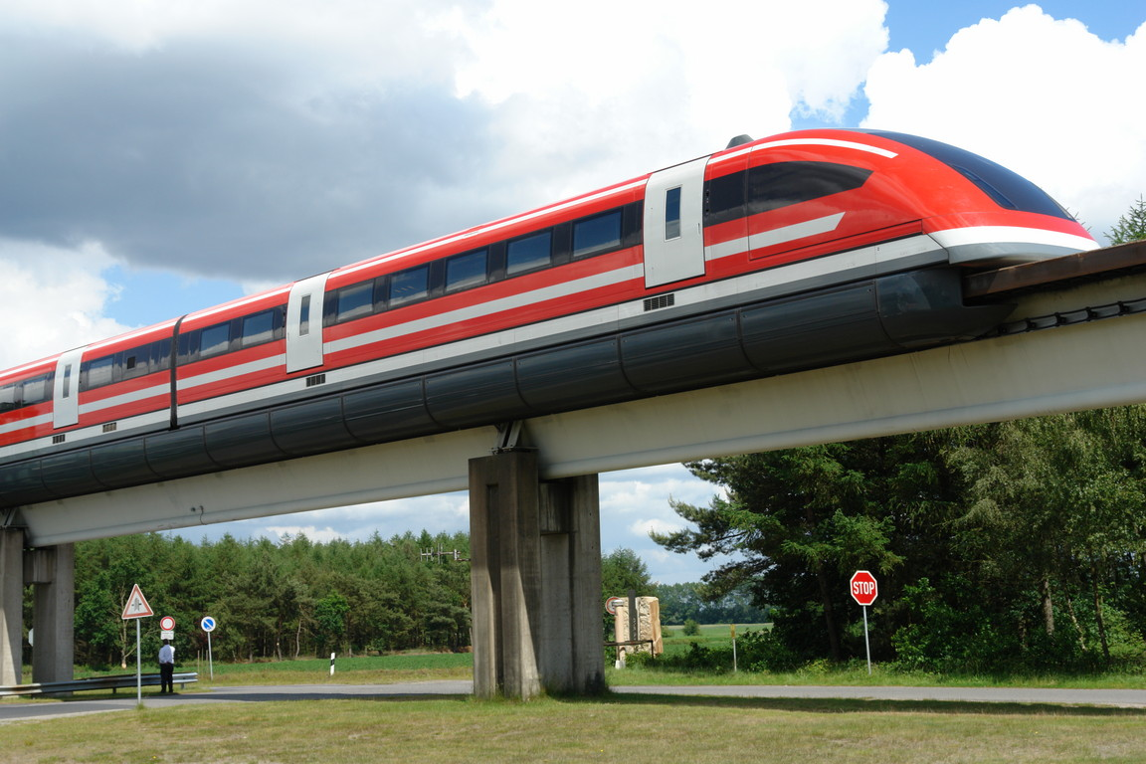
Applications of Electromagnetism
General
Transportation
Electric motors
Relays
Magnetic locks
Speakers and microphones
Electric vehicle motors
Magnetic levitation trains
Regenerative braking systems
Notes:
*This slide contains animations. CLICK to reveal content.
INSTRUCTIONAL ACTIVITY: Present Content, Enhance Transfer and Retention
TIME: 3 min.
Talking points:
In this section we have learned what electromagnetism is and how it works. Let’s take a look at its applications.
Electromagnetism powers a huge range of everyday technologies—it's behind the motion, control, and sound in many electrical systems.
CLICK - Some general examples include:
Electric motors, which convert electrical energy into mechanical movement.
Relays, which use magnetic fields to control electrical circuits.
Magnetic locks, often used in security systems.
Speakers and microphones, where electromagnets create or detect sound vibrations.
CLICK - In the transportation industry, electromagnetism plays a big role in:
Electric vehicle motors
Magnetic levitation (maglev) trains, which glide without touching the track.
Regenerative braking systems, which turn motion back into electricity.
From powering motion to enabling communication and control, electromagnetism is at the heart of modern technology.

Slide 29
Knowledge Check
What creates a magnetic field in an electromagnet?
A. The type of metal used on the coil
B. Heat from the wire
C. Electric current flowing through a coiled wire
C. Electric current flowing through a coiled wire
D. The color of the wire insulation
Notes:
*This slide has animations. Click to reveal content.
Instructional Event: Evaluate Performance, Provide Feedback
Learning Objective: Explain basic magnetism, including magnetic fields, poles, and magnetic materials.
Time: 2 min
Do:
Review the knowledge check questions.
Call on learners to share their responses.
CLICK to reveal the answers. Provide feedback by correcting any thinking errors learners may have.
Answer Key:
C. Increasing the electric current

Slide 30
Knowledge Check
Which action will make the electromagnet stronger?
A. Increasing the electric current
B. Reducing the number of wire loops
A. Increasing the electric current
C. Using a wooden core
D. Spreading the loops farther apart
Notes:
*This slide has animations. Click to reveal content.
Instructional Event: Evaluate Performance, Provide Feedback
Learning Objective: Describe how an electromagnet works and what affects its strength.
Time: 2 min
Do:
Review the knowledge check questions.
Call on learners to share their responses.
CLICK to reveal the answers. Provide feedback by correcting any thinking errors learners may have.
Answer Key:
A. Increasing the electric current

Slide 31
Knowledge Check
Which of the following is a real-world use of electromagnetism?
A. Solar panels
B. Magnetic locks
B. Magnetic locks
C. Diesel engines
D. Incandescent light bulbs
Notes:
*This slide has animations. Click to reveal content.
Instructional Event: Evaluate Performance, Provide Feedback
Learning Objective: Explain how electromagnetism is used in transit systems such as relays, motors, and generators.
Time: 2 min
Do:
Review the knowledge check questions.
Call on learners to share their responses.
CLICK to reveal the answers. Provide feedback by correcting any thinking errors learners may have.
Answer Key:
B. Magnetic locks

Slide 32
Summary and What’s Next
Electromagnetism: Electricity flowing through a wire creates a magnetic field around the wire or coil.
Electromagnets: Coiling wire around a core and adding current creates a controllable magnet.
Magnet Strength: More current, more coil turns, an iron core, and tighter coils make the magnet stronger.
Applications: Motors, relays, magnetic locks, speakers, EV motors, maglev trains, regenerative braking.
Now that we understand electromagnetism, next we’ll explore how these principles create electricity.
Notes:
INSTRUCTIONAL ACTIVITY: Enhance Transfer and Retention
TIME: 2 min
DO: Review key points.
Talking point: Understanding electromagnetism sets the stage for creating electricity.

Slide 33
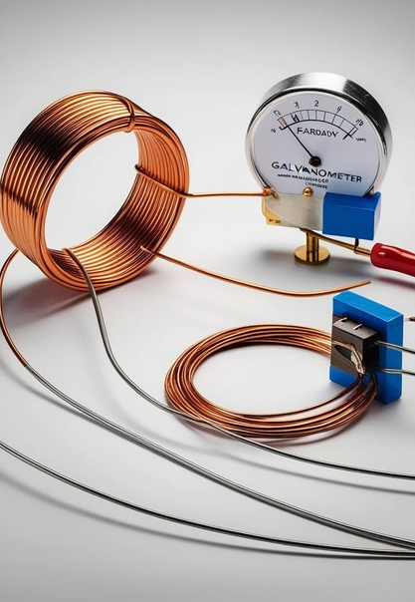
5.3 – How Magnetism Creates Electricity
We’ve seen how electricity can create magnetism, but it also works the other way around. Moving a magnet can create electricity. Let’s see how that happens.
Notes:
INSTRUCTIONAL ACTIVITY: Direction
TIME: 1 min
DO: Introduce section.
Talking Points: We’ve seen how electricity can create magnetism, but it also works the other way around. Moving a magnet can create electricity. Let’s see how that happens.

Slide 34
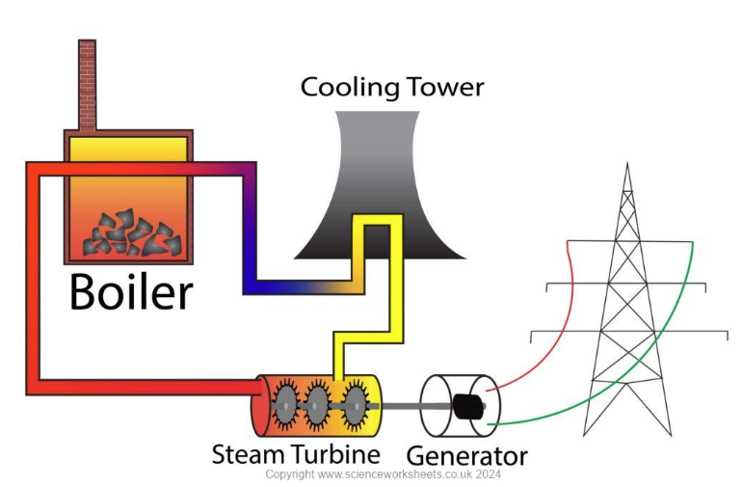
Magnetism and Electricity
At a power plant, energy moves through a system: Boiler → Steam Turbine → Generator → Power Lines
The steam spins the turbine, and the turbine spins the generator.
Inside the generator, a spinning magnet changes the magnetic field around coils of wire.
That change creates voltage and produces electricity.
Notes:
Instructional Activity: Gain Attention
Instructional Time: 2 min
Talking Points:
Think for a moment about a powerplant used to generate electricity. How does that happen?
On the left, the boiler heats water and produces steam.
That steam flows to the turbine and causes it to spin.
The turbine shaft is connected directly to the generator.
Inside the generator, a magnet spins inside coils of wire. As it spins, the magnetic field around the wires changes.
That changing magnetic field induces voltage.
And that voltage becomes the electricity that travels out through the power lines.
Discussion point: Refers back to Section 1-4 of Module 1. Learners may ask whether electricity is “generated” as AC or DC. Most electricity is generated as AC power. As discussed in Section 1-4, DC power is typically created either by converting AC to DC or through a chemical process such as batteries.

Slide 35
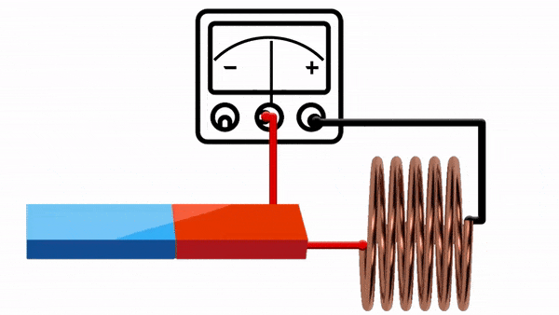
Faraday’s Law of Induction
A changing magnetic field can induce an electric current in a conductor.
A magnet moves near a coil of wire
The magnetic field through the coil changes
Causes electrons to move in the wire
Electron movement creates electric current
Notes:
INSTRUCTIONAL ACTIVITY: Present Content
TIME: 2 min
Talking points:
The power plant scenario is a real-world example of Faraday’s Law.
In 1831, Michael Faraday made a breakthrough discovery: A changing magnetic field can induce an electric current in a conductor.
This became known as Faraday’s Law of Electromagnetic Induction, and it’s the principle behind how we generate most of the world’s electricity today.
Whenever a magnetic field changes near a wire—either by moving the magnet, moving the wire, or changing the field strength—it causes electrons to start moving, creating an electric current.
Without this discovery, we wouldn’t have generators, motors, transformers, or power grids.
Every time a generator or alternator turns, it’s using Faraday’s discovery.
This is the same effect your buses and trains rely on to charge systems while running.
Image Source: Graham Van Brunt. (2025, February). Electromagnetism – Electromagnetic induction & Faraday’s law [Video]. YouTube. https://www.youtube.com/watch?v=l6eIZ2svs28

Slide 36
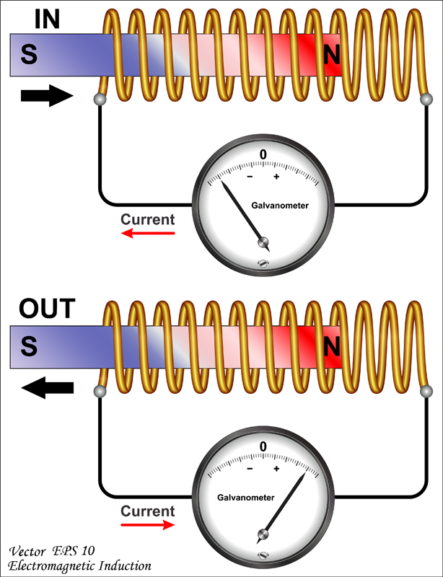
Faraday’s Law of Induction
The faster the magnet moves, the more current is produced.
Faster change = more voltage
Generators and motors move quickly because more movement means more electricity
Notes:
INSTRUCTIONAL ACTIVITY: Present Content
TIME: 2 min
Taking points:
Faraday’s Law says that the voltage induced in a circuit is proportional to how fast the magnetic flux changes through it.
In other words: Faster change = more voltage.
If the magnetic field around a coil changes quickly by moving a magnet faster or changing the field strength sharply, you get a higher voltage.
This is why generators spin so rapidly: more movement means more electricity.
Faraday’s Law is one of the cornerstones of electrical generation, helping explain everything from small motors to massive power plants.
Image Source: Careers360. (n.d.). Electromagnetic induction and alternating currents. https://learn.careers360.com/physics/electromagnetic-induction-and-alternating-currents-chapter/

Slide 37
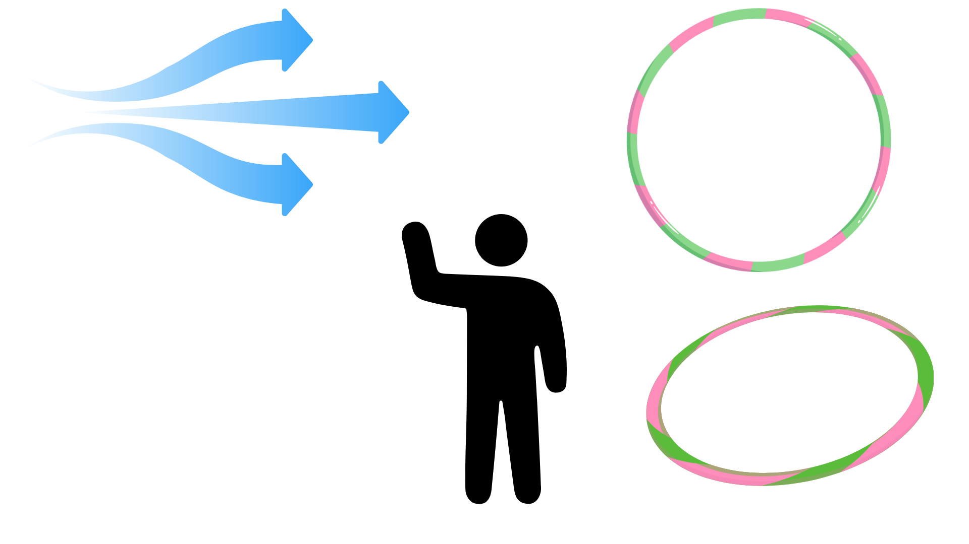
Analogy: Magnetic Flux
Magnetic Flux is the amount of magnetic field passing through an area.
Straight hoop = more flux
Tilted hoop = less flux
Magnetic Flux
Notes:
*This slide contains animations. CLICK to reveal content.
Instructional Activity: Present Content
Instructional Time: 2 min.
Talking Points:
Magnetic flux is a way of describing how much magnetic field passes through a loop of wire.
Analogy:
CLICK - Imagine you’re holding a hula hoop in the wind.
The wind represents the magnetic field. The amount of wind passing through the hoop represents magnetic flux.
If the wind is weak, only a little passes through. If the wind is strong, more passes through.
CLICK - If you turn the hoop sideways, less wind passes through.
If the wind suddenly gusts or changes direction, the amount passing through the hoop changes.

Slide 38
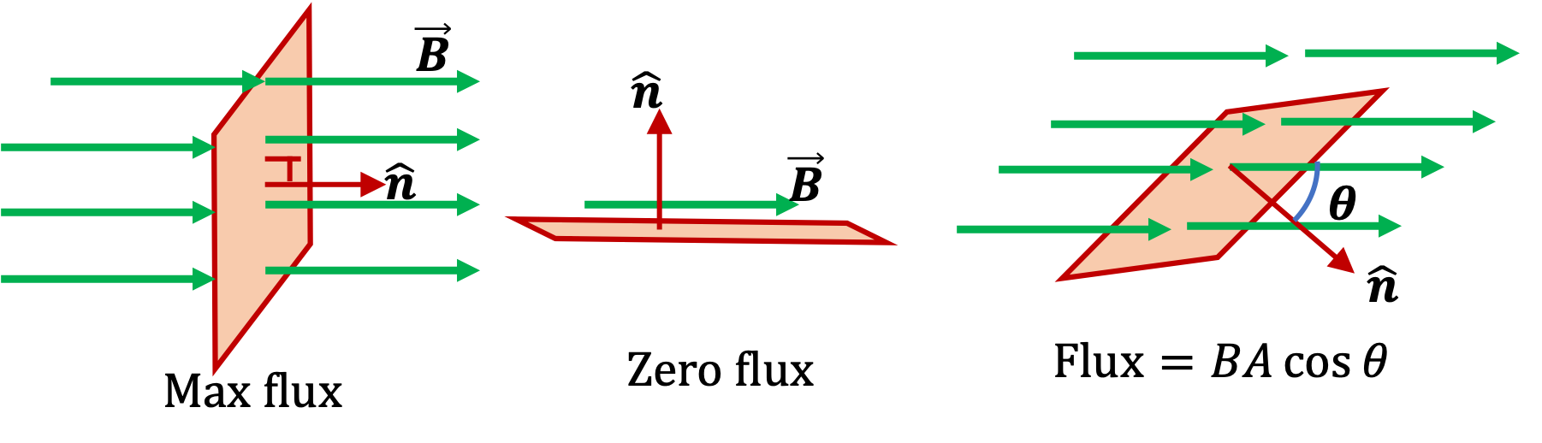
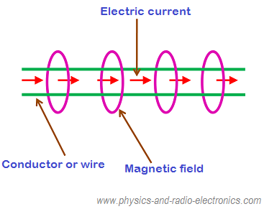
Magnetic Flux
Perpendicular vs. Parallel
Perpendicular magnetic field = maximum flux
Parallel magnetic field = zero flux
Constant vs. Changing
Contant = No electron movement, no current
Changing = Electron movement, current flows, electricity created
Notes:
*This slide contains animations. CLICK to reveal content.
Instructional Activity: Present Content
Instructional Time: 2 min.
Talking Points:
You can think of magnetic flux like counting how many magnetic field lines pass through a surface.
There are several things that can influence magnetic flux.
CLICK - Perpendicular vs. Parallel:
If the magnetic field is perfectly perpendicular to the surface (θ = 0°), you get the maximum flux.
If the field is parallel to the surface (θ = 90°), the flux drops to zero.
CLICK - Changing vs. Constant
Whether the magnetic flux is changing or constant is critical to producing electricity.
If the magnetic flux stays constant, nothing happens—there’s no electric field, and no current is created.
But if the magnetic flux changes—whether by moving a coil, changing the field strength, or tilting the surface—an electric field is generated.
That electric field pushes charges, and current starts flowing through the wire.
Image Sources:
Physics Bootcamp. (n.d.). Magnetic flux. https://www.physicsbootcamp.org/Magnetic-Flux.html
Physics and Radio Electronics. (n.d.). Relation between electricity and magnetism. https://www.physics-and-radio-electronics.com/physics/magnetism/relation-between-electricity-and-magnetism.html

Slide 39
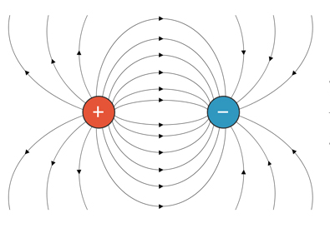
Magnetic Fields
Changing magnetic fields create electric fields which moves electrons.
An electric field is the space around a charged object where other charges feel a force.
Electric fields are invisible but can be represented by arrows.
Direction: Away from positive charges, toward negative charges.
Notes:
Instructional Activity: Present Content
Instructional Time: 2 min.
Talking Points:
To understand electromagnetic induction, we need to understand electric fields, because electric fields are what actually move charges.
An electric field is the space around a charged object where other charges experience a force. Even though we can’t see it, the field is what pushes or pulls charges through space.
Electric fields are a fundamental force, similar to gravity. Gravity acts on mass, while electric fields act on electric charge.
We represent electric fields with arrows to show direction. The arrows point away from positive charges and toward negative charges, helping us visualize how the force would act on another charge placed nearby.
Our Visualizing Magnetic Fields activity from earlier in our lesson also provided a visual of these fields.
The stronger the charge, the stronger the electric field—just like a larger planet creates a stronger gravitational pull.
This idea becomes especially important when we talk about electromagnetic induction.
Faraday showed that a changing magnetic field creates an electric field, and that electric field is what drives current.
So, as we move forward, remember this: magnetic fields don’t directly “push electrons.” They create electric fields—and electric fields are what cause charges to move.
Image Source : Science Facts. (n.d.). Electric field vs. magnetic field. https://www.sciencefacts.net/electric-field-vs-magnetic-field.html

Slide 40
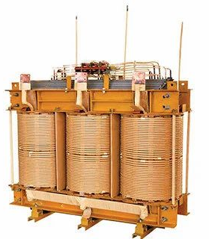
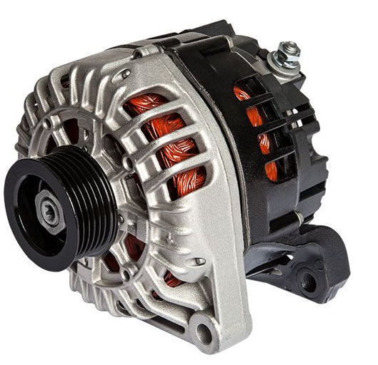
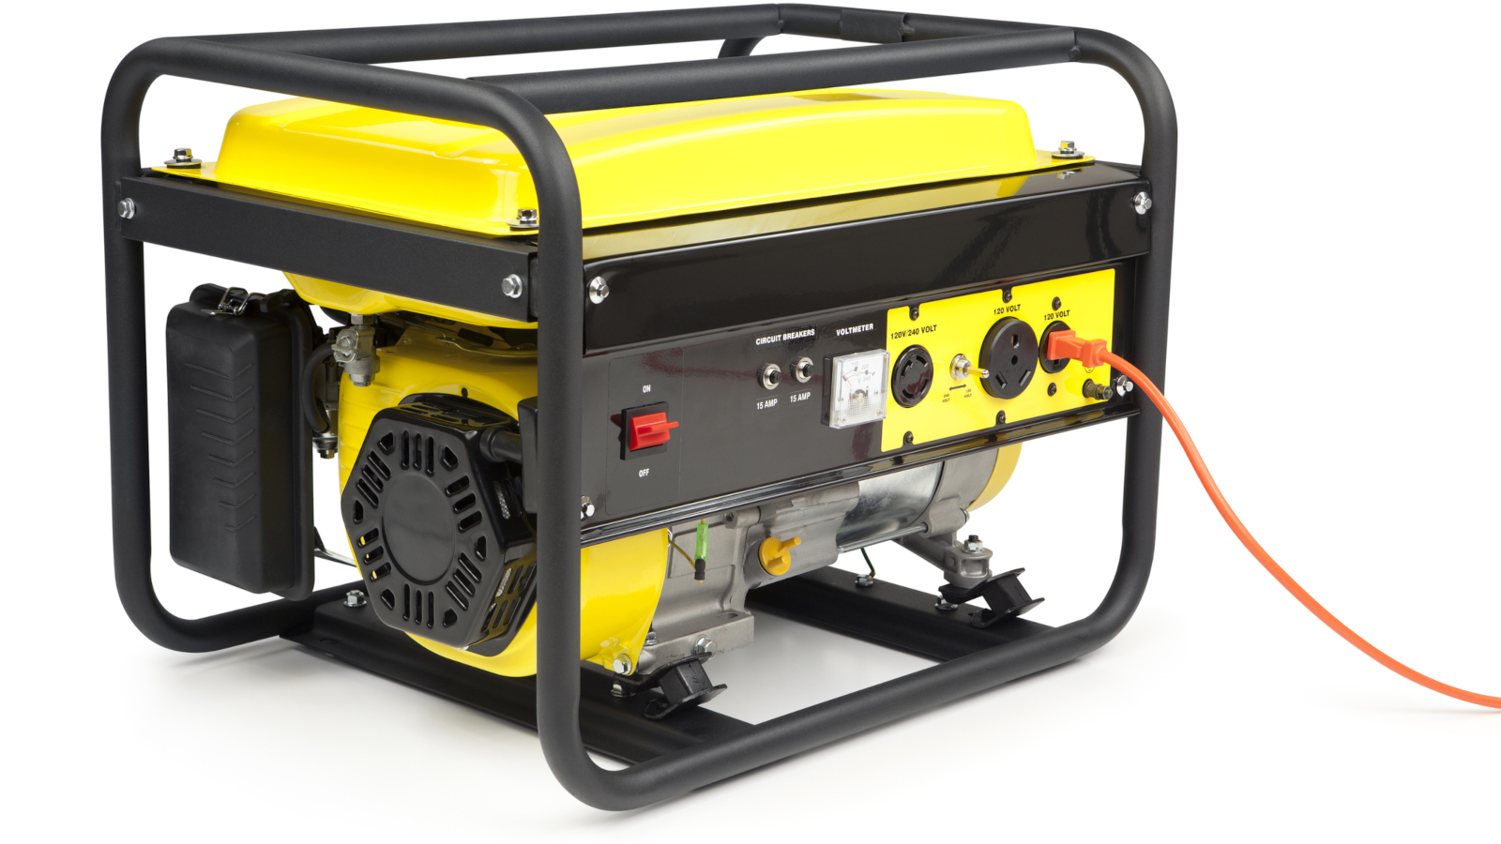

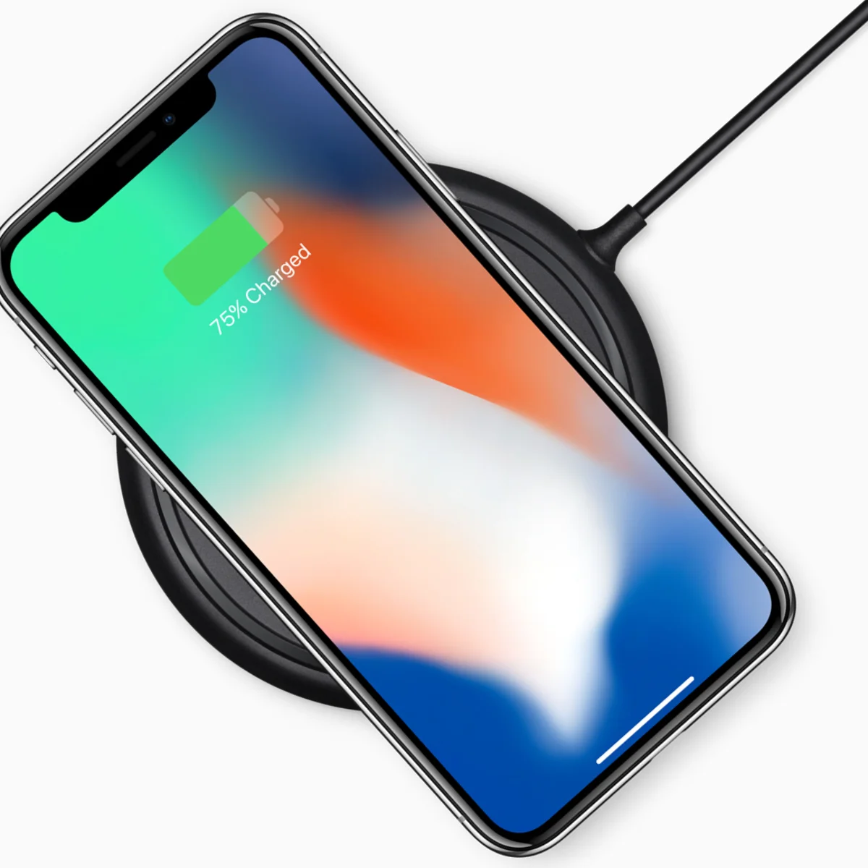
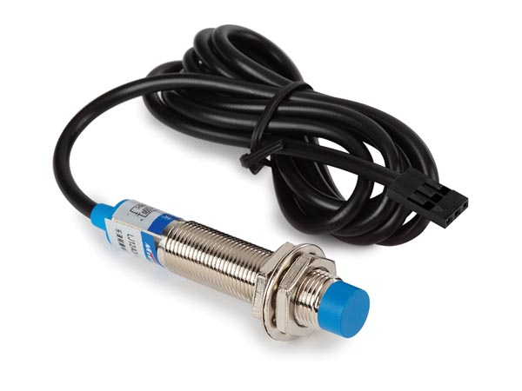
Transformers
Alternators
Electric Generators
Applications of
Faraday’s Law
Inductive Charging
Metal Detectors
Proximity Sensor
Notes:
Instructional Activity: Present Content, Enhance Transfer and Retention
Instructional Time: 2 min.
Talking Points:
Faraday’s Law explains how a changing magnetic field can create electricity. What makes this powerful is how widely it’s used in real systems.
Transformers rely on changing magnetic fields to increase or decrease voltage so electricity can be transmitted efficiently and used safely.
Alternators and electric generators convert mechanical motion into electrical energy. As components rotate within a magnetic field, voltage is induced and current is produced.
Inductive charging uses changing magnetic fields to transfer energy without direct contact, like wireless phone chargers.
Proximity sensors detect metal objects by sensing changes in a magnetic field, which induces a measurable signal.
Metal detectors also use electromagnetic induction. When metal disrupts the magnetic field, a current is induced and detected.
All of these applications come back to the same principle: a changing magnetic field creates an electric field, and that electric field drives current.

Slide 41
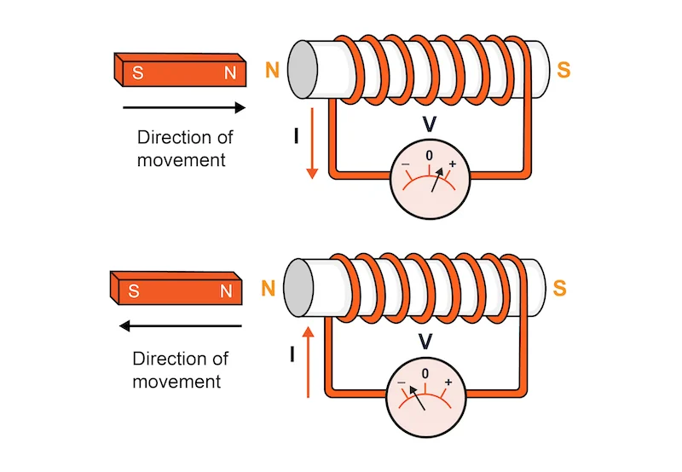
Demo: Faraday’s Law
Goal: Show that moving a magnet near a coil creates electricity, and that faster movement produces a bigger effect.
Steps:
Connect coil ends to the LED or multimeter.
Move the magnet slowly through the coil.
Observe a small flicker/needle jump
Move the magnet faster. Compare the difference.
Try different magnet orientations or multiple passes.
Notes:
INSTRUCTIONAL ACTIVITY: Present Content, Recall
TIME: 15 min.
Materials:
Copper wire coil (100–200 turns)
Small LED or multimeter
Neodymium magnet
Optional kit to purchase: https://statics.teams.cdn.office.net/evergreen-assets/safelinks/2/atp-safelinks.html
Do:
Find a flat surface for the demo where everyone can see.
Facilitate the demonstration
Connect coil ends to the LED or multimeter.
Move the magnet slowly through the coil.
Observe a small flicker (LED) or needle jump (meter).
Move the magnet faster. Compare the difference.
Try different magnet orientations or multiple passes.
Use the debrief questions below to facilitate a discussion.
Debrief Discussion:
Why does the meter only jump when the magnet is moving?
How does speed affect the voltage?
Where do we use this principle in transit systems?
Image Source: All About Circuits. (n.d.). Lenz’s law calculator / Faraday’s law calculator. https://www.allaboutcircuits.com/tools/lenz-law-calculator-faradays-law-calculator/

Slide 42
Knowledge Check
What key action causes electricity to flow in a coil of wire?
A. Keeping a magnet still beside the coil
B. Moving a magnet near the coil
B. Moving a magnet near the coil
C. Heating the coil
D. Adding more wire to the coil
Notes:
*This slide has animations. Click to reveal content.
Instructional Event: Evaluate Performance, Provide Feedback
Learning Objective: Explain how electromagnetism works and describe how electricity and magnetism are related.
Time: 2 min
Do:
Review the knowledge check questions.
Call on learners to share their responses.
CLICK to reveal the answers. Provide feedback by correcting any thinking errors learners may have.
Answer Key:
B. Moving a magnet near the coil

Slide 43
Knowledge Check
According to Faraday’s Law, what increases the amount of current or voltage produced?
A. Using a stronger battery
B. Reversing the coil direction
C. Moving the magnet faster
C. Moving the magnet faster
D. Adding more insulation
Notes:
*This slide has animations. Click to reveal content.
Instructional Event: Evaluate Performance, Provide Feedback
Learning Objective: Explain Faraday’s Law of induction and how changing magnetic fields are used to generate electricity in real-world systems.
Time: 2 min
Do:
Review the knowledge check questions.
Call on learners to share their responses.
CLICK to reveal the answers. Provide feedback by correcting any thinking errors learners may have.
Answer Key:
C. Moving the magnet faster (Changing the magnetic field more quickly)

Slide 44
Knowledge Check
Why does moving a magnet past a coil make electricity?
A. The coil stores energy like a battery
B. The movement creates and electric field that pushes electrons
B. The movement creates and electric field that pushes electrons
C. The magnet rubs electrons off the wire
D. The wire becomes permanently magnetized
Notes:
*This slide has animations. Click to reveal content.
Instructional Event: Evaluate Performance, Provide Feedback
Learning Objective: Explain how electromagnetism works and describe how electricity and magnetism are related.
Time: 2 min
Do:
Review the knowledge check questions.
Call on learners to share their responses.
CLICK to reveal the answers. Provide feedback by correcting any thinking errors learners may have.
Answer Key:
B. The movement creates and electric field that pushes electrons

Slide 45
Summary and On the Job
Key Ideas:
Magnets have poles — like poles repel, opposite poles attract
Magnetic fields act across space, even without contact
Moving electric charges create magnetic fields
Changing magnetic fields create electric current (Faraday’s Law)
On the Job:
Relays, contactors, and solenoids rely on electromagnets
Motors and generators rely on magnetic fields
Understanding magnetism helps you troubleshoot and stay safe
Notes:
INSTRUCTIONAL ACTIVITY: Enhance Transfer and Retention
TIME: 2 min
DO: Review key points.
Talking point:
Let’s step back and look at the big picture of what we covered in this module.
First, magnets have poles. Like poles repel, and opposite poles attract. That push and pull is the foundation of everything we discussed.
Magnetic fields act across space. They don’t require physical contact to create force.
When electric charges move, they create magnetic fields. And when magnetic fields change, they can create electric current. That’s the principle behind Faraday’s Law.
This isn’t just theory. On the job, electromagnets move relays and contactors. Motors turn electrical energy into motion. Generators and alternators produce electricity using magnetic fields.
When you understand how magnetism and electromagnetism work, you’re better prepared to diagnose issues, repair systems correctly, and work safely around energized equipment.
Everything in this module connects back to one idea: electricity and magnetism are not separate — they work together in nearly every electrical system you touch.

Slide 46

Quiz
Time for a quiz! Let’s see what you have learned from today’s lesson.
Notes:
Instructional Activity: Direction, Evaluate/Assess Performance
Instructional Time: 20 min.
Materials: Quiz_M5
Do:
Ask learners if they have any lingering questions. Address them before distributing the quiz.
the quiz and review the directions.
Talking Points:
Time for a quiz! Let’s see what you have retained from today’s lesson.

Slide 47
Revisiting the Objectives
Explain basic magnetism, including magnetic fields, poles, and magnetic materials.
Explain how electromagnetism works and describe how electricity and magnetism are related.
Describe how an electromagnet works and what affects its strength.
Explain how electromagnetism is used in transit systems such as relays, motors, and generators.
Explain Faraday’s Law of induction and how changing magnetic fields are used to generate electricity in real-world systems.
Notes:
Instructional Activity: Enhance Transfer and Retention
Instructional Time: 5 min.
Do: Facilitate a short discussion to review the key topics in the lesson.
Talking Points:
If you were explaining today’s objectives to someone else, how would you summarize what they mean and why they matter?
Which of today’s objectives do you feel most confident about? Which were most challenging? Explain your reasoning.
Can you give an example of how you could apply one of today’s objectives in a real-world situation?
After Discussion:
This conclude this section of the module. Thank you for your participation.

Slide 48
Thank you!

