Slide 1
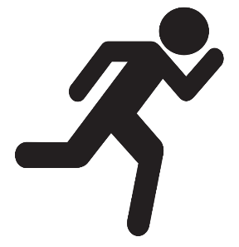


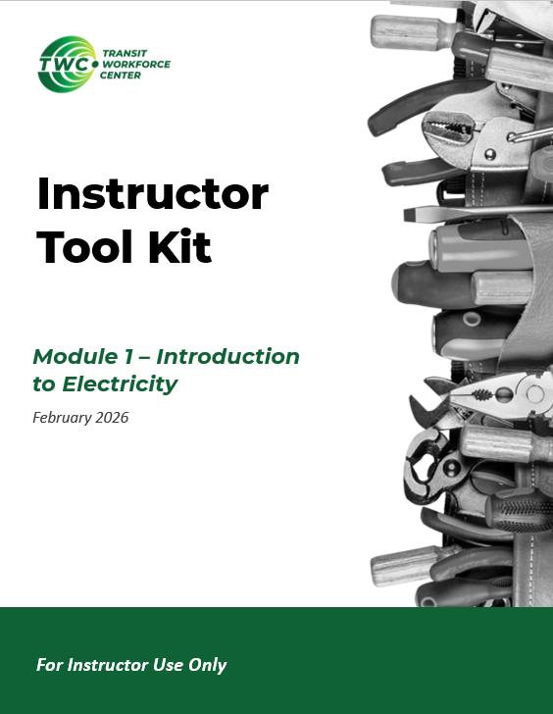
Instructor Guide Snapshot
Icon Key
Activity:
Video:
Instructor Demo:
Knowledge Check:
Instructional Time: 4.5 Hrs.
Preparation before class:
Review all materials - Review all slides, talking points, and handouts before class to understand the structure and flow of the lesson. Pay special attention to animations within the slides.
Package Group Activity Materials - The learning activity in this module is a small group activity. Each group will need the items listed in “Additional Materials” below. Consider packing up 3-4 group bundles in a Ziplock bag before class.
Pre-build a circuit (see slides 10, 36).
Provided Materials:
+Introduction to Electricity_M1.pptx
+Instructor Facilitation Toolkit_M1 – For instructor use only.
  Electricity Review_Answer Key_M1.docx
  Quiz_Answer Key_M1.docx
+Participant Resource Guide_M1.docx - Print one copy for each learner. All handouts that leaners need for activities are embedded in the Participant Resource Guide.
  Electricity Review_M1.docx
  Paper Clip Circuit_M1.docx
Quiz_M1.docx - Print one copy for each learner.
Additional Materials:
A list of additional materials needed for demonstrations and activities can be found in the Instructor Facilitation Toolkit on page 3.
Notes:
*This slide contains animations. CLICK to reveal content.
Instructional Activity:
Instructional Time:
Materials:
Do:
Talking Points:

Slide 2
Pacing Guide
Times have been rounded to the nearest .25 hours.
Total Time: 4.5 Hours
  (.50 Hrs.)– Welcome and Introduction
  (.50 Hrs.) – 1.1 – How We Discovered Electricity
  (1.25 Hr.) – 1.2 – Electricity as Energy
  (1.25 Hr.) – 1.3 – Inside the Atom: Where Electricity Begins
  (.50 Hrs.) – 1.4 – How Electricity is Generated and Its Significance
  (.50 Hrs.) – Quiz and Wrap Up

Slide 3
Module 1 - Introduction to Electricity
Transit Core Competencies Curriculum (TC3)
Electrical Foundations
Notes:
Instructional Activity: Direction
Instructional Time: 1 min.
Do: Welcome learners to class.

Slide 4
Objectives
Explain what electricity is and how it is used in everyday work.
Explain the difference between static electricity and current electricity.
Explain how electricity is made and why it is important in transit systems.
Identify key people who helped develop electricity and how their work affects modern systems.
Describe the basic parts of an atom and explain how electrons create electrical flow.
Recognize the difference between Direct Current (DC) and Alternating Current (AC).
Identify conductors and insulators and explain why both are needed for safety.
Notes:
Instructional Activity: Direction
Instructional Time: 2 min.
Do: Review the module objectives.

Slide 5
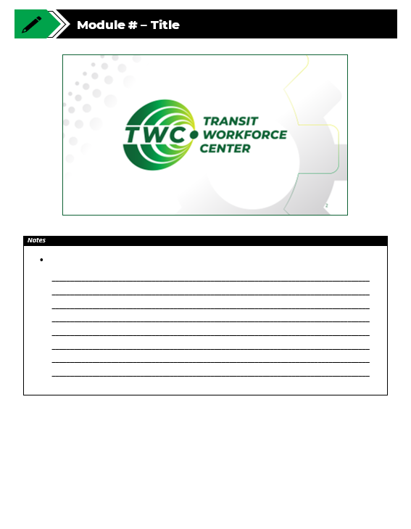
Agenda
Welcome and Introduction
1.1 - How We Discovered Electricity
1.2 - Electricity as Energy
1.3 - Inside The Atom: Where Electricity Begins
1.4 - How Electricity is Generated and Its Significance
Quiz
Notes:
Instructional Activity: Direction
Instructional Time: 2 min.
Materials: Participant Guide Resource
Do:
Review the module agenda.
Remind learners that they have a Participant Guide Resource which they can use for optional notetaking.

Slide 6
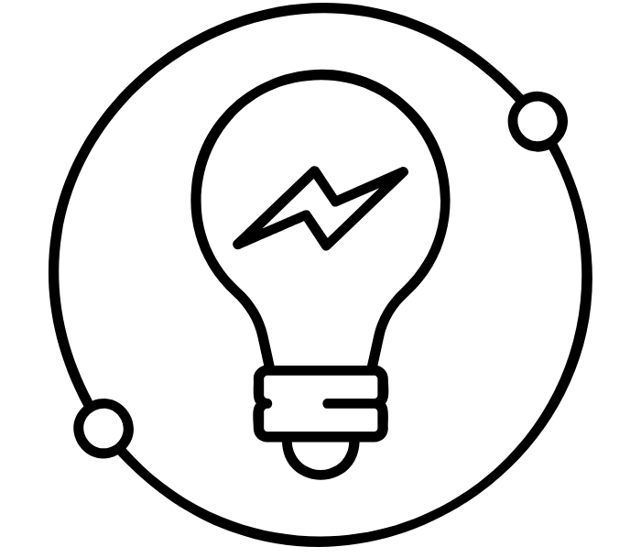
Welcome to Basic Electricity
This course will focus on:
Core ideas behind electricity
Common electrical language used on the job
How electrical systems work
What to Expect:
Concepts that start simple and build over time
Repetition to build understanding
No advanced math or engineering background required
Questions are encouraged
Notes:
Instructional Activity: Direction
Instructional Time: 2 min
Talking Points:
Course Focus:
This course is called Basic Electricity and we’re starting with the core ideas behind electricity — the things that show up no matter what system or job you’re working on.
You’ll hear a lot of common electrical language in this course. These are terms you’ll hear on the job, in procedures, and in conversations with coworkers.
We’re also going to spend time on how electrical systems actually work. The goal is understanding what’s happening in the system, not just memorizing steps
What to Expect:
As we move through the course, concepts will start simple and build over time.
You’ll notice repetition, and that’s intentional. Each time a concept comes back, it should make a little more sense.
There’s no advanced math in this course and you don’t need an engineering background to follow along or be successful.
And finally, questions are encouraged. If something doesn’t click, ask — we’re all here to learn.
Icon Attribution: Created by karyative from The Noun Project

Slide 7
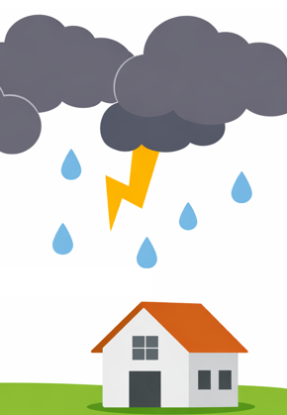
Warm Up
Imagine there is a thunderstorm outside. Suddenly, the power goes out.
What are the first things you notice?
What do you think is happening when your home loses power?
Notes:
Instructional Activity: Gain Attention, Recall
Instructional Time: 5 min.
Materials: Flip chart or white board, markers
Do:
Record learners' responses on white board or flip chart.
Be sure to capture learners’ predictions for question 2. You will be returning to these predictions in a few slide.
Talking Points:
I want you to picture a thunderstorm outside. There’s a loud boom, and suddenly the power goes out.
Take a second and think about the first things you notice. What changes right away when the power is gone?
Pause and call on learners to respond.
When you lose power, nothing inside your house suddenly breaks, but the electricity isn’t available anymore.
What do you think is happening when your home loses power?
Pause and call on learners to respond.
We’re going to come back to these predictions in a few moments.
In the next part, we’ll look at a very simple circuit to help explain what’s happening behind the scenes when power is on — and what changes when it’s not.
Icon Attribution: Home by Kamin Ginkaew from Noun Project (CC BY 3.0)

Slide 8
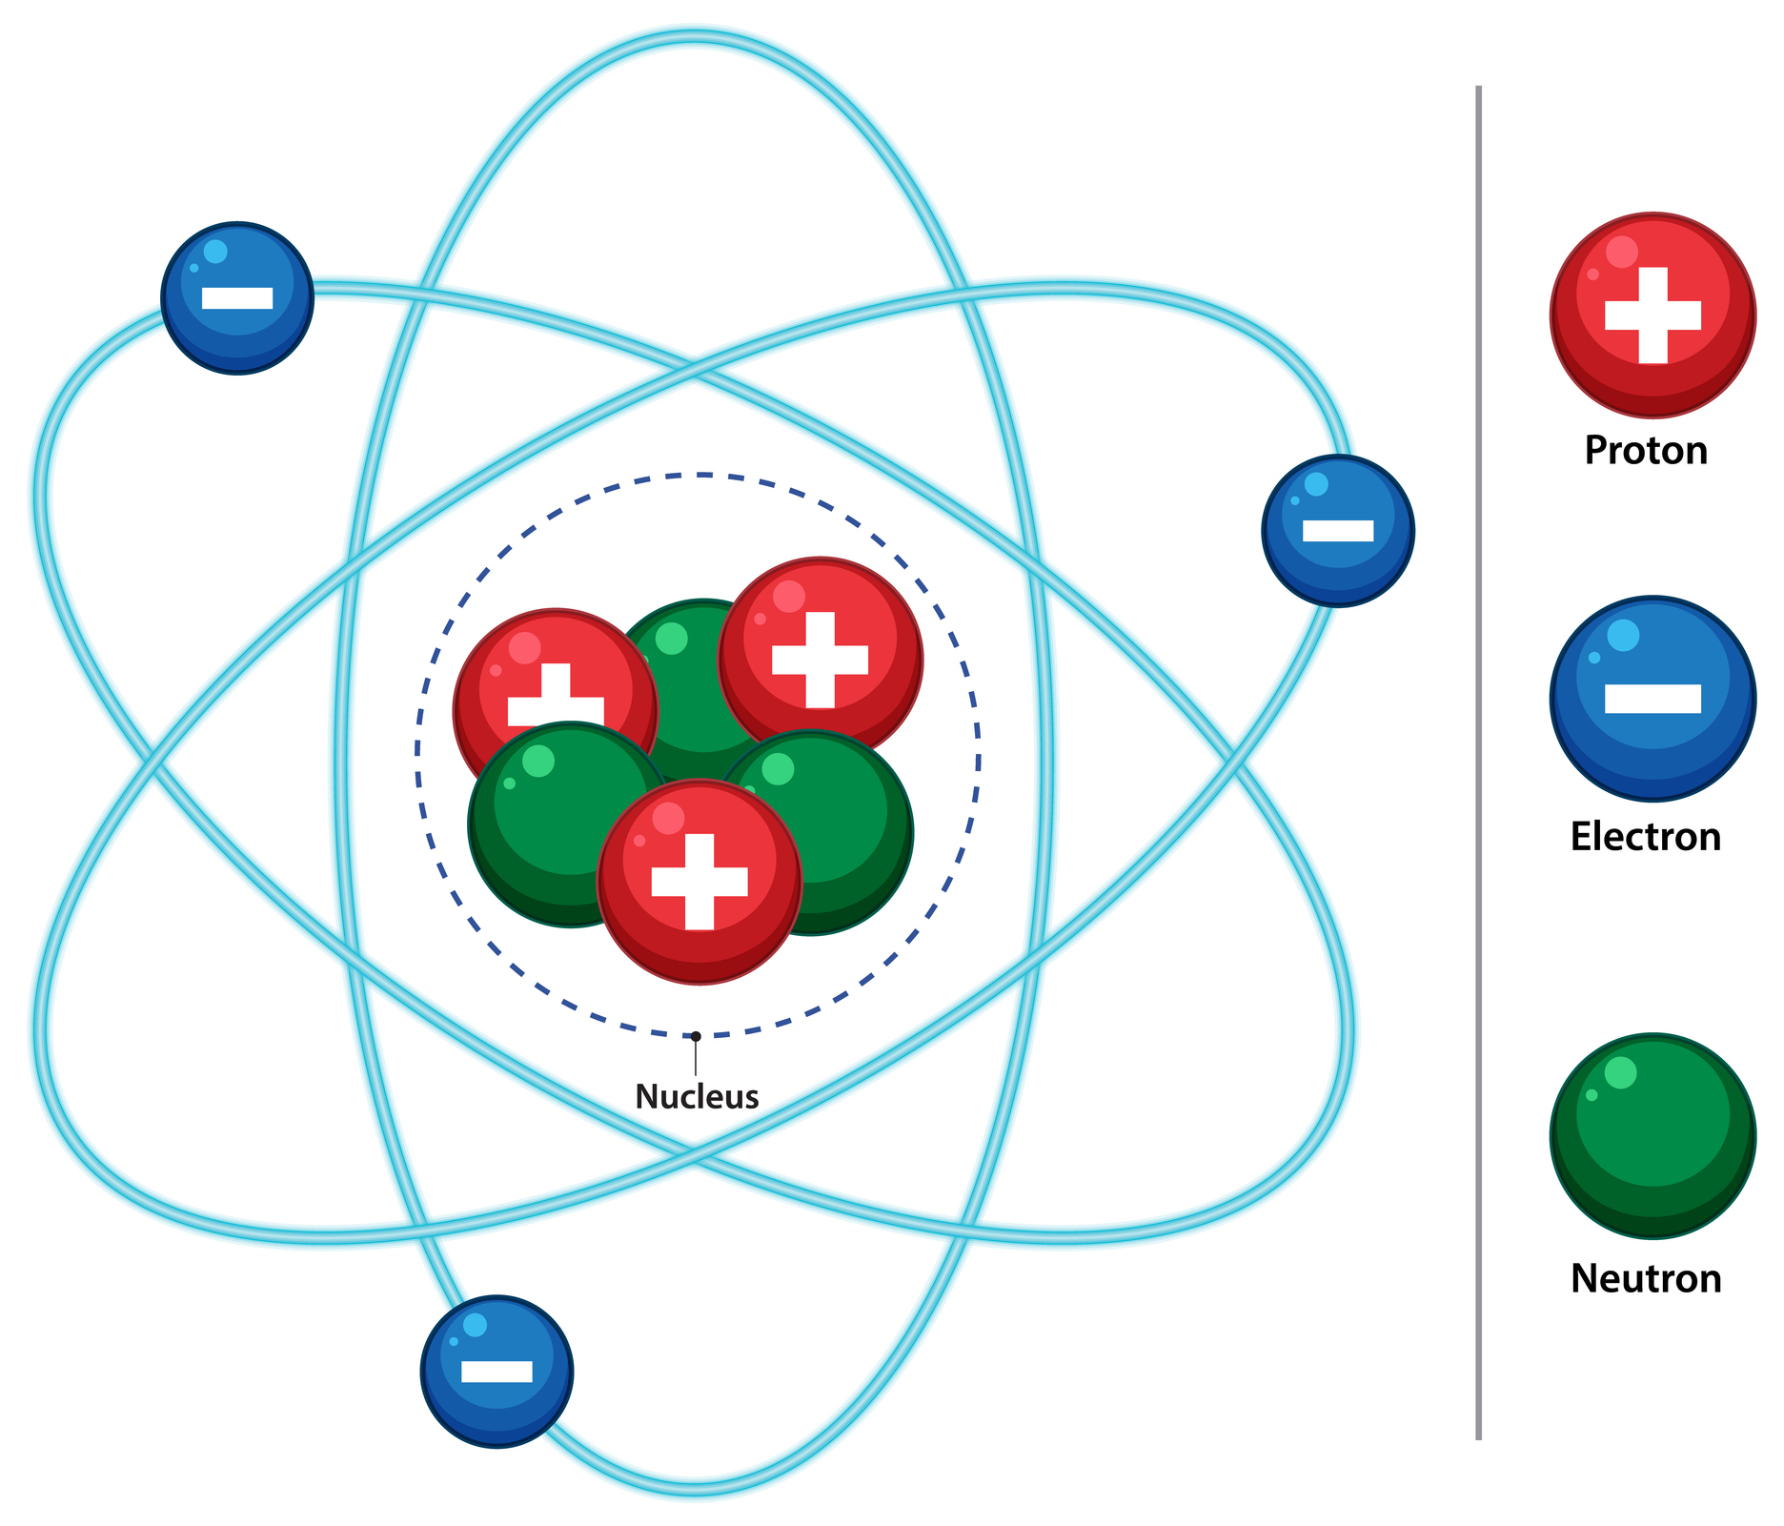
What is electricity?
Everything is made of atoms which contain tiny particles called electrons
Electrons usually stay in place
Electricity happens when electrons move due to a push from a power source
Electricity needs a complete path, called a circuit
Notes:
Instructional Activity: Present Content
Instructional Time: 3 min
Talking Points:
Understanding what happens when the power goes out in your home starts with the question, “What is electricity?”
To understand electricity, we’re going to start very small.
Everything around us is made of atoms.
Inside atoms are tiny particles called electrons.
Under normal conditions, those electrons stay where they are.
Electricity is what we call it when electrons start to move. That movement doesn’t happen on its own — something has to push them.
That push usually comes from a power source. It could be a battery, a power supply, or another electrical source.
One important thing to understand is that electricity doesn’t move randomly.
Electrons need a complete path to travel. That complete path is called a circuit.
If the path is broken, the electrons stop moving — and the electricity stops.
In the next part, we’ll look at a simple circuit so you can see what that path actually looks like

Slide 9
What is a circuit?
2. Load
A complete path that allows electricity to flow
Electricity starts at a power source and returns to that source
  Complete path = electricity flows
  Broken path = electricity stops
A basic circuit needs three things:
3. Wire
1. Power Sources
Notes:
*This slide contains animations. CLICK to reveal content.
Instructional Activity: Present Content
Instructional Time: 3 min.
Talking Points:
On the last slide, we talked about electricity as the movement of electrons. For those electrons to move, they need somewhere to go.
A circuit is the path that allows that movement to happen. It’s a complete loop that starts at a power source and eventually returns back to it.
When that path is complete, electrons can move and electricity flows
If the path is broken anywhere along the way, the movement stops
Every basic circuit needs three things
CLICK - First, a power source — something that provides the push, like a battery or power supply.
CLICK - Second, a load — something that uses the electricity to do work, like a light or a motor.
CLICK -Third, a path — usually wires — that gives the electrons somewhere to travel
All three have to be connected in a loop for the circuit to work. That loop is what keeps the electrons moving
As we move through the course, everything we learn will help explain what’s happening in a circuit
ASK: Quick question - Why is the path so important?
Pause and call on learners to respond to assess understanding.
We’ll study circuits in more detail later, but for now, the key idea is simple: electricity only does useful work when it has a complete path to follow

Slide 10
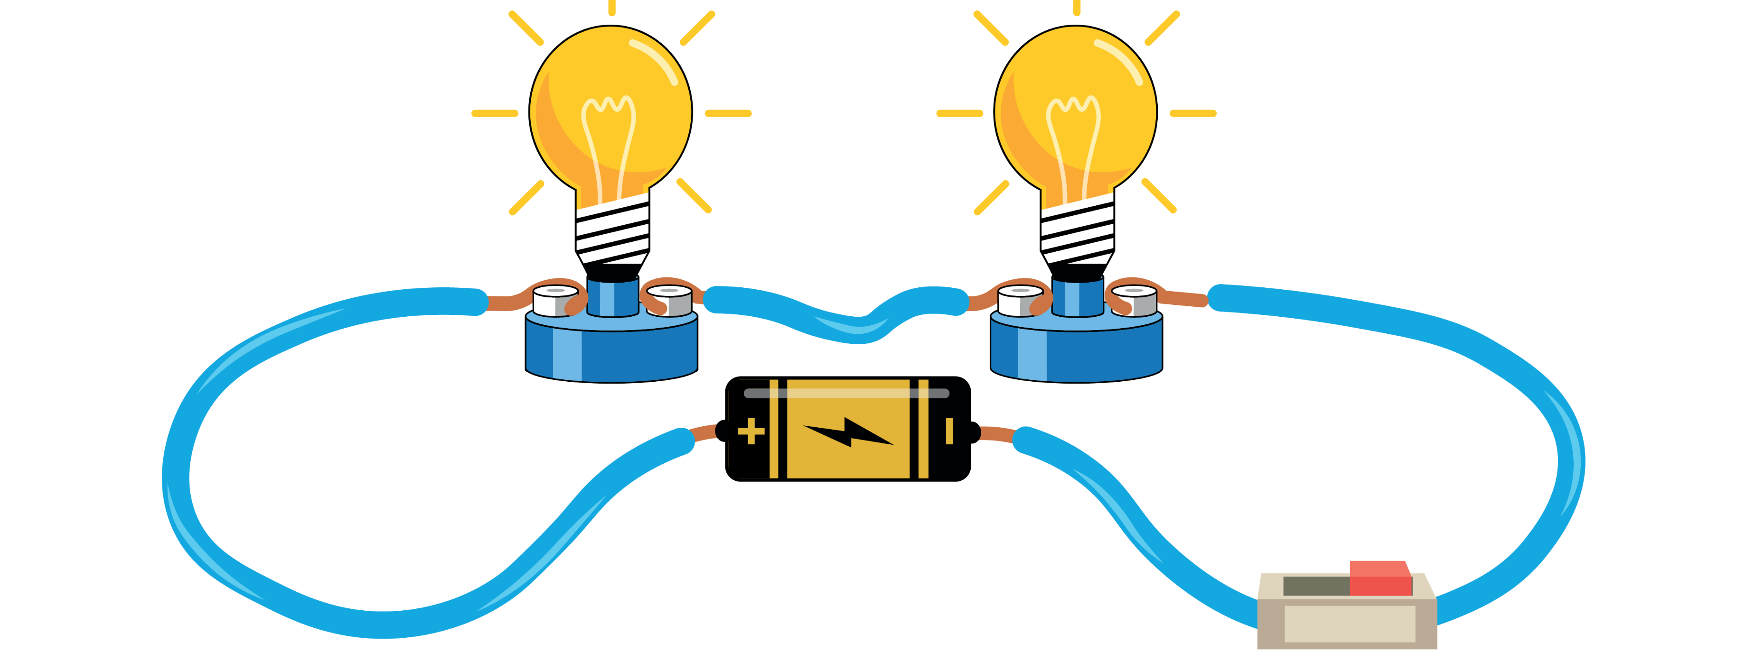
Instructor Demo: Electricity at Work
We’ll use a simple electrical circuit in the course to explore:
How atoms and electrons make electricity possible
How electricity is created
How electricity travels to accomplish work
Notes:
*Reminder – You will need a pre-built circuit for this brief demo.
Instructional Activity: Gain Attention
Instructional Time: 10 min.
Materials:
Jumper wires
D-cell battery and holder, or power source (low voltage)
Load – 2 lightbulbs (3-5 Volts)
Switch – SPST small switch
Do:
Place the basic circuit in the front of the room so it is visible to all learners.
Point out the battery source, wire, switch, and load.
Show learners what happens when you connect and disconnect the path.
If time permits, allow leaners to connect and disconnect the path to bring the concept to life.
Talking Points:
Let’s Start With a Simple Circuit. We’re going to build a small circuit — battery, wires, switch, and a bulb — because the exact same principles apply to:
Headlights and marker lights, fan motors and blowers, door systems, pumps, sensors, and so much more.
If you understand what’s happening in this small circuit, you can apply this understanding to a wide variety of machines.
Image Source: Zefry - stock.adobe.com

Slide 11
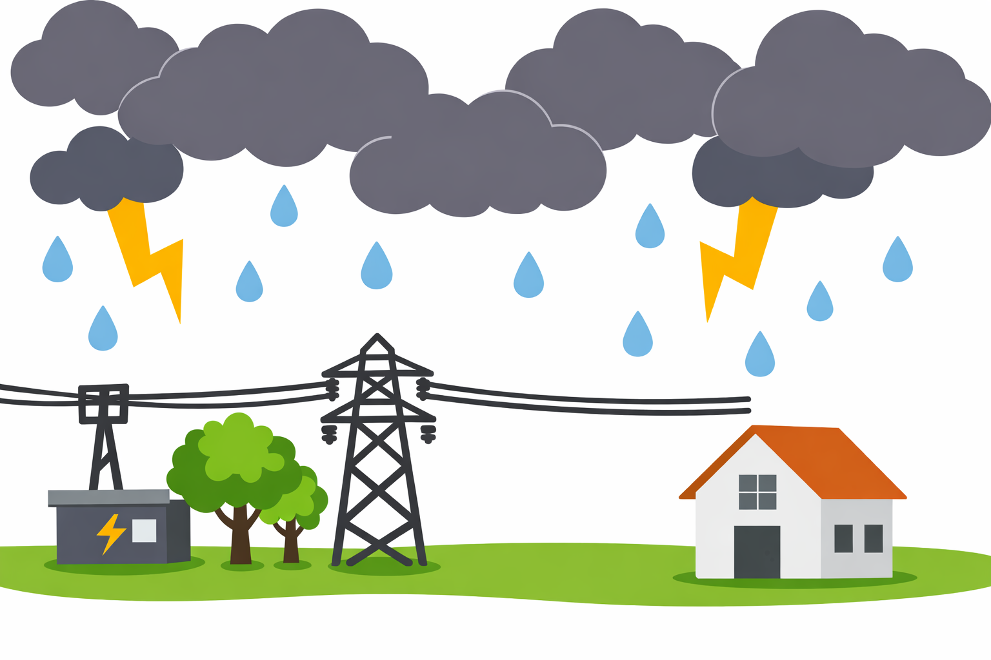
Let’s Return to Our Warm Up
Notes:
Instructional Activity: Gain Attention, Recall
Instructional Time: 5 min.
Materials: Flip chart or white board, markers
Do:
Review the talking points below.
Return to the predictions on the white board/flip chart.
Discuss which predictions were correct and incorrect.
Talking Points:
Let’s return to our warm-up scenario now that we have a fuller picture of what’s going on.
ASK: What are the three things we need for electricity to flow in a circuit?
Pause and call on learners to respond. Use talking point below to review answer.
CLICK – That’s right. We need a power sources, a wire to create a path, and a load. In this case the load is your home – the thing that needs power.
ASK: Same question as our warm up question - What happens when your home loses power?
Pause and call on learners to respond. Use talking point below to review answer.
CLICK – Usually when our home loses power, the path (wire) has been disrupted causing the electricity to stop flowing. The result? Our home loses power.
Let’s look back at our predictions on the white board/flip chart. Did we predict anything correctly? Did we make any errors?
Review predictions.

Slide 12
Why Learn Electricity?
Every day on the job, you work on systems that rely on electricity to run safely:
Lighting, HVAC, doors, pumps
Battery systems on electric buses
Alternators, inverters, converters
Control circuits, sensors, switches
If electricity can’t flow the way it should, the components, devices, and systems won’t work (or won’t work safely).
Notes:
Instructional Activity: Enhance Transfer and Retention
Instructional Time: 2 min.
Talking Points:
Before dive deeper into today’s topic, it’s important to talk about why electricity matters.
This isn’t just theory — it shows up in the systems you work with every day.
Things like lighting, HVAC, doors, pumps and battery systems are critical to keeping vehicles moving.
You’ll also run into components like alternators, inverters, and converters.
And behind the scenes, control circuits, sensors, and switches are constantly at work.
When electricity flows the way, it’s supposed to, these systems do their job. When it doesn’t, systems may not work at all — or they may work in unsafe ways.
The goal of this course is to help you understand what normal looks like. So, when something isn’t right, you can recognize it and respond appropriately.

Slide 13
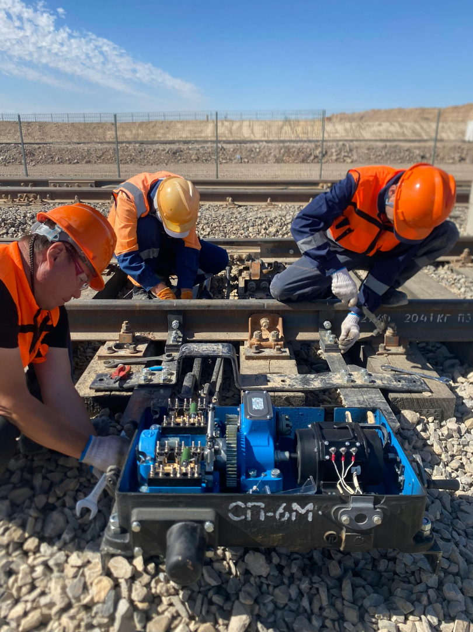
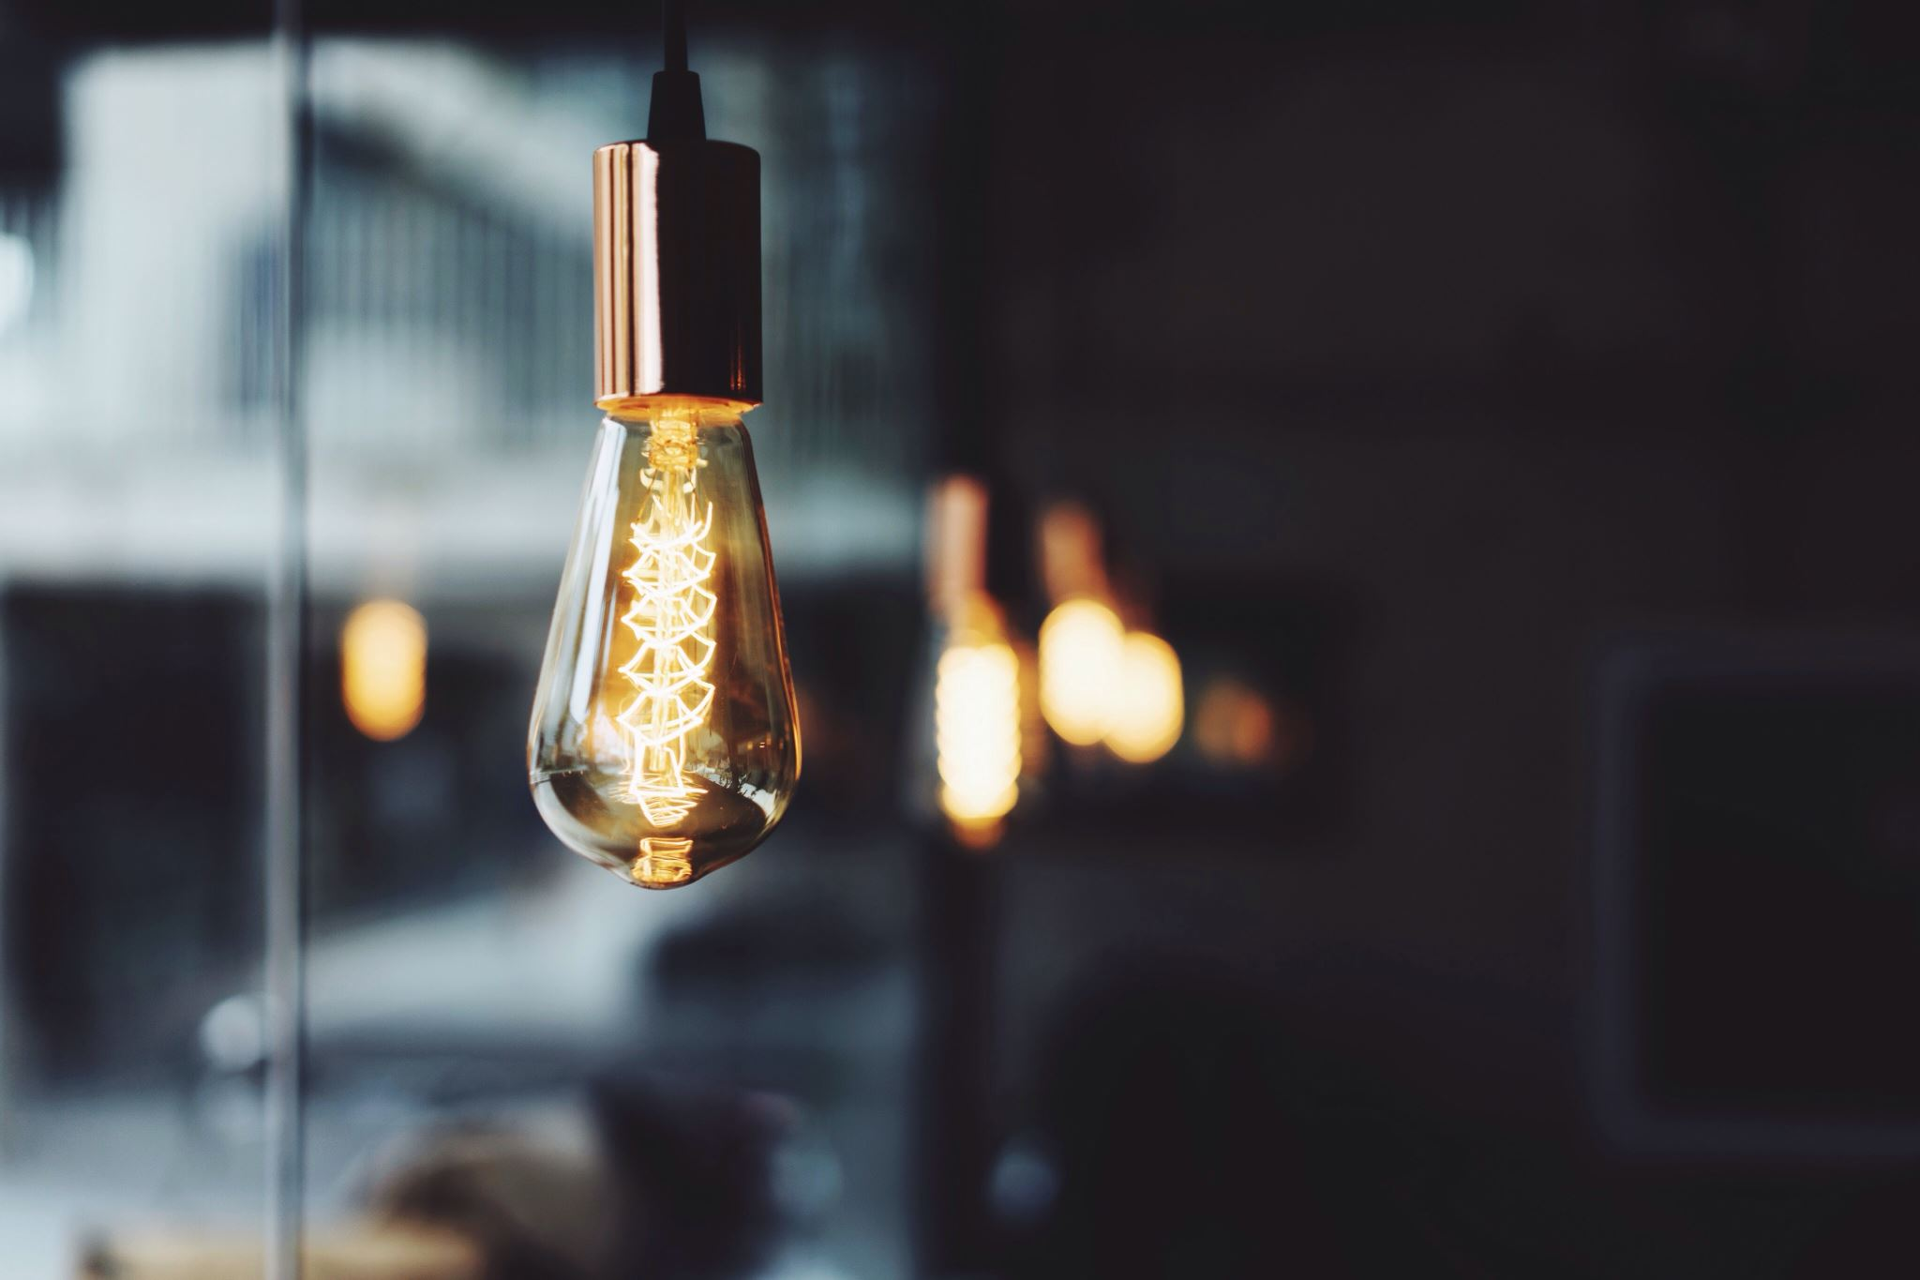
1.1 – How We Discovered Electricity
Electricity changed the world – but who discovered how it works? In this section, we’ll discuss the people and technological breakthrough that got us where we are today.
Notes:
Instructional Activity: Direction
Instructional Time: 1 min.
Do: Introduce the section.
Talking Points:
Electricity changed the world – but who discovered how it works?
In this section, we’ll discuss the people and technological breakthrough that got us where we are today.

Slide 14
Milestones in Electric Technology
1800s
Early 1900s
Late 1900s
21st C.
Electric lighting and power grids
Electric motors, radios, telegraphs
Computers, electronics, telecommunications
Smart grids, renewable energy, electric vehicle
Notes:
*This slide contains animations. CLICK to reveal content.
Instructional Activity: Present Content
Instructional Time: 3 min.
Talking points:
Electricity wasn’t invented—it was discovered, studied, and developed over time by some of the greatest scientific minds.
CLICK - In the 1880s, we saw the first electric lights and the development of power grids to deliver electricity to homes and businesses.
CLICK - By the early 1900s, electric motors, radios, and the telegraph changed communication and manufacturing.
Most don’t know this, but electric cars were invented back in the 1890s! An electric vehicle held the vehicular land speed record until around 1900. The hybrid car was invented in 1903!
CLICK - The late 1900s brought computers, microelectronics, and global telecommunications—revolutionizing work, education, and connection.
CLICK - And today, in the 21st century, we’re seeing smart grids, rapid growth in renewable energy, and widespread use of electric vehicles.
These milestones show how understanding and using electricity has continually shaped society—and will keep doing so into the future.

Slide 15
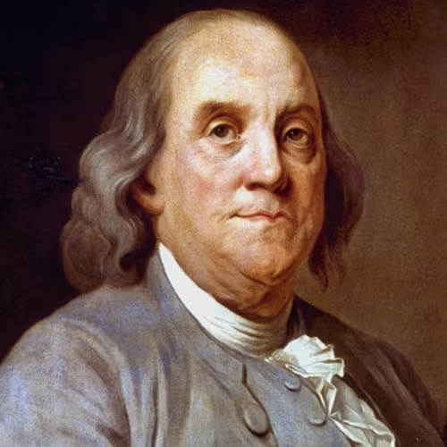
Key Figures in the Discovery of Electricity
Linked lightning to electricity (1752).
Benjamin Franklin
Alessandro Volta
Michael Faraday
Thomas Edison
Notes:
Instructional Activity: Present Content
Instructional Time: 2 min.
Talking points:
Benjamin Franklin demonstrated the connection between lightning and electricity through his famous kite experiment.
Kite Experiment: Ben Franklin waited until a thunderstorm was happening, and went outside with a kite, string and a key.
He wrapped the key in string, which was connected to the kite via the string, which got wet in the rain
As the kite flew up into the sky, Franklin noticed the metal key was attracting the lightning coming from the storm clouds
Based on his observations, he deducted that lightning was another form of static electrical discharge

Slide 16
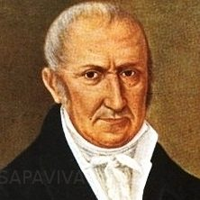
Key Figures in the Discovery of Electricity
Invented the first chemical battery (1800).
Benjamin Franklin
Alessandro Volta
Michael Faraday
Thomas Edison
Notes:
Instructional Activity: Present Content
Instructional Time: 2 min.
Talking points:
Alessandro Volta, a physicist and chemist, created the first chemical battery demonstrating a reliable source of electric current.
The unit of electrical potential – the volt – was named after him.
His work helped make the study of electricity practical and measurable. Specifically, his battery allowed studies of electricity to be more easily controlled

Slide 17
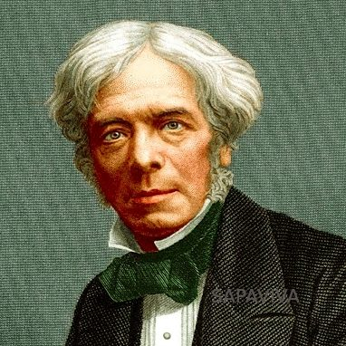
Key Figures in the Discovery of Electricity
Discovered electromagnetic induction (1831).
Benjamin Franklin
Alessandro Volta
Michael Faraday
Thomas Edison
Notes:
Instructional Activity: Present Content
Instructional Time: 2 min.
Do: Share we will talk about Faraday in a later module when we talk about electromagnetism.
Talking points:
Michael Faraday discovered electromagnetic induction, which is the principle behind electric generators.
This also helped form the principles behind transformers.
The principles he discovered help make electricity tangible and offered practical application.

Slide 18
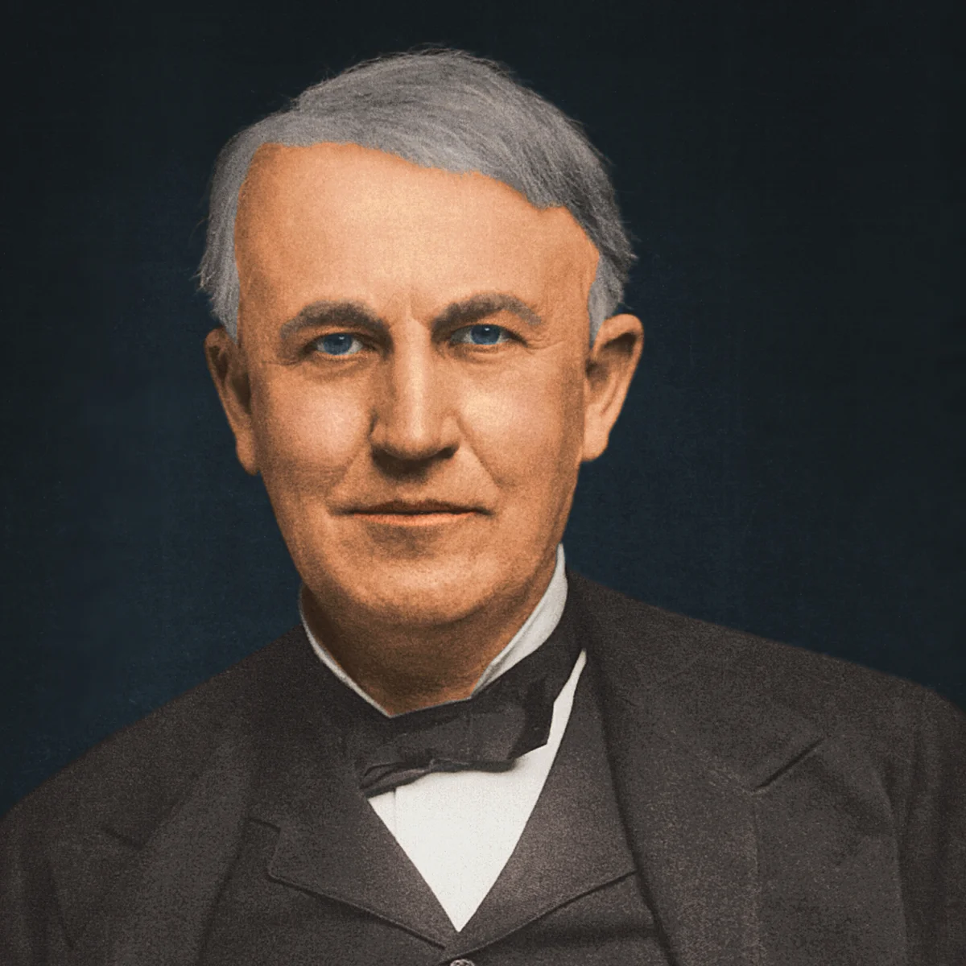
Key Figures in the Discovery of Electricity
Developed practical electric light bulb (1879).
Benjamin Franklin
Alessandro Volta
Michael Faraday
Thomas Edison
Notes:
Instructional Activity: Present Content
Instructional Time: 2 min.
Talking points:
Thomas Edison played a key role in electricity by inventing the practical incandescent light bulb and establishing power distribution system.
He held over 1000 patents on his inventions during his lifetime.
Under electrical power distribution, Edison helped create the first electrical power system that could deliver electricity commercially to homes and businesses.
He also played a part in developing the first motion picture camera and projector, while also improving existing inventions such as the telegraph, phonograph and telephone.

Slide 19
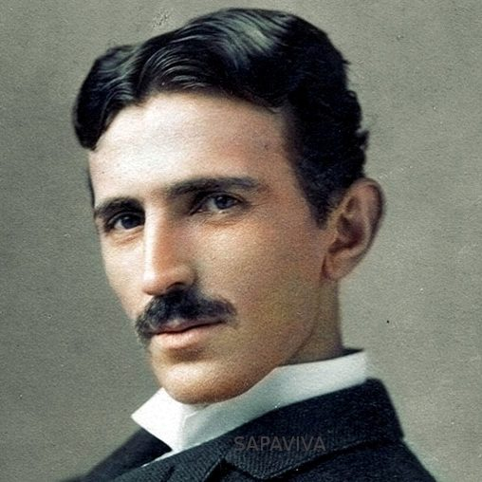
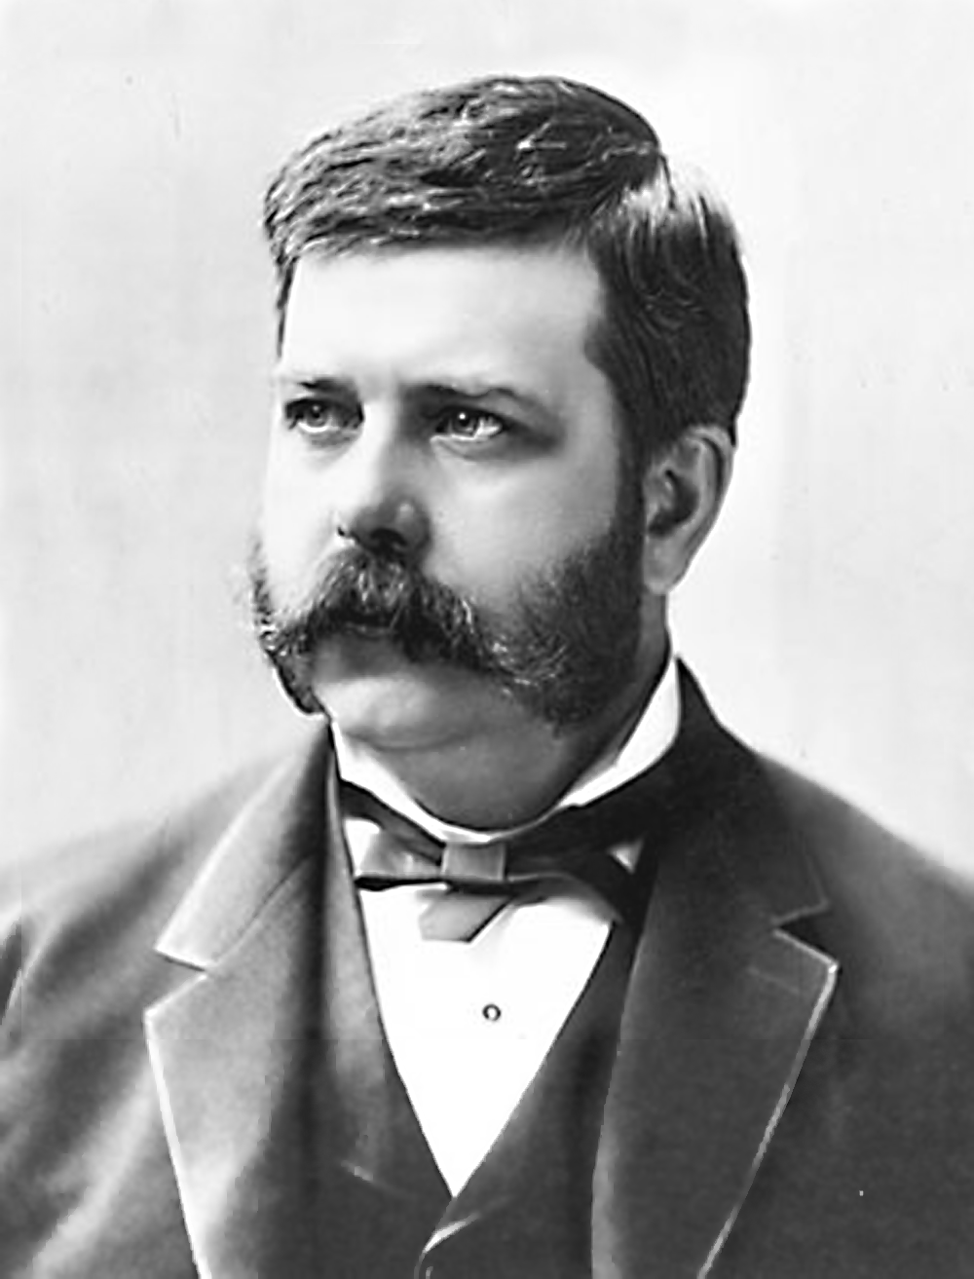
Development of AC Electricity
Nicola Tesla (1856-1943)
  Serbian-American engineer and inventor
  Enabled widespread AC power distribution
  AC power is commonly used in all homes today
  Invented the AC induction motor, vital for industrial use
George Westinghouse (1846-1914)
  Commercialized Tesla’s AC power system
  American inventor and engineer
  Enabled the widespread adoption of alternating current
Notes:
Instructional Activity: Present Content
Instructional Time: 4 min.
Talking points:
To understand AC electricity, it helps to look briefly at how it developed and who was involved.
One of the key figures here is Nikola Tesla, a Serbian-American engineer and inventor working in the late 1800s.
Tesla developed ideas that made alternating current practical for sending power over long distances, which was a big limitation with earlier systems.
He also invented the AC induction motor, which is still the basis for many motors used in industry today—including equipment we rely on across transit systems.
Because of this work, AC power became the standard for distributing electricity, and it’s what we still use in homes and facilities today.
George Westinghouse played a different but equally important role.
He was an American inventor and engineer who took Tesla’s ideas and figured out how to make them work at a large, commercial scale.
Westinghouse invested in and built the infrastructure needed to roll out AC power systems widely.
Together, Tesla’s innovation and Westinghouse’s ability to commercialize it led to the widespread adoption of alternating current.
The big takeaway here is that AC power didn’t just appear overnight—it came from a combination of invention and real-world implementation, which is why it became the backbone of modern electrical systems we still depend on today.

Slide 20
From Discovery to the Shop Floor
Franklin | Volta | Faraday | Edison | Tesla & Westinghouse
Lightning & Electricity | Battery | Electromagnetic Induction | Light Bulb | AC Power Systems
Grounding, static discharge safety during troubleshooting | Bus starting batteries, electric bus energy storage systems (ESS) | Alternators, traction motors, generators | Headlights, signal lights, dashboard illumination | Shop chargers, power tools, test benches
Notes:
*This slide contains animations. CLICK to reveal content.
Instructional Activity: Present Content
Instructional Time: 4 min.
Talking points:
If you look around your shop, you can actually see history in action.
CLICK - Franklin helped identify static electricity (discharge) and how to ground electricity so we can troubleshoot.
CLICK - The battery you test traces back to Volta.
CLICK - The alternator you rebuild is Faraday’s idea in motion.
CLICK - The circuits you troubleshoot owe their roots to Edison and Tesla.
CLICK - Shop chargers, power tools, test benches rely on the AC Power Systems developed by Tesla and Westinghouse.
Understanding where these ideas come from helps you recognize how systems behave—and why safety and precision matter so much in maintenance
These discoveries are built into every vehicle and every shop tool you use.

Slide 21
Knowledge Check
Who Invented the first chemical battery?
  Nikola Tesla
  Alessandro Volta
  Thomas Edison
  Benjamin Franklin
Notes:
*This slide contains animations. CLICK to reveal content.
Learning Objective: Identify key people who helped develop electricity and how their work affects modern systems.
Instructional Activity: Evaluate/Assess Performance, Provide Feedback
Instructional Time: 2 min.
Do: Review the knowledge check questions. Call on learners to share their responses.
Answer Key:
B

Slide 22
Knowledge Check
Which of the following scientists played a key role in electricity by inventing the practical light bulb?
  Alessandro Volta
  Michael Faraday
  Thomas Edison
  Nikola Tesla
Notes:
*This slide contains animations. CLICK to reveal content.
Learning Objective: Identify key people who helped develop electricity and how their work affects modern systems.
Instructional Activity: Evaluate/Assess Performance, Provide Feedback
Instructional Time: 2 min.
Do: Review the knowledge check questions. Call on learners to share their responses.
Answer Key:
C

Slide 23
Summary and What’s Next
Electricity wasn’t invented - since the 1800s, some of the greatest minds discovered and paved the way for practical applications.
Key figures like Volta, Faraday, Edison, and Tesla made groundbreaking discoveries - Their work led to batteries, generators, and widespread power systems.
Key figures like Nicola Tesla and George Westinghouse - Their work led to widespread AC power systems, critical inventions and commercialized use of electricity.
Next, we’ll move on to define electricity, voltage, current and the difference between direct current (DC) and alternating current (AC).
Notes:
Instructional Activity: Enhance Retention and Transfer
Instructional Time: 5 min.
Do:
Review the key takeaways from this section of the module.
Clearly explain how to connects to the next section of the module.
Talking points:
These three areas build a complete picture—from what electricity is, to how it's made, who developed it, and how it works on a microscopic level.
By connecting history, science, and real-world use, we’ve built a foundation for both understanding and applying electrical concepts.
Let’s review the key concepts from this module:
Electricity wasn’t invented – since the 1800s, some of the greatest minds discovered and paved the way for practical applications.
Key figures like Volta, Faraday, Edison, and Tesla made groundbreaking discoveries. Their work led to batteries, generators, and widespread power systems.
Key figures like Nicola Tesla and George Westinghouse - Their work led to widespread AC power systems, critical inventions and commercialized use of electricity.
What’s Next? We’ll move from who discovered electricity to what it actually is — the form of energy that powers every system you maintain.

Slide 24
1.2 – Electricity as Energy
Electricity is a type of energy that makes our systems work. What is it, and how does it power the equipment we maintain?
Notes:
Instructional Activity: Direction
Instructional Time: 2 min.
Do: Introduce the section.
Talking Points:
Electricity is a type of energy that makes our systems work.
In this section we’ll explore what it is and how it powers the equipment we maintain.

Slide 25
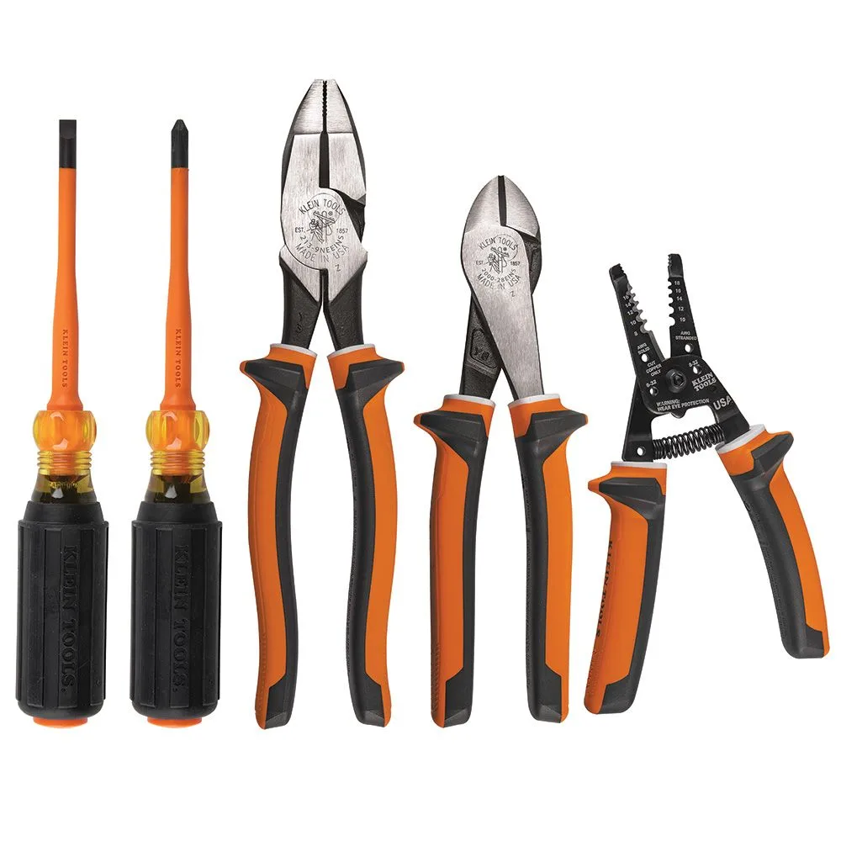
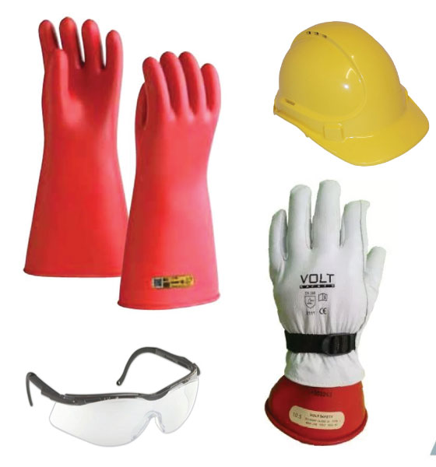
Electrical Safety
Electricity can be dangerous — even at low voltage
Shocks, burns, and fires can occur if safety rules aren’t followed
Best Practices Include:
  Wear proper protective equipment
  Use insulated tools
  De-energize circuits before working
  Follow lockout/tagout procedures
Notes:
*This slide contains animations. CLICK to reveal content.
Instructional Activity: Present Content
Instructional Time: 2 min.
Talking points:
Electrical work always starts with safety — no exceptions.
Electricity is powerful, and even low-voltage systems can be dangerous.
Shocks, burns, and fires can happen if safety rules aren’t followed.
A big part of staying safe is understanding what you’re working with. You should never work with electricity unless you’re confident you know what’s going on.
That’s why there are a few best practices we always follow.
CLICK:
We wear proper protective equipment and use tools designed for electrical work.
We make sure circuits are de-energized before working on them and we follow lockout/tagout procedures.
That means locking out the power source and tagging the equipment, so no one accidentally restores power.
Awareness and preparation are key to working safely around electricity.
We’ll spend more time on electrical safety later in the course.
For now, the takeaway is simple: understanding electricity helps keep you safe.
Image Sources:
Klein Tools. (n.d.). 1000V insulated 5-piece tool kit. GMESupply. https://www.gmesupply.com/klein-tools-1000v-insulated-5-piece-tool-kit
Aegis Safety. (n.d.). Electrical safety equipment. Aegis Sales. https://www.aegissales.com.au/electrical-safety-equipment

Slide 26

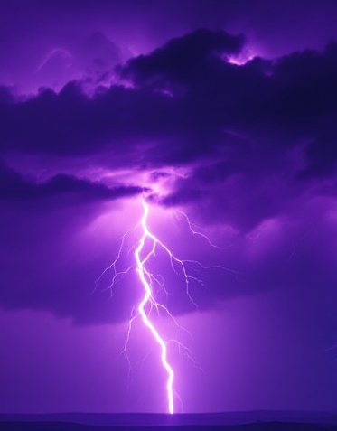
Electricity Basics
Created by moving electrons (usually through a wire)
  When electrons move → devices work
  When electrons stop → devices stop
Electricity can be natural or generated for human use (power plants, solar, wind)
Notes:
Instructional Activity: Present Content
Instructional Time: 2 min.
Talking points:
Electricity isn’t a substance you can hold. It’s the flow of energy, caused by electrons moving through a material, usually a wire.
When electrons are moving, things work. Lights turn on, motors run, blowers spin, relays click, and batteries charge.
When that movement stops, the system stops working. Nothing else has to break — the electrons just aren’t moving anymore.
Electricity can occur naturally, like lightning during a storm, but we’ve also learned how to generate it and control it.
That control is what allows us to power homes, vehicles, tools, and technology.
It’s also what makes electricity so powerful — we can move energy over long distances.
By moving electrons through a wire, we can light cities, operate machinery, and run modern systems.
That’s why electricity is essential to technology, communication, transportation, and even medicine

Slide 27

Static Electricity
Static electricity is built-up charge sitting on a surface until it suddenly releases.
Electrical energy that is stored.
Like a battery, your body can store static charge and release it suddenly.
Notes:
Instructional Activity: Present Content
Instructional Time: 2 min.
Talking points:
There are two main types of electricity you should know about: static electricity and current electricity.
Static electricity is when electric charge builds up on the surface of an object.
It stays in place until it’s suddenly released—like a shock from a doorknob, or a lightning bolt during a storm.
You’ve also felt it when rubbing socks on a carpet and then touching metal.
Static electricity is like water stored in a tank.
Stored energy builds up due to friction or separation of charges.
Image source: Desco Industries. (2017, January 6). Electrostatic charges vs. electrostatic discharges (ESD). Desco Blog. https://desco.blog/2017/01/06/electrostatic-charges-vs-electrostatic-discharges-esd/door-handle-closeup/

Slide 28


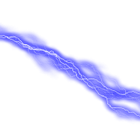

Instructor Demo
Static Balloon Demonstration
Notes:
Instructional Activity: Present Content; Provide Guided Learning; Elicit Performance
Instructional Time: 5 min.
Materials:
2 Balloons
Piece of paper
Do:
Take a balloon and rub it on your shirt.
Place your hand near table and attract small bits of paper.
Give learners a chance to do the same to experiment with static electricity.
Facilitate a short discussion using the talking points below.
Talking Points:
What happened when I/you rubbed the balloons on my shirt?
What do you think happened after I/you put my hand near the paper?
Where have you seen static electricity on the job?
That stored charge built potential energy — that’s like voltage.
Voltage can exist even without a visible current.
Icon Attribution: “Work Management” icon by Soekahurip from Noun Project CC BY 3.0

Slide 29
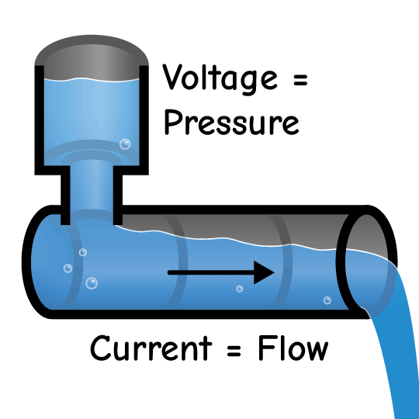
Voltage and its Role in Electricity
Voltage Means Power Is Available
Voltage is the force that pushes electrons through a circuit
Measured in volts (V)
More V means more push on electrons
Voltage = Power Ready
When voltage is present, current can flow
When voltage is removed, current stops
No voltage → no current
Notes:
Instructional Activity: Present Content
Instructional Time: 3 min.
Talking Points:
Voltage does not mean the light is on. It means the light can turn on.
Voltage Means Power Is Available
Voltage is the force that pushes electrons through a circuit.
We measure that force in volts.
More voltage means more push on the electrons
Electrical equipment, like a light bulb, needs voltage (a force) to make current flow, but the voltage might not always be active (flowing).
Voltage = Power Ready
When voltage is present and the circuit is complete, electrons move and the light turns on.
When voltage is removed or disconnected, electrons stop moving and the light turns off.
A good way to think about voltage is water pressure.
The pressure can be there in the pipe, ready to flow, even if the faucet is closed.
That’s why a battery can show voltage but still not power a load.
Voltage simply means power is available

Slide 30
Everyday Maintenance Examples
Scenario | Does it have voltage? | What’s Happening
A bus door when power is off | No Voltage | Control circuit isn’t energized. Electrons aren’t being pushed.
Door motor when door “on” switch is pressed | Yes | Voltage is applied → electrons flow → motor turns
A battery sitting on a work bench | Yes, potentially | Battery itself has voltage potential, but no current flows until connected to a circuit
A break in the wire | Voltage may exist before break, not after | Voltage doesn’t disappear. Just can’t reach the load because path is open.
Notes:
*This slide contains animations. CLICK to reveal content.
Instructional Activity: Present Content, Provide Learning Guidance
Instructional Time: 5 min.
Materials: Pre-built circuit
Do:
Click through each example pausing to ask the learners “Does it have voltage?”
Call on learners to share responses before reviewing “What’s Happening”
Walk learners through each example answering questions as needed.
Use the pre-build circuit to illustrate the examples.
Talking points:
The following table shows several maintenance examples that you might see everyday in your work.
A bus door when power is off. CLICK
Does it have voltage? No voltage
What’s happening? The control circuit isn’t energized. Electrons aren’t being pushed.
The same door motor when door switch is pressed. CLICK
Does it have voltage? Yes
What’s happening? Voltage is applied → electrons flow → motor turns.
A battery sitting on a work bench. CLICK
Does it have voltage? Yes, potentially
What’s happening? The battery itself has voltage potential (ex.12V), but no current flows until connected to a circuit.
A break in the wire. CLICK
Does it have voltage? Voltage may exist before the break, not after.
What’s happening? Voltage doesn’t disappear. It just can’t reach the load because the path is open.

Slide 31
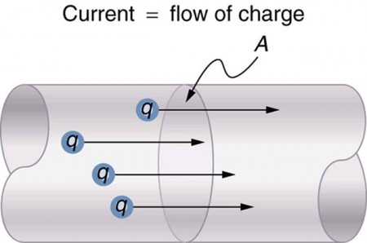
What is Current?
Current is the flow of electric charge through a wire
It is the continuous movement of electrons
Current is measured in amperes (amps, A)
More current means more electrons flowing
If voltage is pressure, current is the flow.
Notes:
Instructional Activity: Present Content
Instructional Time: 2 min.
Talking points:
Now that we’ve talked about static electricity and voltage, let’s talk about current electricity. Current electricity is the type of electricity we use every day.
Current is the continuous movement of electrons through a conductor, usually a wire.
Unlike static electricity, it doesn’t stay in one place — it moves along a complete path.
That steady movement is what powers electrical devices. Everything from your phone to an electric train depends on current flowing.
Current describes how much electric charge is moving through the wire.
We measure current in amperes, or amps.
You can think of it as how many electrons are moving through the circuit at a given time.
A helpful way to picture this is with water.
If voltage is like water pressure, current is the amount of water flowing through the pipe.
A bigger pipe allows more water to flow.
In the same way, a circuit with more current has more electrons moving through it.
There are two types of current electricity that will go over on the next slides.
Source: https://enjoybot.com/blogs/lifepo4-battery-news/what-is-electric-current?srsltid=AfmBOopYC-GB_jn7qLHpyUZIr8fCoikrbPtFA1818ufYkky1M9xX8ru8

Slide 32
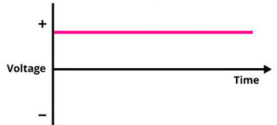
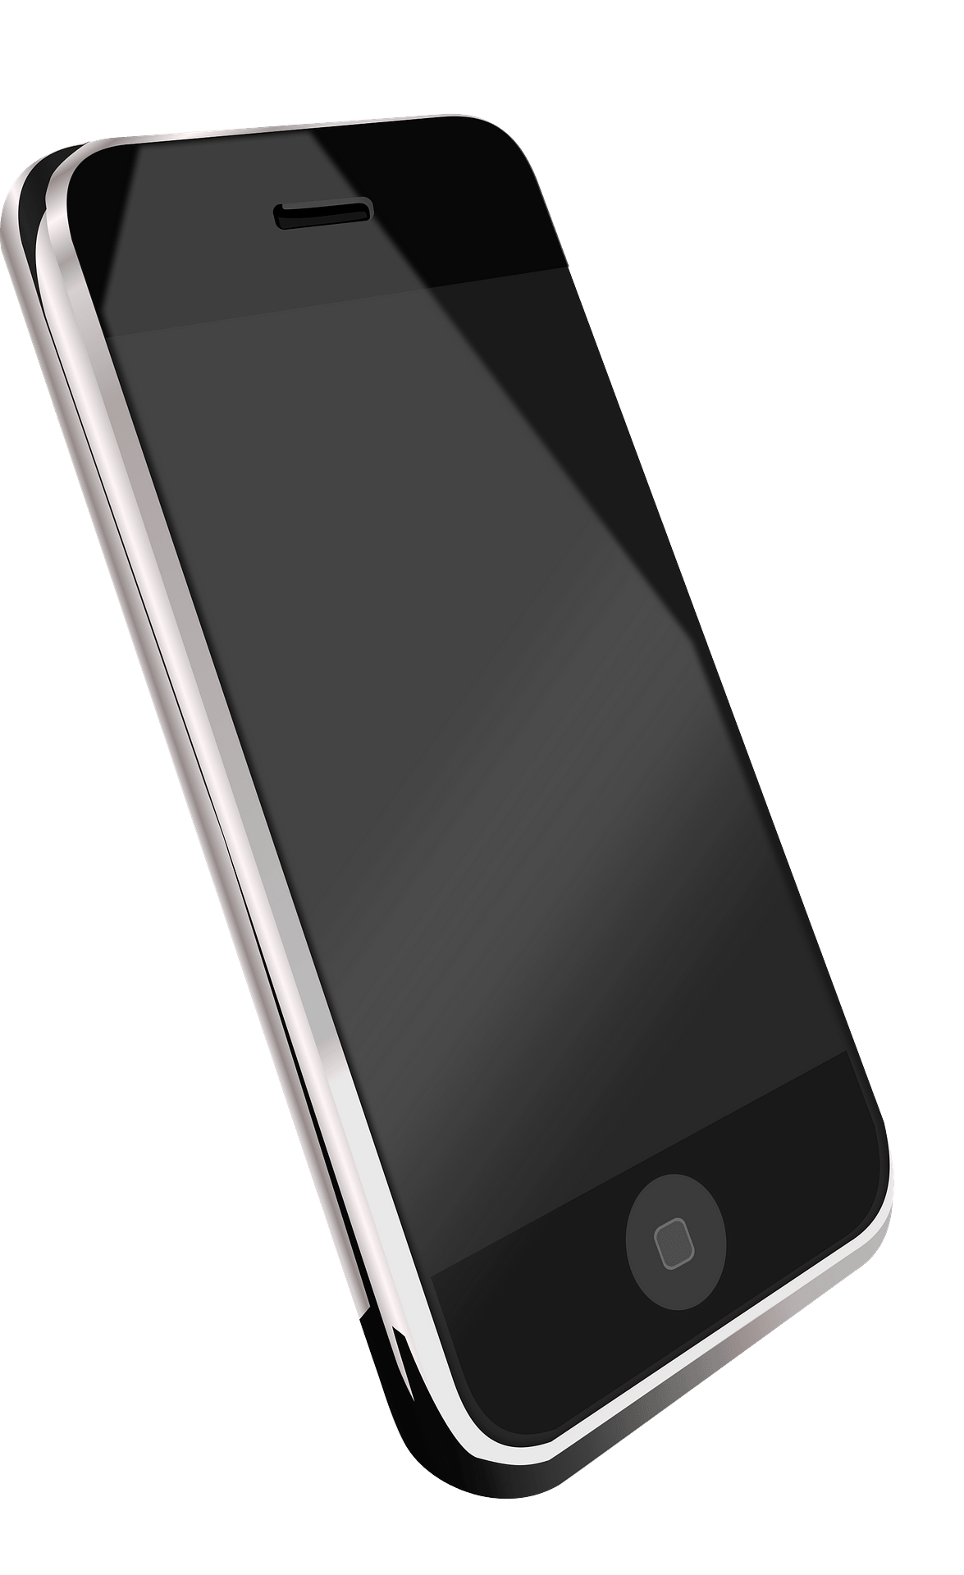
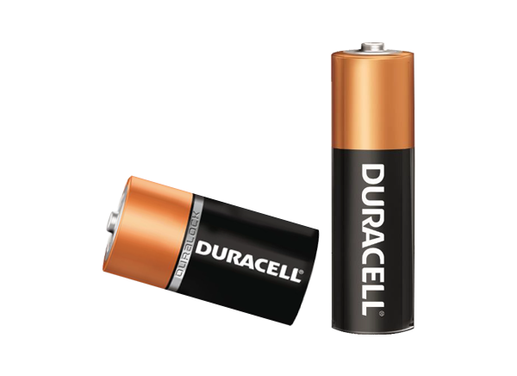
Direct Current (DC)
Flows in one direction from positive (+) to negative (-)
Common in batteries and battery-powered devices
Used in vehicles and mobile electronics
Notes:
Instructional Activity: Present Content
Instructional Time: 2 min.
Talking points:
DC is predictable and easy to use for small, portable devices.
Direct current flows in one direction from the positive terminal to the negative. It is common in batteries, mobile devices, flashlights.
For transit, DC is commonly used in automobiles, trucks and buses.
We will dive deeper into AC and DC in a future electrical module
Image Source: Electronics For You. (2020). AC and DC comparison diagram [Image]. https://www.electronicsforu.com/wp-contents/uploads/2020/10/AC-and-DC-3.png

Slide 33
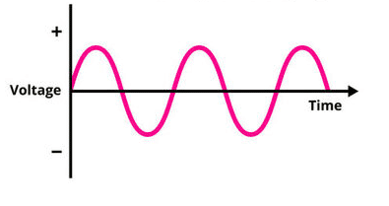
Alternating Current (AC)
Changes direction back and forth
Used for power transmission over long distances
Powers buildings and outlets
Every wall outlet is AC
Notes:
Instructional Activity: Present Content
Instructional Time: 2 min.
Talking points:
Alternating current changes direction periodically and is easier to transmit over distances.
AC’s ability to travel long distances is what makes the power grid work.
AC is commonly used as power supply for household and industrial applications. Every outlet in your house is AC.
Image Source: Electronics For You. (2020). AC and DC comparison diagram [Image]. https://www.electronicsforu.com/wp-contents/uploads/2020/10/AC-and-DC-3.png

Slide 34
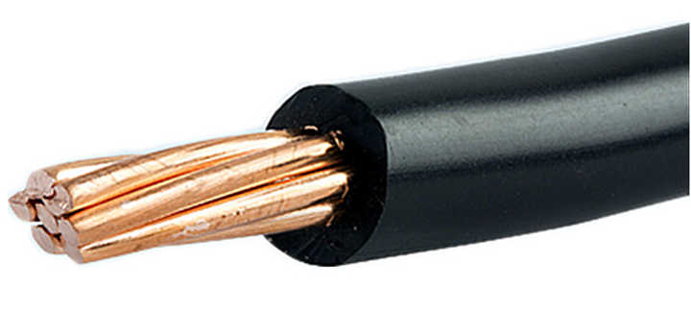
Conductors vs. Insulators
Wires deliver electricity and have two parts:
Conductors let electricity flow (ex: copper, aluminum).
Insulators block electricity (ex: rubber, plastic, glass).
Conductor
Insulator
Both are needed - Conductors carry electricity. Insulators keep it contained and safe.
Notes:
Instructional Activity: Present Content
Instructional Time: 3 min.
Talking points:
To control that flow, we have to control where electricity can move and where it can’t.
Whether electric charge builds up, flows smoothly, or is stopped altogether depends on the type of material it’s in.
Conductors are materials that allow electrons to move easily.
Copper and aluminum are good conductors, which is why they’re commonly used in wires and circuits.
In transit systems, you see conductors in places like copper wiring, aluminum bus bars, and motor windings.
These are the parts of the system designed to carry current.
Insulators serve the opposite purpose. They resist the flow of electrons and keep electricity confined to the conductor.
Materials like rubber, plastic, and glass are insulators.
Without insulators, electricity would be unpredictable and dangerous.
In transit environments, that includes wire insulation, connectors and plugs, gloves and mats, and rubber grommets.
Conductors and insulators always work together. Conductors allow electricity to do useful work. Insulators keep that electricity contained and protect people and equipment.
If a conductor wasn’t insulated, electricity would be everywhere — not just where it’s supposed to be.
That’s why damaged insulation is a safety issue, not just normal wear and tear.
Mechanics rely conductors to make circuits work and insulators to keep those circuits safe.

Slide 35
Electrical Basics – Key Term Quick Review
Energy created by the movement of electrons
1. Electricity
The force that pushes electrons
Means power is available
The flow of electrons through a wire
Measured in amps (A)
2. Voltage
3. Current
DC: Flows in one direction (batteries, vehicles)
AC: Changes direction (buildings, wall outlets)
4. DC vs. AC
Let electricity flow (ex: copper, aluminum)
Insulators block electricity (ex: rubber, plastic, glass)
5. Conductors
6. Insulator
Notes:
Instructional Activity: Recall, Provide Guided Learning
Instructional Time: 6 min.
Do:
Call on learners to define each key term on the flip cards. The flip card answers will be revealed in order.
Use this review as an opportunity to review key concepts and clarify any thinking errors learners may have.

Slide 36
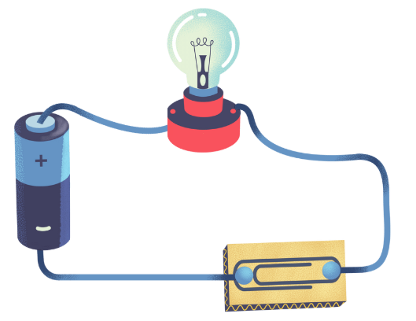
Activity: Paper Clip Circuit
In this activity, we’ll experiment with conductors and insulators to observe their impact on the flow of electricity. Follow the directions below and observe what happens. Then answer the following questions.
Step 1 – Use the battery, light bulb, wires and paperclip to create a simple circuit. Use the image above as a guide.
Step 2 - Next, replace the paperclip with a rubber band.
Notes:
Instructional Activity: Provide Guided Learning; Elicit Performance, Provide Feedback
Instructional Time: 15 min.
Materials:
Paper Clip Circuit_M1 – One per learner
One per group
D-cell battery and holder
Lightbulb (1-5 Volts) and socket
3 Jumper Wires
3x2 inches of cardboard
1 Paper Clip
1 Rubber band
Do:
2 min. - Separate learners into small groups and review the directions.
8 min. - Give learners time to complete the activity.
5 min. - Review the follow up questions as a group.
Talking Points:
In this activity, we’ll experiment with conductors and insulators to observe their impact on the flow of electricity. Follow the directions below and observe what happens. Then answer the following questions.
First, use the battery, light bulb, wires and paperclip to create a simple circuit. Use the image above as a guide.
Next, replace the paperclip with a rubber band.
After leaners have completed the activity…
Follow up questions:
Why did adding the paperclip make the light bulb turn on?
Why did adding the rubber band not work?
Answer Key:
Electricity moves continuously through conductors, like the paperclip. Therefore, the path forms a complete circuit which lights up the bulb.
Insulators, like the rubber band, keep the flow of electricity contained from escaping. That’s why the light does not function with the rubber band.

Slide 37
Activity: Small Group Discussion
Which vehicle systems use DC power?
What happens if current is interrupted in one of those systems?
Where do you see conductors and insulators on vehicles?
How do conductors and insulators help keep us safe when working with electrical systems?
Notes:
Instructional Activity: Provide Guided Learning, Elicit Performance, Provide Feedback
Instructional Time: 10 min.
Do:
Separate participants into several (at least two) small groups.
Give them 5 minutes to review questions and discuss responses. Check in with participants and facilitate small group discussion.
Bring the group back together and facilitate a brief discussion.
Talking points:
Let’s build on our paper clip circuit activity by applying the concepts to vehicle systems.
Take a few minutes to discuss the following questions in small groups
We will debrief as a whole group in a few minutes. I will expect to hear from each group, so be ready to respond.
What kinds of vehicle systems rely on electrical current to function?
What might happen if current flow is interrupted in one of those systems?
Where do you see conductors and insulators on vehicles?
How do insulators keep us safe when working with electrical components?

Slide 38
Knowledge Check
What is the primary difference between static and current electricity?
Static electricity is more dangerous
B) Static electricity involves flowing charges
C) Static electricity is stored; current electricity flows continuously
D) Current electricity is natural; static is man-made
Notes:
*This slide contains animations. CLICK to reveal content.
Instructional Activity: Evaluate/Assess Performance, Provide Feedback
Learning Objective: Explain the difference between static electricity and current electricity.
Instructional Time: 2 min.
Do: Review the knowledge check questions. Call on learners to share their responses.
Answer Key:
C

Slide 39
Knowledge Check
Voltage is best described as:
  The number of electrons in a wire
  The pressure that pushes electrons through a circuit
  The speed of electrical flow
  The amount of heat produced by electricity
Notes:
*This slide contains animations. CLICK to reveal content.
Instructional Activity: Evaluate/Assess Performance, Provide Feedback
Learning Objective: Explain what electricity is and how it is used in everyday work.
Instructional Time: 2 min.
Do: Review the knowledge check questions. Call on learners to share their responses.
Answer Key:
B

Slide 40
Knowledge Check: Scenario
Dead Battery, Live Shop Power
Scenario: A bus won’t start because the battery is dead, but the shop lights and outlets still work.
Which system uses DC?
Which system uses AC?
Why does one work while the other doesn’t?
Notes:
Instructional Activity: Evaluate/Assess Performance, Provide Feedback
Learning Objective: Recognize the difference between Direct Current (DC) and Alternating Current (AC).
Instructional Time: 5 min.
Do: Review the knowledge check questions. Call on learners to share their responses.
Answer Key:
Answers will vary but consider highlighting that DC and AC serve different roles and vehicles rely heavily on DC systems.

Slide 41
Knowledge Check
Which of the following describes current?
  The build-up of charge on an object
  The continuous flow of electrons through a conductor
  The resistance of a material
  The measure of electrical pressure
Notes:
*This slide contains animations. CLICK to reveal content.
Instructional Activity: Evaluate/Assess Performance, Provide Feedback
Learning Objective: Explain what electricity is and how it is used in everyday work.
Instructional Time: 2 min.
Do: Review the knowledge check questions. Call on learners to share their responses.
Answer Key:
B

Slide 42
Knowledge Check
Which of the following materials is a good conductor of electric current?
  Rubber
  Wood
  Copper
  Glass
Notes:
*This slide contains animations. CLICK to reveal content.
Instructional Activity: Evaluate/Assess Performance, Provide Feedback
Learning Objective: Identify conductors and insulators and explain why both are needed for safety.
Instructional Time: 2 min.
Do: Review the knowledge check questions. Call on learners to share their responses.
Answer Key:
C

Slide 43
Summary and What’s Next
Electricity: Energy from moving electrons.
Static vs. Current: Stored vs. constant electrical flow.
AC vs. DC: Alternating vs. one-way current.
Conductors: Required for electrical flow.
Insulators: Isolate electrical current to keep us safe
Next, we’ll explore what’s happening inside the wire and how atoms and charges create current flow.
Notes:
Instructional Activity: Enhance Retention and Transfer, Recall
Instructional Time: 5 min.
Do:
Review the key takeaways from this section of the module.
Clearly explain how to connects to the next section of the module.
Talking points:
Let’s wrap up this section with a few quick takeaways. These are the terms that will show up in our electrical discussions.
Electricity is a form of energy created by the movement of electrons.
Static electricity involves stationary charges, while current electricity involves flowing charges through a circuit.
There are two types of current:
AC (Alternating Current) – changes direction.
DC (Direct Current) – flows in one direction.
To move electricity safely, we use conductors to carry current and circuits to control where it flows.
These core ideas form the foundation for everything else you’ll learn in electrical systems.
Next, we’ll explore what’s happening inside the wire and how atoms and charges create current flow.

Slide 44
1.3 – Inside the Atom: Where Electricity Begins
We’ve talked about electricity as energy. Now let’s looks closer and see what’s actually moving inside those wires?
Notes:
Instructional Activity: Direction
Instructional Time: 1 min.
Do: Introduce the section.
Talking Points:
We’ve talked about electricity as energy. Now let’s look closer - what’s actually moving inside those wires?

Slide 45
Reflection
Everything you fix, test, or replace in an electrical system comes down to one thing — how electrons move.
If electrons don’t move, what happens to that circuit you’re working on?
Notes:
Instructional Activity: Recall, Direction
Instructional Time: 5 min.
Do:
Review the content on the slide.
Ask the question in the second box and call on learners to respond.
If needed, revisit the pre-built circuit to demonstrate the concept again.

Slide 46
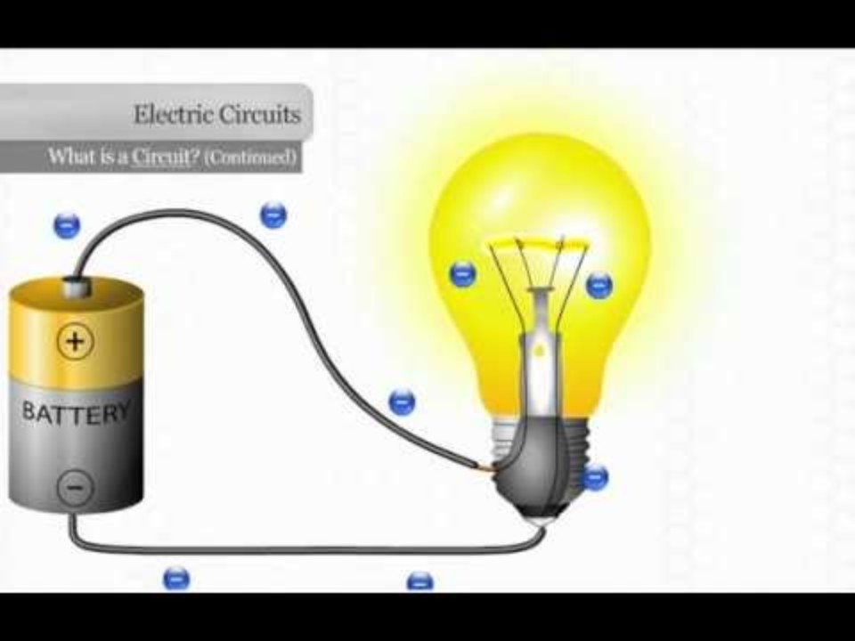
Video: Explaining a Circuit
How do the electrons flow in this circuit?
What is a complete circuit?
Why wouldn’t the light bulb light up if electricity flow is not complete?
What is a short circuit?
Notes:
Instructional Activity: Recall, Present Content
Time: 10 min.
Do:
Watch a brief video to review how a circuit functions and the flow of electors.
Use the questions on the slide to facilitate a discussion.
Talking Points:
What is a complete circuit?
Why wouldn’t the light bulb light up if electricity flow is not complete?
How does electricity flow in a circuit?
What is a short circuit?
Video Link: https://www.youtube.com/watch?v=VnnpLaKsqGU (3 min)
Video Source: Region 10 Education Service Center. (2012, February 13). Explaining an electrical circuit [Video]. YouTube. https://www.youtube.com/watch?v=VnnpLaKsqGU

Slide 47
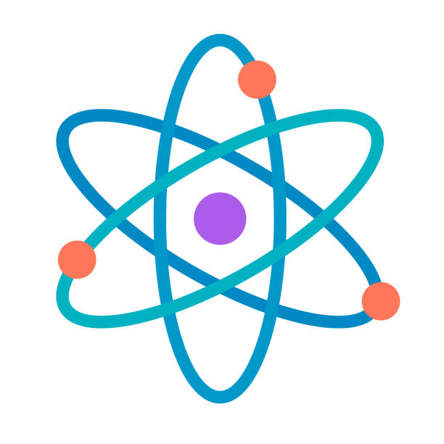
Where Does Electricity Begin?
Electricity begins at the atomic level.
All matter is made of atoms which contain electrons.
In some materials (like copper), electrons move easily.
When electrons move from atom to atom, electric current flows.
Notes:
Instructional Activity: Present Content
Instructional Time: 2 min.
Talking points:
To understand electricity, we have to start very small because electricity begins at the atomic level.
Everything around us is made of atoms. Inside atoms are tiny particles called electrons.
In some materials, like copper, electrons can move easily. Those materials are especially useful in electrical systems and in transit.
When electrons move from atom to atom, electric current flows.
That movement is what allows electricity to do useful work.
Electricity doesn’t just appear — it starts with electrons moving at the atomic level.

Slide 48
What is an Atom?
Protons (positive)
Electrons (negative)
Nucleus
Electricity happens when electrons move from atom to atom.
Neutrons (neutral)
Notes:
*This slide contains animations. CLICK to reveal content.
Instructional Activity: Present Content
Instructional Time: 5 min.
Talking points:
An atom is the smallest piece of anything, a subatomic piece of all matter.
Everything around us - tools, wires, buses, and even us is made of atoms. You can’t see atoms but they’re the basic building blocks of everything.
You can think of an atom like a tiny solar system:
CLICK - In the center is the nucleus. The nucleus is an atom’s dense center, stays still and is where all the heavy parts of an atom live:
CLICK - Protons are positively charged particles of an atom (labeled with a “+ sign”) and are fixed in the nucleus
CLICK - Neutrons are particles of the atom with no charge (labeled with a zero). These make up an atom’s mass, but do not affect its charge.
CLICK - Spinning around the outside are electrons, which are the smallest particles within an atom, are light compared to protons and neutrons, have a negative charge (labeled with a “–” sign) and move fast. When those electrons move from one atom to another, that’s electricity. Electrons are mobile and reside outside an atom’s nucleus/center.
It’s important to note, the elements that make up electricity are extremely small, and wires carry a countless number invisible to the eye.
When atoms gain or lose electrons, they can create electricity — that’s what makes current flow through a wire.
In short: Atoms are the tiny building blocks of everything, and the movement of their electrons is what gives us electricity.

Slide 49
How Electrons Move
Electrons carry a charge
Voltage make electrons flow in one direction
+
Conductor - Copper
Notes:
*This slide contains animations. CLICK to reveal content.
Instructional Activity: Present Content
Instructional Time: 3 min.
Talking points:
Electric current happens when electrons move through a material, and that movement starts with a push called voltage.
When voltage is applied, electrons begin moving, and that movement is what we call electric current.
Electrons actually move from negative to positive, but by long-standing convention, we describe current as flowing from positive to negative. It’s important to remember that difference as we talk about circuits.
A helpful way to picture this is with water. Voltage is like a pump creating pressure, the wire acts like the pipe, and current is the flow of water through that pipe.
In metals like copper or aluminum, some electrons are free to move from atom to atom. When voltage is applied, those free electrons begin moving in one direction, creating current.
We measure current in amperes, or amps, similar to how we measure how much water flows through a pipe.
This movement of electrons is what makes electricity useful. It’s what allows tools to run, lights to turn on, and trains to move.
Voltage sources are what make electrons start moving. In transit systems, that might be a battery pushing electrons to crank an engine, an alternator pushing electrons back into a battery, or inverters and control modules pushing electrons through different circuits.
If electrons can’t move, the system won’t work. Motors won’t spin, relays won’t close, and circuits won’t complete.

Slide 50
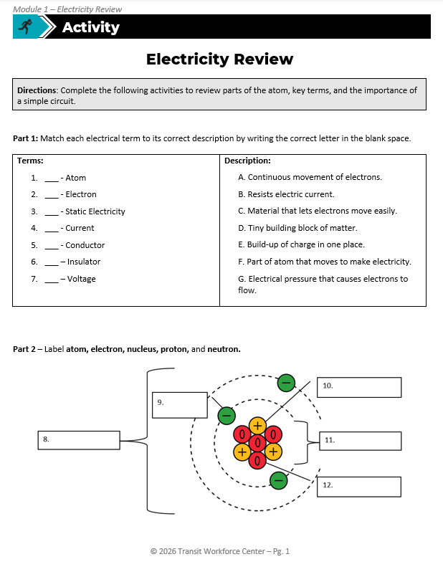
Activity: Electricity Review
Directions: Complete the following activities to review parts of the atom, key terms, and the importance of a simple circuit.
Part 1: Matching electrical terms
Part 2: Labeling the atom
Part 3: Simple circuit review
Notes:
Instructional Activity: Provide Guided Learning, Elicit Performance, Provide Feedback
Instructional Time: 15 min.
Materials:
Electricity Review_M1
Electricity Review_Answer Key_M1
Do:
Refer learners to the “Electricity Review” handout embedded in the Participant Resource Guide. An answer key has also been provided for instructor use only.
Review the directions and select a facilitation option.
Facilitation Options:
You can allow leaners to work with a partner if you choose.
You can walk through the activity as a full group.
Ask leaners to complete Parts 1 and 2 with a partner, then do Part 3 as a full group.
Give learners 10-12 minutes to complete the activity.
Note – the next few slides provide an answer key for all questions so you can review the answers as a group.

Slide 51
Answer Key: Electricity Review
Terms: D___ - Atom F___ - Electron E___ - Static Electricity A___ - Current C___ - Conductor B___ – Insulator G___ – Voltage | Description: A. Continuous movement of electrons. B. Resists electric current. C. Material that lets electrons move easily. D. Tiny building block of matter. E. Build-up of charge in one place. F. Part of atom that moves to make electricity. G. Electrical pressure that causes electrons to flow.
Notes:
Instructional Activity: Provide Guided Learning, Elicit Performance, Provide Feedback
Instructional Time: 7 min.
Materials:
Electricity Review_M1
Electricity Review_Answer Key_M1
Do:
Review Part 1 of the Electricity Review handout by calling on learners.
The animations will reveal the answers in numerical order.

Slide 52
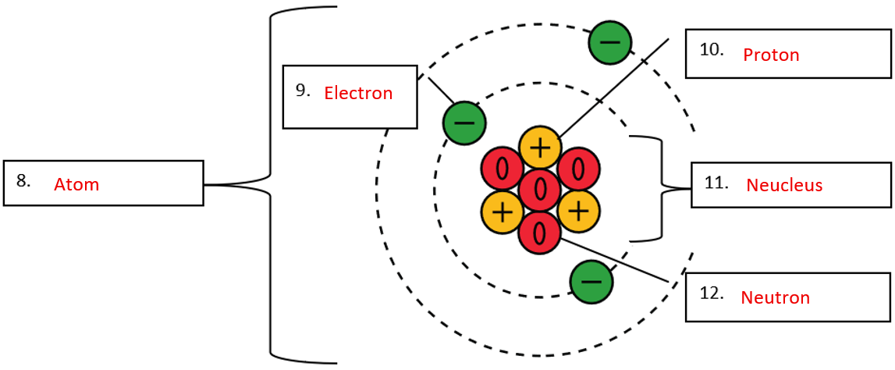
Answer Key: Electricity Review
Notes:
Instructional Activity: Provide Guided Learning, Elicit Performance, Provide Feedback
Instructional Time: 5 min.
Materials:
Electricity Review_M1
Electricity Review_Answer Key_M1
Do:
Review Part 2 of the Electricity Review handout by calling on learners.
The animations will reveal the answers in numerical order.

Slide 53
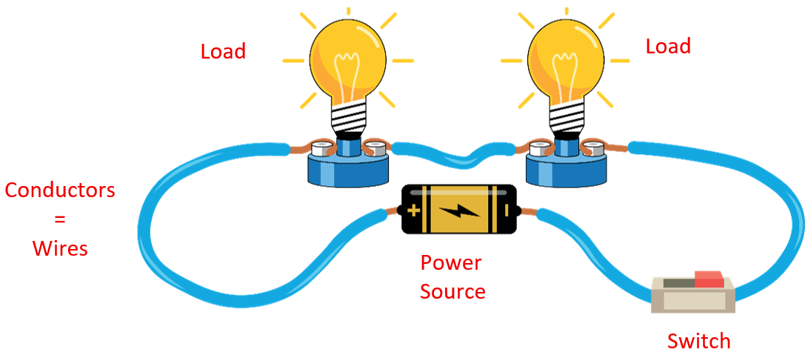
Answer Key: Electricity Review
13. Draw and arrow around the circuit to show which way the path of electricity flows. The electricity flows from the positive terminal to the negative terminal.
14. Label each part of the circuit: Power Source, Conductors, Load, Switch, Positive (+) terminal, Negative (–) terminal
+ Terminal
- Terminal
Notes:
Instructional Activity: Provide Guided Learning, Elicit Performance, Provide Feedback
Instructional Time: 5 min.
Materials:
Electricity Review_M1
Electricity Review_Answer Key_M1
Do:
Review Part 3 of the Electricity Review handout by calling on learners.
The animations will reveal the answers in numerical order.

Slide 54
Answer Key: Electricity Review
15. Which part pushes electrons? Battery/Power Source
16. Which part uses the energy? Light Bulbs/Load
17. Which parts provide a path? Wires/Conductors
18. Are electrons created by the battery?
No, the battery does not create electrons. It provides the voltage (push) that makes electrons already in the circuit move.
19. Where are electrons already present?
In the conductors and components of the circuit, especially in the wires.
Notes:
Instructional Activity: Provide Guided Learning, Elicit Performance, Provide Feedback
Instructional Time: 5 min.
Materials:
Electricity Review_M1
Electricity Review_Answer Key_M1
Do:
Review Part 3 of the Electricity Review handout by calling on learners.
The animations will reveal the answers in numerical order.

Slide 55
Answer Key: Electricity Review
20. What happens if the switch is closed? What changes when the switch is opened?
Switch closed: The circuit is complete, electrons can move, current flows, and the lights turn on.
Switch open: The circuit is broken, electrons stop moving, current stops, and the lights turn off.
21. If we flipped the battery, would the light still turn on? Why or why not?
Yes, the light would still turn on because the circuit is complete. The direction of current would reverse, but the light bulb works either way.
Notes:
Instructional Activity: Provide Guided Learning, Elicit Performance, Provide Feedback
Instructional Time: 2 min.
Materials:
Electricity Review_M1
Electricity Review_Answer Key_M1
Do:
Review Part 3 of the Electricity Review handout by calling on learners.
The animations will reveal the answers in numerical order.

Slide 56
Answer Key: Electricity Review
22. How is this circuit different from the paper clip circuit we made earlier in our lesson? What’s the same?
  Different: This circuit uses a switch to control current. It has two lights instead of one. It uses standard wires instead of a paper clip.
  Same: Both require a power source, a complete path, and a load. Both only work when the circuit is closed.
Notes:
Instructional Activity: Provide Guided Learning, Elicit Performance, Provide Feedback
Instructional Time: 2 min.
Materials:
Electricity Review_M1
Electricity Review_Answer Key_M1
Do:
Review Part 3 of the Electricity Review handout by calling on learners.
The animations will reveal the answers in numerical order.
Talking Points: After you have reviewed the answer to #22.
Let’s review a few key takeaways from this activity.
Electricity requires a complete conductive path.
The battery pushes electrons by creating a charge difference.
Wires do not store electricity.
Polarity defines direction and matters in real systems.
Circuits have distinct components with specific roles.
The battery pushes. The wire carries. The light uses.

Slide 57
Knowledge Check
In an atom, electrons are the particles that____________.
  Stay fixed in the nucleus
  Move and allow electricity to flow
  Provide insulation
  Block electric current
Notes:
*This slide contains animations. CLICK to reveal content.
Instructional Activity: Evaluate/Assess Performance, Provide Feedback
Learning Objective: Describe the basic parts of an atom and explain how electrons create electrical flow.
Instructional Time: 2 min.
Do: Review the knowledge check questions. Call on learners to share their responses.
Answer Key:
B

Slide 58
Knowledge Check
Question:
What causes electrons to start moving in a circuit? Why does that matter when a vehicle system doesn’t work?
Answer:
Electrons start moving when voltage is applied, which drives current through the circuit. If a vehicle system doesn’t work, it often means voltage isn’t present or the circuit path is broken, so electrons can’t move and the system can’t operate.
Notes:
*This slide contains animations. CLICK to reveal content.
Instructional Activity: Evaluate/Assess Performance, Provide Feedback
Learning Objective: Explain how electricity is made and why it is important in transit systems.
Instructional Time: 2 min.
Do: Review the knowledge check questions. Call on learners to share their responses.
Answer Key:
Electrons start moving when voltage is applied, which drives current through the circuit. If a vehicle system doesn’t work, it often means voltage isn’t present or the circuit path is broken, so electrons can’t move and the system can’t operate.

Slide 59
Knowledge Check
Question:
Why do conductors like copper work well in buses and rail cars, while materials like rubber or plastic do not?
Answer:
Conductors like copper allow electrons to move easily, making them ideal for carrying current in electrical systems.
Notes:
*This slide contains animations. CLICK to reveal content.
Instructional Activity: Evaluate/Assess Performance, Provide Feedback
Instructional Time: 2 min.
Do: Review the knowledge check questions. Call on learners to share their responses.
Answer Key:
Conductors like copper allow electrons to move easily, making them ideal for carrying current in electrical systems.

Slide 60
Knowledge Check
Question:
What signs or symptoms tell you that electrons aren’t flowing properly? What does that tell you about the circuit?
Answer:
Signs include lights not turning on, motors not running, relays not clicking, or systems behaving intermittently. These symptoms indicate that the circuit may be open, de-energized, poorly connected, or preventing electrons from flowing properly.
Notes:
*This slide contains animations. CLICK to reveal content.
Instructional Activity: Evaluate/Assess Performance, Provide Feedback
Instructional Time: 2 min.
Do: Review the knowledge check questions. Call on learners to share their responses.
Answer Key:
Signs include lights not turning on, motors not running, relays not clicking, or systems behaving intermittently. These symptoms indicate that the circuit may be open, de-energized, poorly connected, or preventing electrons from flowing properly.

Slide 61
Knowledge Check
Question:
Where on a bus or train is electron flow critical? What happens when that flow is interrupted?
Answer: Electron flow is critical in systems such as propulsion, lighting, controls, doors, braking, and communication circuits. When electron flow is interrupted, those systems stop working or may fail in ways that affect safety and reliability.
Notes:
*This slide contains animations. CLICK to reveal content.
Instructional Activity: Evaluate/Assess Performance, Provide Feedback
Instructional Time: 2 min.
Do: Review the knowledge check questions. Call on learners to share their responses.
Answer Key:
Electron flow is critical in systems such as propulsion, lighting, controls, doors, braking, and communication circuits. When electron flow is interrupted, those systems stop working or may fail in ways that affect safety and reliability.

Slide 62
Summary and What’s Next
Atoms contain electrons that can move.
Electricity is the flow of these electrons.
Voltage is what pushes them.
Next, we’ll move from where electricity begins to how it can be generated.
Notes:
Instructional Activity: Enhance Retention and Transfer
Instructional Time: 5 min.
Do:
Review the key takeaways from this section of the module.
Clearly explain how to connects to the next section of the module.
Talking points:
Let’s review the key concepts from this module:
Atoms contain electrons that can move.
Electricity is the flow of these electrons.
Voltage is what pushes them.
What’s Next? We’ll move from where electricity begins to how it can be generated.

Slide 63
1.4 – How Electricity is Generated and its Significance
Now that we know what electricity is made of, how do we create it?
Notes:
Instructional Activity: Direction
Instructional Time: 2 min.
Do: Introduce the section.
Talking Points:
We know what electricity is — now let’s see how we make it.
Let’s see how we generate and deliver that energy to use it safely.

Slide 64
How is Electricity Generated?
Natural Sources:
Lightning
Nerve impulses in the human body
Static charges from friction
Man-Made Sources:
Generators
Batteries
Power Stations
Notes:
Instructional Activity: Present Content
Instructional Time: 3 min.
Talking points:
Electricity can come from both natural and man-made sources.
Natural sources include:
Lightning, which is a massive buildup and release of static electricity in the atmosphere.
Electric eels, which generate electric fields to hunt or defend themselves.
Static electricity from friction, like rubbing socks on carpet or combing dry hair.
Man-made sources are what we rely on to power the modern world:
Generators, which use magnets and motion to produce electricity.
Batteries, which convert chemical energy into electrical energy.
Power stations, which generate electricity on a large scale—using wind, water, fossil fuels, or nuclear energy.
No matter the source, the goal is the same: move electrons to produce usable energy.

Slide 65
How is Electricity Generated?
Electricity is generated through various methods, primarily by converting different forms of energy into electrical energy
Traditional Methods
Nuclear Power Plants
Renewable Energy Sources
Geothermal Energy
Biomass Energy
Notes:
Instructional Activity: Present Content
Instructional Time: 1 min.
Talking points:
Electricity is generated by converting other forms of energy—like motion, heat, or sunlight—into electrical energy.
There are several ways we do this:
Traditional Method
Nuclear Power Plants
Renewable Energy Sources
Geothermal Energy
Biomass Energy
In each case, the goal is the same: turning energy into motion, and motion into electricity which is then distributed through power grids to homes, businesses, and industries.

Slide 66
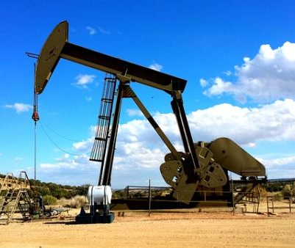
How is Electricity Generated?
Traditional Methods
Include use of fossil fuels to make steam that spins turbines to generate electricity.
Nuclear Power Plants
Renewable Energy Sources
Geothermal Energy
Biomass Energy
Notes:
Instructional Activity: Present Content
Instructional Time: 1 min.
Talking points:
Traditional methods of generating electricity rely on fossil fuels—like coal, natural gas, and oil.
Here’s how it works:
These fuels are burned, producing heat.
That heat is used to boil water into steam.
The steam spins a turbine, which is connected to a generator that produces electricity.

Slide 67
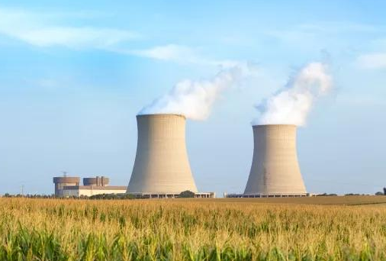
How is Electricity Generated?
Traditional Methods
Use nuclear reactions to produce heat and steam for the same purpose.
Nuclear Power Plants
Renewable Energy Sources
Geothermal Energy
Biomass Energy
Notes:
Instructional Activity: Present Content
Instructional Time: 1 min.
Talking points:
Nuclear power plants use nuclear reactions—specifically, fission—to produce heat for the same purpose as traditional plants.
That heat boils water into steam.
The steam spins a turbine.
And the turbine powers a generator to create electricity.

Slide 68
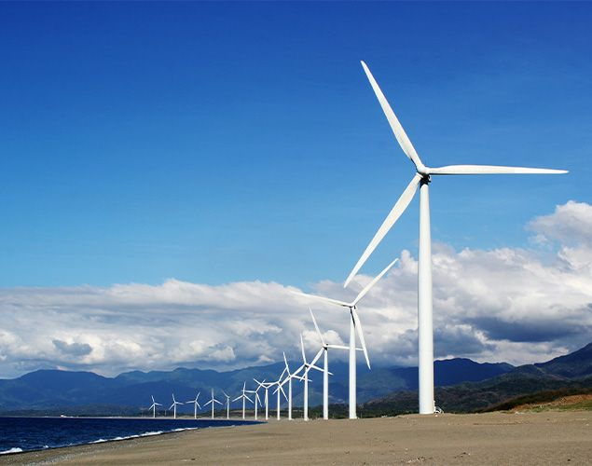
How is Electricity Generated?
Traditional Methods
Produces electricity through natural means: hydroelectric power, wind
power, and
solar power.
Nuclear Power Plants
Renewable Energy Sources
Geothermal Energy
Biomass Energy
Notes:
Instructional Activity: Present Content
Instructional Time: 1 min.
Talking points:
Renewable energy sources are becoming more important as we shift toward cleaner, sustainable power.
These methods don’t burn fuel—instead, they capture natural energy from the environment:
Hydroelectric power uses the force of flowing water to spin turbines.
Wind power turns wind turbines, converting motion into electricity.
Solar power uses photovoltaic panels to convert sunlight directly into electrical energy.

Slide 69
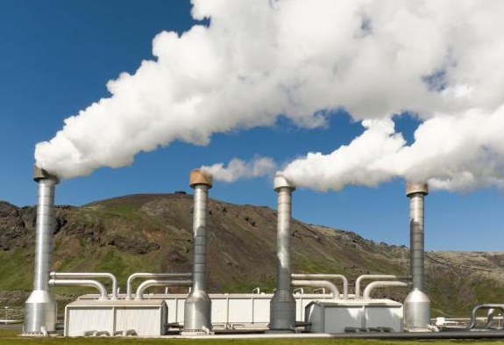
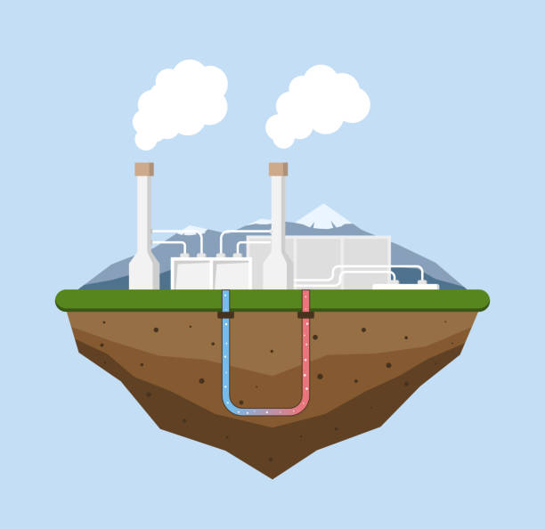
How is Electricity Generated?
Traditional Methods
Taps into the Earth’s internal heat.
Nuclear Power Plants
Renewable Energy Sources
Geothermal Energy
Biomass Energy
Notes:
Instructional Activity: Present Content
Instructional Time: 1 min.
Talking points:
Geothermal energy taps into the Earth’s natural internal heat—energy stored beneath the surface.
Wells are drilled into hot underground reservoirs.
That heat is used to produce steam.
And the steam drives a turbine connected to a generator, just like in other power plants.

Slide 70

How is Electricity Generated?
Traditional Methods
Is derived from organic materials.
Nuclear Power Plants
Renewable Energy Sources
Geothermal Energy
Biomass Energy
Notes:
Instructional Activity: Present Content
Instructional Time: 1 min.
Talking points:
Biomass energy is generated by burning organic materials, like wood, crop waste, or even landfill gases.
These materials are rich in stored chemical energy from the sun.
When burned, they release heat, which is used to produce steam and generate electricity, just like fossil fuels.

Slide 71
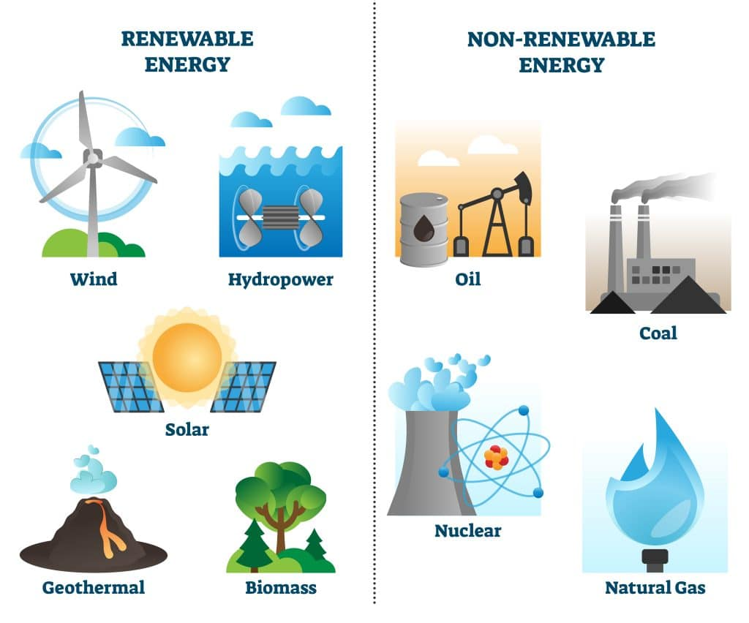
Renewable vs. Non-Renewable Sources
Renewable: Solar, wind, hydro, geothermal (sustainable and clean)
Non-Renewable: Coal, oil, natural gas (limited and polluting)
Energy systems are transitioning toward renewables for sustainability and environmental advantages.
Notes:
Instructional Activity: Present Content
Instructional Time: 2 min.
Talking points:
The future of power is clean, but today’s grid still relies heavily on fossil fuels.
Renewable sources include solar, wind, hydroelectric, and geothermal. These are clean, sustainable, and naturally replenished.
Non-renewable sources include coal, oil, and natural gas. These are limited resources and often produce pollution and greenhouse gases.
Because of climate concerns and resource limits, energy systems around the world are shifting toward renewables—not only for sustainability, but also for long-term reliability.
Image Source: https://ngsmagnified.com/textbooks/population-dynamics/section-3-renewable-nonrenewable-resources/

Slide 72
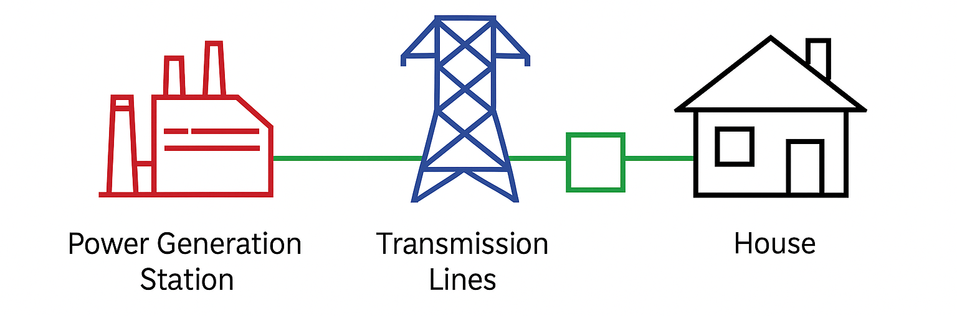
Electricity Transmission Through Electrical Grid
Notes:
Instructional Activity: Present Content
Instructional Time: 2 min.
Talking points:
Once electricity is generated, it doesn't go straight to your home—it travels through a system called the electrical grid.
This entire journey happens in seconds—powering your lights, appliances, and electronics almost instantly.
Electricity is often generated in centralized locations because large power plants can produce electricity more efficiently and reliably, then transmit it over long distances to where it’s needed.
The journey depicted on this slide represents AC transmission.

Slide 73


Economic and Social Impact of Electricity
Powers households, communication, transportation, and industry
Drives economic growth and innovation
Critical for health, education, and public safety
Lack of electricity limits opportunity and quality of life
Understanding electricity supports safety and problem-solving
Notes:
Instructional Activity: Present Content
Instructional Time: 2 min.
Talking points:
Electricity is one of the most important foundations of modern life.
It powers everything—from homes and schools, to hospitals, factories, and transit systems. Without it, most modern systems can’t function.
Access to electricity is directly tied to economic growth and development. Countries with reliable electrical systems can support industry, education, communication, and healthcare.
Where electricity is unavailable or unreliable, it becomes much harder to learn, earn, or stay safe—making access to electricity a key issue for equity and opportunity worldwide.
In developing electricity, there is waste generated. There is the nuclear waste of spent fuel and waste in the form of emissions from burning fossil fuels.
This is why wind and solar are becoming popular because they eliminate the waste.

Slide 74
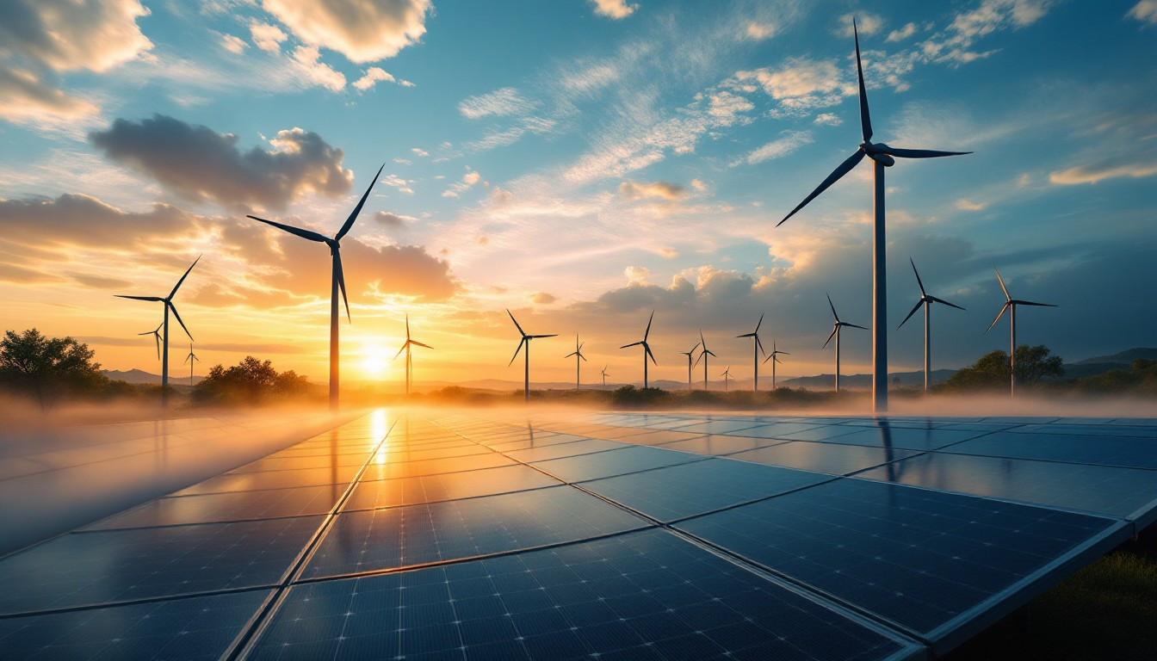

Environmental Considerations
Generating electricity impacts the environment:
Air pollution (fossil fuels)
Land use (solar and wind)
Water usage (steam generation)
Transitioning to cleaner energy is a major global priority.
Notes:
Instructional Activity: Present Content
Instructional Time: 2 min.
Talking points:
Being energy-aware also means understanding our responsibility to reduce harm.
While electricity is essential, the way we generate it has real environmental consequences.
Fossil fuel plants release air pollutants and greenhouse gases that contribute to climate change and poor air quality.
Solar farms and wind turbines are much cleaner, but they often require large areas of land, which can affect wildlife and natural habitats.
Some power plants, including nuclear and fossil fuel stations, also use a lot of water for cooling, which can strain water resources.
That’s why there’s a global push to transition to cleaner, more sustainable energy sources—reducing harm while still meeting our growing energy needs.
In summary (tie it all together): We’ve gone from the microscopic level of electrons to the massive systems that power our vehicles and shops.

Slide 75
Knowledge Check
Which of the following is a renewable source of electricity?
  Natural gas
  Coal
  Wind
  Nuclear
Notes:
*This slide contains animations. CLICK to reveal content.
Instructional Activity: Evaluate/Assess Performance, Provide Feedback
Instructional Time: 2 min.
Do: Review the knowledge check questions. Call on learners to share their responses.
Answer Key:
C. Wind

Slide 76
Knowledge Check
Why is electricity often generated in one locations but used many miles away?
  Electricity is safer when used far from where it’s generated
  Electricity can only be used where it is produced
  Renewable energy cannot be generated locally
  Large generators are more efficient than small, local ones
Notes:
*This slide contains animations. CLICK to reveal content.
Instructional Activity: Evaluate/Assess Performance, Provide Feedback
Instructional Time: 2 min.
Do: Review the knowledge check questions. Call on learners to share their responses.
Answer Key:
D

Slide 77
Module Summary
Electricity begins at the atomic level, with electrons flowing in conductors. Electromagnetism links electric current with magnetic fields, enabling motors and generators.
Key figures like Volta, Faraday, Edison, and Tesla made groundbreaking discoveries. Their work led to batteries, generators, and power systems.
Electricity is the flow of electric charge. Current electricity powers most modern systems; it requires a closed circuit and conductive materials.
Electricity is generated by converting other energy forms (e.g., mechanical, solar) into electrical energy. It is essential to nearly every aspect of daily life.
Notes:
Instructional Activity: Enhance Retention and Transfer, Recall
Instructional Time: 5 min.
Do:
Review the key takeaways from this module.
Clearly explain how to connects to the next module/course.
Talking points:
These four areas build a complete picture—from what electricity is, to how it's made, who developed it, and how it works on a atomic level.
By connecting history, science, and real-world use, we’ve built a foundation for both understanding and applying electrical concepts.
Let’s review the key concepts from this module:
At its core, electricity starts with electrons moving through atoms. These tiny particles are responsible for creating current in a wire.
Through electromagnetism, we learned how electric current produces magnetic fields, and how changing magnetic fields can generate electricity—a principle that powers motors, transformers, and generators.
Pioneers like Volta, Faraday, Edison, and Tesla made major breakthroughs—creating the first batteries, generators, and power distribution systems that we still depend on today.
Electricity is the flow of electric charge, and in most modern systems, we rely on current electricity, which needs a closed circuit and conductive materials to function.
It’s generated by converting other forms of energy—like mechanical motion, sunlight, or chemical reactions—into electrical energy. This process powers everything from homes and hospitals to trains and communication systems.

Slide 78
Reflection
What’s one thing about electricity that surprised you today?
Notes:
Instructional Activity: Recall,
Instructional Time: 5 min.
Do:
Review the reflection question.
Call on learners to respond.

Slide 79

Quiz
Time for a quiz! Let’s see what you have learned from today’s lesson.
Notes:
Instructional Activity: Direction, Evaluate/Assess Performance
Instructional Time: 20 min.
Materials: Quiz_M1
Do:
Ask learners if they have any lingering questions. Address them before distributing the quiz.
Pass out the quiz and review the directions.
Talking Points:
Time for a quiz! Let’s see what you have retained from today’s lesson.

Slide 80
Revisiting Objectives
Explain what electricity is and how it is used in everyday work.
Tell the difference between static electricity and current electricity.
Explain how electricity is made and why it is important in transit systems.
Identify key people who helped develop electricity and how their work affects modern systems.
Describe the basic parts of an atom and explain how electrons create electrical flow.
Recognize the difference between Direct Current (DC) and Alternating Current (AC).
Identify conductors and insulators and explain why both are needed for safety.
Notes:
Instructional Activity: Enhance Transfer and Retention
Instructional Time: 5 min.
Do: Facilitate a short discussion to review the key topics in the lesson.
Talking Points:
If you were explaining today’s objectives to someone else, how would you summarize what they mean and why they matter?
Which of today’s objectives do you feel most confident about? Which were most challenging? Explain your reasoning.
Can you give an example of how you could apply one of today’s objectives in a real-world situation?
After Discussion:
This conclude this section of the module. Thank you for your participation.

Slide 81
Thank you!
Notes:
Instructional Activity: Enhance Transfer and Retention
Instructional Time: 2 min.
Do:
Thank learners for their participation.
If possible, stay after class to answer any lingering questions learners may have.

