Slide 1



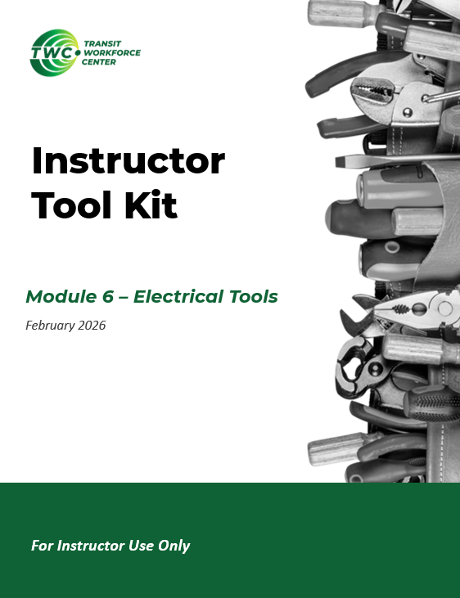
Instructor Guide Snapshot
Icon Key
Activity:
Video:
Instructor Demo:
Knowledge Check:
Instructional Time: ~6 Hrs.
Preparation before class:
  Review all materials - Review all slides, talking points, and handouts before class to understand the structure and flow of the lesson. Pay special attention to animations within the slides.
  Prep for demos and activities – Review the full list of “Additional Materials” located in the Instructor Facilitation Toolkit. Gather and prepare all necessary materials.
  Review slide 63 notes – Decide if you would like to play the long video (19 min.) or short video (3 min.).
Provided Course Materials:
  +Electrical Tools_M6.pptx
  +Instructor Facilitation Toolkit_M6.docx - For Instructor use only.
  +Participant Resource Guide_M6.docx - Print one copy for each learner. All handouts that leaners need for activities are embedded in the Participant Resource Guide.
    Electrical Tools Resource_M6.docx
    Multimeter Testing_M6.docx
    Wire Connection Practice_M6.docx
  Quiz_M6.docx - Print one copy for each learner.
Additional Materials:
A list of additional materials needed for demonstrations and activities can be found in the Instructor Facilitation Toolkit on page 4.
Notes:
*This slide contains animations. CLICK to reveal content.
Instructional Activity:
Instructional Time:
Materials:
Do:
Talking Points:

Slide 2
Pacing Guide
Times have been rounded to the nearest .25 hours.
Total Time: ~6 Hours
  .25 Hrs. – Welcome and Warm Up
  3 Hrs. – 6.1 - Basic Electrical Tools
  2.25 Hrs. – 6.2 - Measurement and Testing Tools
  .25 Hrs. – Quiz and Wrap Up

Slide 3
Electrical Tools
Transit Core Competencies Curriculum (TC3)
Electrical Foundations
Notes:
Instructional Activity: Direction
Instructional Time: 1 min.
Do: Welcome learners to class. Introduce the course and module.

Slide 4
Objectives
Identify common electrical and testing tools.
Describe the purpose and limitations of common electrical testing tools.
Make a proper wire connection using the correct tools.
Inspect wire connections to ensure they are safe.
Select the right tool to test an electrical circuit.
Perform basic electrical tests safely.
Notes:
Instructional Activity: Direction
Instructional Time: 2 min.
Do: Review the module objectives.
Talking Points:
This module focuses on tools that create, protect, and verify electrical connections because most electrical problems start at the connection.
You will not diagnose complex electrical problems yet. The goal here is to become familiar with electrical tools that you will use on the job and how to safely check and verify basic conditions.

Slide 5
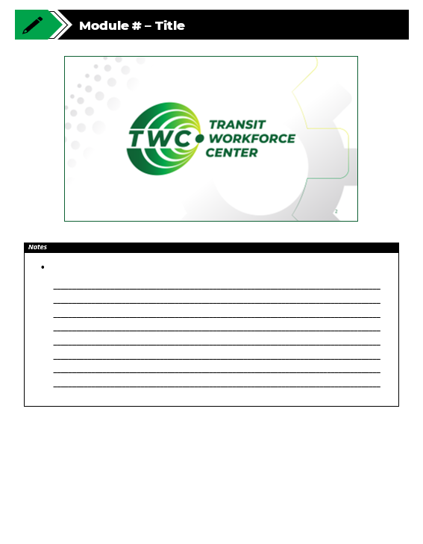
Agenda
Welcome and Warm Up
6.1 - Basic Electrical Tools
6.2 - Measurement and Testing Tools
Quiz and Wrap Up
Notes:
Instructional Activity: Direction
Instructional Time: 2 min.
Materials: Participant Guide Resource
Talking Points:
Review module agenda.
Take a moment to review the timeline for the day, location of bathroom and emergency exits, etc.
Remind learners that they have a Participant Guide Resource which they can use for optional notetaking. This is a resource for learners to use if they choose and will not be collected.

Slide 6
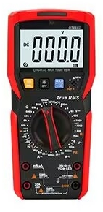

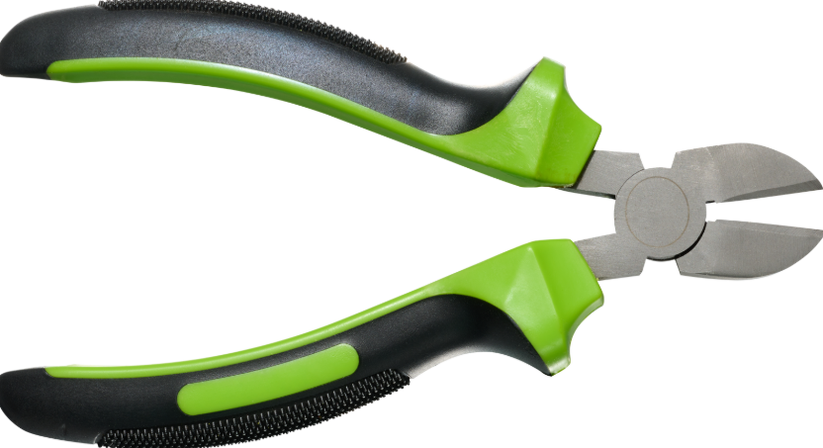
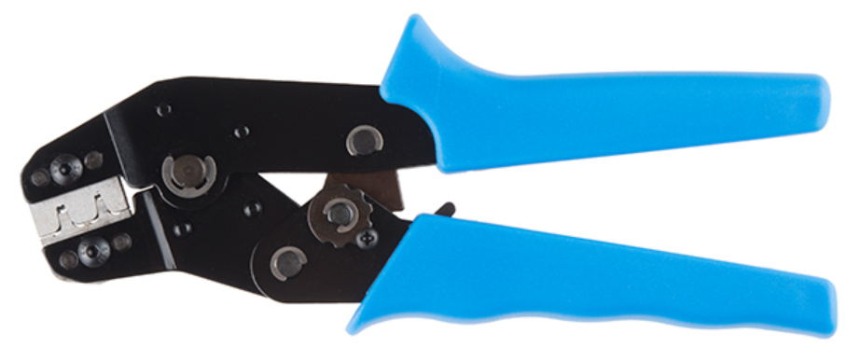
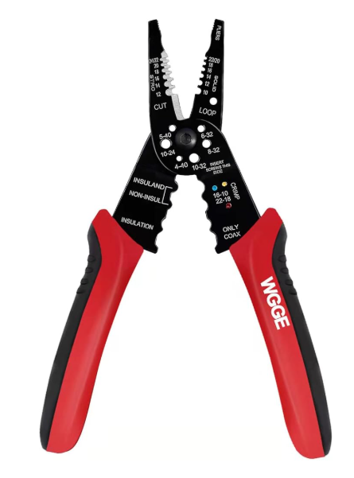
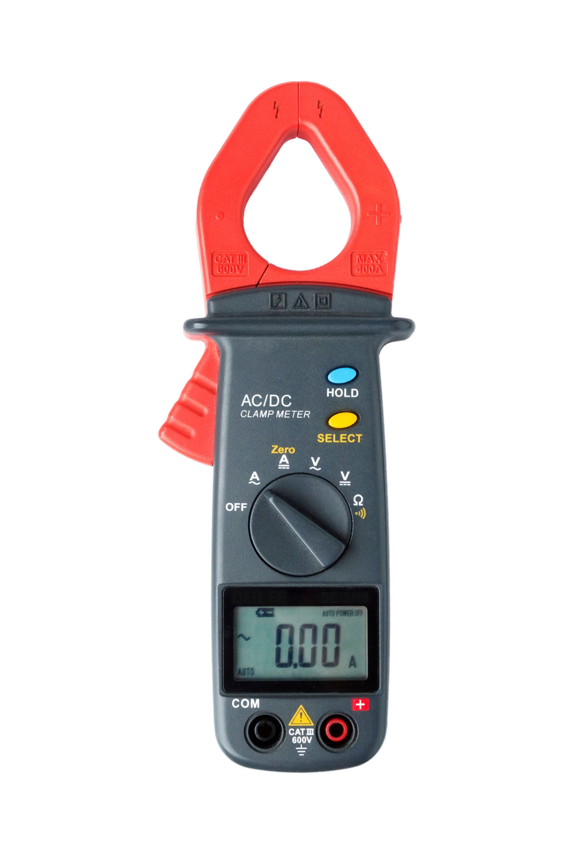
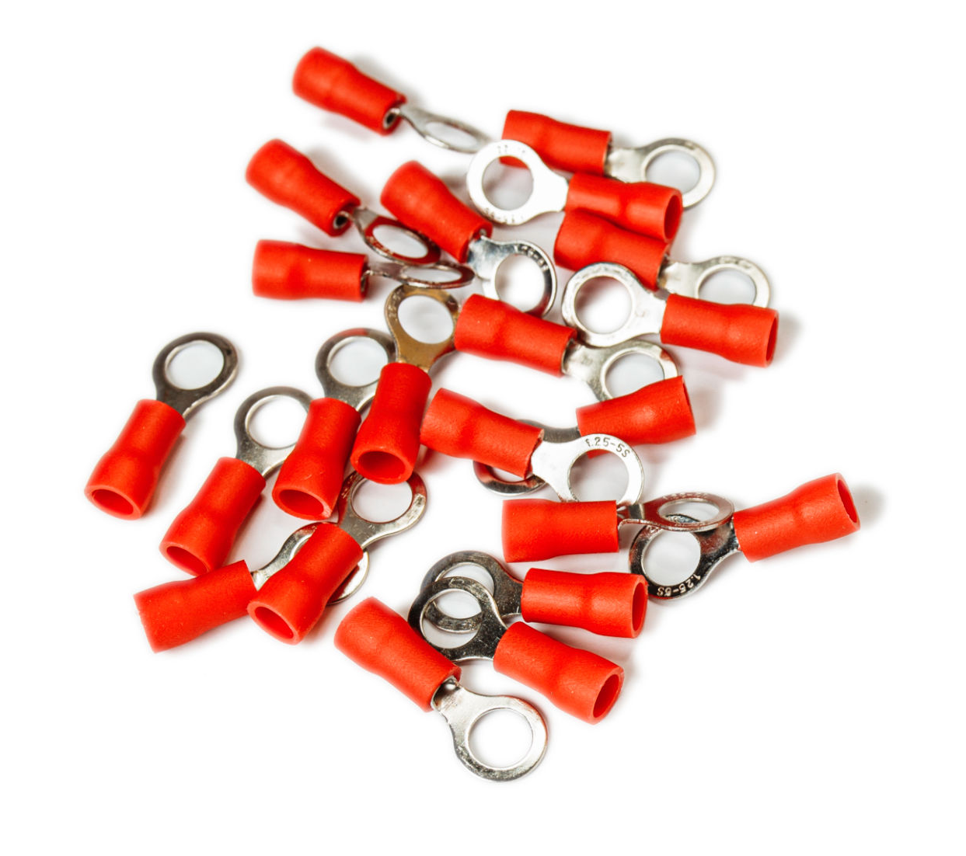
Warm Up
Are you familiar with any of the following tools?
How have you used them?
Notes:
Instructional Activity: Gain Attention, Recall
Instructional Time: 5 min.
Do:
Review the talking points below.
Call on learners to respond to the questions.
Facilitate a short discussion to connect real life experiences to magnetism.
Talking Points:
Before we get into today’s topic, I am curious if any of you have experience with these tools.
If so, can you tell me what they are and how you have used them?
If you have never used theses tools below, that’s OK too. We’ll learn all about them in today’s lesson.

Slide 7
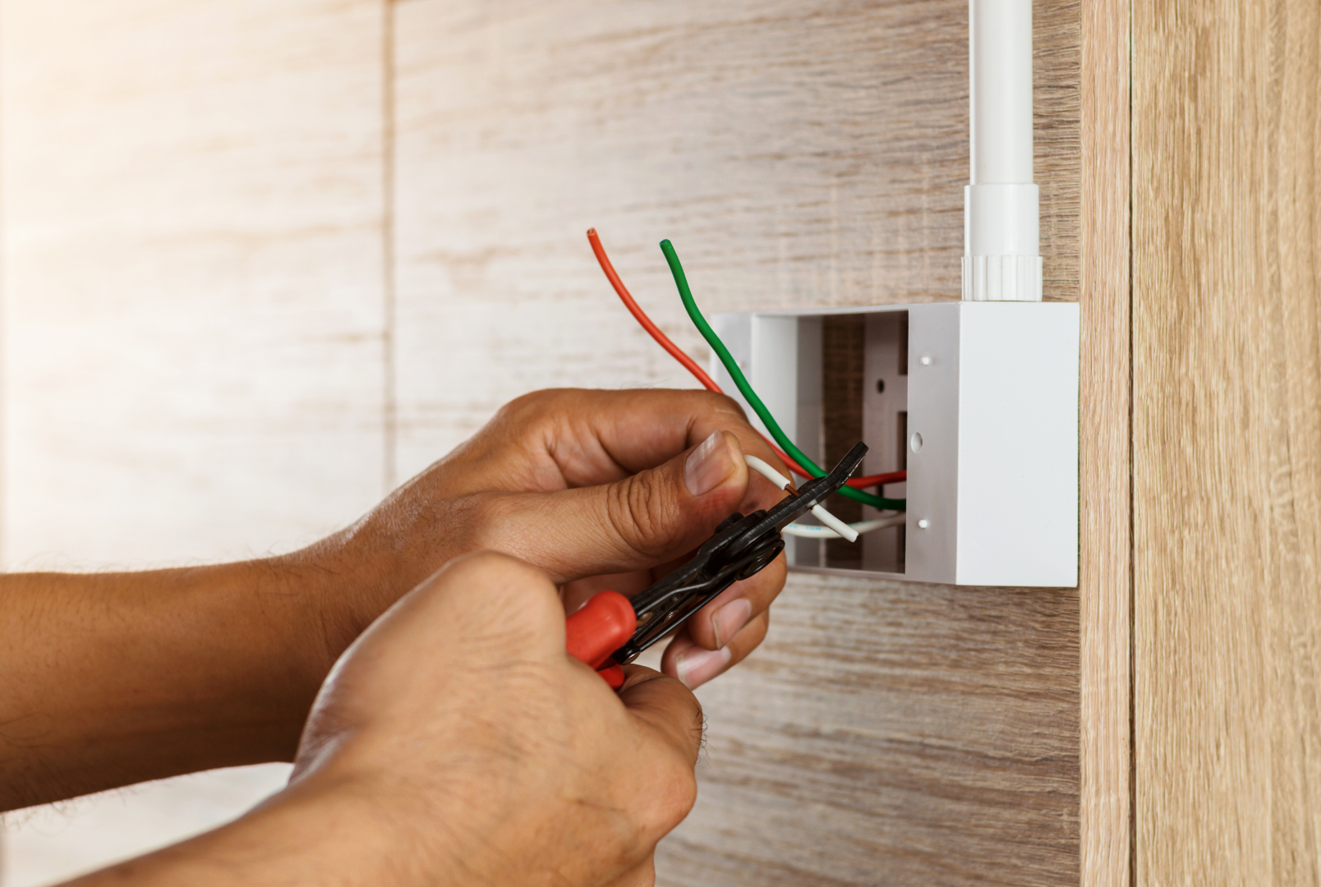
CUT
STRIP
CRIMP
PROTECT
VERIFY
The Big Picture
Electrical tools create a connection that is mechanically secure, electrically reliable, and protected from damage.
Notes:
INSTRUCTIONAL ACTIVITY: Present Content
TIME: 2 min.
Before we get into individual tools, it’s important to understand what we’re trying to accomplish.
Electrical tools aren’t used in isolation; they work together to create one reliable connection.
A good electrical connection must be:
Mechanically secure (won’t pull apart or loosen)
Electrically reliable (low resistance, consistent current flow)
Protected from damage, vibration, and the environment

Slide 8
VERIFY
CUT
Meters confirm what’s happening electrically
Removes damaged wire and creates a clean starting point
Electrical tools create a connection that is mechanically secure, electrically reliable, and protected from damage.
PROTECT
STRIP
Shrink tubing seals and protects the connection
Exposes copper without weakening it
The Big Picture
CRIMP
Exposes copper without weakening it
Notes:
INSTRUCTIONAL ACTIVITY: Present Content
TIME: 2 min.
Talking Points:
To achieve this connection, electrical tools work together to…
Cut – Removes damaged wire and creates a clean starting point
Strip – Exposes copper without weakening it
Crimp – Secures the wire to a connector so current can flow
Protect – Shrink tubing seals and protects the connection
Verify – Meters confirm what’s happening electrically
If any one of these steps is done poorly; the entire connection is at risk.
Most electrical problems are not caused by bad components. They start at poor connections, often due to small mistakes early in the process.
Now that we understand the goal, let’s talk about wire thickness and the parts we’re attaching wires to; connectors and terminals.

Slide 9
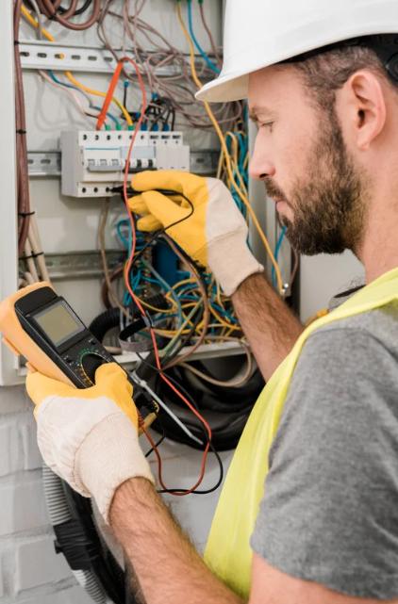
6.1 – Basic Electrical Hand Tools
Basic electrical hand tools build the foundation for safe and reliable electrical work.
Notes:
Instructional Event: Direction
Time: 1 minute.
Do: Review the purpose of this section of the module.
Talking Points:
This section covers the important basic electrical tools every mechanic should master.
Errors made during cutting, stripping, and crimping cause many real-world electrical failures on buses and rail cars.

Slide 10
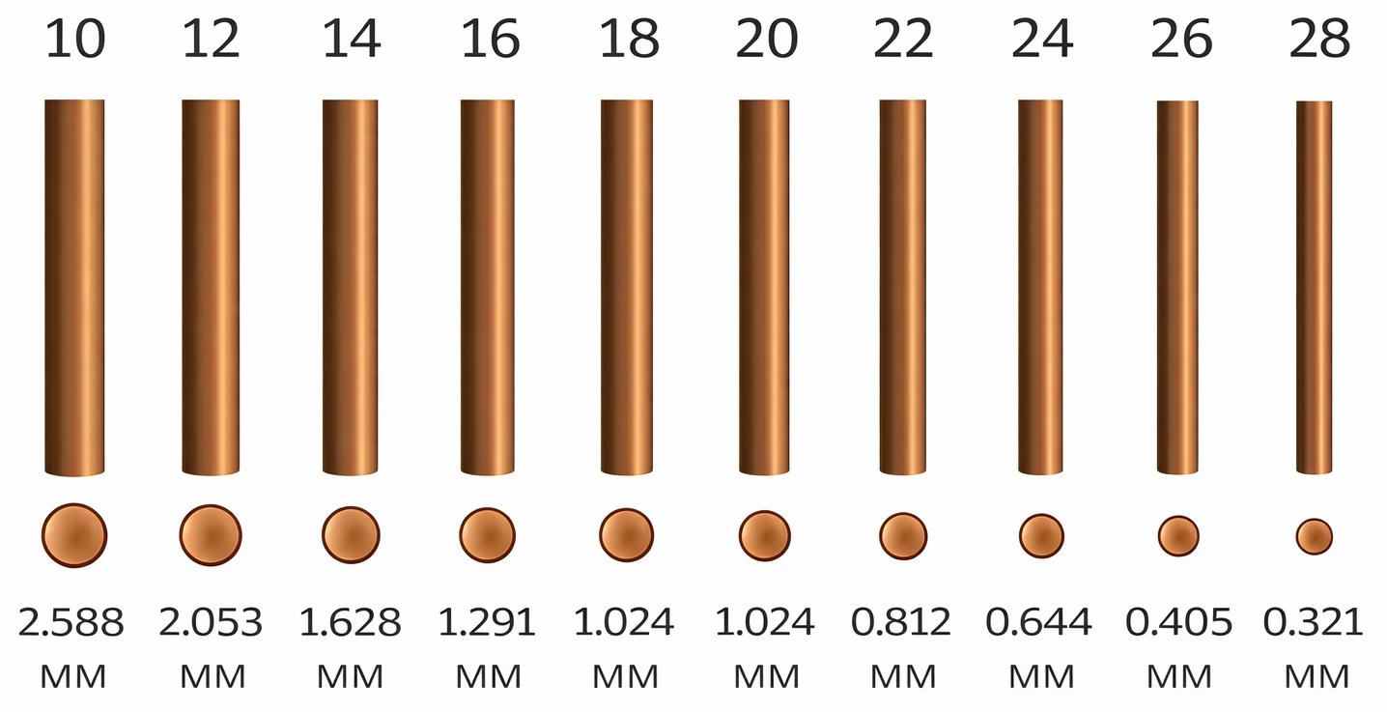
Wire Gauge
Gauge is used to define wire thickness and determine how much current a wire can safely handle.
Smaller gauge, thicker wire, more current
Larger gauge, thinner wire, less current
Notes:
*This slide contains animations. CLICK to reveal content.
INSTRUCTIONAL ACTIVITY: Present Content
TIME: 3 min.
Talking Points
Before we jump into wire cutters, strippers, and crimpers, we need to understand wire gauge.
Gauge defines wire thickness, not length, and determines how much current a wire can safely handle. Wire thickness directly affects tool selection and connection quality.
AWG stands for American Wire Gauge. It’s the standard system used in the U.S. to identify the diameter (thickness) of an electrical wire. The AWG number will be printed on the wire.
CLICK -
The smaller the AWG gauge number, the thicker the wire, the more current it can handle.
The larger the AWG gauge number, the thinner the wire, the less current it can handle.
In addition to current, wire thickness will also determine wire stripper notch to use and which crimper and terminal size are appropriate
Take a look at this graphic. As the gauge number increases (10 → 28), the wire gets thinner.
Thinner wire is easier to damage if the wrong tool or setting is used
Image Source: SparkFun Electronics. (n.d.). Working with wire: Wire thickness. https://learn.sparkfun.com/tutorials/working-with-wire/wire-thickness

Slide 11
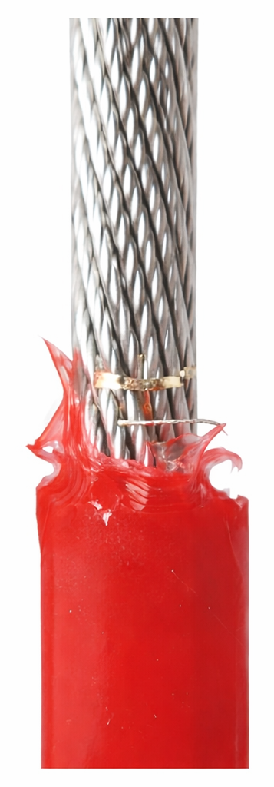
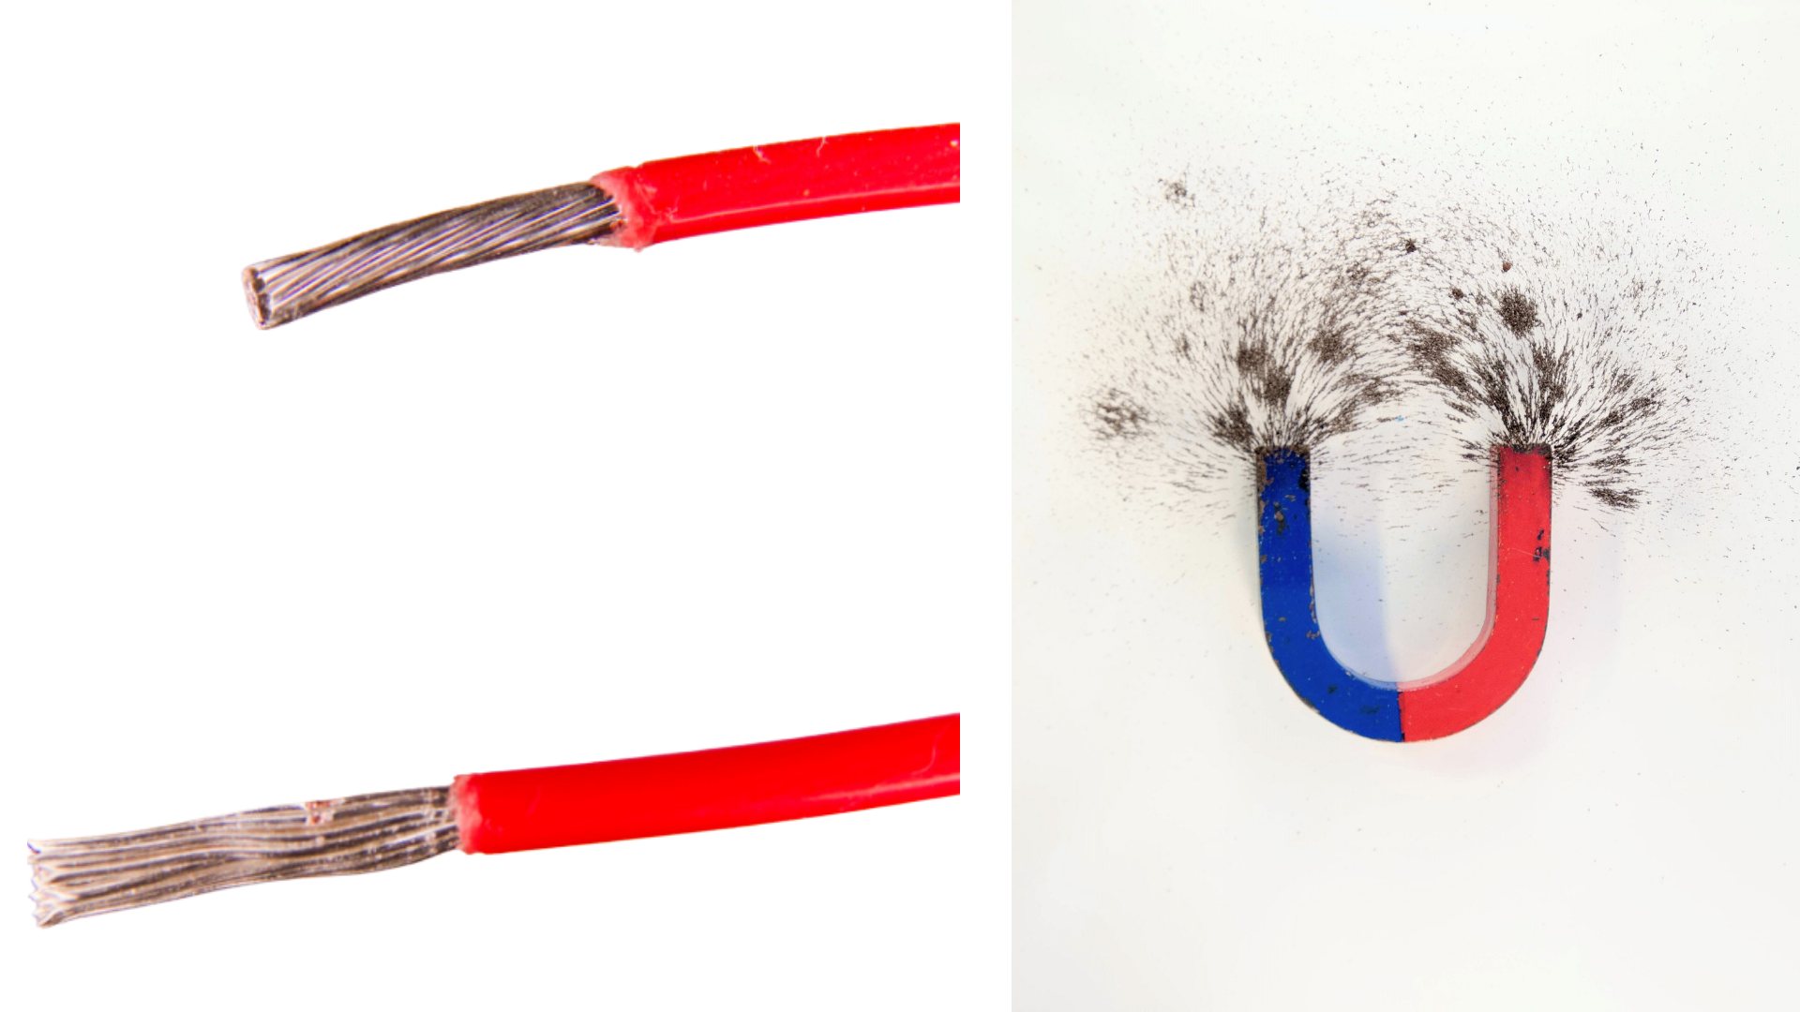
Wire Gauge Mistakes
Stripping with the wrong gauge can nick or cut strands.
Crimping the wrong size wire can create loose connections, high resistance, or intermittent failures.
Tight strands
Loose strands
Nick and Ragged Edge
Notes:
INSTRUCTIONAL ACTIVITY: Present Content
TIME: 5 min.
Talking Points
Most wiring mistakes start with using the wrong gauge setting on a tool.
Stripping with the wrong gauge can nick or cut strands
Crimping the wrong size wire can create loose connections, high resistance, or intermittent failures.
This is why you should never guess the wire size. Verify it by checking the markings, documentation, or by using a gauge tool.
Let’s do a quick check-in to review some important points.
ASK: Where do you usually find the wire gauge?
Call on learners to respond. Answer: Printed on the insulation.
ASK: What should you do if you’re not sure of the gauge?
Call on learners to respond. Answer: Check markings, documentation, or compare using a gauge tool.
Wire thickness affects what kind of tools we use including wire cutters, strippers, and crimpers which we’ll learn more about shortly.
Image Source:
Hakko USA. (n.d.). The need for thermal wire strippers. https://hakkousa.com/whats-new/the-need-for-thermal-wire-strippers.html
DigiKey TechForum. (n.d.). How to prepare a hook-up wire before crimping. https://forum.digikey.com/t/how-to-prepare-a-hook-up-wire-before-crimping/751

Slide 12
Connectors, Terminals, and Wiring Tools
Connector: Used to join wires together
Terminal: Used to attach a wire to equipment or connection point
Together they create a secure, removable, and reliable connection
Common examples: Butt connectors, Ring terminals, Spade terminals
Connectors
Wiring Tools
Terminals
Notes:
INSTRUCTIONAL ACTIVITY: Present Content
TIME: 2 min.
Talking Points
Recall what we said at the beginning of the lesson - electrical tools create a connection that is mechanically secure, electrically reliable, and protected from damage.
Connectors, terminals, and wiring tools all play an important role in making that connection happen.
Connectors are used to join wires together.
Terminals are used to attach a wire to a piece of equipment or a connection point.
Wiring tools such as cutters, strippers, and crimpers are used to properly prepare and secure those connections.
We use connectors and terminals to attach a wire to something. That “something” might be another wire, a component, or a connection point such as a stud, screw, or terminal block.
When installed correctly, connectors and terminals provide a consistent, reliable contact point.
They create a connection that can safely handle current flow, withstand vibration, and allow for maintenance or replacement when needed.
Common examples you will see include butt connectors, which join two wires end-to-end; ring terminals, which attach a wire to a stud or bolt; and spade terminals, which slide under a screw or terminal block.
It’s important to remember that connectors themselves do not carry current independently.
The quality of the wire-to-connector connection is what determines whether the circuit performs safely and reliably.

Slide 13
Wiring Tools
Wire Cutters | Wire Strippers | Wire Crimpers
Cut wire cleanly | Remove insulation without damaging copper | Attach terminals securely
1
2
3
Notes:
INSTRUCTIONAL ACTIVITY: Present Content
TIME: 2 min.
Talking Points
Electrical tools are not just for cutting and shaping wire.
They are used to properly prepare and secure those connections.
They protect current flow, system reliability, and worker safety.
Three core tools to master include:
Wire cutters which cut wire cleanly
Wire strippers which remove insulation without damaging copper
Crimpers which attach terminals securely
You will always follow the same order. Cut – strip - crimp

Slide 14
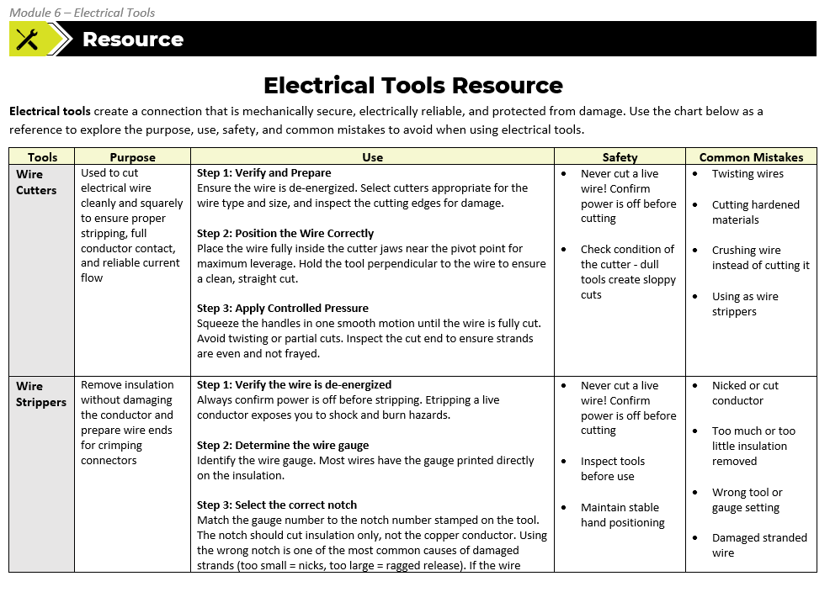
Electrical Tools Resource
Notes:
INSTRUCTIONAL ACTIVITY: Direction
TIME: 1 min.
Materials: Electrical Tools Resource_M6
Talking Points:
In your Participant Guide you’ll find an “Electrical Tools Resource.”
Use this handout as a guide as we review the purpose and use of electrical tools along with safety best practices and common mistakes.

Slide 15
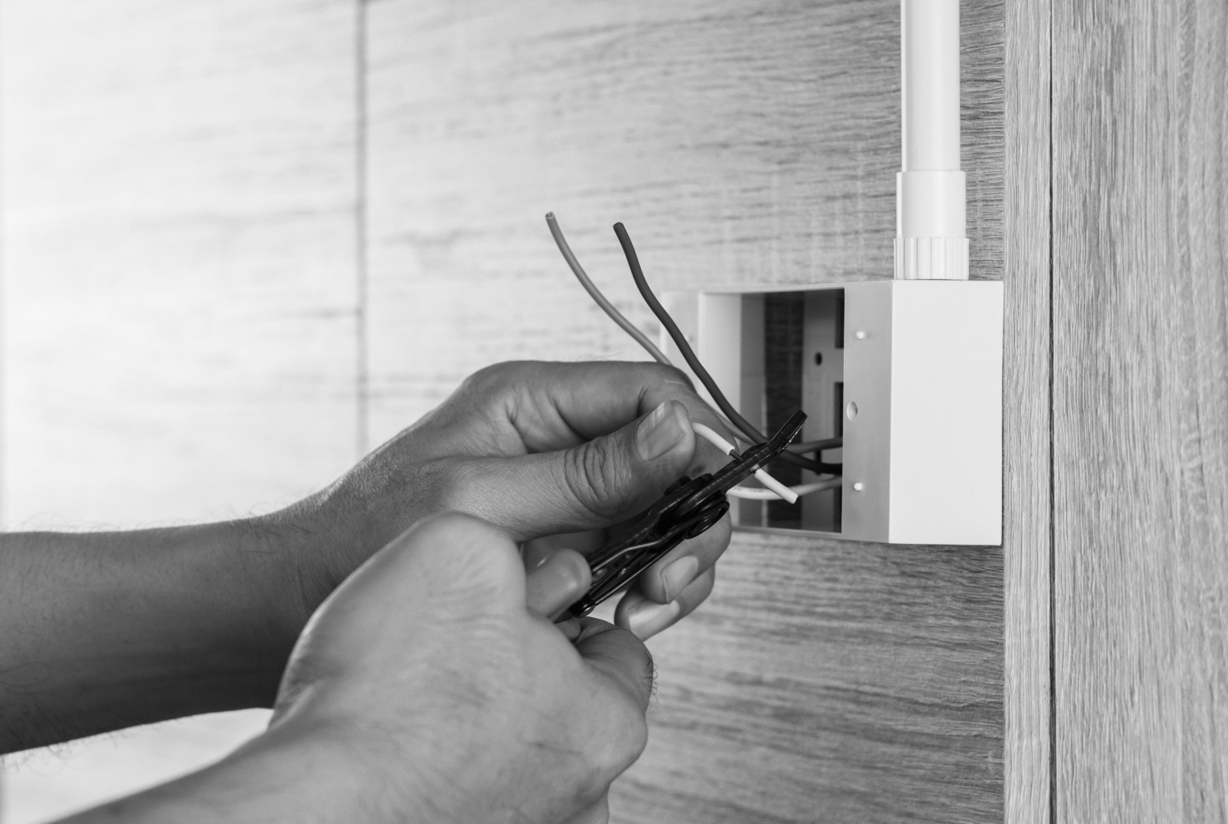
Purpose
Wire Cutters
Used to cut electrical wire cleanly and squarely to ensure proper stripping, full conductor contact, and reliable current flow
Cutting wire to length
Removing damaged wire
Replacing connectors
A clean cut is the first step to a
reliable circuit
Use
Safety
Mistakes
Notes:
INSTRUCTIONAL ACTIVITY: Present Content
TIME: 2 min.
Talking Points
Wire cutting is usually the first step before stripping and crimping.
Wire cutters are used to cut electrical wire cleanly and squarely to ensure proper stripping, full conductor contact, and reliable current flow.
They are also useful for:
Cutting wire to the correct length
Removing damaged, corroded, or overheated sections of wire
And cutting off old connectors before installing new ones
A clean cut is the first step to a reliable circuit.
Crushed or frayed ends make stripping harder and lead to weak crimps.
Wire cutters aren’t just about length. They protect the conductor for everything that comes next.
If you damage the conductor here, you won’t see the problem immediately. It shows up later as heat, voltage drop, or intermittent issues.

Slide 16
Purpose
Wire Cutters
Step 1: Verify and Prepare
Step 2: Position the Wire Correctly
Step 3: Apply Controlled Pressure
Use
Safety
Mistakes
Notes:
INSTRUCTIONAL ACTIVITY: Present Content
TIME: 2 min.
Talking Points
Using wire cutters take a little preparation and a steady hand.
Step 1: Verify and Prepare - Ensure the wire is de-energized. Select cutters appropriate for the wire type and size and inspect the cutting edges for damage.
Step 2: Position the Wire Correctly - Place the wire fully inside the cutter jaws near the pivot point for maximum leverage. Hold the tool perpendicular to the wire to ensure a clean, straight cut.
Step 3: Apply Controlled Pressure - Squeeze the handles in one smooth motion until the wire is fully cut. Avoid twisting or partial cuts. Inspect the cut end to ensure strands are even and not frayed.
Source: SparkFun Electronics. (n.d.). How to strip a wire. https://learn.sparkfun.com/tutorials/working-with-wire/how-to-strip-a-wire

Slide 17
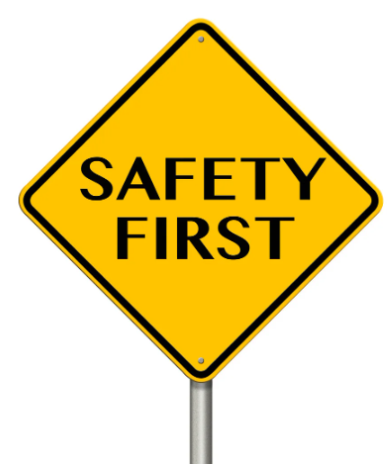
Purpose
Wire Cutters
Never cut a live wire. Energized conductor can cause personal injury or damage tool
Always confirm power is off before cutting
Check condition of
the cutter - dull tools
slip and create sloppy
cuts
Use
Safety
Mistakes
Notes:
INSTRUCTIONAL ACTIVITY: Present Content
TIME: 2 min.
Talking Points
Wire cutters are simple tools, but can still cause injury or damage if used incorrectly
Never cut a live wire! Cutting a live wire can cause arcing, tool damage, or injury. Even low-voltage DC can arc.
Always verify the circuit is de-energized and confirm power is off.
Don’t rely on labels or assumptions
Follow proper lockout/tagout and verification steps
Inspect the cutter
Check for dull or chipped edges, misaligned jaws, or damaged handles
Dull cutters are more likely to slip or crush wire
Key takeaway: Safe cuts start with power off and a tool in good condition.

Slide 18
Purpose
Wire Cutters
Using cutters to:
Twist wires
Cut hardened materials
Crushing wire instead of cutting it
Using as wire strippers
Use
Safety
Mistakes
Notes:
INSTRUCTIONAL ACTIVITY: Present Content
TIME: 2 min.
Talking Points
These mistakes damage the wire, the tool, or both. Small shortcuts here cause problems later.
Using cutters to twist wires
Cutters are not made for twisting. Twisting can break strands and deform the wire.
Twist by hand if needed, not with cutters.
Cutting hardened materials
Cutters are designed for copper wire only.
Cutting hardened materials dulls or chips the blades.
Damaged cutters lead to poor cuts on future wires.
Crushing wire instead of cutting
Crushing flattens and damages the conductor.
Damaged wire is harder to strip and crimp properly.
If it won’t cut cleanly, stop and inspect the tool.
Key takeaway: A clean cut sets up everything that follows.

Slide 19
Purpose
Wire Strippers
Remove insulation without damaging the conductor and prepare wire ends for crimping connectors
Damaged wire strands will:
  Reduce conductor size
  Increase resistance
  Create weak points that
  can fail later
Use
Safety
Mistakes
Notes:
INSTRUCTIONAL ACTIVITY: Present Content
TIME: 2 min.
Talking Points
Stripping is where most electrical failures begin.
If you nick strands while stripping, that weakens the connection.
Wire strippers remove insulation without damaging the copper underneath, but only if you use the correct notch for the wire gauge.
When strands are damaged:
The effective conductor size is reduced
Resistance increases
The connection becomes a weak point that can fail over time
These failures often show up later as:
Intermittent issues
Heat at the connection
Vibration-related problems
Key reminder: Stripping is about protecting the conductor, not just exposing copper.

Slide 20
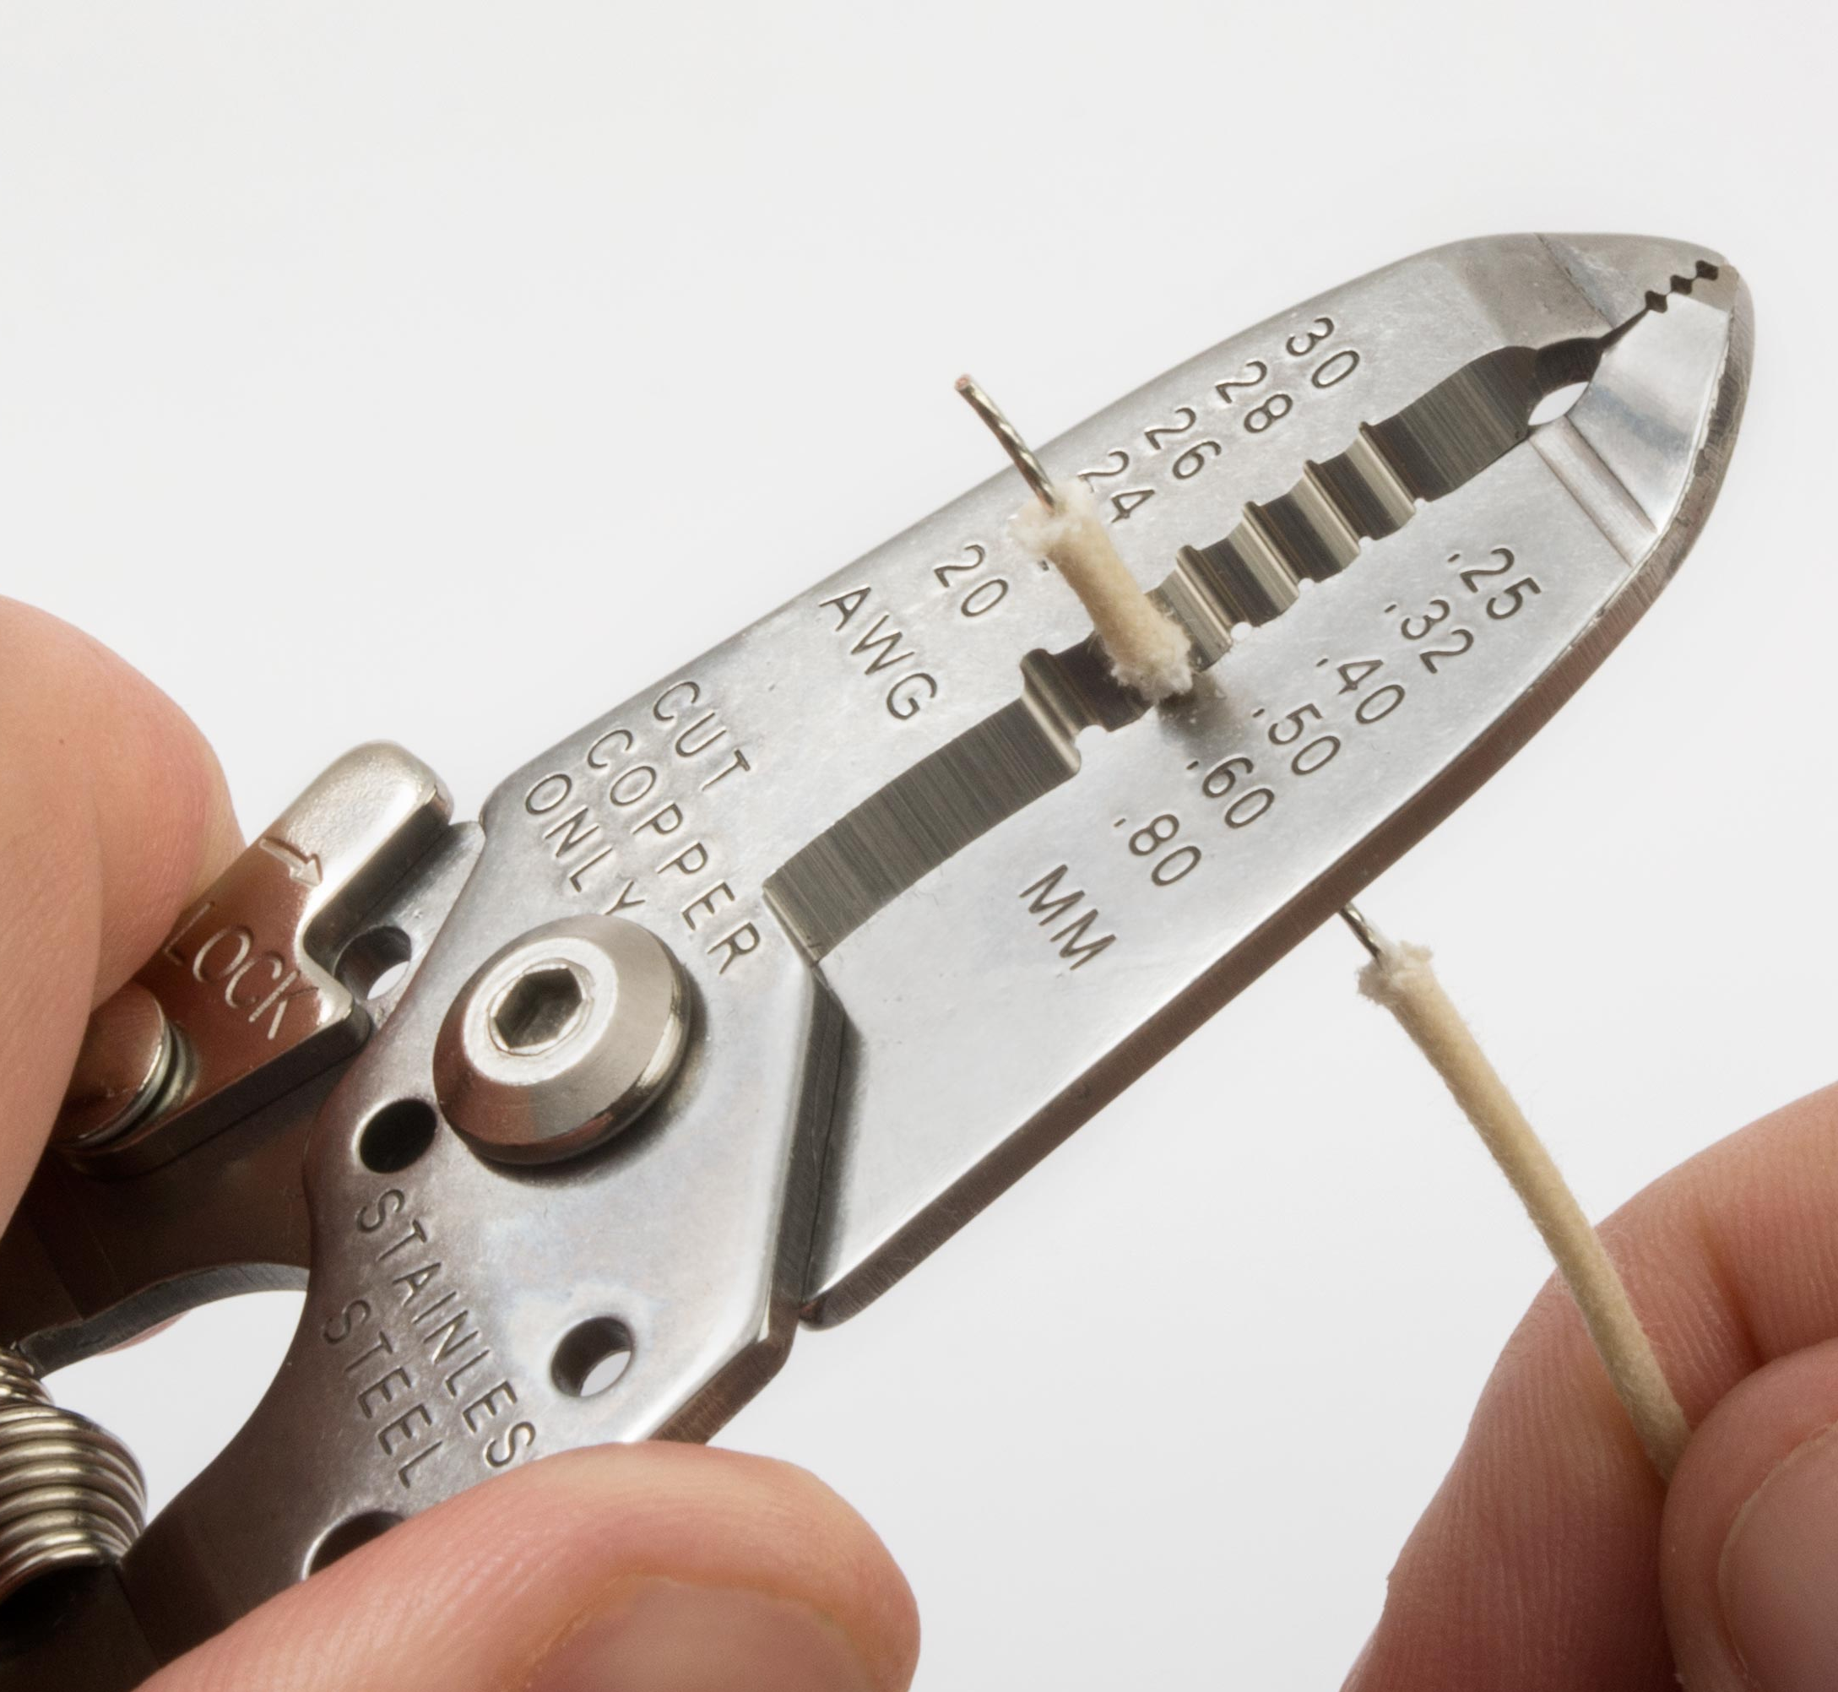
Purpose
Wire Strippers
Step 1: Verify the wire is de-energized
Step 2: Determine the wire gauge and select the correct notch on the stripper
Step 3: Insert wire into notch
Step 4: Apply controlled pressure to cut insulation
Step 5: Pull to remove the insulation
Use
Safety
Mistakes
Notes:
INSTRUCTIONAL ACTIVITY: Present Content
TIME: 5 min.
Talking Points
Using wire strippers is relatively simple, but each step is important.
Before using wire strippers, always verify the wire or circuit is de-energized and safe to handle.
Wire strippers are designed to remove insulation without damaging the conductor underneath.
Wire strippers have multiple notches for different wire gauges. Using the correct notch is important to avoid nicking or weakening the wire.
Insert the wire into the correct notch at the desired strip length.
Apply controlled pressure to cut only the insulation layer. Too much force can damage the conductor.
Pull the insulation off the wire to expose the bare conductor.
If the conductor appears nicked, cut, or damaged after stripping, the wire should be restripped.
Clean wire stripping is important for creating safe and reliable electrical connections.

Slide 21
Purpose
Wire Strippers
Never strip a live conductor. Always verify the circuit is de-energized
Inspect tools before use
Maintain stable hand positioning
Use
Safety
Mistakes
Notes:
INSTRUCTIONAL ACTIVITY: Present Content
TIME: 2 min.
Talking Points
Stripping a live conductor exposes you to shock, burns, or arc hazards. Always verify the circuit is de-energized before stripping.
Inspect your tools before use. If the insulated handles are cracked or damaged, your protection is reduced.
Jerking the tool or using poor hand positioning can cause it to slip, leading to cuts or puncture injuries.
Dull or misaligned blades require more force. More force increases the chance of losing control of the tool.
Most of these injuries are preventable with inspection, proper technique, and verifying de-energization first.

Slide 22
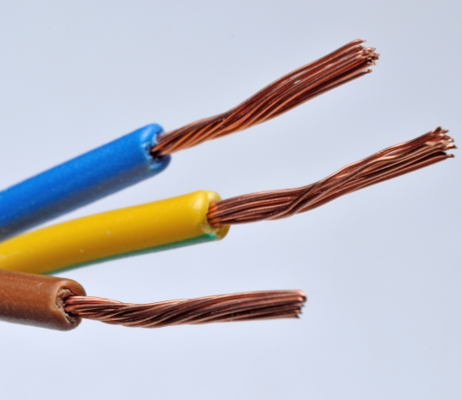
What a Properly Stripped Wire Looks Like
Insulation removed cleanly
All strands intact
No nicks or cuts
Correct strip length
Notes:
INSTRUCTIONAL ACTIVITY: Present Content
TIME: 2 min.
Talking Points
Most terminals used in transit require about a quarter inch of stripped wire.
If it’s too short, it will lead to a poor contact.
If it’s too long, it will lead to exposed conductor.
The goal is for the copper to be fully inside the terminal barrel with insulation right up to the edge.
The insulation should be removed cleanly.
The insulation edge should be smooth and even.
No torn or ragged insulation left behind.
All strands should be intact.
Every strand carries current. Missing strands reduce capacity and weaken the connection.
There should be no nicks or cuts.
Even small nicks increase resistance. Damaged strands are failure points over time.
Correct strip length
Have enough bare copper to fully seat in the connector.
Be sure there is no exposed copper outside the terminal once crimped.
Inspect before you crimp because fixing it later takes longer.

Slide 23
Purpose
Wire Strippers
Nicked or cut conductor
Too much or too little insulation removed
Wrong tool or gauge setting
Damaged stranded wire
Use
Safety
Mistakes
Notes:
INSTRUCTIONAL ACTIVITY: Present Content
TIME: 2 min.
Talking Points
These are some common reasons electrical connections fail after installation
Many of these issues are hard to see once the connector is installed
Nicked or cut conductor
Even small nicks weaken the wire.
Reduced conductor size increases resistance which can lead to heat buildup and eventual failure.
Too much or too little insulation removed
Too much insulation removed leaves excess copper exposed.
This can increase the list of shorts and create a shock hazard.
This is especially dangerous in tight or vibrating spaces.
If too little insulation removed, it can prevent the terminal from making full contact.
This can result in a loose or high-resistance connection and causes intermittent problems.
Wrong tool or gauge setting
Using the wrong notch crushes or cuts strands.
Sometime the damage may not be obvious until the wire is under load.
This reinforces the need to verify the gauge before stripping.
Damaged stranded wire
Missing strands reduce current-carrying capacity.
This makes the connection more sensitive to vibration.
If the wire isn’t right after stripping, the connection won’t be right later.

Slide 24
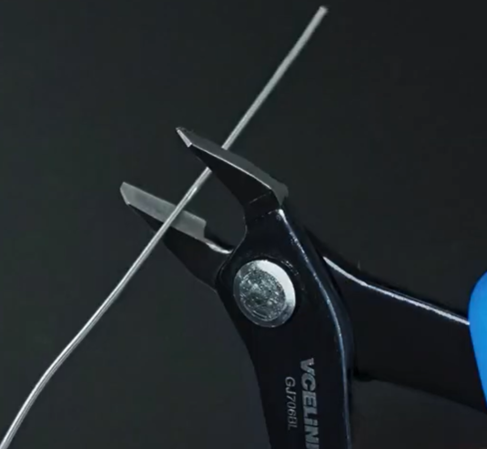
Demo: Wire Cutter
Tool inspection
Step 1: Verify and Prepare
Step 2: Position the Wire Correctly
Step 3: Apply Controlled Pressure
Cut inspection
Notes:
INSTRUCTIONAL ACTIVITY: Provide Guided Learning
TIME: 10 min.
Materials:
Wire cutters
Insulated copper wire for cutting
Examples of poorly cut wires - frayed edge, angled cut, etc.
Do:
Demonstrate how to cut a wire.
Start by briefly inspecting the wire cutters for dull edges or other defects.
Step 1 - Simulate what you would do to verify a wire is de-energized.
Step 2 - Position the wire correctly inside the cutter jaws near the pivot point for maximum leverage. Hold the tool perpendicular to the wire to ensure a clean, straight cut.
Step 3 – Apply controlled pressure and squeeze the handles in one smooth motion until the wire is fully cut. Avoid twisting or partial cuts. Inspect the cut end to ensure strands are even and not frayed.
Show the class a properly cut wire with a clean, flat, and even edge.
Show the class a few examples of improperly cut wires include wires with a frayed or angled edge. Hold the good and bad example wires up and pause so learners can clearly see the difference.
Image Source: VCELINK. (2022, May 31). Small wire cutters [Video]. YouTube. https://www.youtube.com/watch?v=f6ANJ6FBFLs

Slide 25
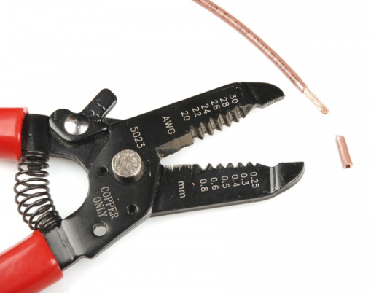
Demo: Wire Stripper
Tool inspection
Step 1: Verify wire is de-energized
Step 2: Determine wire gauge
Step 3: Select the correct notch
Step 4: Remove the insulation
Cut inspection
Notes:
INSTRUCTIONAL ACTIVITY: Provide Guided Learning
TIME: 10 min.
Materials:
Wire strippers
Insulated copper wire for stripping
Examples of poorly stripped wires - with nicked or cut strands, insulation cut at an angle, exposed shielding or fillers, damaged conductor under the insulation, etc.
Do:
Demonstrate how to strip a wire.
Again, start by briefly inspecting the wire strippers for dull edges or other defects.
Reinforce the importance of this step: Stripping is a pass/fail step. If it’s not right here, it won’t get better later.
Crimping and shrink tubing can hide problems, not fix them. Inspection must happen before moving on
Step 1 - Simulate what you would do to verify a wire is de-energized.
Step 2: Determine the wire gauge. Most wires have the gauge printed directly on the insulation.
Step 3: Select the correct notch by matching the gauge number to the notch number stamped on the tool. Remind learners that the notch should cut insulation only, not the copper conductor.
Step 4: Remove the insulation by applying steady, controlled pressure and pull the insulation straight off. Do not twist or jerk the tool, as this can nick or stretch the copper. If the insulation does not release easily, stop and recheck the notch size before trying again.
Review what makes this a well-stripped wire. Highlight the clean insulation edge, intact strands, and correct strip length of the conductor.
Show learners a poorly stripped wire with some of the following issues:
Nicked or cut strands
Insulation cut at an angle
Exposed shielding or fillers
Damaged conductor under the insulation
Reinforce that these are all reasons to stop and redo the strip.
Hold the good and bad example wires up and pause so learners can clearly see the difference.

Slide 26
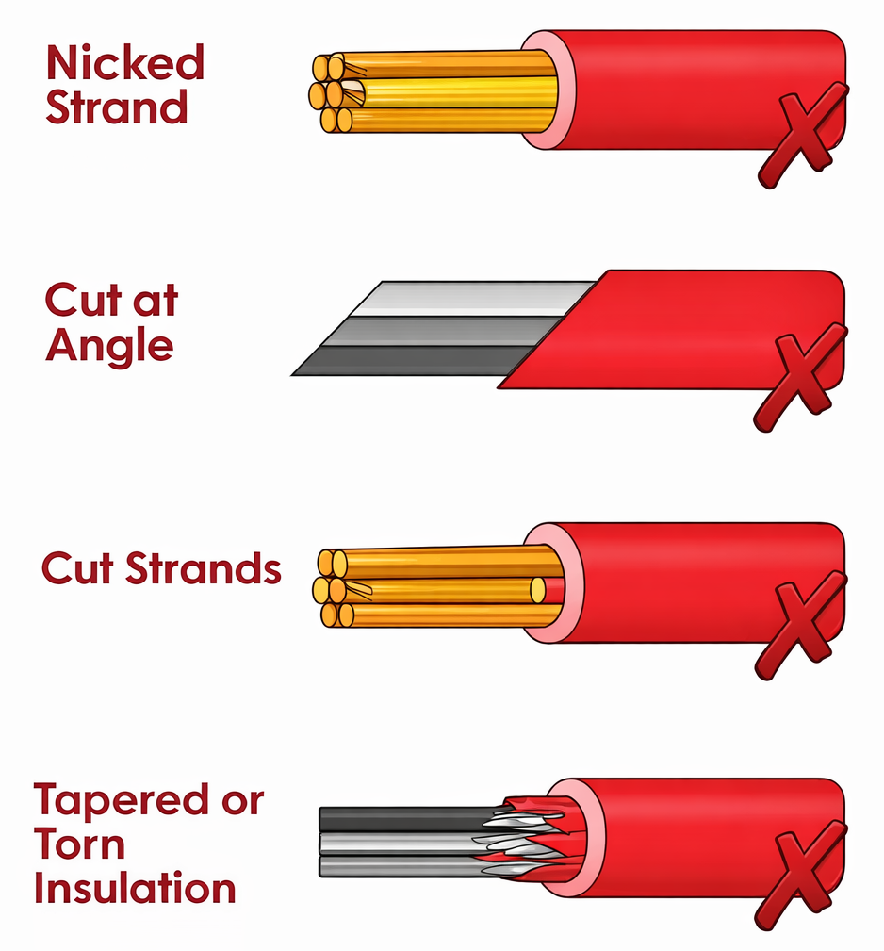
Demo Debrief Discussion
What problems could show up later if this wire were cut on an angle or had a frayed edge?
If the wire gauge is between sizes, what should you do?
What problems could show up later if a poorly stripped wire were crimped anyway?
Which of the mistakes on the poorly stripped wires would be hardest to see once the connector is installed?
Notes:
INSTRUCTIONAL ACTIVITY: Recall, Give Feedback
TIME: 10 min.
Do:
Facilitate a demo debrief discussion using these questions. Give feedback and correct understand errors as needed:
What problems could show up later if this wire were cut on an angle or frayed edge?
Answer: An angled cut may prevent full seating inside a terminal or connector barrel. Frayed strands reduce effective conductor size and make proper crimping difficult.
If the wire gauge is between sizes, what should you do?
Answer: Start with the larger notch, inspect the result, and adjust if necessary to avoid damaging strands.
What problems could show up later if a poorly stripped wire were crimped anyway?
Answer: A poorly stripped wire can lead to weak mechanical connections, increased resistance, overheating, and eventual connection failure.
Which of the mistakes on the poorly stripped wires would be hardest to see once the connector is installed?
Answer: Nicked or cut strands would be the hardest to see once the connector is installed because the damage is hidden inside the crimp.
Image Source: The Van Conversion. (n.d.). The mega guide to wires for campervans. https://www.thevanconversion.com/post/the-mega-guide-to-wires-for-campervans

Slide 27
Wire Crimper
Purpose
Attaches connectors or terminals to wires by compressing the conductor and terminal barrel together to create a secure mechanical and reliable electrical connection.
Why Proper Crimps Matter
Provides strong mechanical hold
Maintains low electrical resistance
Withstands vibration and movement
Common connectors include:
Ring terminals, Spade connectors,
Butt connectors
Use
Safety
Mistakes
Notes:
INSTRUCTIONAL ACTIVITY: Present Content
TIME: 2 min.
Talking Points
Crimpers are one of the most common and important tools in electrical work.
Their purpose is simple: they attach connectors or terminals to prepared wires.
This step turns a stripped wire into a usable electrical connection. A solid crimp is what makes these connections reliable.
Crimping squeezes the copper conductor and the terminal barrel together. The goal is two things: a strong mechanical hold and a solid electrical path for current. A crimp isn’t just holding the wire in place, it’s carrying current.
A proper crimp won’t pull off under normal force, maintains low resistance, and survives vibration and movement. A poor crimp, on the other hand, is one of the most common causes of electrical failures.
You’ll commonly see connectors like ring terminals, spade connectors, and butt connectors. Each has a different job, but they all depend on one thing — a solid crimp.

Slide 28
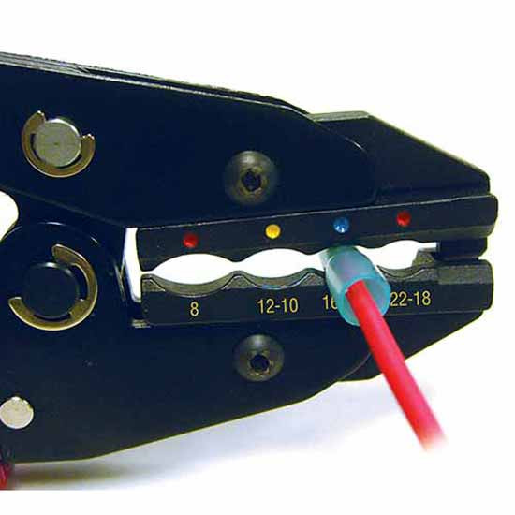
Wire Crimper
Purpose
Step 1: Inspect the Prepared Wire - Confirm clean cut, proper strip length, and intact strands.
Step 2: Select the Correct Terminal and Die - Match the wire gauge to the terminal type and crimping die size.
Step 3: Insert the Wire Fully - Ensure the conductor is fully seated inside the terminal barrel.
Step 4: Complete the Crimp –
Squeeze firmly until the crimp is
fully compressed.
Step 5: Inspect and Test - Perform a
visual inspection and gentle pull test.
Use
Safety
Mistakes
Notes:
*This slide contains animations. CLICK to reveal content.
INSTRUCTIONAL ACTIVITY: Present Content
TIME: 2 min.
Talking Points
Let’s walk though how to use a wire crimper.
CLICK - Step 1: Inspect the prepared wire
Before crimping, inspect the strands, strip length, and insulation edge. The quality of the crimp depends on earlier steps — a clean cut, proper stripping, and correct tool selection. If the crimp isn’t mechanically secure, it won’t be electrically reliable.
CLICK - Step 2: Select the correct terminal and die.
Select a connector or terminal that matches the wire size. Then choose the correct crimping die.
Confirm whether the terminal is insulated or non-insulated.
Always use the correct die (slot) size - Crimper dies are designed for specific wire gauges. If the die is too small, strands can be crushed or cut. If it’s too large, the wire won’t be held securely. Either mistake leads to loose connections, high resistance, and intermittent failures.
Remember the sequence: wire gauge determines terminal type, and terminal type determines crimper selection.
CLICK - Step 3: Insert the wire fully.
Insert the wire completely into the connector so all exposed strands are inside the barrel. The conductor should be fully seated before crimping.
CLICK - Step 4: Complete the crimp.
Squeeze the tool firmly until the crimp is complete. Use steady pressure and ensure the barrel is fully compressed.
CLICK - Step 5: Inspect and test.
Every crimp should be followed by a visual inspection and a gentle tug test. If it pulls out, it fails. A proper crimp should hold under normal force
Let’s check in to see if we’re understanding how to use a crimper.
ASK: What happens electrically when a connection is loose?
Call on learners to respond. Answer: A loose connection increases resistance, which can cause overheating, voltage drop, intermittent operation, and eventual electrical failure.
ASK: If a crimp looks tight but used the wrong die, would you trust it? Why or why not?
Call on learners to respond. Answer: No, because using the wrong die can damage strands or fail to fully compress the terminal, creating hidden weaknesses that may lead to high resistance, vibration failure, or connection loss over time.

Slide 29
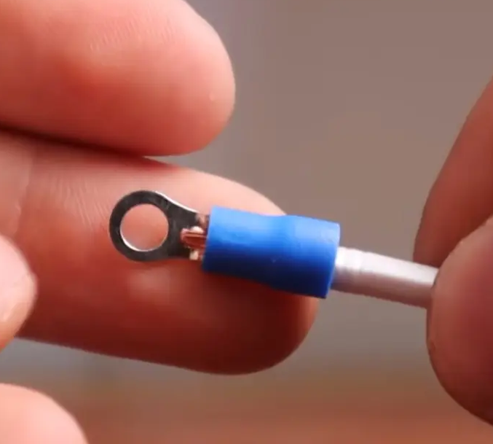
What a Properly Crimped Wire Looks Like
Connector tightly secured to the wire
No wire pull-out
Correct crimp location used on the tool
Insulation and conductor crimped correctly
Notes:
INSTRUCTIONAL ACTIVITY: Present Content
TIME: 2 min.
Talking Points
These are the minimum standards a crimp must meet. If it doesn’t meet these criteria, it should be redone.
Connector tightly secured - The connector should feel solid on the wire with no movement between the wire and the terminal. Any looseness means poor mechanical hold and poor electrical contact.
No wire pull-out - Perform a gentle tug test. The wire should not slide or pull out of the connector. If it moves, the crimp has failed — even if it looks acceptable.
Correct crimp location used - The crimp must be made on the metal barrel, not on the insulation alone. Using the wrong section of the tool can crush the barrel or leave the wire loose. This reinforces matching the wire gauge, terminal type, and crimper selection.
Insulation and conductor properly compressed - The copper strands should be compressed inside the barrel without being cut. There should be no exposed copper outside the connector.

Slide 30
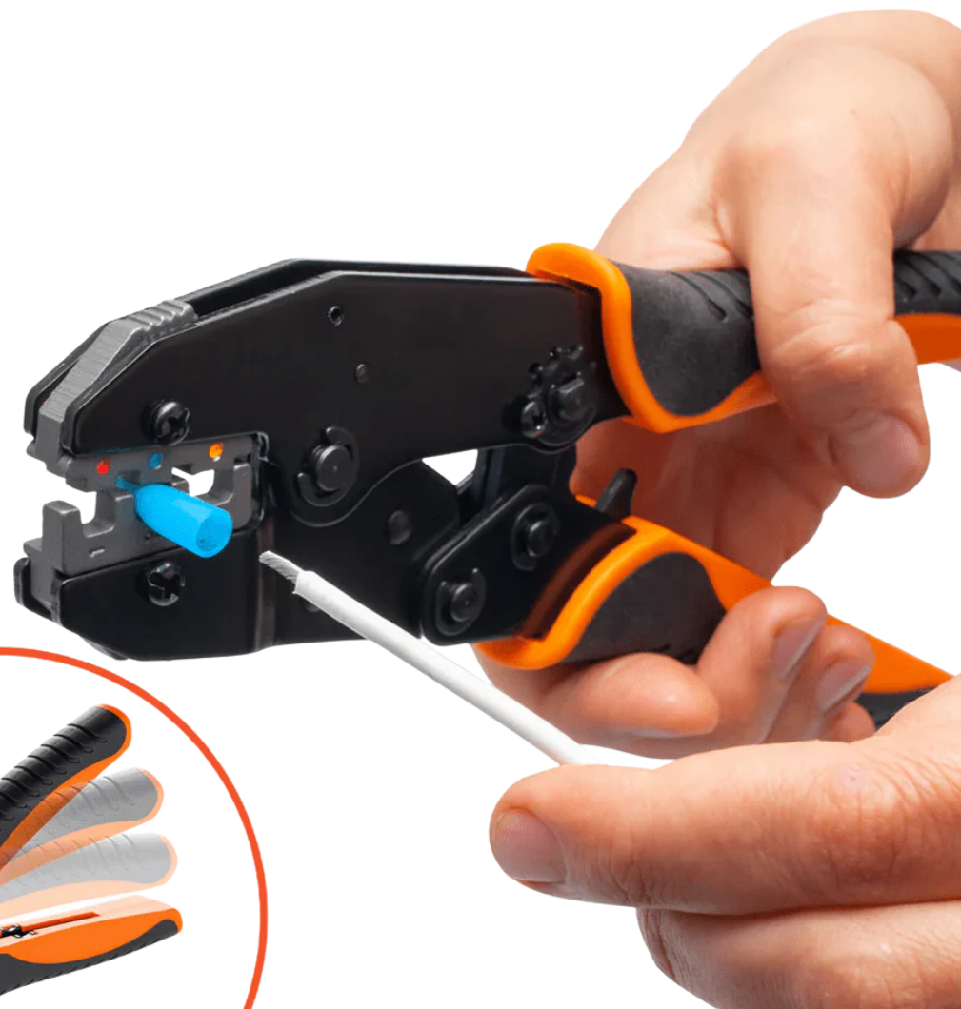
Wire Crimper
Purpose
Verify the circuit is de-energized before crimping
Inspect tool condition and die selection
Keep fingers clear of crimping jaws
Perform a visual
inspection and
pull test after crimp
Use
Safety
Mistakes
Notes:
INSTRUCTIONAL ACTIVITY: Present Content
TIME: 2 min.
Talking Points
Crimping may seem low-risk, but there are both immediate and long-term safety considerations.
First, always verify the circuit is de-energized. Even though you’re not cutting insulation at this step, you’re still working on a conductor.
Inspect the crimper before use. Check that the die is appropriate for the wire gauge and terminal type. Using the wrong die doesn’t just affect quality — it can crush strands, create high resistance, and lead to overheating later.
Keep your fingers clear of the crimping jaws. Ratcheting crimpers apply significant force, and pinched fingers are a common shop injury.
Apply steady pressure and let the tool complete the crimp cycle. Don’t try to stop midway.
After every crimp, perform a visual inspection and a gentle pull test. A crimp that isn’t mechanically secure isn’t electrically reliable.
Remember — poor crimps are one of the most common causes of electrical failures. In transit environments, vibration amplifies small mistakes. A bad crimp today can become an equipment failure tomorrow.
Image Source: SolderStick. (n.d.). Wire crimping tool. https://solderstick.com/products/wire-crimping-tool

Slide 31
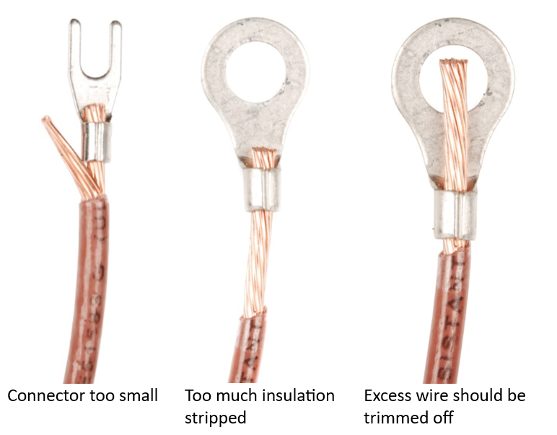
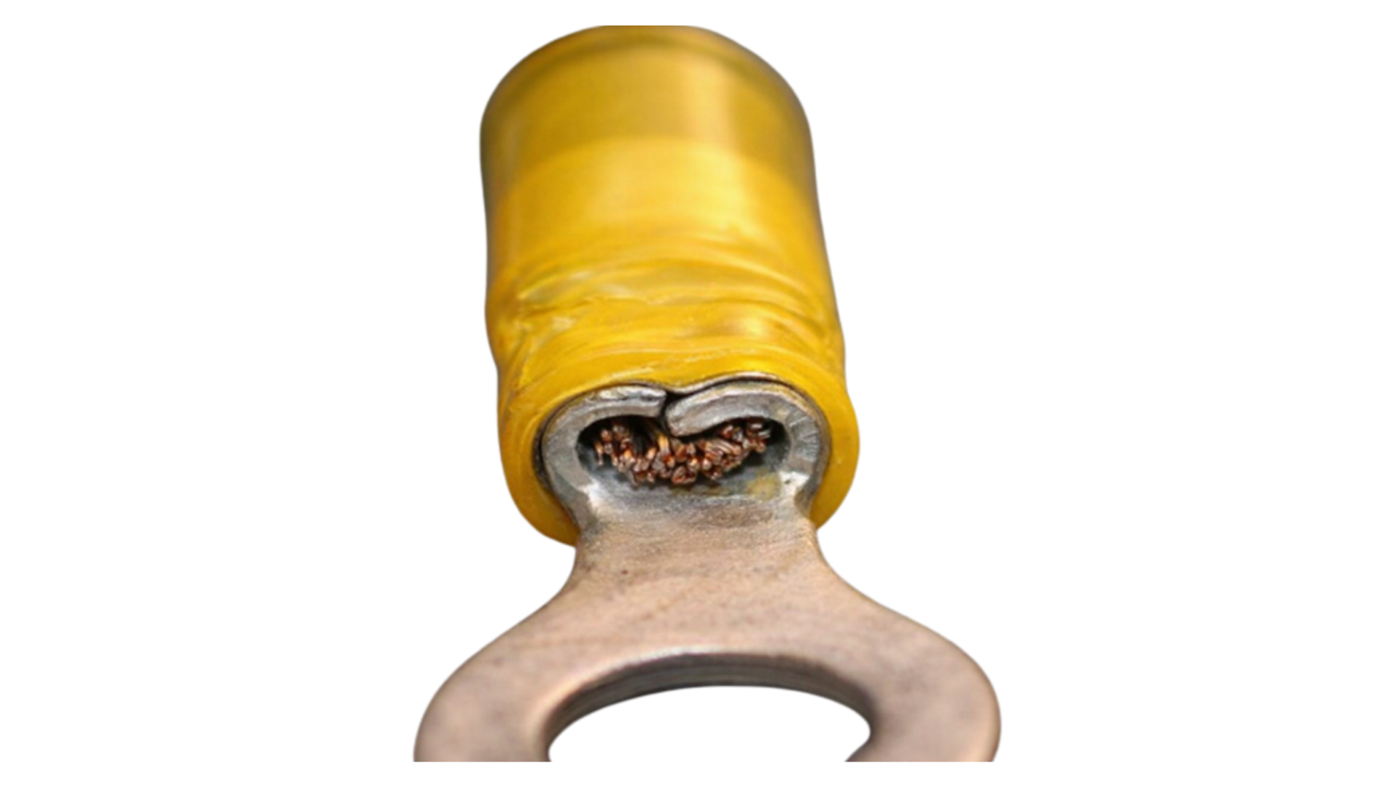
Wire Crimper
Purpose
Connector too small
Too much insulation stripped
Crushed crimp
Excess wire not trimmed
Use
Safety
Mistakes
Notes:
INSTRUCTIONAL ACTIVITY: Present Content
TIME: 2 min.
Talking Points
These examples look almost correct — and that’s what makes them dangerous. These are common causes of intermittent electrical failures.
Connector too small
If the connector is undersized, the wire won’t seat fully in the barrel and strands may flare or bunch up.
An undersized connector creates high resistance and weak mechanical hold, which can lead to overheating, arcing, and potential fire hazards under vibration.
Too much insulation stripped
Excess bare copper increases the risk of shorts and shock hazards. It also reduces insulation support inside the terminal, weakening the connection.
Excess wire not trimmed
If copper extends past the terminal barrel, this usually means the strip length was incorrect. Copper extending past the terminal can contact nearby metal parts, creating hidden short circuits that may only appear after movement or installation.
Crushed crimp
A crushed crimp happens when the wrong die size is used (usually too small) or when excessive force is applied, causing the terminal barrel to over-compress. This can flatten or deform the barrel and cut or severely compress the copper strands inside.
A crushed crimp reduces current-carrying capacity and can overheat or fail under load, creating dangerous intermittent or high-resistance faults.
If you see exposed copper or any looseness, reject the crimp and redo it.
ASK:
Which of these would be hardest to catch without close inspection?
Call on learners to respond.
Which mistake is most likely to cause problems under vibration?
Call on learners to respond.
Source:
The wrong crimp tool. (2017, October 17). DIYnot Forums. https://www.diynot.com/diy/threads/the-wrong-crimp-tool.490671/
Cc. (2025, August 11). How to use crimp Connectors: Full Wire Terminal guide. TEJTERF | Components & Communication Solutions. https://tejte.com/blog/how-to-use-crimp-connectors-guide/
Engineering Guide | Crimping Diagram | ETCO. (2020, December 3). ETCO. https://www.etco.com/engineering-guides/

Slide 32
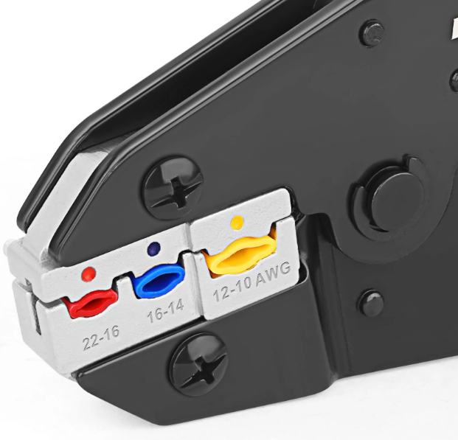
Types of Crimpers
Insulated Crimper
For insulated terminals only
Color-coded:
  Red (22–18 AWG),
  Blue (16–14 AWG),
  Yellow (12–10 AWG)
Supports insulation for strain relief
Notes:
INSTRUCTIONAL ACTIVITY: Present Content
TIME: 2 min.
Talking Points
There are three common types of crimpers you’ll encounter, and selecting the correct one determines connection quality.
An insulated crimper is used only with insulated terminals. The crimping areas are color-coded — red, blue, and yellow — to match common wire sizes. These tools are designed to crimp the metal barrel while also supporting the insulation for strain relief.

Slide 33
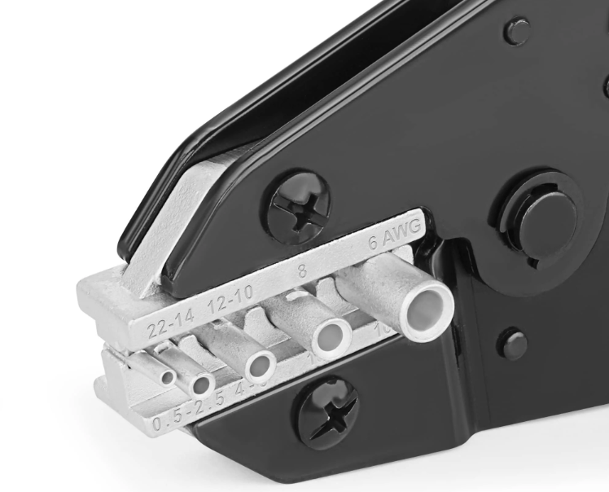
Types of Crimpers
Non-Insulated Crimper
For non-insulated terminals only
Sized by wire gauge (no color coding)
Creates tight metal-to-metal crimp
Insulation added after (e.g., heat shrink)
Notes:
INSTRUCTIONAL ACTIVITY: Present Content
TIME: 2 min.
Talking Points
A non-insulated crimper is used with bare terminals. It creates a tight metal-to-metal crimp, but insulation or heat shrink must be added afterward. Because there’s no built-in insulation support, technique and inspection are critical.

Slide 34
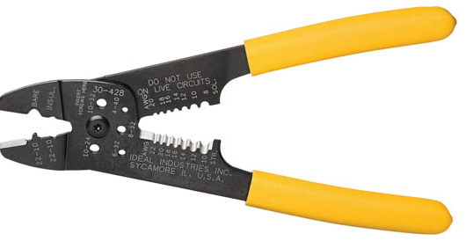
Types of Crimpers
Combination Tool
Cuts, strips, and crimps
Each section has a specific purpose
Convenience tool —
not one-size-fits-all
Notes:
INSTRUCTIONAL ACTIVITY: Present Content
TIME: 2 min.
Talking Points
Combination tools are common in the field because they combine cutting, stripping, and crimping in one tool. However, each section has a specific purpose. Convenience does not replace correct selection.
One mistake shows up repeatedly — mixing insulated and non-insulated crimpers. That leads to loose crimps, crushed barrels, and poor electrical contact.
The decision rule is simple: wire gauge determines terminal size; terminal type determines the correct crimper.

Slide 35
Demo: Proper Wire Crimp
Goal: Distinguish between a proper crimp and a poor crimp
Step 1: Inspect the prepared wire
Step 2: Select the correct terminal and die
Step 3: Insert the wire fully
Step 4: Complete the crimp
Step 5: Inspect and test
Notes:
INSTRUCTIONAL ACTIVITY: Provide Guided Learning
TIME: 10 min.
Materials:
Wire crimper
Prepared stripped wire
Matching terminals (proper and incorrect examples)
Examples of properly and improperly crimped terminals
Do:
Demonstrate how to properly crimp a terminal. If possible, demonstrate using a live wire and terminal.
Step 1 – Briefly inspect the prepared wire. Confirm proper strip length, intact strands, and no damaged insulation. Reinforce that poor crimps often start with poor preparation.
Step 2 – Select the correct terminal and crimper. Verbally reinforce the decision rule: Wire gauge → Terminal type → Correct crimper.
Step 3 – Insert the wire fully into the terminal barrel so all strands are seated inside.
Step 4 – Position the terminal in the correct crimping die and complete the crimp with firm, steady pressure.
Step 5 – Inspect the properly crimped example and perform a gentle tug test to demonstrate mechanical security. Point out the following:
Connector is tight on the wire
No exposed copper
Crimp centered on the metal barrel
Insulation properly supported (if insulated terminal)

Slide 36
Demo: Poor Wire Crimp
Goal: Distinguish between a proper crimp and a poor crimp
Discussion:
What would happen if we covered the bad crimp with shrink tubing?
Which problem would be hardest to detect later?
Notes:
INSTRUCTIONAL ACTIVITY: Recall, Provide Guided Learning, Provide Feedback
TIME: 10 min.
Materials:
Wire crimper
Prepared stripped wire
Matching terminals (proper and incorrect examples)
Examples of properly and improperly crimped terminals
Do:
Demonstrate how to poorly crimp a terminal. If possible, demonstrate using a live wire and terminal.
Point out issues such as:
Wire movement or pull-out
Crushed or uneven barrel
Crimp made in the wrong location
Exposed copper
Pause again so learners can visually compare the proper and improper crimped wire.
If live demonstration is not available, direct learners to the side-by-side photos on the slide and walk through the same comparison process.
Facilitate a brief discussion (provide feedback as needed):
What would happen if we covered the bad crimp with shrink tubing?
Which problem would be hardest to detect later?
Reinforce inspection habits and tie back to earlier steps:
A crimp must pass two tests — how it looks and how it holds. Always perform a visual inspection and a gentle tug test
Many bad crimps begin with poor stripping, wrong wire size, or incorrect crimper selection
Always follow the correct sequence: Cut → Strip → Crimp.
Source:
Yacht, D. (2021, April 22). Crimping small wires. Digital Yacht News. https://digitalyacht.net/2015/03/26/crimping-small-wires/
HAISST, R. (2025a, September 24). 7 common crimping mistakes (and how to avoid them). Haisstronica. https://haisstronica.com/it/blogs/wire-connectors/7-common-crimping-mistakes-and-how-to-avoid-them?srsltid=AfmBOorXxTbtqYhvXS_H1qmDPBEii-e2J-YpMEeF2rjJPf1ZHlTHEWcJ

Slide 37
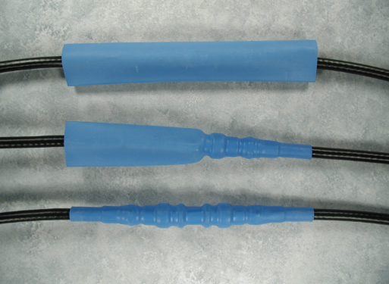
Purpose
Shrink Tubing
Shrink tubing contracts tightly around the wire or connection to form a snug barrier to protect crimps, splices, and exposed conductors.
Provides insulation protection and helps prevent:
  Shorts to ground
  Moisture intrusion
  Corrosion
Inspect the crimp before
applying shrink tubing
Use
Safety
Mistakes
Notes:
INSTRUCTIONAL ACTIVITY: Present Content
TIME: 2 min.
Talking Points
Shrink tubing is used after the electrical connection is complete.
When heat is applied, shrink tubing contracts tightly around the wire or connection to form a snug barrier to protect crimps, splices, and exposed conductors.
It does not carry current, and it does not improve a bad crimp. Its job is to protect good work.
Electrically, this matters because shrink tubing provides insulation protection. It helps prevent shorts to ground, moisture intrusion, and corrosion at the connection. This is especially important in environments with vibration, moisture, and temperature changes.
It’s critical to reinforce the sequence: shrink tubing protects a good connection — it does not fix a bad one.
Always inspect the crimp before applying shrink tubing. Once the tubing is applied, problems underneath are much harder to see.
Facilitate discussion by asking:
What problems could show up if we skip shrink tubing?
Call on learners to respond. Answer: Without shrink tubing, the connection is more vulnerable to moisture intrusion, corrosion, vibration damage, and accidental contact that can lead to shorts or premature electrical failure.
What happens if we cover a loose crimp with shrink tubing?
Call on learners to respond. Answer: Shrink tubing may hide the defect, but the loose crimp will still have high resistance and poor mechanical hold, increasing the risk of overheating, intermittent faults, and eventual failure.

Slide 38
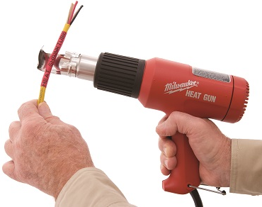
Purpose
Shrink Tubing
Step 1: Slide Tubing Onto the Wire
Step 2: Complete the Connection
Step 3: Position the Tubing
Step 4: Apply Heat Evenly
Step 5: Inspect the Seal
Use
Safety
Mistakes
Notes:
INSTRUCTIONAL ACTIVITY: Present Content
TIME: 2 min.
Talking Points
Let’s walk though how to use shrinking tube.
Step 1: Slide Tubing Onto the Wire - Place shrink tubing on the wire before installing the connector.
Step 2: Complete the Connection - Crimp the connector onto the wire.
Step 3: Position the Tubing - Slide tubing over the completed connection.
Step 4: Apply Heat Evenly - Using a heat gun, evenly heat the wire until the tubing fully contracts.
Step 5: Inspect the Seal - Confirm tubing has fully shrunk and verify adhesive has begun to flow at the ends.
Image Source: Meter. (n.d.). K-Sun heat shrink tubing. https://www.meter.com.au/labellingproducts/ksunheatshrinktubing/

Slide 39
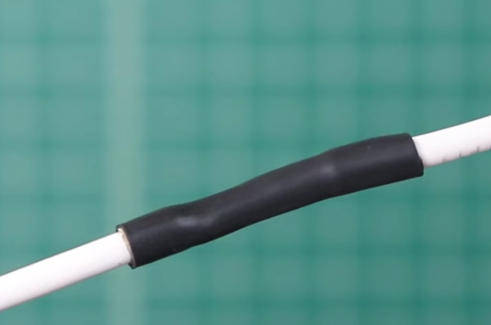
What a Proper Shrinking Tube Looks Like
Tubing fully shrunk around the wire or connector
No gaps of exposed conductor
Tubing extends slightly past the connection on both sides
Notes:
INSTRUCTIONAL ACTIVITY: Present Content
TIME: 2 min.
Talking Points
This slide shows what an acceptable, finished connection should look like.
Shrink tubing is the final protection step.
First, the tubing should be fully shrunk around the wire or connector. It should fit snug and uniform with no loose sections or soft spots. An even shrink pattern tells you heat was applied in a controlled way, not overheated in one spot.
Second, there should be no exposed conductor. All copper and metal should be completely covered. Any exposed copper creates both a shock risk and a short-to-ground risk. If copper is visible, the tubing should be redone.
Third, the tubing should extend slightly past the connection on both sides. This provides insulation, strain relief, and helps keep moisture and contaminants out. It also shows that the tubing was sized and positioned correctly before heating.
Shrink tubing protects the connection after the electrical work is complete — but only if it’s installed correctly.
ASK:
What could happen if shrink tubing stops right at the connector?
Call on learners to respond. Answer: If the tubing stops at the connector, it provides little to no strain relief and leaves the edge vulnerable to moisture intrusion, vibration damage, and eventual insulation failure.
Why is it important that we don’t see any copper here?
Call on learners to respond. Answer: Visible copper creates a shock hazard and increases the risk of short-to-ground or contact with other metal parts, which can lead to electrical failure.

Slide 40
Purpose
Shrink Tubing
Verify the circuit is de-energized before working
Use controlled heat (heat gun > open flame)
Apply heat evenly and keep it moving
Avoid overheating the tubing
or wire insulation
Allow connection to cool
before handling
Use
Safety
Mistakes
Notes:
INSTRUCTIONAL ACTIVITY: Present Content
TIME: 2 min.
Talking Points
When it comes to safety, we start as we always do, by verifying the circuit is de-energized before applying shrink tubing. Even though you’re in the protection phase, you’re still working on a conductor.
Use controlled heat such as a heat gun, never an open flame. Open flames can damage insulation, overheat connectors, and create fire hazards.
Apply heat evenly and keep the heat source moving. Concentrating heat in one area can scorch the tubing, melt insulation, or damage the connection underneath.
Avoid overheating. If tubing bubbles, burns, or splits, it has been overheated and should be replaced.
After shrinking, allow the connection to cool before touching it. Recently heated connectors and conductors can cause burns.
Sources:
Occupational Safety and Health Administration. (n.d.). Hand and portable powered tools and equipment. https://www.osha.gov/laws-regs/regulations/standardnumber/1910/1910.242
3M. (n.d.). Heat shrink tubing installation guidelines. https://www.3m.com

Slide 41
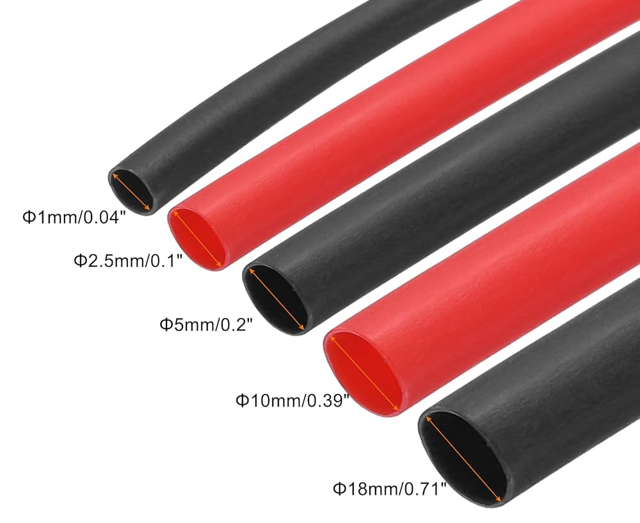
Purpose
Shrink Tubing
Forgetting to slide tubing on
before crimping
Using the wrong tubing size
Overheating the tubing
Uneven shrink or soft spots
Tubing too short to cover the full connection
Use
Safety
Mistakes
Notes:
INSTRUCTIONAL ACTIVITY: Present Content
TIME: 2 min.
Talking Points
One of the most common mistakes is forgetting to slide the tubing onto the wire before crimping. Once the connector is installed, you must cut it off to fix it.
Using the wrong tubing size causes problems. If it’s too large, it won’t seal properly. If it’s too small, it may split during heating.
Overheating is another common issue. Burned or brittle tubing reduces insulation protection and may damage the wire underneath.
Uneven shrink or soft spots indicate inconsistent heat application and may leave weak areas. Shrink from the center outward for even coverage.
Tubing that stops right at the connector instead of extending past it reduces strain relief and moisture protection.
Most importantly, shrink tubing does not fix a bad crimp. It protects good work — it does not repair poor workmanship.
Sources:
TE Connectivity. (n.d.). Heat shrink tubing application guide. https://www.te.com/en/videos/transportation/heat-shrink-tubing-installation.html
3M. (n.d.). Heat shrink tubing installation guidelines. https://www.3m.com

Slide 42
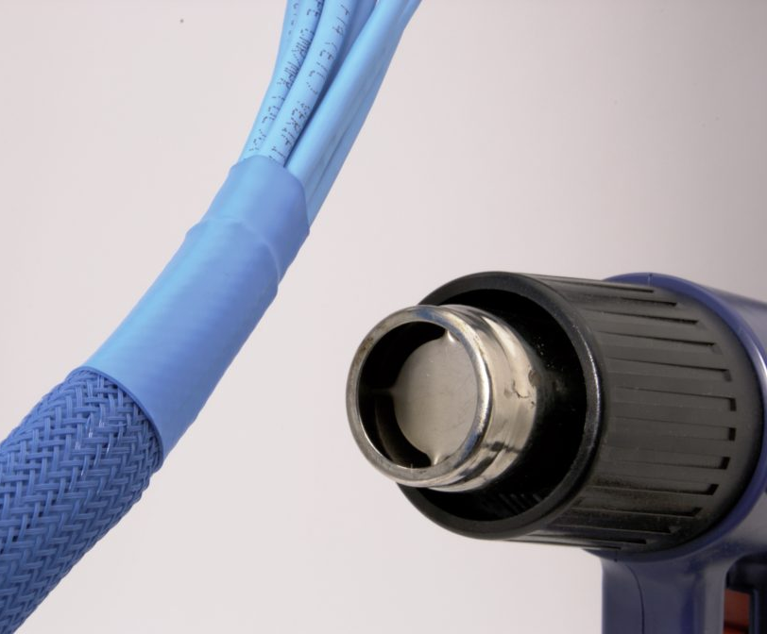
Demo: Proper Shrinking Tube
Goal: Recognize what properly applied shrink tubing looks like and what should be rejected
Step 1: Slide Tubing Onto the Wire
Step 2: Complete the Connection
Step 3: Position the Tubing
Step 4: Apply Heat Evenly
Step 5: Inspect the Seal
Notes:
INSTRUCTIONAL ACTIVITY: Provide Guided Learning
TIME: 10 min.
Materials:
Heat gun
Prepared crimped wire connections
Shrink tubing (correct size and incorrect examples)
Examples of properly and improperly shrunk tubing
Do:
Explain the purpose of the demonstration: this activity helps learners visually and physically recognize what properly applied shrink tubing looks like and what should be rejected before moving into hands-on practice.
If possible, demonstrate using live wire and shrink tubing.
Demonstrate how to properly use shrinking tube.
Step 1: Slide Tubing Onto the Wire - Place shrink tubing on the wire before installing the connector.
Step 2: Complete the Connection - Crimp the connector onto the wire.
Step 3: Position the Tubing - Slide tubing over the completed connection.
Step 4: Apply Heat Evenly - Using a heat gun, evenly heat the wire until the tubing fully contracts.
Step 5: Inspect the Seal - Confirm tubing has fully shrunk and verify adhesive has begun to flow at the ends.
Point out the following items:
Tubing is centered over the connection
Even shrink along the entire length
No exposed copper or connector ends
Tubing extends slightly past the connection on both sides
Pause and allow learners time to observe closely.

Slide 43
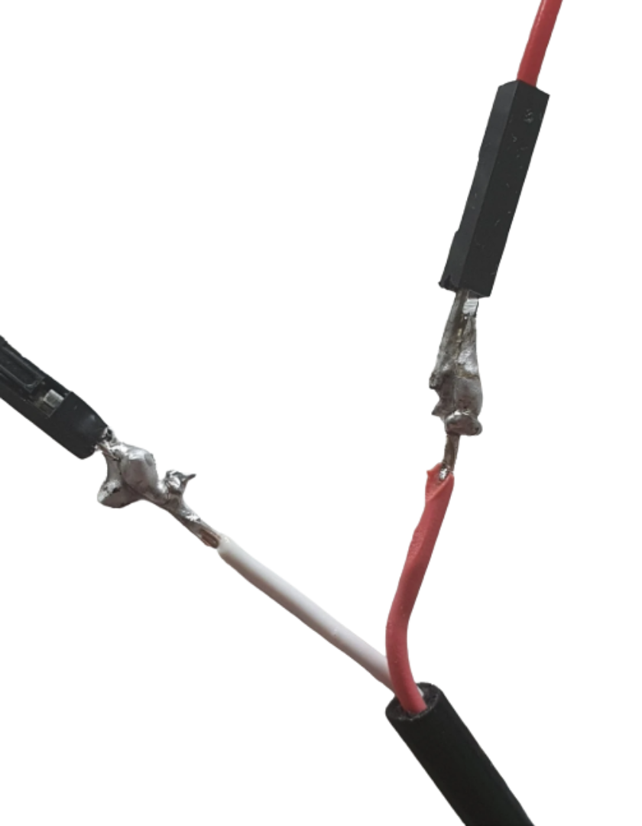
Demo: Poor Shrinking Tube
Goal: Recognize what properly applied shrink tubing looks like and what should be rejected
Discussion:
What problems could show up if shrink tubing doesn’t fully cover the connection?
Can shrink tubing fix a bad crimp? Why or why not?
Notes:
INSTRUCTIONAL ACTIVITY: Recall, Provide Guided Learning, Provide Feedback
TIME: 10 min.
Materials:
Heat gun
Prepared crimped wire connections
Shrink tubing (correct size and incorrect examples)
Examples of properly and improperly shrunk tubing
Do:
Show an improperly applied example.
Point out issues such as:
Tubing not fully shrunk
Tubing too short
Burned, brittle, or uneven shrink
Copper or metal still visible
Compare the proper and improperly applied shrinking tube. Point out:
What looks correct
What would cause you to reject the connection
Which problems would be hidden once installed
Facilitate guided discussion (provide feedback as needed):
What problems could show up if shrink tubing doesn’t fully cover the connection?
Can shrink tubing fix a bad crimp? Why or why not?
Close by reinforcing that shrink tubing is the protection phase. It protects good electrical work, but it does not repair poor workmanship.

Slide 44
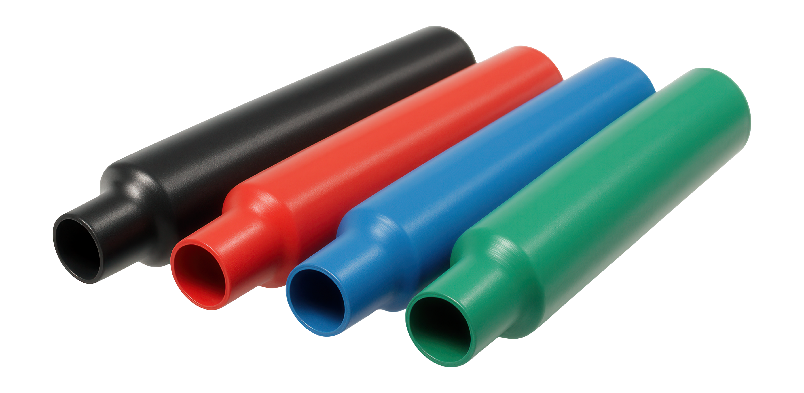
Summary
Cut
Strip
Crimp
Shrink
Notes:
INSTRUCTIONAL ACTIVITY: Enhance Transfer and Retention
TIME: 4 min.
Talking Points
Before we move into hands-on practice, let’s review the process. Everything we’ve covered fits into this three-step sequence. If you follow this order every time, you prevent most wiring problems.
Step one is Cut.
Start with a clean, square cut and remove any damaged or corroded wire. A bad cut makes stripping harder and crimping less reliable. A clean cut sets up everything that follows.
Step two is Strip.
Remove the insulation without damaging the strands. Use the correct gauge on the stripper and remove only as much insulation as needed. This is a pass/fail step. If the wire isn’t right here, stop and redo it before moving on.
Step three is Crimp.
Attach the connector to create a strong mechanical hold and a reliable electrical path. Use the correct wire gauge, terminal, and crimper. Always inspect the crimp and perform a gentle tug test. Low resistance equals reliable current flow.
Step four is Shrink.
Protect and seal the connection after crimping. Shrink tubing provides insulation, strain relief, and protection from moisture and vibration. Remember, it protects good work — it does not fix a bad crimp.
The key takeaway is this: most electrical failures don’t come from bad parts — they come from poor connections.
Following this sequence — Cut → Strip → Crimp → Shrink — protects you from that.

Slide 45
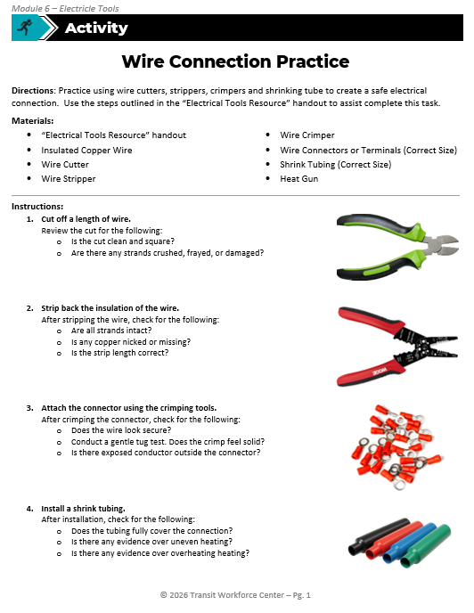
Activity: Wire Connection Practice
“How to Use” steps are here
Directions: Practice using wire cutters, strippers, crimpers and shrinking tube to create a safe electrical connection. Use the steps outlined in the “Electrical Tools Resource” handout to assist complete this task.
Activity directions are here
Notes:
Instructional Activity: Provide Guided Learning, Elicit Performance, Provide Feedback
Instructional Time: 15 minutes
Materials:
Wire Connection Practice_M6
Electrical Tools Resource_M6
One per learner or pair: Insulated Copper Wire, Wire Cutter, Wire Stripper, Wire Crimper, Wire Connectors or Terminals (Correct Size), Shrink Tubing (Correct Size), Heat Gun
Do:
(5 min.)
Pass out Wire Connection Practice_M6 handout and review the directions.
Reminder learners that they will need the steps outlined on the Electrical Tools Resource_M6 handout for this activity.
(10 min.)
Give learners time to complete the activity.
Circulate the room answering questions and connecting the activity to the content taught thus far.
Debrief using the questions on the next slide.

Slide 46
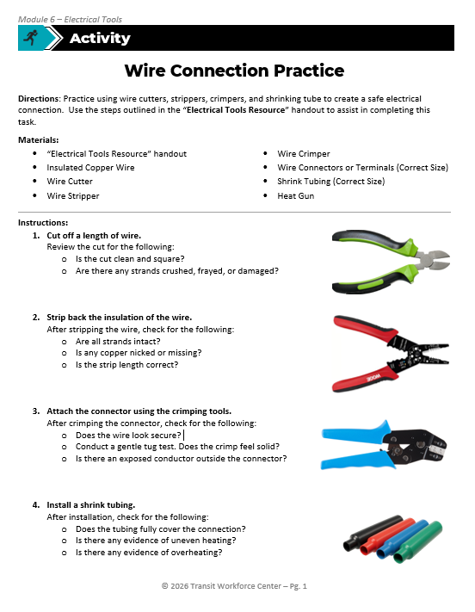
Activity: Debrief
Which step is easiest to rush and what happens when you do?
Which mistake is hardest to see once the connector and shrink tubing are installed?
How could a poor connection show up on a vehicle?
Notes:
Instructional Activity: Provide Guided Learning, Elicit Performance, Provide Feedback
Instructional Time: 10 minutes
Do:
Using the questions on the slide to facilitate a short discussion.
Call on learners to share their responses.
Talking Points
Now that you’ve completed the hands-on portion, let’s reflect on where mistakes tend to happen and how that connects to what you might see on a vehicle.
First question: Which step is easiest to rush — and what happens when you do?
Call on learners to share their responses.
Many people rush stripping or crimping because they look like simple tasks. But the step that looks easiest is often where the most damage happens.
Rushing stripping can nick strands. Rushing crimping can create a loose or crushed connection. Small shortcuts here lead to bigger failures later.
Second question: Which mistake is hardest to see once the connector and shrink tubing are installed?
Call on learners to share their responses.
Common answers here include nicked strands under the insulation, a loose crimp hidden by shrink tubing, or insulation caught under the terminal barrel.
The key point is that some mistakes become invisible once they’re covered.
That’s why inspection must happen at three critical points — after stripping, after crimping, and before shrink tubing is applied.
Third question: How could a poor connection show up on a vehicle?
Call on learners to share their responses.
A poor connection might cause intermittent operation, failures after vibration or movement, heat at the connection, or components that work sometimes but not always. These are the kinds of problems technicians spend hours chasing — and many of them start with a small connection issue.

Slide 47
Recall and Review
Why do clean cuts matter?
How do you choose the correct stripper gauge?
Why is too much or too little stripped insulation is a problem?
Perform a pull test after crimping without being prompted.
What makes a crimp mechanically strong and electrically reliable?
What does shrink tubing protects against?
Notes:
Instructional Activity: Recall, Enhance Transfer and Retention
Instructional Time: 10 minutes
Do:
Take a few minutes to review some key concepts.
Ask learners to choose a question and provide an answer.
Facilitate a short discussion and provide feedback as needed.

Slide 48
Knowledge Check
What is the best sequence for creating a strong wire connection? Name the step and the tool needed to complete the step.
Cut
Wire Cutter
Strip
Wire Stripper
Crimp
Wire Crimper
Shrink
Shrink Tube
Notes:
*This slide has animations. Click to reveal content.
Instructional Event: Evaluate Performance, Provide Feedback
Learning Objective: Identify common electrical and testing tools.
Time: 2 min
Do:
Review the knowledge check questions.
Call on learners to share their responses.
CLICK to reveal the answers. Provide feedback by correcting any thinking errors learners may have.
Answer Key:
Cute (wire cutter) → Strip (wire stripper) → Crimp (wire crimper) → Shrink (shrink tube)

Slide 49
Knowledge Check
Scenario: A vehicle system powers on normally and voltage is confirmed at the circuit. However, after the vehicle begins moving and experiences vibration, the system stops working intermittently even though voltage is still present.
Which tool was most likely used incorrectly? Why?
A. Wire Cutters
B. Crimpers
C. Wire strippers
D. Insulation tape
Notes:
*This slide has animations. Click to reveal content.
Instructional Event: Evaluate Performance, Provide Feedback
Learning Objective: Describe the purpose and limitations of common electrical testing tools.
Time: 2 min
Do:
Review the knowledge check questions.
Call on learners to share their responses.
CLICK to reveal the answers. Provide feedback by correcting any thinking errors learners may have.
Answer Key:
B.) A poor crimp can create a loose, high-resistance connection that fails under vibration.

Slide 50
Knowledge Check
Scenario: Safety Focus. A wire connection looks secure, but the insulation is stripped back too far leaving the conductor exposed.
Why is this a safety concern?
A. It can short to ground or create a shock hazard
B. It reduces voltage
C. It blocks current
D. It improves conductivity
Notes:
*This slide has animations. Click to reveal content.
Instructional Event: Evaluate Performance, Provide Feedback
Learning Objective: Perform basic electrical tests safely.
Time: 2 min
Do:
Review the knowledge check questions.
Call on learners to share their responses.
CLICK to reveal the answers. Provide feedback by correcting any thinking errors learners may have.
Answer Key:
A.) It can short to ground or create a shock hazard

Slide 51
Knowledge Check
Inspect the wire crimp connections below:
Identify the issue
Explain the impact of this issue.
Notes:
*This slide has animations. Click to reveal content.
Instructional Event: Evaluate Performance, Provide Feedback
Learning Objective: Inspect wire connections to ensure it is safe.
Time: 2 min
Do:
Review the knowledge check questions.
Call on learners to share their responses.
CLICK to reveal the answers. Provide feedback by correcting any thinking errors learners may have.
Answer Key:
Answers will vary based on which issue the learner chooses to inspect and explain.
Connector too small
If the connector is undersized, the wire won’t seat fully in the barrel and strands may flare or bunch up.
An undersized connector creates high resistance and weak mechanical hold, which can lead to overheating, arcing, and potential fire hazards under vibration.
Too much insulation stripped
Excess bare copper increases the risk of shorts and shock hazards. It also reduces insulation support inside the terminal, weakening the connection.
Excess wire not trimmed
If copper extends past the terminal barrel, this usually means the strip length was incorrect. Copper extending past the terminal can contact nearby metal parts, creating hidden short circuits that may only appear after movement or installation.
Crushed crimp
A crushed crimp happens when the wrong die size is used (usually too small) or when excessive force is applied, causing the terminal barrel to over-compress. This can flatten or deform the barrel and cut or severely compress the copper strands inside.
A crushed crimp reduces current-carrying capacity and can overheat or fail under load, creating dangerous intermittent or high-resistance faults.

Slide 52
Summary and What’s Next
Wire cutters create clean starting points by removing damaged wire.
Wire strippers remove insulation without damaging the conductor.
Crimpers secure wires to connectors for reliable current flow.
Shrink tubing protects connections from shorts, moisture, and damage.
Using the right tool, in the right order, creates safe and dependable connections.
Next, we’ll learn how to test and verify those connections using electrical measurement tools.
Notes:
Instructional Event: Enhance Retention and Transfer.
Time: 4 minutes.
Do: Review main topics in the module and check to see if participants have any questions about the content.

Slide 53
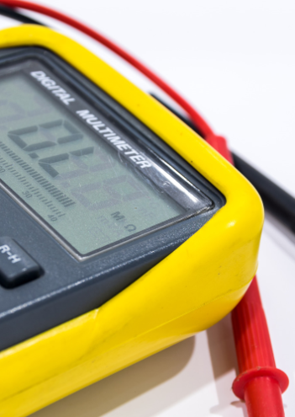
6.2 - Measurement and Testing Tools
In this section, we’ll earn how to safely use common tools to measure and test electrical circuits.
Notes:
Instructional Event: Direction
Time: 1 minute.
Do: Review the purpose of this section of the module.
Talking Points:
In this section, we’ll earn how to safely use common tools to measure and test electrical circuits.

Slide 54
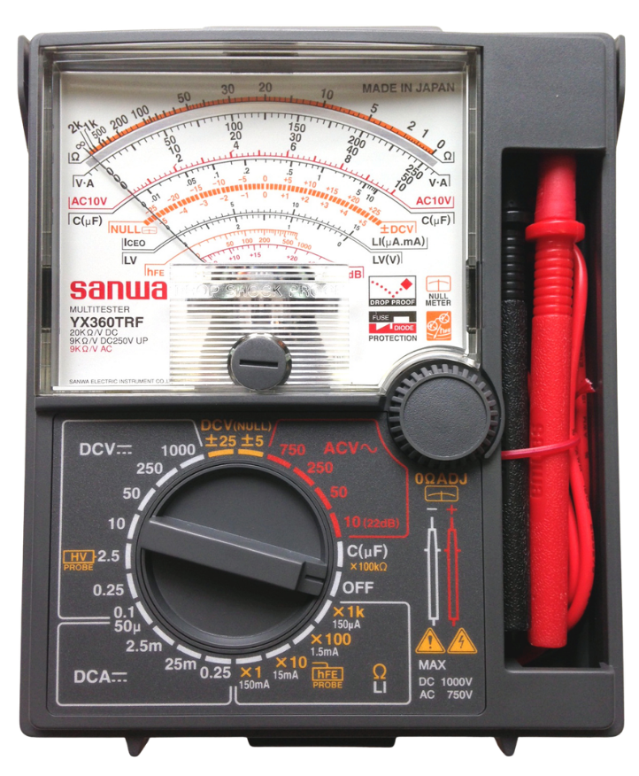
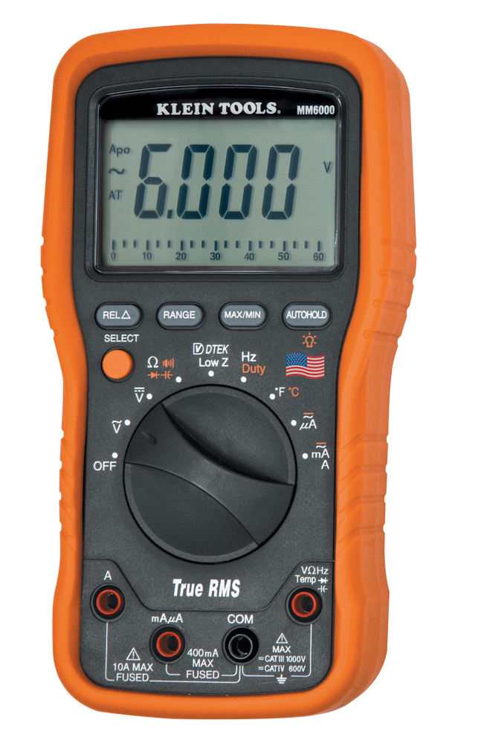
Why We Use Electrical Meters
How Meters Fit into the Process
  Hand tools create the connection
  Shrink tubing protects the connection
  Meters confirm the connection works
What Meters Help Us Verify
  Is voltage present?
  Is there a complete path for current?
  Is insulation doing its job?
Notes:
*This slide contains animations. CLICK to reveal content.
Instructional Activity: Present Content
Instructional Time: 4 min.
Talking Points:
Up to this point, we’ve focused on making the connection — cutting, stripping, crimping, and protecting it. Now we’re shifting to verifying the connection.
Meters don’t repair wiring. They tell us what’s happening electrically.
Think about the sequence we’ve built:
Hand tools create the connection.
Shrink tubing protects the connection.
Meters confirm whether the connection is actually working as intended.
CLICK - When we use a meter, we’re typically verifying three things:
Is voltage present? In other words, is power available at this point?
Is there a complete path for current? Can electricity actually flow through the connection?
And is insulation doing its job? Is electricity staying where it’s supposed to be?
Here’s an important misconception to address: Seeing voltage does not automatically mean the system will work.
A poor connection can still show voltage — but it may overheat, fail under load, or act intermittently.
ASK: If a system shows voltage but doesn’t work, what might that tell us?
Pause and allow learners to respond before moving forward.
Sources:
Klein Tools, CC BY-SA 4.0 <https://creativecommons.org/licenses/by-sa/4.0>, via Wikimedia Commons
By KZang - Own work, CC BY-SA 3.0, https://commons.wikimedia.org/w/index.php?curid=32873569

Slide 55
Multimeters
Primary verification tool for electrical work to confirm circuit conditions
Sometimes called a Volt-Ohm Meter (VOM) or Digital Voltmeter (DVM
Measures
  Voltage → Is power available?
  Continuity → Complete path?
  Resistance → Healthy connection?
Digital
Analog
Notes:
Instructional Activity: Present Content
Instructional Time: 4 min.
Talking Points:
Now that we’ve talked about verifying connections, let’s introduce the primary tool we use to do that — the multimeter.
You may also hear multimeters called volt-ohm meters, or VOMs, and sometimes digital voltmeters, or DVMs.
A multimeter is our main verification tool in electrical work. After we cut, strip, crimp, and shrink, this is what tells us whether the connection is actually functioning properly.
A multimeter helps us verify three core things.
First, voltage — is power available at this point in the circuit?
Second, continuity — is there a complete path for current to flow?
Third, resistance — is the connection healthy, or is resistance higher than it should be?
It’s important to remember: a multimeter does not fix problems. It confirms the condition of the circuit. It tells you what’s happening electrically, but it doesn’t automatically tell you why.
Most of what we use today are digital multimeters. They’re easier to read and more common in the field. Analog meters are older and less common, but you may still see them in some settings.
Let’s check in for a moment:
ASK: If a system isn’t working, which test would you use first — voltage or continuity?
Pause and allow discussion before moving forward.

Slide 56
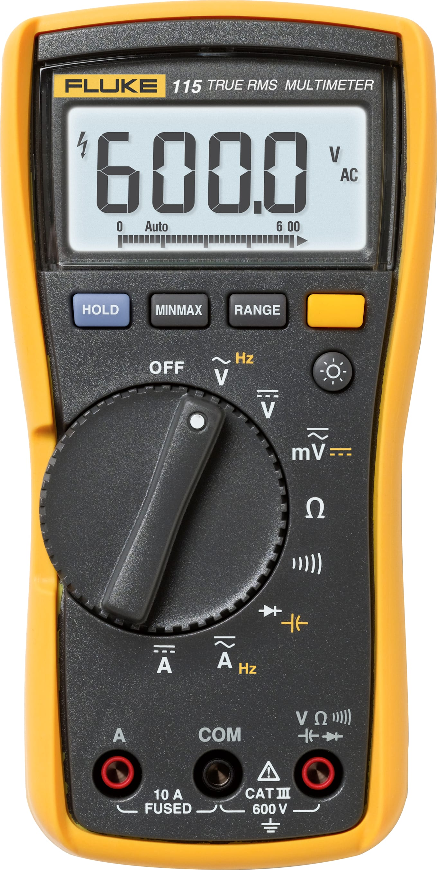
AC Voltage
DC Voltage
Mili Voltage
AC Current & Frequency
Resistance
DC Current
Continuity
Diode & Capacitance
Notes:
Instructional Event: Present Content
Time: 2 minutes.
Do:
Give a demonstration on how to use a multimeter
Be sure to cover what you need to do, how to do it, and why it matters.
Talking points:
The multimeter takes the most basic measurements - measure AC voltage, DC voltage, resistance, check continuity, check diodes, milliamps and amps AC and DC.
The Fluke® multimeter shown here is a popular type of VOM used in many rail maintenance shops.
There are several switch positions each measuring or testing a number of functions.

Slide 57
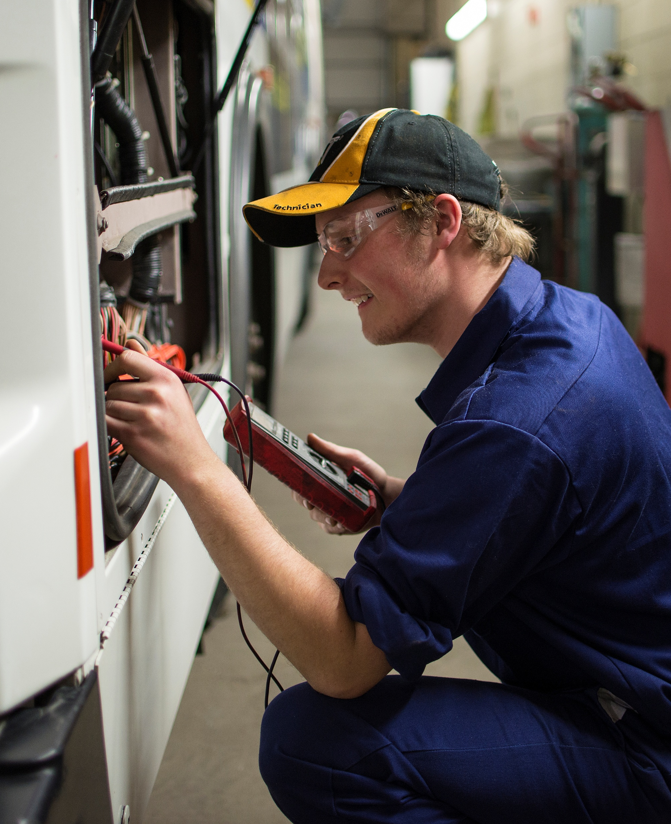
Demo: Using a Multimeter
Goal: Observe how to use a multimeter to measure voltage, resistance, and continuity, and interpret results to identify normal versus poor electrical connections.
Meter Measurements:
  Measure AC voltage
  Measure DC voltage
  Resistance
  Checks continuity
  Checks diodes or resistors
  Checks milliamps and amps (AC and DC)
  Compare to a poor or loose connection
Notes:
INSTRUCTIONAL ACTIVITY: Provide Guided Learning
TIME: 15 min.
Materials:
A Pre-Built Circuit with a 9v battery
Multimeter
Do:
Introduce Meter Functions
Briefly demonstrate how the meter measures:
AC voltage
DC voltage
Resistance
Continuity
Diodes/resistors
Milliamps and amps (AC and DC)
Emphasize proper dial selection before testing.
Measure DC Voltage (9V Battery)
Set meter to DC voltage.
Measure a 9V battery.
Discuss expected reading and what it means.
Measure Resistance
Set meter to resistance (Ω).
Test a known resistor.
Compare measured value to labeled value.
Check Continuity
Switch to continuity mode.
Demonstrate tone/indicator for a complete path.
Show example of open vs. closed path.
Test a Pre-Built Circuit
Measure voltage within the circuit.
Demonstrate resistance or continuity where appropriate.
Compare results between:
A properly secured connection
A loose or poor connection
Debrief
Ask learners what differences they observed.
Reinforce: Meters confirm condition — they don’t fix problems.

Slide 58

Continuity and Voltage Testing
Continuity Test
Confirms a complete electrical path exists
Does NOT tell us if the connection is strong
Voltage Test
Confirms electrical potential is available
Does NOT tell us if current is flowing properly
Notes:
Instructional Activity: Present Content
Instructional Time: 2 min
Talking Points:
Two tests frequently done with multimeters are continuity and voltage tests.
Now let’s clarify what these two common tests actually tell us — and just as importantly, what they don’t tell us.
A continuity test confirms that a complete electrical path exists. In simple terms, it tells us electricity can travel from one point to another.
But here’s the limitation — continuity does not tell us if the connection is strong. A loose or partially damaged connection can still show continuity. It only confirms the path exists, not the quality of that path.
A voltage test confirms that electrical potential (voltage) is available at a given point. In other words, power is present.
But voltage alone does not tell us whether current is flowing properly. A system can show voltage and still fail under load if there’s high resistance or a weak connection.
So, the key takeaway is this:
Continuity confirms a path.
Voltage confirms power is available.
Neither one alone confirms a healthy, reliable connection.
That’s why we interpret meter readings in context — not in isolation.

Slide 59

Continuity & Voltage Testing
Click the image to play the video.
Notes:
Instructional Event: Gain Attention, Present Content
Time: 2 minutes.
Do: Use the image or use the link below to play the video.
Video Link (01:38 min) - https://www.youtube.com/watch?v=_uiY8rI4cbM
Source: Fluke Corporation. (n.d.). How to measure voltage and current using the Fluke T5 [Video]. YouTube. https://www.youtube.com/watch?v=_uiY8rI4cbM
Important Safety Information:
Always connect your clip lead to the ground or neutral first before testing the hot wire.
Use one hand whenever possible when testing a live circuit. This helps reduce the chance of current traveling across your chest if a fault occurs.
Avoid using both hands to test a live circuit. A two-handed method can create a path for electricity to travel through vital organs.
After securing the ground or neutral lead, carefully place the second lead on the hot conductor to take the measurement.
Safe meter testing habits help reduce the risk of electrical shock and injury.

Slide 60
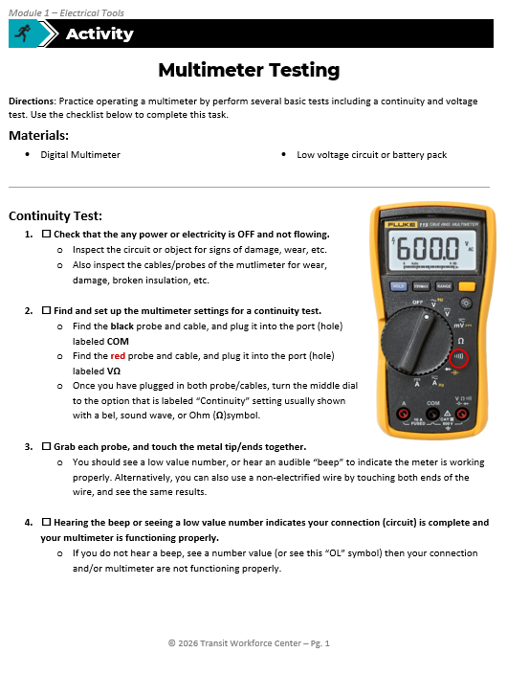
Activity
Directions: Practice operating a multimeter by perform several basic tests including a continuity and voltage test. Use the checklist on the handout to complete this task.
Materials:
  Digital Multimeter
  Low voltage circuit or battery pack
Continuity Test - Confirms an electrical path exists
Voltage Test - Confirms electrical potential (current) is available
Notes:
Instructional Activity: Provide Guided Learning, Elicit Performance, Provide Feedback
Instructional Time: 15 minutes
Materials:
Multimeter Testing_M6
One per learners or pair: digital multimeter, Low voltage circuit or battery pack
Do:
(5 min.)
Pass out the Multimeter Testing_M6 handout and review the directions.
(10 min.)
Give learners time to complete the activity.
Circulate the room answering questions and connecting the activity to the content taught thus far.
Use the discussion questions on the next slide to debrief.

Slide 61
Activity Debrief
What’s the difference between measuring voltage and checking continuity?
Can you have voltage present but still have a bad connection? Explain.
If a system shows voltage but won’t operate, what might you test next?
Notes:
Instructional Activity: Provide Guided Learning, Elicit Performance, Provide Feedback
Instructional Time: 10 minutes
Do:
Use the following questions to debrief:
What’s the difference between measuring voltage and checking continuity?
Answer: Voltage confirms power is available at a point, while continuity confirms there is a complete path for current to flow.
Can you have voltage present but still have a bad connection? Explain.
Answer: Yes, voltage can be present even if the connection is loose or high resistance, which may prevent current from flowing properly under load.
If a system shows voltage but won’t operate, what might you test next?
Answer: Check continuity or resistance to verify there is a complete, low-resistance path for current to flow.

Slide 62
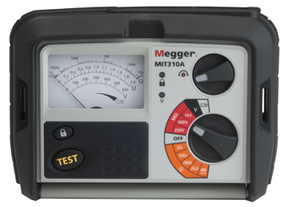
Megohmmeter (“Megger”)
Device that applies a high DC test voltage (50–10,000 volts) to measure insulation resistance using a built-in DC generator
Measures insulation strength - how well insulation prevents current from leaking
Prevents equipment damage and is required by some safety codes
Notes:
Instructional Event: Present Content
Time: 2 minutes.
Talking points:
Let’s start with the tool itself.
A megohmmeter, often called a “Megger”, is a portable device used to test insulation resistance. The name comes from the original manufacturer, but it’s commonly used to describe this type of tester in general.
A megohmmeter applies a high DC test voltage, typically anywhere from 50 volts up to 10,000 volts. It has a built-in DC generator and reads resistance directly in ohms, independent of the applied voltage.
Now, what is it actually measuring?
It measures insulation strength — in other words, how well insulation prevents current from leaking.
Over time, dirt, moisture, vibration, and aging can weaken insulation.
When insulation weakens, current doesn’t stay confined to the intended conductor. Instead of flowing through the motor or cable as designed, some of it leaks toward ground.
So, why does this insulation strength matter?
This is especially important in motors. If insulation breaks down, not all power flows through the windings, some escapes. That leads to heat, inefficiency, and eventually failure.
Megohmmeters are commonly used to test cables and motor coils because detecting insulation breakdown early helps prevent equipment damage and safety hazards. In many cases, insulation testing is required to meet safety standards.
Because this tool generates high voltage, it must be handled carefully. Improper use can create shock hazards. That’s why we are not conducting a hands-on activity with this tool in this course — it requires proper PPE and specific procedures.
The key takeaway: The megohmmeter verifies insulation health. Strong insulation keeps current where it belongs. Weak insulation allows leakage — and that’s where serious problems begin.
Source: PCE Instruments. (n.d.). Isolation meter PCE-IT 55. https://www.pce-instruments.com/us/measuring-instruments/test-meters/isolation-meter-pce-instruments-isolation-meter-pce-it55-det_2132582.htm?_list=kat&_listpos=2

Slide 63
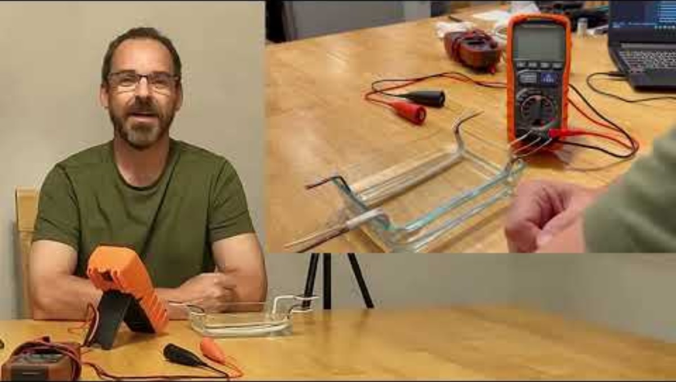
Continuity & Voltage Testing
Notes:
Instructional Event: Gain Attention, Present Content
Time: 20 minutes.
Do: Use the embedded video or link below to play the video.
Video Link (19 min.) - https://www.youtube.com/watch?v=VVbQBitWp7E
Optional Shorter Video (3 min.) - https://www.youtube.com/watch?v=3GuSKwlxbVU
Sources:
The Electrical Craftsman. (n.d.). Introduction to insulation testing using a Megger [Video]. YouTube. https://www.you
tube.com/watch?v=VVbQBitWp7E
Paradigm Cooling. (n.d.). How to use a Megger insulation tester – Complete beginners guide [Video]. YouTube. https://www.youtube.com/watch?v=3GuSKwlxbVU

Slide 64
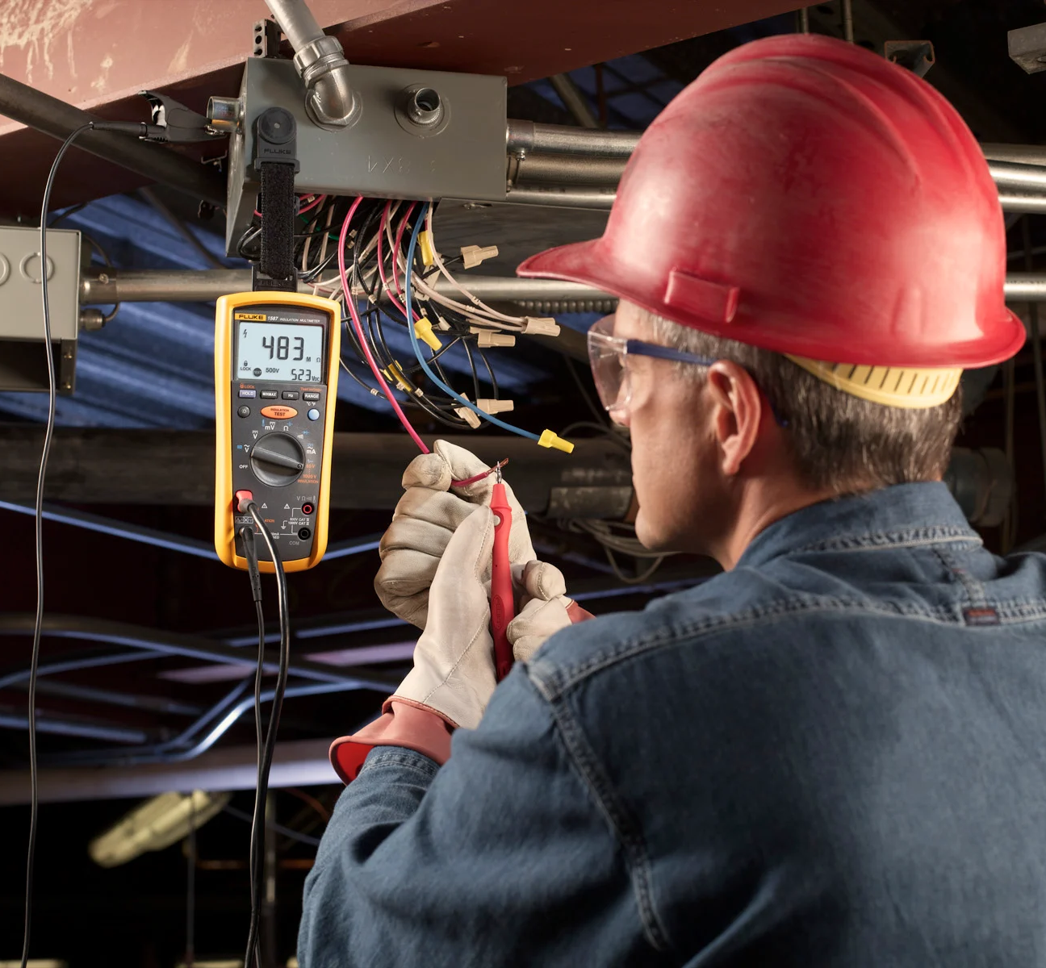
Demo: Using a Megohmmeter
Goal: Checks insulation resistance to detect hidden leakage paths
Steps:
Safety check – De-energize, put on PPE when applicable
Connect one lead to conductor, one to ground
Select appropriate DC test voltage
Press test button and allow reading to stabilize
Interpret results
  High resistance = good insulation
  Low resistance = damage or moisture
Discharge circuit by releasing the test button (allow time for discharge)
Notes:
INSTRUCTIONAL ACTIVITY: Provide Guided Learning
TIME: 15 min.
Materials:
Megohmmeter
De-energized motor, cable section, or training mock-up
Ground reference point (equipment frame or grounding bar)
Insulated test leads (rated for test voltage)
Lockout/Tagout device (demonstration only)
Required demo PPE: Electrical-rated gloves, safety glasses, insulated mat, etc.
Talking points:
We’re going to walk through how a megohmmeter is used but remember, this is demonstration only.
First, safety. This tool injects high DC voltage into the circuit. Never use it on energized equipment. The circuit must be de-energized and verified before testing. Because it generates high voltage, PPE and proper procedures are required.
The purpose of this test is to check insulation resistance and detect hidden leakage paths.
Think of insulation like the rubber coating on a wire. You may not see cracks or breakdown on the outside. This test helps us find insulation damage we can’t see.
Megohmmeters are commonly used on motors, cables, traction power components, and before energizing new or repaired equipment.
Now, the basic steps…
Do:
Complete a megohmmeter test:
Safety check –
Remind learners to never use a megohmmeter on an energized device.
If you are working with high voltage, put on the necessary PPE.
Connect one lead to conductor, one to ground
Select appropriate DC test voltage
Press test button and allow reading to stabilize
Interpret results
High resistance = good insulation
Low resistance = damage or moisture
Discharge circuit by releasing the test button and allow time for discharge.

Slide 65
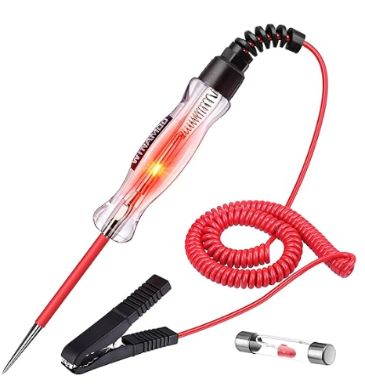
Test Light
What Is a Test Light?
Simple tool used to check for the presence of voltage
Lights up when voltage is detected
Common for basic troubleshooting
When to Use It
Check if a circuit is energized
Verify power at a fuse, connector, or terminal
Confirm a ground connection
Quick yes/no voltage check
Notes:
Instructional Event: Present Content
Time: 2 minutes.
Optional: test light with no clamp
Talking points:
A test light is one of the simplest electrical verification tools.
Its job is straightforward - it checks for the presence of voltage. If voltage is detected, the light turns on.
Because it’s quick and easy to use, it’s commonly used for basic troubleshooting.
You might use a test light to check whether a circuit is energized, verify power at a fuse or connector, or confirm a ground connection.
It’s especially useful for a fast yes-or-no voltage check.
But here’s the key limitation: Just because the test light turns on does not mean the circuit can actually perform work.
Voltage may be present, but the connection could still be weak, high resistance, or unable to carry current under load.
So, think of a test light as a quick screening tool — not a full diagnostic tool.

Slide 66
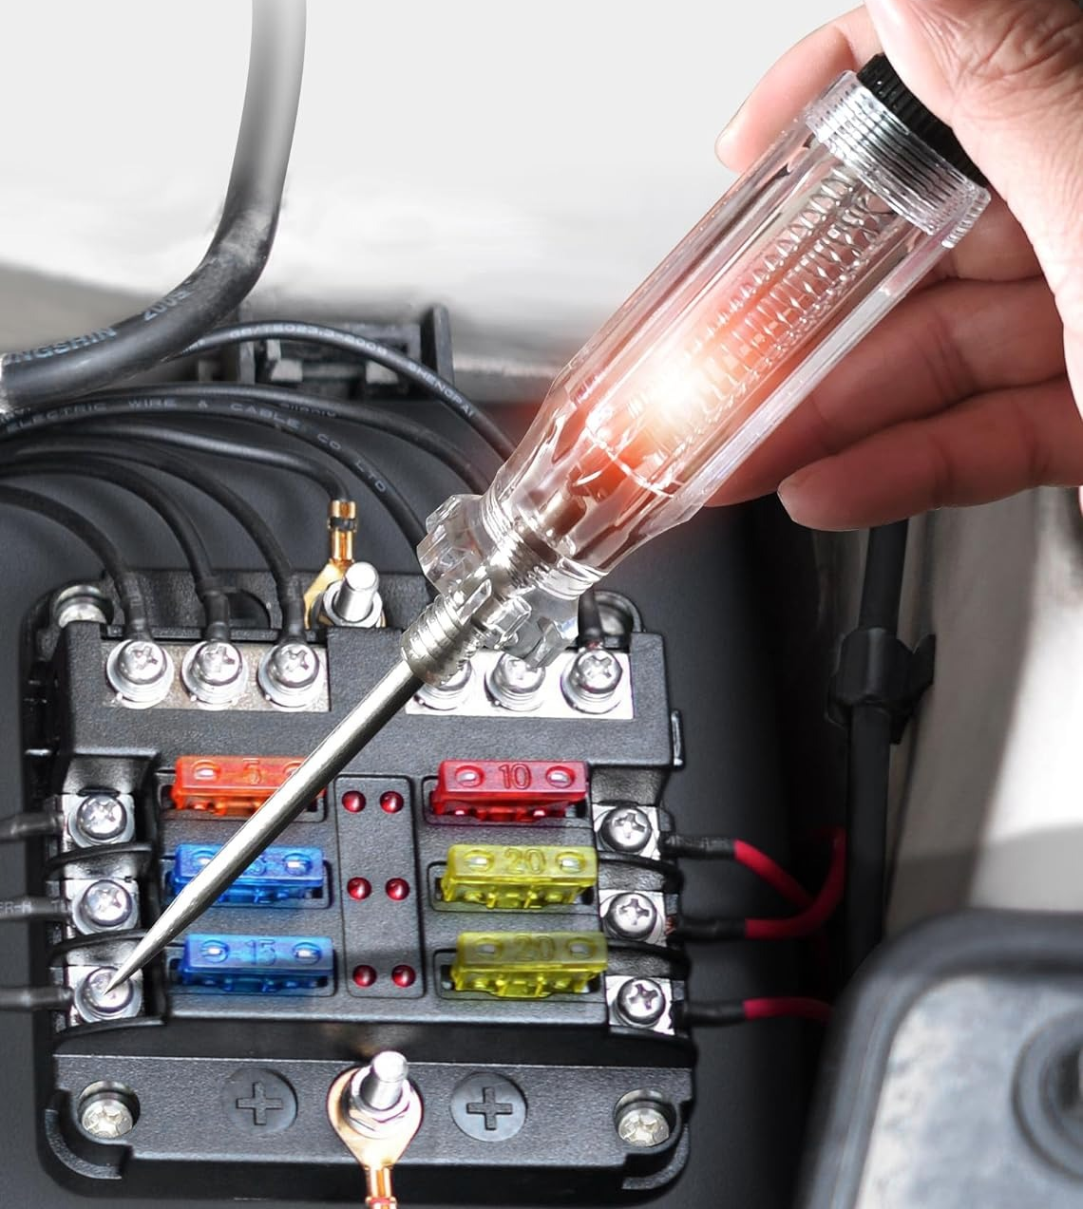
How a Light Test Works
Basic Operation
Verify the test light is rated for the suspected voltage
Clip the ground lead to a known ground
Touch the probe tip to the test point
What the Light Indicates
Light ON → Voltage present
Light OFF → No voltage detected
Notes:
Instructional Event: Present Content
Time: 2 minutes.
Talking points:
Here’s how a test light works.
First, verify the test light is rated for the suspected voltage
Next, clip the ground lead to a known good ground point.
Then, touch the probe tip to the test point you want to check.
If the light turns on, voltage is present at that point.
If the light stays off, no voltage is detected.
It’s important to remember — this tool does not measure voltage level. It only tells you whether voltage is present or not.
So, it’s a quick yes-or-no tool, not a precision measurement device.
That’s why we use it for basic checks — not detailed diagnostics.
Source: JASTIND. (n.d.). Heavy duty 6–24V automotive circuit tester premium test light with 135 inches extended spring wire stainless probe circuit voltage tester with replacement indicator light for car vehicles. https://jastind.net/product/heavy-duty-6-24v-automotive-circuit-tester-premium-test-light-with-135-inches-extended-spring-wire-stainless-probe-circuit-voltage-tester-with-replacement-indicator-light-for-car-vehicles/

Slide 67
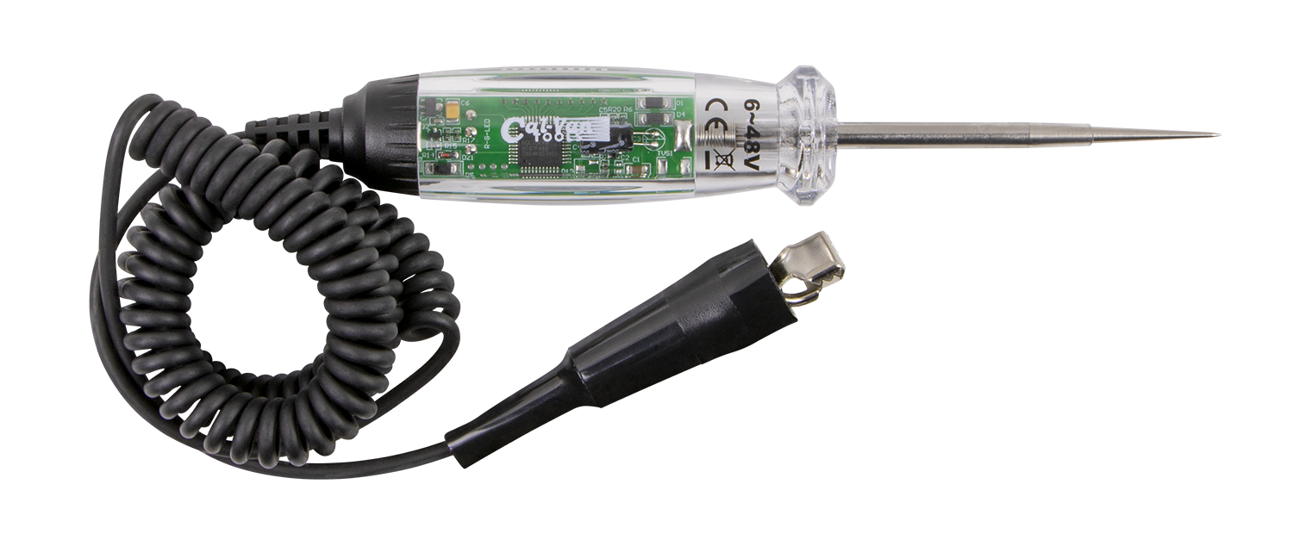
Demo: Light Test
Goal: Quick check to see if power is present
Steps:
Verify the test light is rated for the suspected voltage
Clip ground lead to a known ground
Touch probe tip to the test point
  Light ON = Power present
  Light OFF = No power detected
Reminder:
Does not measure voltage level
Does not confirm circuit can carry load
Notes:
INSTRUCTIONAL ACTIVITY: Provide Guided Learning
TIME: 15 min.
Materials:
Automotive test light (6–24V rated)
De-energized training circuit or low-voltage demo board
9V battery or 12V DC power source
Known good ground point
Safety glasses
Do:
Explain the purpose: this tool provides a quick yes/no check for voltage presence.
Demonstrate proper setup:
Verify the test light is rated for the suspected voltage.
Clip the ground lead to a known good ground.
Verify the ground connection before testing.
Touch the probe tip to the test point.
Observe the light and explain indication:
Light ON means voltage is present.
Light OFF means no voltage detected.
Review limitations:
Explain that the test light does not measure voltage level.
Reinforce that voltage present does not guarantee the circuit can carry load.
Close by reinforcing: A test light is a quick screening tool — not a full diagnostic tool.
Image Source: Cal-Van Tools. (n.d.). LCD test light. https://cal-vantools.com/products/lcd-test-light-2/

Slide 68
Clamp Ammeter
A current-measuring tool that clamps around a single conductor to measure electrical current (amps) without disconnecting the circuit.
When to Use It
Check how much current a circuit or device is drawing
Verify motors, heaters, or loads are operating normally
Troubleshoot overcurrent or undercurrent conditions
Notes:
Instructional Event: Present Content
Time: 2 minutes.
Talking points:
A clamp ammeter is a current-measuring tool that allows us to measure amps without disconnecting the circuit.
Instead of placing test leads in series, we simply clamp the meter around a single conductor. This makes it a quick and safer way to measure current.
You would use a clamp ammeter when you need to know how much current a device or circuit is drawing — especially for motors, heaters, or other loads. It’s useful for verifying normal operation or diagnosing overcurrent and undercurrent conditions.
Now, a few important limitations.
This tool does not measure voltage or resistance — it only measures current.
It also will not work if you clamp around multiple conductors at once. The magnetic fields cancel each other out, and you’ll get an incorrect reading.
Finally, always make sure the clamp meter is properly rated for the voltage and current class of the circuit.
To keep the tools straight:
A test light checks for the presence of voltage.
A multimeter measures voltage, resistance, and continuity.
A clamp ammeter measures current.
Each tool answers a different electrical question.

Slide 69

How to Use a Clamp Ammeter
Safety First
Follow LOTO and PPE procedures
Verify meter rating before use
Keep hands behind finger guards
Basic Steps
Set meter to AC or DC current (as required)
Open clamp and place around ONE conductor only
Close clamp fully
Read current value on display
Notes:
Instructional Event: Present Content
Time: 2 minutes.
Talking points:
Before using a clamp ammeter, safety comes first.
Always follow lockout/tagout procedures and wear appropriate PPE.
Verify the meter is properly rated for the voltage and current of the circuit you’re testing.
And keep your hands behind the finger guards while measuring.
Now the basic steps.
Set the meter to the correct current setting — AC or DC, depending on the circuit.
Open the clamp and place it around one conductor only. This is critical.
Close the clamp fully to ensure an accurate reading.
Then read the current value on the display.
Here’s an important concept: If you clamp around both conductors — for example, the hot and neutral together — their magnetic fields cancel each other out. The meter will show a false zero reading.
Also remember: A clamp ammeter does not measure voltage or resistance. And it must always be properly rated for the circuit you’re working on.
This tool answers one question: How much current is flowing right now?

Slide 70

How To Choose Between A Clamp Meter And Digital Multimeter
Notes:
Instructional Event: Gain Attention, Present Content
Time: 3 minutes.
Do: Use the embedded video or link below to play the video.
Video Link (2:35 min.) - https://www.youtube.com/watch?v=E76bEdlUN1I
Source: Klein Tools. (2014). How to choose between a clamp meter and digital multimeter [Video]. YouTube. https://www.youtube.com/watch?v=E76bEdlUN1I

Slide 71
Review and Recall
What does a test light confirm about a circuit? What does it NOT tell you?
What does a continuity test verify? What can it NOT determine about the connection?
Why is a megohmmeter used before energizing new or repaired equipment?
Why must a clamp ammeter be placed around only one conductor at a time?
Notes:
Instructional Activity: Recall, Enhance Transfer and Retention
Instructional Time: 10 minutes
Do:
Take a few minutes to review some key concepts.
Ask learners to choose a question and provide an answer.
Facilitate a short discussion and provide feedback as needed.

Slide 72
Knowledge Check
Choose one of the tools below and explain its purpose.
Notes:
*This slide has animations. Click to reveal content.
Instructional Event: Evaluate Performance, Provide Feedback
Learning Objective: Identify common electrical and testing tools.
Time: 2 min
Do:
Review the knowledge check questions.
Call on learners to share their responses.
CLICK to reveal the answers. Provide feedback by correcting any thinking errors learners may have.
Answer:
Multimeter - Verification tool for electrical work to confirm circuit conditions including voltage, current, and resistance
Megohmmeter - Device that applies a high DC test voltage (50–10,000 volts) to measure insulation resistance using a built-in DC generator
Test Light - Simple tool used to check for the presence of voltage
Ammeter - A current-measuring tool that clamps around a single conductor to measure electrical current (amps) without disconnecting the circuit.

Slide 73
Knowledge Check
You need to quickly check whether power is present at a connector before starting work. Which tool is the best choice?
Which tool is the best choice?
A. Clamp ammeter
B. Megohmmeter
C. Test light
D. Wire stripper
Notes:
*This slide has animations. Click to reveal content.
Instructional Event: Evaluate Performance, Provide Feedback
Learning Objective: Select the right tool to test an electrical circuit.
Time: 2 min
Do:
Review the knowledge check questions.
Call on learners to share their responses.
CLICK to reveal the answers. Provide feedback by correcting any thinking errors learners may have.
Answer:
C. Test light. A test light gives a quick yes/no check for power.

Slide 74
Knowledge Check
Which measurement can a multimeter perform?
Insulation resistance at a high voltage
Current without opening the circuit
Shrinking insulation tubing
Voltage, continuity, and resistance
Notes:
*This slide has animations. Click to reveal content.
Instructional Event: Evaluate Performance, Provide Feedback
Learning Objective(s): Explain what each tool does and does not do.; Select the right tool to test an electrical circuit.
Time: 2 min
Do:
Review the knowledge check questions.
Call on learners to share their responses.
CLICK to reveal the answers. Provide feedback by correcting any thinking errors learners may have.
Answer:
D. Multimeters are used to measure voltage, continuity and resistance.

Slide 75
Knowledge Check
A motor cable shows normal voltage during testing but later fails because of insulation breakdown. Which tool would have been most useful to test the insulation before energizing the system?
A. Test light
B. Megohmmeter
C. Multimeter
D. Clamp ammeter
Notes:
*This slide has animations. Click to reveal content.
Instructional Event: Evaluate Performance, Provide Feedback
Learning Objective: Select the right tool to test an electrical circuit.
Time: 2 min
Do:
Review the knowledge check questions.
Call on learners to share their responses.
CLICK to reveal the answers. Provide feedback by correcting any thinking errors learners may have.
Answer:
B. Megohmmeter checks insulation strength and finds hidden leakage paths.

Slide 76
Summary
Test lights give a quick yes/no check for power.
Multimeters measure voltage, continuity, and resistance.
Megohmmeters check insulation strength and hidden leakage paths.
Clamp ammeters measure current without disconnecting the circuit.
Each tool tells us something different about what’s happening electrically.
Notes:
Instructional Event: Enhance Retention and Transfer
Time: 4 minutes.
Do: Review main topics in the module and check to see if participants have any questions about the content.

Slide 77

Quiz
Time for a quiz! Let’s see what you have learned from today’s lesson.
Notes:
Instructional Activity: Direction, Evaluate/Assess Performance
Instructional Time: 20 min.
Materials: Quiz_M6
Do:
Ask learners if they have any lingering questions. Address them before distributing the quiz.
Pass out the quiz and review the directions.
Talking Points:
Time for a quiz! Let’s see what you have retained from today’s lesson.

Slide 78
Objectives
Identify common electrical and testing tools.
Describe the purpose and limitations of common electrical testing tools.
Make a proper wire connection using the correct tools.
Inspect wire connections to ensure they are safe.
Select the right tool to test an electrical circuit.
Perform basic electrical tests safely.
Notes:
Instructional Activity: Enhance Transfer and Retention
Instructional Time: 5 min.
Do: Facilitate a short discussion to review the key topics in the lesson.
Talking Points:
If you were explaining today’s objectives to someone else, how would you summarize what they mean and why they matter?
Which of today’s objectives do you feel most confident about? Which were most challenging? Explain your reasoning.
Can you give an example of how you could apply one of today’s objectives in a real-world situation?
After Discussion:
This conclude this section of the module. Thank you for your participation.

Slide 79
Thank you!

