Slide 1


Instructor Guide Snapshot
Icon Key
Activity:
Video:
Instructor Demo:
Knowledge Check:
Instructional Time: 4.25
Preparation before class:
  Review all materials - Review all slides, talking points, and handouts before class to understand the structure and flow of the lesson. Pay special attention to animations within the slides.
  Prep for Instructor Demo (See slide 30) – Set up a simple circuit with a power source, light bulb, and wire. Be prepared to add additional lights and measure with a multimeter.
Provided Course Materials:
  +Basic Electrical Principles_M2.pptx
  +Instructor Facilitation Toolkit_M2.docx - For Instructor use only.
  +Participant Resource Guide_M3.docx - Print one copy for each learner. All handouts that leaners need for activities are embedded in the Participant Resource Guide.
    Converting Decimals_M2
    Predicting Current Changes Resource_M2
    Calculating Ohm's Law_M2
  Quiz_M4.docx - Print one copy for each learner.
Additional Materials:
A simple circuit with a power source, light bulb, and wire
One or two additional light bulbs to add to the circuit to simulate resistance
Multimeter

Slide 2
Pacing Guide
Times have been rounded to the nearest .25 hours.
Total Time: 3.25 Hours
  (.25 Hrs.) Welcome and Warm Up
  (.5 Hrs.) 2.1 – Voltage, Current, and Resistance
  (2 Hrs.) 2.2 – Ohm’s Law
  (.5 Hrs.) Quiz and Wrap Up

Slide 3
Basic Electrical Principles
Transit Core Competencies Curriculum (TC3)
Electrical Foundations
Notes:
Instructional Activity: Direction
Instructional Time: 1 min.
Do: Welcome learners to class.

Slide 4
Objectives
Define and explain voltage, current, and resistance.
Describe how voltage, current, and resistance are related in a simple circuit.
Predict how changes in voltage or resistance affect current before measuring.
Use Ohm’s Law to calculate a missing value in a basic circuit.
Notes:
Instructional Activity: Direction
Instructional Time: 2 min.
Do: Review the module objectives.

Slide 5

Agenda
Welcome and Warm Up
2.1 – Voltage, Current, and Resistance
2.2 – Ohm’s Law
Quiz and Wrap Up
Notes:
Instructional Activity: Direction
Instructional Time: 2 min.
Materials: Participant Guide Resource
Do:
Review the module agenda.
Remind learners that they have a Participant Guide Resource which they can use for optional notetaking.

Slide 6

Warm Up
Have you ever experienced any of the following?
What do you think causes these issues?
Lights dimming when something turns on
Phone charging faster/slower
Space heater drawing a lot of power
Circuit breaker tripping
Car battery struggling to start
HINT
There are three forces at play. Can you name them all?
Notes:
Instructional Activity: Gain Attention
Instructional Time: 5 min.
Talking Points:
Let’s start with a quick question—have you ever experienced any of these situations?
Maybe lights dim when something turns on, or a circuit breaker trips.
Maybe your phone charges faster or slower, or a car struggles to start.
These are all real-world electrical issues you’ve likely seen before.
ASK: What do you think causes these problems?
Call on learners to respond.
ASK: Take a look at the hint—there are three forces at play here. Can you name them all?
Call on learners to respond.
We’ve been talking about them: voltage, current, and resistance.
Throughout this lesson, we’re going to connect these everyday experiences to what’s happening inside the circuit.
By the end, you’ll be able to explain and predict these situations using Ohm’s Law.

Slide 7
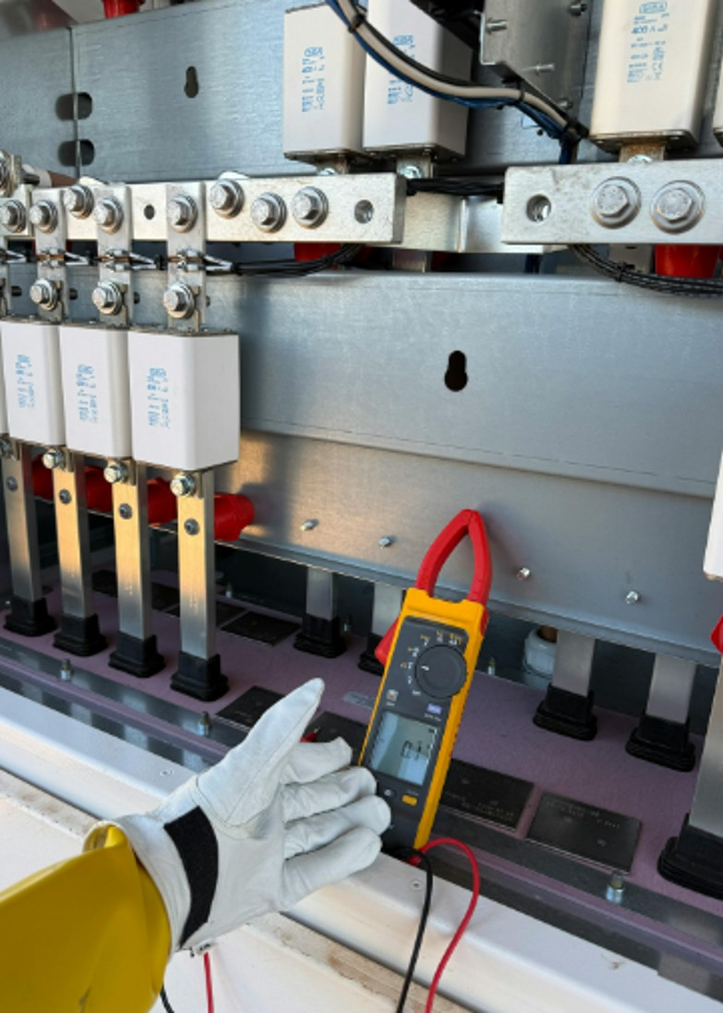
2.1 – Voltage, Current, and Resistance
This section defines voltage, current, and resistance, and explains their roles in electrical circuits.
Notes:
Instructional Activity: Direction
Instructional Time: 2 min.
Do: Introduce the section.
Talking Points:
This section defines voltage, current, and resistance, and explains their roles in electrical circuits.

Slide 8
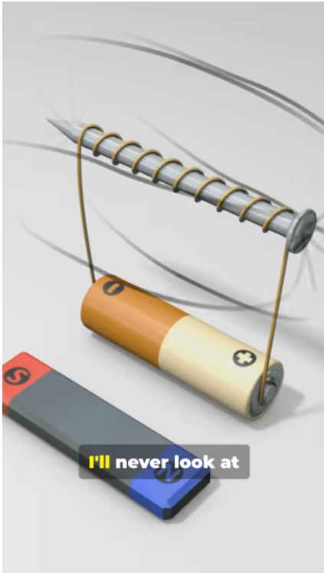

Voltage, Current, and Resistance
Before Video: What do you remember about the following terms from Module 1?
Current
Voltage
After video: How would you describe voltage, current, and resistance using the water analogy?
Notes:
*This slide contains animations. CLICK to reveal content.
INSTRUCTIONAL EVENT: Present Content, Recall
TIME: 10 minutes
Video Link: https://www.youtube.com/watch?v=p6oaTMhjO6I
DO:
Call on learners to share what they remember from module 1 about the voltage and current.
Play the video to introduce learners to resistance. Click the image on the slide or copy/paste link in a browser to view the video.
Facilitate a short discussion.
Talking Points:
ASK: What do you remember about voltage and current from module 1?
Call on learners to respond.
We’ll learn more about current and voltage in today’s lesson. We will also introduce a new term in this module: Resistance.
This is an important concept in Ohms Law, which we’ll learn more about in today’s lesson.
CLICK - This video reviews the relationship between voltage, current, and resistance using a water analogies and pulls everything all together in under a minute. Let’s take a look.
Play the video.
After the video ASK: How would you describe voltage, current, and resistance using the water analogy?
Call on learners to respond. Answer: Voltage is like water pressure. Current is the amount of water actually flowing. Resistance is like narrowing the pipe water is flowing through. The skinnier the pipe, the harder it is for water or electricity to flow.
Source: ConnectEd. (2025). How to understand voltage, current, and resistance fast [Video]. YouTube. https://www.youtube.com/watch?v=p6oaTMhjO6I

Slide 9
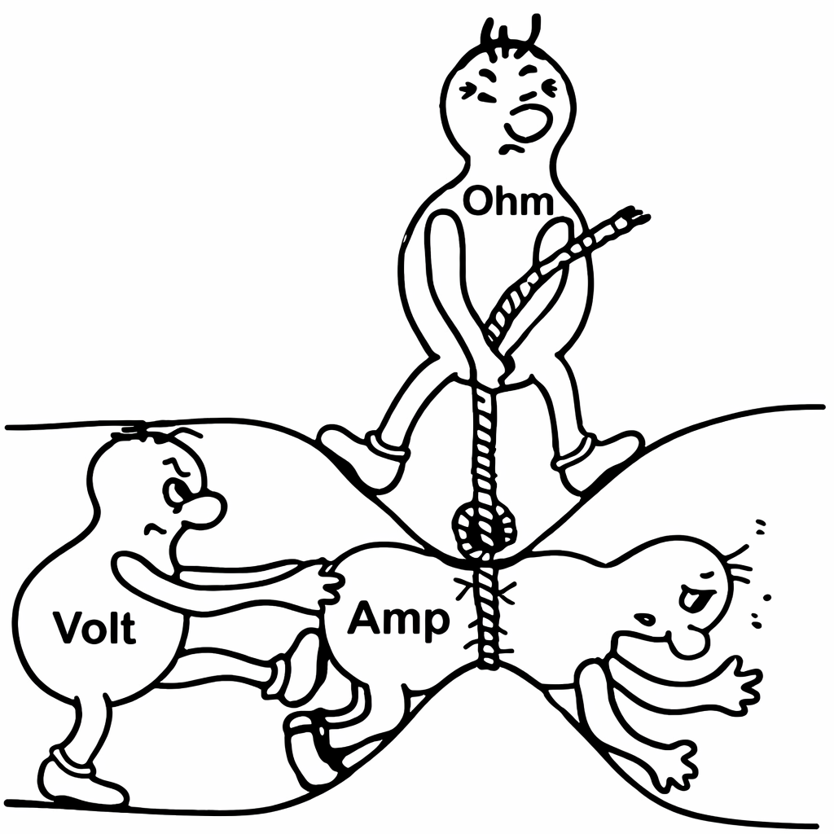
How does electricity move through a circuit?
Voltage = Push of electrons
Current = Movement of electrons
Resistance = What slows the movement of electrons
Notes:
INSTRUCTIONAL ACTIVITY: Present Content
TIME: 2 min.
Talking Points:
Voltage, current, and resistance help explain how electricity behaves in a circuit.
Each part plays a role:
Voltage is what pushes electrons and drives electricity through the system. Again, this is similar to water pressure in a pipe.
Current is the movement of electric charge, like water flowing through a pipe.
Resistance is the opposition that slows the flow down. This is similar to pipe size or anything that might slow water running through a pipe.
Just like in plumbing, higher pressure pushes more water, narrower pipes slow the flow, and the system only works if everything is balanced.
This comparison makes it easier to visualize what’s happening in an electrical circuit—even if you can’t see the electrons moving.
Higher pressure (voltage) = faster flow (current), unless resistance blocks it.
Source: TES. (n.d.). Relationship between volts, amps and ohms. TES. https://www.tes.com/teaching-resource/relationship-between-volts-amps-and-ohms-13005318

Slide 10
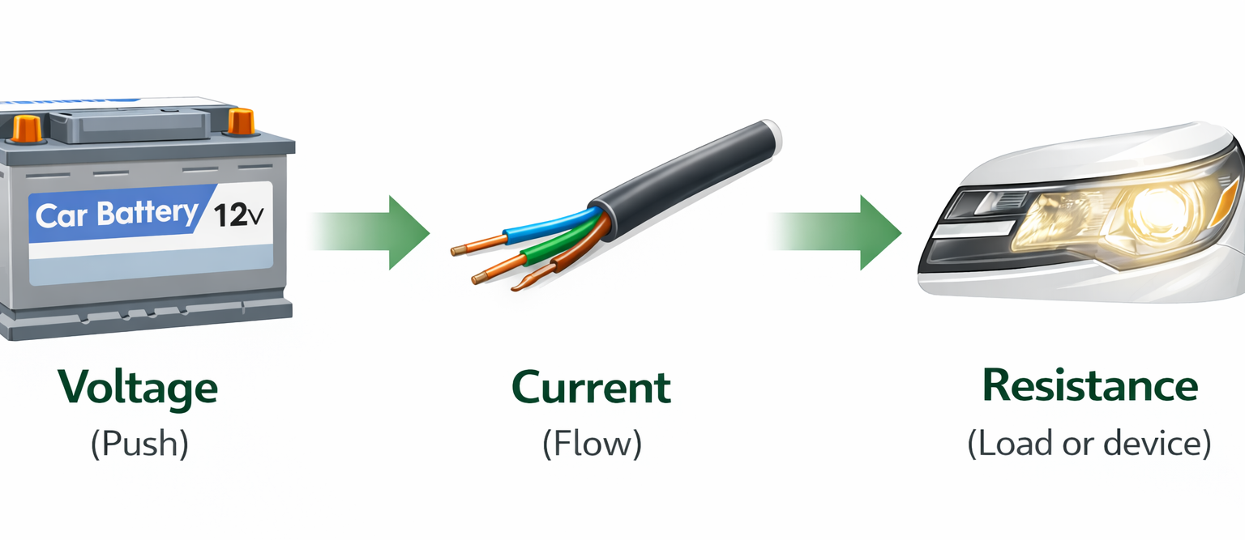
Example: Voltage, Current, and Resistance
Notes:
INSTRUCTIONAL ACTIVITY: Present Content
TIME: 2 min.
Do: Review how voltage, current, and resistance are used in a vehicle.

Slide 11
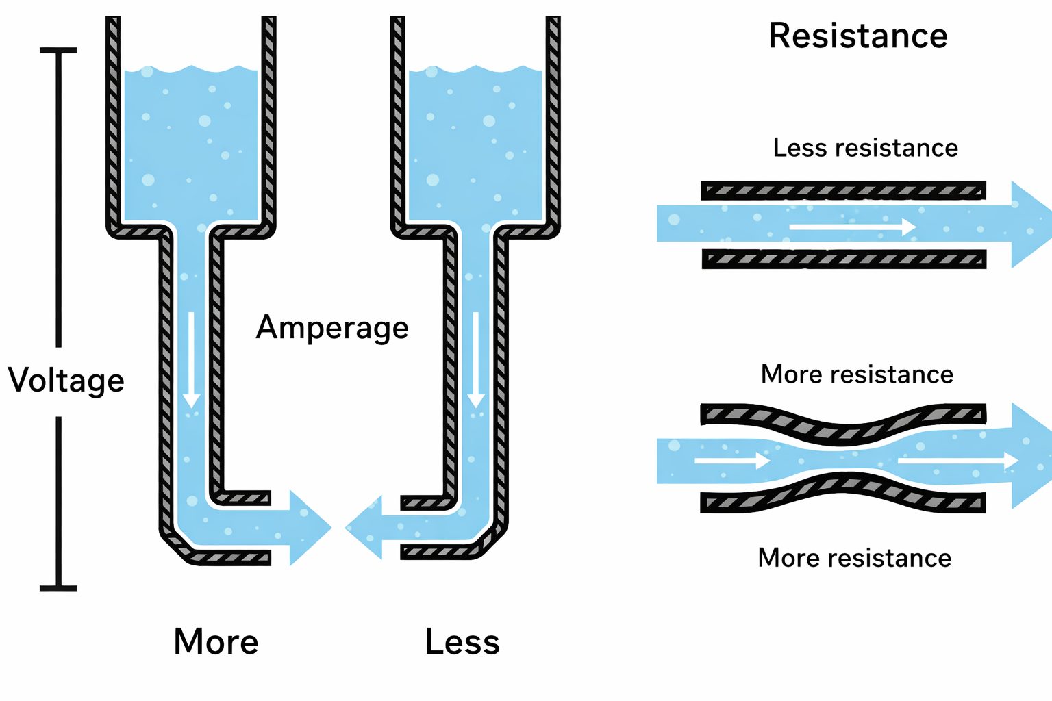
What is Voltage?
Voltage is the push that makes electricity move.
If there is no voltage, nothing moves even if the wires are perfect.
Notes:
INSTRUCTIONAL ACTIVITY: Present Content
TIME: 2 min.
Talking Points:
When thinking about voltage, ask yourself: What pushes electricity?
Voltage is the force that pushes electric charges through a conductor. It’s what gives electrons the energy to move.
In a water analogy, the pressure at the end of the hose represents voltage, and the water in the tank represents electrical charge.
The more water in the tank, the greater the charge available, which increases the pressure measured at the end of the hose—just like higher charge levels can result in higher voltage.
We measure voltage in volts, and the higher the voltage, the more energy there is to push those charges through the circuit.
Think back to the water analogy: voltage is like water pressure. If the pressure increases, the water flows faster. The same is true in electricity—higher voltage means a stronger push for current.
If there is no voltage, nothing moves—even if the wires and components are working perfectly.
Low voltage = weak push
High voltage = strong push
It’s also important to understand limits:
Too much voltage can damage equipment
Too little voltage can cause improper operation or shutdown
Source: SparkFun Electronics. (n.d.). Transistors: Extending the water analogy. SparkFun Learn. https://learn.sparkfun.com/tutorials/transistors/extending-the-water-analogy

Slide 12
What is Current?
Current is the flow of electric charge.
It's what happens when electrons move through a conductor, like a wire.
We measure it in amperes, or amps.
A circuit can have voltage but no current if something is broken or turned off.
Notes:
INSTRUCTIONAL ACTIVITY: Present Content
TIME: 2 min.
Talking Points:
Current is the flow of electric charge—it’s what happens when electrons move through a conductor, like a wire. We measure it in amperes, or amps.
Current represents the actual movement of electrons in a circuit—how many charges pass a point each second.
In a water analogy, current is like the flow rate of water through a pipe. The stream of water represents electrons moving through a wire.
The faster and stronger the flow, the more current is moving through the system.
This also connects to other parts of the system:
A bigger tank creates more pressure (voltage), which can increase flow.
A narrower pipe creates more resistance, which reduces flow.
So, if voltage is the push, current is the movement that push creates.
Current is what actually does the work in a circuit—powering lights, motors, and equipment.
It’s important to control current levels:
Too much current can blow fuses or trip breakers.
It can also cause overheating in wires or equipment.
Too little current can cause equipment to malfunction or struggle to operate properly.
Source: SparkFun Electronics. (n.d.). Transistors: Extending the water analogy. SparkFun Learn. https://learn.sparkfun.com/tutorials/transistors/extending-the-water-analogy

Slide 13
What is Resistance?
Resistance is anything that slows electricity down.
Represented by the Greek letter Ω.
Heaters, motors, and light bulbs are resistance in a circuit using current and voltage to do useful work.
Notes:
INSTRUCTIONAL ACTIVITY: Present Content
TIME: 2 min.
Talking Points:
Resistance is the opposition to the flow of electric current; it slows the movement of electrons through a circuit. It is measured in ohms, represented by the Greek letter Ω.
In a water analogy, resistance is like a narrow or rough section of a pipe, it makes it harder for water to flow.
Narrow sections of a pipe slow the flow of water, just like resistance slows the movement of electricity.
The key idea: higher resistance means less current will flow for a given voltage.
This relationship is important when troubleshooting:
Increased resistance can reduce system performance.
Bad connections or damaged wires increase resistance.
Increased resistance often leads to heat buildup in the circuit.
Heaters, motors, and light bulbs are resistance in a circuit using current and voltage to do useful work.
Understanding resistance helps technicians identify problems like loose connections, corrosion, or damaged conductors.
Source: SparkFun Electronics. (n.d.). Transistors: Extending the water analogy. SparkFun Learn. https://learn.sparkfun.com/tutorials/transistors/extending-the-water-analogy

Slide 14
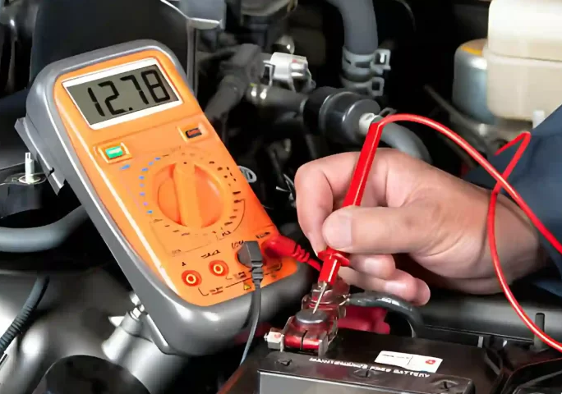
Electrical Problems On The Job
When something isn’t working, it’s because voltage, current and/or resistance has changed.
What you see on the job:
Equipment faults
Dim lights
Hot wires or enclosures
Devices off
Notes:
INSTRUCTIONAL ACTIVITY: Present Content
TIME: 2 min.
Talking Points:
When something isn’t working, it usually comes down to a change in voltage, current, or resistance.
These changes show up as problems you can see or feel on the job.
For example: dim lights, equipment faults, or devices not turning on.
Sometimes you’ll notice heat—like hot wires or enclosures—which can signal too much current or resistance issues.
As technicians, your job is to recognize these symptoms and trace them back to what changed in the circuit.
Source: SW Batteries. (n.d.). What voltage is low for a car battery? https://www.swbatteries.com.au/what-voltage-is-low-for-a-car-battery/

Slide 15
Knowledge Check
Which statement best describes current in an electrical circuit?
(A). The push that makes electricity move.
(B). The motor runs slower.
(B). The flow of electricity through the circuit.
(B). The flow of electricity through the circuit.
(C). Anything that slows electricity down.
(D). The voltage rating printed on equipment.
Notes:
*This slide contains animations. CLICK to reveal content.
Instructional Activity: Evaluate/Assess Performance, Provide Feedback
Instructional Time: 3 min.
Learning Objective: Define and explain voltage, current, and resistance.
Do: Review the knowledge check question. Call on learners to share their responses.
Answer:
B

Slide 16
Knowledge Check
A circuit has voltage, but no electricity is flowing. What is missing?
(A). Voltage
(B). Power
(C). Current
(D). Resistance
(C). Current
Notes:
*This slide contains animations. CLICK to reveal content.
Instructional Activity: Evaluate/Assess Performance, Provide Feedback
Instructional Time: 3 min.
Learning Objective: Describe how voltage, current, and resistance are related in a simple circuit.
Do: Review the knowledge check question. Call on learners to share their responses.
Answer:
C

Slide 17
Summary and What’s Next
Voltage is the push that tries to move electricity through a circuit
Current is the flow of electricity that does the work
Resistance is anything that slows the flow of electricity
Understanding voltage, current, and resistance helps technicians describe what electricity is doing, even before using formulas or tools.
Next, we’ll use these ideas to predict what equipment should be doing.
Notes:
Instructional Activity: Enhance Transfer and Retention
Instructional Time: 3 min.
Talking Points:
Let’s recap the key ideas from this section.
Voltage is the push that moves electricity through a circuit.
Current is the flow—it’s what actually does the work.
Resistance is what slows that flow down.
When you understand how these three work together, you can start to describe what electricity is doing, even before using tools or formulas.
Next, we’re going to build on this and start predicting what equipment should be doing in real situations.

Slide 18
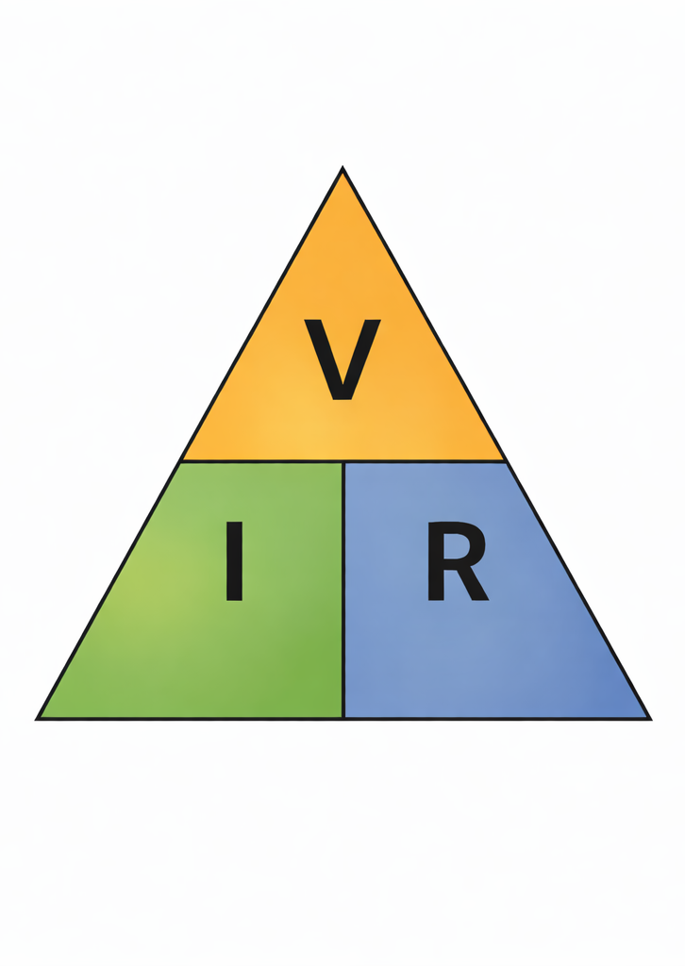
2.2 – Ohm’s Law
Now that we know what voltage, current, and resistance are, we’ll learn how they depend on each other using Ohm’s Law.
Notes:
Instructional Activity: Direction
Instructional Time: 2 min.
Do: Introduce the section.
Talking Points:
Now that we know what voltage, current, and resistance are, we’ll learn how they depend on each other using Ohm’s Law.

Slide 19
Why Ohm’s Law Matters on the Job
Ohm’s Law is how electricity behaves in real equipment, not just a formula.
It explains what’s happening in every light, motor, heater, and control circuit you work on.
It helps you:
Find problems faster. Voltage drops, shorts, open circuits
Protect equipment. By preventing too much current
Trust your meter readings. And know what they mean
Work safer. By knowing how much current a circuit can handle
Notes:
Instructional Activity: Present Content
Instructional Time: 3 min.
Talking Points:
Ohm’s Law isn’t just a formula. It explains how electricity behaves in real equipment.
You’ll see it in everything you work on lights, motors, heaters, and control circuits.
It helps you in a few keyways:
It helps you find problems faster—like voltage drops, shorts, or open circuits.
It helps protect equipment by preventing too much current.
It helps you trust your meter readings and understand what they’re telling you.
And it helps you work safer by knowing how much current a circuit can handle.
Bottom line: Ohm’s Law helps you understand what’s happening, so you can make better decisions on the job. Understanding that relationship saves time, parts, and headaches.

Slide 20
Units of Measurements
Quantity | Unit | Symbol | Other things you may see
Voltage | Volts | V, E | E = Electromotive force (EMF)
Current | Ampere | A, I | I = Intensity
Resistance | Ohm | Ω, R
Notes:
INSTRUCTIONAL ACTIVITY: Present Content
TIME: 2 min.
Talking points:
To be able to make meaningful statements about these quantities in circuits, we need to be able to describe their quantities in the same way that we might quantify mass, temperature, volume, length, or any other kind of physical quantity.
Just like feet measure distance, volts, amps, and ohms measure electrical properties.
Voltage
V – Most common (e.g., V=IRV = IRV=IR)
E – Sometimes used in textbooks, especially for electromotive force (EMF)
Current
A – Most common, interchangeable with “I”
I – Standard symbol for electric current, used for describing intensity
i – Used for instantaneous or time-varying current (AC analysis)
Resistance
R – Standard symbol for resistance
r – Sometimes used for internal resistance or small resistance values in circuits
What you see in the third column is an old school way of communicating these terms. However, you may still see them in the field, so it is important to know.

Slide 21
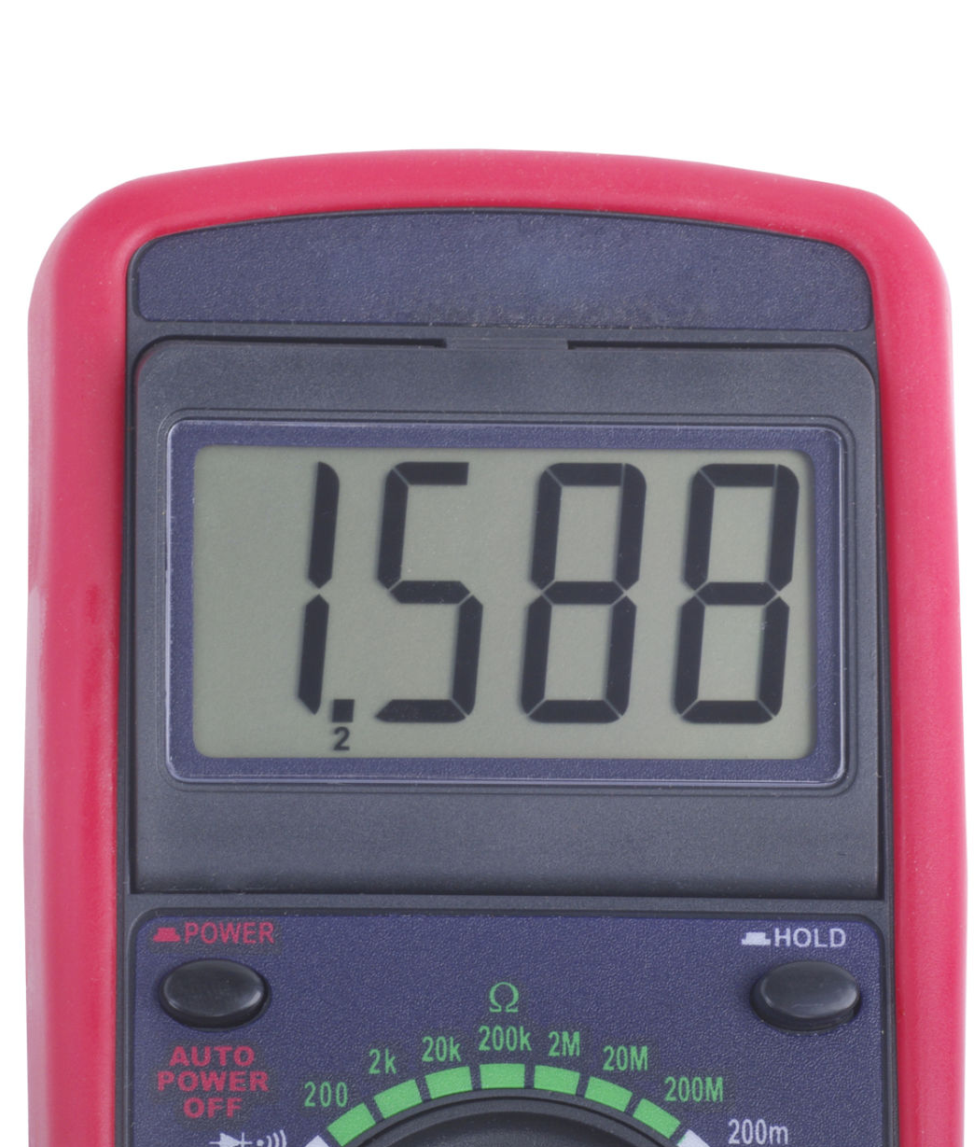
Decimals in Electrical Work
Technicians frequently see decimal values when measuring electricity.
Examples:
12.6 V
0.35 A
0.02 Ω
Small decimal differences can indicate voltage drops, resistance changes, or equipment problems.
Thousandths
Hundredths
Tenths
Notes:
*This slide contains animations. CLICK to reveal content.
INSTRUCTIONAL ACTIVITY: Present Content
TIME: 2 min.
Talking points:
Technicians often work with decimal values when measuring electricity.
Decimals help us see small but important differences in voltage, current, and resistance.
For example, readings like 12.6 volts or 0.35 amps may seem small, but they can tell us a lot about what’s happening in a circuit.
These small differences can help identify issues like voltage drops, poor connections, or failing components.
Let’s break down a decimal:
In 1.588
CLICK - 5 is in the tenths place
CLICK - 8 is in the hundredths place
CLICK - 8 is in the thousandths place
The more precise the measurement, the better we can diagnose problems.
As a technician, paying attention to decimals helps you catch issues early—before they become bigger problems.

Slide 22
Decimals in Electrical Work
Each step changes the value by 10 times.
Example:
1 → 10 → 100 → 1000
Each step = 10× larger
Decimals move the other direction:
1 → 0.1 → 0.01 → 0.001
Thousandths
Hundredths
Tenths
Notes:
INSTRUCTIONAL ACTIVITY: Present Content
TIME: 2 min.
Talking Points:
Our number system is based on 10—each place value changes by a factor of 10.
When you move to the right, numbers get larger:
1 → 10 → 100 → 1000
Each step is 10 times bigger
Decimals move in the opposite direction:
1 → 0.1 → 0.01 → 0.001
Each step is 10 times smaller
Another way to think about it:
Move the decimal to the right → the number gets larger.
Move the decimal to the left → the number gets smaller.
On the meter display:
The first digit is the tenths place
Next is the hundredths
Then the thousandths
Understanding place value helps you read measurements accurately and recognize small changes that can point to real issues in a circuit.

Slide 23
Electrical Prefixes
Prefix | Symbol | Value
Mega | M | Million: 1,000,000
Kilo | k | Thousand: 1,000
Base | — | 1
Milli | m | Thousandth: 0.001
Micro | µ | Millionth: 0.000001
BIG
Small
Notes:
INSTRUCTIONAL ACTIVITY: Present Content
TIME: 2 min.
Talking Points:
Electrical values can vary a lot—from very large to very small—so we use prefixes to make them easier to read and work with.
Starting at the top with larger numbers:
Mega means one million—used for very large values.
Kilo means one thousand.
The base unit is just 1—this is your standard unit like volts, amps, or ohms.
Moving smaller numbers:
Milli means one-thousandth.
Micro means one-millionth.
As you move down the chart, the values get smaller each step.
These prefixes help you quickly understand the size of a measurement without dealing with long numbers or lots of zeros.
On the job, you’ll see larger prefixes in power systems and smaller ones in control circuits and electronics.

Slide 24
Understanding Amps and Milliamps
Electrical values are often very small. We use milliamps (mA) and millivolts (mV) to communicate these small numbers.
To convert Amps to Milliamps (A → mA) | To convert Milliamps to Amps (mA → A)
Multiply by 1,000 or move decimal 3 places right. Examples: 1 A = 1,000 mA 0.5 A = 500 mA 0.002 A = 2 mA | Divide by 1,000 or move decimal 3 places left. Examples: 1,000 mA = 1 A 250 mA = 0.25 A 2 mA = 0.002 A
Notes:
*This slide contains animations. CLICK to reveal content.
INSTRUCTIONAL ACTIVITY: Present Content
TIME: 2 min.
Talking Points:
Electrical values are often very small, so instead of using long decimals, we use prefixes like milli.
Milli means one-thousandth, or 1/1000.
You’ll commonly see this with millivolts (mV) and milliamps (mA).
When converting, the key is moving the decimal 3 places:
CLICK - Amps to milliamps → move the decimal right (number gets bigger)
For example:
1 volt equals 1,000 millivolts
0.5 volts equals 500 millivolts
0.002 amps equals 2 milliamps
CLICK - Milliamps to amps → move the decimal left (number gets smaller)
For example:
1,000 mA = 1 A
250 mA = 0.25 A
2 mA = 0.002 A
These conversions help you read meters correctly and communicate measurements clearly on the job.

Slide 25
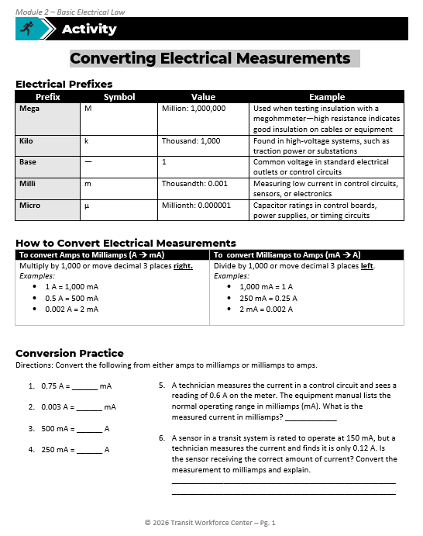
Converting Electrical Measurements
Directions: Convert the following from either amps to milliamps or milliamps to amps.
0.75 A = 750 mA
0.003 A = 3 mA
500 mA = 0.5 A
250 mA = 0.25 A
What is the measured current in milliamps? 600 mA
Is the sensor receiving the correct amount of current? Convert the measurement to milliamps and explain.
  0.12 A = 120 mA → No, the sensor is not receiving the correct current (it is below 150 mA)
Notes:
*This slide contains animations. CLICK to reveal content.
Instructional Activity: Provide Guided Learning, Elicit Performance, Provide Feedback
Instructional Time: 20 min.
Materials:
Converting Electrical Measurements_M2
Do:
2 min.
Refer learners to the “Converting Electrical Measurements” handout embedded in the Participant Resource Guide.
Review the directions and answer any questions learners may have.
15 min.
Give learners time to work. You may have them work with partners or groups if you choose.
Circulate the room answering questions and providing feedback as needed.
3 min.
Review answers together and ask volunteers to explain their reasoning.
CLICK to reveal the answers.
Answer Key:
0.75 A = 750 mA
0.003 A = 3 mA
500 mA = 0.5 A
250 mA = 0.25 A
600 mA
0.12 A = 120 mA → No, the sensor is not receiving the correct current (it is below 150 mA)

Slide 26
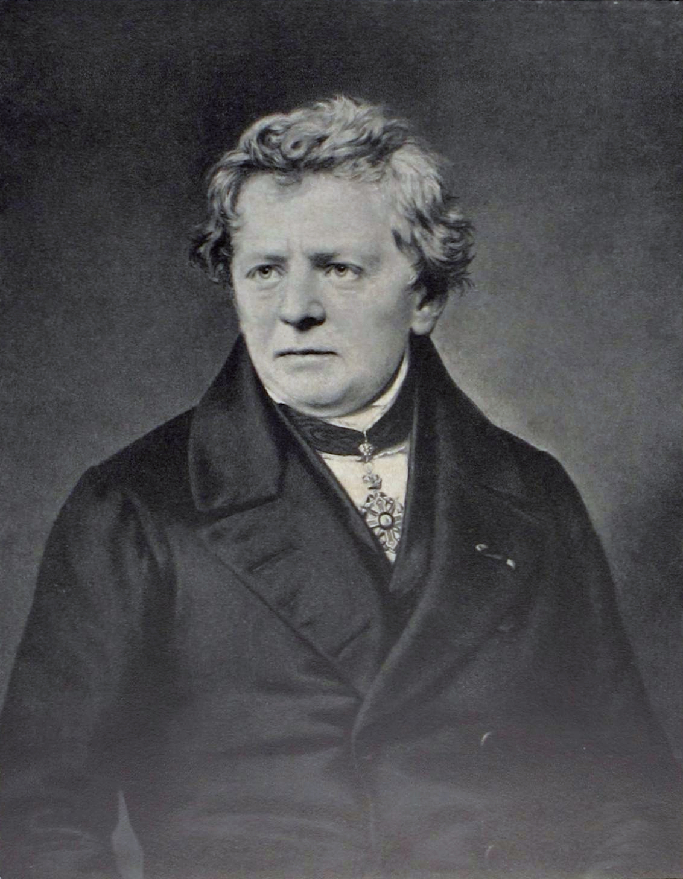
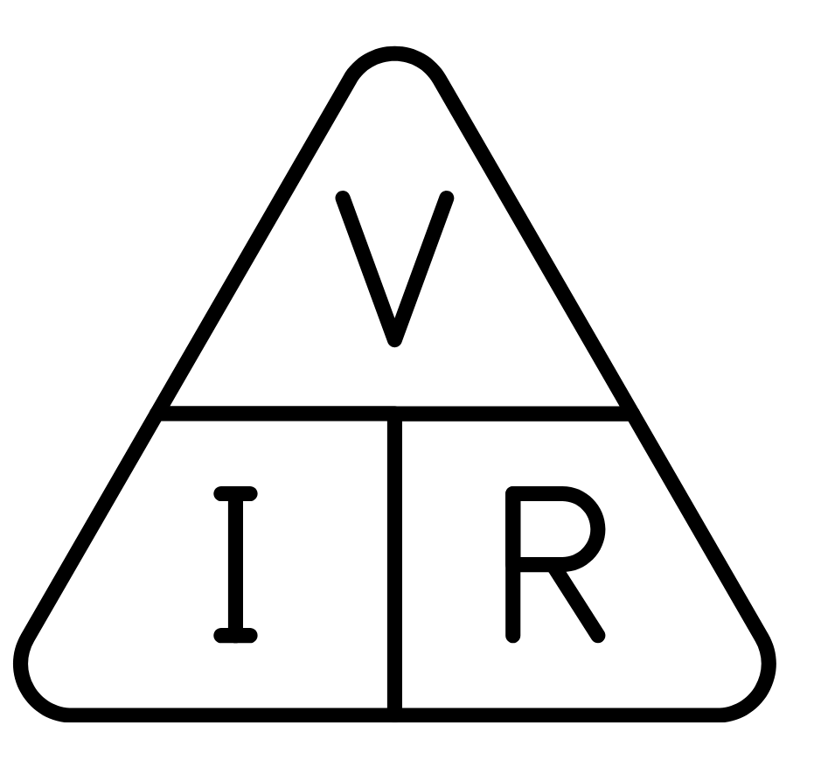
Ohms Law
Describes the relationship between voltage, current, and resistance in a circuit.
V = I x R
V – Voltage (volts)
I – Current (amperes)
R – Resistance (ohms)
Notes:
INSTRUCTIONAL ACTIVITY: Present Content
TIME: 3 min.
Talking points:
Ohm’s Law was discovered by George Simon Ohm and is a fundamental principle in electronics and electrical engineering.
It describes the relationship between voltage, current, and resistance in a circuit with a simple formula:
V = I × R
V stands for Voltage (measured in volts).
I stands for Current (measured in amperes or amps).
R stands for Resistance (measured in ohms).
This equation tells us that voltage equals current times resistance. If you know any two of these values, you can always figure out the third.

Slide 27
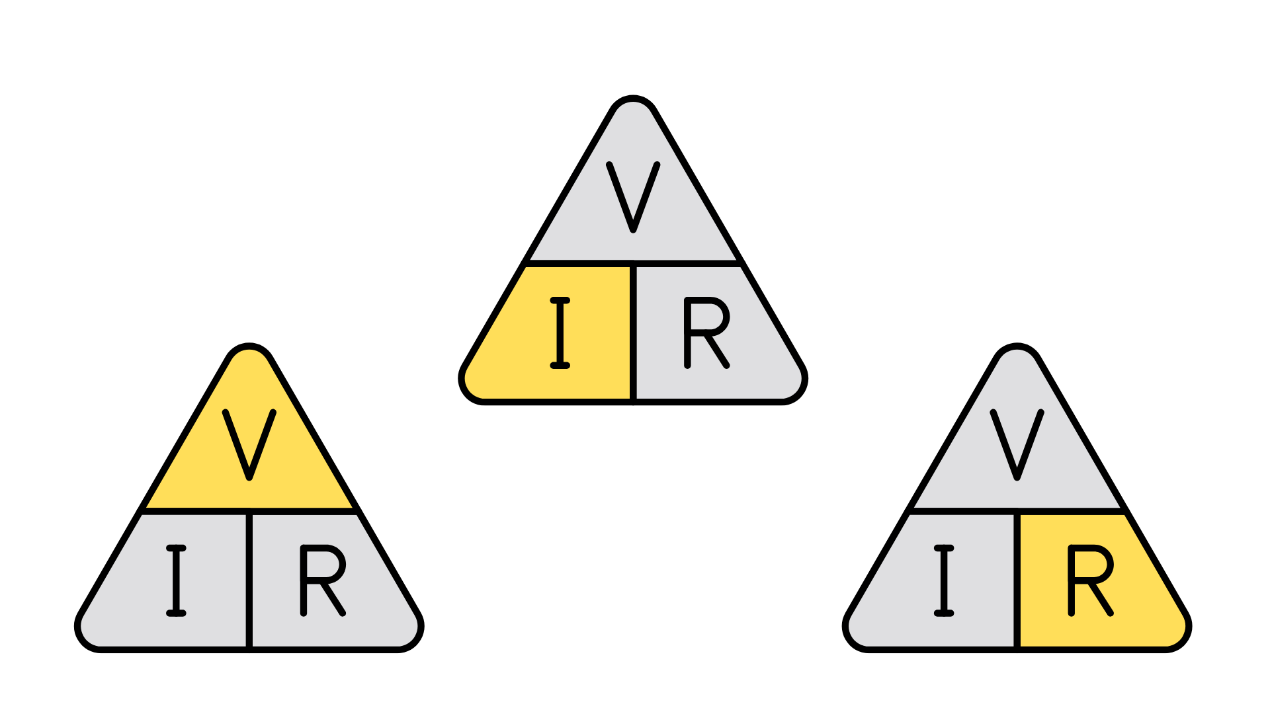
Using Ohm’s Law
Using Ohm’s Law, you can easily calculate any one of the three variables, if the other two are known. Cover the value you’re trying to find, and what’s left gives you the equation.
V = I X R
I =
V
R
R =
V
I
Reminder - The symbol for resistance is interchangeable for both R and Ω.
Notes:
INSTRUCTIONAL ACTIVITY: Present Content
TIME: 3 min.
Talking Points:
Ohm’s Law isn’t just a formula—it’s a tool you can use to solve problems in any electrical circuit.
Remember, the symbol for resistance is interchangeable for both R and Ω.
The triangle diagrams make it easy: Cover the value you’re trying to find, and what’s left gives you the equation.
If you're solving for voltage, use V = I × R
To find current, use I = V ÷ R
And for resistance, use R = V ÷ I
These triangle charts are a great way to quickly remember which formula to use, especially when troubleshooting or doing basic calculations in the field.
We’re not going to calculate every time we see a problem.
Most of the time, technicians notice the result first — then use Ohm’s Law to think through what must have changed.

Slide 28
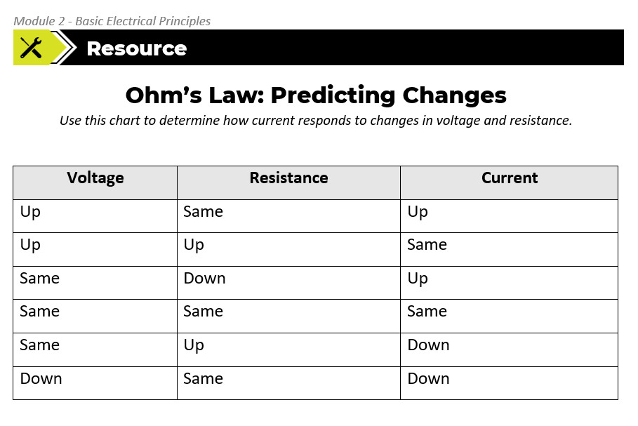
Notes:
INSTRUCTIONAL ACTIVITY: Direction
TIME: 1 min.
Materials: Predicting Current Changes Resource_M2
Talking Points:
In your Participant Resource Guide, you’ll find “Ohm’s Law: Predicting Changes” chart with practice problems.
This chart will be a useful reference for you to determine how current responds to changes in voltage and resistance.

Slide 29
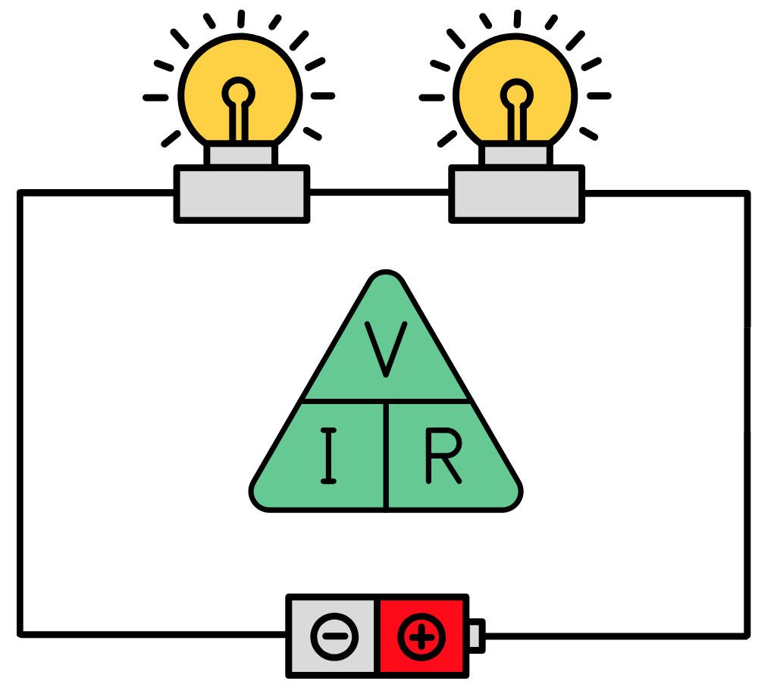
Ohm’s Law in Action
Goal: Predict what will happen to the current when changes are made to voltage and resistance in a simple circuit.
Notes:
Instructional Activity: Provide Guided Learning, Provide Feedback
Instructional Time: 20 min.
Materials
A simple circuit with a power source, light bulb, and wire
One or two additional light bulbs to add to the circuit to simulate resistance
Multimeter
Do:
In this demonstration, you will ask leaners to predict what will happen to the current by making changes to voltage and resistance in a simple circuit.
Place the circuit in a location where everyone can clearly see the circuit.
Step 1: Baseline
Turn on the circuit at a starting voltage and show the reading.
ASK: What is the current right now?
Call on learners to respond.
Step 2: Increase the Voltage
Increase voltage (adjust power supply if possible)
ASK: What do you expect current to do?
Call on learners to respond. Answer: Voltage increased → current increased; More push = more flow
Step 3: Decrease the Voltage
Decrease voltage (adjust power supply if possible)
ASK: What do you expect current to do now?
Call on learners to respond. Answer: Voltage decreased → current decreased; Less push = less flow
Transition learners from analyzing voltage changes to analyzing resistance changes. Ex: Now we’re going to keep voltage the same and change resistance.
Step 4: Baseline Reminder
Return to original voltage and show the current again.
ASK: What is the current right now?
Call on learners to respond.
Step 5: Add Resistance
Add another light bulb (series) to the circuit.
ASK: What do you expect current to do?
Call on learners to respond. Answer: Resistance increased → current decreased; More opposition = less flow
Step 6: Remove Resistance
Remove added light bulb (or bypass a load) from the circuit.
ASK: What will happen now?
Call on learners to respond. Answer: Resistance decreased → current increased

Slide 30
Calculating Ohm’s Law
Task: Given a circuit with a 12V battery and a 4 Ω resistance, calculate the current.
Which equation do we need?
What goes in the equation?
What is the solution?
I = V / R
I = 12V / 4Ω
I = 3A
Notes:
*This slide contains animations. CLICK to reveal content.
Instructional Activity: Provide Guided Learning, Provide Feedback
Instructional Time: 4 min.
Do:
Review the practice equation with learners.
Call on learners to share their responses to each question on the slide.
CLICK to reveal the answers.

Slide 31
Calculating Ohm’s Law
Task: A heater pulls 5A current and has a 3 Ω resistance, calculate the voltage.
Which equation do we need?
What goes in the equation?
What is the solution?
V = I X R
V = 5A x 3Ω
V = 15V
Notes:
*This slide contains animations. CLICK to reveal content.
Instructional Activity: Provide Guided Learning, Provide Feedback
Instructional Time: 4 min.
Do:
Review the practice equation with learners.
Call on learners to share their responses to each question on the slide.
CLICK to reveal the answers.

Slide 32
Calculating Ohm’s Law
Task: Given a circuit with a 20V battery and a 5A current, calculate the resistance.
Which equation do we need?
What goes in the equation?
What is the solution?
R = V / I
R = 20V / 5A
R = 4Ω
Notes:
*This slide contains animations. CLICK to reveal content.
Instructional Activity: Provide Guided Learning, Provide Feedback
Instructional Time: 4 min.
Do:
Review the practice equation with learners.
Call on learners to share their responses to each question on the slide.
CLICK to reveal the answers.

Slide 33
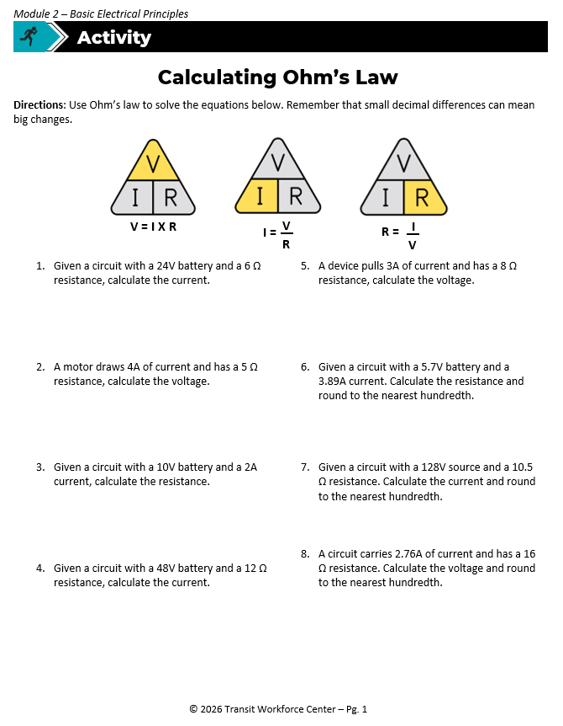
Calculating Ohm’s Law
Directions: Use Ohm’s law to solve the equations on the “Calculating Ohm’s Law” handout. Remember that small decimal differences can mean big changes.
You may work with a partner if you choose.
There is an additional practice sheet if you choose to use it
Notes:
Instructional Activity: Provide Guided Learning, Elicit Performance, Provide Feedback
Instructional Time: 20 min.
Materials:
Calculating Ohm’s Law_M2
Calculating Ohm’s Law_Answer Key_M2
Do:
5 min.
Refer learners to the “Calculating Ohm’s Law” handout embedded in the Participant Resource Guide.
Review the directions and answer any questions learners may have.
For additional practice, refer to Additional Practice – Ohm’s Law handout.
15 min.
Give learners time to work. You may have them work with partners or groups if you choose.
Circulate the room answering questions and providing feedback as needed.
You will review the answers as a group on the next two slides.

Slide 34
Review: Calculating Ohm’s Law
1. Given a circuit with a 24V battery and a 6 Ω resistance, calculate the current. | 2. A motor draws 4A of current and has a 5 Ω resistance, calculate the voltage. | 3. Given a circuit with a 10V battery and a 2A current, calculate the resistance. | 4.Given a circuit with a 48V battery and a 12 Ω resistance, calculate the current.
I = V / R I = 24V / 6Ω I = 4 A | V = I × R V = 4A × 5Ω V = 20 V | R = V / I R = 10V / 2A R = 5Ω | I = V / R I = 48V / 12Ω I = 4 A
Notes:
*This slide contains animations. CLICK to reveal content.
Instructional Activity: Provide Guided Learning, Elicit Performance, Provide Feedback
Instructional Time: 5 min.
Materials:
Calculating Ohm’s Law_M2
Calculating Ohm’s Law_Answer Key_M2
Do:
Review the answers to questions 1-4 by calling on learners to share their responses.
CLICK to reveal the answers.

Slide 35
Review: Calculating Ohm’s Law
5. A device pulls 3A of current and has an 8 Ω resistance, calculate the voltage. | 6. Given a circuit with a 5.7V battery and a 3.89A current. Calculate the resistance and round to the nearest hundredth. | 7.Given a circuit with a 128V source and a 10.5 Ω resistance. Calculate the current and round to the nearest hundredth. | 8.A circuit carries 2.76A of current and has a 16 Ω resistance. Calculate the voltage and round to the nearest hundredth.
V = I × R V = 3A × 8Ω V = 24 V | R = V / I R = 5.7V / 3.89A R = 1.47 Ω | I = V / R I = 128V / 10.5Ω I = 12.19 A | V = I × R V = 2.76A × 16Ω V = 44.16 V
Notes:
*This slide contains animations. CLICK to reveal content.
Instructional Activity: Provide Guided Learning, Elicit Performance, Provide Feedback
Instructional Time: 5 min.
Materials:
Calculating Ohm’s Law_M2
Calculating Ohm’s Law_Answer Key_M2
Do:
Review the answers to questions 1-4 by calling on learners to share their responses.
CLICK to reveal the answers.

Slide 36

Predicting Current
Use a thumbs up, thumbs down, or flat hand to respond.
What happens to current when…
resistance increases and voltage stays the same?
voltage increases but resistance stays the same?
both voltage and resistance increase?
voltage stays the same and resistance decreases?
voltage decreases and resistance stays the same?
Increase
Stays the same
Decrease
Notes:
Instructional Activity: Provide Guided Learning, Elicit Performance, Provide Feedback
Instructional Time: 10 min.
Do:
Ask learners to use a thumbs up, thumbs down, or flat hand to respond to the following statements.
What happens to current when…
resistance increases and voltage stays the same?
voltage increases but resistance stays the same?
both voltage and resistance increase?
voltage stays the same and resistance decreases?
voltage decreases and resistance stays the same?
Answer Key:
When resistance increases and voltage stays the same → Current decreases
If voltage increases but resistance stays the same → Current increases
When both voltage and resistance increase → Current stays the same
If voltage stays the same and resistance decreases → Current increases
When voltage decreases and resistance stays the same → Current decreases

Slide 37
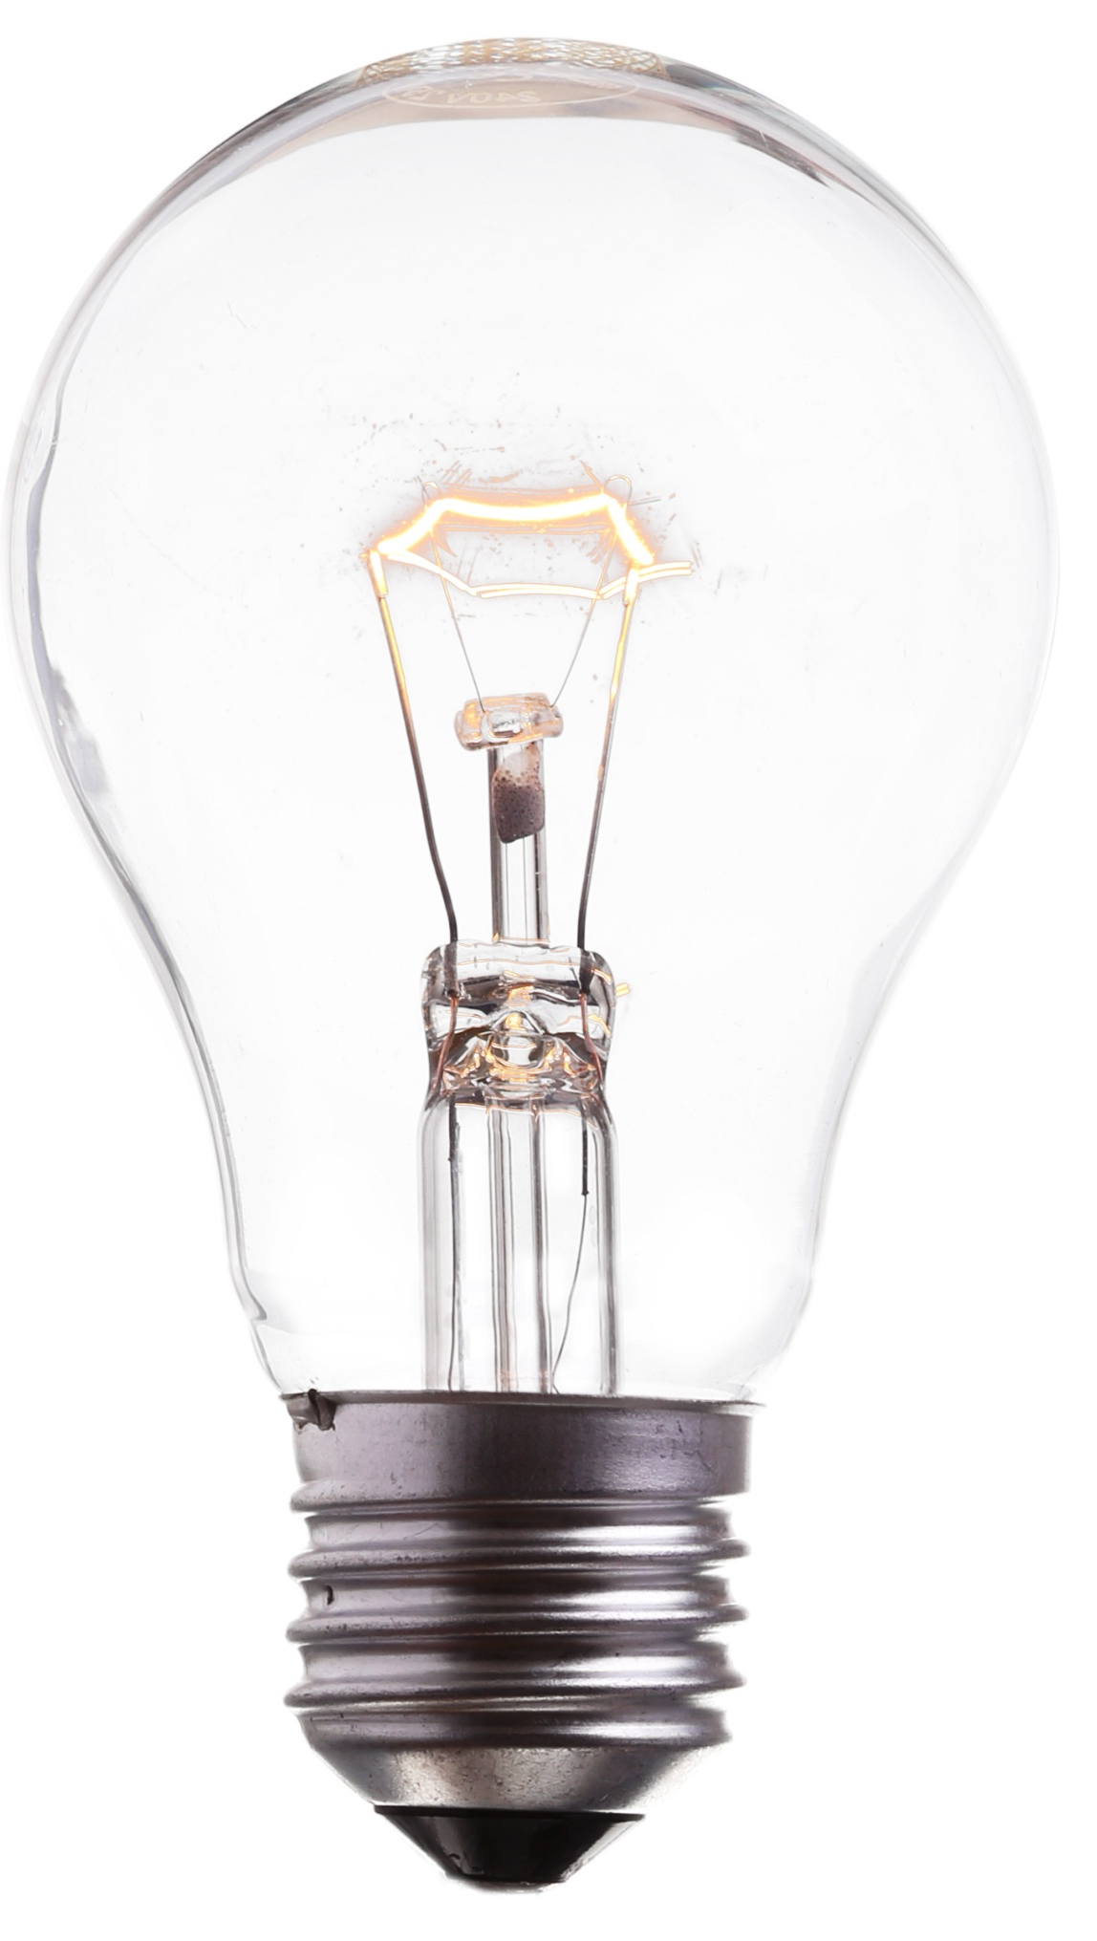
Watts (W)
Electrical power is measured in watts (W).
Power describes how much electrical energy is used or produced.
Examples:
  Light bulb → 60 W
  Heater → 1500 W
  Motor → 500 W
Watts = Volts × Amps
Higher watts = more power being used
Notes:
INSTRUCTIONAL ACTIVITY: Present Content
TIME: 2 min.
Talking Points:
Power is measured in watts, and it tells us how much electrical energy is being used or produced.
Think of watts as the total work being done in a circuit.
Looking at these examples:
A light bulb uses a small amount of power.
A heater uses a lot more.
A motor falls somewhere in between.
We calculate power using volts and amps: Watts = Volts X Amps
So, if either voltage or current increases, power also increases.
Higher watts means more energy is being used—which often means more heat, more work, or more output from the equipment.

Slide 38
Horsepower (HP)
Mechanical power is measured in Horsepower (HP).
HP describes how much work a motor or engine can do over time.
Examples:
  Small fan motor → ¼ HP
  Air compressor → 5 HP
  Train traction motor → Hundreds or Thousands of HP
1 HP = 746 W
Horsepower = Mechanical Power
Notes:
INSTRUCTIONAL ACTIVITY: Present Content
TIME: 2 min.
Talking Points:
Horsepower (HP) is another way to measure power, but it is usually used to describe mechanical power instead of electrical power.
Electric motors are often rated in horsepower because they produce motion or mechanical work.
In transit systems, horsepower can describe the strength or output capability of motors used in equipment such as fans, pumps, compressors, or traction systems.
One horsepower is equal to about 746 watts.
In general, higher horsepower means a motor can do more work or move heavier loads.
Examples:
Small fan motor = 1/4 HP
Shop air compressor = 5 HP
Train traction motor = hundreds or thousands of HP

Slide 39
Knowledge Check
Ohm’s Law explains the relationship between which three electrical quantities?
(A). Voltage, power, and time
(B). Voltage, resistance, and temperature
(D). Voltage, current, resistance
(C). Voltage, resistance, and speed
(D). Voltage, current, resistance
(D). Three Phase
Notes:
*This slide contains animations. CLICK to reveal content.
Instructional Activity: Evaluate/Assess Performance, Provide Feedback
Instructional Time: 3 min.
Learning Objective: Describe how voltage, current, and resistance are related in a simple circuit.
Do: Review the knowledge check question. Call on learners to share their responses.
Answer:
D

Slide 40
Knowledge Check
If the voltage in a circuit increases and the resistance stays the same, what happens to the current?
(A). Current decreases
(B). Current increases
(B). Current increases
(C). Resistance increases
(D). Resistance decreases
(D). Three Phase
Notes:
*This slide contains animations. CLICK to reveal content.
Instructional Activity: Evaluate/Assess Performance, Provide Feedback
Instructional Time: 3 min.
Learning Objective: Predict how changes in voltage or resistance affect current (before measuring).
Do: Review the knowledge check question. Call on learners to share their responses.
Answer:
B

Slide 41
Knowledge Check
Task: Given a circuit with a 25V battery and a 5A current, calculate the resistance.
Which equation do we need?
What goes in the equation?
What is the solution?
R = V / I
R = 25V / 5A
R = 5Ω
Notes:
*This slide contains animations. CLICK to reveal content.
Instructional Activity: Evaluate/Assess Performance, Provide Feedback
Instructional Time: 3 min.
Learning Objective: Use Ohm’s Law to calculate a missing value in a basic circuit.
Do: Review the knowledge check question. Call on learners to share their responses.
Answer:
5Ω

Slide 42
Knowledge Check
Scenario: A circuit breaker repeatedly trips in an electrical circuit. Based on voltage, current, and resistance, what might be causing this?
Excessive current
Notes:
*This slide contains animations. CLICK to reveal content.
Instructional Activity: Evaluate/Assess Performance, Provide Feedback
Instructional Time: 3 min.
Learning Objective: Describe how voltage, current, and resistance are related in a simple circuit.
Do: Review the knowledge check question. Call on learners to share their responses.
Answer:
Excessive current

Slide 43
Module Summary
Identify voltage, current, and resistance.
Describe how each functions within an electrical circuit.
Use Ohm’s Law to understand their relationship.
Recognize the symbols (V, I, R) and calculate missing values.
Notes:
INSTRUCTIONAL ACTIVITY: Enhance Retention and Transfer
TIME: 3 min.
Talking points:
Let’s wrap up the key ideas from this module.
First, being able to identify voltage, current, and resistance is essential.
You should be able to describe each one and recognize how they show up in a circuit.
Second, Ohm’s Law ties everything together.
It helps you understand how voltage, current, and resistance are related.
You should now be able to identify the symbols—V, I, and R—and use them to calculate missing values.
These concepts are the foundation for troubleshooting and understanding how electrical systems behave on the job.

Slide 44

Quiz
Time for a quiz! Let’s see what you have learned from today’s lesson.
Notes:
Instructional Activity: Direction, Evaluate/Assess Performance
Instructional Time: 20 min.
Materials: Quiz_M2
Do:
Ask learners if they have any lingering questions. Address them before distributing the quiz.
Pass out the quiz and review the directions.
Talking Points:
Time for a quiz! Let’s see what you have retained from today’s lesson.

Slide 45
Revisiting Objectives
Define and explain voltage, current, and resistance.
Describe how voltage, current, and resistance are related in a simple circuit.
Predict how changes in voltage or resistance affect current before measuring.
Use Ohm’s Law to calculate a missing value in a basic circuit.
Notes:
Instructional Activity: Enhance Transfer and Retention
Instructional Time: 5 min.
Do: Facilitate a short discussion to review the key topics in the lesson.
Talking Points:
If you were explaining today’s objectives to someone else, how would you summarize what they mean and why they matter?
Which of today’s objectives do you feel most confident about? Which were most challenging? Explain your reasoning.
Can you give an example of how you could apply one of today’s objectives in a real-world situation?
After Discussion:
This conclude this section of the module. Thank you for your participation.

Slide 46
Thank you!
Notes:
Instructional Activity: Enhance Transfer and Retention
Instructional Time: 2 min.
Do:
Thank learners for their participation.
If possible, stay after class to answer any lingering questions learners may have.

