Slide 1
Transit Workforce Center
National Technical Assistance Center
for Transit Workforce Development
ZEB Workforce Transition Plan
Powering Up the Workforce:
TWC's Zero-Emission Bus Resources
June 17, 2024

Slide 2
Webinar Agenda
Introductory Remarks
Critical Elements in Zero-Emission Fleet Transition Planning – ZEB Workforce Development Transit Plan – Eights Steps for Development
Zero-Emission Bus Maintenance Training Standards
Battery Electric Bus Familiarization Course
TWC Resources
Q&A
Evaluation and Wrap-up

Slide 3
Transit Workforce Center – Mission
Operated by the ITLC, the Transit Workforce Center (TWC) is FTA’s first ever national technical assistance center for transit workforce development.

Slide 4
Examples of TWC Programs and Resources Supporting Workforce Development Initiatives
Trainer and Mentor Development
American Transit Training and Apprenticeship Innovators Network (ATTAIN)
Transit Workforce Data Dashboard
#ConnectingMyCommunity —
National Transit Frontline Worker Recruitment Campaign Toolkit
Information on Workforce Development
Funding Opportunities
Zero Emission Bus transition —
workforce preparation and development
Notes:
Full Bullet wording:
Helping all agencies to meet workforce development challenges
Engaging all stakeholders, including frontline workforce
Mentoring programs
Partnerships – labor and management, education, community, government
Webinars
Apprenticeship - ATTAIN
National Transit Frontline Worker Recruitment Campaign
Zero Emission Bus transition
Note that he and David will go into a bit more depth on the last three points, see slides that follow.

Slide 5
Dr. Mary Leary
Associate Administrator for Research, Demonstration and Innovation

Slide 6
John Schiavone
Program Director, International Transportation Learning Center/Transit Workforce Center

Slide 7
ZEB Workforce Transition Plan
Required document in FTA’s Low-No grant application process
Included as Element 6
Intended to help frontline works make a smooth and successful transition to ZEBs
Plan applies to both operators and technicians, but focus here will be on technicians due to extent of their preparation
Transit Workforce Center Resources and Best Practices for a Zero Emission-Workforce Fleet Transition Plan: Detailed Plan

Slide 8
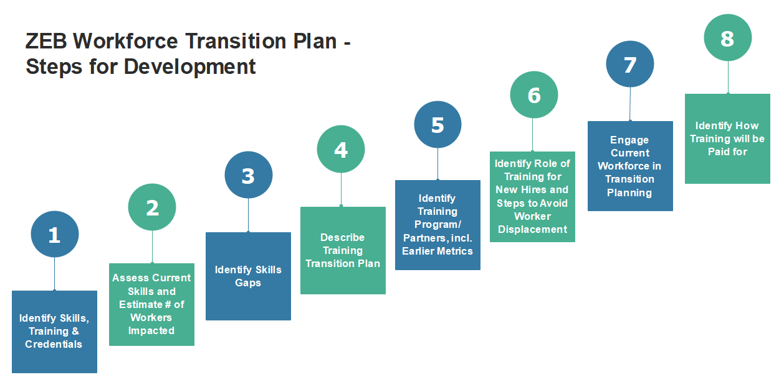
ZEB Workforce Transition Planning

Slide 9
Step #1 - Identify Needed ZEB Skills
American Public Transportation Association’s (APTA) Zero Emission Bus Maintenance Training Standard/Recommended Practice
This will be discussed later by Lisa Jerram, APTA

Slide 10
ZEB Workforce Transition Plan
Transition Plan is well laid out and easy to follow
8-step process
Includes best practice examples and links to several resources
Requires effort in the face of several challenges
Many agencies lack formal training department
Transit facing unpresented workforce shortages
Many technicians lack basic electrical skills, an essential prerequisite to high voltage work
Regardless, adequate preparation is essential
Upwards of 800 volts introduces serious safety concerns

Slide 11
Step #2 - Identify Current Skills & Workers Impacted
Identify technicians with existing electrical/electronic skills
Shop-floor supervisors know who “go-to” techs are
Hybrid experience a plus
So are techs with Automotive Service Excellence (ASE) Certifications
Especially ASE H6 - Electrical/Electronic Systems
Estimate number of workers impacted
Depends on agency (generalists vs specialists)
Eventually, all will be impacted

Slide 12
Step #3 - Identify Skills Gap
Gap = Shortfall between what’s needed & what exists
Skills Gap Survey = Useful Tool
Asks workers to rate their own skills & understanding on scale
Identifies shortfalls
Can’t be used to punish workers for what they don’t know
Use instead to direct training to specific areas to fill gaps
Joint labor-management participation essential
TWC has a ZEB example that includes Basic Electrical

Slide 13
Step #4 - Describe Training Transition Plan
Purpose: Establish pathway to provide technicians with needed skills
Includes strategies & partners to facilitate the transition
E.g., In-house training, Train-the-Trainer, Original Equipment Manufacturer (OEM) training, Apprenticeship
Third-Party Training (community colleges, private firms, etc.)
TWC Plan offers several useful resources
Recommended training procurement language
Apprenticeship Framework, BEB Familiarization Webinar & Course
All includes as links in TWC’s ZEB Transition Plan
Identify any additional staff needed

Slide 14
Step #5 - Identify Training Programs & Partners
Essential to include workforce in transition process
Their perspectives will help shape the transition
Can provide valuable input into specifications for training procurement
OEMs & vendors as potential source for ZEB training
So are vocational schools, other agencies, TWC & other organizations
Explore innovative training technology - gamification, virtual reality, augmented reality
Measure outcomes & success of training
Pre/Post assessments, receiving ASE certification

Slide 15
Step #6 - Identify Training For New Hires
Aging workforce & shortages necessitate new hires
New workers will need ZEB training
Good chance auto technicians have e-propulsion skills
Transit should be seen as source for good jobs
Address diversity, equity, and inclusion when hiring
Ensure new technology does not displace current workers

Slide 16
Step #7 - Engage Workforce in Transition Plan
This step should really come first
Message to engage frontline workers needs to come from highest levels of management
Expertise of workers essential to successful transition
Trained techs minimize use of extended warranties
Bipartisan Infrastructure Law requires FTA recipients to form Joint Safety Committees (populations of 200,000 or more)

Slide 17
Step #8 - Identify How Training Will Be Paid For
First establish cost basis to include all training elements
Take advantage of funding built into the Bipartisan Infrastructure Law
0.5 % of certain grant funds can be used for training, an additional 0.5 percent for National Transit Institute (NTI) training
Full 5% available for ZEB Training
$50 K for each $1 M bus (that’s above bus cost)
See Transition Plan for more details

Slide 18
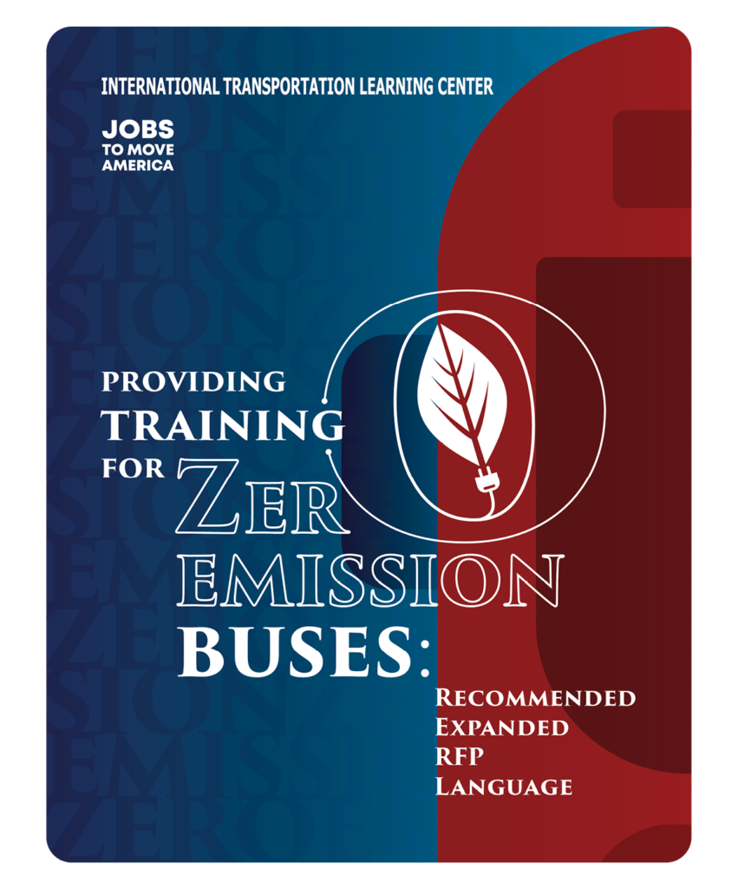
TWC ZEB Workforce Development Resources
National ZEB Maintenance and Training Standards
Transit Bus Zero Emissions Bus (ZEB) Skill Survey
Resources and Best Practices for ZEB Workforce Transition
Recommended RFP Language for ZEB Training
Notes:
National ZEB Maintenance and Training Standards
In collaboration with APTA, transit unions, and ZEB manufacturers
Basis for training programs and courses
Resources and Best Practices for ZEB Workforce Transition
ITLC Resource - Recommended Expanded RFP Language for ZEB Training
Recommendations for specifying the type, quality, and duration of training and personal protective equipment (PPE).
Builds and expands upon material contained in the APTA Standard Bus Procurement Guidelines

Slide 19
Lisa Jerram
Senior Director, Bus Operations and New Vehicles Technologies, American Public Transportation Association

Slide 20
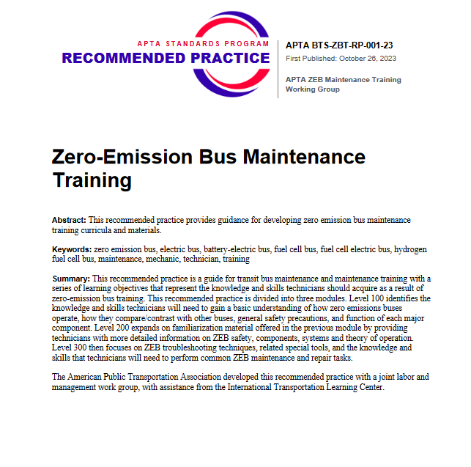
ZEB Maintenance Training Recommended Practice
Recommended Practice for developing a ZEB maintenance training curriculum
Published October 2023
Developed through APTA’s Standards Program, with ITLC as subject matter lead
Working group of transit agencies, labor representatives, and manufacturers, in consensus based process
In use by transit agencies
APTA Zero-Emission Bus Maintenance Training Standard

Slide 21
Brandon Liu
Instructional Designer, International Transportation Learning Center/Transit Workforce Center
Henry Lukasik
Director of Maintenance, Pinellas Suncoast Transit Authority
Billy Terry
Executive Director, National Transit Institute

Slide 22
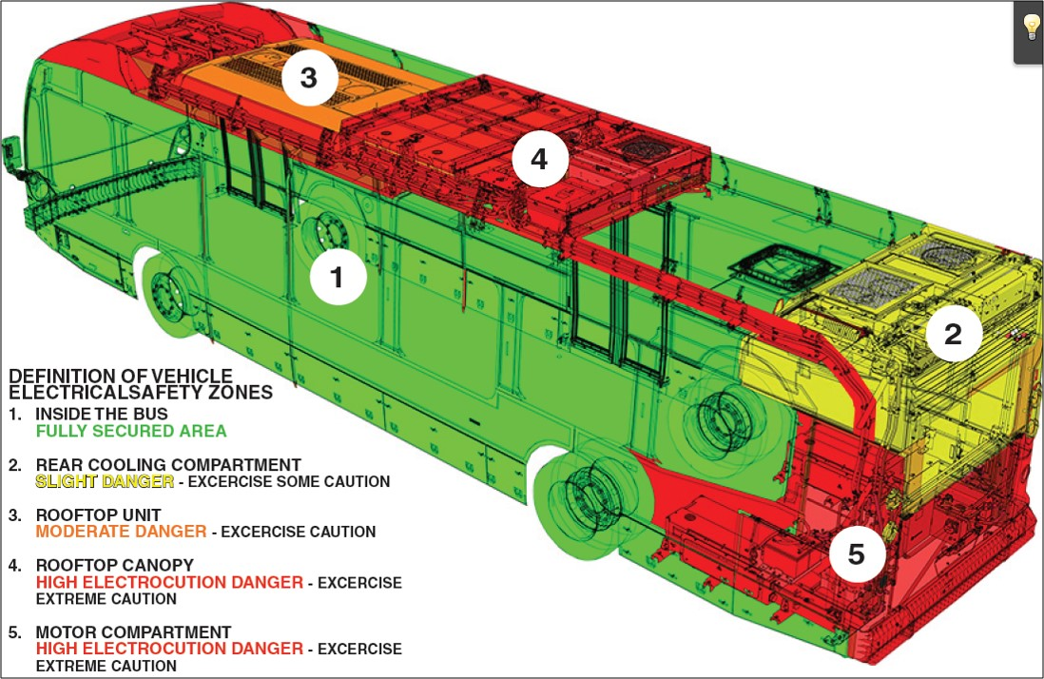
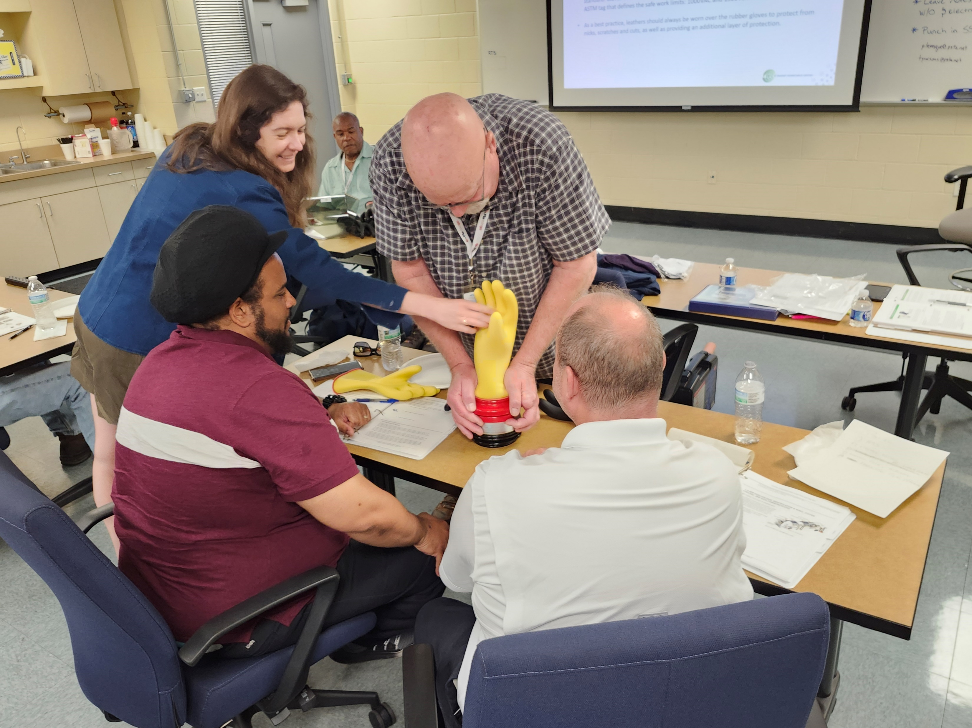
TWC Battery Electric Bus Familiarization Course

Slide 23
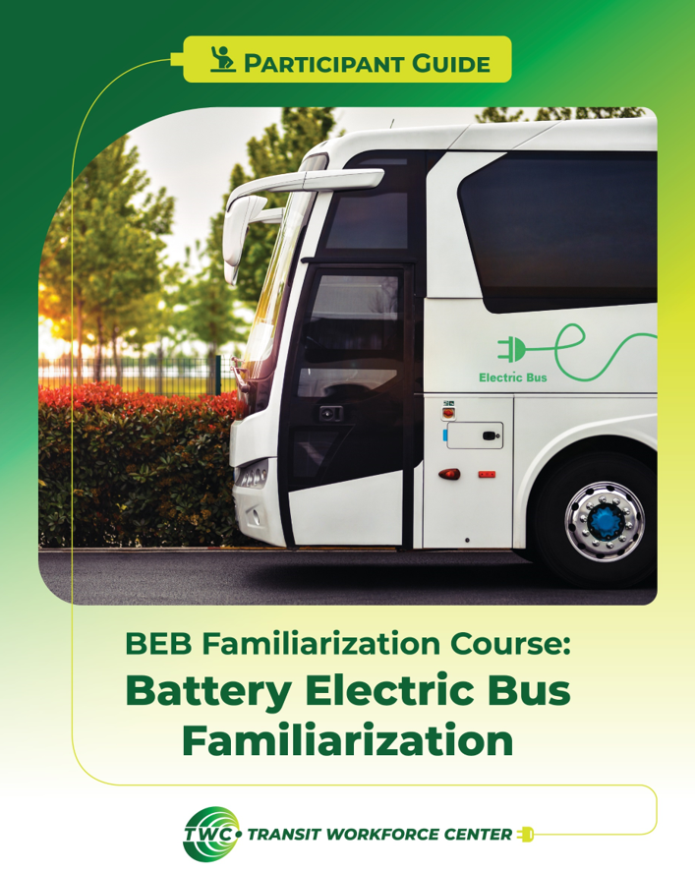
TWC Battery Electric Bus Familiarization Course
TWC Battery Bus Familiarization Course webpage
Transportation Learning Network
Pinellas Suncoast Transit Authority (PSTA) Delivery
NTI and TWC collaboration

Slide 24
TWC Resource Center
50+ resources on transit ZEBs, including:
Providing Training for Zero Emission Buses: Recommended Expanded RFP Language
Electric Vehicle Maintenance Best Practices
Resource Center
Making Connections 2024 – The National Transit Workforce Conference

Slide 25
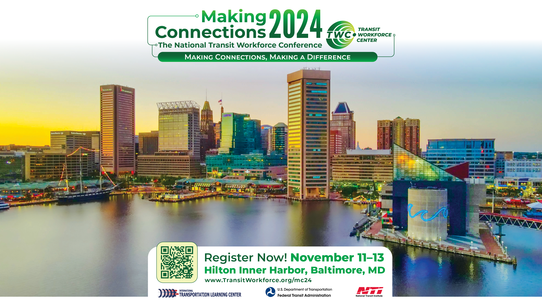
MAKING CONNECTIONS 2024
www.TransitWorkforce.org/mc24

Slide 26
Jason Macumber
Introducing:
Zero Emission Specialist, International Transportation Learning Center/Transit Workforce Center

Slide 27
Q&A session

Slide 28
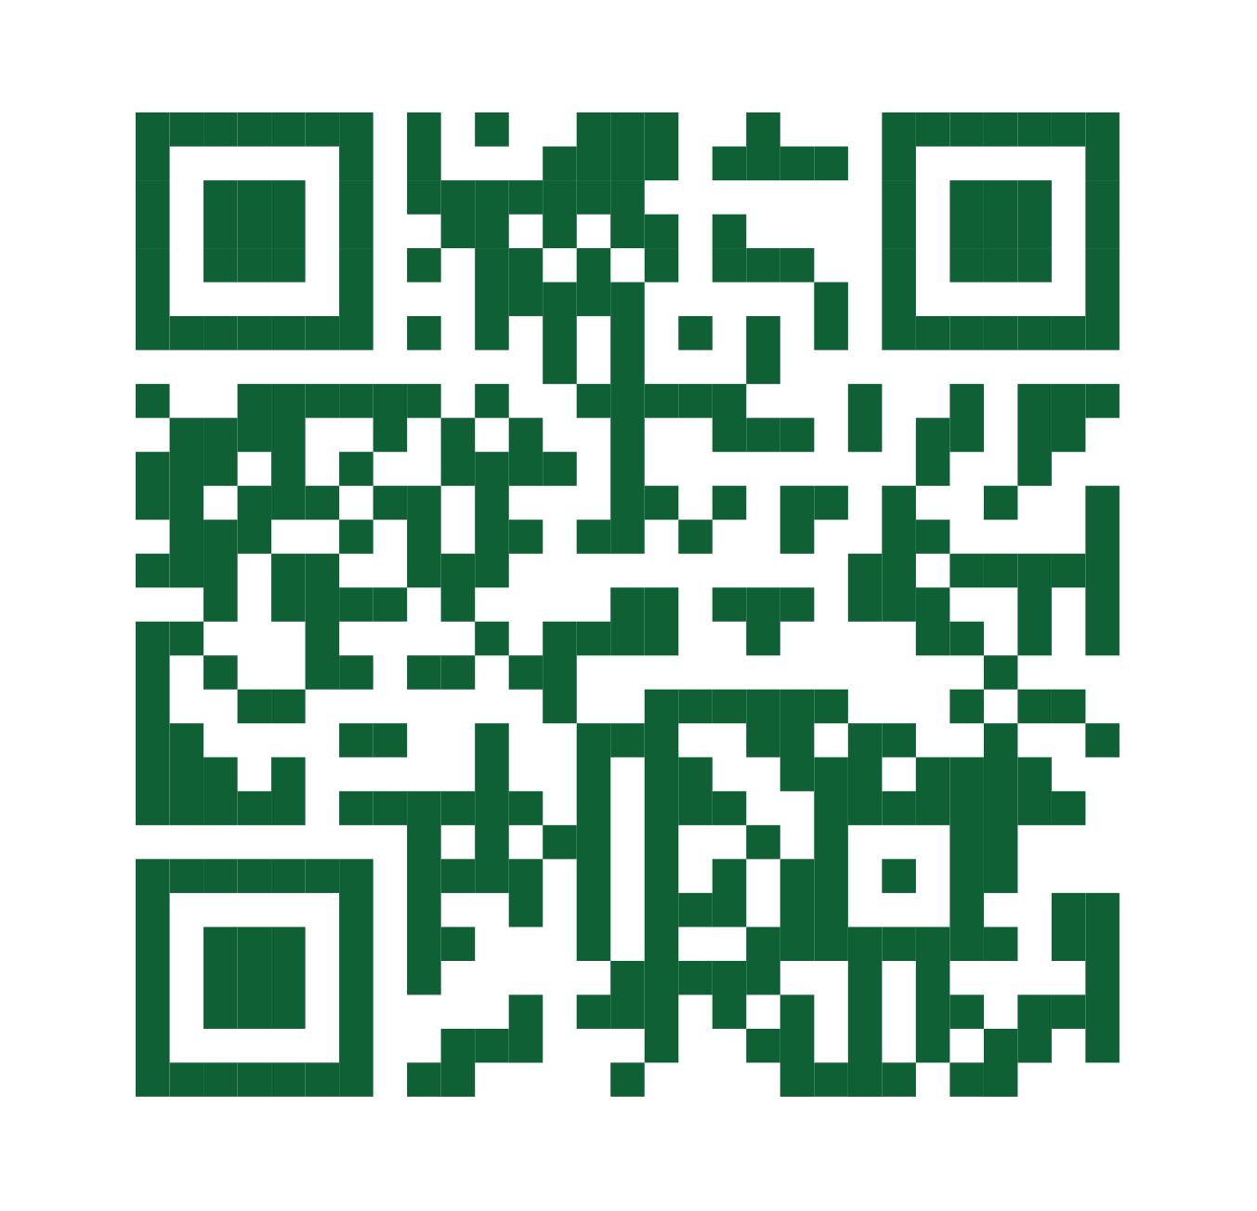
Thank You!
John Schiavone JohnJSchiavone@cs.com
Brandon Liu bliu@transportcenter.org
Jason Macumber jmacumber@transportcenter.org
www.transitworkforce.org
Notes:
.

