Slide 1
Transit workplace Health Protection and Promotion
TCRP F-17 Developing Best-Practice Guidelines for Improving Bus Operator Health and Retention
Notes:
This presentation is designed to help transit worksite health protection and promotion advocates make a case to their organizations. It describes the current research and provides a framework for making the best argument. Boilerplate slides are included to insert local information.

Slide 2
A Healthy Workplace
Addressing the health and safety concerns in the physical work environment
Meeting the health, safety and well-being concerns in the psychosocial work environment including organization of work and the workplace culture
Allowing access to personal health resources in the workplace
Providing opportunities for participating in the community to improve the health of workers, their families and others
  World Health Organization, 2010
Notes:
These are the characteristics of a healthy workplace

Slide 3
Bus operators ARE at risk world-wide
Increased prevalence
Hypertension
Diabetes
Cardiovascular disease
Stroke
Related conditions
Sleep disturbance
Overweight
Limited physical activity
Notes:
References to all these issues are reviewed in the F-17 final report.

Slide 4
TCRP F-17: research and practice
In-depth background literature review
Survey sent to 238 agencies and unions
Responses from 93 different agencies
  68 employers: 52 US and 15 Canadian
  44 local unions: 36 US and 8 Canadian
Interviews with 40 informants from 26 agencies
5 detailed case studies
Subject matter experts from transit agencies and unions
Research team including health promotion, occupational health and safety, epidemiology, economics
Notes:
This project was designed to define best practices for transit health protection and promotion, to highlight return on investment, and help agencies deal with retention and operations concerns as well as improving operator health. This is how the study was carried out.

Slide 5
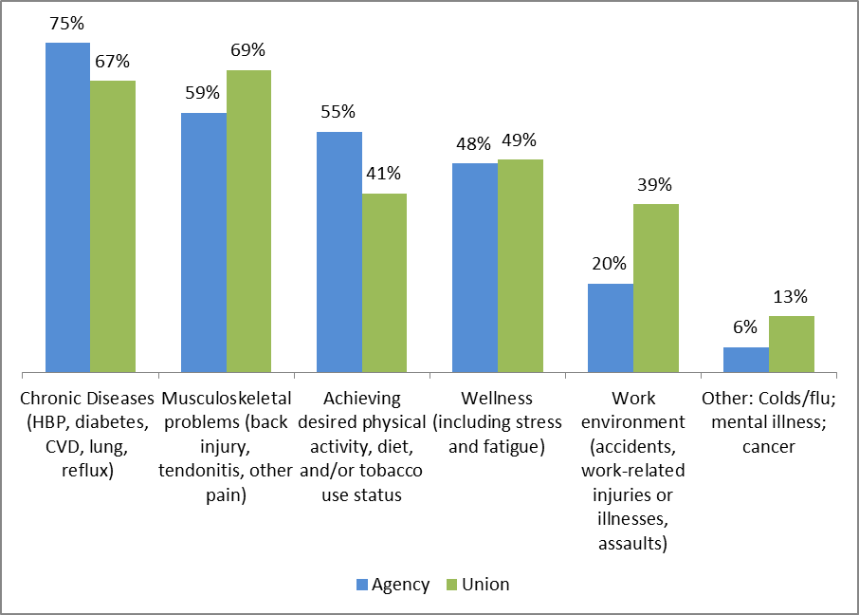
What matters in the transit workplace
Notes:
Transit agency representatives and unions take the health problems of operators seriously. They may differ in some of the details.

Slide 6
F-17 findings: summary
Operator health is a universal concern
The work environment is important in health
Bus operator participation in program activities is low
Schedule demands makes participation harder
Family is important in prevention
There is a need to consider and address multiple factors
The industry is looking for transit-specific programs
All stakeholders have something to contribute
Notes:
These core findings are discussed in detail in the project report and practitioner’s guide.

Slide 7
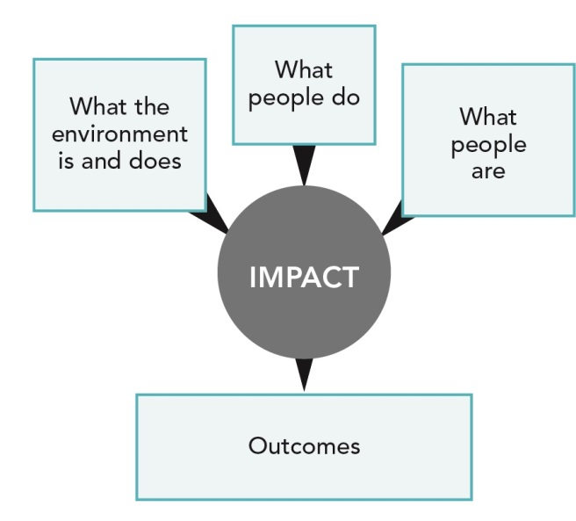
Notes:
This is a model that can help define and address health issues in the transit workplace.

Slide 8
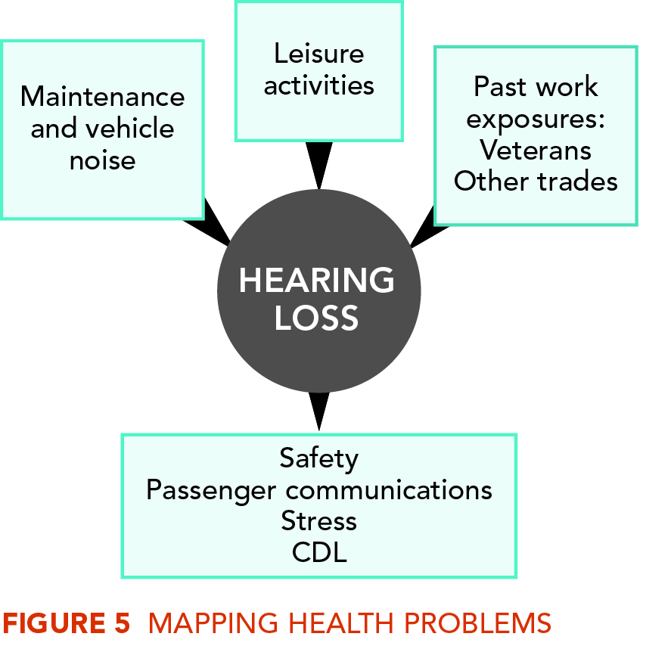
Notes:
For a health issue like hearing loss, it is clear how the person’s and the working conditions can affect the outcomes and have a negative impact on the organization.

Slide 9
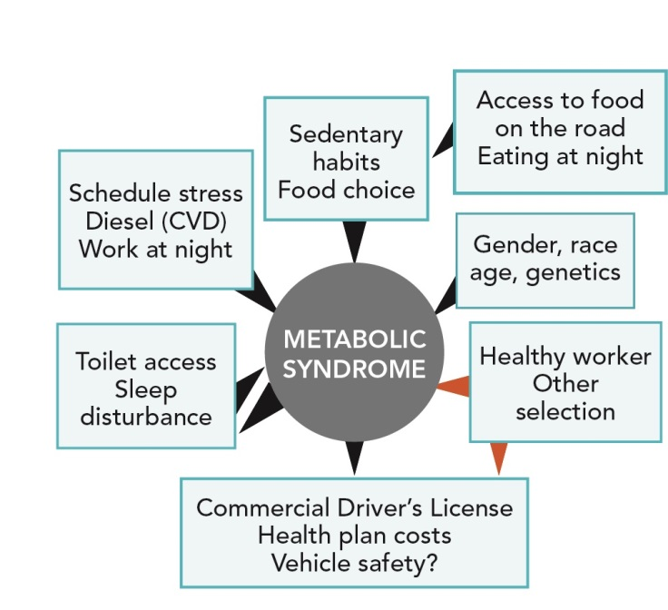
Notes:
And this shows how complicated a common bus operator health problems can be. It is important to look at as many contributing conditions as possible. That means thinking about the individual, the work organization and the environment.

Slide 10
Resources provided by TCRP F-17
Workplace Health Protection and Promotion Practitioner’s Guide
  For a transit-specific program
  Extensive ideas and examples
  Materials from transit agencies
Planning, Evaluation and Return on Investment Spreadsheet
Background and literature review in final report
Notes:
The resources provided by the F-17 project are designed to help transit agencies understand and address operator health problems, and those of other transit employees. The big advantage is that they are TRANSIT SPECIFIC. These are the tools the organization can use to start or improve health protection and promotion activities. They are available as downloads from the TRB and the Transportation Learning Center.

Slide 11
Transit Agency good practice Cases
Preparing the Organization and Making the Commitment
  United Transportation Workers (UTU) and Los Angeles County Metropolitan Transit Authority (LACMTA) – Los Angeles, CA
Building the Workplace Health Promotion Team
  Dallas Area Rapid Transit (DART) Dallas, TX
Setting Targets in Transit Health Protection and Promotion
  Edmonton Transit System, Edmonton, AB
Implementing & Integrating an Effective Transit Workplace Health Protection and Promotion Program
  Orange County Transportation Authority (OCTA), Orange County, CA
Evaluation, Return on Investment, and Ongoing Improvement
  Capital Metro, Austin, TX
Maintaining Effectiveness with Growth
  UTU and LACMTA
Notes:
These transit agencies have developed programs that illustrate the phases and issues involved in developing an effective transit WHPP program. These and other examples are described in detail in the F-17 report and Practitioner’s Guide.

Slide 12
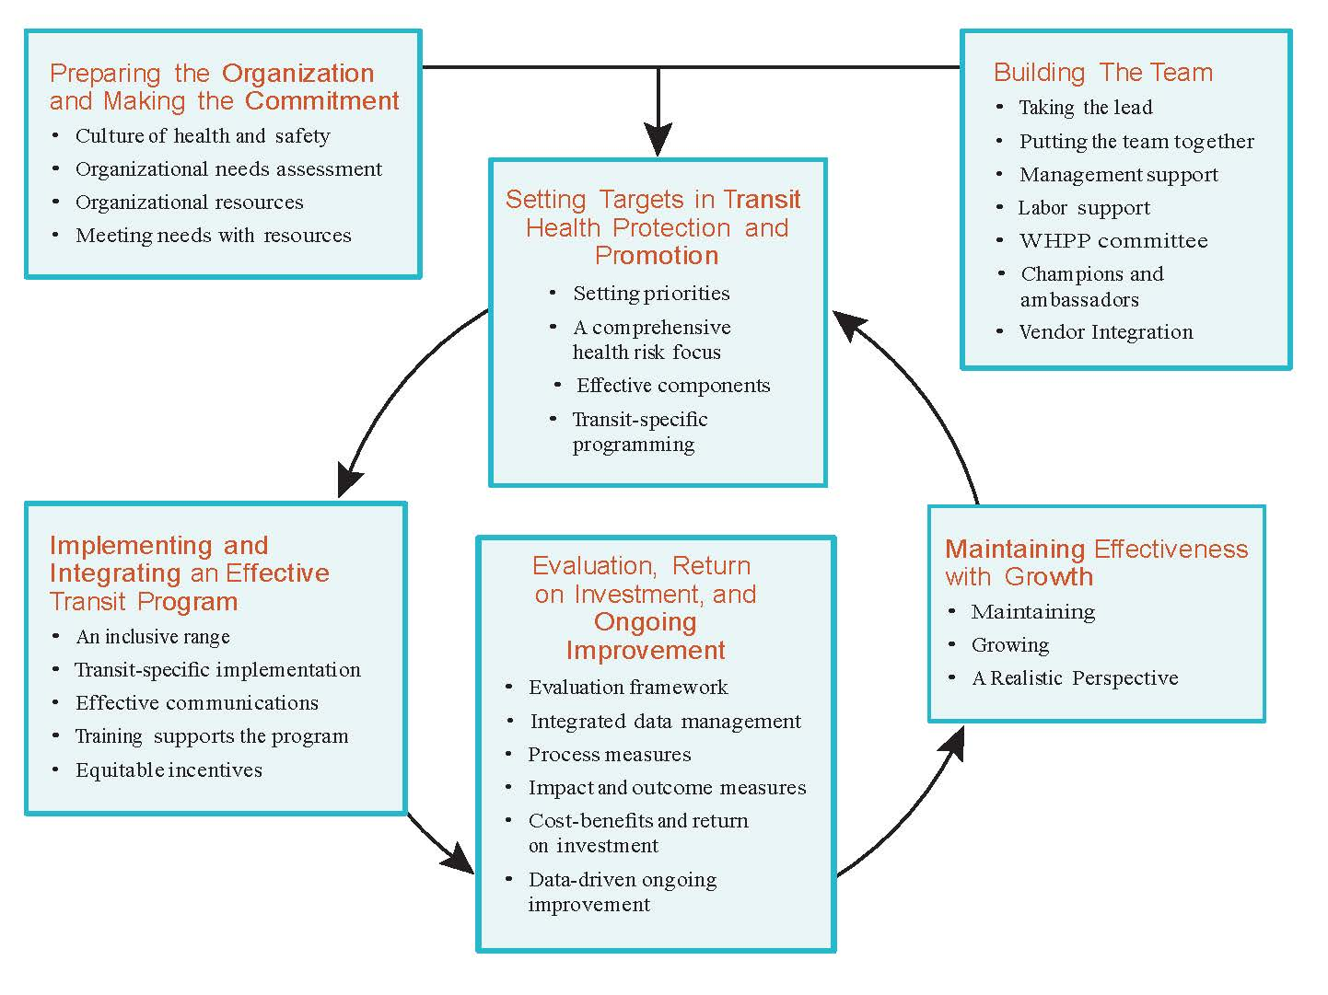
Notes:
These are the action areas and best practice elements described in the Transit Workplace Health Protection and Promotion Practitioner’s Guide. Using this guide, and the ROI Template, will let us select the components of the program that we need. It provides guidance on starting out, growing, and maintaining effectiveness.

Slide 13
Current concerns and costs
Notes:
Insert your data describing you organizaton’s need for a comprehensive WHPP program, including health problems, costs and barriers you have encountered.

Slide 14
[this organization’s] Current whpp status

Slide 15
What WHPP could mean for us
Notes:
This slide is for placing the WHPP model in the organization. List components that already exist, and describe potential improvements and savings.

Slide 16
Why Worksite Health Protection and Promotion
More effective method for addressing operator health problems
Increases credibility of prevention efforts
Joins existing initiatives
  Health promotion
  Health culture
  Safety and health
Brings together all stakeholders
  Management
  Union
  Health care providers
Notes:
This is why the WHPP approach will improve health and conditions in transit organizations

