Slide 1
National Technical Assistance Center
for Transit Workforce Development
Approaches to Childcare Support in the Transit Industry
November 29, 2023

Slide 2
Transit Workforce Center – Mission
Operated by the ITLC, the Transit Workforce Center (TWC) is FTA’s first ever national technical assistance center for transit workforce development.

Slide 3
The Story of This Webinar
What we all know: childcare is a challenge for working people across the country
No one-size-fits-all solution
2 million Americans made career sacrifices in 2016 due to childcare issues—a figure which has likely grown since the pandemic began
½ of American families struggle to find adequate childcare
10% decrease in childcare costs
0.5-2.5% percent increase in maternal employment

Slide 4
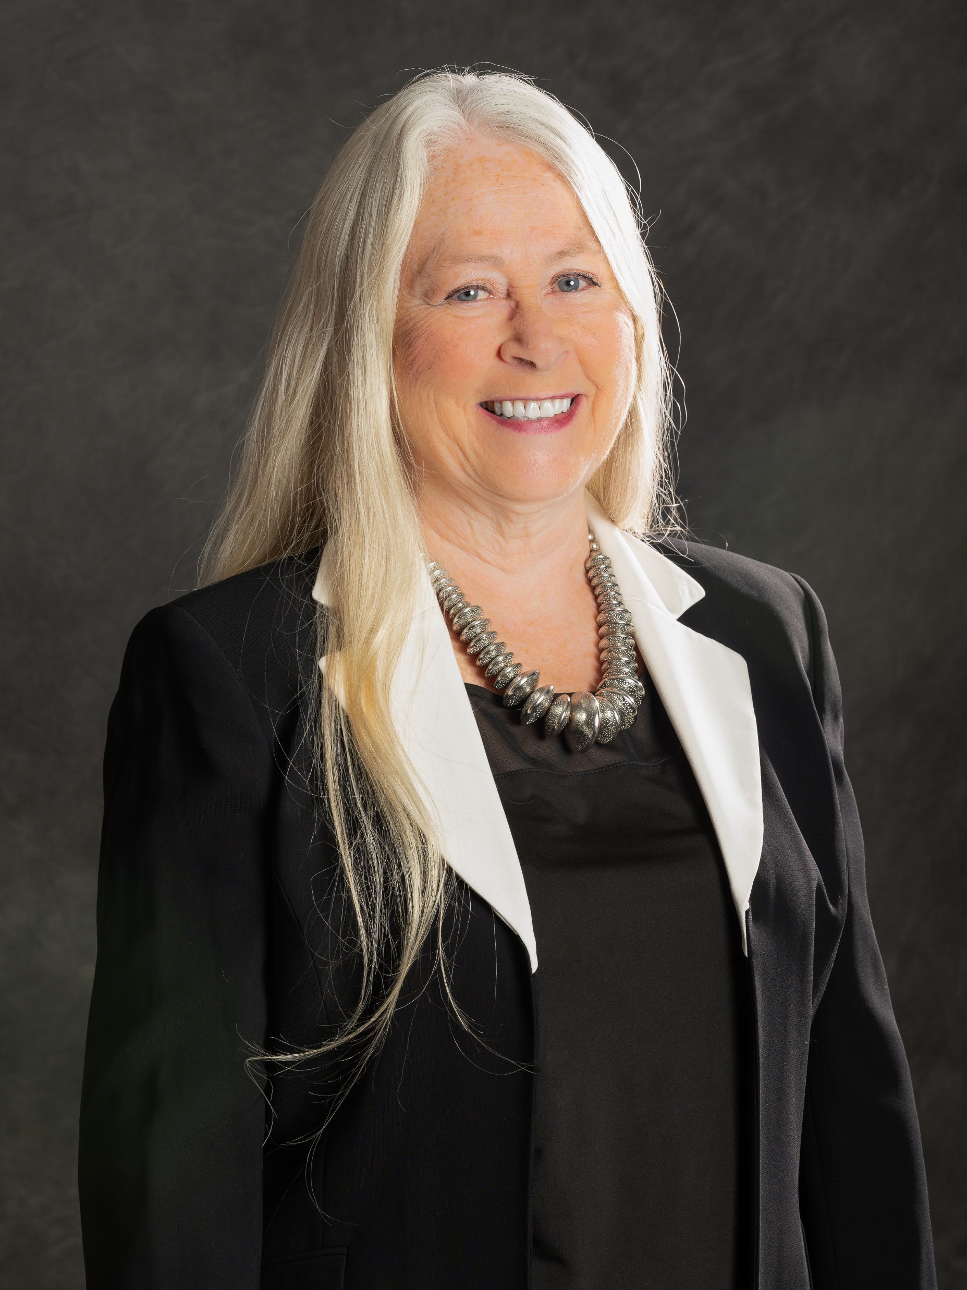
Our Speakers Today
Barb Cline
Executive Director
Prairie Hills Transit
Spearfish, SD
Charles Jenkins
Director
Transport Workers Union Local 100 - New York City Transit Training & Upgrading Fund
New York, NY

Slide 5
References
Slide 4:
https://www.americanprogress.org/article/2-million-parents-forced-make-career-sacrifices-due-problems-child-care/
https://www.americanprogress.org/article/child-care-crisis-keeping-women-workforce/
https://link.springer.com/article/10.1007/s11150-016-9331-3

Slide 6
Save-the-Date: Making Connections 2024
November 11 – 13, 2024
Baltimore, MD

